Slide 1

K₂CsSb Cathode Development
John Smedley
Triveni Rao
Andrew Burrill
BNL ERL needs – 50 mA, 7 mm dia., 1.3 mA/mm²

Slide 2
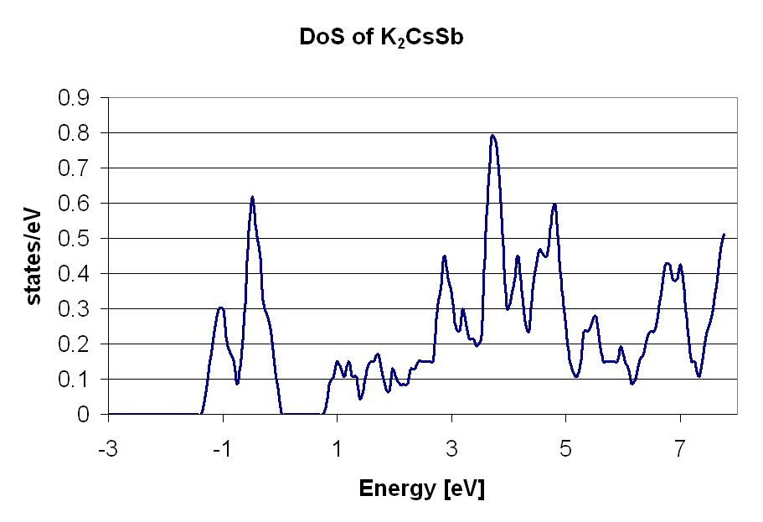
K₂CsSb (Alkali Antimonides)
Work function 1.9eV, E_{g}= 1.2 eV
Good QE (4% -12% @ 532 nm, >30% @ 355nm)
Deposited in 10⁻¹¹ Torr vacuum
Typically sequential (Sb->K->Cs); Cs deposition used to optimize QE
Oxidation to create Cs-O dipole
Co-deposition increases performance in tubes
Cathode stable in deposition system (after initial cooldown)
D. H. Dowell et al., Appl. Phys. Lett., 63, 2035 (1993)
C. Ghosh and B.P. Varma, J. Appl. Phys., 49, 4549 (1978)
A.R.H.F. Ettema and R.A. de Groot, Phys. Rev. B 66, 115102 (2002)

Slide 3
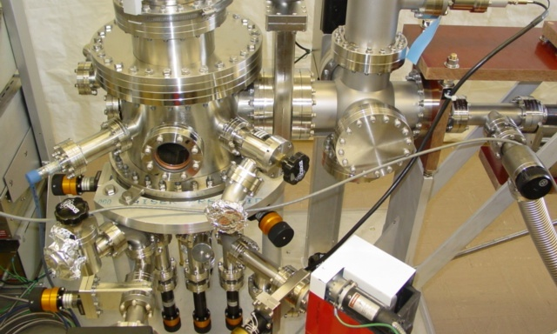
Deposition System
Sb
K
Cs
Sequential deposition with retractable sources (prevents cross-contamination)
Cathode mounted on rotatable linear-motion arm
Typical vacuum 0.02 nTorr (0.1 nTorr during Sb deposition)

Slide 4
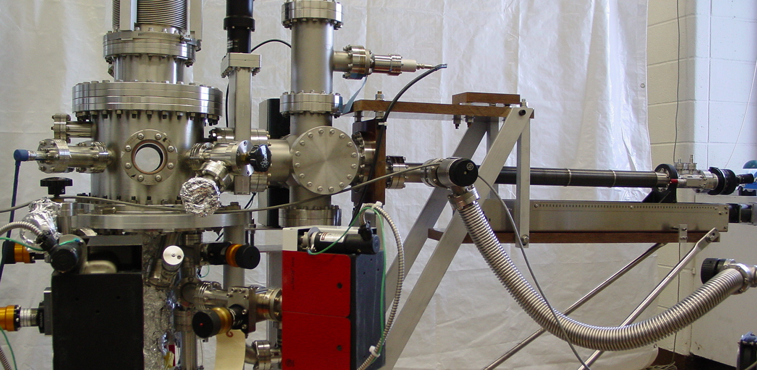
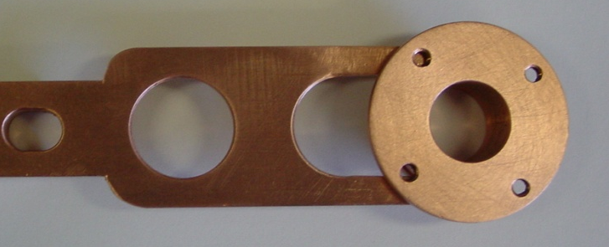
Deposition System
Laser access from bottom during deposition
from front and back for measurement
Anode for HV bias (2.5 cm gap, up to 5 kV)

Slide 5
Substrate
Copper Substrate
Recipe
Following D. Dowell (NIM A356 167)
Cool to room temperature as quickly as possible (~15 min)
 | Substrate Temperature
100 Å Sb | 150 C
200 Å K | 140 C
Cs to optimize QE | 135 C
Stainless Section
Polished Solid Copper
~30 nm Copper Sputtered on Glass
Stainless Steel Shield

Slide 6
10 min to cool to 100C
Lose 15% of QE

Slide 7
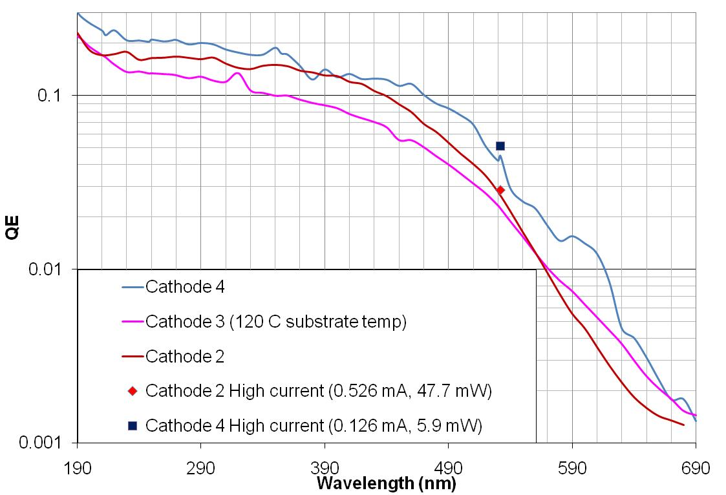
Spectral Response

Slide 8
Position Scan (532 nm)
SS Shield
SS Cath
Window
Cu Cath
Cu transmission ~20%

Slide 9
Copper vs Stainless
47.7 mW @ 532 nm
0.526 mA

Slide 10
Temperature Dependence

Slide 11
QE Decay
500 V bias
3 mm diameter spot
Current ~ 60µA
0.07 nTorr

Slide 12
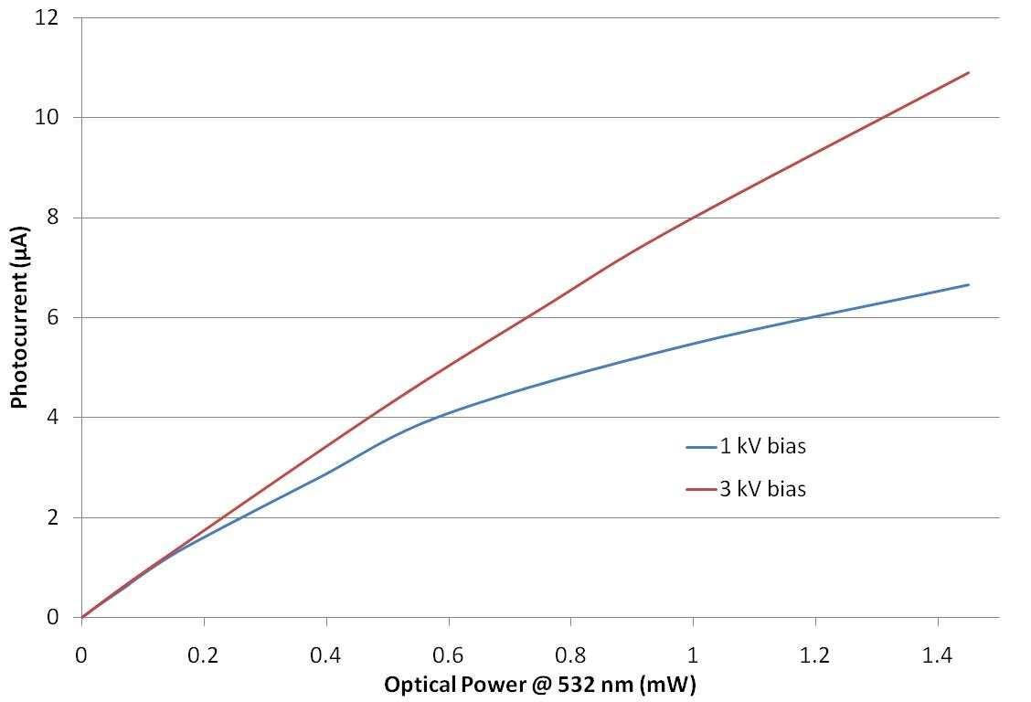
Linearity and Space Charge
80 µm FWHM spot on cathode

Slide 13
QE Decay, Small Spot
80 µm FWHM spot on cathode
1.3 mA/mm² current density
1.5x10⁵ C/mm²

Slide 14
Conclusions
Cathodes have better QE on Stainless than on Cu
QE decreases 15% during cathode cool-off
QE at 355 nm is 19%, better than the 10% required
ERL current density has been met (1.3 mA/mm²)
QE does not change in storage (even illuminated)
  Ion bombardment seems to limit lifetime under bias
QE at -77C same as at 20C
Charge density of 1.5x10⁵ C/mm² extracted from a small (80 µm fwhm) spot; 15 C extracted from a 3 mm fwhm spot; both with small but measurable QE loss
Thanks!

Slide 15
Deposition Notes
Initial vacuum <0.1 nTorr
  Primary contaminants H₂ and Ar
Source to substrate distance of ~45 mm
Antimony and Potassium deposition rates set by crystal monitor
  Crystal monitor to source spacing ~70mm
QE measured (@ 532 nm) during Cs deposition
Substrate takes 15 min to reach room temperature
QE drops rapidly during this period
  Initial QE decay occurs prior to QE map, so we may miss peak QE

Slide 17
Alkali Sources
Initial attempts with Saes Getters Chromate sources
  Could not obtain evaporation below 10A (should be <6.5A)
Used Alvasources
  Pure Alkali sources, with In seal
  Two stage heating cycle
  Two geometries – line and V
  Ar fill gas produces gas load on initial heating

Slide 18
Reflection QE (543 nm) vs Position
SS Guard
Cu Cathode
Transparent
Substrate

Slide 19
Transmission QE (543 nm) vs Position

Slide 21
Three Step Model - Semiconductors
Excitation of e⁻
  Reflection, Transmission, Interference
  Energy distribution of excited e⁻
2) Transit to the Surface
  e⁻-lattice scattering
  mfp ~100 angstroms
  many events possible
  e⁻-e⁻ scattering (if hν>2E_{g})
  Spicer’s Magic Window
  Random Walk
  Monte Carlo
  Response Time (sub-ps)
3) Escape surface
Overcome Electron Affinity
Empty States
E_{a}
hν
Φ
E_{g}
No States
Energy
Filled States
Laser
Medium
Vacuum

Slide 22
A.R.H.F. Ettema and R.A. de Groot, Phys. Rev. B 66, 115102 (2002)

Slide 25
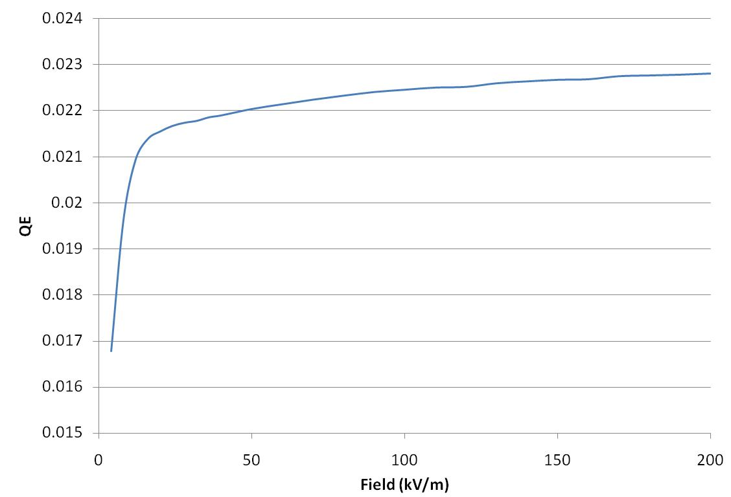
QE vs Field

