Slide 1
Accelerator Based Backgrounds in a Muon Collider
Steve Kahn
Mar 2, 2011
MAP Winter Meeting at JLAB

Slide 2
Background on Muons, Inc. and NIU
Muons, Inc. is a small company composed primarily of physicists that earns a large fraction of its money from SBIR grants from DOE.
We have just been awarded (in June) a phase I grant in collaboration with Northern Illinois University to simulate accelerator backgrounds for a Muon Collider.
This is a new project for us consequently we are light in results at this point. We are describing our plan of action.
Our team include
Steve Kahn, Mary Anne Cummings, Kevin Beard, Tom Roberts, Muons, Inc.
Dave Hedin, Aaron Morris, NIU
Joe Kominski, Lewis University
As part of my personal experience, I worked with Iuliu Stumer to calculate muon collider backgrounds circa 1997.
For those calculations we used Geant 3.21
These calculations along with MARS provided mutual confidence in the understanding of accelerator backgrounds to a muon collider.

Slide 3
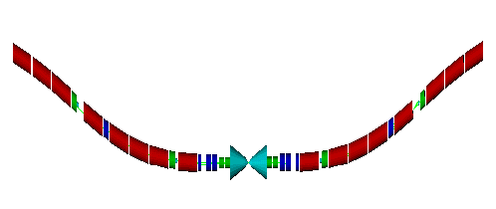
What Did We Promise in our SBIR?
The development of a Monte Carlo package to simulate muon accelerator backgrounds.
The package should be able to accept a MAD lattice description.
Provide particle fluxes.
Output a file of background events for use with the physics analysis.
Verification of the MC package by comparing to MARS.
Evaluate the shielding necessary for a muon collider detector.
What cone angle do we need?
Develop output format for background events so they can be used for physics analysis.

Slide 4
The Simulation Package
Simulate accelerator based backgrounds in the muon collider intersection region.
This package will use G4beamline. (Described last week)
Also we plan to interface to MARS for verification.
The program input uses the MAD lattice description of collider beam
We are currently the Eliana Gianfelice-Wendt’s recent lattice for our studies.
Using the MAD lattice description allows rapid adjustment to changes in the collider lattice design.
Model material in beam line and detector interface.
Reasonable description of magnet material and magnetic fields.
Accommodate special kinds of magnets such as open mid-plane dipoles
Dipoles are arcs! Significant magnet sagita with 10 m long dipoles
Masks and collimators
Conic shielding
Requirements
Establish muon closed orbit
Assume that muon can decay anywhere along the orbit.
Track decay electrons as primary particles
Scoring energy deposition.

Slide 5
Final Focus Region of E. Gianfelice-Wendt’s New Lattice
a (cm)
QLB1
5σ_{y}
5σ_{x}
z (m)
Note the relatively small quench margin

Slide 6
Sources of Muon Collider Backgrounds
Electrons from muon decays.
We expect 8.6×10⁵ muon decays per meter for both 750 GeV µ⁺, µ⁻ with 2×10¹² µ per bunch.
These electrons are off momentum and could hit magnets, etc.
Synchrotron radiation from decay electrons.
Photo-nuclear interactions.
This is the source of hadron backgrounds. This is largely neutrons.
Bethe-Heitler muon production: γA→µ⁺µ⁻X
Source is energetic photons on beam line and shielding material.
Incoherent pair production: µ⁺µ⁻ →µ⁺µ⁻e⁺e⁻
~3×10⁴ pairs expected per beam crossing.
Detector magnetic field should trap most of these.
Beam halo.

Slide 7
What exists to produce G4beamline input
BruitDeFond
BeamMaker
Background.in
BeamMaker.txt
G4beamline
Geant4
BruitDeFond produces an ASCII file of G4beamline commands that describe the ±75 m of muon collider interface region
BeamMaker produces a BLTrackFile that can be read by beam input card. This file contains e⁺ and e⁻ thrown with the Michel decay distribution.

Slide 8
The BruitDeFond Program
The BruitDeFond program creates an input file to G4beamline that describes the intersection region of a muon collider.
The collider configuration is meant to be flexible and uses the MAD element description.
We currently have modeled ±75 m from the IP.
We are currently using Eliana Gianfelice-Wendt’s recent lattice.
Magnet description is important. Currently all magnets are described by multipole command.
Material is described my multiple tubes of Nb₃Sn, SS collar, Fe yoke.
IR Quadrupole magnets are based on V. Kashikhin designs.
5 T solenoid field over the detector.
We have described the Tungsten conical shielding configuration with a scaling algorithm that allows conical angle studies.

Slide 9
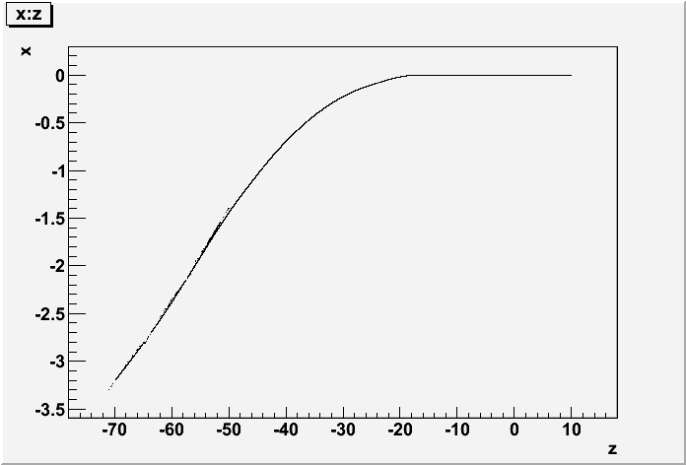
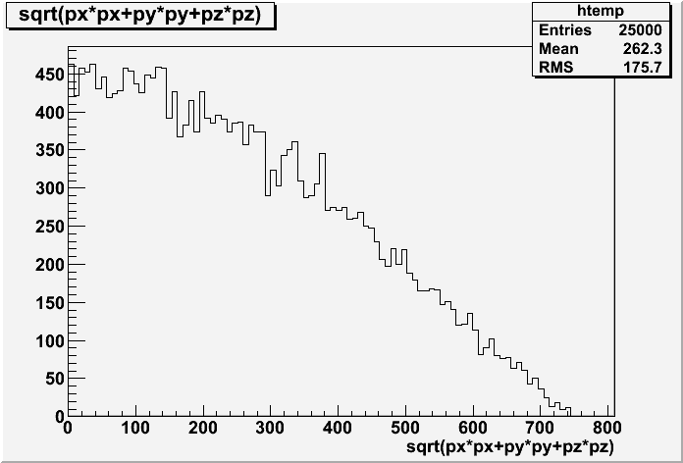
BeamMaker– A tool to provide background events to G4beamline
Decay electrons are fed to G4beamline uniformly along the muon reference orbit.
Electron energy generated using Michel decay and boosting from muon frame to lab.
A constant weight factor can be used to normalize background to the number of muons per bunch.

Slide 10
We can also use this program to produce MARS input for Verification
BruitDeFond
BeamMaker
MARS.INP
GEOM.INP
FIELD.INP
BeamMaker.txt
Mars15
BruitDeFond can generate MARS.INP and GEOM.INP files.
The extended geometry is description is used.
The field is described by the FIELD.INP file which is read by the MARS user subroutine “field” that we wrote.
We use the same BeamMaker.txt file for the MARS input.

Slide 11
Mars Geometry Generated by BruitDeFond Package

Slide 12
Differences in Running Conditions
 | G4BL | Mars
Beam | BeamMaker File -30 m -> 10 m | BeamMaker File -30 m -> 30 m
Physics Lists | QGSP_ BERT, No _HP | Standard, NO MCNP
Event Sample | 10,000 events | 400,000 weighted events
Minimum Energy | 200 KeV for all particles | 200 KeV imposed by cut.
Borated Poly-ethylene | It appears that B-CH₂ does not work right in Geant4 | OK

Slide 13
G4beamline Studies
Collider configuration as described.
Use 10° shielding cone.
10 K event samples with minimum KE set to 200 keV.
This requires 3 days on NICADD cluster.
Events carry a constant weight to normalize to 2×10¹² muons/bunch.
Detector planes positioned at SiD locations.
Vertex and tracker detector plane have equivalent SiD material description. Particles are scored as they pass through planes.
Calorimeter material present, but no particle scoring.

Slide 14
Energy Spectra of γ and n
GeV
GeV
Particle spectra at R=47 cm. There is a 200 keV minimum KE threshold.

Slide 15
Time Distribution of γ and n crossing a plane at R=47 cm
ns
ns
Can cut neutron time tale with electronic gate

Slide 16
Particle Fluxes at r=25 cm
Neutrons come from the conical shields

Slide 17
G4BL: Fluxes at Radial Positions for 10° Cone
Particle Fluxes
Normalized Counts
Do not understand the neutron flux increasing with radius. This implies other sources than the beam.

Slide 18
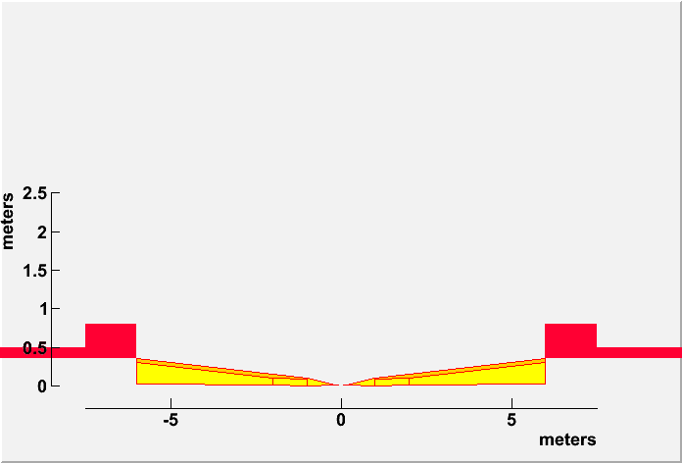
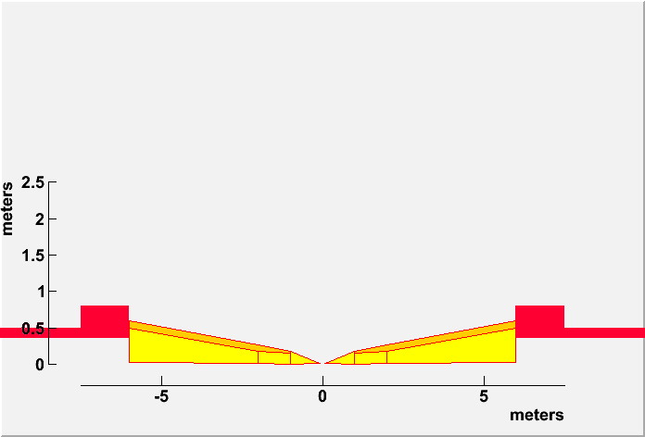
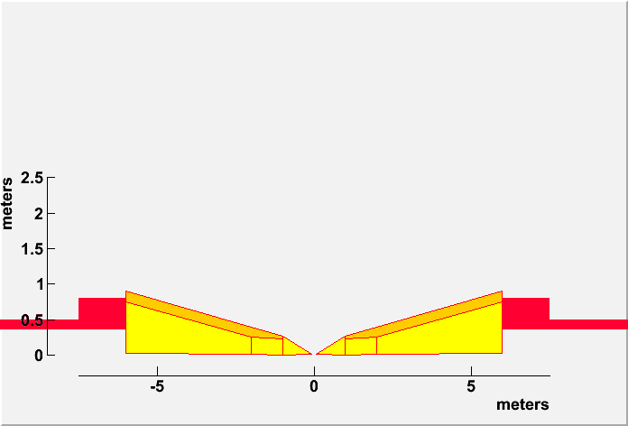
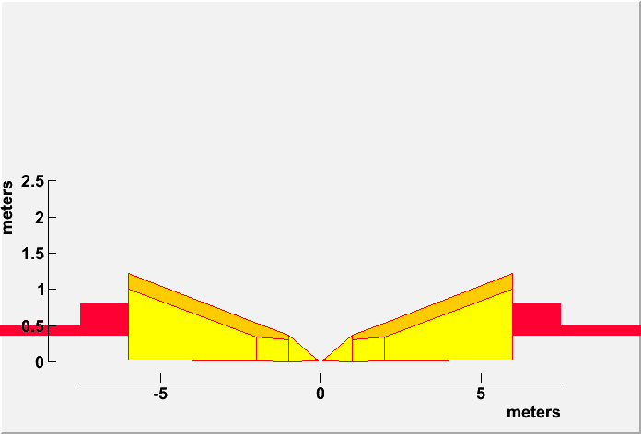
Scaling the Cone for Shielding Simulations
6° Cone
10° Cone
Examine conical shielding with angles from 6° to 20°
For each configuration we run 10 K e⁺ and e⁻.
Each run takes 3 days on the NICADD (NIU grid) cluster
Minimum energy cut of 200 keV to stop tracking.
Fluxes are scored at a 47 cm cylindrical plane.
15° Cone
20° Cone

Slide 19
G4BL Fluxes as a Function of Conical Angle
Particle fluxes at R=47 cm
Minimum particle kinetic energy: 200 keV

Slide 20
Mars: Fluxes at Radial Positions for a 10° Cone
Normalized Counts
Particle Fluxes

Slide 21
Mars Fluxes as a Function of Cone Angle

Slide 22
Comparison of G4BL and Mars Fluxes
G4BL neutron data should fall off as 1/r as the Mars data does. We are looking into this.

Slide 23
Future Plans for Phase II
Clean up items that may not have been finished in phase I:
Boron issues.
Other enhancements to improve the background package and G4beamline for background analysis.
Package BruitDeFond for use by others.
Enter into a CVS repository. Current it exists on laptops.
Instruction manual
Bethe-Heitler muon study.
Aaron Morris is looking at Bethe-Heitler issues in our study.
Muons can penetrate magnets and shielding and enter into detector region.
We need to include all material such as concrete and earth surroundings.
Reverse field in the magnet yokes.
Include more of the lattice that is further from the IR.
We need a large sample of Bethe-Heitler muons, however the cross-section is not large.
We may need to enhance the cross-section and weight those events
A small number of high energy muons undergoing a catastrophic interaction can deposit isolated energy into a single calorimeter cell.
Can fast time-of-flight or shower shape analysis distinguish Bethe-Heitler muons.

Slide 25
Future Plans (Cont.)
Perform a physics analysis by superimposing beam backgrounds onto physics events.
The superposition should be done at the digitization level
Use reconstruction techniques to see if backgrounds can be removed without corrupting.
Evaluate the effect of beam backgrounds on specific physics channels.
Can support university grad student or post doc to do these studies. (?)
Perform optimization of shielding to reduce backgrounds.
The next slide shows shield shaping that was performed in the original study.
Optimize magnets to reduce energy deposition
Use shielding instrumentation to reduce cone angle.
Analysis to demonstrate that it works.

Slide 26
Interior Design of the Tungsten Shielding
The tungsten shielding is designed so that the detector is not connected by a straight line with any surface surface hit by a decay electron in forward or backward direction.
50×50 GeV case
250×250 GeV case
Borated Polyethelene
W
Cu

Slide 27
Conclusions
We have developed a simulation tool to investigate muon collider detector backgrounds.
Background particle fluxes from muon beam decays are calculated using G4BL.
Comparison with Mars shows agreement for γ fluxes. There are differences in the neutron fluxes which need to be understood.
The amount of background in the detector region is dependent on the conical shielding angle.
G4BL shows a different dependence from MARS at this point
Choosing the optimum angle is a trade-off between the size of the physics signal relative to the size of the background. Increasing the 10° cone angle to 15°(20°) reduces the background by a factor of ~2 (~4).

