Slide 1
SOLENOID-DIPOLE MUON 6D COOLING LATTICES Al Garren Particle Beam Lasers
Muon Accelerator Program Winter Meeting
February 28 – March 4, 2011
Jefferson Lab – Newport News, VA

Slide 2
Outline
Properties of the lattices
Achromatic arcs
Zero dispersion straight sections
Drift spaces for rf cavities, absorbers, injection kickers
Producing a channel lattice corresponding to a ring lattice
Example 1: 4-period ring & Channel, each period with a
4 cell arc, 4 cell straight section; period tune 1.75
Example 2: 4-period ring & Channel, each period with 4 cell arc,
2 cell straight section; period tune 1.25
Example 3: 4-period ring & Channel, each period with a 5 cell arc
Cell has a zero-dispersion drift; period tune 1.25
Conclusions
Acknowledgments

Slide 3
Introduction
The purpose of this study is to investigate an approach to muon
ionization cooling using a series of rings and channels with magnet lattices composed of coplanar solenoids and dipoles.
The channels would connect the rings to produce a staged tapering of the apertures to fit the cooling emittances.
Properties of the proposed lattices and examples are discussed.
The rings presented here all have four 90 degree arcs connected by straight sections, and are similar in structure to previous designs with two 180 degree arcs, which had lower performance due to higher dispersion in the absorbers.

Slide 4
Properties of the Lattices
Coplanar magnet layout, design orbit, and dispersion
Achromatic arcs with phase advance 360 degrees
Inclusion of dispersion-free straight sections
Lattices configured either as rings or channels
Structure of cells: one solenoid at their centers, with a dipole on each side of the solenoid in the arcs,, not in the straights
Alternating solenoid field directions
Period fractional tunes are 1/4 or 3/4, centered between two stop bands
Dipoles focus equally in both transverse directions:
Option 1: edge angles 1/4 X bend angle (option chosen)
Option 2: field index n = -R/B(dB/dR) = 1/2
Result: beams are round, betax=betay=beta
Calculations made with SYNCH program
Solenoid coupling terms not included in beta function plots.
Coupling terms included using FXPT subroutine of SYNCH

Slide 5
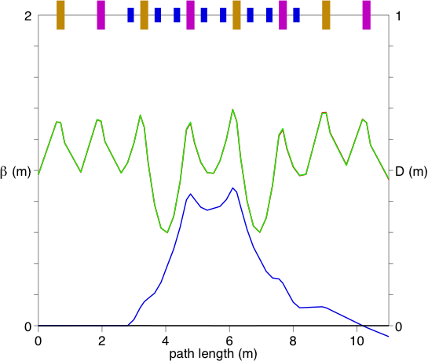
Ring 1: Period lattice of a 32 cell, 4 arc ring
plot inaccuracies due to truncation of solenoid off-diagonal terms
solenoids
Dipoles
betax, betay
D

Slide 6
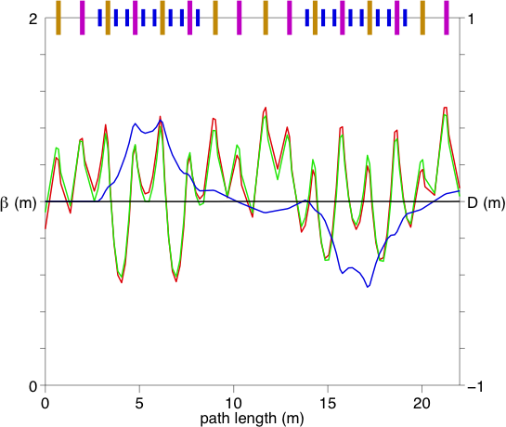
Channel super-period corresponding to Ring 1

Slide 7
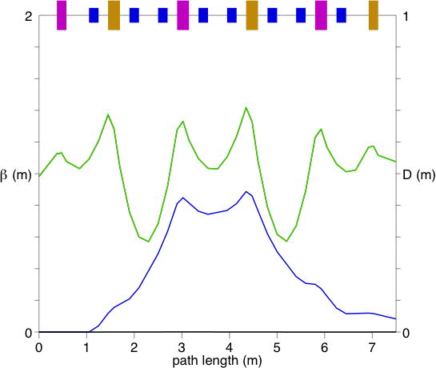
Ring 2: Period lattice of a 24 cell, 4 arc ring

Slide 8
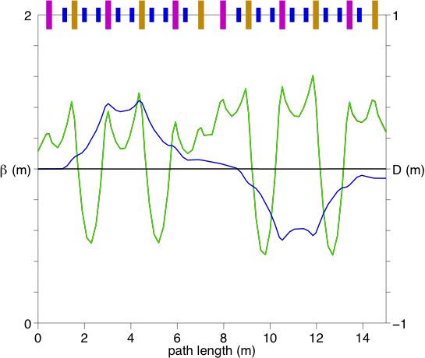
Channel period corresponding to Ring 2

Slide 9
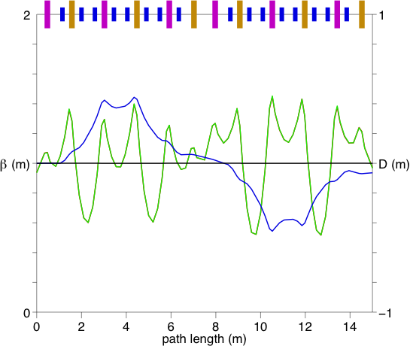
Channel period corresponding to Ring 3

Slide 10
Conclusions
A number of solenoid-dipole ring and channel cooling lattices have been designed having many attractive features.
The cooling performance has grown significantly do to work during the past year, but requires additional improvement.
ICOOL simulation of ring 1 show emittance reduction
times transmission of about 16.
Some of this improvement might result from adjustments of the peak beta values and the low beta values in the absorber drifts.
Another possibility is to reduce the length of all the drift spaces in the channel lattices, since these are not needed for injection;
this will reduce the betas, which are proportional to cell length.

Slide 11
Acknowledgments
Harold Kirk has been a collaborator on this problem for many years. He has madeallof the previous performance studies with ICOOL. Xiaoping Ding is currently making these studies.
Scott Berg has studied the lattices theoretically,
made key suggestions. In addition he has brought the SYNCH program up to date, eliminating bugs and installed it on UNIX and WINDOWS.
David Cline has enthusiastically supported and encouraged this work.
This work is supported by an SBIR contract.

Slide 12
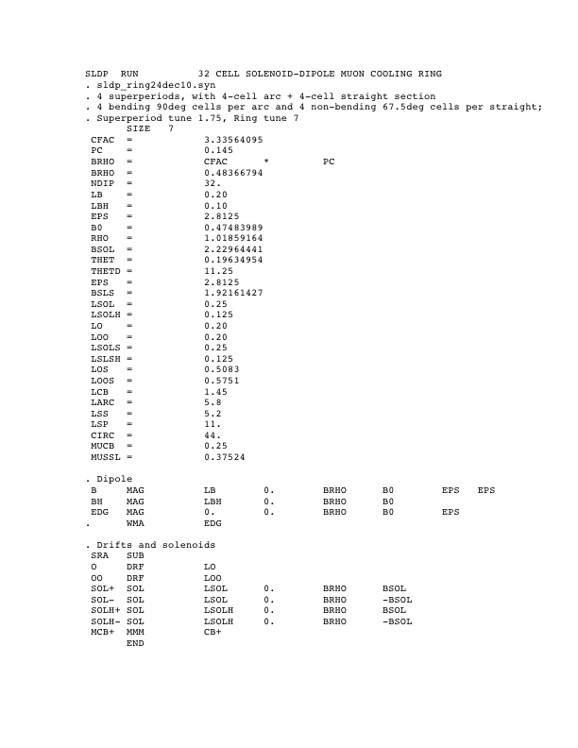
Synch Input for Ring 1

Slide 13
