Slide 1

Practical design of helical cooling channel
Katsuya Yonehara
APC, Fermilab

Slide 2
Outline
Show result of 200 MHz base HCC simulation by using analytical electromagnetic field
  To demonstrate cooling efficiency and compare with other cooling channels
Show beam & lattice parameter list
  To find out what is critical parts in channel
No cost estimation of HCC made yet but made some practical design of beam elements
  Demonstrate tolerance of helical solenoid (HS) coil
  Estimate RF power dissipation and possible cryogenics
  Possible RF cavity to incorporate into the HS magnet

Slide 3
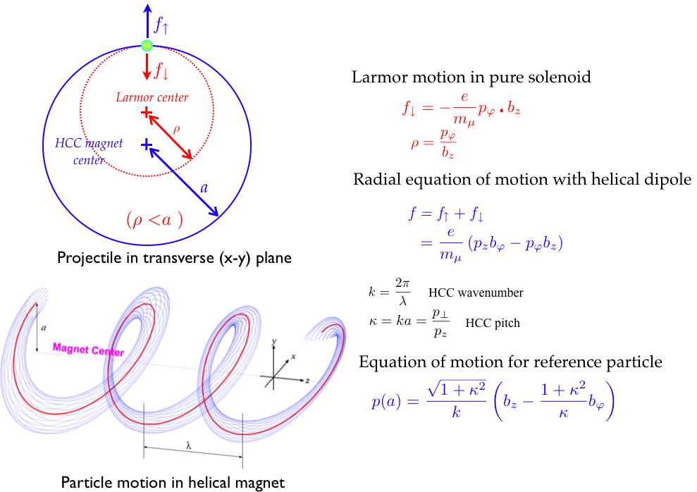
Helical Cooling Channel
No periodic structure ⇒ Large beam phase space

Slide 4
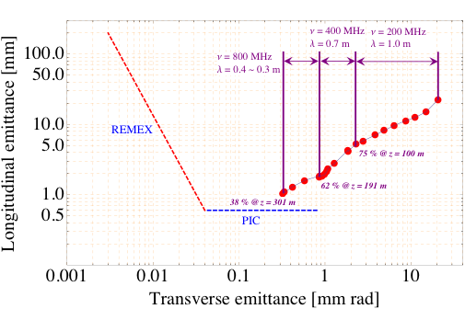
200 MHz base HCC
Analytical Electromagnetic field
PIC=Parametric resonance Ionization Cooling channel
REMEX=Reverse EMittance EXchange channel

Slide 5
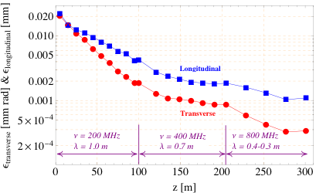
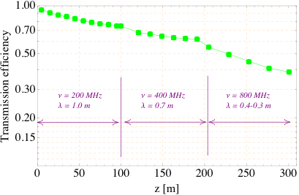
Cooling efficiency in 200 MHz base HCC
Use analytical Electromagnetic field
There is an RF window between two
RF cavities
0.12, 0.08, 0.06 mm thick Be window
in 200, 400, and 800 MHz HCCs,
respectively
GH2 pressure = 160 atm @ STP
Phase space matching between two
helices is NOT optimized
Main beam loss mechanism is due to
mismatching in longitudinal phase space
Nevertheless, we observe similar cooling
performance as in 325 MHz base HCC
(see backup slide)

Slide 6
Parameter list
 | Z | b | b’ | bz | ν | E | κ | λ | ε_{μ} | ε_{T} | ε_{L} | ε_{6D}
unit | m | T | T/m | T | GHz | MV/m |  | m |  | mm rad | mm | mm³
 | Channel length | @ ref | @ ref | @ ref | RF |  | p⊥/p_{z} |  | Trans- mission | RMS normalized
0 |  |  |  |  |  |  |  |  | 1.0 | 21 | 23 | 8900
1 | 100 | 1.2 | -0.21 | -4.2 | 0.2 | 16 | 1.0 | 1.0 | 0.75 | 1.9 | 4.3 | 9.4
2 | 91 | 1.8 | -0.42 | -6.0 | 0.4 | 16 | 1.0 | 0.7 | 0.62 | 0.86 | 1.8 | 0.99
3 | 86 | 3.1 | -1.29 | -10.7 | 0.8 | 16 | 1.0 | 0.4 | 0.41 | 0.32 | 1.0 | 0.08
4 | 24 | 4.2 | -2.29 | -14.0 | 0.8 | 16 | 1.0 | 0.3 | 0.38 | 0.34 | 1.1 | 0.07

Slide 7

Estimate RF parameter
 | Z | κ | λ | ν | E | L_{cavity} | R_{cavity} | Dissipation P_{peak} | Stored E | Dissipation P_{ave}
unit | m |  | m | GHz | MV/m | cm | cm | MW/m | J/m | kW/m
 | Channel length |  |  | RF |  | 10 cavities/λ |  |  |  | Rep rate = 15 Hz
0
1 | 100 | 1.0 | 1.0 | 0.2 | 16 | 10 | 57.1 | 43.3 | 313 | 17.9
2 | 91 | 1.0 | 0.7 | 0.4 | 16 | 7 | 28.6 | 23.2 | 78.2 | 3.4
3 | 86 | 1.0 | 0.4 | 0.8 | 16 | 4 | 14.3 | 14.7 | 19.5 | 0.76
4 | 24 | 1.0 | 0.3 | 0.8 | 16 | 3 | 14.3 | 18.5 | 19.5 | 0.95
Total P_{ave}: 2.2 MW
Based on NRF (Cu, σ=5.8×10⁸ mho/m@room temperature) pillbox cavity

Slide 8
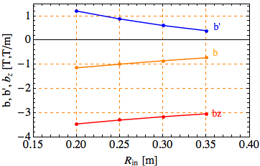
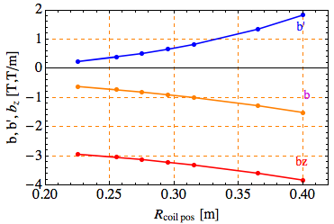
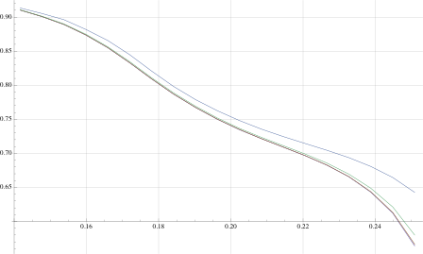
Tolerance of helical solenoid magnet
Tolerance in transverse direction
Tolerance in longitudinal direction
α
β
HS coil radius
dependence
Chromaticity curve
Longitudinal spacial
occupancy rate = β/α
HS coil position
(r offset from
magnet center)
dependence
30.0 %
37.5 %
50.0 %
No change up to 30 %
70 % of space will be used
for infrastructure
15.0 %
22.5 %
Transverse geometry study suggests
optimum HS coil shape may not be a circle
HS coil has a better cooling performance than analytical field
because of better uniformity of field

Slide 9
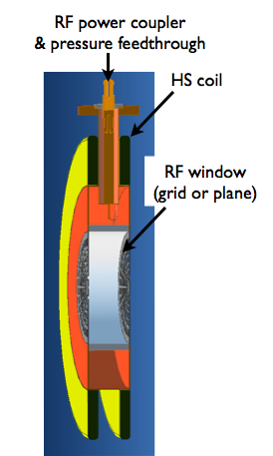
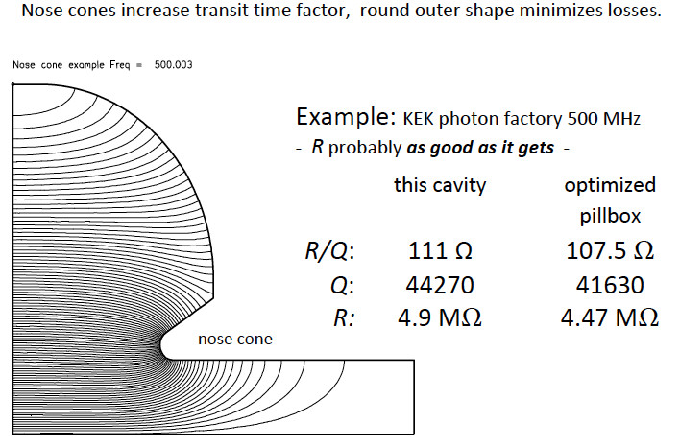
RF cavity in HS magnet
Dielectric loaded RF
Re-entrant RF
HS coil will be located in the nose cone
Practical helical RF cavity will be
combined both concepts
Q_{77K} ~ 20,000 for full ceramic loaded cavity
Optimization (shape, material, etc) is needed

Slide 10
Cryogenic operation
Possible temperature range
55 Kelvin: Oxygen melting point < T < 80 Kelvin LN2 @ 1 atm
Merit
Disadvantage
Low pressure gas wall
High conductivity RF
  Less RF power dissipation
  Less peak power
  Ex) Reduction factor 4.5 @ 77 K
Low loss tangent
Less temperature difference between RF cavity and SC magnet
Complicate & more cost
State of many materials are liquid or solid at low temperature (limit on the species of dopant gas)

Slide 11
Compare RF power consumption in
200 and 325 MHz base HCCs
In STP condition
ν | E | L_{cavity} | R_{cavity} | Dissipation P_{peak} | Stored E | Dissipation P_{ave}
GHz | MV/m | cm | cm | MW/m | J/m | kW/m
RF |  | 10 cavities/λ |  |  |  | Rep rate = 15 Hz
0.2 | 16 | 10 | 57.1 | 43.3 | 313 | 17.9
0.4 | 16 | 7 | 28.6 | 23.2 | 78.2 | 3.4
0.8 | 16 | 4 | 14.3 | 14.7 | 19.5 | 0.76
0.325 | 27 | 10 | 35.3 | 65.4 | 341 | 13.1
0.65 | 27 | 7 | 17.7 | 36.0 | 85.2 | 2.6
1.3 | 27 | 4 | 8.8 | 23.2 | 21.3 | 0.58
Tried to find 20 kW/m @ 77 Kelvin of cooling power
Need a special cooling system

Slide 12
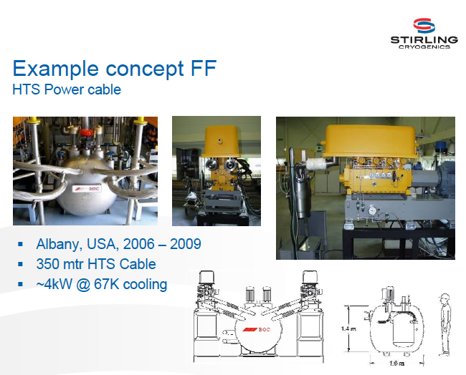
Force flow LN2 cooling system
LN2 inlet (66 K)
LN2 chiller
& circulator
Cryo RF
system
LN2 outlet (70 K)
m: LiN2 flow rate m³/s
c: Specific heat 2019 J/K/kg
ΔT: Temperature difference
(TLN₂ from 66.4 to 77 K)
ρ: Density 853 kg/m³
m ~ 3 Litters/s @ΔT = 4K
Cooling efficiency of chiller: ~10 %

Slide 13
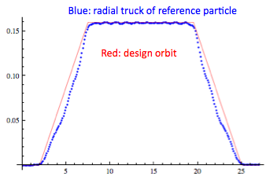
Study matching section
Baseline design of matching section (transport beam from coaxial straight to helical structure) has been made
Change HS coil center position adiabatically
Tune longitudinal beta oscillation by changing the length of section and the current density of HS coil
Almost 100 % transmission
Longitudinal phase space grows
This can be fixed by putting RF cavity in the section
Or tune phase slip factor
Include pressure window effect in future study

Slide 14
Fill high pressurized gaseous hydrogen in RF cavity
GH2 is one of the best ionization cooling absorber
GH2 is a buffer gas to suppress the breakdown
In fact, high pressure GH2 filled cavity is insensitive with B field
GH2 is a good coolant to keep temperature of cavity and RF window
Need more tests
Beam loading effect with intense beam

Slide 15
Working group
For homogeneous absorber filled HCC
Original inventors & analytic investigation
Yaroslav Derbenev, Rolland Johnson
Simulation tool developer
Tom Roberts, Rick Fernow
Developer in simulation
Alex Bogacz, Kevin Beard, Katsuya Yonehara
Kevin Paul, Cary Yoshikawa, Valeri Balbekov, Dave Neuffer
Developer of beam elements
RF: Mike Neubauer, Gennady Romanov, Milorad Popovic, Alvin Tollestrup,
Al Moretti, Moses Chung, Andreas Jansson
Magnet: Gene Flanagan, Steve Kahn, Vladimir Kashikhin, Mauricio Lopes,
Miao Yu, John Tompkins, Sasha Zlobin, Vadim Kashikhin

Slide 16
Current design issue
Need more professional support to design practical channel to see
  Feasibility
  Cost estimate
Need more tests
  High pressure RF cavity
  HS coil test
  6D cooling demonstration

Slide 17
Conclusion
Cooling in 200 MHz base HCC is as good as 325 MHz one
Feasibility of helical solenoid coil
  Initial & 2nd HCCs look will be ok
  Need more work on final HCC
  Great progress with Fermilab TD & Muons Inc
Practical design of helical RF cavity
  Need to demonstrate high pressure RF cavity with beam!
  Find less expensive and low loss tangent ceramics
  Combine dielectric loaded and and re-entrant cavity to design new RF module
  Some progress with Fermilab TD & Muons Inc
Estimate RF power consumption
  Current design is too premature to see the cost and feasibility
Design cryogenic system
  Force flow LN2 cooling system looks feasible

Slide 18
Backup slide

Slide 19
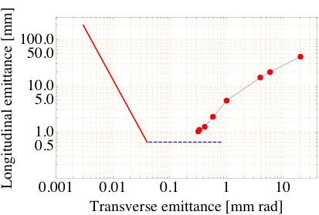
325 MHz harmonics base HCC
Backup slide
Goal phase space
ν = 0.325 GHz
λ = 1.0 – 0.8 m
ν = 0.65 GHz
λ = 0.5 – 0.3 m
100 % @ z = 0 m
Study2a
92 % @ z = 40 m
REMEX
86 % @ z = 49 m
73 % @ z = 129 m
ν = 1.3 GHz
λ = 0.3 m
66 % @ z = 219 m
60 % @ z = 303 m
PIC
GH2 pressure = 160 atm
60 μm Be RF window
E ~ 27 MV/m

Slide 20
