Slide 1
Muon Capture for a Muon Collider
David Neuffer
July 2009

Slide 2
0utline
Motivation
  μ⁺-μ⁻ Collider front end
Produce, collect and cool as many muons as possible
    Start with ν-Factory IDS design study
  Reoptimize for Collider
    Shorter bunch train
      Higher energy capture, shorter front-end
    Larger gradients
Beam Loss problem
  Chicane, Absorber, shielding
Discussion

Slide 3
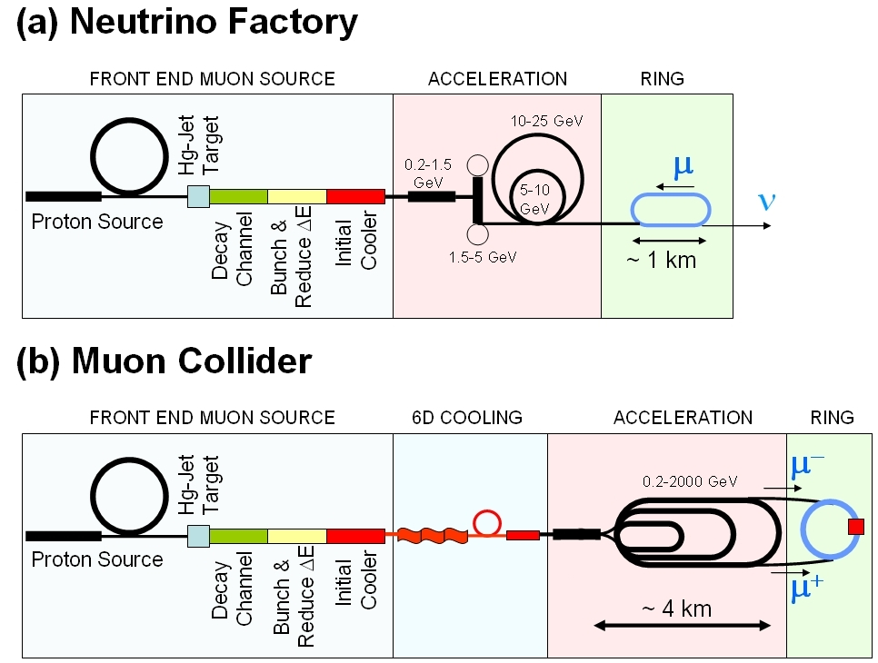
Muon Collider/NF Beam Preparation
Baseline Muon Collider beam preparation system similar to that for Neutrino Factory
  downstream portions (6D cooling, acceleration, collider) are distinct
    much more cooling and acceleration needed for collider
Neutrino
Factory
Muon
Collider

Slide 4
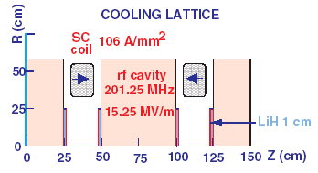
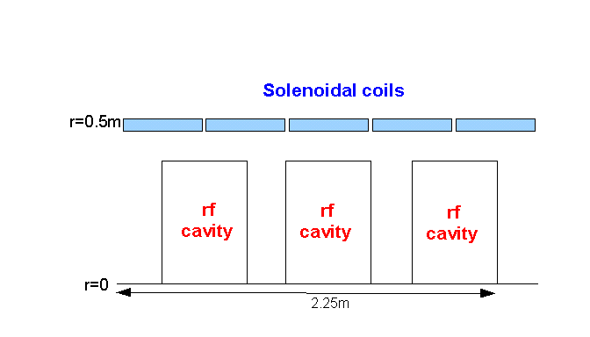
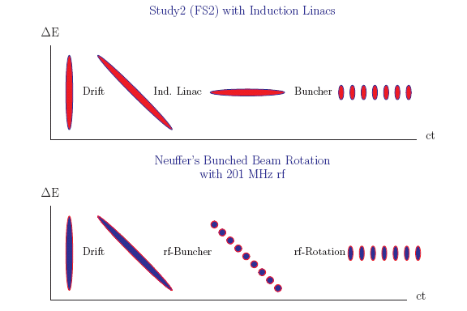
IDS Baseline Buncher and φ-E Rotator
Drift (π→μ)
“Adiabatically” bunch beam first (weak 320 to 232 MHz rf)
  P0 = 233; PN=154 MeV/c N=10
Φ-E rotate bunches – align bunches to ~equal energies
  232 to 2022 MHz, 12MV/m
Cool beam 201.25MHz
p
π→μ
FE Target
Solenoid
Drift
Buncher
Rotator
Cooler
18.9 m
~60.7 m
~33m
42 m
~80 m

Slide 5
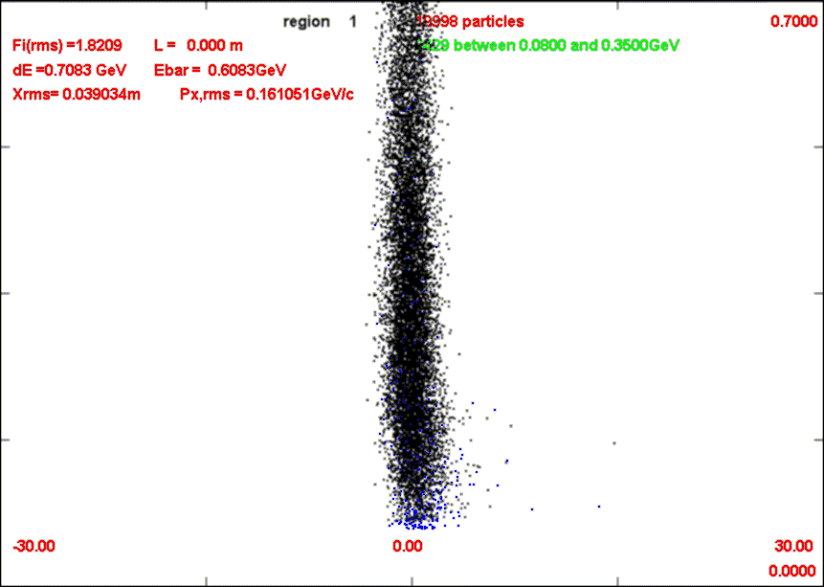
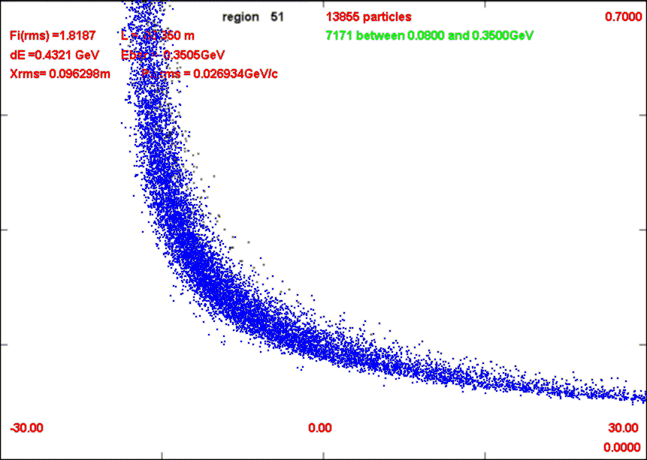
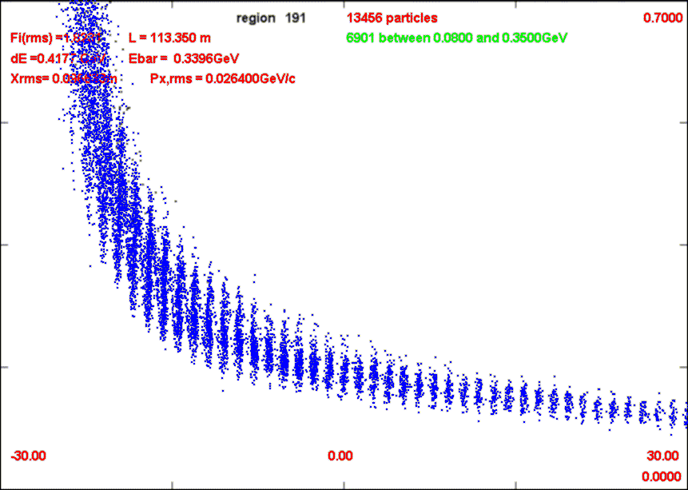
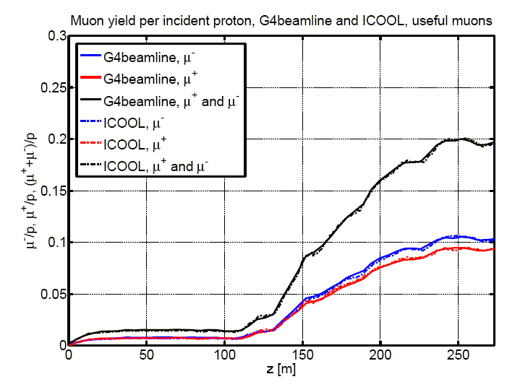
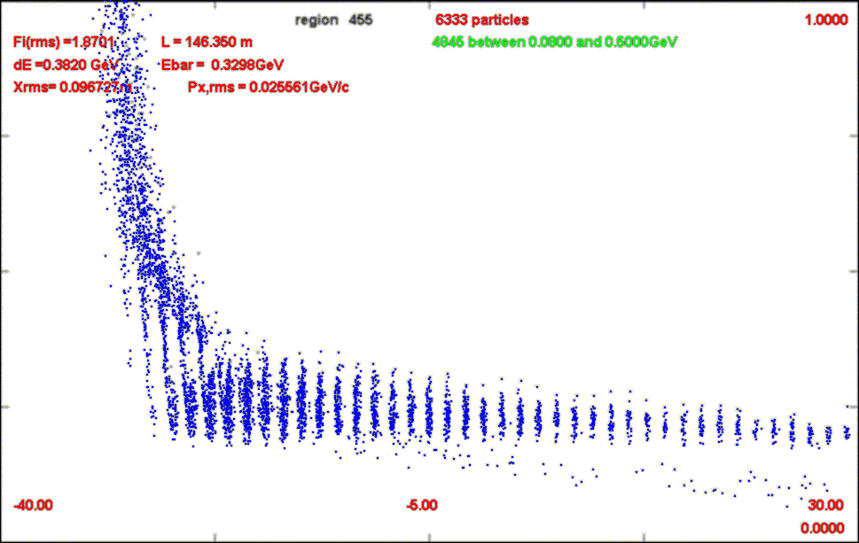
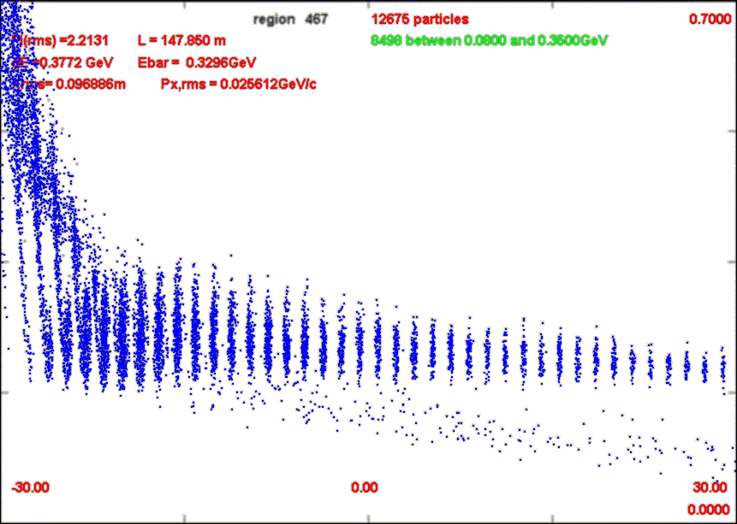
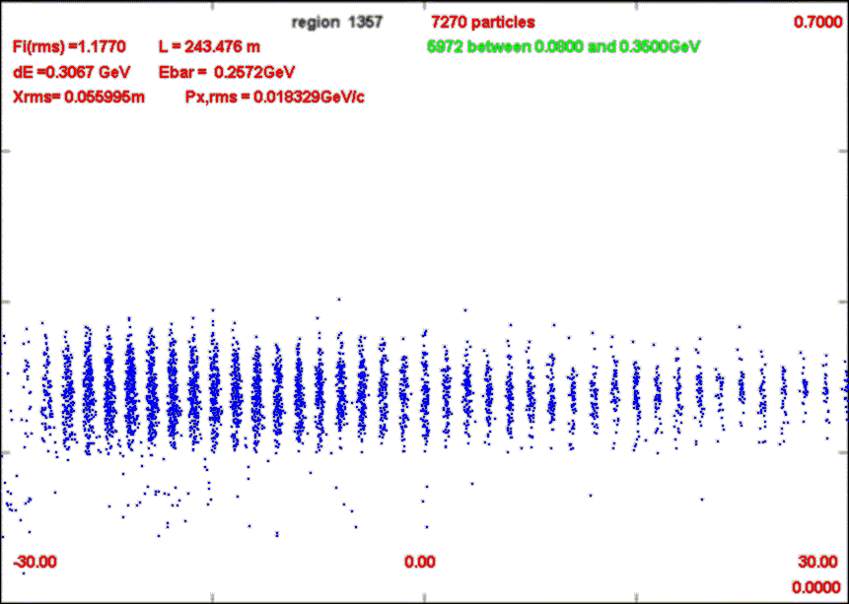
Neutrino Factory version
NF baseline version
  Captures both µ⁺ and µ⁻
  ~0.1 µ/p within IDS acceptance
    ε_{T} < 0.03, ε_{L} < 0.15
Basis for cost/design studies
  rf requirements
  Magnet requirements
700 MeV/c
0m
0 MeV/c
Drift - 80m
-30m
30m
Bunch-110m
v
Rotate-150m
23 bunches
Cool-240m

Slide 6
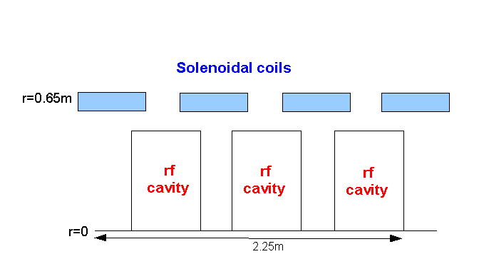
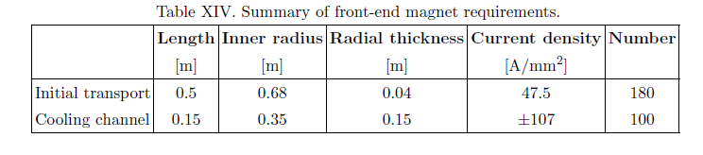
Rf Buncher/Rotator/Cooler requirements
Buncher
  37 cavities (13 frequencies)
  13 power supplies (~1—3MW)
RF Rotator
  56 cavities (15 frequencies)
  12 MV/m, 0.5m
  ~2.5MW (peak power) per cavity
Cooling System – 201.25 MHz
  100 0.5m cavities (75m cooler), 15MV/m
  ~4MW /cavity
Front End section | Length | #rf cavities | frequencies | # of freq. | rf gradient | rf peak power requirements
Buncher | 33m | 37 | 319.6 to 233.6 | 13 | 4 to 7.5 | ~1 to 3.5 MW/freq.
Rotator | 42m | 56 | 230.2 to 202.3 | 15 | 12 | ~2.5MW/cavity
Cooler | 75m | 100 | 201.25MHz | 1 | 15 MV/m | ~4MW/cavity
Total drift) | ~240m | 193 |  | 29 | ~1000MV | ~550MW
rf
Magnet Requirements:

Slide 7
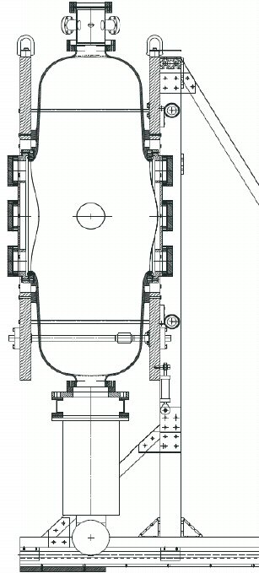
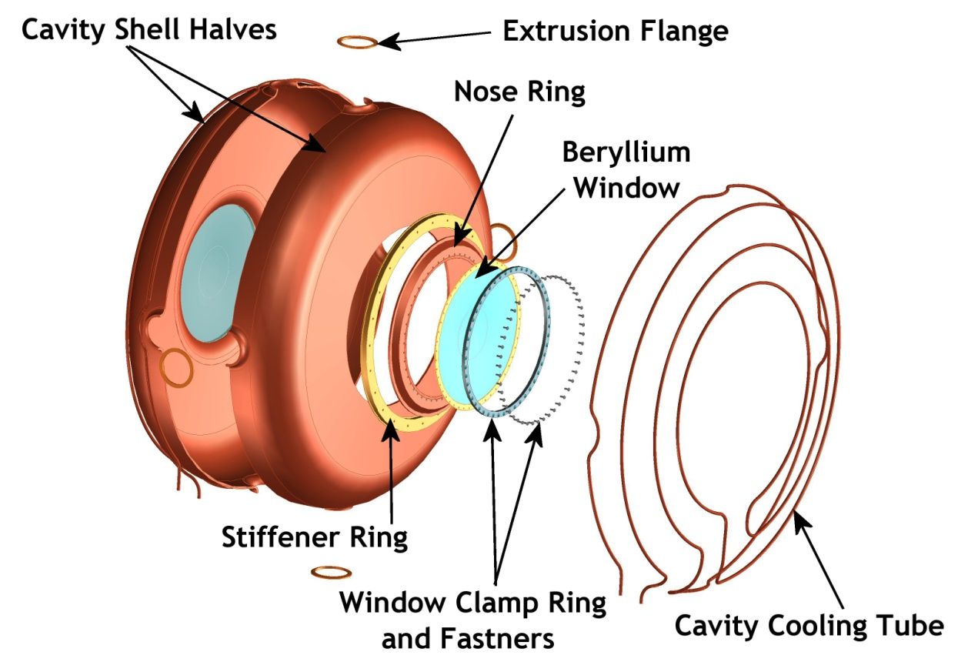
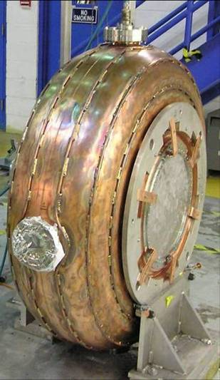
Rf cavity
Concept design construction operation

Slide 8
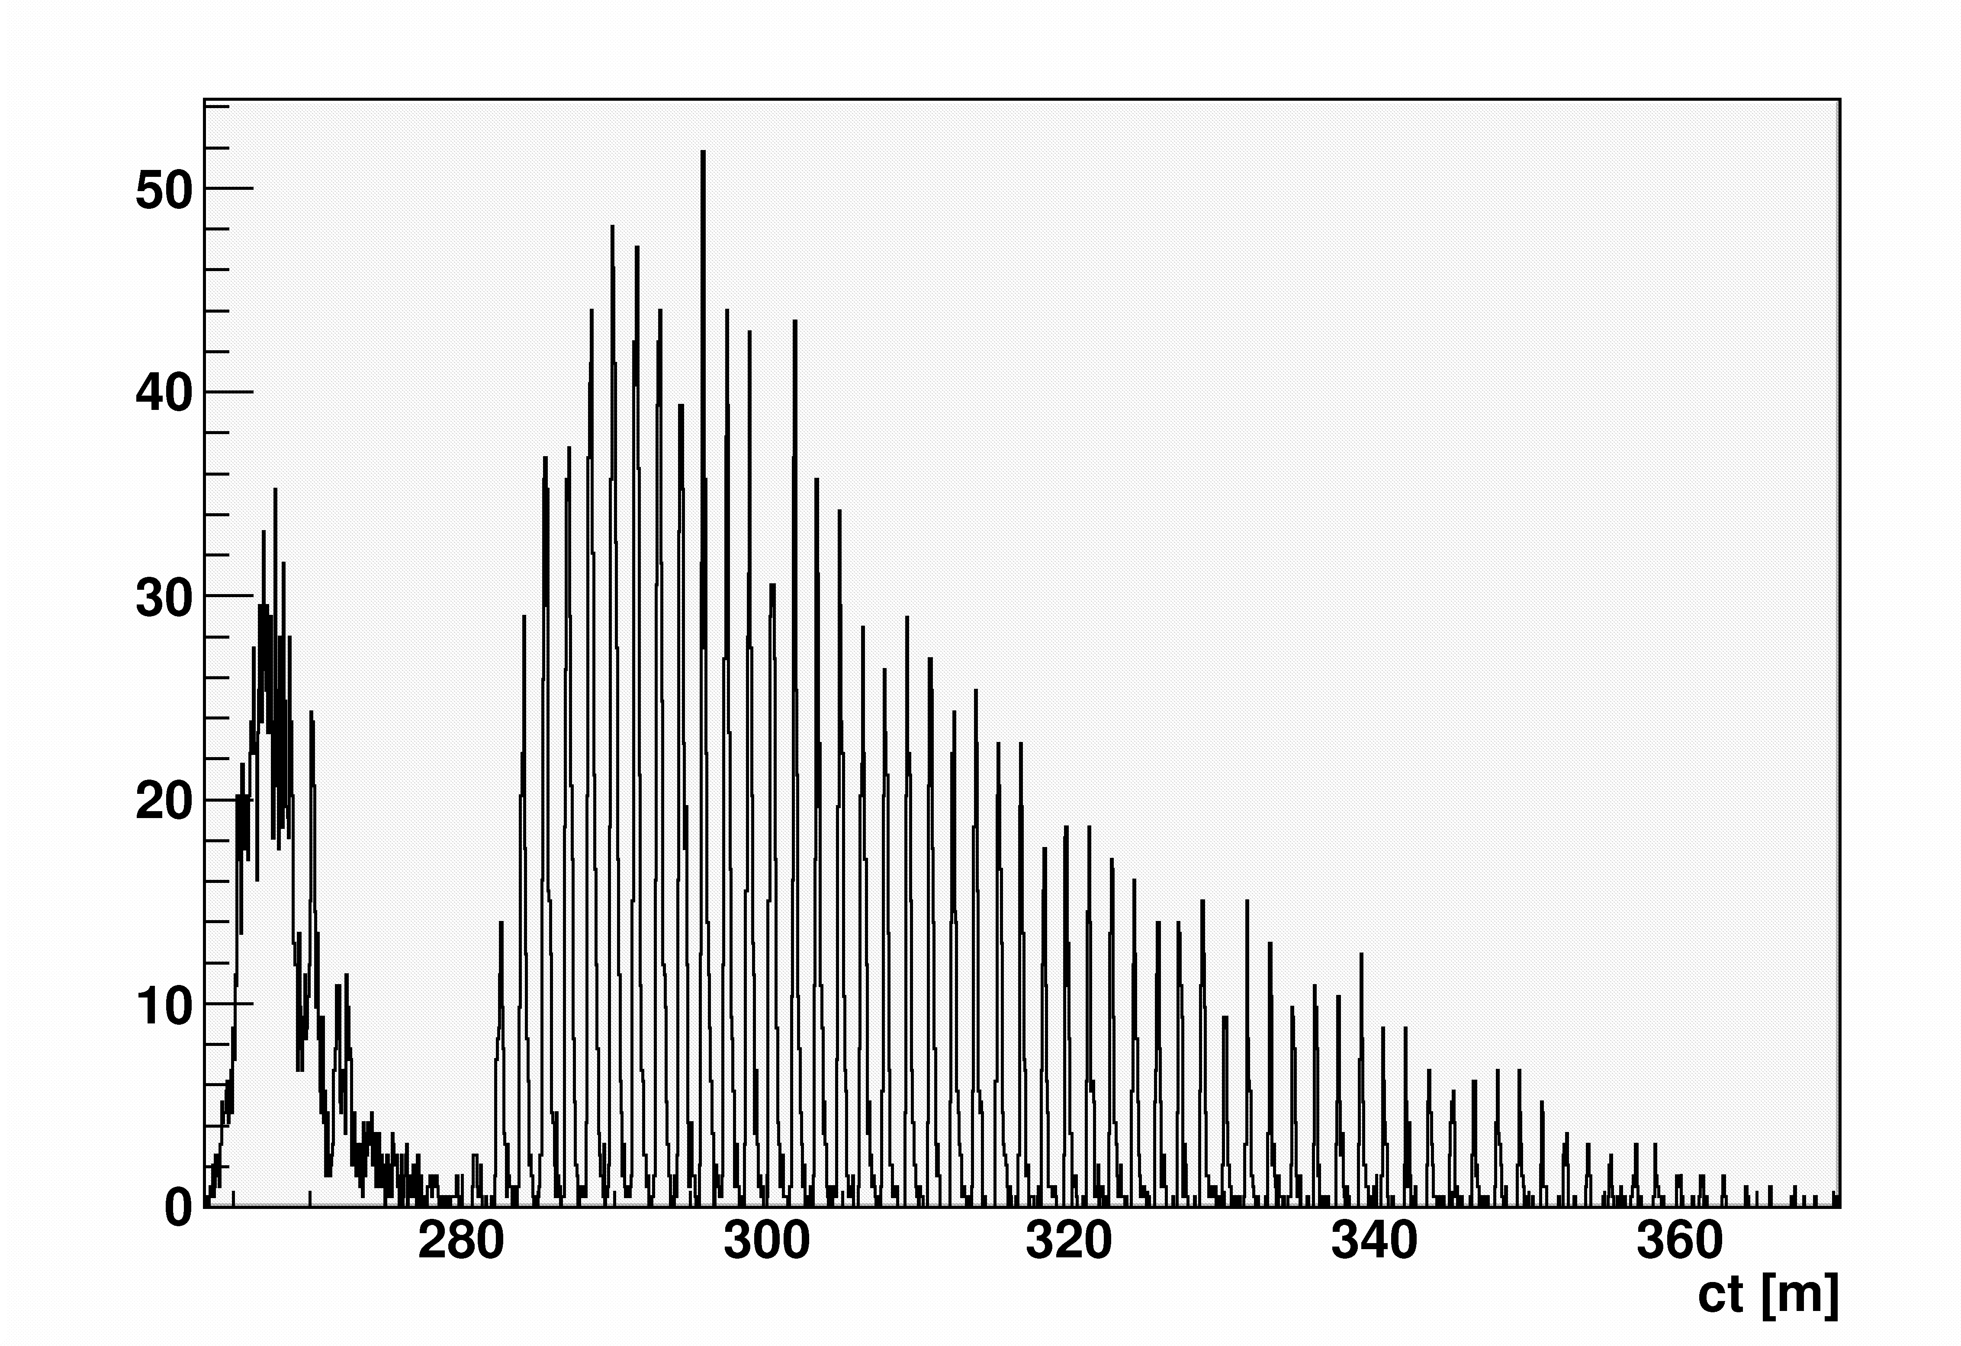
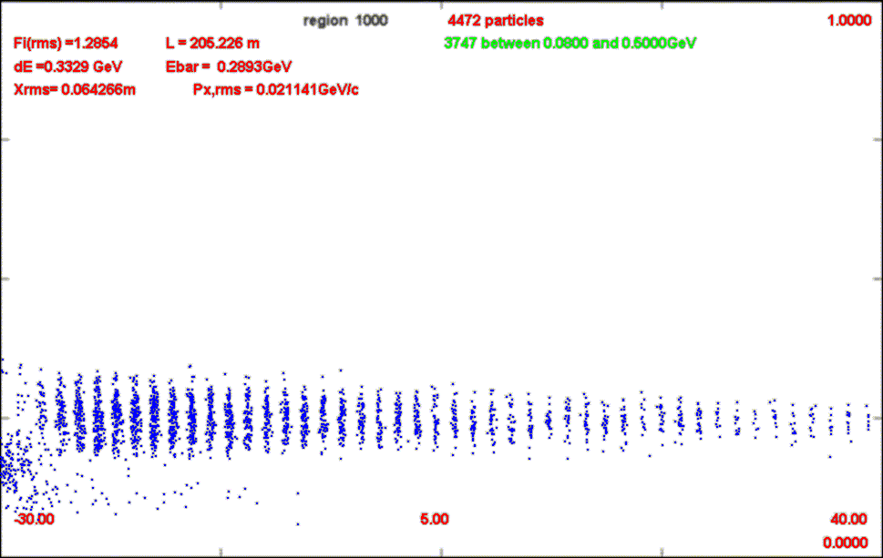
Toward Muon Collider
Bunch trains for NF - ~80m
  Best 23 bunches (~35m) have ~75% of captured muons
Rf within magnetic field problem must be solved
  Pill box rf baseline
  Magnetic insulation
  Bucked-coil
  Gas-filled rf
Assume will be solved
  µ+µ- Collider will improve to the next level of performance

Slide 9
Reoptimize for µ⁺µ⁻ Collider Front End
Muon Collider front end optimum is somewhat different
  Short bunch train preferred
    Bunches are recombined later …
  Maximum μ/bunch wanted
  Longitudinal cooling included; may accept larger δp
  Larger rf gradient can be used (?)
    NF will debug gradient limits
    Cost is less constrained
For variant, we will have shorter BR system, more gradient, and capture at higher momentum
  230 → 275 MeV/c
  150m → 120m
  9/12/15 MV/m → 12.5/15/18 or 15/18/20 MV/m
  1.5T→2T

Slide 10
High-frequency Buncher and φ-E Rotator
Drift (π→μ)
“Adiabatically” bunch beam first (weak 350 to 232 MHz rf)
  P0 = 280; PN=154 MeV/c N=10
Φ-E rotate bunches – align bunches to ~equal energies
  232 to 202 MHz, 15MV/m
Cool beam 201.25MHz
  1.2cm Li H, 15 MV/m
Similar to Neutrino Factory
p
π→μ
FE Target
Solenoid
Drift
Buncher
Rotator
Cooler
18.9 m
~40m
~33m
34 m
~80 m

Slide 11
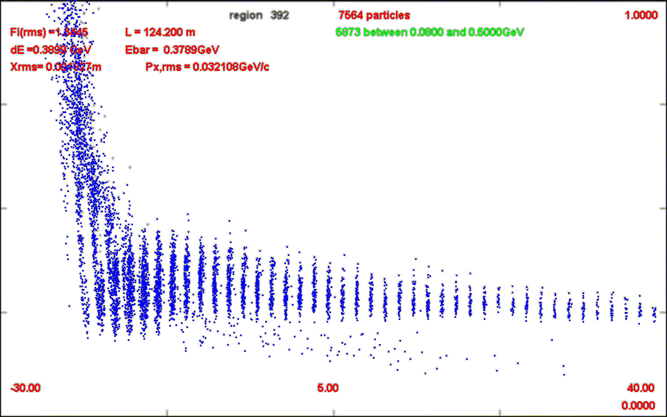
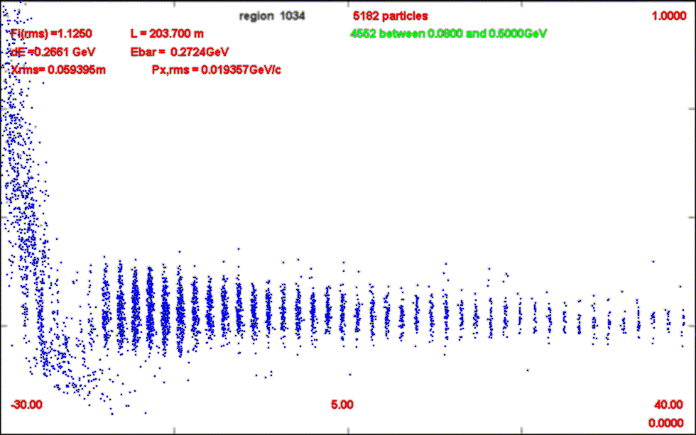
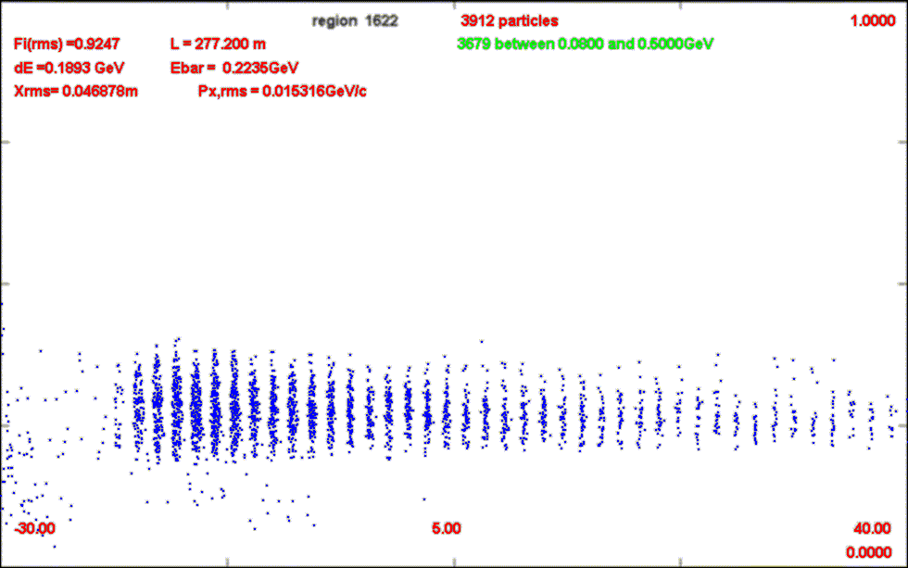
Rotated version
End up with fewer, larger N, bunches
  More μ/p ~
    20-40% more ??
  Larger δp (larger ε_{L}/bunch)
15 bunches

Slide 12
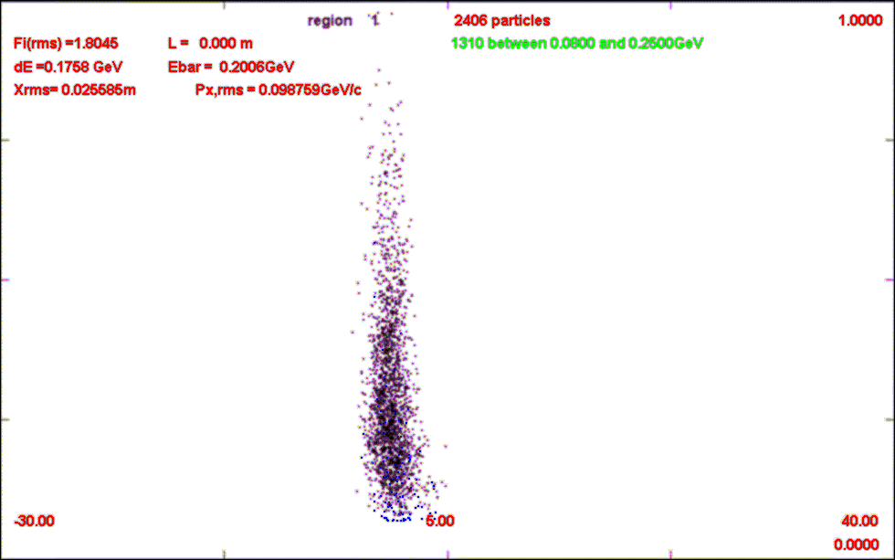
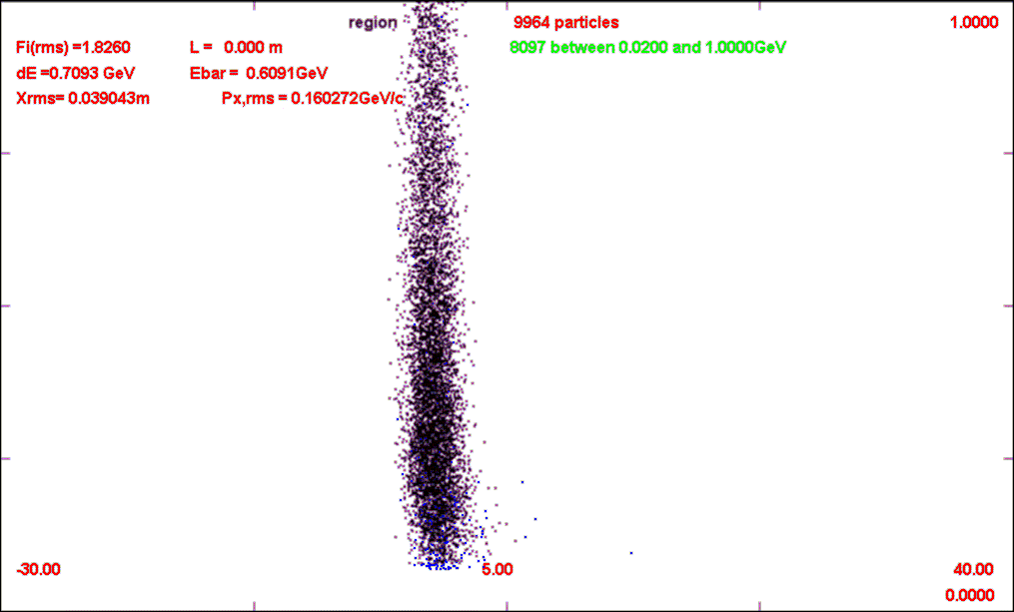
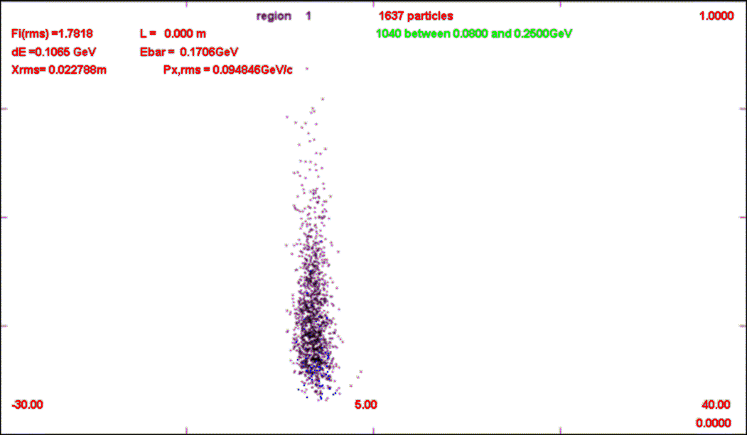
Collider version
1.0 GeV/c
Has ~30% shorter train
More μ/p
  ~0.15 μ/p (from ~0.11)
Captures more of the “core” of the initial π/μ
  Rather than lower half of the core …
NEW MC
0
All at target
IDS

Slide 13
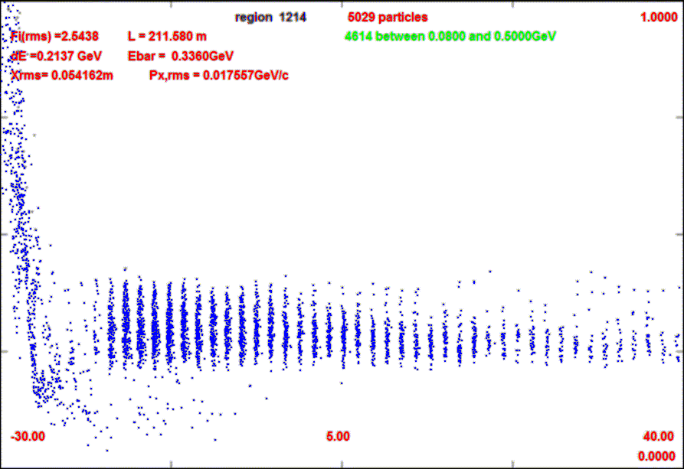
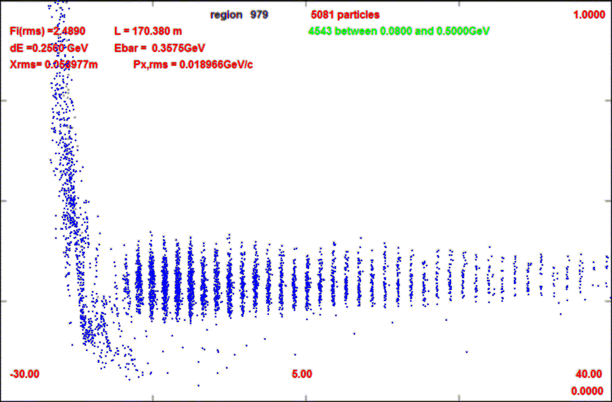
Further iteration?
ΔN: 10→8
Rf gradients: 12.5 → 15 → 18 MV/m
  Or 15 → 18 → 20 MV/m
Shorter system ~102m
p
π→μ
FE Target
Solenoid
Drift
Buncher
Rotator
Cooler
14.05 m
~33m
~25.5m
27 m
~80 m

Slide 14
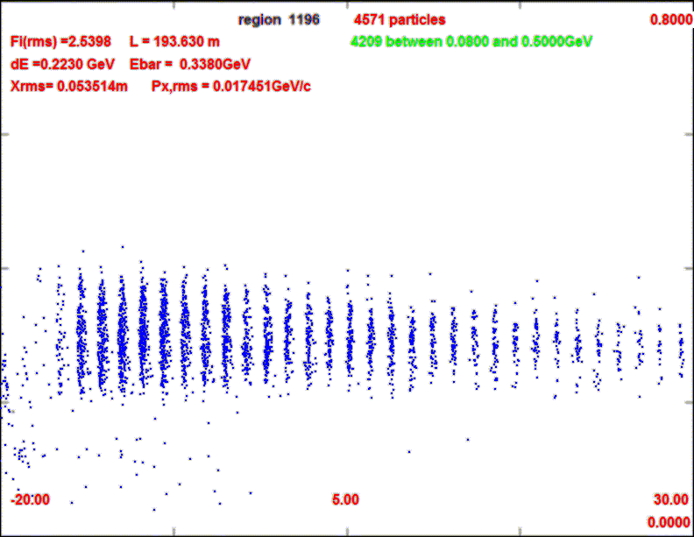
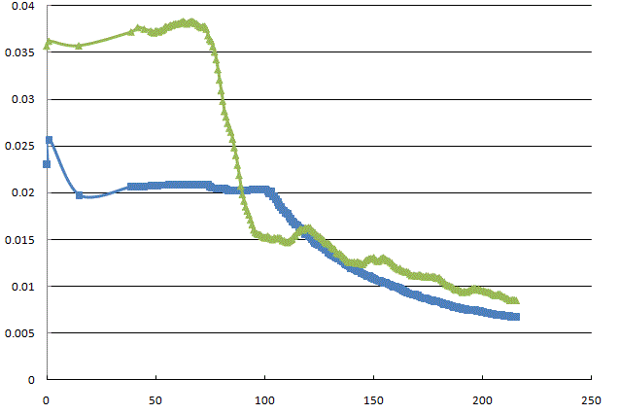
N=8 variant
Shorter bunch train
  But not that much
    15 → 12 bunches
  Bunch phase space larger
  Longitudinal cooling ?
800 MeV/c
0
0.3
µ⁻/p
ε_{L}/10
0.2
ε_{T}

Slide 15
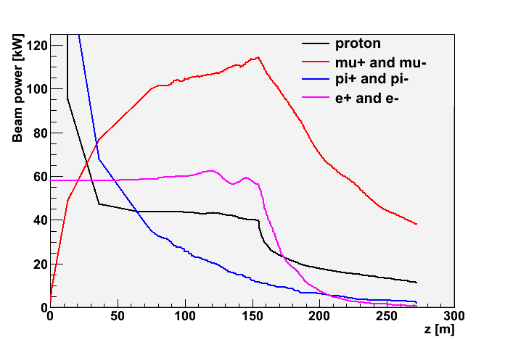
Beam losses along Front End – half-full?
Start with 4MW protons
  End with ~50kW μ⁺ + μ⁻
    plus p, e, π, …
    ~20W/m μ-decay
  ~0.5MW losses along transport
    >0.1MW at z>50m
“Hands-on” low radiation areas if hadronic losses < 1W/m
  Booster, PSR criteria
  Simulation has >~100W/m
    With no collimation, shielding, absorber strategy
Need more shielding, collimation, absorbers
  Reduce uncontrolled losses
  Special handling
Drift
Cool

Slide 16
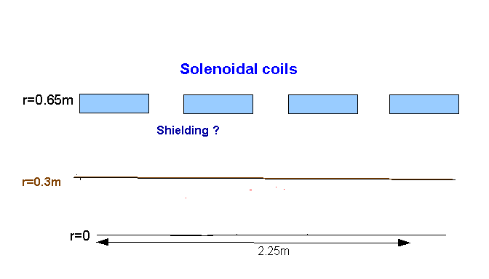
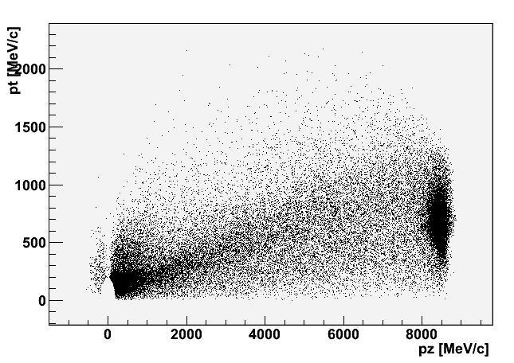
Comments on Front End Losses
First ~70m has 30cm beam pipe within ~65cm radius coils
  ~30+ cm for shielding
  Radiation that penetrates shielding is what counts …
    < 1W/m ?
  Could the shielding handle most of the losses in the first ~70m?
Major source is protons
p
π→μ
FE Target
Solenoid
Drift
Buncher
Rotator
Cooler
12.7 m
~60.0 m
~33m
42 m
~90 m
Shielding ?
Protons after target

Slide 17
Comments on Losses
High energy Protons (>4GeV) do not propagate far
  8 GeV lost in Beam dump
Large spectrum at lower energies
  ~20kW; 1GeV protons
  significant number propagate down cooling channel
  Losses at absorbers
Some protons captured in “cooling rf buckets”
  ~30/10000
  2GeV p
Other than protons, most losses are μ’s and e’s from μ-decay
  Less dangerous in terms of activation
    > 1W/m OK ?
  μ’s would penetrate through more shielding

Slide 18
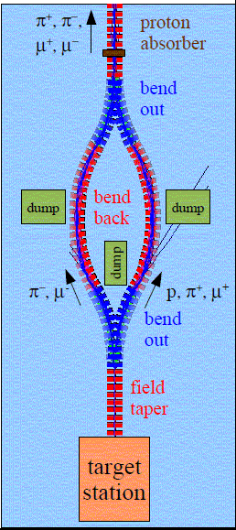
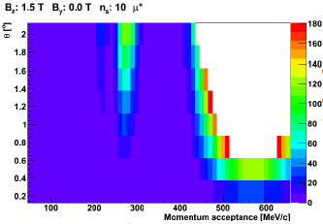
Chicane to remove high-energy p
C Rogers ( see also Gallardo/Kirk) suggests using Chicane to filter out unwanted p/e/μ
  Sample parameters
    5m segments-10 coils 1.25°/coil
    Larger momenta >400─500 MeV/c not accepted

Slide 19
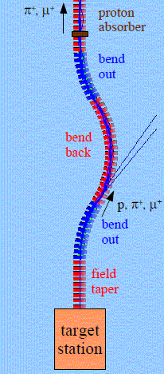
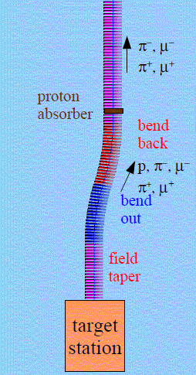
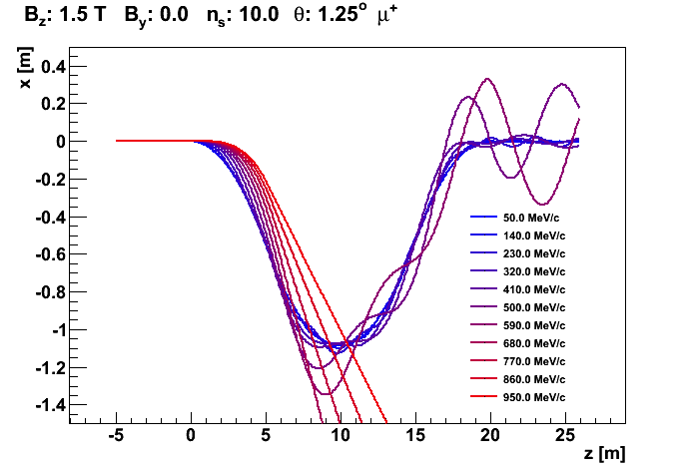
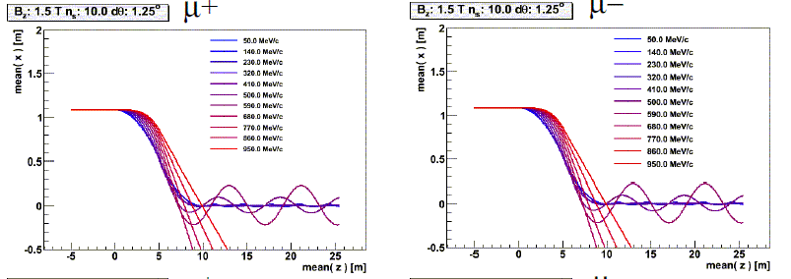
Chicane removes high-energy particles
Single chicane works as well as double chicane (?)
  Offsets orbit
Works for both signs
Would remove most hadronic residual
  Heats beam? <10% ?
But must absorb losses somehow …

Slide 20
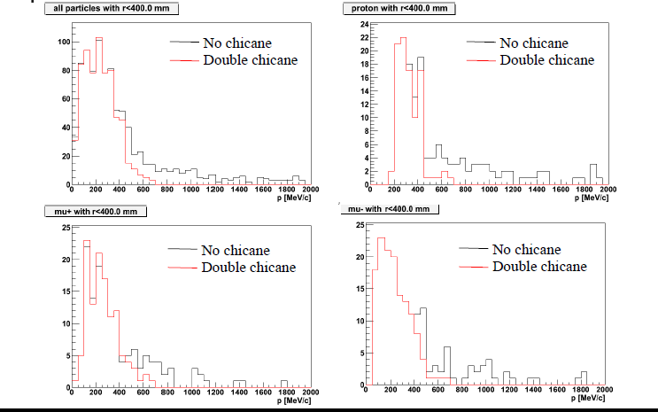
Chicane Performance

Slide 21
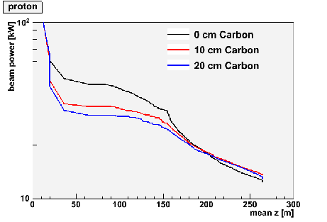
Parameters of Proton Absorber
Absorbers reduce number of protons
  Losses occur near absorber
  Significant proton power remains
10cm C = 40MeV
Tried 1 to 4 cm Be
  Similar localized losses
  Less perturbation to cooling system

Slide 22
Comments
Muon Collider version is an incremental change from IDS
  ~25 to 33% shorter
  Higher gradients
    9/12/15 → 15/16/18 ?
  Capture at ~275MeV/c rather than 230MeV/c
Collider optimum might be a further increment along … ?
Optimization should include initial cooling with 6-D
  Used only transverse in present study, LiH absorbers (~1.2cm)

Slide 23

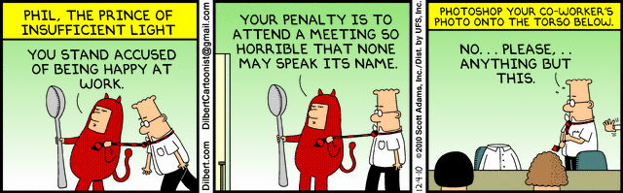

Summary
Muon Accelerator Program

