Slide 1


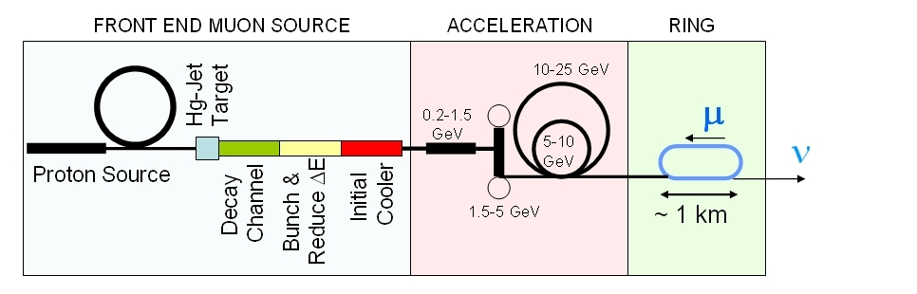
Proton Drivers
Leo jenner – Joint Fermi / Imperial
FERMILAB

Slide 2
Proton Drivers
Leo jenner – Joint Fermi / Imperial
FERMILAB

Slide 3
Proton Drivers
Leo jenner – Joint Fermi / Imperial
FERMILAB
Slides borrowed from C. Ankenbrandt, J. Pasternak, C. Johnstone, Y. Mori etc

Slide 4
Outline
Proton driver parameters for nf/muon collider
Proton Driver options/designs, here and abroad
FFAG options - why FFAG?
Proton driver/ffag collaboration
Simulation strategy: zgoubi, cosy, full 3d field maps
Work in progress / work done so far: mostly understanding ffag theory, codes and existing lattices
Conclusions, future plans

Slide 5
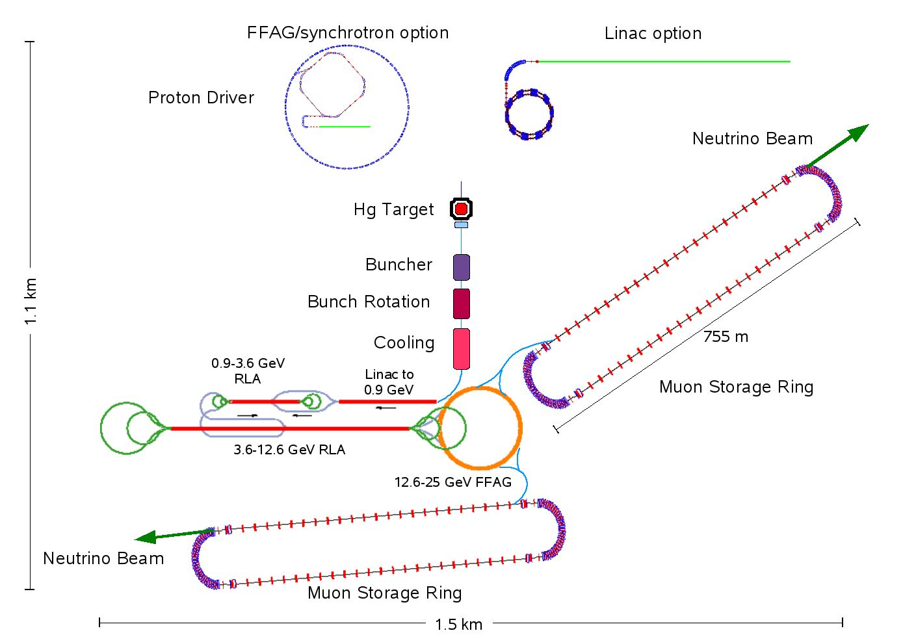

Slide 6
Changes to ISS recommendations
No change!
Fixed to 3!
New baseline assumes,
120 us delay time between
the bunches (240 us total
pulse duration) - based on
MERIT results. This may even
be OK for solid target.
HARP results suggest a possibility
of lowering the proton energy ~6-8 GeV
-> cheaper
P. Soler,
IDS Meeting at Fermilab, April 2010

Slide 7
Current options for NF proton driver
Project X
Linac based (SPL) proton driver at CERN.
Synchrotron(s)/FFAG based proton driver (green field solution).
Multi-MW ISIS upgrade at RAL (UK).
Japanese advanced scaling-FFAGs
Other solutions (multiple FFAGs, NS-FFAGs, etc.) – ideas in development.

Slide 8
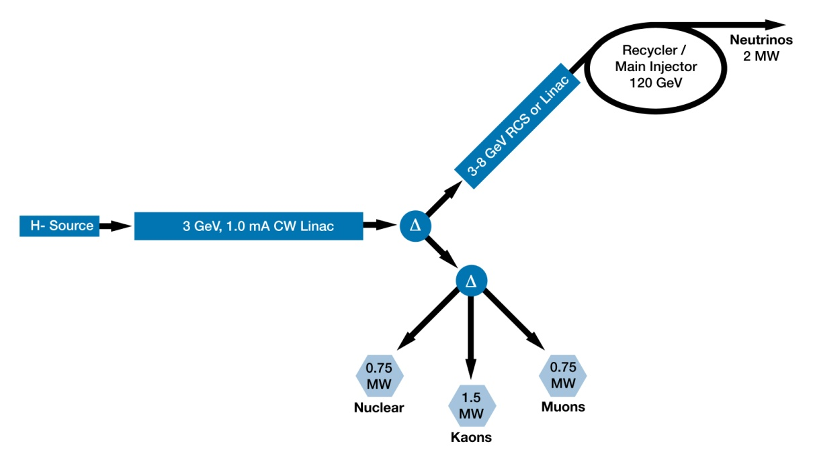
Initial Configuration-2
3-GeV, 1-mA CW linac provides beam for rare processes program
  ~3 MW; flexible provision for beam requirements supporting multiple users
  <5% of beam is sent to the MI
Options for 3-8 GeV acceleration: RCS or pulsed linac
  Linac would be 1300 MHz with <5% duty cycle
Notes:
The real cartoon…

Slide 9
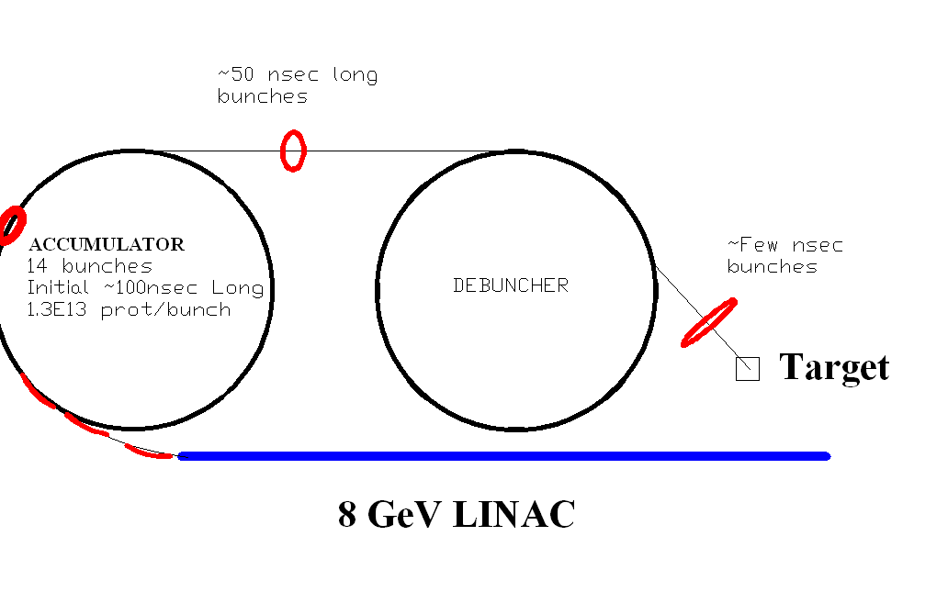
Proton Driver Studies for a ν Factory or a μ Collider based on Project-X at Fermilab, C. Ankenbrandt
9
Notes:
Test
9
Test
9

Slide 10
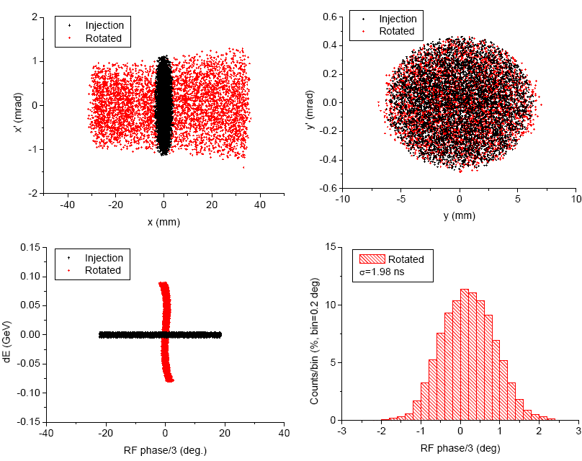
SPL based Proton Driver at CERN
from M. Aiba,R. Garoby
and collaborators
Accumulator
[~100 ns pulses ~110 ns gaps]
Accumulation | Duration = 400 μs
Compression | t = 0 μs
 | t = 30 μs
 | t = 60 μs
SPL beam
[35 ± 7 bunches,
38 ± 7 gaps]
Compressor
[120 ns bunch -
V(h=3) = 1.7 MV]
Target
[2 ns bunches – 3 times]
etc. until
t = 120 μs

Slide 11
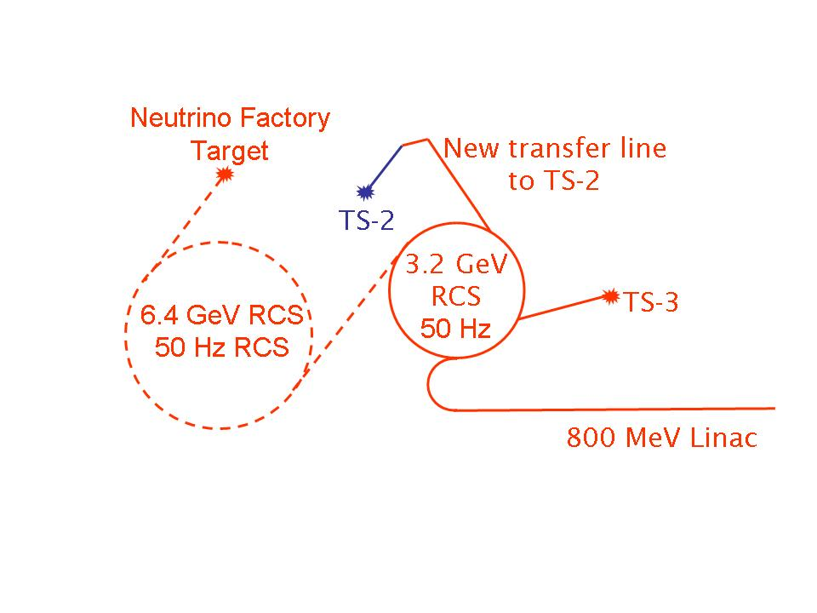
UK - Common Proton Driver for the Neutron Source
and the Neutrino Factory
Based on MW ISIS upgrade with
0.8 GeV linac and 3.2 GeV RCS.
Assumes a sharing of the beam power
at 3.2 GeV between the two facilities
Requires additional RCS machine
in order to meet the power and energy
needs of the Neutrino Factory
Both facilities can have the same
ion source, RFQ, chopper, linac,
H⁻ injection, accumulation and
acceleration to 3.2 GeV
Additional RCS
ISIS MW upgrade

Slide 12

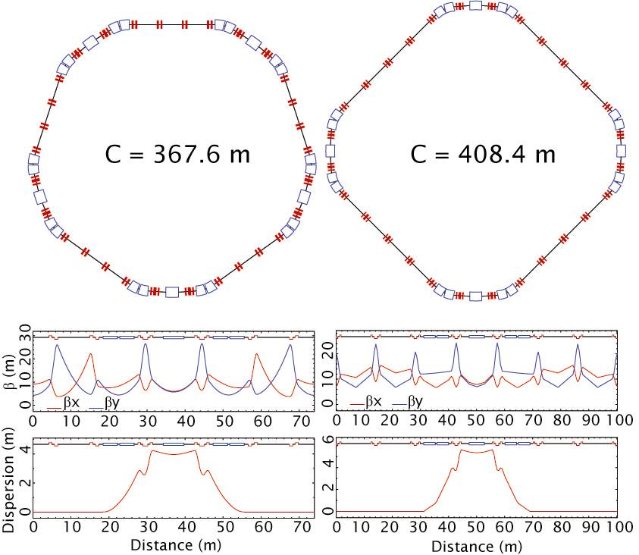
RAL @ UK - Possible RCS Rings
(Chris Warsop, Grahame Rees, Dean Adams,
Ben Pine, Bryan Jones, Rob Williamson)

Slide 13
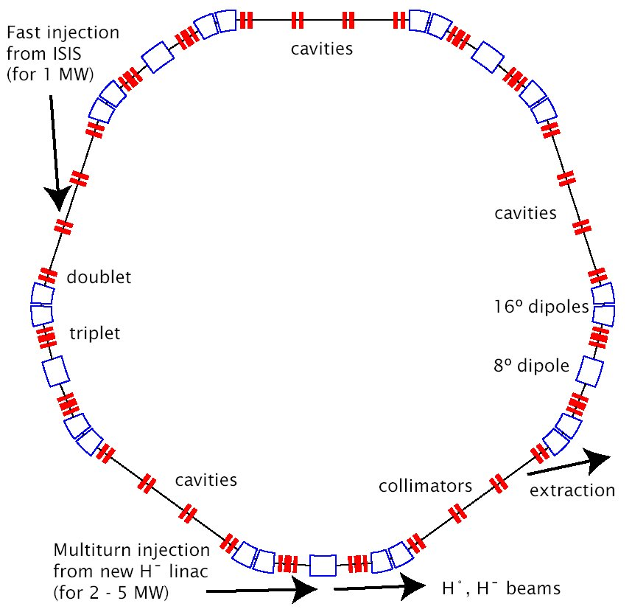
5SP RCS Ring
Energy | 0.8 – 3.2 GeV
Rep Rate | 50 Hz
C, R/R₀ | 367.6 m, 9/4
Gamma-T | 7.2
h | 9
f_{rf} sweep | 6.1-7.1 MHz
Peak V_{rf} | ~ 750 kV
Peak K_{sc} | ~ 0.1
ε_{l} per bunch | ~ 1.5 eV s
B[t] | sinusoidal

Slide 14
Preliminary Main Ring Design for the NF beam at RAL
3.2-9.6 GeV RCS

Slide 15
Alternative Proton Driver layout at RAL
800 MeV H⁻ linac
NF target, 4 MW,
3 bunches
RCS
3.2 GeV,
50 Hz
RCS
6.4 GeV,
50 Hz
Small Compressor
Ring
Neutron
target, 2.6 MW
Fast phase rotation in the dedicated compressor ring
(most economic from the RF point of view, but another ring is needed).
Bunches will be extracted one by one from the RCS.
Compressor ring works above transition, but the rotation is very fast.
The bunches in the RCS will wait uncompressed for 200 us,
but they will come with different energies.
We do not have a design for the compressor ring at the moment,
but CERN design could be adopted.

Slide 16
Other alternative Proton driver based on FFAG
FFAG,
5.2 GeV, 50 Hz
440 MeV H⁻ Linac
Neutrino factory
target, 4 MW, 50 Hz
2.6 GeV, 4 MW FFAG,
100 Hz
Neutron production
target, 2 MW, 50 Hz
Needs 2 rings
FFAG operation should be possible, maybe part rotation in both

Slide 17
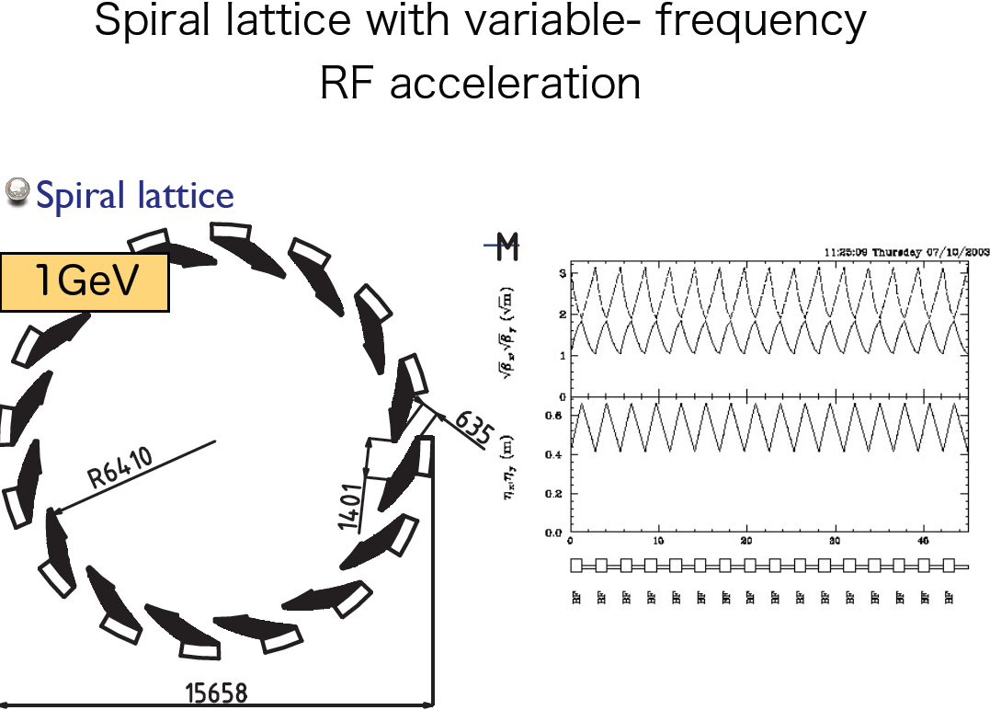
Japan: Material from Yoshi Mori

Slide 18
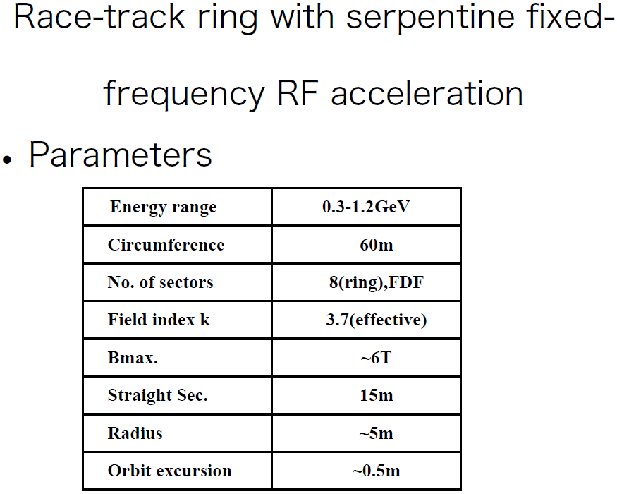

Slide 19
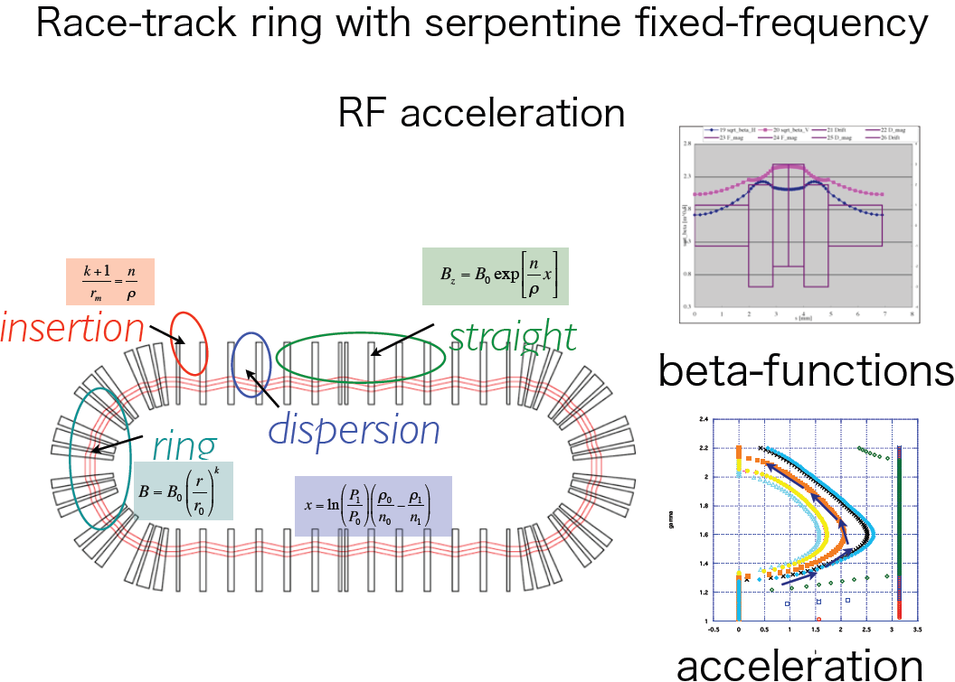

Slide 20
Targets
6/8 GeV lattice in OptiM
(harmonic 4, gamma_t ~ 7.5, final bunch length <3ns (3m total bunch length),
dp/p <1.5% after rotation)
7 x 10¹³ p/p x 4 x15Hz = 4MW
Study compression, space charge...
But the plan evolved...

Slide 21
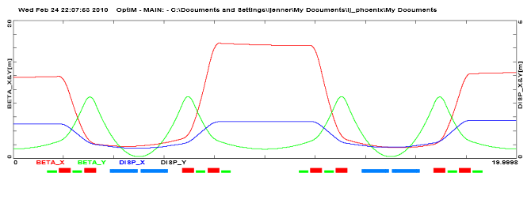
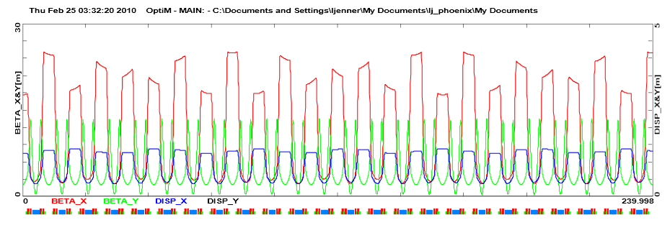
8 GeV lattice – Fermilab in mind
O Sf o qQf o Sd o qQd o1 bB bBc bB o2 o2 bB bBc bB o1 qQd o Sd o qQf o Sf O

Slide 22
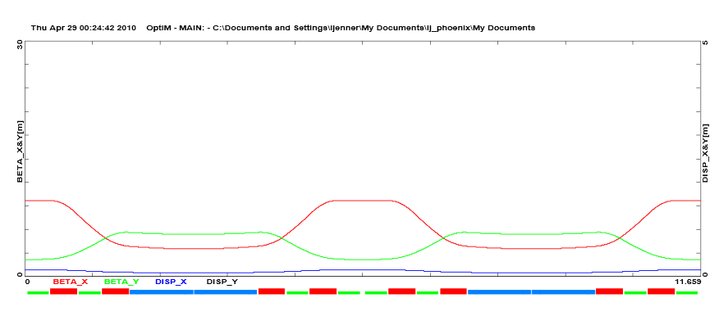
6 GeV

Slide 23
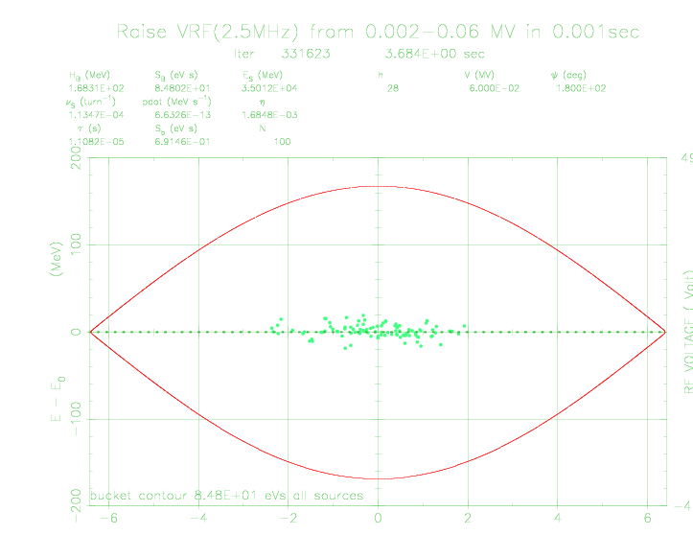
ESME

Slide 24
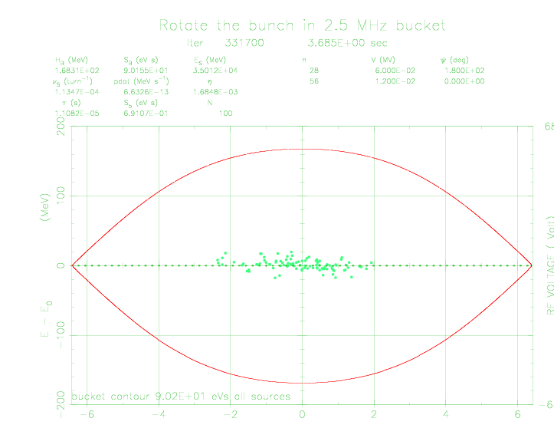

Slide 25
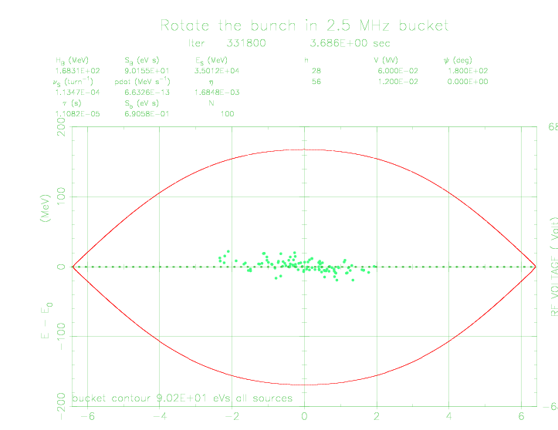

Slide 26


Slide 27


Slide 28


Slide 29


Slide 30
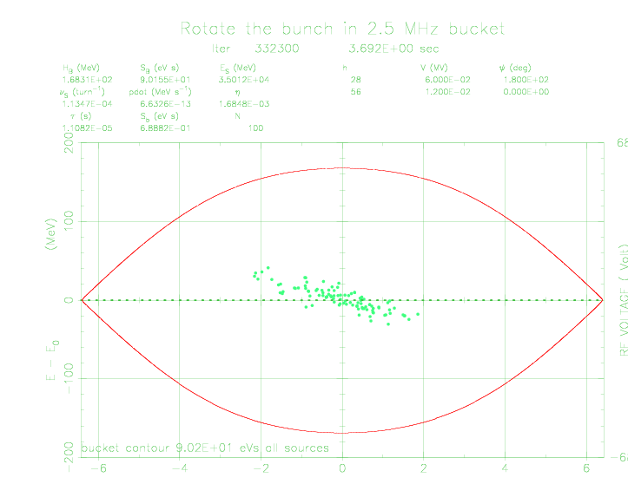

Slide 31
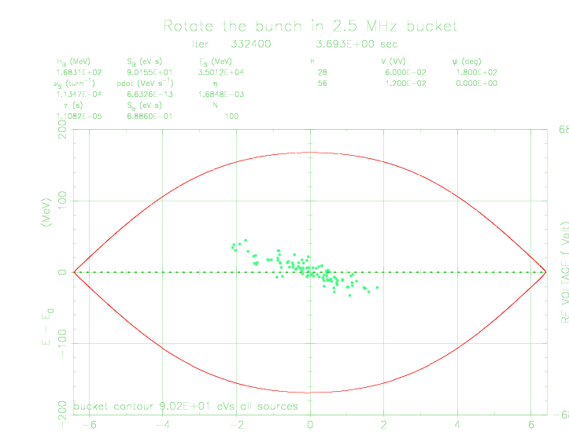

Slide 32
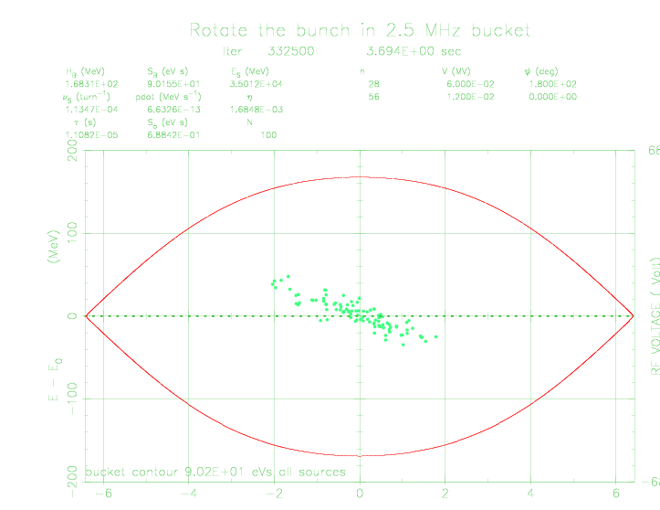

Slide 33
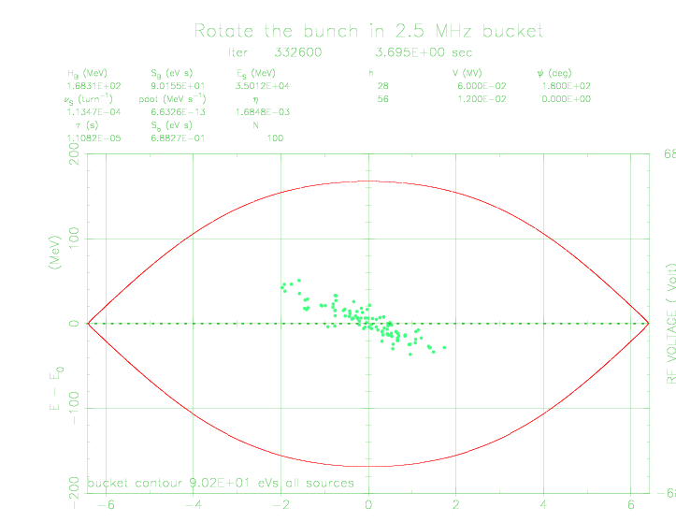

Slide 34


Slide 35
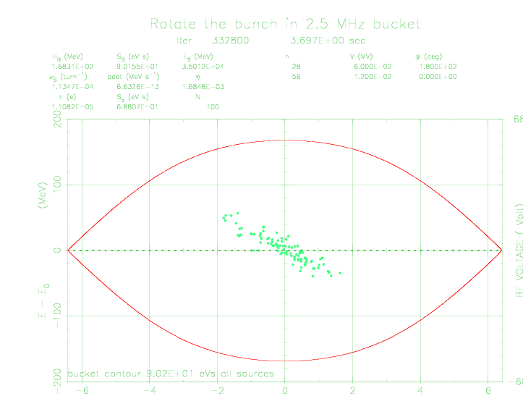

Slide 36
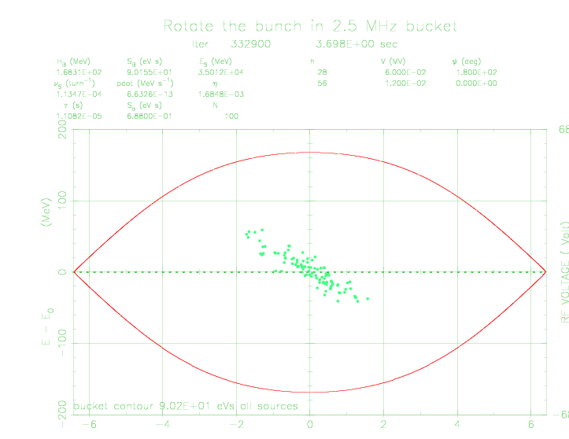

Slide 37
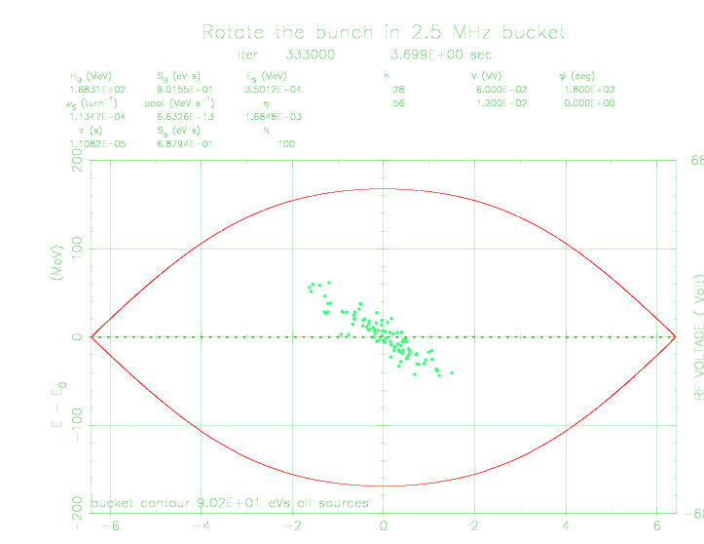

Slide 38
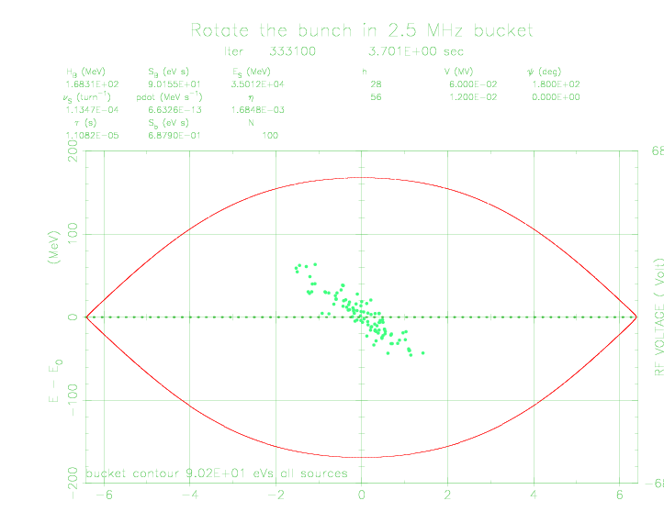

Slide 39


Slide 40
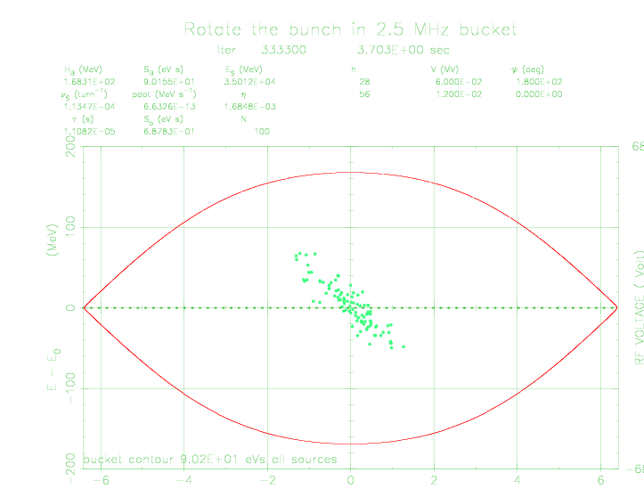

Slide 41
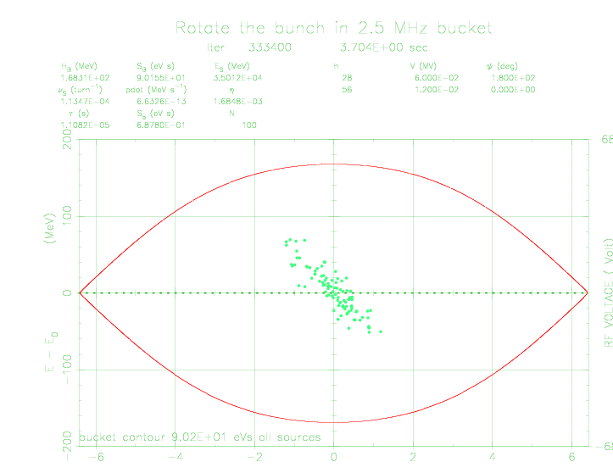

Slide 42
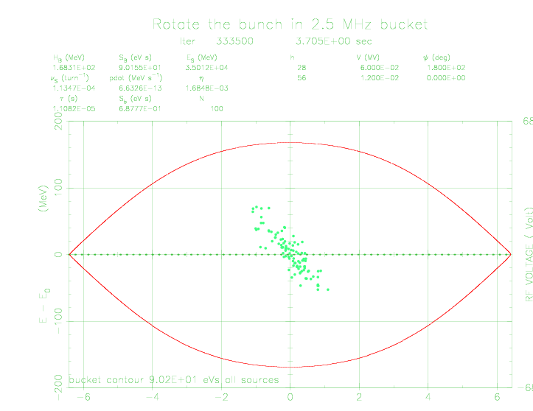

Slide 43


Slide 44
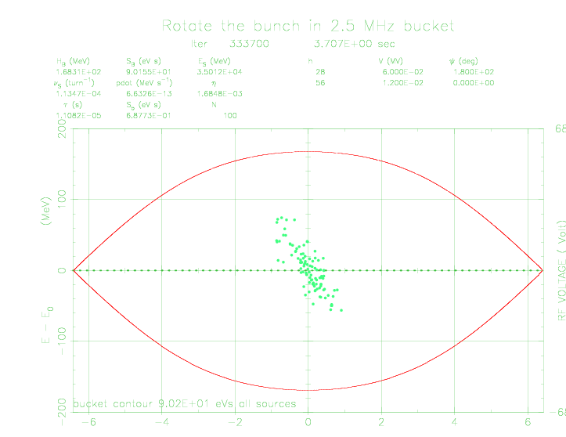

Slide 45
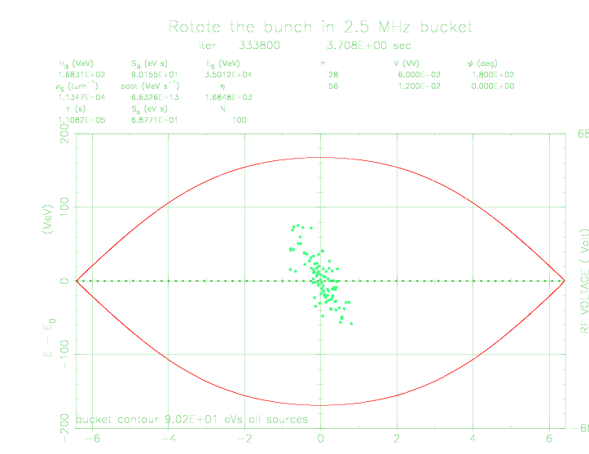

Slide 46


Slide 47


Slide 48
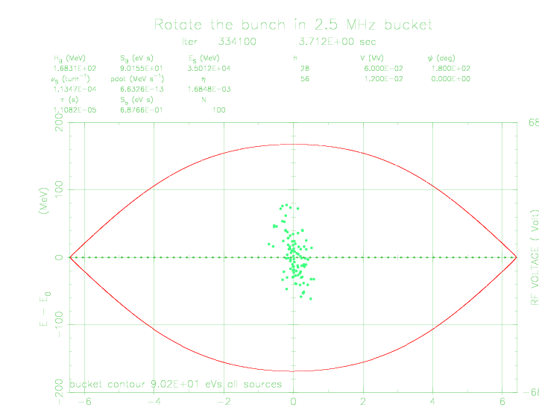

Slide 49


Slide 50
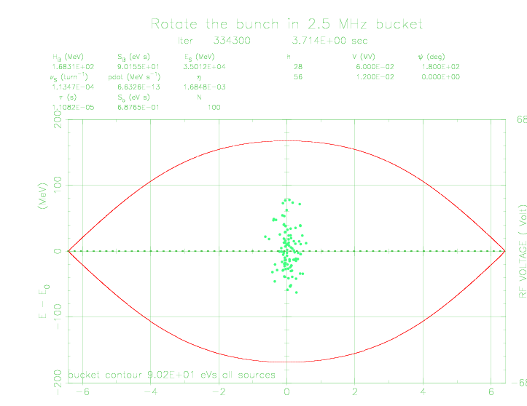

Slide 51
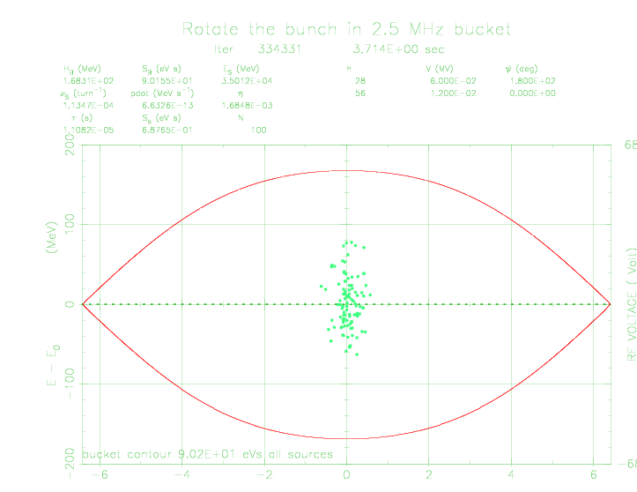

Slide 52
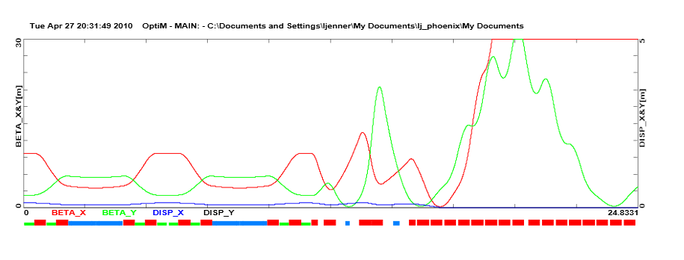
Put it all together...

Slide 53


Slide 54
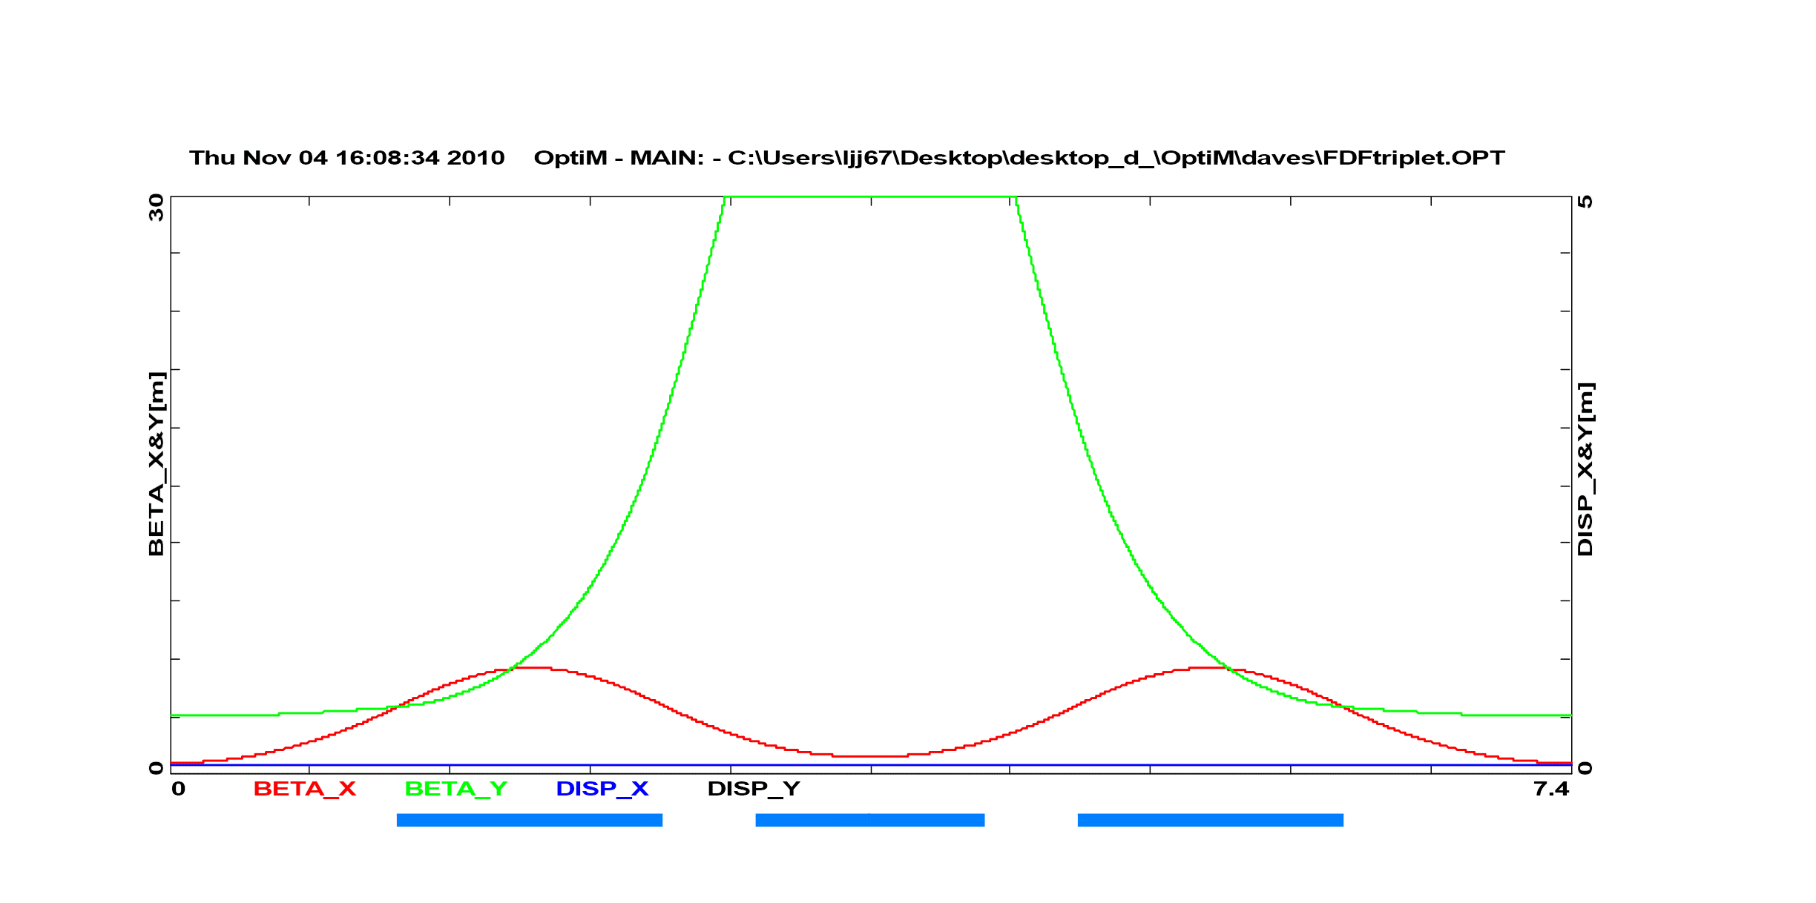
OptiM – Dave N’s FDF triplet

Slide 55
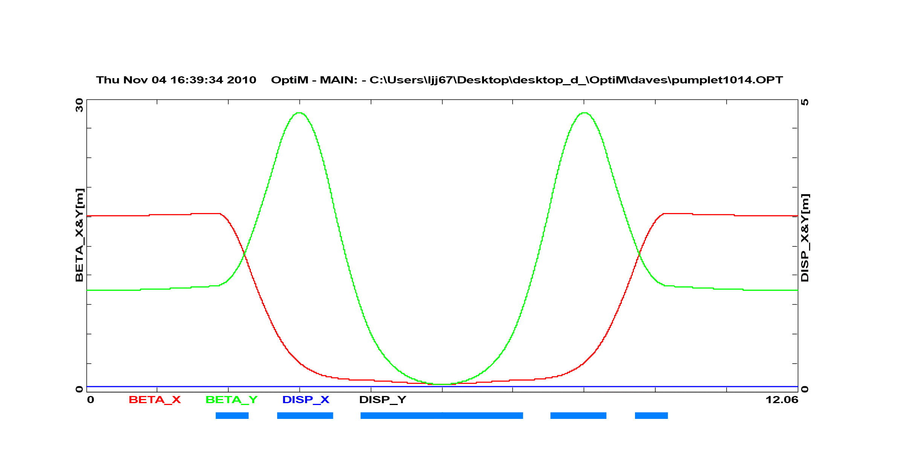
Pumplet(Rees) – 5.5GeV

Slide 56
FFAG advantages
SRF linac: high associated cost and footprint
a 10-20 MW proton driver is not presently considered technically achievable with conventional re-circulating accelerators.
Its strong focusing optics are expected to mitigate space charge effects,higher bunch charges
Advanced FFAG: isochronous orbits, making the FFAG capable of fixed-frequency, CW acceleration

Slide 57
A small collaboration forming...
FNAL: Dave Neuffer, Carol Johnstone
Imperial: Jaroslaw Pasternak , Leo Jenner
BNL: Francois Meot (Zgoubi)
MSU: Kyoko Makino, Martin Berz (COSY Infinity)

Slide 58
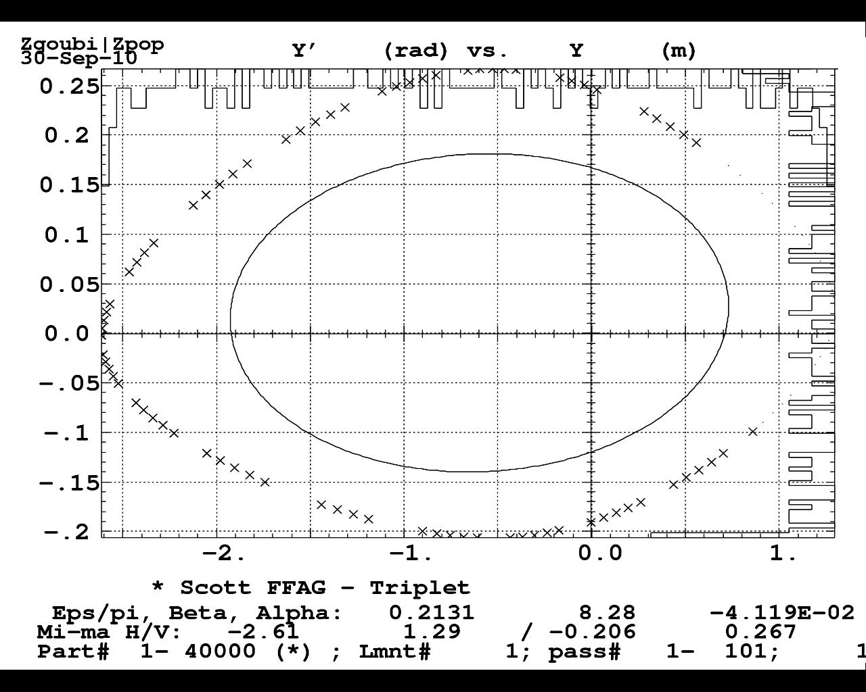
Start modelling with Zgoubi, move on to COSY Infinity when tools are ready

Slide 59
2m
COSY Infinity – 3D field maps
Figure 9. Ring layout and 3D field profile from COSY for 0.25 – 1 GeV. Possible ADSR lattice.
The 3D field profile of a quarter of the ring generated by the new tools in
COSY INFINITY expanded from a simple hard-edge, radial field profile and azimuthal distribution.
COSY Infinity + FACT (FFAG and Cyclotron tools)
Allows calculation of nonlinear fields and kinematics to arbitrary order

Slide 60
Assumptions for 3-8 GeV FFAG
Machine would use direct injection from the CW linac
with stripping injection (cost effective) or an accumulator
ring would be used before the FFAG ring (higher intensity).
Estimation of length of straight section for extraction
5 m (septum field ~1.5 T –standard technology).
Machine could feed MI (radius 528.1 m) and a potential
NF/MC compressor ring.
Best option would be to have a machine of the Booster size
(radius 1/7 of MI – 75.4 m).

Slide 61
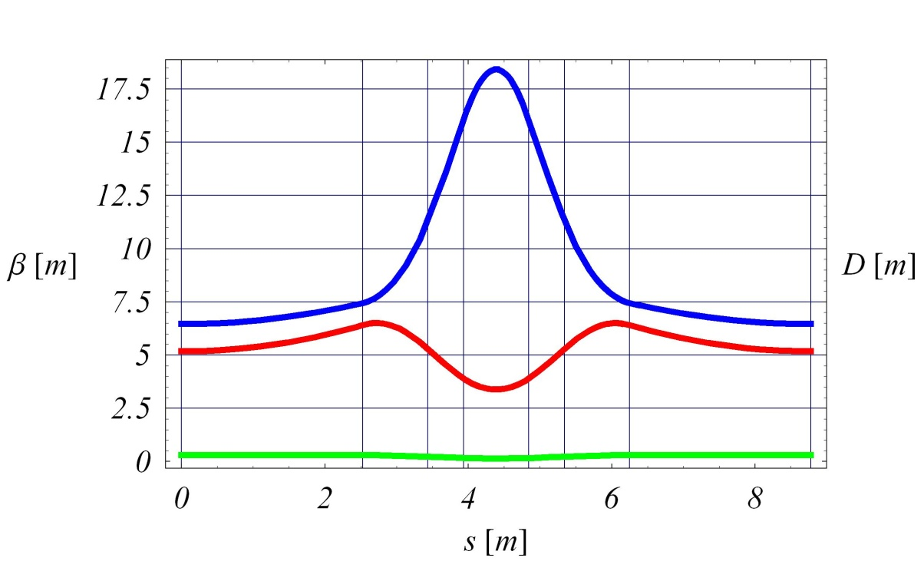
Non-scaling FFAG option – Booster size (preliminary)
Lattice FDF triplet
N 54
Magnets combined function, rectangular
R 75.44 m
Orbit excursion ~25 cm (Is this good enough?)
Dispersion at 8 GeV 0.29 m
(Qx, Qy) (14.43, 9.29)
B_{max} 6.0 T
p_{f} 0.31
Injection energy 3000 MeV
Extraction energy 8000 MeV
h 85 (53.46 MHz)

Slide 62
It seems to be possible to design the scaling option with the Booster size
ring. However the orbit excursion and top magnetic field are large.
This can be mitigated by making the scaling machine larger (2-3 times).
Non-scaling option sems to offer smaller orbit excursion (needs to be shown
in tracking) and lower top magnetic fields. However the chromaticity correction
must be corrected.
Still work on lattices (optimisation, spiral solutions).
Tracking.
Chromaticity correction in non-scaling solution.

Slide 63
Conclusions
Much to be done – these studies are in their infancy (for me anyway)
Lots of software expertise being obtained – tentative plans to visit BNL/MSU for accelerated software tutorials
Much to be done: tracking and implementation of 3D maps a priority
Space Charge – return to Esme?
Old work can be revisited if necessary
Work in progress: hope to tell you more at the next MAP meeting!

Slide 64
Extras

Slide 65

SPL based CERN proton driver parameters
(M. Aiba, CERN)
No. of bunches | 6 | 3 / 1
No. of protons/bunch | 1.67E+13 | 3.3E13 / 1E14
Kinetic energy (GeV) | 5 | 5
Repetetion rate (Hz) | 50 | 50
Output beam power (MW) | 4 | 4
Circumference accumulator (m) | 318.5 | 185.8
Circumference compressor (m) | 314.2 | 200.0
RMS bunch length at target (ns) | ~2 | ~2
Output pulse duration (μs) | 60 | 60 / -
RF for phase rotation (MV) | 4 | 1.7
Remarks | (Present) Baseline Compatible to ISS | Compatible to IDS

Slide 66
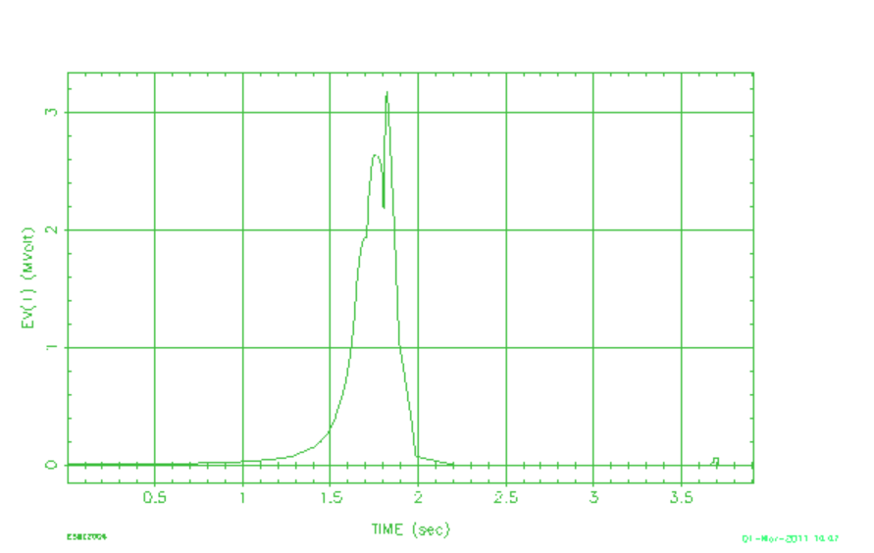

Slide 67
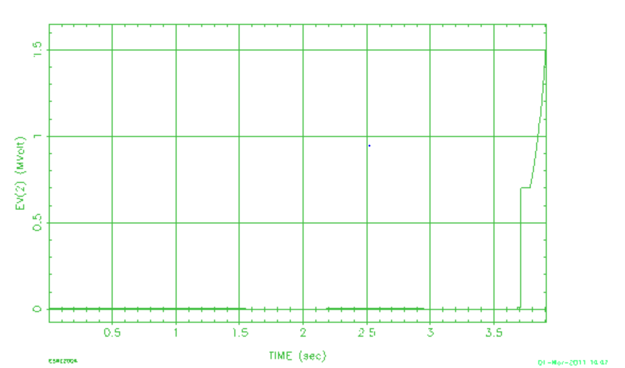
3.68 secs: rotation: RF(2.5MHz bucket) 0.002 - 0.06 MV in 0.001sec

Slide 68
Booster – to 8 GeV – 75.47m radius
Main injector – 150 GeV – 528.3m radius
Tevatron – 1 TeV – 1000m radius

