Slide 1

High pressure RF cavity project
Katsuya Yonehara
APC, Fermilab

Slide 2
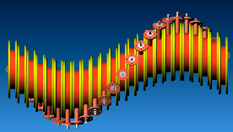
Current project task
Demonstrate high pressurized hydrogen gas filled RF cavity
  Test cavity in strong B fields
  Test cavity in cryogenic condition
  Study beam loading effect (beam induced plasma dynamics) and develop cavity for muon cooling channel and general muon acceleration
Apply HPRF in 6D HCC
Apply HPRF
in front-end
4D cooler

Slide 3
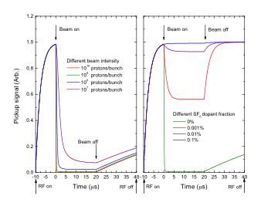
Possible problem:
Beam loading effect in HPRF cavity
Simulated RF pickup signal in HPRF cavity with high intensity proton beam passing though the cavity
Beam loading effect:
Beam-induced ionized-electrons are
produced and shaken by RF field and
consume large amount of RF power
Such a loading effect was estimated as a
function of beam intensity
Recombination rate, 10⁻⁸ cm³/s are chosen
in this simulation
Scientific goals:
RF field must be recovered in few nano seconds to apply for bunched beam
Measure RF Q reduction to test
beam loading model
Study recombination process in
pure hydrogen gas
Study attachment process with
electronegative dopant gas
Study how long does heavy ions
become remain in the cavity
M. Chung et al., Proceedings of IPAC’10, WEPE067
3

Slide 4
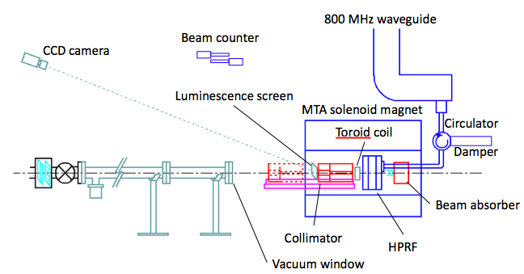
New apparatus for beam test
No energized device within 15 feet from HP cavity due to
hydrogen safety issue
Beam must be stopped in the magnet due to radiation safety
Elastic scattered proton from
vacuum window (100~1000 events/pulse)
400 MeV
H⁻ beam
New apparatus:
New HPRF cavity
Beam extension line
Collimator + Beam absorber
Luminescence screen + CCD
Beam counter
RF circulator + damper
etc…
(Ti)
Bound electrons of H⁻ will be
fully stripped in the vacuum window
Ex) Thickness = 4.5 g/cm³ × 0.1 = 0.45 g/cm²
Stripping cross section ~ 10⁻¹⁸ cm²
0.45/47.9 × 6.0 10²³ = 5.6 10²¹
5.6 10²¹ 10⁻¹⁸ = 5600
4

Slide 5
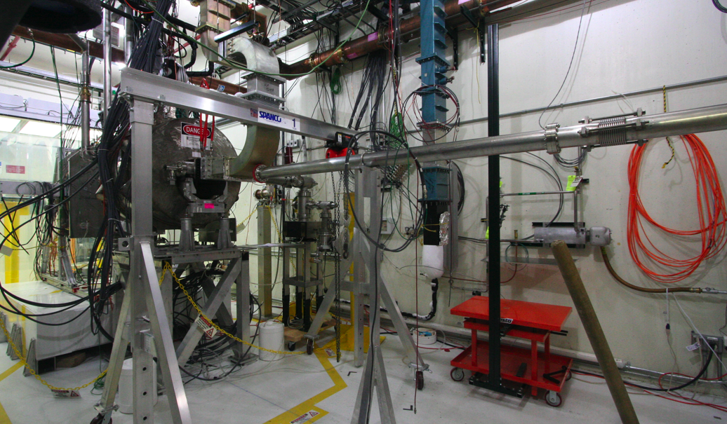
Status of MTA beamline
All beam elements including with beam extension line for beam test were assembled
Beam has been commissioned up to upstream of beam extension pipe from 2/28/11
1st RF wave guide
(will be changed
for beam test)
Beam extension pipe
400 MeV H- beam
Vacuum window
2nd RF station
Beam parameters:
400 MeV H⁻ beam
1.6 10¹³ protons/pulse
Pulse duration: 20 μs
Rep rate: 1 Hz for emittance measurement
1/60 Hz for high pressure RF beam test
HPRF cavity table

Slide 6
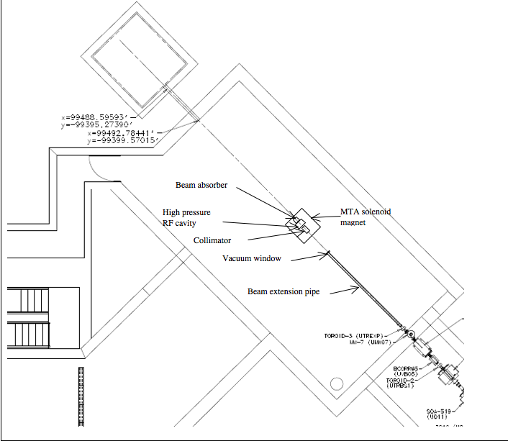
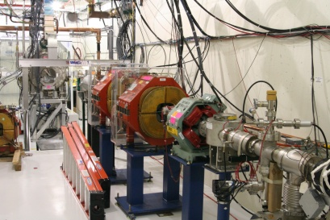
MTA beamline
Beam profile:
Deliver 400 MeV H⁻ beam in the MTA exp. Hall
Rep rate 1/60 Hz
10¹² to 10¹⁴ H⁻/pulse
Tune beam intensity by collimator and triplet
Reduce factor from full linac int. down to 1/40 or less
Beam currently reached
up to here

Slide 7
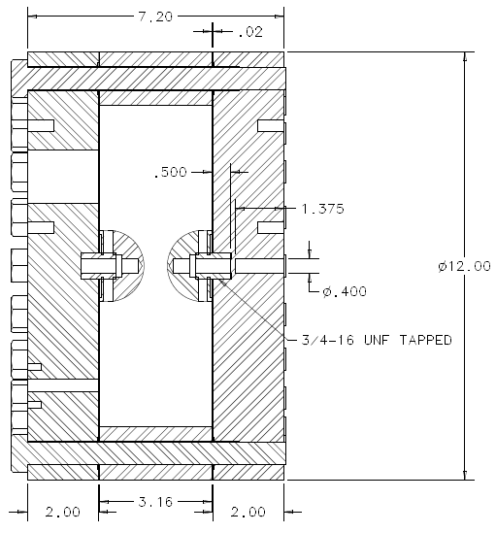
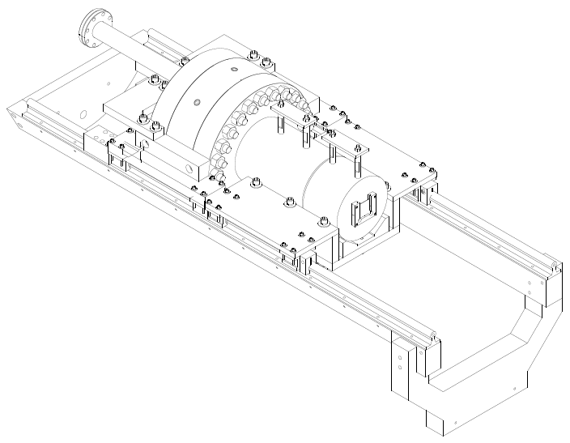
New HPRF cavity and collimator
Current cavity is operated in low pressure region (≤ 1000 psi) due to pressure safety
  Commissioning cavity at 2nd RF station for beam test
  Investigate plasma-electron dynamics in breakdown
Plan to increase MAWP to 1600 psi for beam test
RF coax line
HPRF cell
Collimator
RF
inlet
Luminescence
screen
beam
Gas
inlet
beam
Support rail

Slide 8
Residual radiation dose level
RF cavity
collimator
Beam absorber
Surface residual dose rate at collimator
(red & blue) and Cu electrode
Inject full intensity linac beam for 1 beam pulse/min
12 hours operation
Less than 10² mrem/hr at 1 ft after 1 wk cooling
  → Class II radioactive material
  → Allow to remove apparatus without big issue

Slide 9
Dope electronegative gas to eliminate beam loading effect
Electronegative gas to mitigate beam loading effect
  SF₆+e -> SF₆⁻, NH₃+e->NH₃⁻
  Attachment cross sections are strongly dependent on impact energy of electron
  Investigate electronegative gas effect with spectroscopic measurement

Slide 10
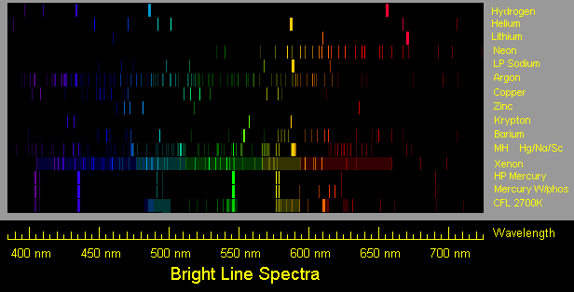
Dope photo luminescence gas
Dope noble gas to illuminate electron dynamics in HP cavity
  Argon has lower first excitation energy (13.1 eV) than Hydrogen ionization energy (13.6 eV for H & 15.4 eV for H₂)
  Rare gas is not sensitive in any chemical interactions while H⁺ and H₂⁺ are very active to form poly hydrogen with H₂ ex. H₃⁺
  H₃ breaks up immediately w/o light emission
  Argon de-excitation light tells us population of electrons

Slide 11
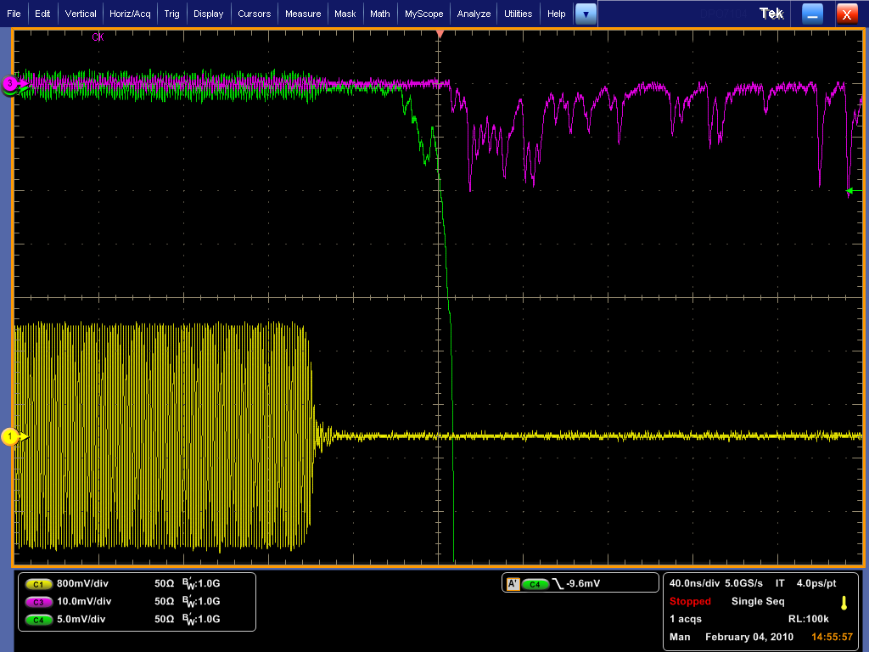
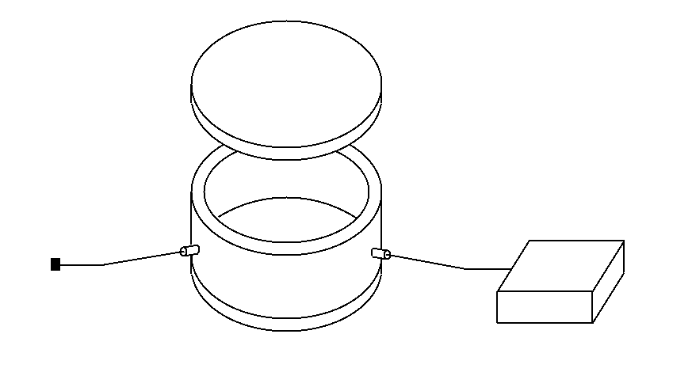
Timing calibration system
Data taking system is needed finer timing resolution to investigate BD phenomenon
Timing between RF PU signal and emission light is issued
Required timing accuracy is less than 100 psec
Special pico sec laser that provides a clear light and a trigger signal in 4 psec timing resolution
Use SiPM (τ << 100 ps w/o preamp) to trigger breakdown event
Spectroscopic light (656 nm: Lα)
PMT Trigger
Δt
PU
HPRF
Digital Oscilloscope
Optical feedthrough
SiPM/PMT
ps Laser
½” Heliax for
RF pickup signal
½” Heliax for
Optical signal
Goal: Timing calibration < 100 ps

Slide 12
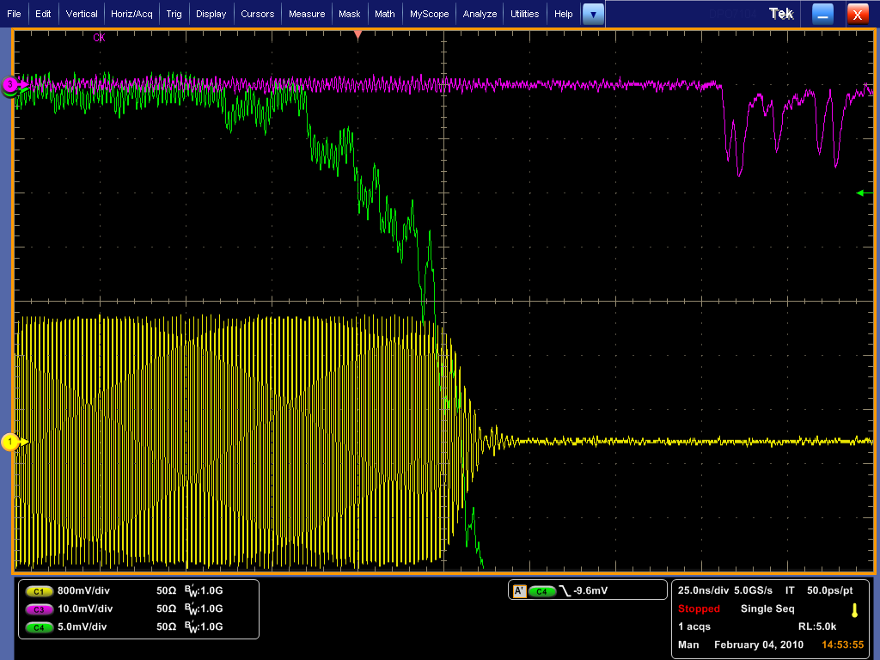
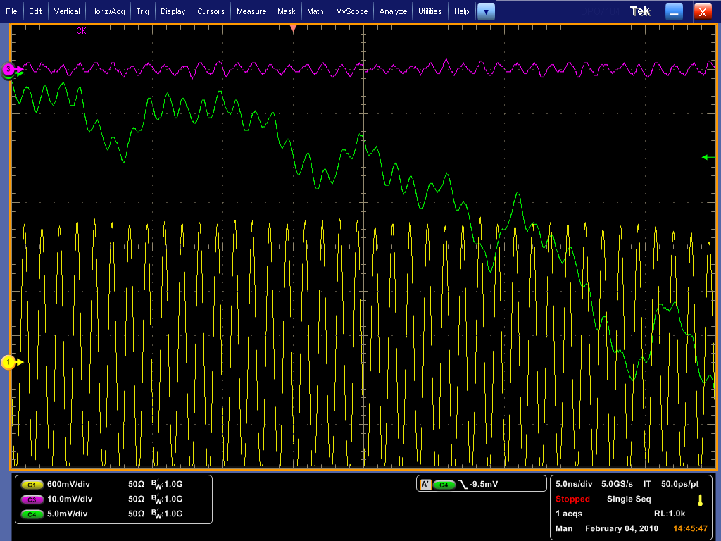
Unknown light
Optical signal in old cavity was accessed from side wall
In last test, we occasionally accessed from front side
We sometimes observed mysterious light that appears even before the breakdown!
Is it precursor light??
  If yes, we have a way to measure electron accumulation process
  If no, some electron may directly hit fiber and make scintillation light
  Or something else going on
Spectroscopic light (656 nm: Lα)
PMT Trigger
Cavity was breakdown
after taking this data
PU

Slide 13
Critical issues for down selection
RF field must be recovered in few nano seconds
DC to 800 MHz, Hydrogen breaks down at E/P = 14. It indicates we can use DC data as a framework to explain results.
  Need different frequency measurements to test frequency dependence
Electrons move with a velocity, . Current .
Power dissipation due to electrons in phase with RF and dissipate energy through inelastic collisions =
Measurements with beam verify mobility numbers and verify our loss
calculation
Electrons recombine with positive ions and removed. If this is very fast they don’t load cavity, if slow cause trouble
  Beam measurement will give the recombination rate
Solution: use electronegative gas(es) to capture electrons and form negative ions
  Beam measurement will verify attachment rate
A+e →A⁻ heavy negative ions. How long do these hang around and do they cause the breakdown voltage of the cavity to be lowered
  Beam measurement will give necessary answers
Feasibility including with hydrogen safety analysis also need to be answered
13

Slide 14
Schedule on 1st beam test
Commissioning cavity
  Pressure test & calibration
Prepare beam monitor system
  Toroid coil, CCD + luminescence screen, telescope beam counter
Breakdown test w/o beam (3 wks)
Beam loading test (3 wks)

Slide 15
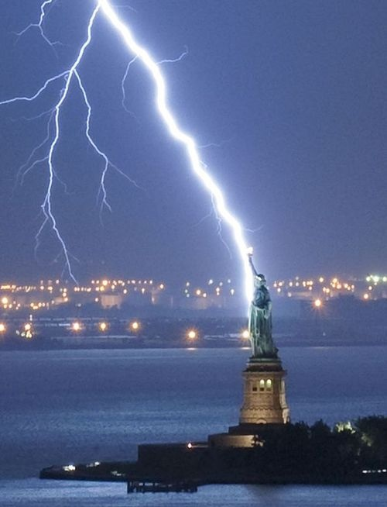
Summary
This program is very actively going on
  We have man power and more brains now
  Formed data analysis group to see all kinds of breakdown data
  Involved graduate students and post docs
  Consider simulation effort
We will see how good (or bad) high pressure RF cavity is
  1st beam test will be made in March and April
  Find out beam loading effect
  Study how to remove or mitigate beam loading effect
  Will do 2nd trial at the end of this year
  May need 3rd test in practical (4D/6D demo cooling) channel

