Slide 1
Solenoid Capture Magnet
&
Open-Midplane Dipole Magnet
Windings, Stresses, Deformation & Energy Deposition
Magnet Design: Bob Weggel (Particle Beam Lasers & BNL)
Energy Deposition: Xiaoping Ding & Harold Kirk (BNL)

Slide 2
Desired Field Profile of Target Magnet

Slide 3
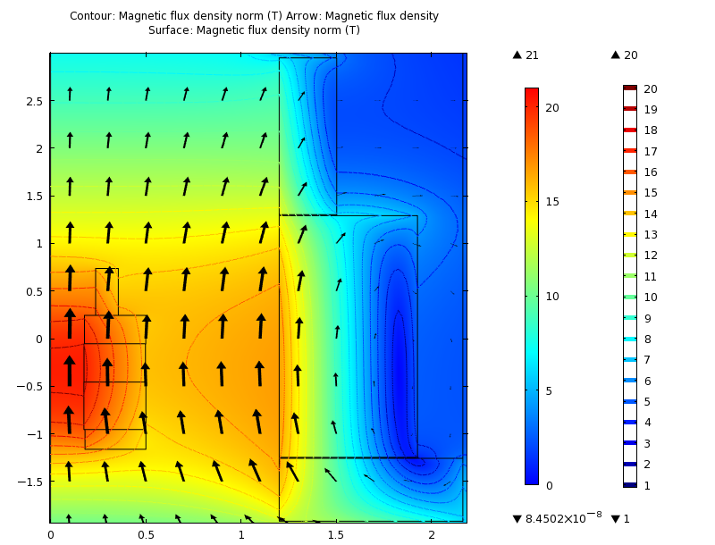
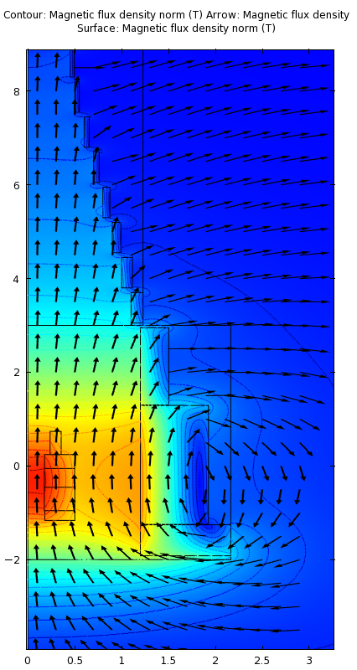
Field Distribution of 20 Tesla Target Magnet
Copper & 11 SC coils
Peak field seen by superconductor ≈ 16.8 T

Slide 4
Field Profiles of Magnets
Resistive (red); SC (blue); combined (magenta); desired (black)

Slide 5
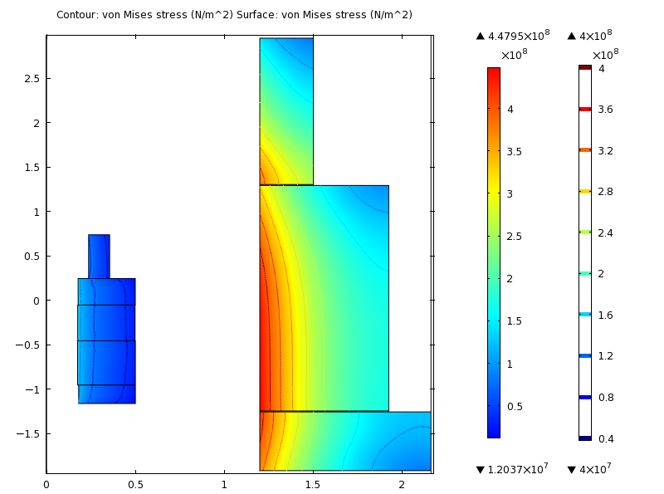
Max. von Mises Stress = 448 MPa in SC Coil #2

Slide 6
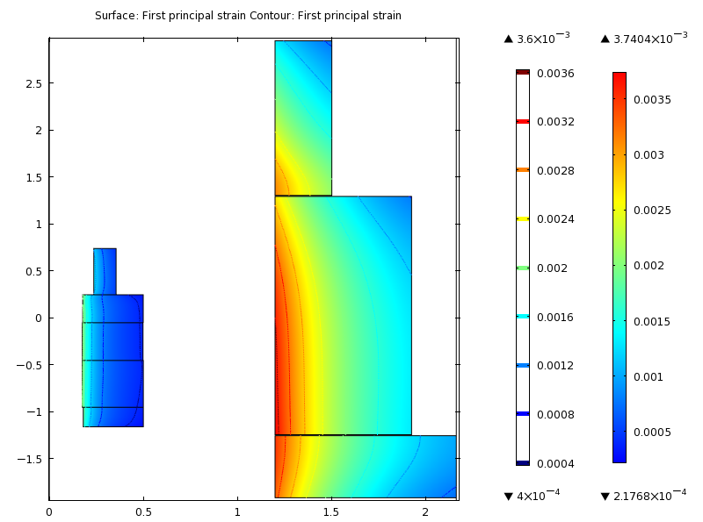
Maximum Strain = 0.37% in SC #2

Slide 11
Open-Midplane Dipole Magnet (First Quadrant)
Half-gap = 1.5 cm; B₀ = 10 T @ 200 A/mm²
Field Homogeneity = 0.01% at x = ±1 cm; B_{max}/B₀ = 1.067

Slide 12
Von Mises Stress = 245 MPa at x = 24.4 cm, y = 0
F_{x} = (1.36+4.14) = 5.50 kN/m; F_{y} = (0.06-3.65) = -3.59 kN/m

Slide 13
Deformation, Magnified Twentyfold
Maximum deformation = 0.27 mm

Slide 14
Half Gap = 3.0 cm
Von Mises Stress = 306 MPa at x = 33.3 cm, y = 0
F_{x} = 7.24 kN/m; F_{y} = -5.08 kN/m
Steel increased from (40 x 20) cm to (50 x 25) cm

Slide 15
Half-gap = 3.0 cm
20x Deformation; Maximum deformation = 0.46 mm

Slide 16
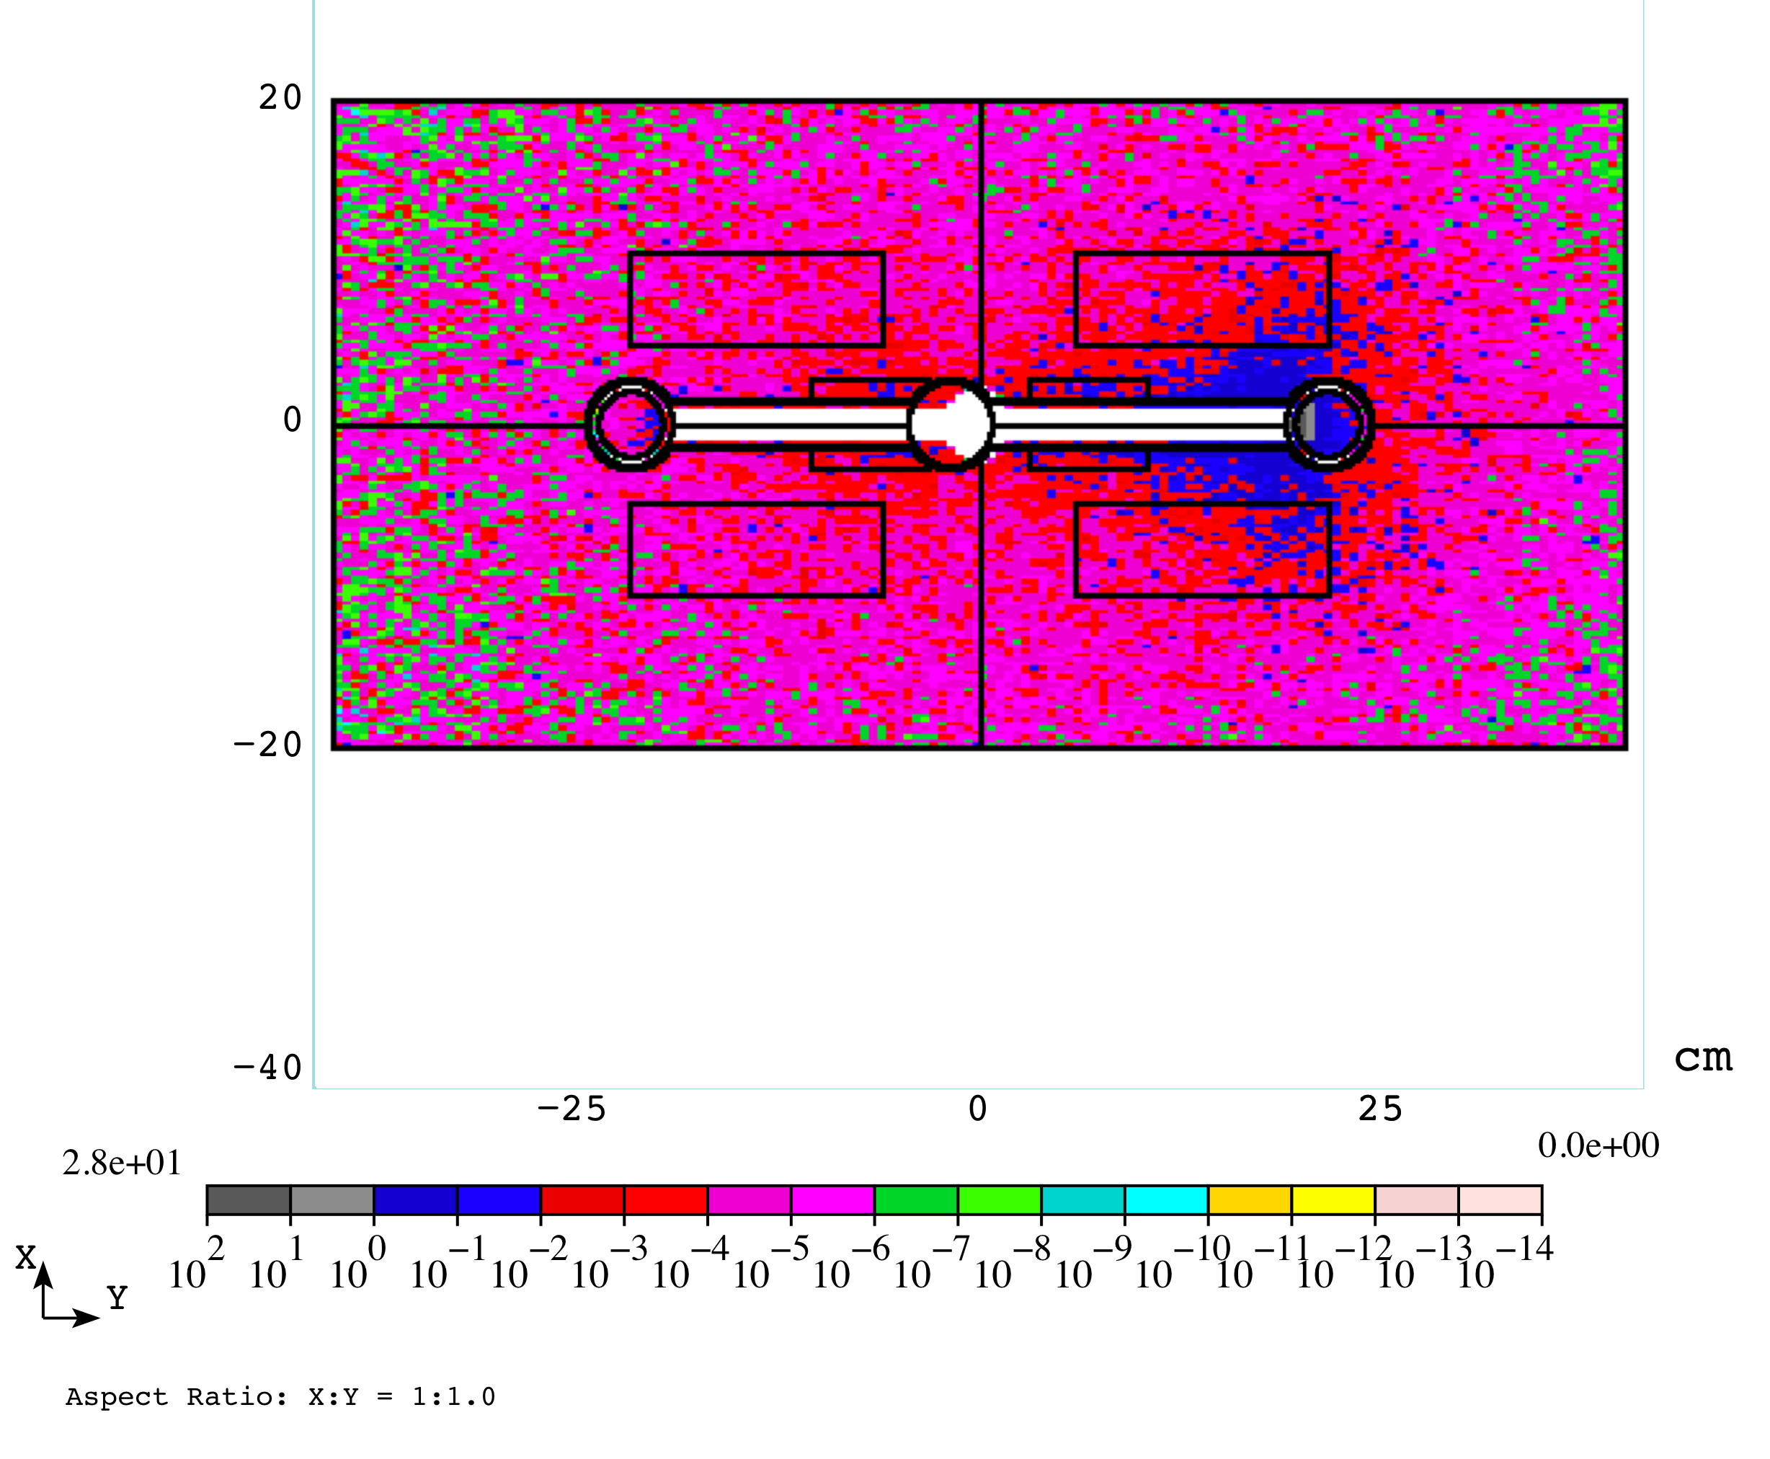
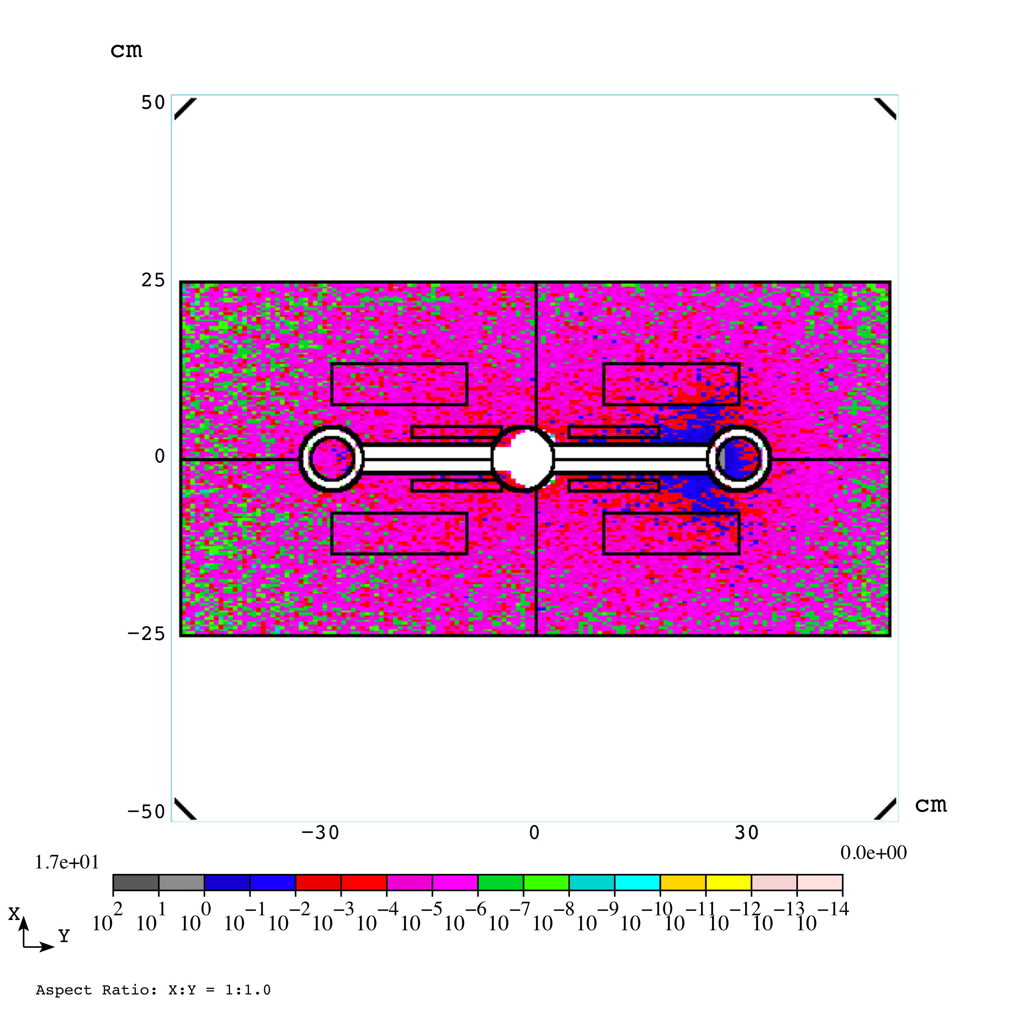
Power Density with 1.5 & 3.0 cm Half-Gap
40 cm slab at end of 10 T dipole 6 meters long
Half gap = 1.5 cm
Absorber radius = 2.78 cm
Center = 21.6 cm
Half gap = 3.0 cm
Absorber radius = 4.90 cm
Center = 26.5 cm

Slide 17

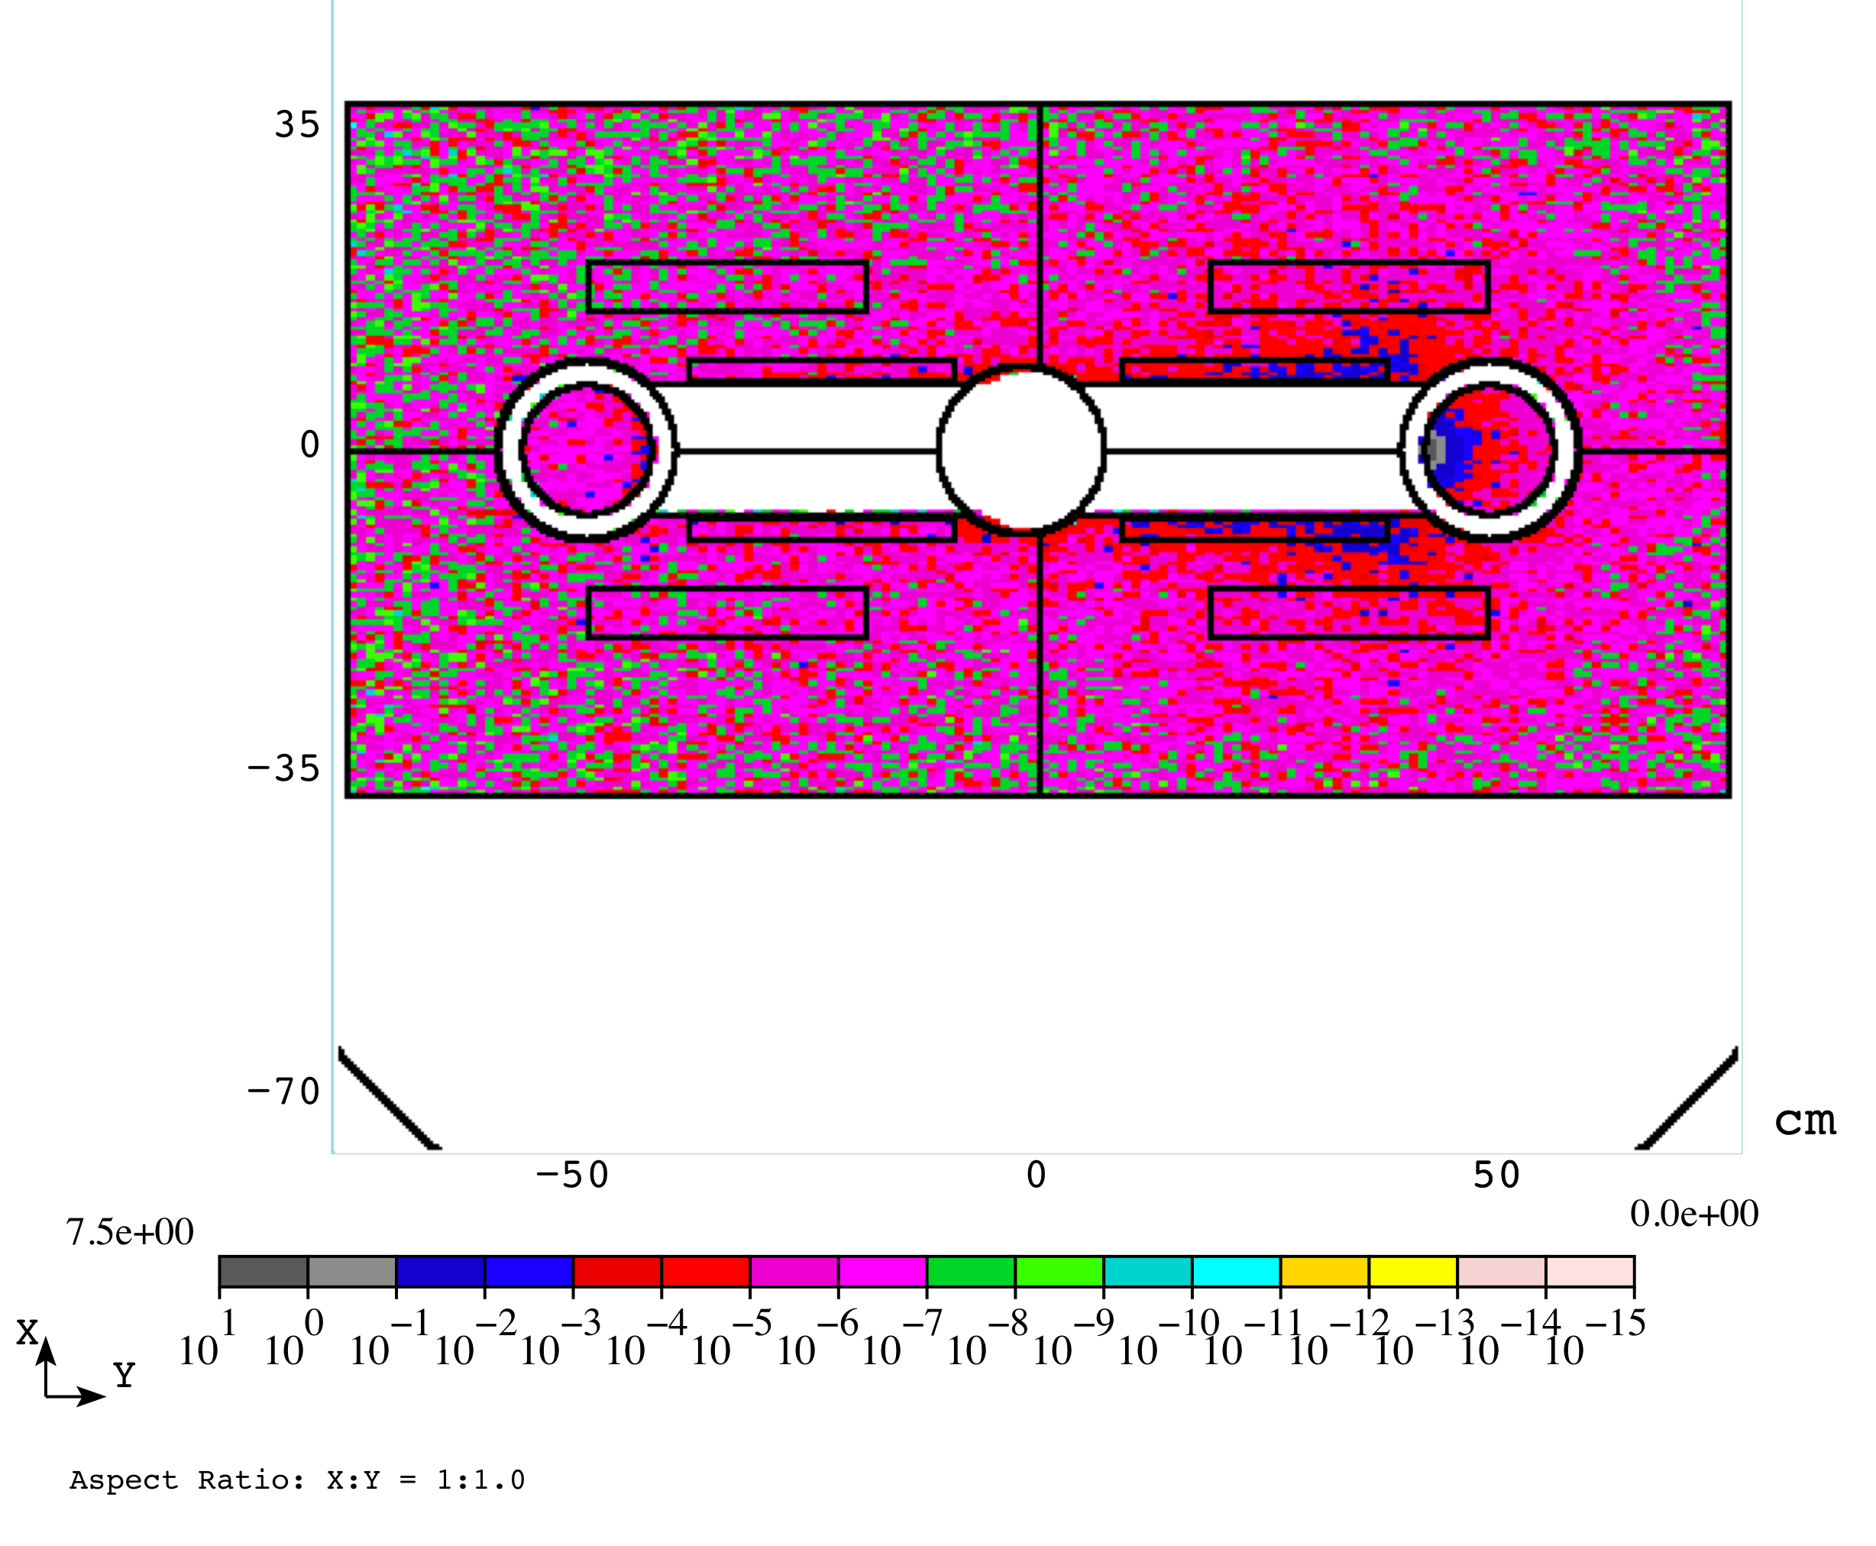
Power Density with 50 & 75 mm Half Gap
Half gap = 5.0 cm
Absorber radius = 7.11 cm
Center = 35.3 cm
Half gap = 7.5 cm
Absorber radius = 11.07 cm
Center = 46.3 cm

Slide 19
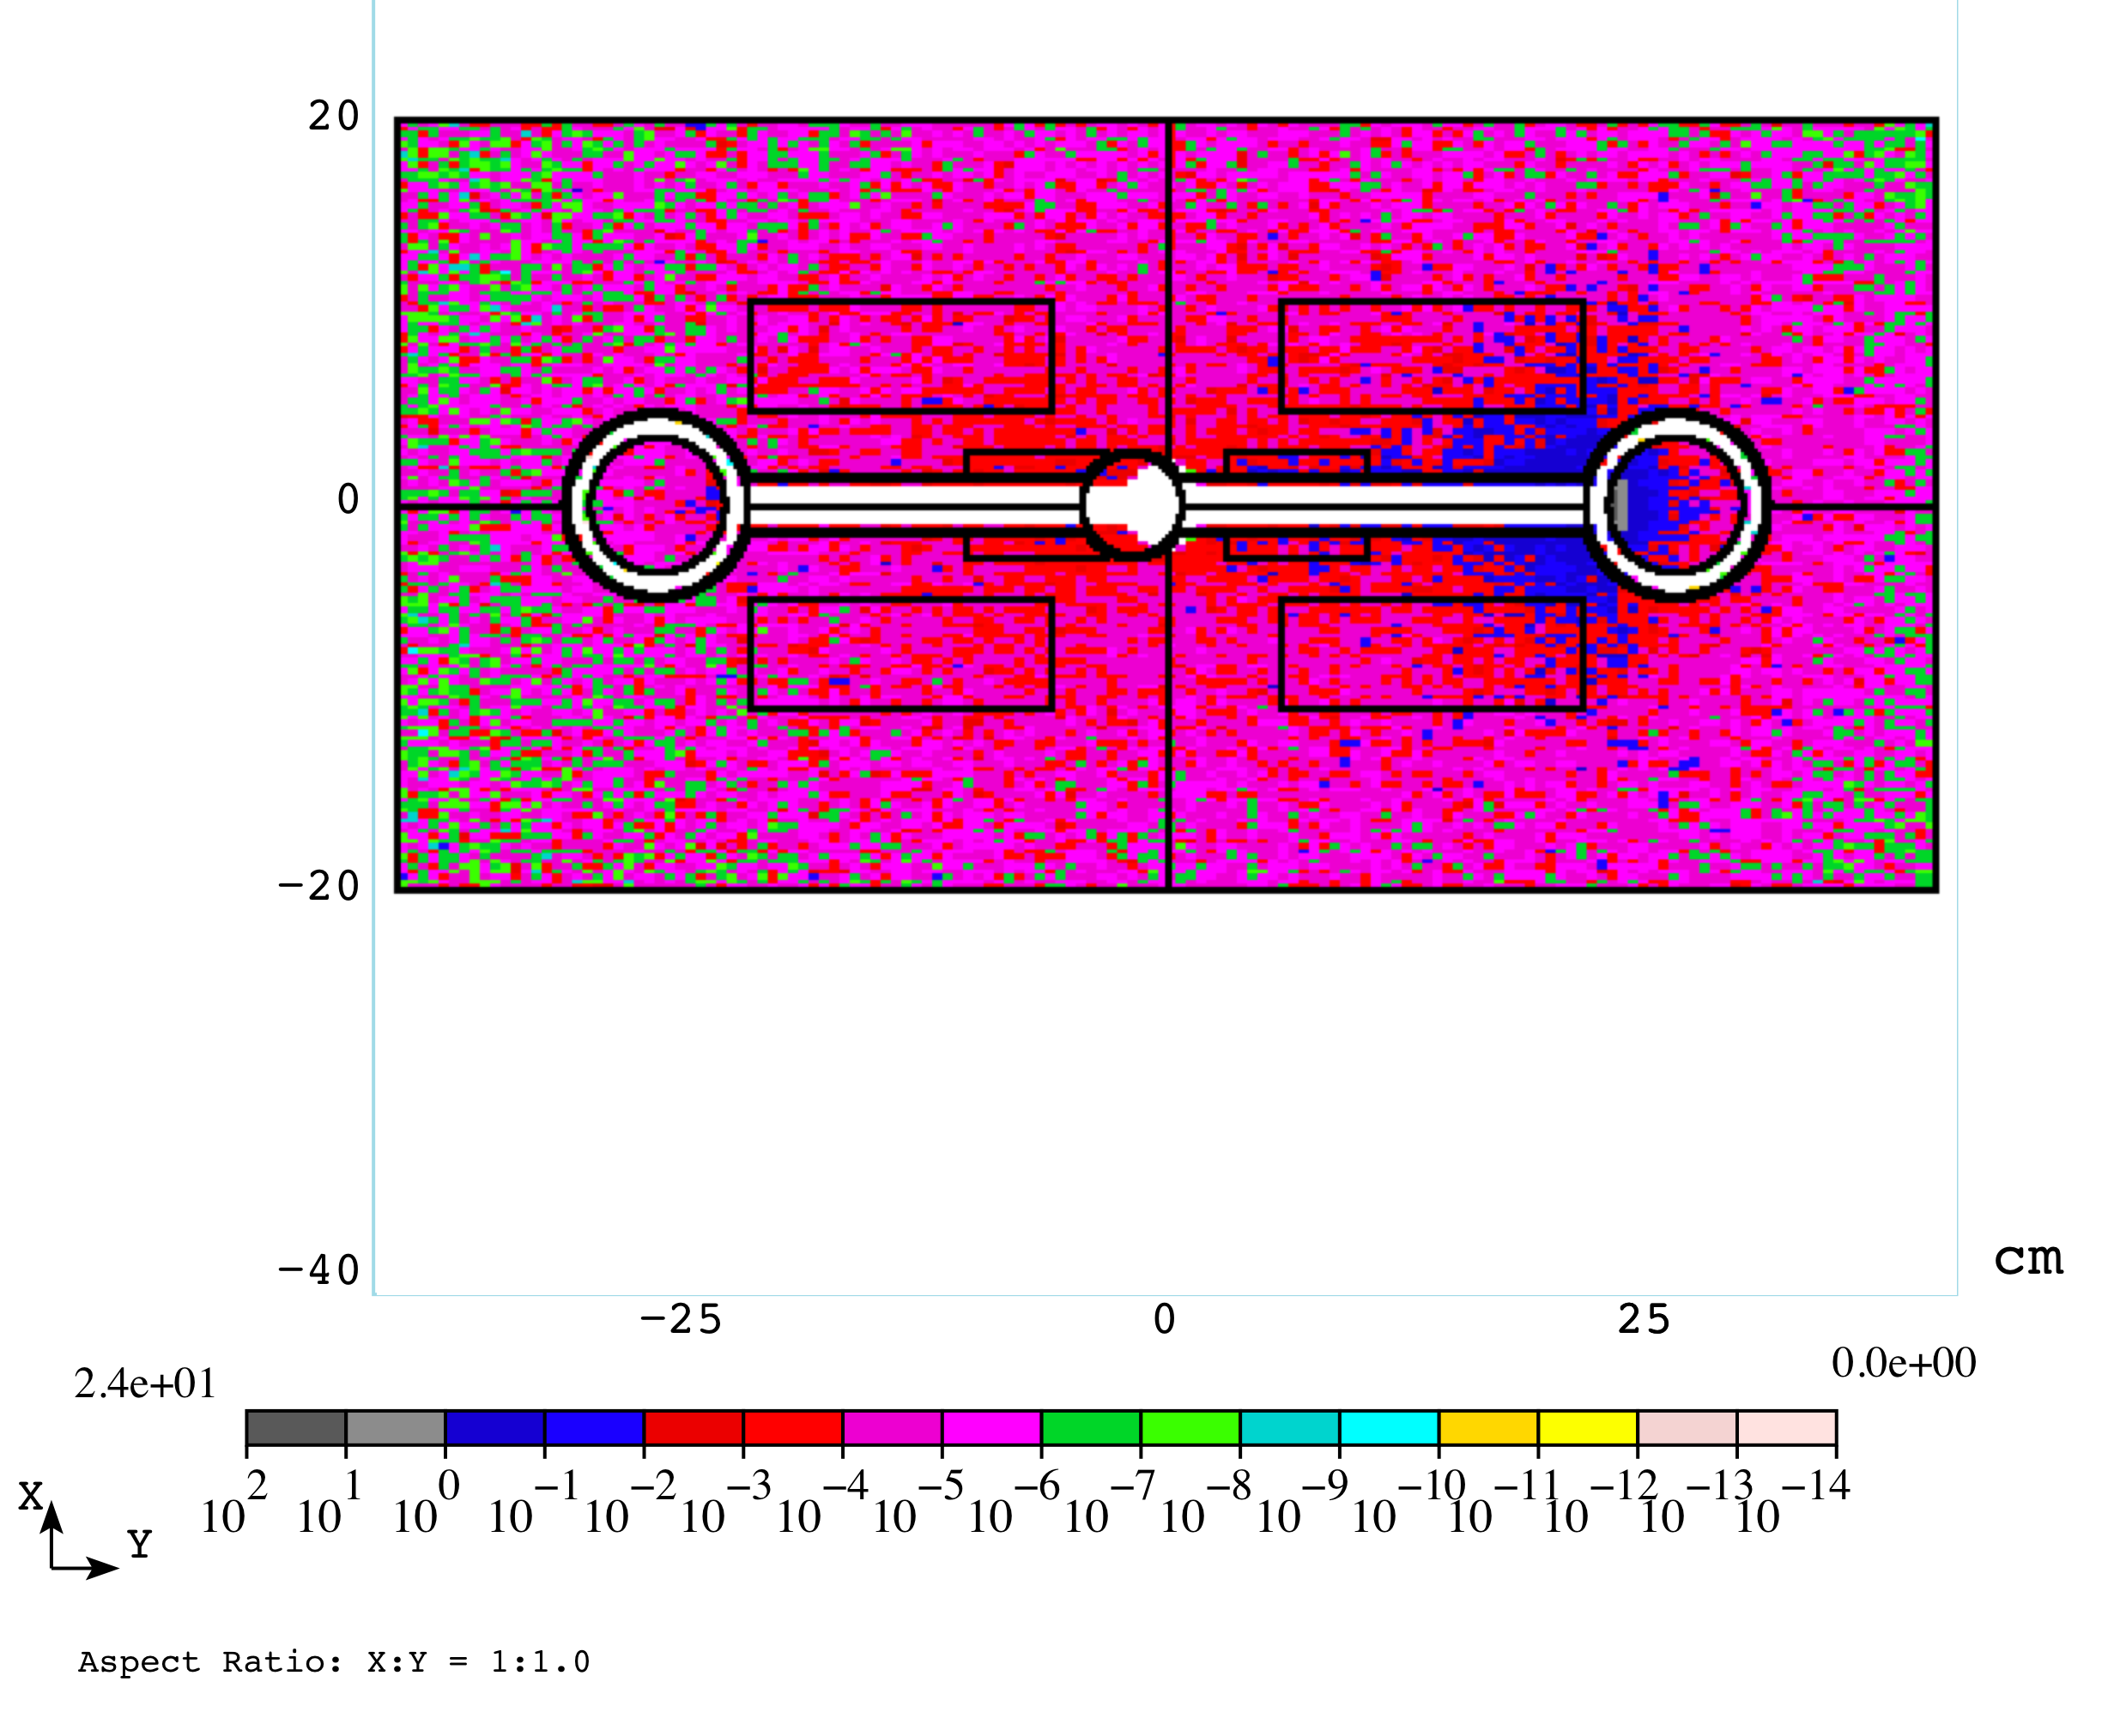
Power Density with Half-Gap = 15 mm with absorber larger & further away from beam
Absorber radius = 2.78 cm
Center = 21.6 cm
Absorber radius = 4.90 cm
Center = 26.5 cm

Slide 20

Half-Gap = 30 mm with modified absorber
Absorber radius = 4.65 cm
Center = 28.7 cm
Absorber radius = 7.54 cm
Center = 36.2 cm

Slide 21
σ_{Von Mises} = 346 MPa at x = 31.4 cm, y = 0
Absorber radius increased from 2.78 cm to 4.90 cm
Center of absorber moved 4.9 cm from 21.6 cm to 26.5 cm

Slide 22
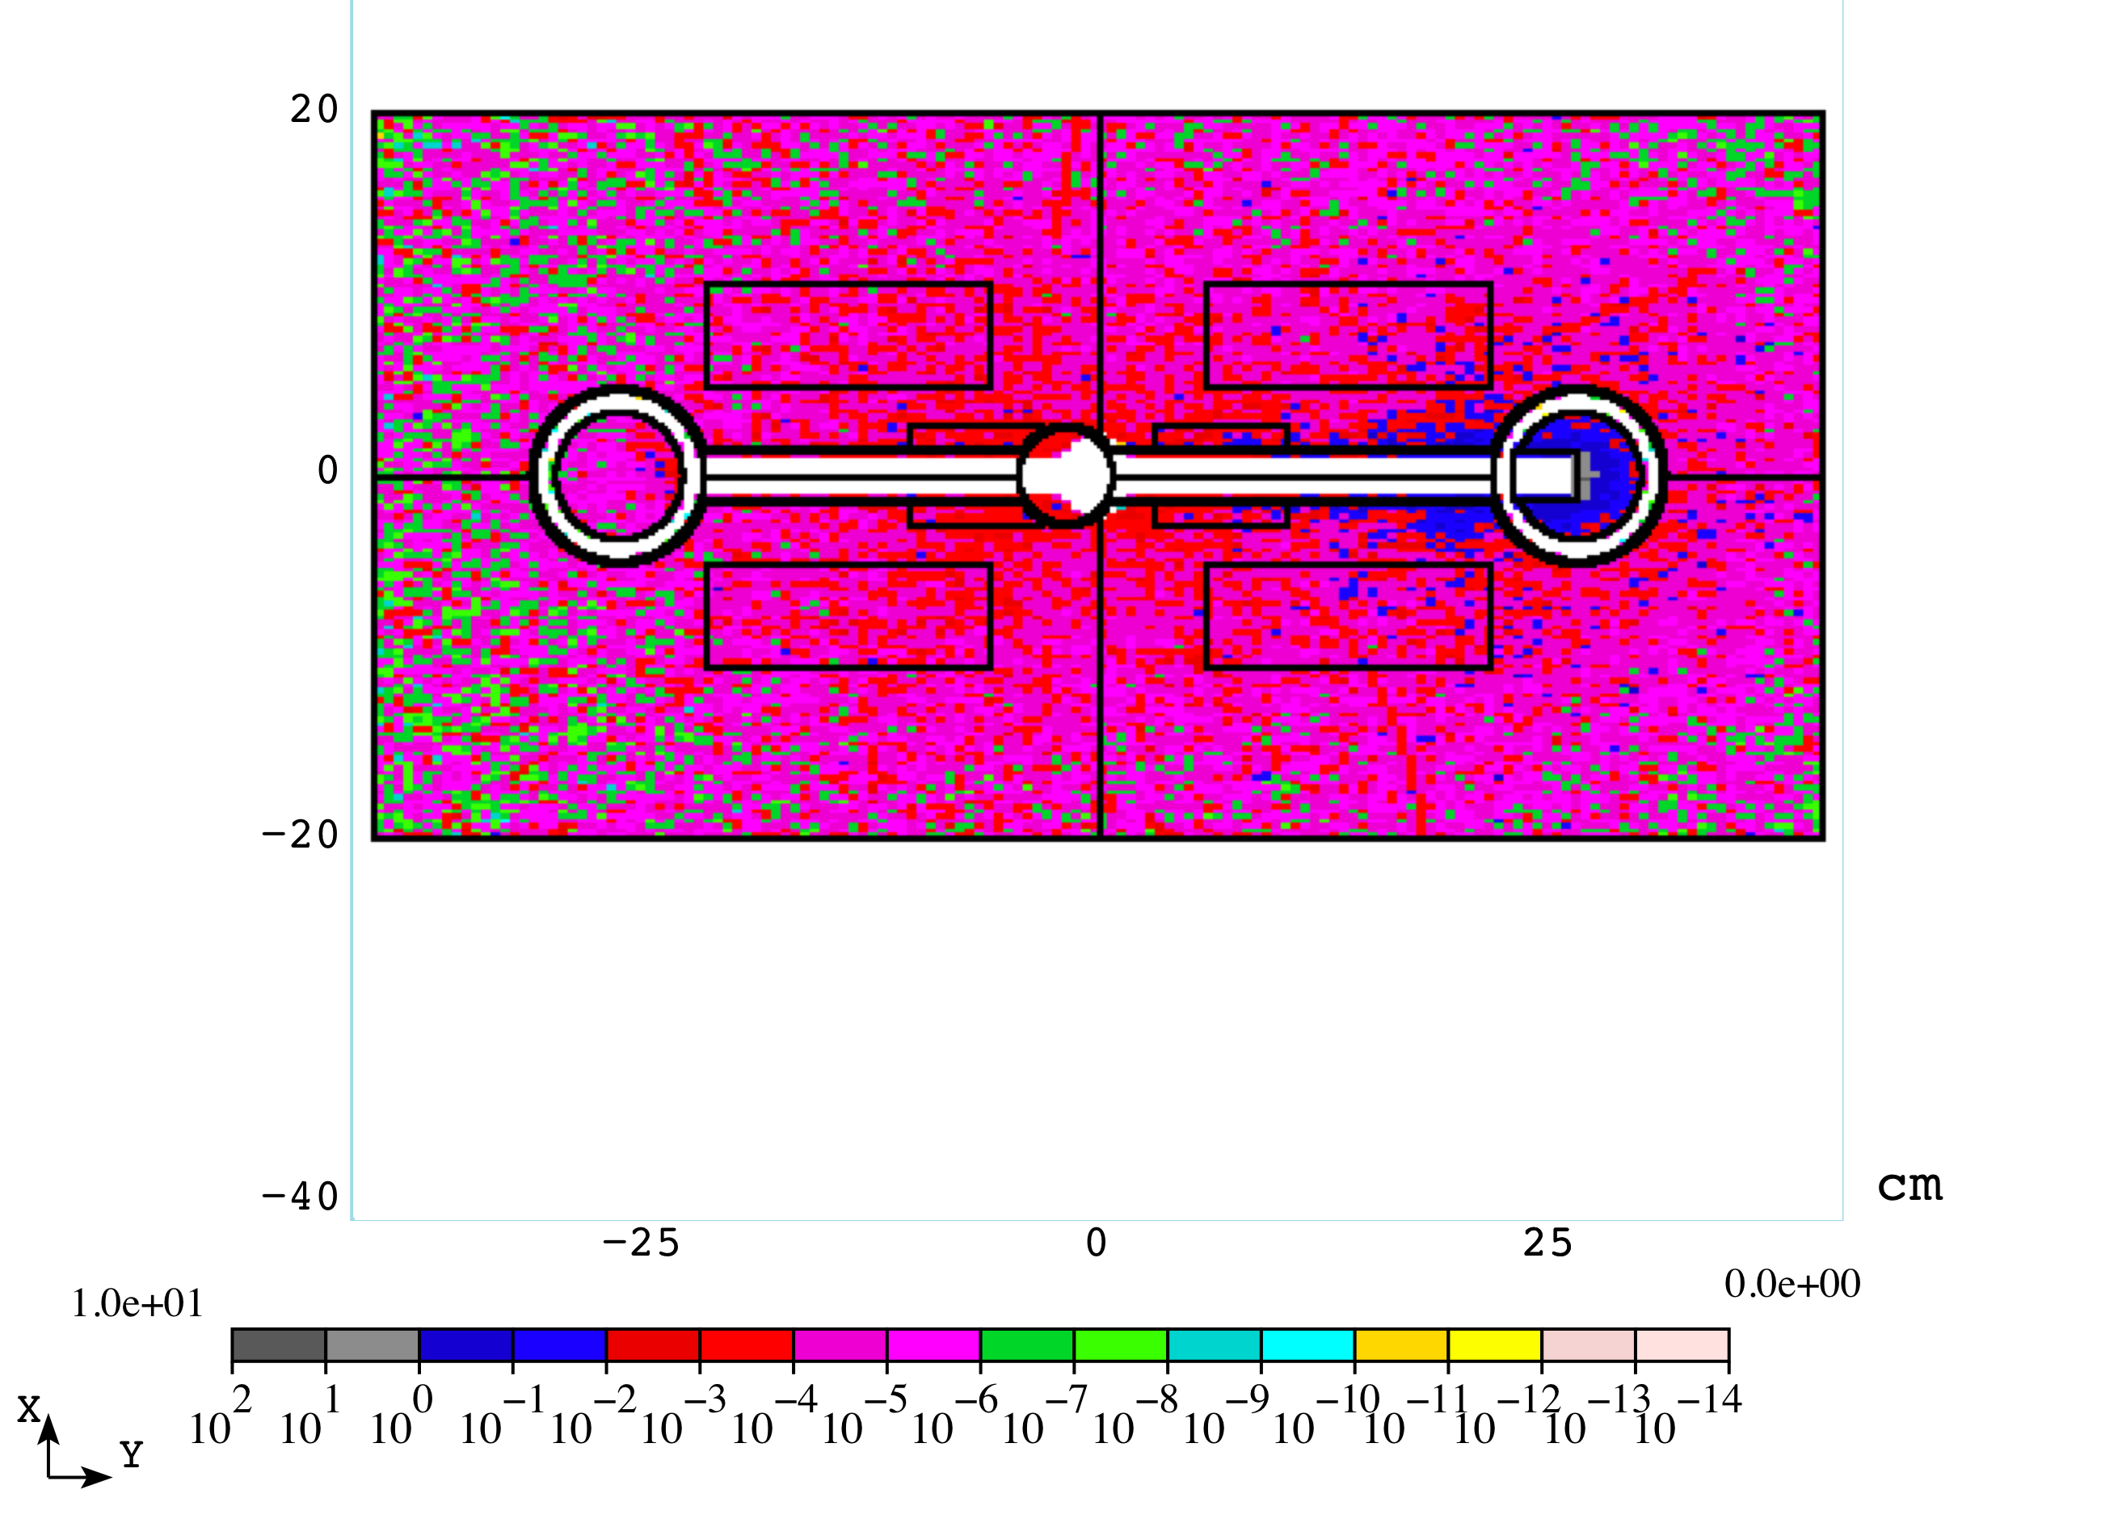
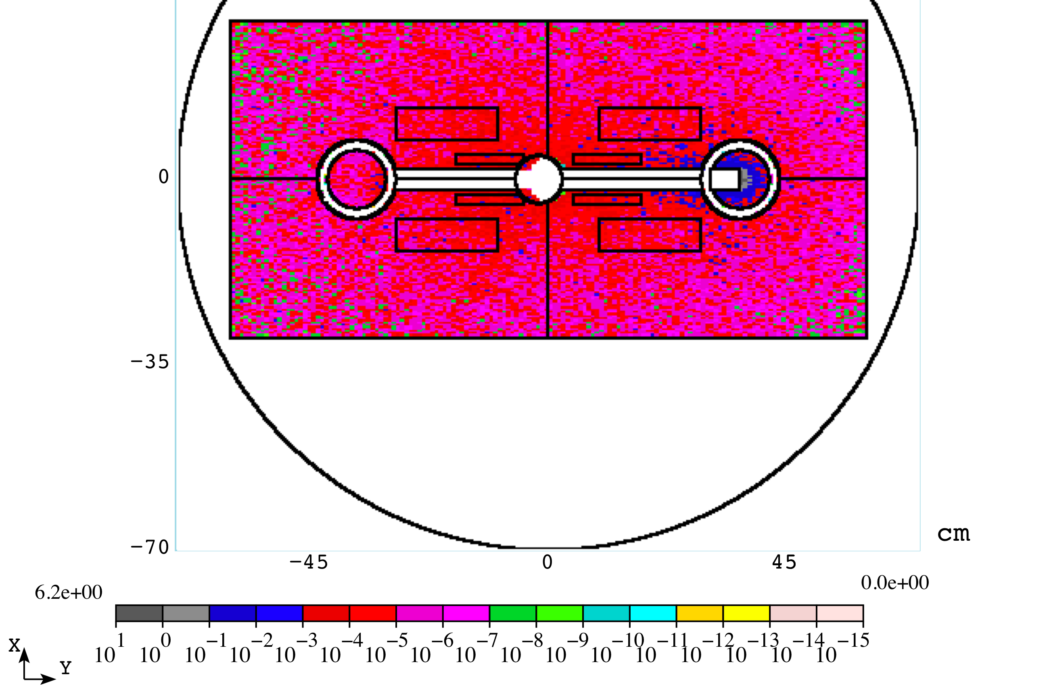
Half-Gap = 30 mm with modified absorber
Absorber radius = 4.65 cm
Center = 28.7 cm
Absorber radius = 7.54 cm
Center = 36.2 cm

Slide 23
Power Deposited in the OMD
(Hg1.5_W26.479 case with slit in the right tungsten rod)
Component | Power Deposition (W)
Superconducting Coil | 0.72
Iron (supporting structure) | 4.11
Tungsten Rod | 63.7
Vacuum Chamber in the Dipole | 1.3
Vacuum chamber downstream the Dipole | 222.8
Vacuum chamber upstream the Dipole | 8.6*10⁻⁶
Total | 293

Slide 24
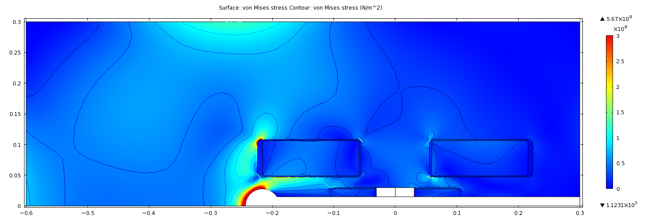
“C”Magnet (Supported from One Side Only) σ_{Von Mises} = 422 MPa at x = -24.4 cm, y = 0

Slide 25
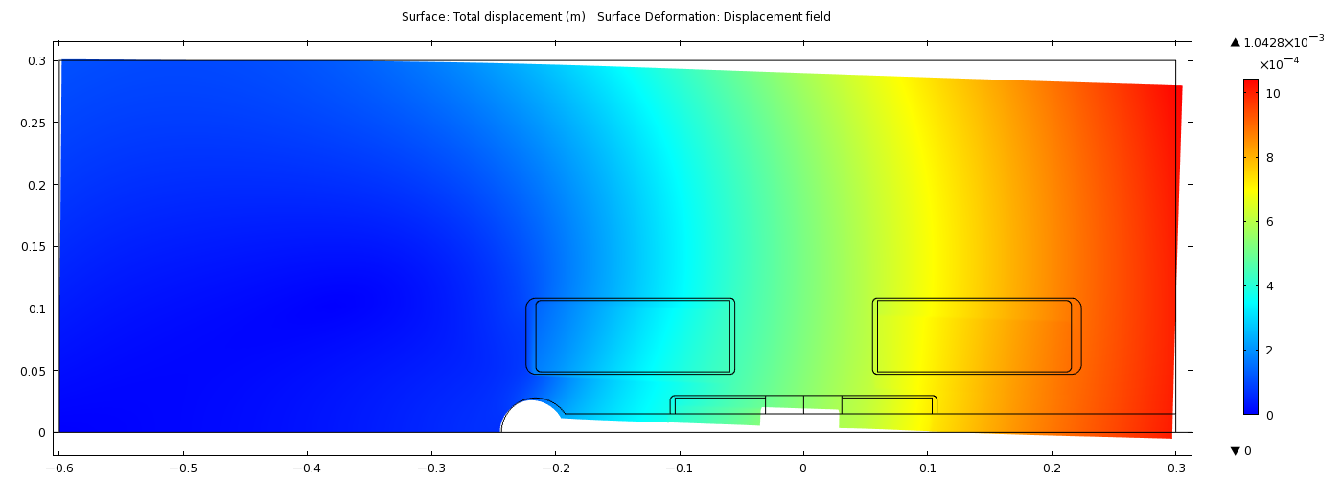
20x Deformation in “C”Magnet
Maximum deformation = 1.04 mm

