Slide 1
A little physics about breakdown in HPRF cavities
Jefferson Lab MAP Meeting
Feb 28, 2011

Slide 2
Three Topics:
1. Frequency shifts down during discharge.
2. Frequency shifts up during discharge.
3. Multiple discharge surprise.

Slide 3
Postulated theory of breakdown in a HPRF cavity without beam
Field emission supplies a source of electrons.
A Townsend avalanche starts across the cavity.
Finally an arc develops.
4. Paschen Region:
Breakdown for E/P>14
Theory in good shape
Plateau Region:
Breakdown E fixed
No verified theory
Many conjectures
Need Experiments!

Slide 4
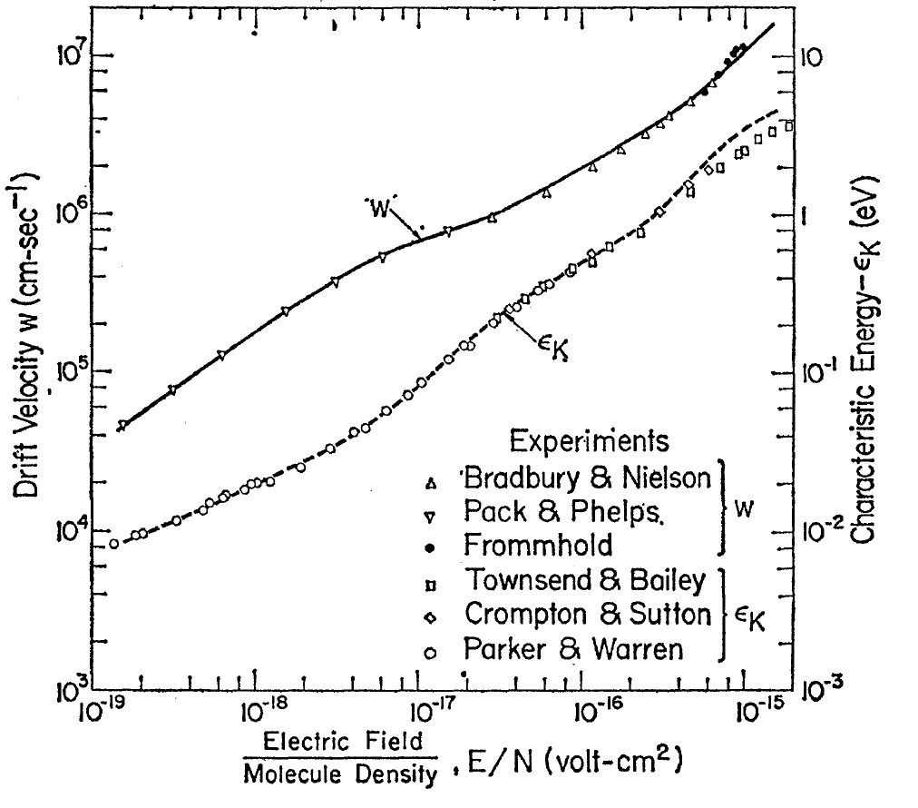
Some gas physics
The variable that describes what happens in gas filled cavities is E/P where E is in volts/cm and P is in mm pressure. The Paschen part of the breakdown curve has an E/P of about 14. E/N is also used where N is the number of molecules of gas/cm³ . E/P=1 is the same as E/N=2.83e-17, E/P=14 is the DC value and fits the RF measurements rather well.
The curves are both measured and calculated from the collision cross section of electrons in hydrogen. A bunch of electrons is injected at one end of a tube with hydrogen at pressure P and with field E and the time of transit measured. The electrons are not thermalized and their rms energy is ε_{k} At
E/P = 1 the velocity is ~10⁶ and at E/P=14 is about 5 10⁶ .
E/P=1
E/P=14

Slide 6
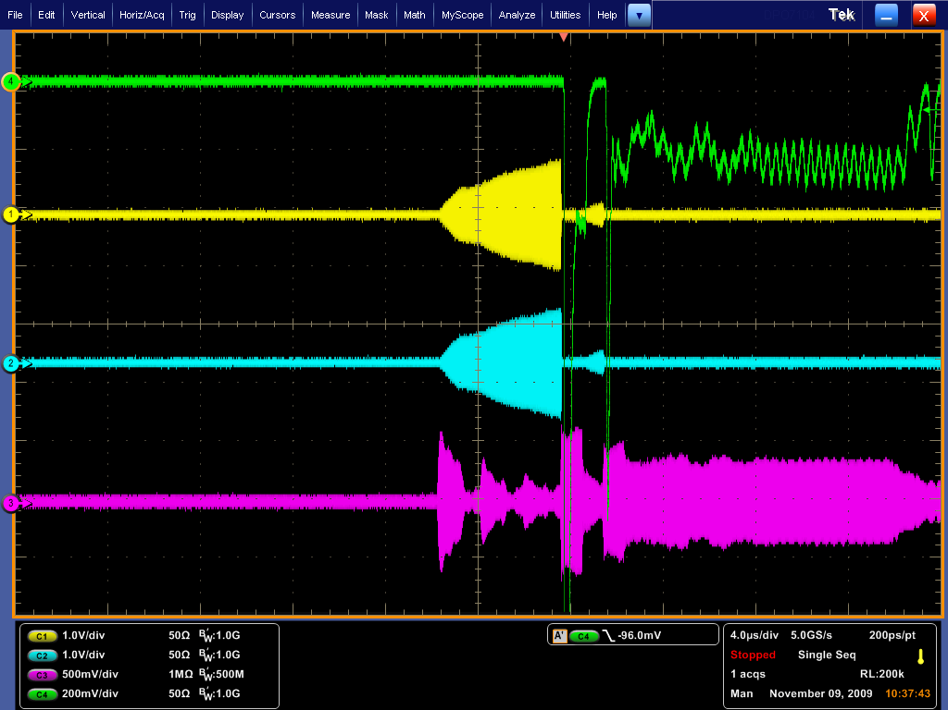
Frequency shifts down
620 PSI
E breakdown
=26 MV/M
Vcavity = 462 KV
PMT
Magnetic Pickup
ElectricPickup
Reflected power

Slide 7
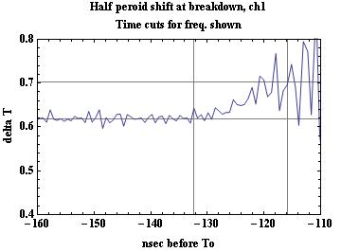
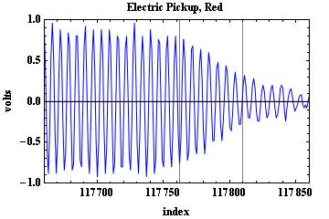
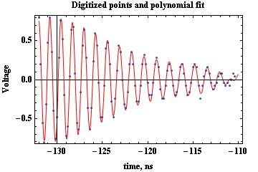
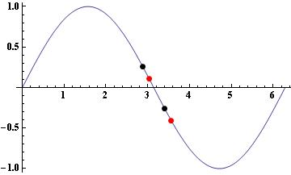
Frequency shifts down: Data
Error = 0 when sample centered or at either end !

Slide 8
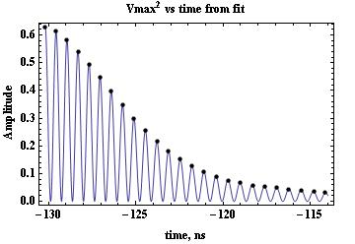
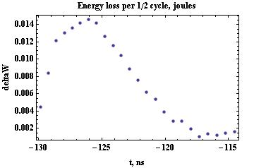
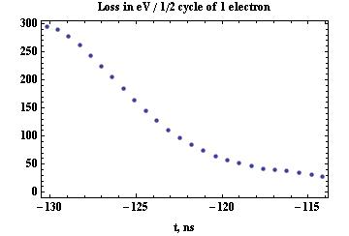
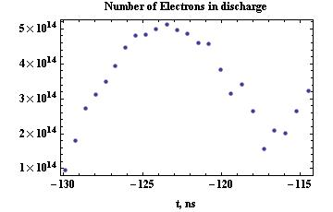
Frequency shifts down

Slide 9
Q=q x/d
Q=q Δx/d
+
_
d
q
+
Δx
x
x
2/27/2011
Alvin Tollestrup, MAP 2-28-2011
9

Slide 10
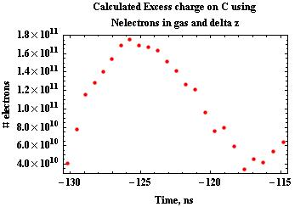
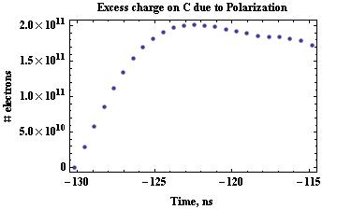
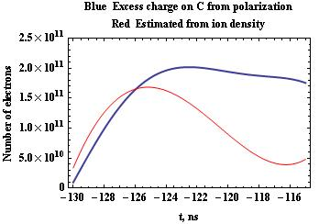
Frequency shifts down
Polarization charge = Delta Ccav Vcav
Delta Ccav comes from freq shift.
Calculated Polarization comes from:
a. Total number of electrons
Ne = Delta Joules/ joules for 1 electron
Agreement ok increasing part. Mystery at end.
Frequency stays low, charge decreases. Happy
About order of magnitude, unhappy about details.

Slide 11
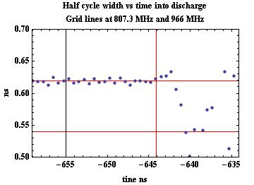
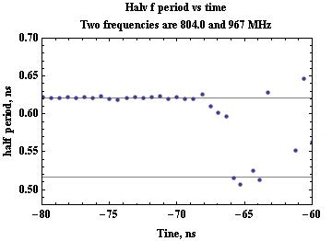
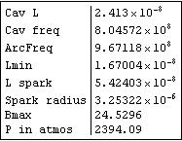
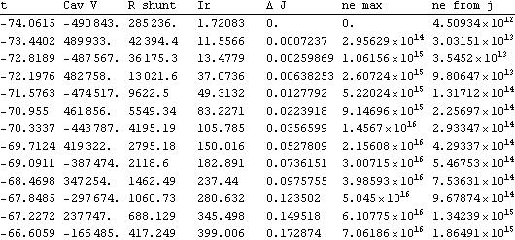
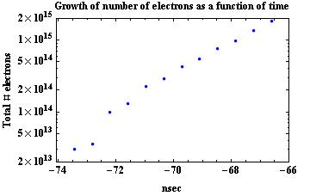
Frequency shifts up
810 psi
1150 psi

Slide 12
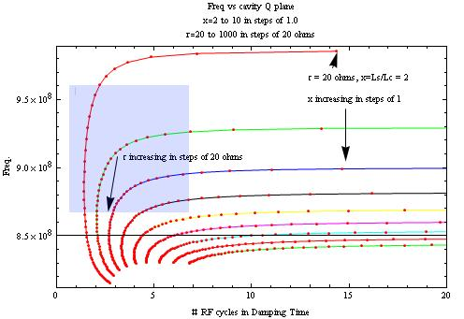
spark

Slide 13
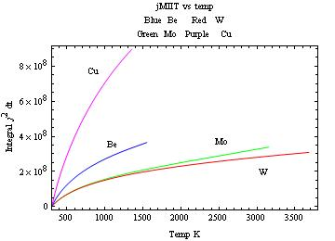
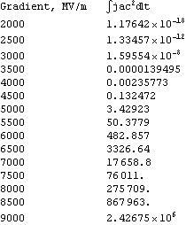
dW = j(t)² / σ(T) dt dV – Cooling = C(T) Rho dV dT

Slide 14
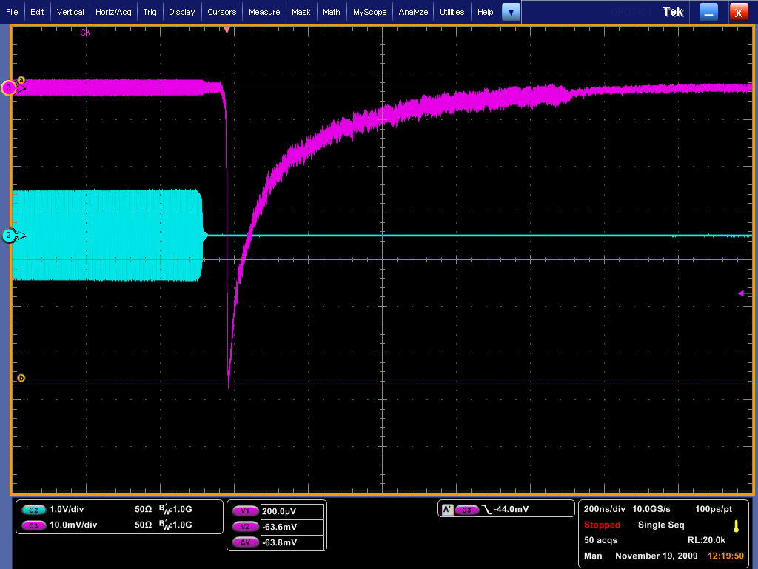
Multiple scope sweeps

Slide 15
Multiple scope sweeps
Scope was triggered by the PMT and collects 50 breakdowns in about 4-5 minutes. So about every 50 pulses. Amplitude proportional to
(N₊ - N₋ ) / (N₊ + N₋ ) is between ½ and 1.0
2. Implies triggering on one side or the other predominately. Maybe cavity is slightly asymmetric due to coupler.
Implies that the light it tightly coupled to the phase of RF in the cavity, ie keeps phase information within a single half cycle and knows which polarity of half cycle it is tied to. Field emission is a logical explanation.
Is it the same asperity? . If there is a pinch, it melts, if not the current density seems too low.

Slide 16
Status
Have a theory that needs testing in detail:
A. Need to check the mobility at high pressure. This determines the losses in the cavity. Q of 100 is not useful except for single transit.
B. Need to measure the recombination rate. If it is high, the losses are less.
C. Need to find suitable electronegative gas to eat the electrons and that has a very high crossection.
D. Unknown Region: What does the residual plasma do? Does it recombine between pulses? Composed of heavy negative and positive ions. This is an experimental problem!
E. We look forward to beam shortly.

