Slide 1
Al Moretti, APC, Fermilab
MAP- Winter Meeting February 28 - March 4, 2011 TJNAF Newport News, VA

Slide 2
Discussion of the Magnetically Insulated Cavity The orthogonal Box Cavity
Palmer and D. Stratakis developed as theory that a large magnetic field at right angle to the RF electric would magnetically insulate a vacuum RF cavity from electric breakdown.
It was then decided to construct a build cavity to test this theory.
A low cost design was chosen in the shape of a box
Two cavities of this type have been built and only one has been tested.
We need to decide what to do with the second cavity. It has been suggested that this cavity be coated with TiN and tested in the MTA?
There is in storage material to built 2 more cavities. It has been suggested that the material be used to built the parallel B and E configuration cavities?

Slide 3
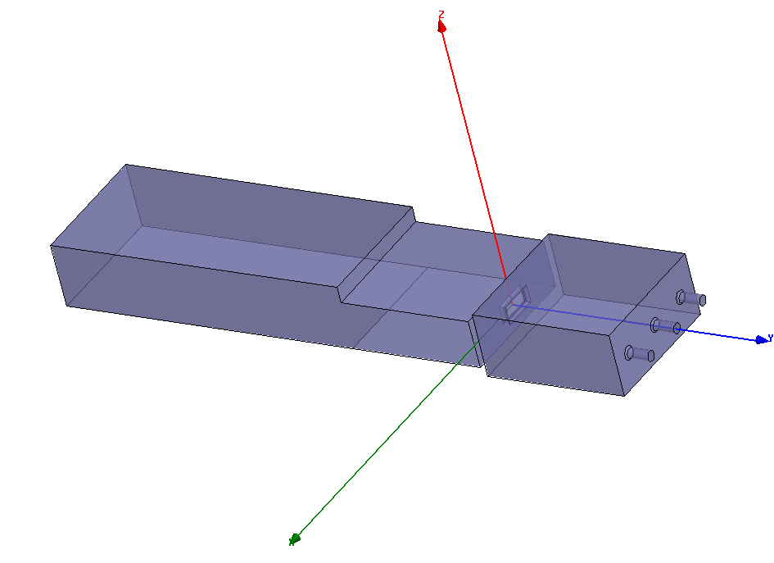
Orthogonal E and H Cavity Coupled to the Waveguide
Rectangular Coupling aperture with rounded edges
E
Sapphire Viewing Port
B
Original LBL Waveguide RF power Coupler section; ½ height Standard WG section
Pickup Ports
¼ height Coupling Cell. This is built in two sections with WG; flanges not shown.
HFSS Model RF cavity and WG coupler

Slide 4
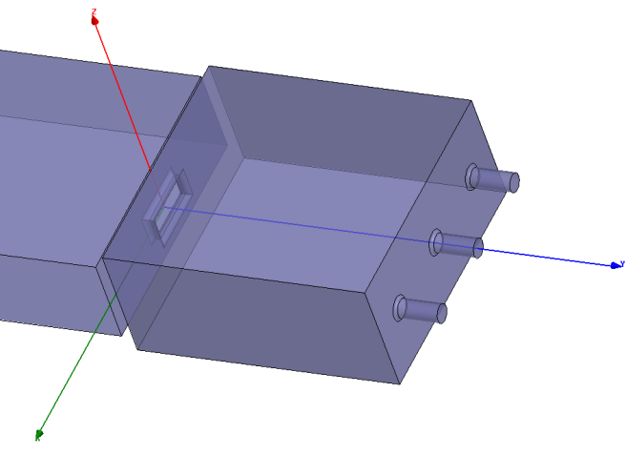
Calculated Parameters of the cavity and cavity dimensions
Aperture Fields about a factor 4 lower than central max. field.
HFSS normalizes all parameters to 1 W of input power to the waveguide coupler and solves for the frequency, gradient, coupling factor, Qo (in cavity mode) etc.
1W produces a gradient of 25 kV/m by scaling:
25 MV/m would take 1 MW ideal.
The Impedance across the center of the cavity is
Imp =9.5 MΩ.
This is the resistance across the center of the cavity given by
Imp = (gap Voltage)²/1 W.
This uses the peak voltage and is in agreement with SuperFish and most published accelerator designs.
Qo = 27,400.
276.50 mm
250 mm
E
B
123.82 mm

Slide 5
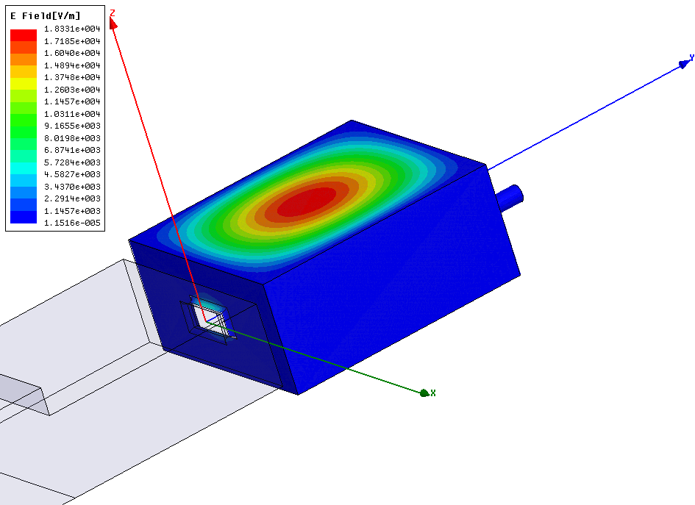
Orthogonal Cavity Electric Field Simulation Measurement Results
Peak Surface field on-axis (Eps)
Network analyzer measurements:
Fo = 805.33 MHz test lab;
Simulation Fo=806.2 MHz
Qo= 27,400;
Simulation Qo= 27,400
β= 0.96 coupling factor;
Simulation β= 1.06.
These values are preliminary and may change when attached to the LBL stepped WG coupler and mounted in the magnet. Even with a coupling factor of β= 0.96, 99.95 % of the transmitted RF power go into the cavity.
Ratio Eps/ Epap= 3.5 for orthogonal case.
Peak Surface Field on Aperture (Epap)

Slide 6
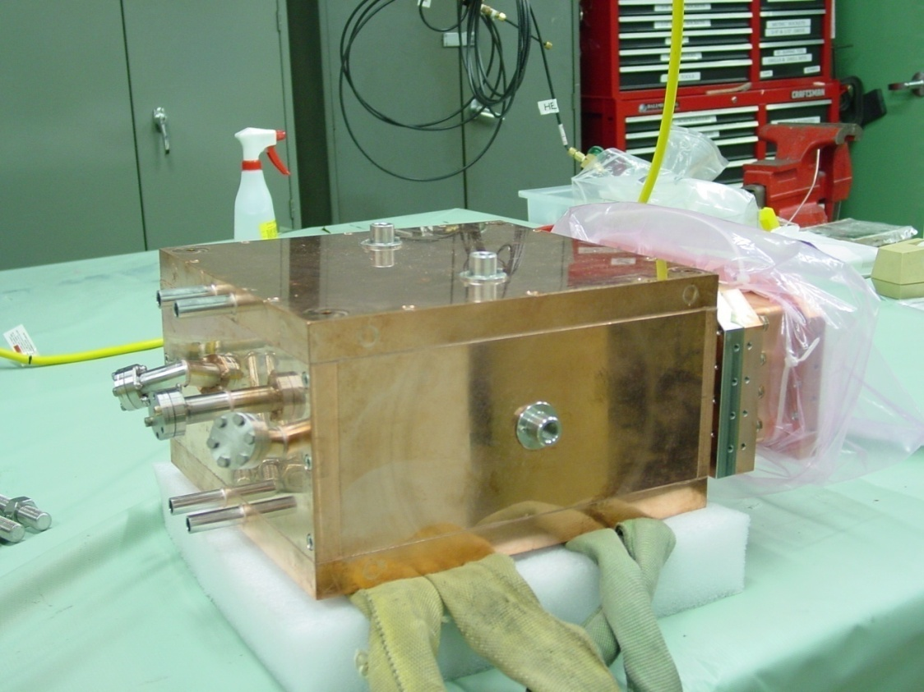
Box Cavity in A0 Test Lab
Compound Tin Seal Location
Pickup ports
Sapphire Viewing port location
Water cooling tubes
End ¼ height Waveguide Coupling Piece

Slide 7
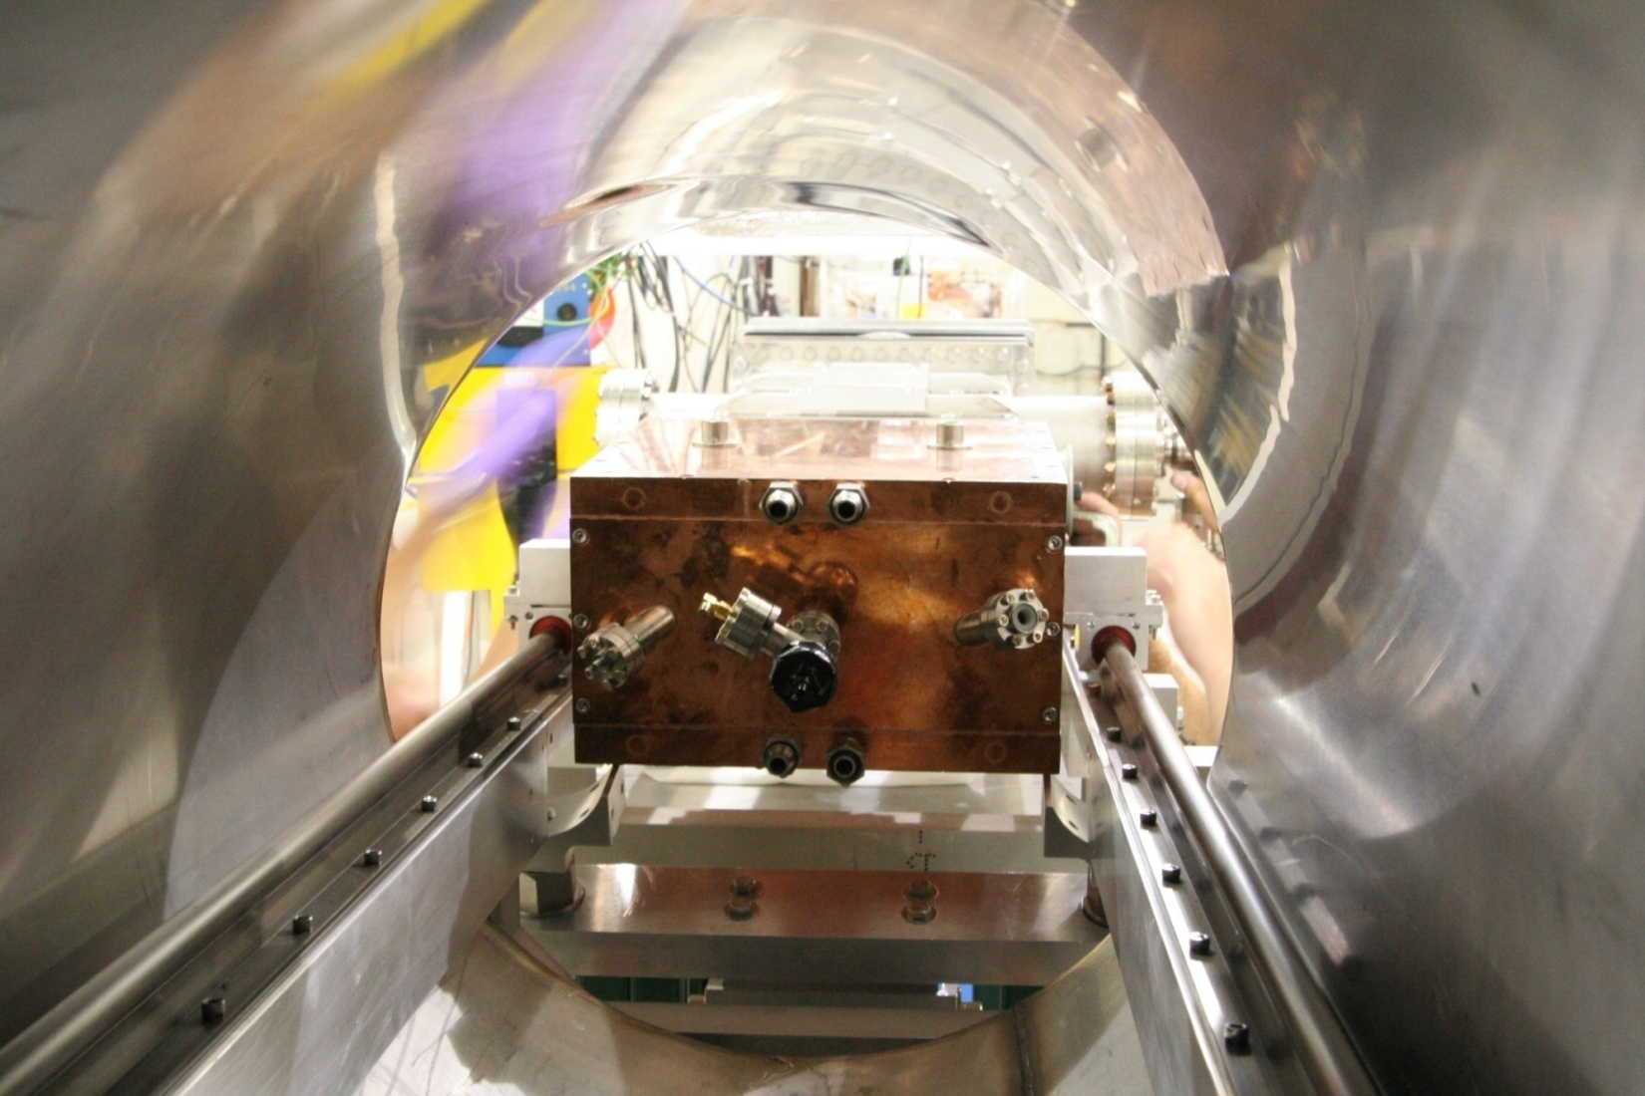
Box Cavity in the MTA Magnet on its Rail Support
Water cooling tubes
Pick-up and Sapphire ports

Slide 8
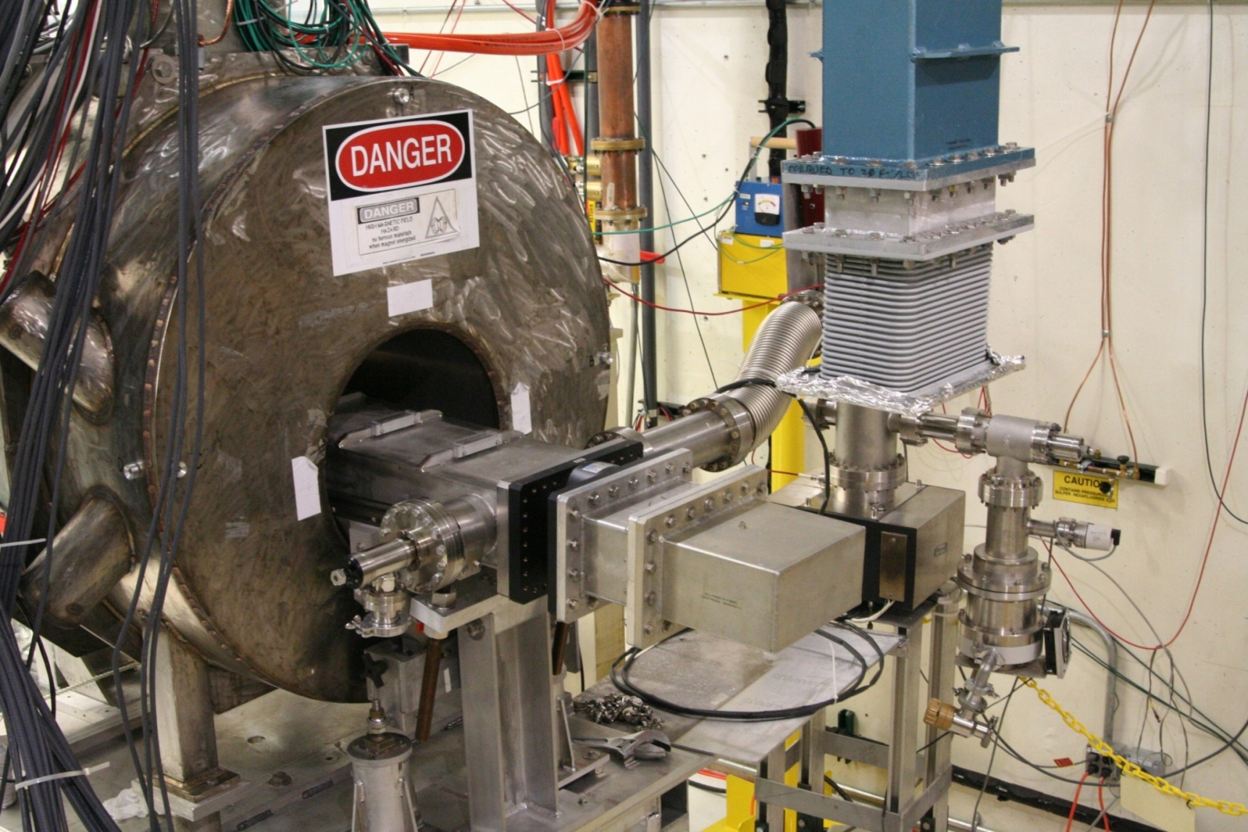
Calibration Setup befor connection to 12 MW Supply WG
WG Flex Section for Angle Changing
Ceramic window for Vacuum
Calibration Adapter WG to type N
Vacuum Pump

Slide 9
Large YOYO Effect starts here

Slide 11
The cavity was also tested at magnetic field levels from 0.5 to 3.5 T at 0 Deg. There was very little drop off observed in the break down levels.
There was no X-Ray’s observed with the Magnetic field on
There may have been single surface mult-pactiring observed in the early phase of the RF commissioning with the magnetic field
The vacuum burst were 10 to 100 times larger during a spark with the magnetic field than without.

Slide 12
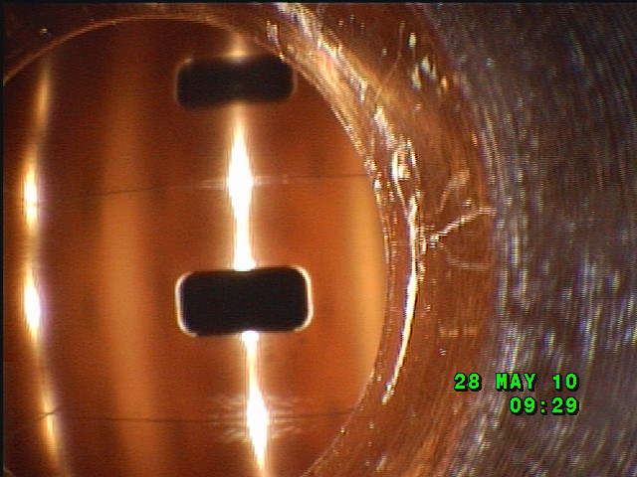
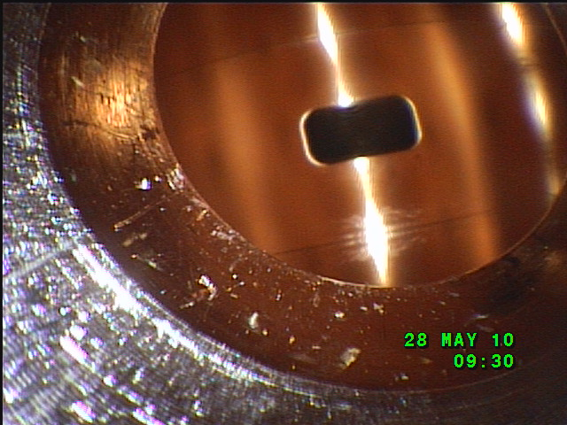
Pictures of Damaged Area in the Box Cavity
Cu to SS pickup hole surface.
Blistered Areas
The inside of the cavity was very clean with not many spark pits visible if any.
There were blistered areas in appearance in the top and bottom corners along the axis of the cavity both the upstream and downstream ends.
These are pictures of the cavity at about ½ the running time. At the end of the experiment, the areas appeared darker and spread out further and this was also after the 50 MV/m RF commissioning at 0 T.
12

Slide 13
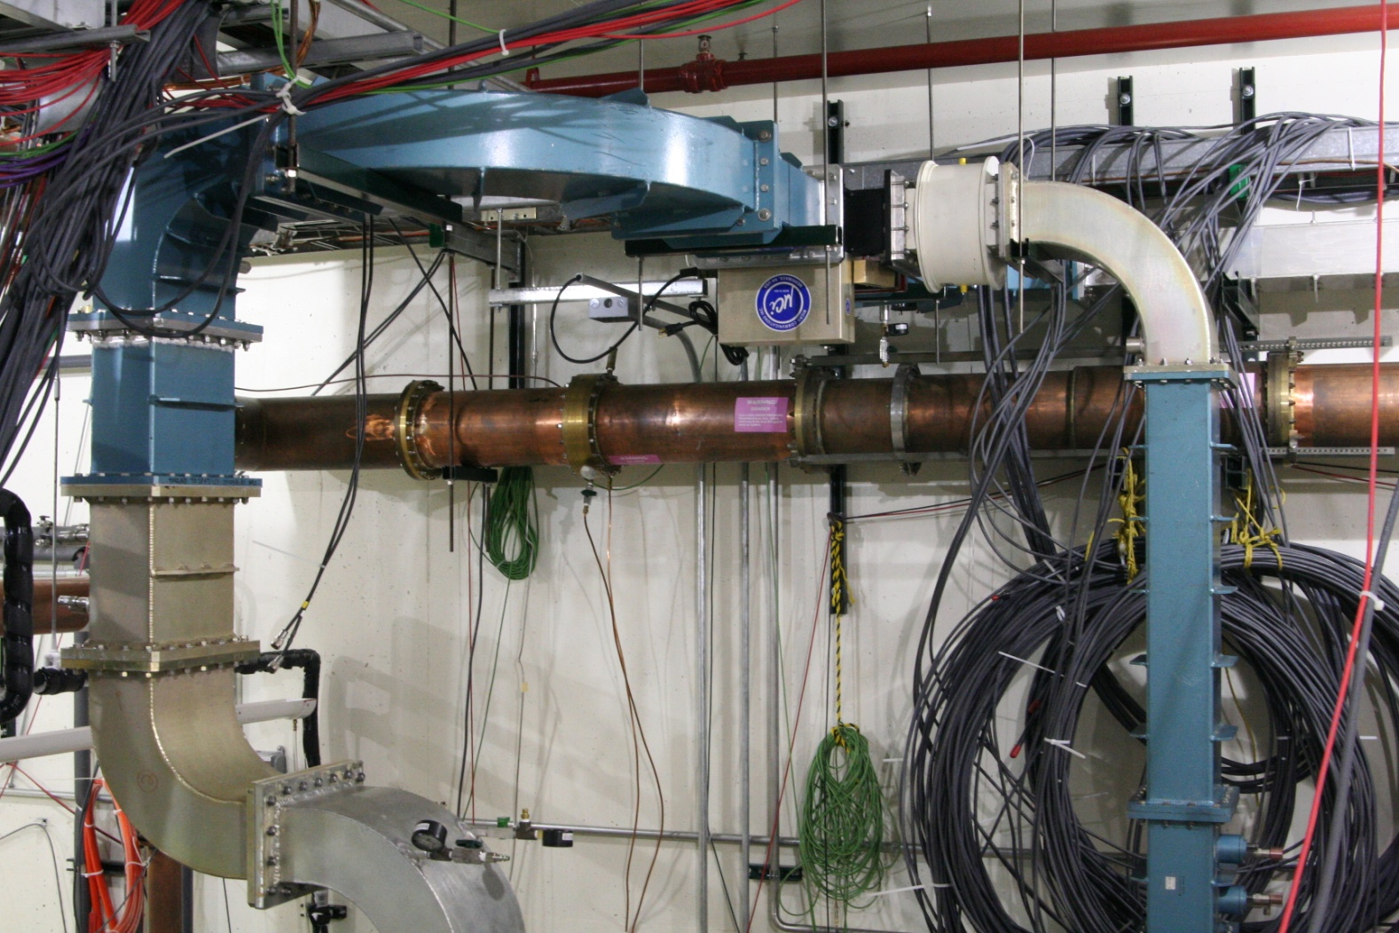
The SPDT RF Switch has been installed in the MTA
This gives us 2 RF test location in the MTA Hall.

Slide 14
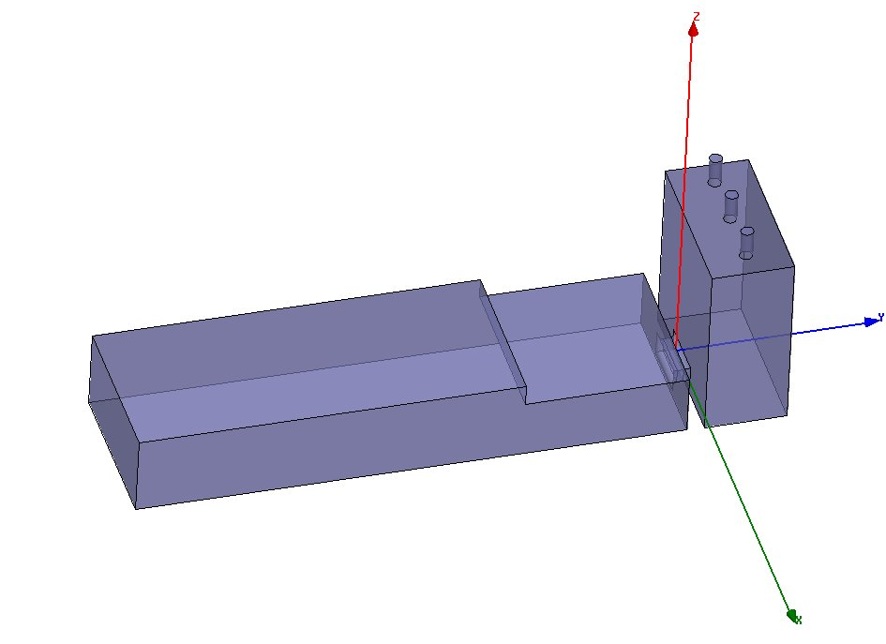
Parallel E and H field Design:
Optical View port
E Field pick-ups
E & B
Original LBL Waveguide RF power Coupler section; ½ height Standard WG section
¼ height Coupling Cell. This is built in two sections with WG flanges not shown.

Slide 15
Summary Of the Box cavity
We have completed the Box cavity Study ( magnetic field insulation effect) at 91,90, 89, 87 and 86 Degrees at 3. Tesla. Before each run we commissioned the cavity upto 33 MV/m at 0. T except for the first 0 Degree run commissioned to 23 MV/m. In some of the later runs, we commissioned the cavity to 50 MV/m at 0 T.
The results have been shown: from 89 to 91 deg we reached a low sparking rate at a average gradient of 33 MV/m
at 87 deg a average gradient of 25 MV/m and
at 86 deg a average gradient of 22.5 MV/m.
We need to decide if the second orthogonal box cavity should be tested with a TiN coating or tested at all?
We also need to decide if we need to build a parallel Box for testing in the MTA from the copper in storage?
The second RF test station is now ready for RF commissioning cavities that do not require a magnetic field.

