Slide 1
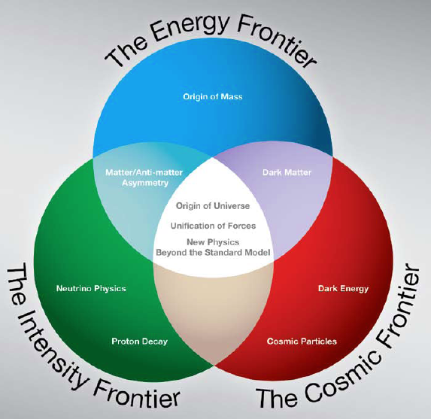
MAP Overview
Steve Geer
Accelerator Physics Center
Fermi National Accelerator Laboratory
MAP Winter Meeting
JLab, February 28, 2011
μ⁺
μ⁻
ν

Slide 2
MAP MISSION STATEMENT
The mission of the Muon Accelerator Program (MAP) is to develop and demonstrate the concepts and critical technologies required to produce, capture, condition, accelerate, and store intense beams of muons for Muon Colliders and Neutrino Factories. The goal of MAP is to deliver results that will permit the high-energy physics community to make an informed choice of the optimal path to a high-energy lepton collider and/or a next-generation neutrino beam facility. Coordination with the parallel Muon Collider Physics and Detector Study and with the International Design Study of a Neutrino Factory will ensure MAP responsiveness to physics requirements.

Slide 3
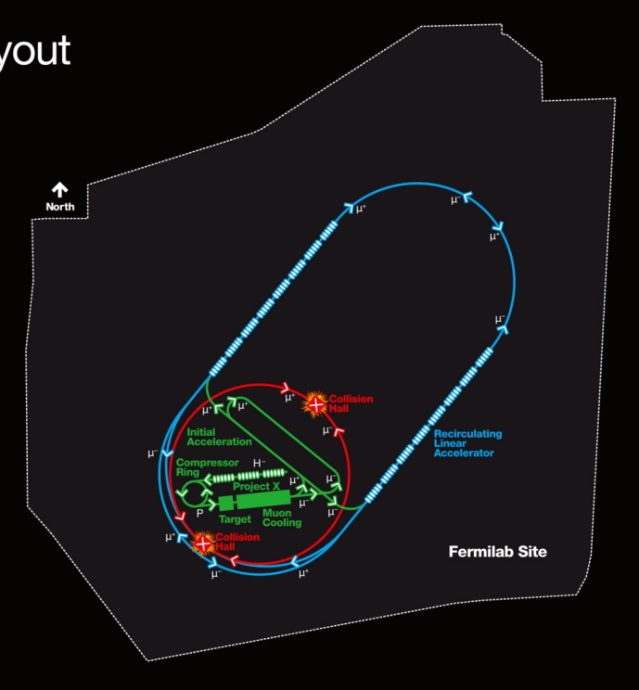
MUON COLLIDER MOTIVATION
If we can build a muon collider, it is an attractive multi-TeV lepton collider option because muons don’t radiate as readily as electrons (m_{μ} / m_{e} ~ 207):
- COMPACT
Fits on laboratory site
- MULTI-PASS ACCELERATION
Cost Effective operation &
construction
- MULTIPASS COLLISIONS IN
A RING (~1000 turns)
Relaxed emittance requirements
& hence relaxed tolerances
- NARROW ENERGY SPREAD
Precision scans, kinematic constraints
- TWO DETECTORS (2 IPs)
- ΔT_{bunch} ~ 10 μs … (e.g. 4 TeV collider)
Lots of time for readout
Backgrounds don’t pile up
- (m_{μ}/m_{e})² = ~40000
Enhanced s-channel rates for Higgs-like particles
A 4 TeV Muon Collider would
fit on the Fermilab Site
COST
PHYSICS

Slide 4
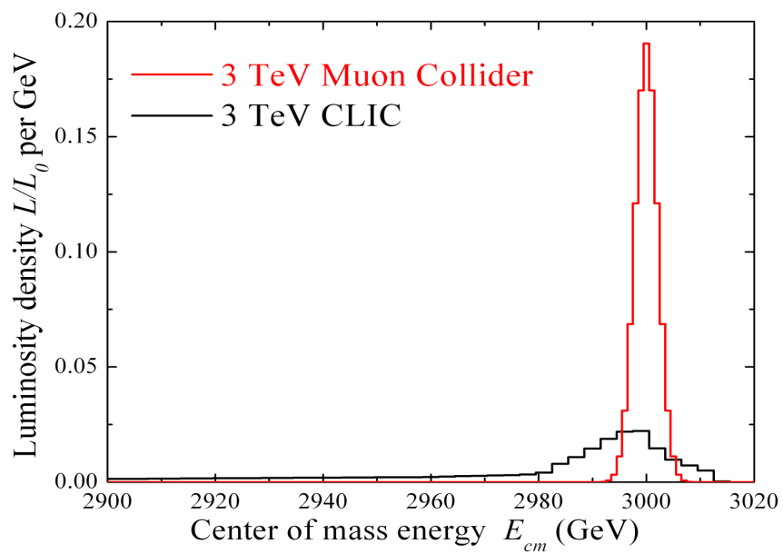
ENERGY SPREAD
Beamstrahlung in
any e+e- collider
δE/E ∝ γ²

Slide 5
NEUTRINO FACTORY MOTIVATION
• Mono-energetic muon decays would produce a unique neutrino beam consisting of 50% ν_{e}(ν_{e}) & 50% ν_{μ}(ν_{μ}) … very well known fluxes & spectrum – hence low systematic uncertainties
–
–
sin²2θ₁₃
MASS HIERARCHY
CPV
NF
NF
NF
0.8
0.6
Fraction of δ
Conventional Beams
Conventional Beams
0.4
Conventional Beams
0.2
0
10⁻⁴ 10⁻³ 10⁻² 10⁻⁴ 10⁻³ 10⁻² 10⁻⁴ 10⁻³ 10⁻²
sin²2θ₁₃
If θ₁₃ small, a 25 GeV NF (above) has exquisite sensitivity.
If θ₁₃ large, a ~5 GeV NF offers exquisite precision.

Slide 6
CHALLENGES
Muons are produced as tertiary particles. To make enough of them we must start with a MW scale proton source & target facility.
Muons decay ⇒ everything must be done fast and we must deal with the decay electrons (& neutrinos for CM energies above ~3 TeV).
Muons are born within a large 6D phase-space. For a MC we must cool them by O(10⁶) before they decay ⇒ New cooling technique (ionization cooling) must be demonstrated, and it requires components with demanding performance (NCRF in magnetic channel, high field solenoids.)
After cooling, beams still have relatively large emittance.

Slide 7
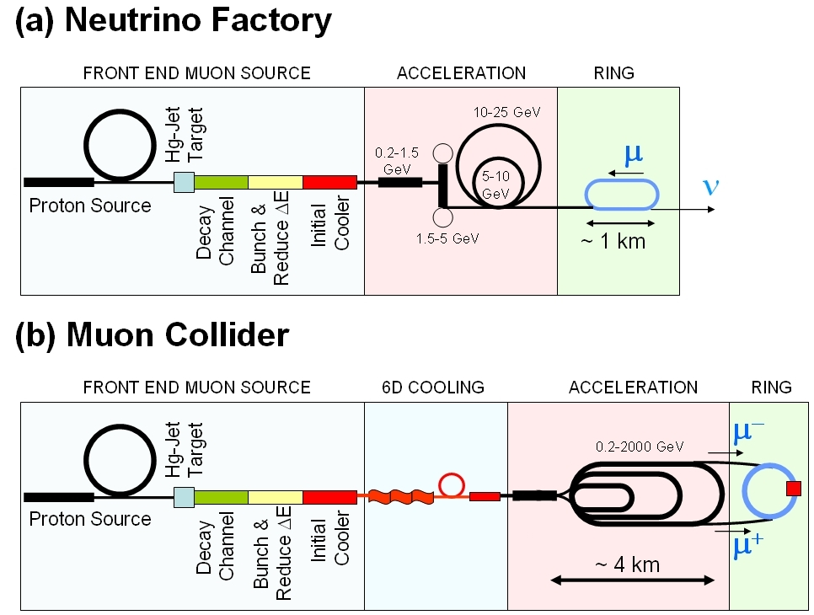
Muon Collider cf. Neutrino Factory
NEUTRINO
FACTORY
MUON
COLLIDER
In present MC baseline design, Front End is same as for NF

Slide 8
A DECADE OF PROGRESS
Successful completion of NF feasibility studies 1, 2, 2a, & International Scoping Study; launching of the ongoing International Design Study for a NF (IDS-NF).
Successful demonstration of the target technology (MERIT: Mercury jet in 15T solenoid hit by intense beam)
Conceptual development & simulation of a complete, self-consistent, muon cooling scheme (further conceptual development probably needed).
Built a unique accelerator R&D facility (MuCool Test Area) at end of FNAL Linac for testing cooling channel components.
Launching of MICE: international ionization cooling experiment at RAL.
First multi-TeV Muon Collider ring design & magnet concepts (to operate in decay background environment)
First detector background studies (10 years ago), & launching of 2nd generation of studies (now).

Slide 9
THE BIRTH OF MAP
Oct 1, 2009 letter from Denis Kovar to FNAL Director:
  “Our office believes that it is timely to mount a concerted national R&D program that addresses the technical challenges and feasibility issues relevant to the capabilities needed for future Neutrino Factory and multi-TeV Muon Collider facilities. ...”
Letter requested a new organization for a national Muon Collider & Neutrino Factory R&D program, hosted at FNAL. Muon Accelerator Program Organization is now in place & functioning: >200 participants from 15 institutions:
  ANL, BNL, FNAL, Jlab, LBNL, ORNL, SLAC, Cornell, IIT, Princeton, UCB, UCLA, UCR, U-Miss, U. Chicago
MAP R&D proposal reviewed August 2010 … committee concluded that the “proposed work was very important to the field of high energy physics.”

Slide 10
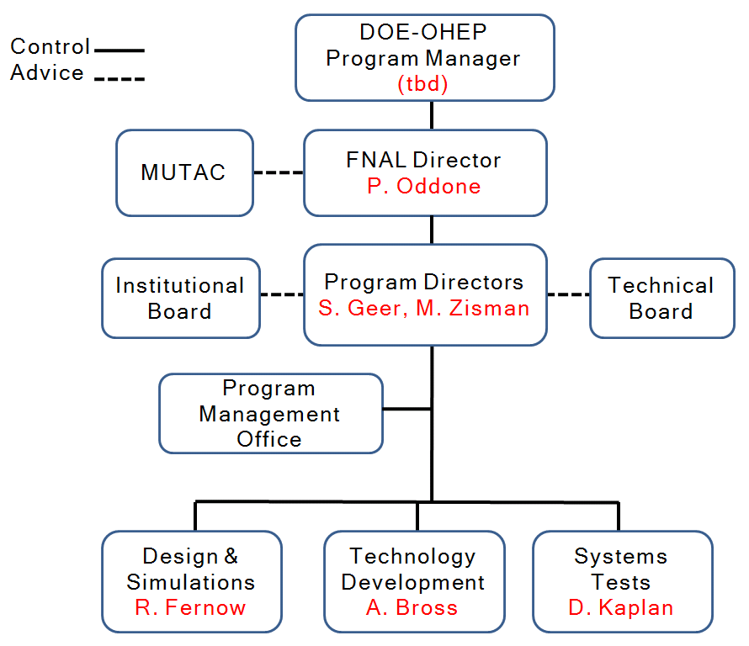
MAP ORGANIZATION
“Level 0”
“Level 1”

Slide 11
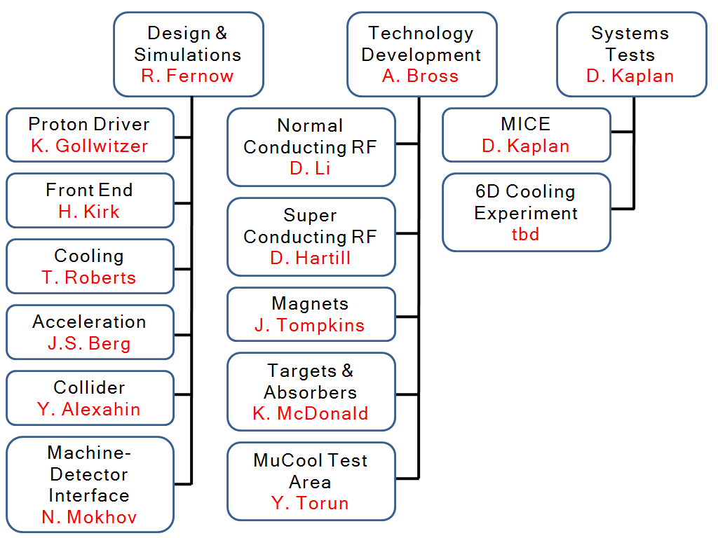
ORGANIZATION: L1 & L2
“Level 1”
L2 assignments
- FNAL; 4½ people
- Other Labs: 3 people
- Universities: 3½ people
- SBIR Companies: 1 person

Slide 12
INSTITUTIONAL BOARD
IB advises MAP Director(s) on matters of policy, and
  Maintains membership list & directory
  Annual list of publications based on MAP funded work
  Guideline for MAP membership
  Publication & presentation policies
  Advises on communication & outreach
  Scheduling & organizing workshop/meetings requested by the MAP Director(s)
IB members are the first point of contact between the institutions and the MAP Director(s).
Harry Weerts (ANL)
Ilan Ben-Zvi (BNL)
Vladimir Shiltsev (FNAL)
Andrew Hutton (JLab)
Steve Gourlay (LBNL)
Van Graves (ORNL)
Tor Raubenheimer (SLAC)
Don Hartill (Chair) (Cornell)
Dan Kaplan (Secretary) (IIT)
Kirk McDonald (Princeton)
Jonathan Wurtele (UCB)
David Cline (UCLA)
Gail Hanson (UCR)
Don Summers (U-Miss)

Slide 13
TECHNICAL BOARD
IB advises MAP Director(s) on technical matters, and in particular on
  Support required to attain milestones
  Process to make technical choices
  Guideline for MAP membership
  Changes to the MAP plan in response to new results
  Proposals from new institutions to carry out MAP supported R&D
Note that the board includes the three L1 managers.
Alan Bross (FNAL)
Rick Fernow (BNL)
Juan Gallardo (Secretary) (BNL)
Steve Geer (Co-Chair) (FNAL)
Don Hartill (Cornell)
Dan Kaplan (IIT)
Derun Li (LBNL)
Kirk McDonald (Princeton)
Bob Palmer (BNL)
John Tompkins (FNAL)
Mike Zisman (Co-Chair) (LBNL)

Slide 14
OTHER MANAGEMENT GROUPS
There are two other important management groups that, although not dictated by the “MAP Management Plan”, have been put in place by the present management to help things run smoothly:
MAP MANAGEMENT COUNCIL
(makes week-by-week management decisions):
- MAP Director(s)
- MAP L1 Managers
- Additions desired by MAP Director(s) - currently Bob Palmer
- MC Physics/detectors leader (Estia Eichten) – as needed
MAP PROGRAM MANAGEMENT GROUP
(monthly meetings between resource providers & MAP leadership)
- Stuart Henderson (chair)
- Agenda set in consultation with MAP Director(s)
- Participants include relevant Division Heads & MAP L1’s

Slide 15
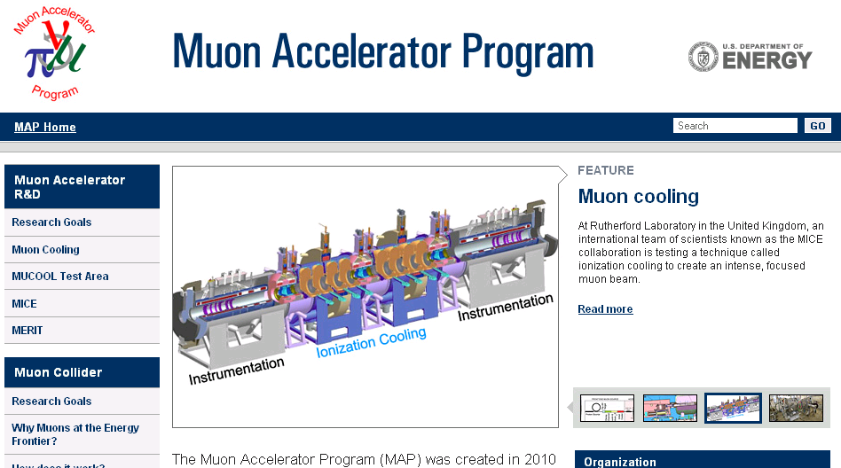
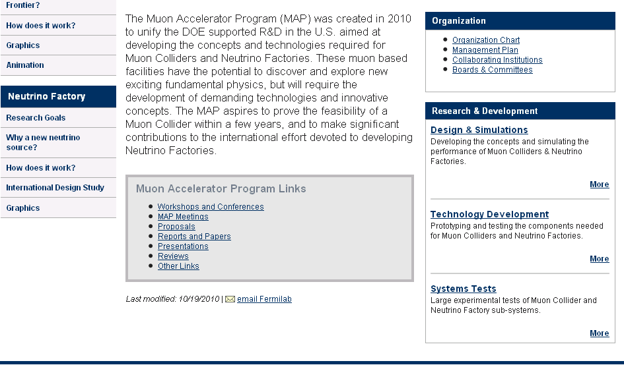
WEBSITE http://map.fnal.gov/

Slide 16
MAP PLAN: GOALS
Deliver on our commitments to making MICE and the IDS-NF studies a success.
Deliver a Design Study to enable the community to judge the feasibility of a multi-TeV Muon Collider, including:
(i) an end-to-end simulation of a MC complex based on technologies in-hand or that can be developed with a specified R&D program.
(ii) hardware R&D and experimental tests to guide & validate the design work.
(iii) Rough cost range.

Slide 17
MILESTONES & DELIVERABLES
Muon Collider Design Feasibility Report (FY16)
  Based on end-to-end simulation of MC complex which uses components that are in-hand or can be developed with a specified R&D program
Hardware R&D results → technology choice
MC Cost range (FY16)
Contributions to the IDS-NF RDR (FY14)
R&D plan for longer-term activities (including 6D cooling experiment)
Deliverable | Nominal schedule | Augmented schedule
MC DFS
Interim | FY14 | –––
Final + cost range | FY16 | FY15
MICE hardware completion | FY13
RF studies (down-select) | FY12
IDS-NF RDR | FY14
6D cooling definition | FY12
6D cooling section component bench test | FY16 | FY15
6D demonstration proposal | FY16 | FY15

Slide 18
PAST-PRESENT-FUTURE
First
~10 years
FY07 –
FY09
FY10
NOW
≥FY11
NFMCC
+
MCTF
NFMCC
Interim
MAP
MAP
MAP
~4 M$
~9 M$
~10 M$
~15 M$ (requested)

Slide 19
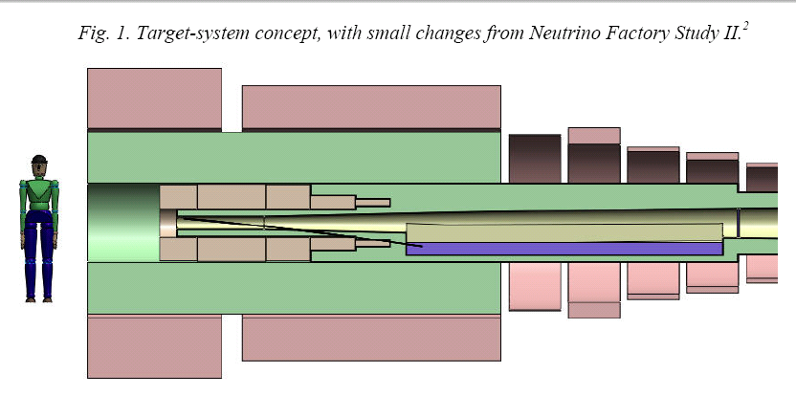
KEY CHALLENGES:
4 MW
4 MW !

Slide 20
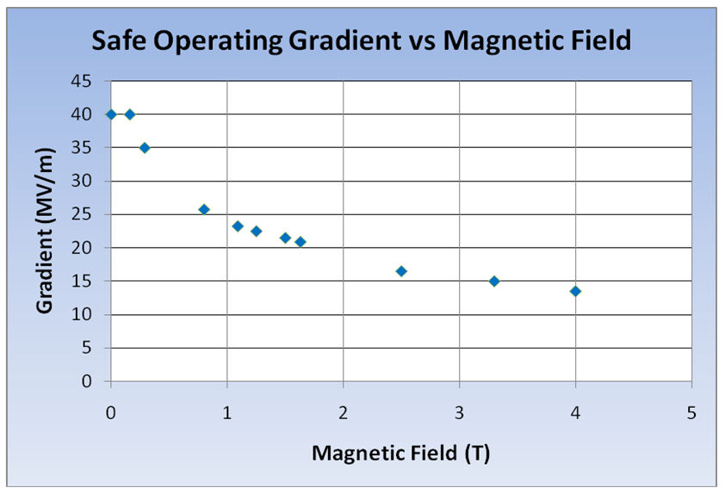
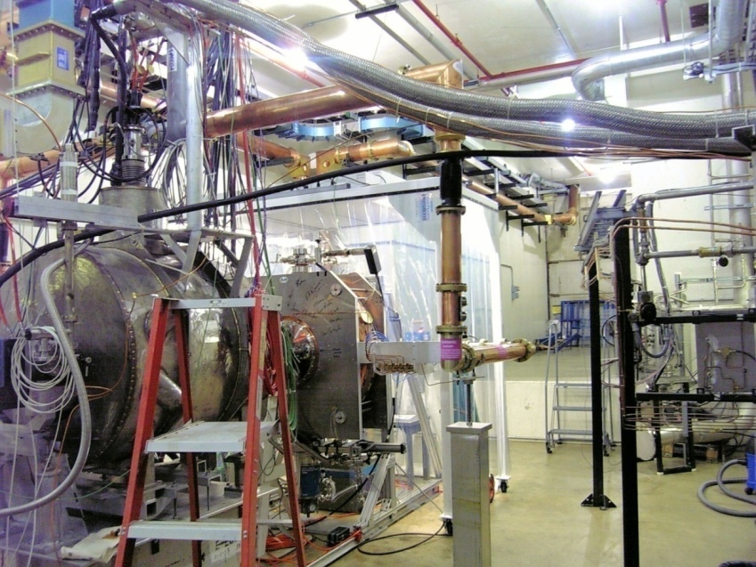
KEY CHALLENGES:
RF in Magnetic Fields
Significant degradation in maximum stable operating gradient for NCRF copper cavities in few Tesla coaxial field
Mucool Test Area
HOW CAN WE MITIGATE THIS EFFECT?
WHAT OPERATIONAL RF PARAMETERS SHOULD WE ASSUME IN OUR COOLING CHANNEL SIMULATIONS?

Slide 21
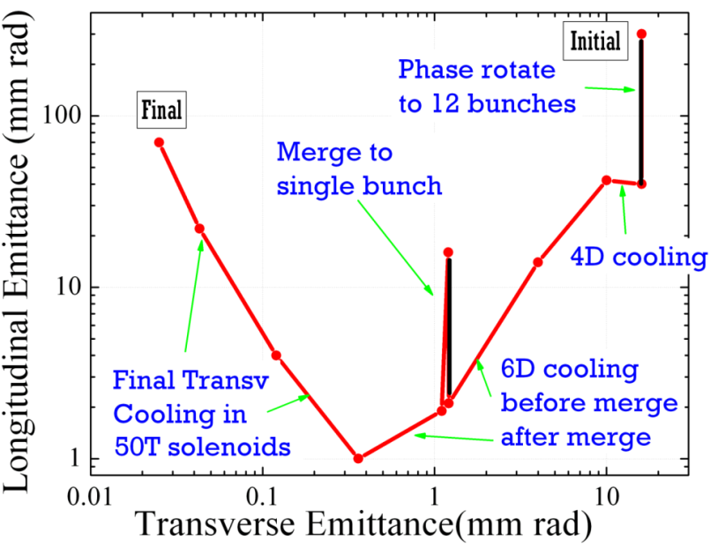
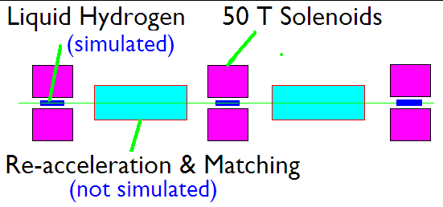
KEY CHALLENGES:
Last Stages of Cooling
Palmer
CAN WE MAKE THIS WORK ?
CAN WE DEVELOP THIS TECHNOLOGY?
IS THERE A BETTER IDEA?

Slide 22
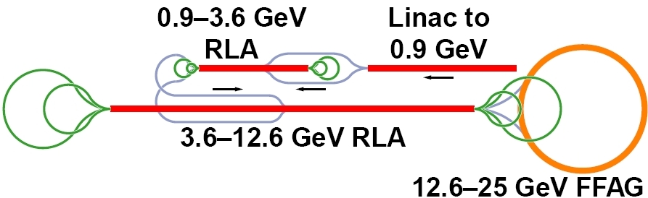
KEY CHALLENGES:
Cost –Effective Acceleration
We have a baseline acceleration scheme for the NF, which delivers muons at 25 GeV.
COST-EFFECTIVE ACCELERATION IS A HUGE ISSUE FOR A
MULTI-TEV LEPTON COLLIDER
WHAT SHOULD WE USE FOR THE MAIN ACCELERATION?
CAN WE MAKE RAPID CYCLING SYNCHROTRONS WORK?
MAGNETS?
LATTICE & DYNAMICS?

Slide 23
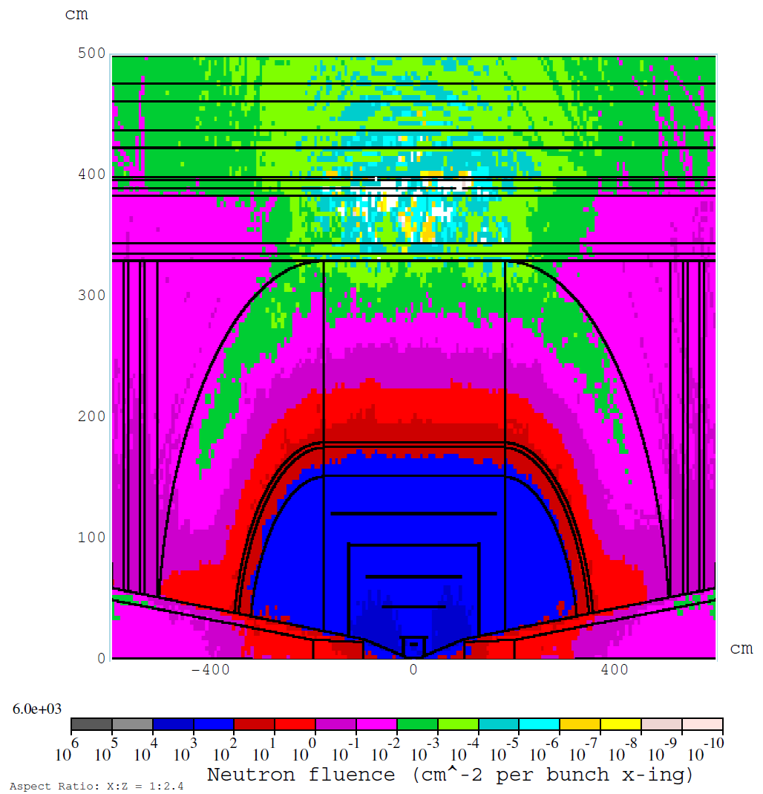
KEY CHALLENGES:
The Ring & MDI
There is a growing physics/detector/background activity.
ENOUGH HAS BEEN DONE TO KNOW WE HAVE A CHALLENGE
EVERY FACTOR OF 2 REDUCTION IN BACKGROUND COUNTS !

Slide 24
FINAL REMARKS
The birth of MAP has already resulted in a much-needed increased exposure for Muon Accelerator R&D
Together, we proposed an R&D plan that was reviewed last August → the “proposed work was very important to the field of high energy physics.”
The plan requires us to continue to be inventive, but also to be disciplined in our R&D !
  Keep in touch with the appropriate L1/L2 managers to make sure your critical contributions fit within the plan & really count.
We are proposing to deliver an option for the future of high energy physics:
  CHALLENGE
  OPPORTUNITY

Slide 25
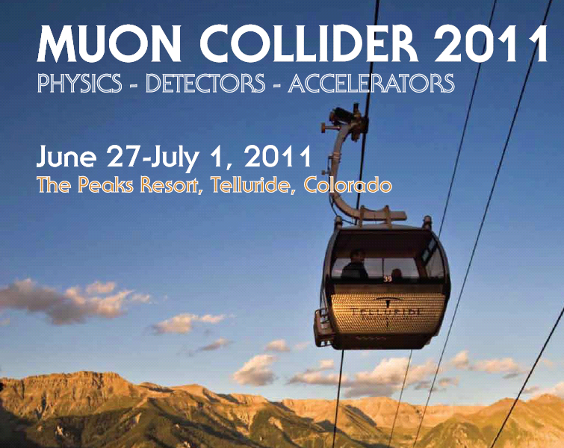
GIVE TALKS AT UNIVERSITIES NOT PRESENTLY INVOLVED IN MAP
LETS SEE IF WE CAN GET A GOOD TURN-OUT FOR TELLURIDE
http://conferences.fnal.gov/muon11/

