Slide 1
Neutrino Factory physics and detectors;
IDS-NF IDR and first steps towards the RDR

Slide 2

Acknowledgements:
I have taken material freely from the IDR and from recent talks at the EUROnu/IDS-NF meeting at RAL ...
  My thanks to the International Design Study for the Neutrino Factory (the IDS-NF) collaboration and the EUROnu collaboration!

Slide 3
Contents:
The physics case for the Neutrino Factory
Neutrino detectors for the Neutrino Factory
IDS-NF IDR and first steps towards the RDR
Timescales, responsibilities, stakeholders
Conclusions

Slide 4
The physics case for the Neutrino Factory
Neutrino Factory physics and detectors:
[Emphasis: what changed since ISS report]

Slide 5
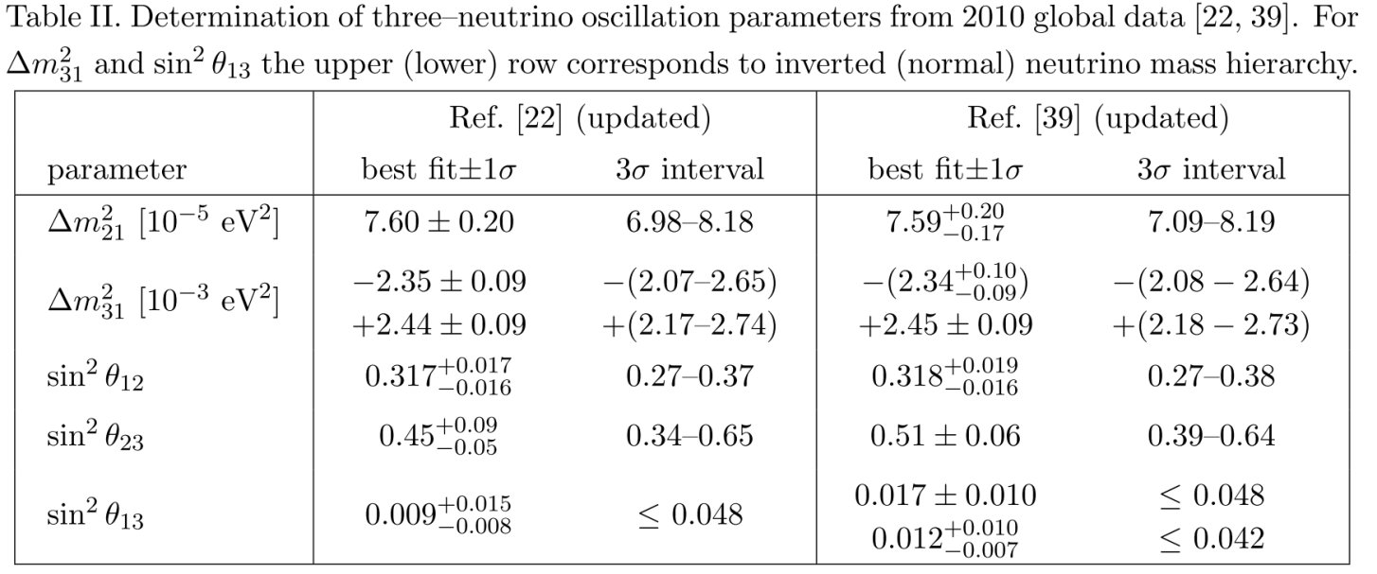
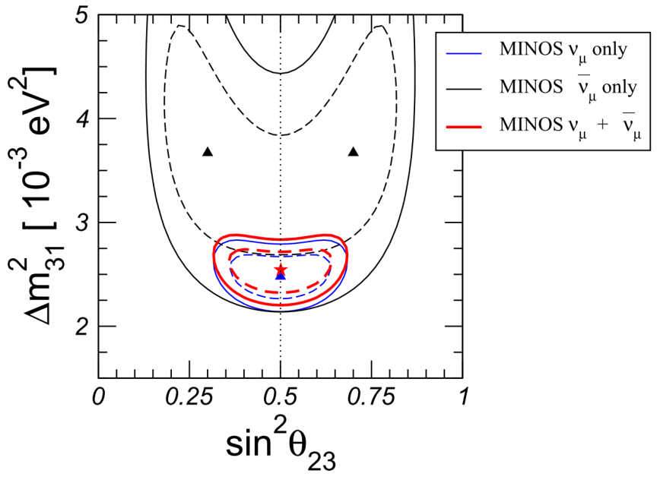
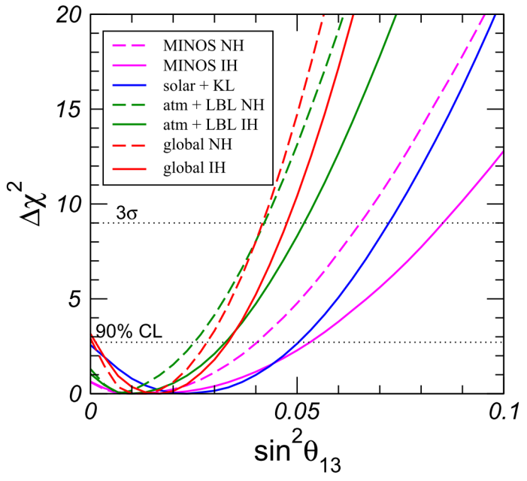
Status of knowledge of parameters:
New data, and new analyses, from MINOS, KamLAND, SNO, MiniBOONE, SuperKamiokande, used in updated global fits
Gonzales-Garcia,
Maltoni, Salvado
Mezzetto, Schwetz
Improvement in precision with which Δm²₃₁ (MINOS) and Δm²₂₁ (KamLAND) and known. Evidence for
θ₁₃ > 0 far from compelling.

Slide 6
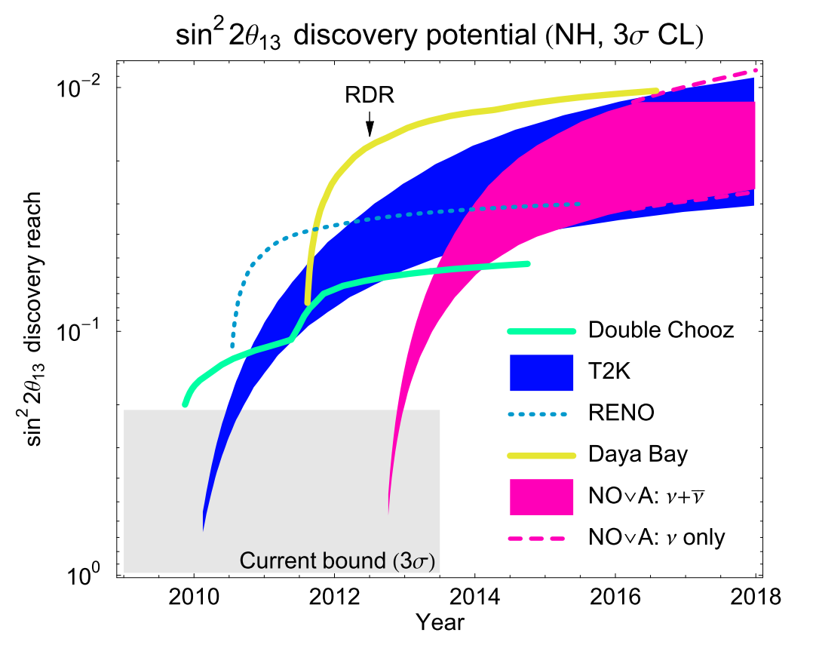
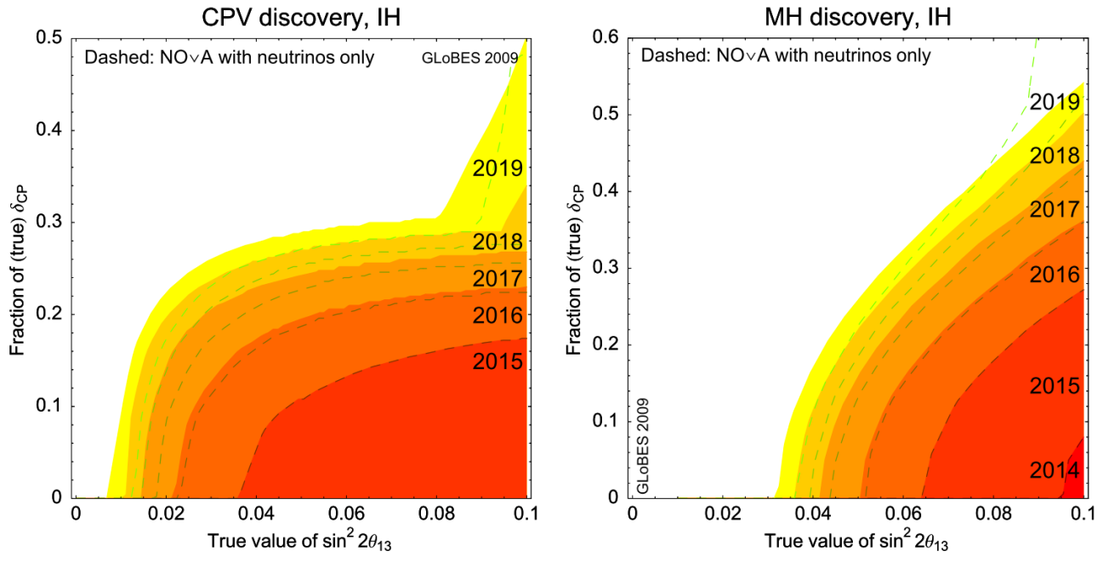
The risk of the incremental approach:
Present, and near future, experiments that seek to measure θ₁₃:
  Reactor: D-Chooz; Daya Bay; Reno
  Long-baseline: T2K, NOνA
‘Sensitivity plateau’ of ~10⁻² reached around 2016
Incremental upgrade programme:
  If sin²2θ₁₃ ~ 0.06 then have potential to discover CPV and mass hierarchy over 30% of parameter space at 90% C.L.
Neutrino Factory required to make discovery and to make detailed measurements
Huber, Lindner,
Schwetz, Winter

Slide 7
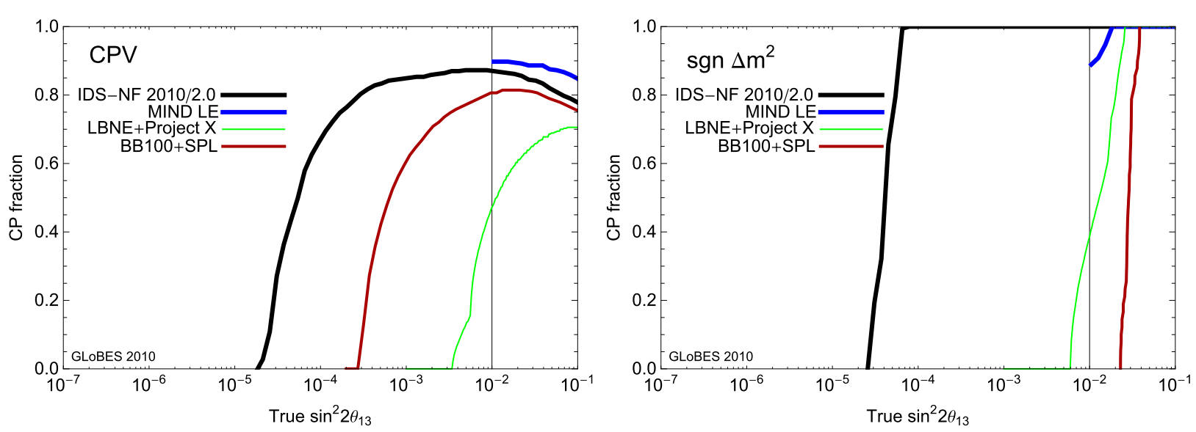
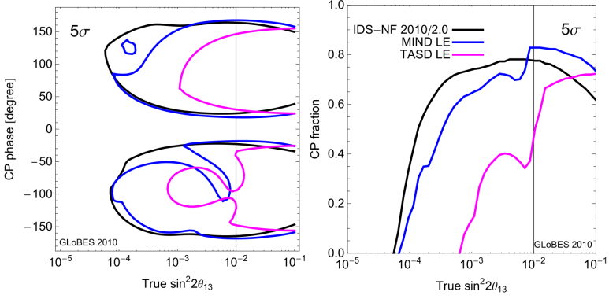
Large θ₁₃ case:
Were θ₁₃ to be shown to be > 0 before start of Neutrino Factory project:
  Re-optimise present IDS-NF baseline
  For example; 10 GeV muon energy serving a single 100 kTon MIND at a baseline of 2000 km

Slide 8
Neutrino detectors for the Neutrino Factory
Neutrino Factory physics and detectors:
[Emphasis: what changed since ISS report]

Slide 9
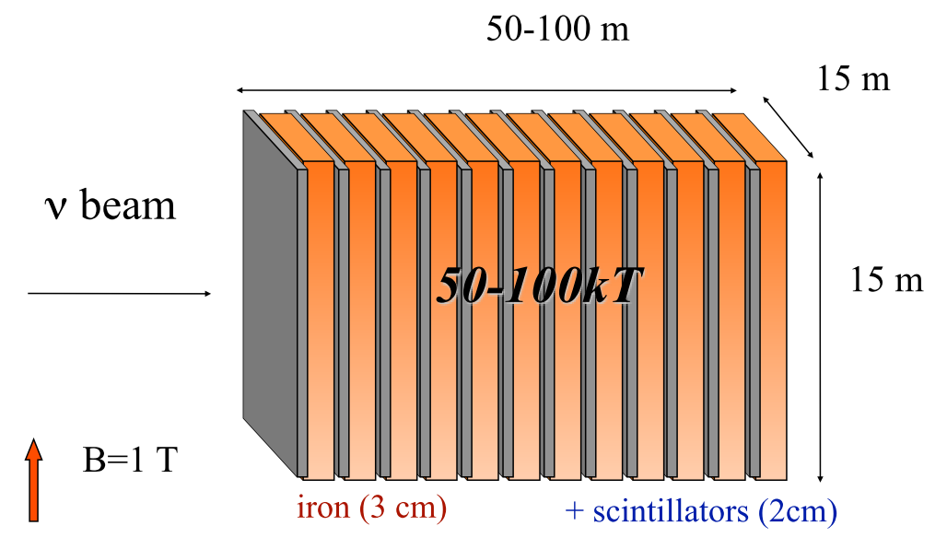
Magnetised Iron Neutrino Detector (MIND):
Cervera, Laing,
Martin-Albo, Soler
MIND:
  Re-optimised sampling: Fe/Sci = 3 cm/2 cm
  Cuboid emersed in 1 T dipole field
  Detector mass:
    Intermediate detector [2000—4000 km]: 100 kT
    Far detector [7000—8000 km]: 50 kT

Slide 10
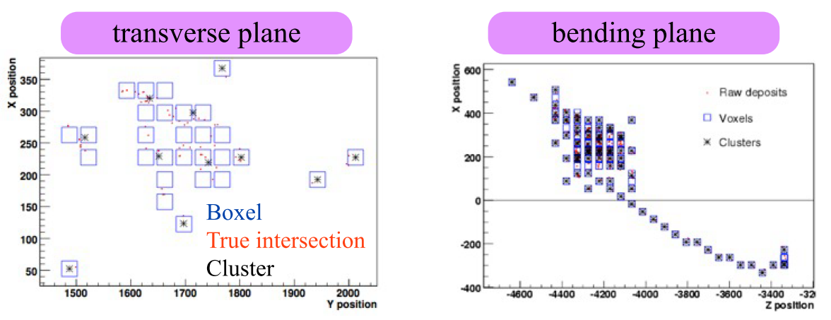
MIND: new simulation:
Cervera, Laing,
Martin-Albo, Soler
Improved simulation:
  Neutrino interactions with Nuance:
    Includes non-DIS processes, important at low E (Q²)
  Detector simulation with Geant4:
    Two layers of orthogonal scintillator bars
      Perfect matching, but light attenuation in WLS
      Energy split between bars and views and smeared
        Low light-yield hits (‘voxels’) rejected
      Voxel clustering implemented

Slide 11
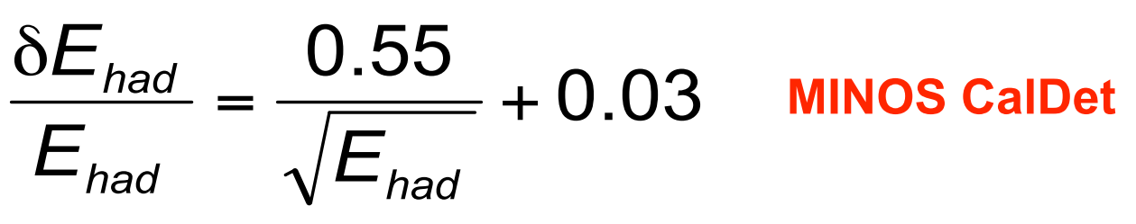
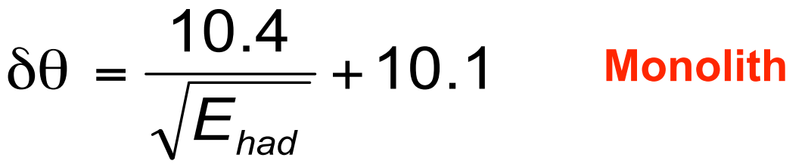
MIND: new reconstruction:
Cervera, Laing,
Martin-Albo, Soler
Muon pattern recognition:
  Start at most upstream cluster:
    Incremental Kalman filter used to find long muon tracks
    Cellular automaton used on short events
  Muon candidate is the longest track in the event
Hadronic shower reconstruction:
  Interim solution: smear ‘true’ hadronic quantities:

Slide 12
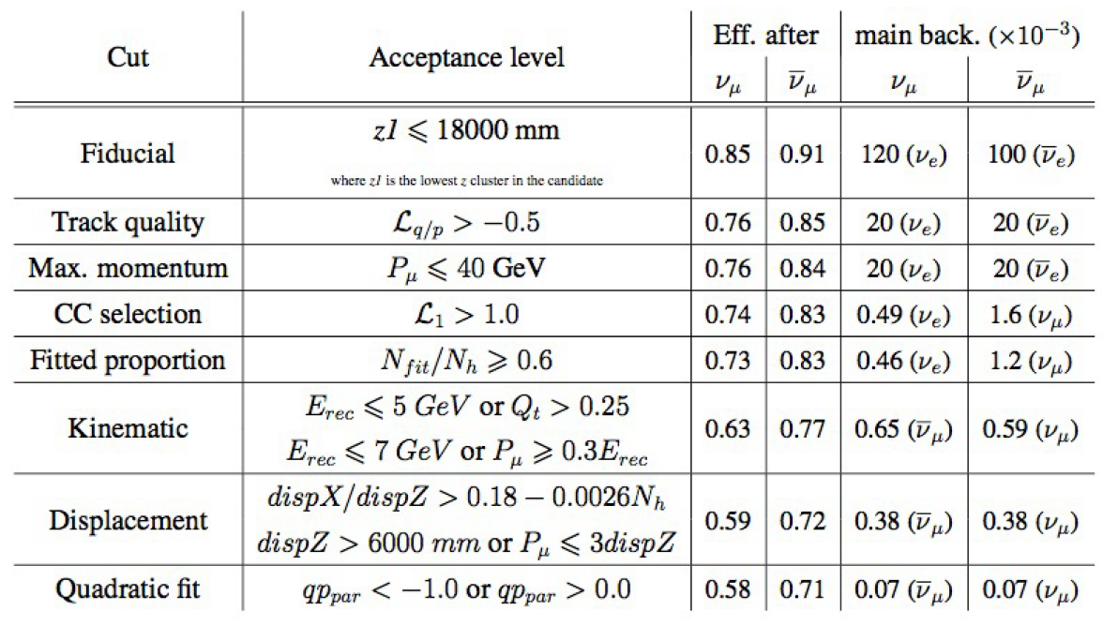
MIND: new analysis:
Cervera, Laing,
Martin-Albo, Soler

Slide 13
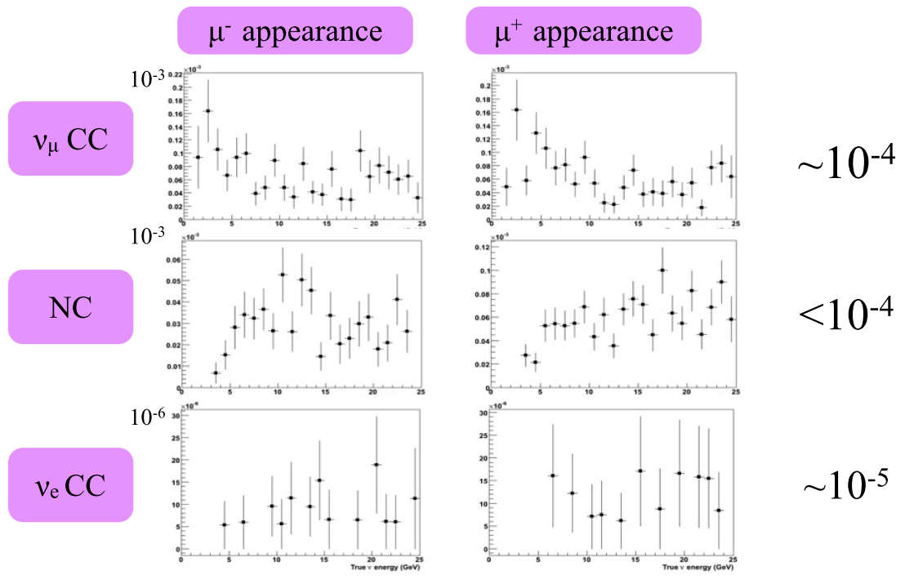
MIND: background rejection:
Cervera, Laing,
Martin-Albo, Soler

Slide 14
MIND: efficiency:
Cervera, Laing,
Martin-Albo, Soler
Threshold: 50% of plateau at ~2.25 GeV
  Improved by more than 2 GeV compared to ISS report

Slide 15
IDS-NF baseline 2010-2.0:
Cervera, Laing,
Martin-Albo, Soler
Migration matrices and treatment of taus (see IDR)
  Significant improvement over IDS-NF baseline 2007/1.0

Slide 16
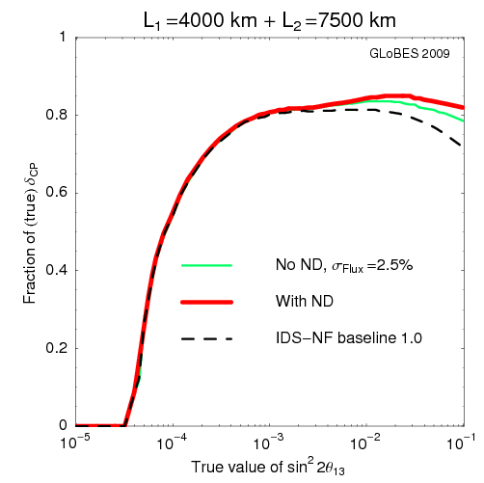
Near detector: motivation:
Oscillation analysis:
  Direct measurement
  of neutrino flux
  Detailed study of charm
  cross sections
  Detailed study of
  neutrino-nucleon
  scattering
    Including deep inelastic,
    quasi-elastic, and
    resonance scattering
Near detector physics programme:
  Search for non-standard interactions
    In particular, require sensitivity to taus
  Neutrino physics:
    Polarised (and unpolarised) structure functions
      Determination of α_{S}
    Electroweak physics: Weinberg angle
    CP violation from D⁰, D⁰ mixing, polarised Λ production, …
Winter, Tang

Slide 17
Near detector: concept:
Soler
ISS:
  No near detector in the baseline:
    Known to be a shortcoming
IDS-NF near detector concept (baseline 2010/2.0)

Slide 18
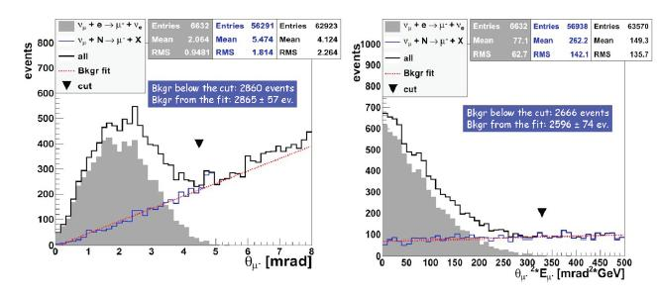
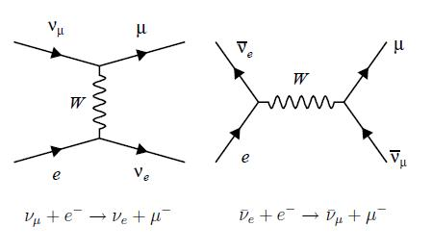
Option A: Scintillating Fibre Tracker
Simulation near detector for Neutrino Factory (Tsenov/Kharadzhov)
Measure flux through leptonic interactions like IMD:
Can achieve 1% flux resolution

Slide 19
Option B: High resolution near detector
NOMAD-like resolution in HiRes detector allows to:
  Measure flux (low ν⁰ method):
  Compare to Inverse Muon Decay
  Measure absolute flux using ν-e elastic scattering
  Measure quasi-elastic scattering
  Fermi motion
  NC vs CC events (NOMAD with 90% purity)
  Coherent π⁰
  Measure A dependence in nuclear targets
  Comparison sin²θ_{W} from DIS and
  77 different physics topics!
Mishra

Slide 20
Tau/Charm detector
Soler
We want near detector also to study:
  Charm: to measure main background for oscillation search
  Tau: to search for NSI at source and detection
Can achieve this using a silicon vertex detector
  But also looking at feasibility of replaceable emulsion target

Slide 21
Near detector workshop:
Migliozzi, Tsenov, Morfin
Near Detector Workshop:
  CAPRI; 16—18Mar11
    https://www.ids-nf.org/wiki/NDW-2011-05-16
      http://indico.cern.ch/conferenceDisplay.py?confId=124307

Slide 22
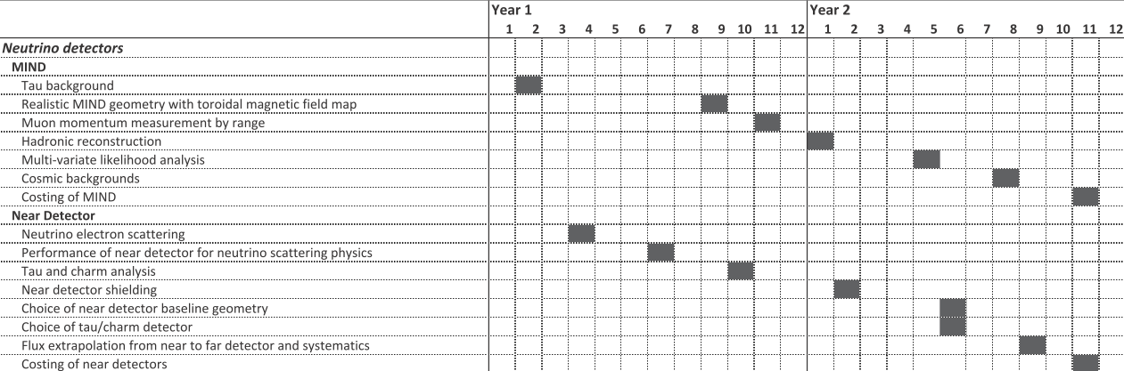
Detector planning for RDR:
Soler
Initial evaluation of tasks presented in IDR:
  Need to review within working group
  Engineering investigations of MIND have started
    Near detector concept needs to converge before engineering considerations can begin

Slide 23
IDS-NF IDR and first steps towards the RDR
Neutrino Factory physics and detectors:
IDS-NF IDR and first steps towards the RDR

Slide 24
Closing the IDR: the next steps:
Complete version to be circulated/presented | 15Jan11
Deadline for final comments | 20Feb11
Final version for review panel | 07Mar11
ECFA review | 5/6 May 2011
ECFA Panel’s feedback to us on the IDR will come late May or in June
  We should then:
    Update IDR where appropriate
    Respond to panel, explaining where we disagree
    Publish the report on the arXiv, as a CERN Yellow Report and laboratory pre-prints
To publish in a refereed journal?
  Need to reach an ‘IDS-NF view’ on this
    Strong views for and against
    Final decision at the IDS-NF plenary meeting at Virginia Tech 17—19 October 2011 [IDS-NF#7]
In the mean time, it will be important to step up our ‘out-reach’

Slide 25
Costing the Neutrino Factory:
Ducked costing for the IDR:
  While some subsystems had made a reasonable start on costing, overall the costing was not far enough advanced
Costing critical for RDR (and can’t be ducked!)
Costing conceived as including:
  Cost of R&D programme by which remaining risks will be addressed;
  Design and manufacture of components;
  Construction of facility (including materials, equipment and labour);
  Cost of inspection, commissioning and testing;
  Cost of meeting safety and radiation requirements

Slide 26
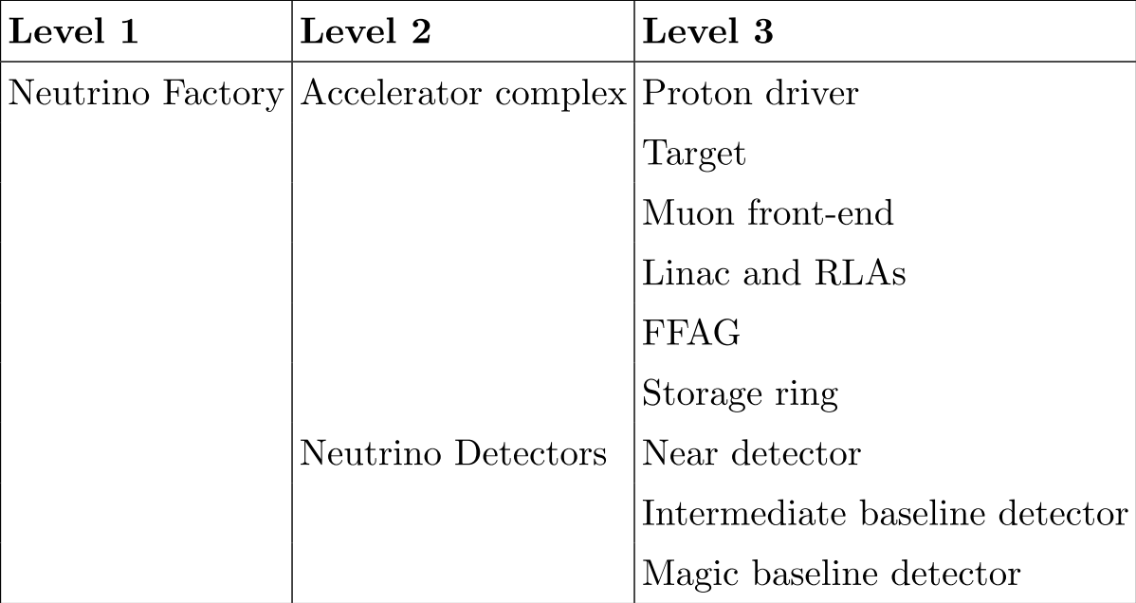
Costing methodology:
Methodology has been agreed:
  Develop ‘Project Breakdown Structure’ (PBS)
  Cost elements at ‘appropriate level’;
    Could be:
      Component or system based;
      Scaled from previous experience of existing equipment
      Based on a cost model (for magnets, for example)
Will use CERN costing tool which implements PBS and contains organisational structures (e.g. cost of components, justification, change log)
  Important: CERN colleagues (P. Bonal et al) have agreed to modify tool to meet our needs
Some additional discussion
in Steering Group:
  Have agreed:
    Iterative approach:
      Must not wait too long
      before first site of full cost
      Concentrate on cost drivers
  To be discussed:
    ‘Secret or full disclosure’
      Discuss at CERN costing w/s
      May 2011
      Close at IDS-NF meeting at VT
      17—19 October 2011
    Some preference for ‘secret’ within
    SG

Slide 27
Costing: organisation:
Ilias Efthymiopoulos (CERN) coordinating development of costing tool (P. Bonal et al, CERN)
Coordination of accelerator costing:
  Neil Bliss (DL) ⊕ Ajit Kurup (Imperial, EUROnu)
    Working towards Costing Workshop at CERN
  NB and AK form focal point:
    Interface to CERN costing tool;
    Help make costing uniform across subsystems
    Will be coming to ‘you’ to ask for your help!
Coordination of detector costing:
  In one sense quite advanced (MINOS is good basis for development of MIND costing);
  In another sense requires some effort (near detector concept to be defined)

Slide 28
Timescales, responsibilities, stakeholders:
Neutrino Factory physics and detectors:
IDS-NF IDR and first steps towards the RDR
[Really the start of a discussion.]

Slide 29
?

Slide 30
Responsibilities:

Slide 31
Stakeholders:
Muon Accelerator Programme
  IDS-NF part of MAP design programme
Europe:
  EUROnu: [~4 FTEs]
    FP7 contract with EC,
    runs until 31Aug12
    Final report to include
    cost estimates for SB, BB, and Neutrino Factory
  UK Neutrino Factory collaboration: [~7 FTEs]
    Present programme runs to 31Mar12
    SoI for future of programme was submitted at the end of January
      SoI to be evaluated by STFC Accelerator Strategy Board 04Mar11
      Optimistic that ‘call for proposal’ will follow
Asia:
  Contributions from Japan (principally Kyoto, Osaka)

Slide 32
Delivering the RDR:
Impact! At least as large as the ISS reports:
Task of delivering RDR is large!
  Time to review contributions from the various stakeholders and assess the match to the effort required:
    Hope to begin this discussion at this meeting

Slide 33
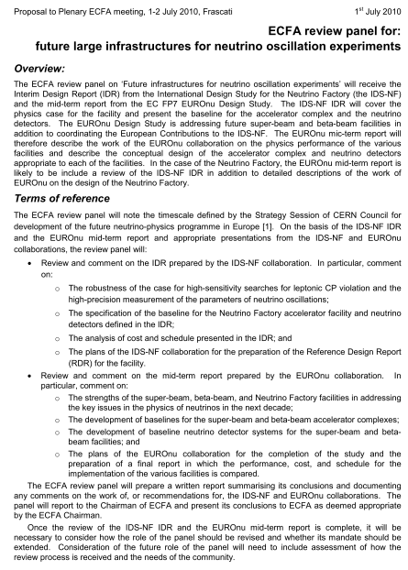


Slide 34
Composition of the panel:
Chair:
  Prof. Francis Halzen (US, Wisconsin)
Accelerator specialists:
  Terence Garvey (CH, PSI)
  David Findlay (UK, STFC/RAL)
  Philippe Lebrun (CERN)
Experimental physicists:
  Koichiro Nishikawa (JP, KEK)
  Patrick Decowski (NL. NIKHEF)
  Ewa Rondio (PL, NSI)
Theoretical physicists:
  Gianluigi Fogli (IT, INFN/Bari)
  Pepe Bernabeu (ES, Valencia IFIC)
  Jukka Maalampi (FI, Jyi)

Slide 36
Conclusions:
Neutrino Factory physics and detectors:
IDS-NF IDR and first steps towards the RDR

Slide 37
Conclusions:
Driven by scientific imperative to make Neutrino Factory an option for the field
Interim Design Report in the process of being finalised:
  Excellent document
  Important step on the way
    Much remains to be done to deliver the RDR
ECFA Neutrino Panel convened to review IDS-NF IDR and EUROnu mid-term report
  Potentially an important review:
    In Europe: CERN Council European Strategy Update will be launched at the EPS meeting in Grenoble
      Expect Strategy Update process to close at the end of 2012
      IDR, EUROnu mid-term (and final) reports and ECFA Panel’s review likely to be important inputs to this process
A great opportunity for the IDS-NF collaboration to take the activity to the next level!

