Slide 1
A new method of calculating the running coupling constant --- numerical results ---
Etsuko Itou
(YITP, Kyoto University)
Lattice 2008@College of William and Mary

Slide 2
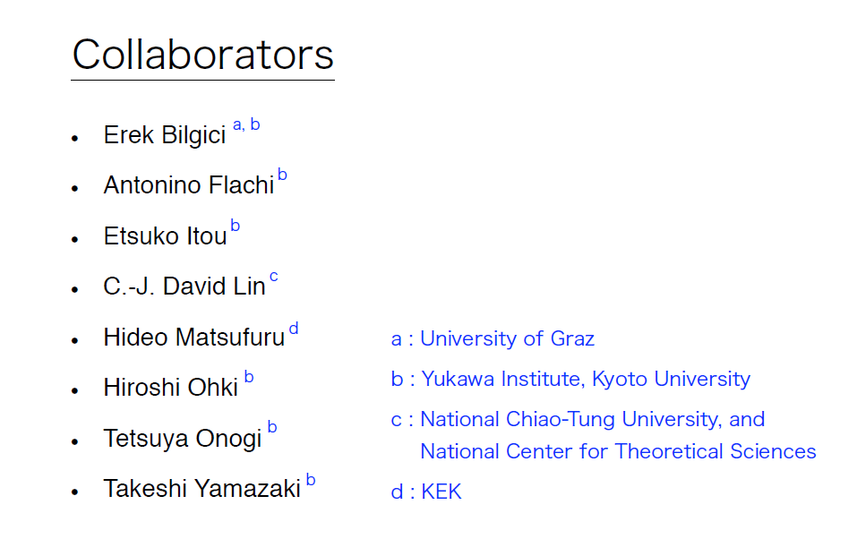
Numerical simulation was carried out on the vector supercomputer NEC SX-8 in YITP.

Slide 3
1.Introduction
Recently, it is suggested that there can exist a conformal fixed point in large flavor QCD using the running coupling in Schroedinger Functional scheme.
It is important to confirm this result using an independent method.
We develop a new scheme ("Wilson loop scheme") for the running coupling constant.
We carry out a quenched QCD test of our scheme.

Slide 4
Outline
1. Introduction
2. Basic idea –summary of the method-
3. Simulation parameters
4. Simulation details
5. Results
6. Conclusion

Slide 5
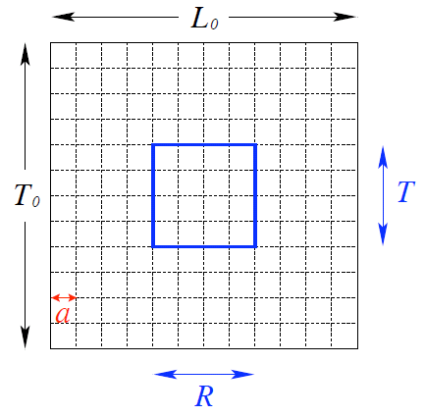
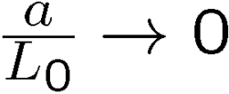
1.Basic idea –summary of the method-
We choose the renormalization scheme:
renormalized coupling
fix the free parameter in the renormalization condition
take the continuum limit
is the scale which defines the running coupling constant of step scaling
Notes:
This is te summary of our method. We choose the renormalization scheme following equation. Here, g is renormalized coupling and it depends on L, R/L and a/L.
To see the running of the coupling constant, first we fix the free parameter R/L in renormalization condition. For example 0.25, 0.30,0.35.
Secondly, we take the continuum limit. And L is the …

Slide 6
How to take the continuum limit
To take the continuum limit, we have to set the scale “ ”.
It corresponds to tuning to keep a certain input physical parameter constant.
Examples of input physical parameters:
Sommer scale,
Note: available only for low energy scale
Alpha collaboration (Nucl.Phys. B544 (1999) 669-698, S. Capitani et. al.)
step scaling in Schroedinger functional scheme
Choose as a constant input,
is an output.
Our choice in this quenched QCD test
Choose or Sommer scale as inputs,
are outputs .
Notes:
The problem is how to take the continuum limit. That is basic idea of our work.

Slide 7
2. Simulation parameters
pseudo-heatbath algorithm and Over-relaxation
# of gauge configurations 100
periodic b.c. and twisted b.c. (’t Hooft ,1979)
lattice
parameter sets of the lattice size and bare coupling to keep the input physical quantities constant
(Today’s talk)
Notes:
Let’s show the Simulation parameters. We use PHB alg. The remarkable point is the # of conf. is only 100. We study in both periodic and twisted b.c., however, twisted one is now in progress, so in today’s talk I will introduce the periodic case. And the parameter sets of …is following.

Slide 8
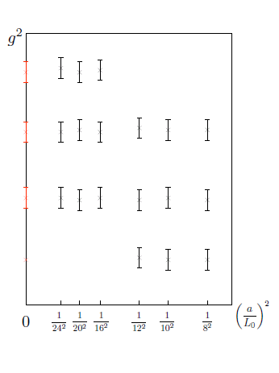
Parameter sets of the lattice size and bare coupling
Set 1
Set 2
Ref 1 : Set1-4
(Nucl.Phys. B544 (1999) 669-698, S. Capitani et. al.)
Ref 2 : Set5
(Nucl.Phys. B535 (1998) 389-402, M. Guagnelli et. al.)
is constant for each column. (Ref.1)
Sommer scale is a constant. (Ref.2)
Set1 |  |  | Set2 |  |  | Set3 |  |  | Set4 |  |  | Set5
beta | L0/a (s=1) | L0/a (s=2) | beta | L0/a (s=1) | L0/a (s=2) | beta | L0/a (s=1) | L0/a (s=2) | beta | L0/a (s=1) | L0/a (s=2) | beta | L0/a (s=1) | L0/a (s=1.5) | L0/a (s=2)
8.2500 | (8) | 16 | 7.6547 | (8) | 16 | 7.0197 | (8) | 16 | 6.4527 | (8) | 16 | 6.1274 | (8) | 12 | 16
8.4677 | (10) | 20 | 7.8500 | (10) | 20 | 7.2098 | (10) | 20 | 6.6629 | (10) | 20 | 6.2647 | (10) |  | 20
8.5873 | 12 | 24 | 7.9993 | 12 | 24 | 7.3551 | 12 | 24 | 6.7750 | 12 | 24 | 6.3831 | 12 | 18 | 24
8.7289 | 14 |  | 8.1352 | 14 |  | 7.4986 | 14 |  | 6.9169 | 14 |  | 6.4841 | 14
8.8323 | 16 |  | 8.2415 | 16 |  | 7.6101 | 16 |  | 7.0203 | 16 |  | 6.5700 | 16 | 24
High energy Low energy
In this test, we study the step scaling in our scheme.
Notes:
As I explained in Basic idea, according to Ref1, these parameter sets give the step scaling in SF scheme. The coupling in SF scheme is constant for s=1 of Set1. Second column is double scale of the first one. It corresponds to the this circle. And the first column of Set2 is there, and so on.
In low energy region, we choose these parameter sets to keep Sommer scale constant.

Slide 9
3.Simulation details
We define the renormalized coupling constant in our scheme:
is estimated by calculating the Creutz ratio.
Renormalized coupling in “Wilson loop scheme”
Notes:
Now I’d

Slide 10
Technical steps
Smearing of link variables
Interpolation of the Creutz ratios
Extrapolation to the continuum limit of the running coupling
APE Smearing of the link variables
Definition:
smearing level : n
smearing parameter:

Slide 11
Conditions for good choice of r and n
definition :
Discretization error should be controlled
larger r
Noise (statistical error) should be small
smaller r or higher n
Oversmearing should be avoided
n should be smaller than R/2,
n | r=0.25 | r=0.30 | r=0.35
n=1 | L0/a >10 | L0/a >8.3 | L0/a >7.1
n=2 | L0/a >18 | L0/a >15 | L0/a >12.8
n=3 | L0/a >26 | L0/a >21.6 | L0/a >18.5
Oversmearing
for n=1,2
Optimal choice!!
Table: The lower bound for L0/a
Notes:
There are some condition for r and n. First, we’d like to control the discritization error then r should be large.
Second, statistical error should be small, then smaller r or higher n is better. In third condition, we have to avoid over smearing. Then, n should be smaller than R/2. This gives the lower bound of lattice size for each r and n. We found these is optimal choice to satisfy these conditions.

Slide 12
Interpolation of the Creutz ratios
To obtain the value of the Creutz ratios for noninteger R, we have to interpolate them.
Ex)
Fit function :
Fit ranges :
L0/a | R+1/2 | R min | R max
12 | 3.6 | 2 | 4
14 | 4.2 | 2 | 5
16 | 4.8 | 3 | 5
18 | 5.4 | 4 | 6
20 | 6.0 | 4 | 6
24 | 7.2 | 5 | 7
Notes:
We take a quadratic fn. As a fit fn. And from the data graphs, we found these fit range is suitable for each lattice size.

Slide 13
Extrapolation to the continuum limit of the running coupling
Fit function:
Set 1

Slide 14
4.Results
Set1

Slide 15
Set1
Set2
The parameter set to give step scaling in SF scheme also gives step scaling in our scheme!

Slide 16
Set1,2
Set3

Slide 17
Set1 - 3
Set4

Slide 18
Set1 -4
Set5

Slide 19
1 loop
MC
Notes:
We compare the our numerical results with one-loop results. There two couplings are matching in high energy region. But in low energy, there is difference because of higher loop effect.

Slide 20
1 loop
2 loop
MC
Notes:
And this is two loop result. It is better to match with our result. However, still there is difference in low energy region. It shows the higher loop correction or non-perturbative effect.

Slide 21
5.Conclusion
We calculate the running coupling of quenched QCD in “Wilson loop scheme”.
The number of gauge configurations is only 100, however, we have shown that smearing drastically reduces the statistical error.
We found there is a window for the parameters (r,n) which both the statistical and discretization errors are under control.
This method is promising. We will investigate the large flavor QCD using this new renormalization scheme.

