Slide 1
Recent Results of PandaX Dark Matter Searching Experiment
Changbo Fu
Shanghai Jiao Tong University
On Behalf of Collaboration
27July2017

Slide 2
Outline
Introduciton
Dark Matter: WIMPs, Axion, …
PandaX at China Jinping Underground Lab（CJPL)
Operation and Data Analysis
Calibration
Energy/Position Calibration
Electrical Recoil (ER) and Nuclear Recoil (NR)
Radiation Background Analysis
⁸⁵Kr, ¹³⁷Xe…
Results: WIMPs (Spin-indep. and Spin-dep.)
Results: Axion (preliminary)
Summary and Future Plan
Operation of PandaX-I&II
Upgrade: PandaX-IV (4-ton Detector)
Upgrade: PandaX-III (¹³⁶Xe 0vbb)

Slide 3
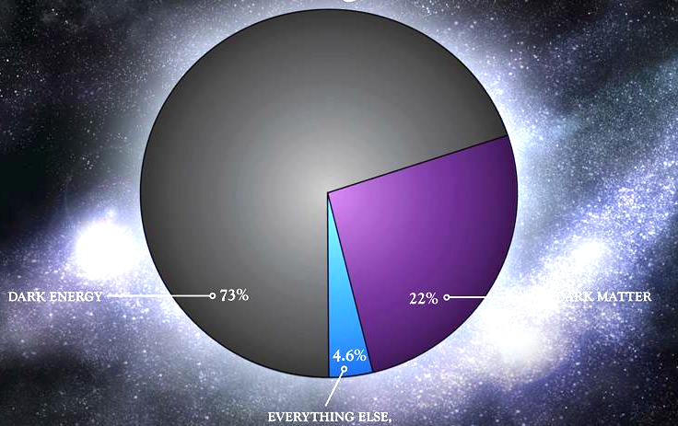
The Mass in Our Universe
？
？
Dark matter 26.8%
WIMP?
Axion?
Dark Photon?
…
Dark energy 68.3%
4.9%
Ordinary matter

Slide 4
WIMP? Axion? …
WIMP
May freeze out early as universe cooling down
Extremely small CS with normal matter
Spin-Dependent or not?
1977, Peccei-Quinn Sym.
If the Symmetry breaks
----> Axion
Good Theoretical Solution
Good dark matter candidate
Notes:
Lambda range, window

Slide 5
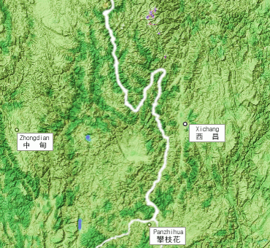
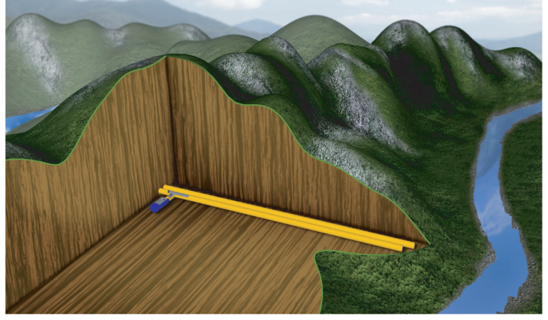
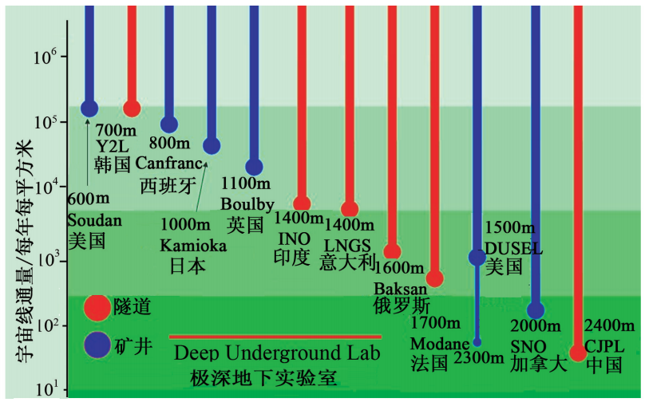
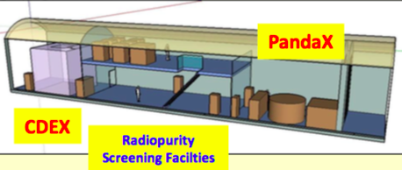
China JinPing Underground Laboratory (CJPL-I)
Deepest in the world ( 1µ/week/m²) and Horizontal access!
锦屏山
2400m
8000m

Slide 6
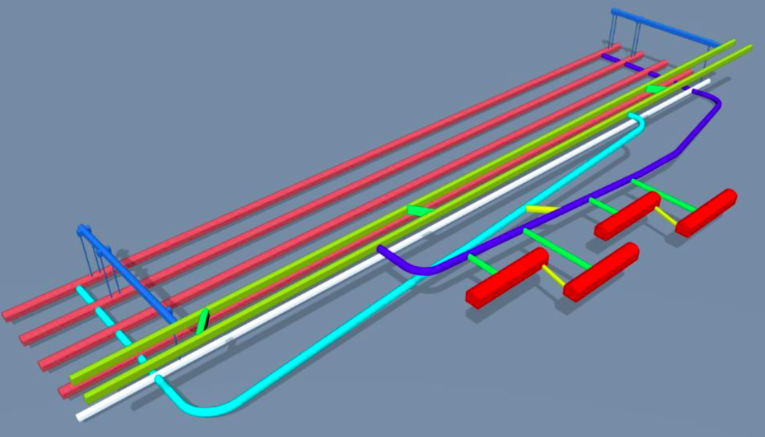
From CJPL-I ➔ CJPL-II
Headrace Tunnels
Traffic Tunnels
Exp. Halls

Slide 7
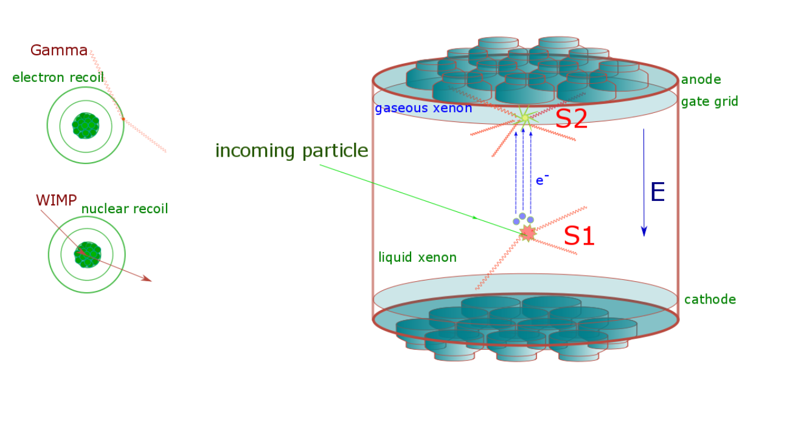
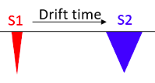
PandaX: a Dual-phase Xe TPC
dT
Energy: Photon(S1)+e(S2)
Position: XYZ(light pattern+TOF)
PID: S1/S2
ER: photon, Axion, Dark Photon…
NR: neutron, WIMP, …

Slide 8
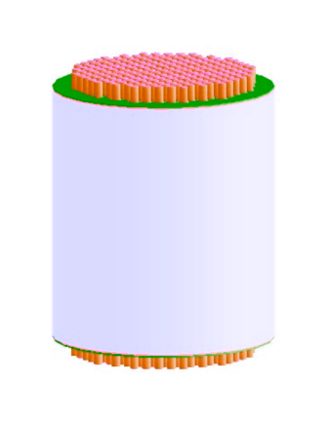
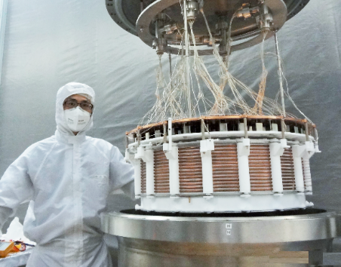
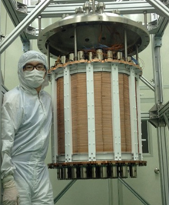
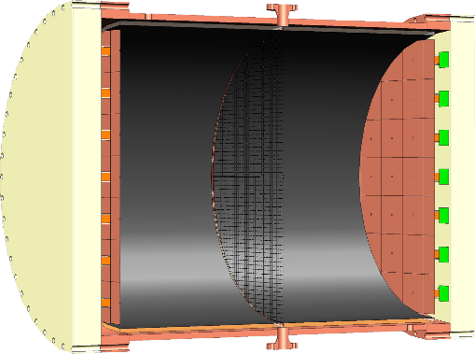
PandaX @ CJPL-I&II
PandaX-I: 120 kg DM experiment
2009-2014
PandaX-II: 500 kg DM experiment
2014-2018
PandaX-xT: multi-ton (~4-T) DM experiment
Future
PandaX-III: 200 kg to 1 ton HP gas ¹³⁶Xe 0vDBD experiment
Future
CJPL-I
CJPL-II
＝Particle and Astrophysical Xenon Experiments
Notes:
The first such experiment I am going to discuss is PandaX, that I work on. This experiment had a rather late start since 2009, but ramped up very quickly. Up-to-now, we have two phases developed in CJPL. The 2nd phase is running with 500-kg active target. In the future, PandaX will also move to the new CJPL-II to perform multi-ton DM experiment (we call it xT for now), as well as ton-scale 136Xe 0vDBD experiment, named PandaX-III.

Slide 9
PandaX-II Running History
Enginnering Running： from the beginning of 2015, Fix various problems
Commissioning Run I(Run8)： 2015.11. 22 – 12.14 (19.1days 306kg， FV) with high Kr background (Phys. Rev. D. 39, 122009 (2016))
Commissioning Run II (Run9)：First Low background Running, re-distillation to remove Kr, 2016.03.09-06.30 (79.6 days) PhysRevLett.117.121303
Running Now smoothly at this moment!

Slide 10
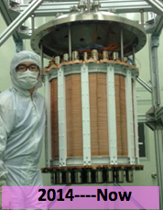
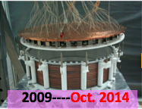
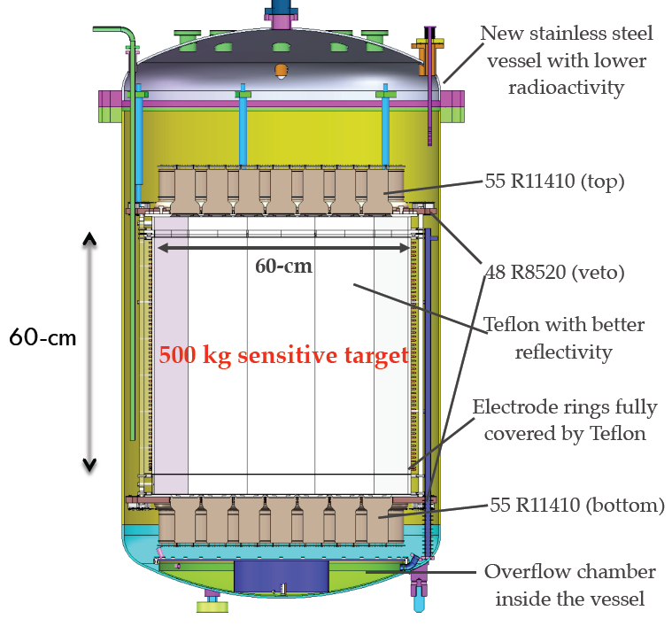
PandaX-II, New Features
More than Large Volume
New IV: inner vessel with clean Low Rad. SS
New PMTs: 55+55, 3” High Quam Eff., improved base design (±650V).
New Veto PMTs in skin
New OC: overflow chamber at Bottom, save expensive Xenon
Better Reflector: Improved Reflectivity

Slide 11
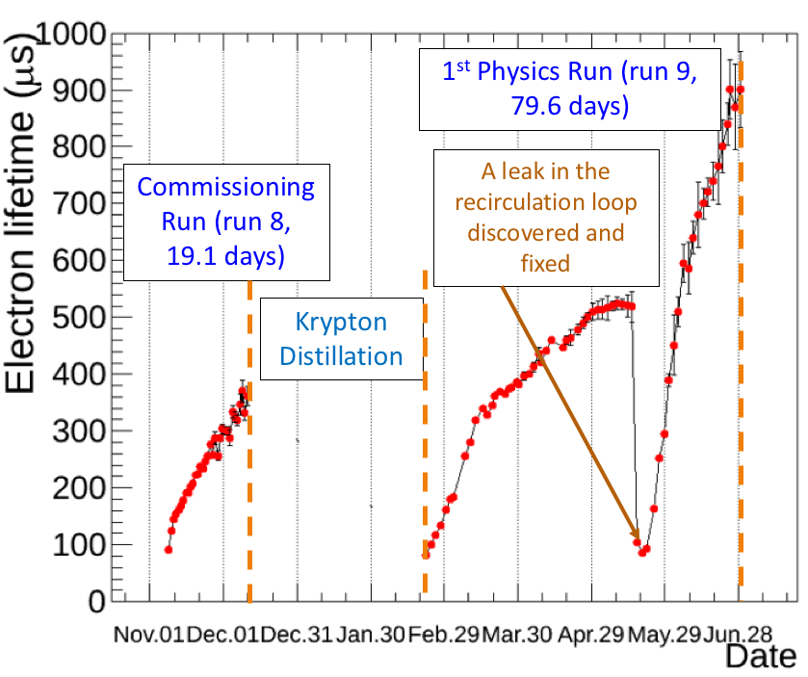
Electron Lifetime
2015.11.22---12.14
2016.03.09---06.30

Slide 12
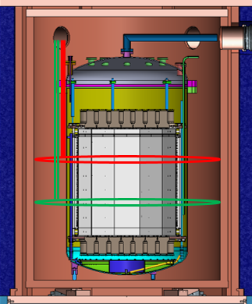
Calibration Program
Electrical Recoil（ER）
Internal/external ER peaks:
Detector uniformity corrections
Light/charge collection parameters
CH₃T injection: tritium beta decays
Simulate ER background
Nuclear Recoil（NR）
Low rate AmBe neutron source:
Simulate DM NR signal
Energy Cali.
Position Cali
ER/NR Cali.

Slide 13
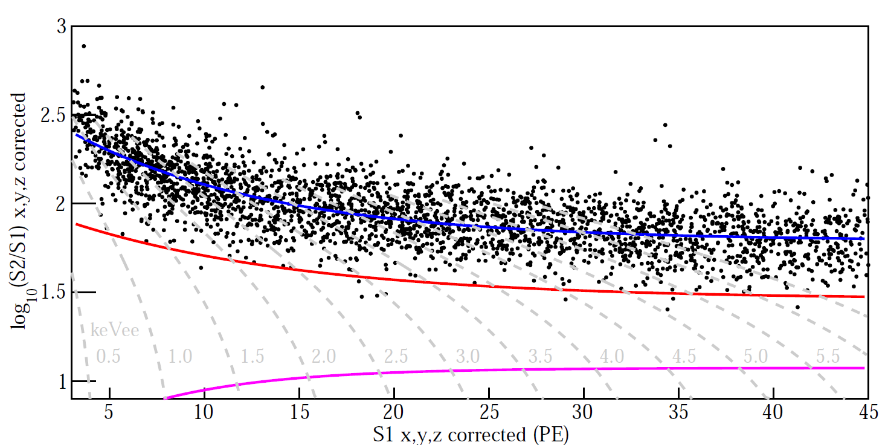
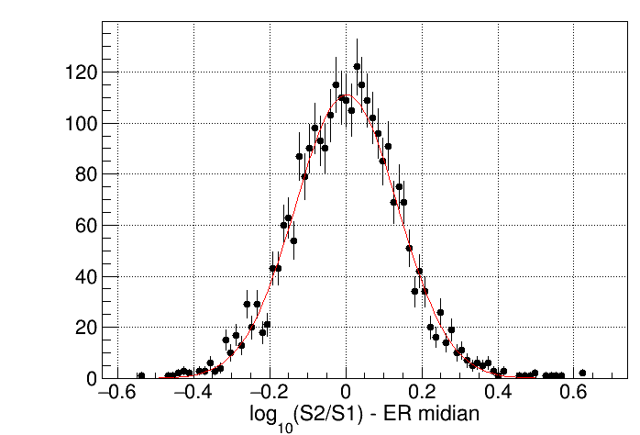
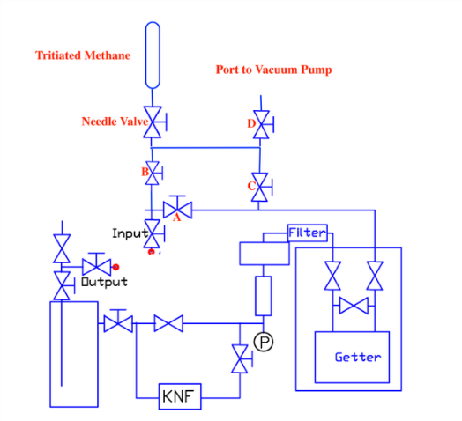
ER cal. w/ CH₃T β source
18.0 hours of tritium data taken, with ~2800 low energy ER events collected
9 events leaked below NR median, (0.32+/-0.11)%
Consistent with Gaussian expectation
Following method from PRD93 (2016)072009

Slide 14
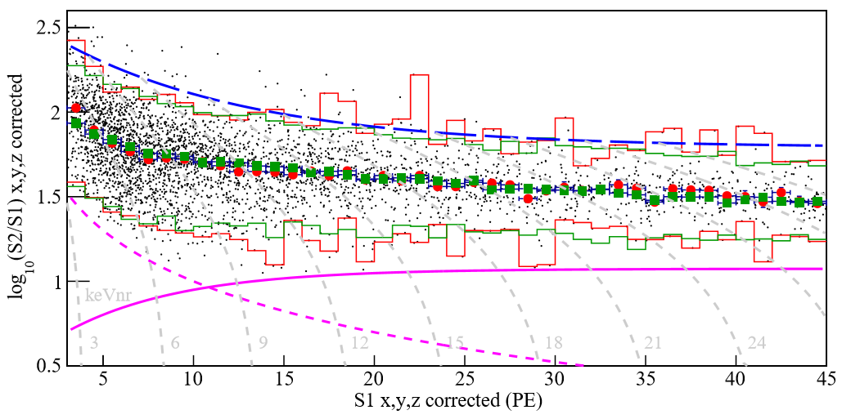
Nuclear Recoil (NR) calibration
162.4 hours of AmBe data taken, with ~3400 low energy single scatter NR events collected
NR median curve and NR detection efficiency determined

Slide 15
Radiation Background
ER background
⁸⁵Kr (suppressed by a factor 10)
¹²⁷Xe (due to surface exposure of Xe during distillation)
Others: U/Th/Rn…
Accidental background (determined by data)

Slide 16
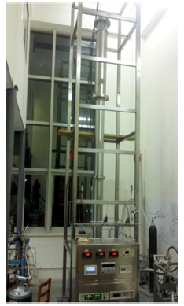
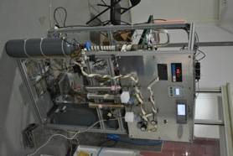
Radioactive background: ⁸⁵Kr in Xe
Kr-85, T_{1/2}=10.756 y, Beta E_{max}=687 keV
Journal of Instrumentation 11/2014; 9:11024

Slide 17
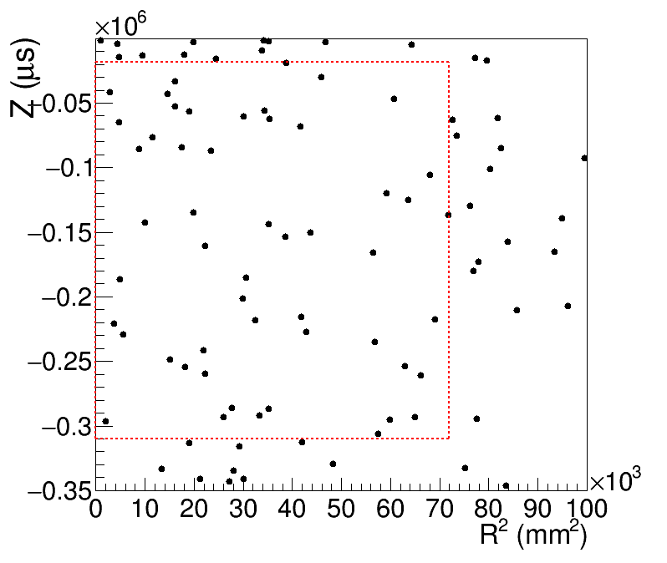
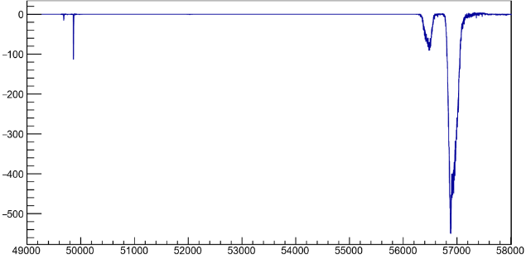
⁸⁵Kr Indentified by the TPC
⁸⁵Kr
10.73y
Identified by delayed β−γ coincidence analysis
Uniform distribution
Significantly reduced after distillation
β₁(0.437%)
β₂(96.563%)
γ₁(514KeV)
⁸⁵Rb (stable)
Waveform: one β
one γ

Slide 18
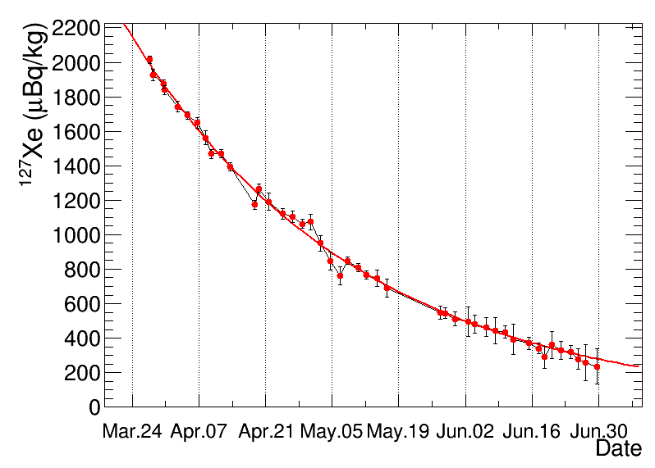
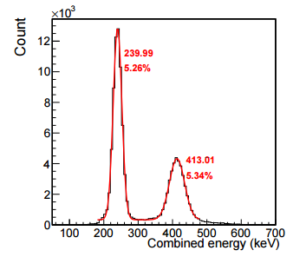
¹²⁷Xe
^{128,129}Xe(ɣ, xn)¹²⁷Xe
¹²⁷Xe/^{129m}Xe
Fitted half-life: 33.3 day (expected 36.4 day)
¹²⁷Xe (408 keV)
Average ¹²⁷Xe rate in the low energy DM search region (<10 keV) estimated to be 0.42±0.10 mDRU (DRU = evt/kg/keV/day)

Slide 19
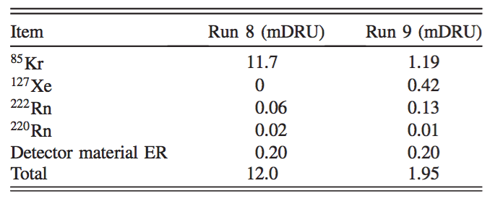
Major Radiation Background

Slide 20
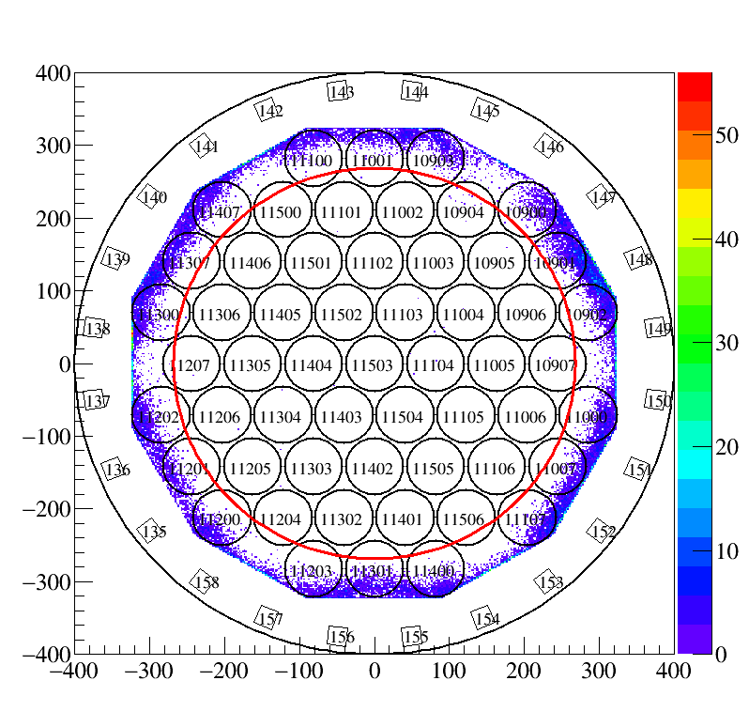
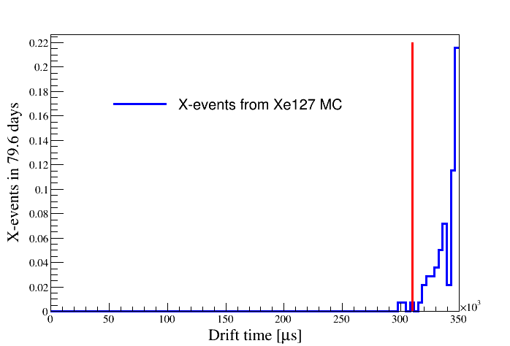
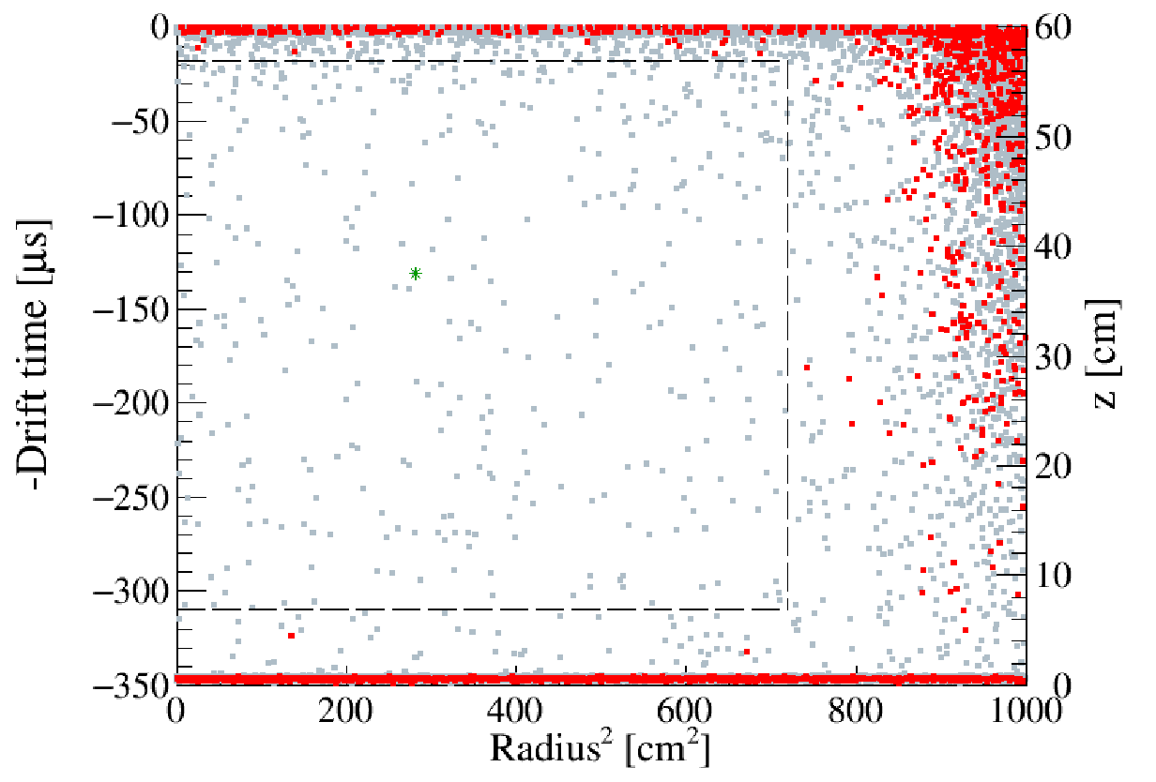
Final selection cuts
Volume Cut (FV in Run 9 with 328.9 kg)
Horizontal cut determined by distribution of events with S1 between [45,200] PE and suppressed S2
Vertical cut: Upper boundary consistent with the previous analysis; Lower boundary determined by X-events from ¹²⁷Xe MC
Threshold
S1 cut:[3,45] PE
S2 cut[100raw, 10000]PE

Slide 21
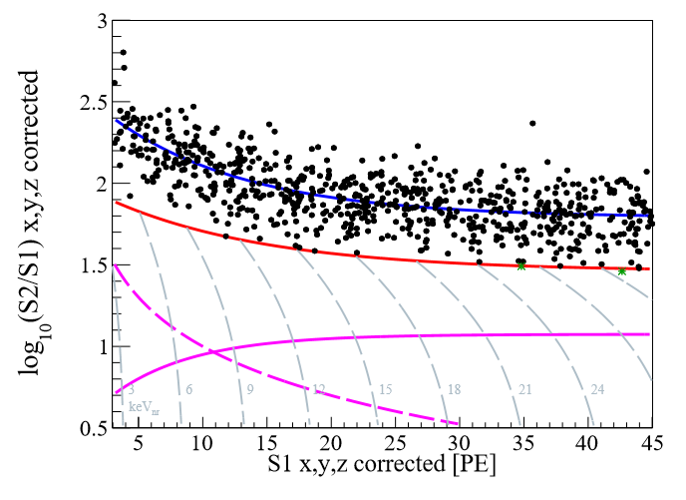
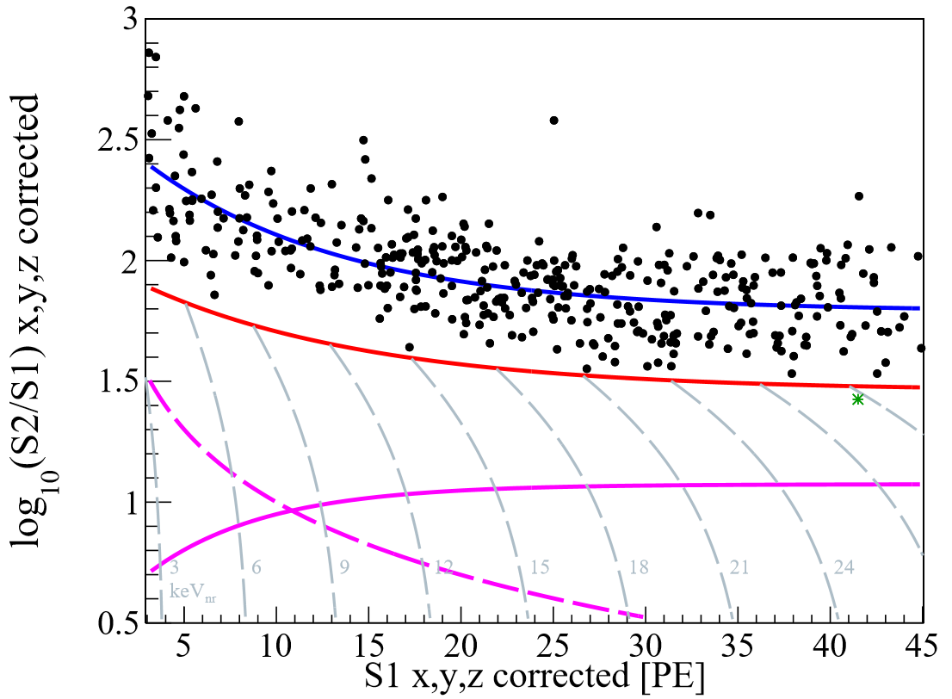
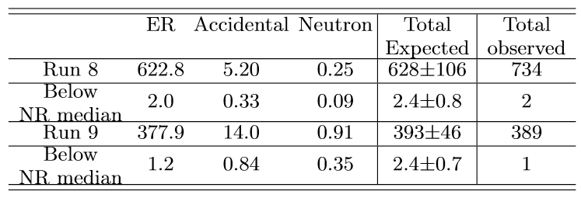
Final WIMP candidates (run 8&9)
Run8
ER median
NR median
Run9
ER median
NR median
99.9% NR acceptance
99.9% NR acceptance
100 PE S2 cut
100 PE S2 cut
Total exposure:
33,000 kg-day

Slide 22
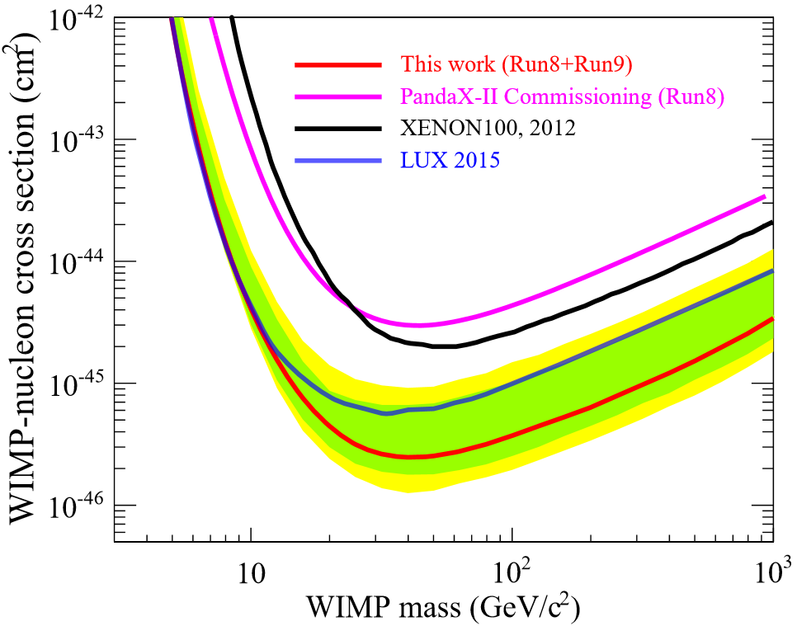
Searching Results: WIMPs (Spin-Indep.)
1-σ band
2-σ band
2.5x10⁻⁴⁶ cm²
Phys. Rev. Lett. 117, 121303 (2016)
Notes:
Phys. Rev. Lett. 117, 121303 (2016)

Slide 23
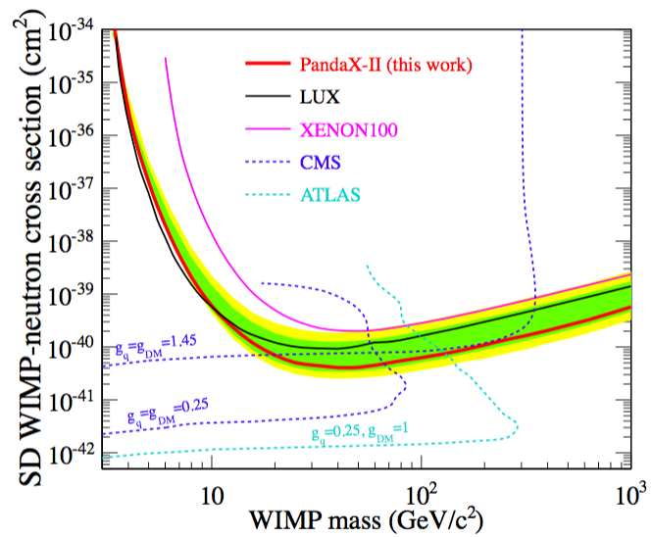
Results: WIMPs (Spin-dep.)
Phys. Rev. Lett. 118, 071301 (2017)

Slide 24
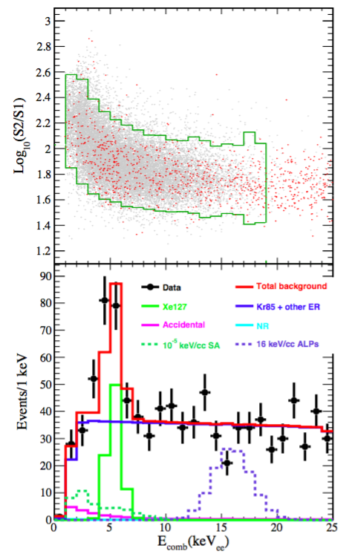
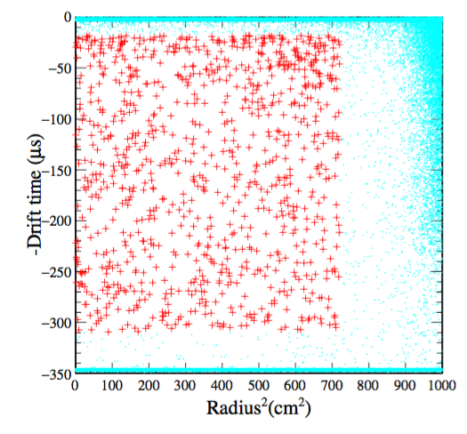
Data Set for Axion Searching
Almost the same data set as WIMP-search case, but E extended to 25keV

Slide 25
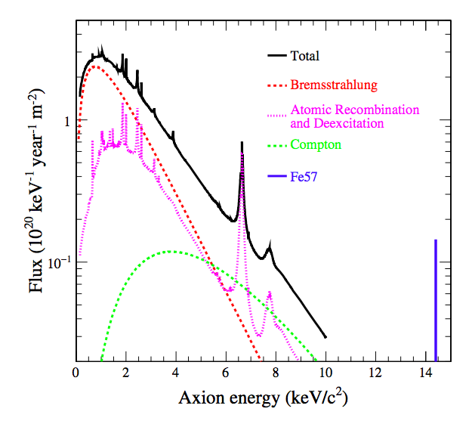
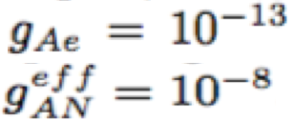
Solar Axion Sources
Compton-like scattering (C)
Axion-bremsstrahlung (B),
Atomic-recombination (R),
Atomic-deexcitation(D)
E. Armengaud, et al., J. Cosmol. Astropart. Phys. 2013, 067 (2013).

Slide 26
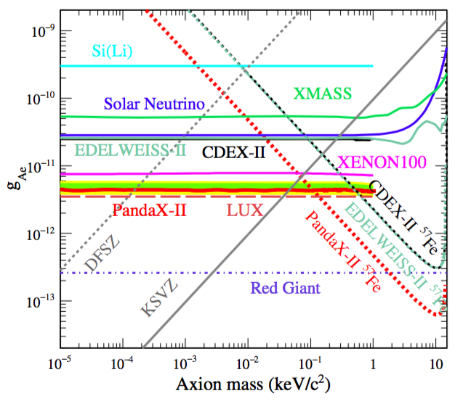
Searching Results: Solar Axion (Preliminary)

Slide 27
Galactic ALP Sources
Milky Way Dark Matter
on the Earth location
Detecting Rate by something like Xe
J. Cosmol. Astropart. Phys. 2013, 067 (2013)
Phys. Rev. D 78, 115012 (2008)

Slide 28
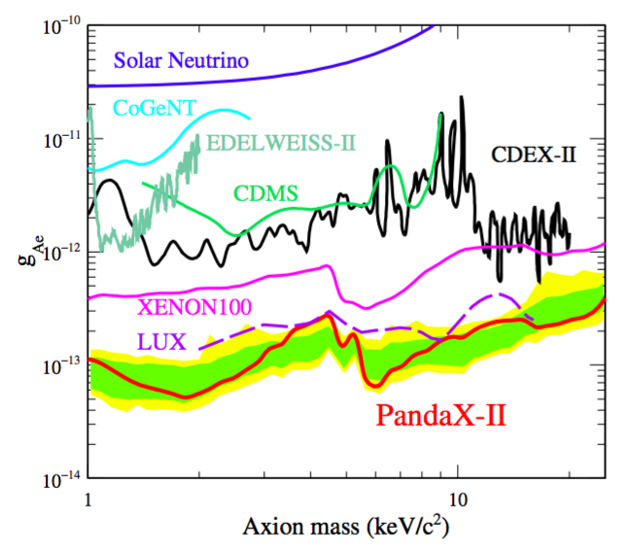
Searching Results: (Preliminary) Galactic Axion-Like Particles

Slide 29
PandaX ---- in Future
PandaX-I: 120 kg DM experiment
2009-2014
PandaX-II: 500 kg DM experiment
2014-2018
PandaX-xT: multi-ton (~4-T) DM experiment
Future
PandaX-III: 200 kg to 1 ton HP gas ¹³⁶Xe 0vDBD experiment
Future
CJPL-I
CJPL-II
Notes:
The first such experiment I am going to discuss is PandaX, that I work on. This experiment had a rather late start since 2009, but ramped up very quickly. Up-to-now, we have two phases developed in CJPL. The 2nd phase is running with 500-kg active target. In the future, PandaX will also move to the new CJPL-II to perform multi-ton DM experiment (we call it xT for now), as well as ton-scale 136Xe 0vDBD experiment, named PandaX-III.

Slide 30
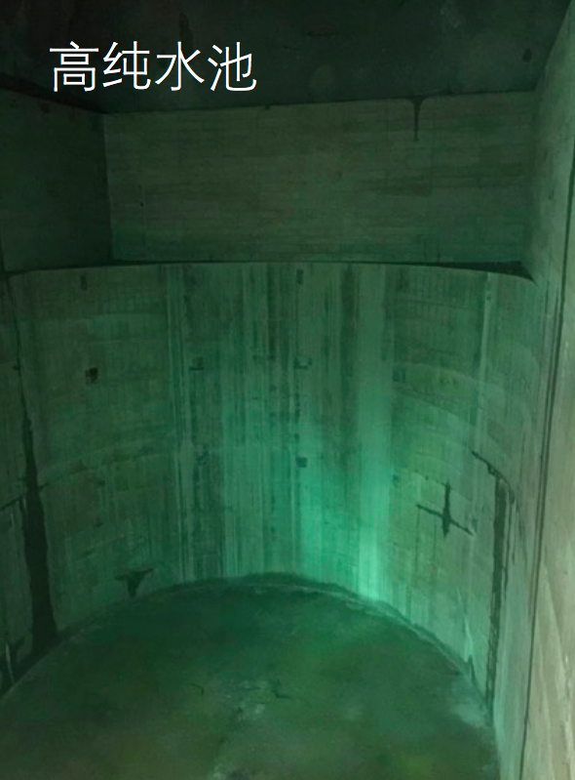
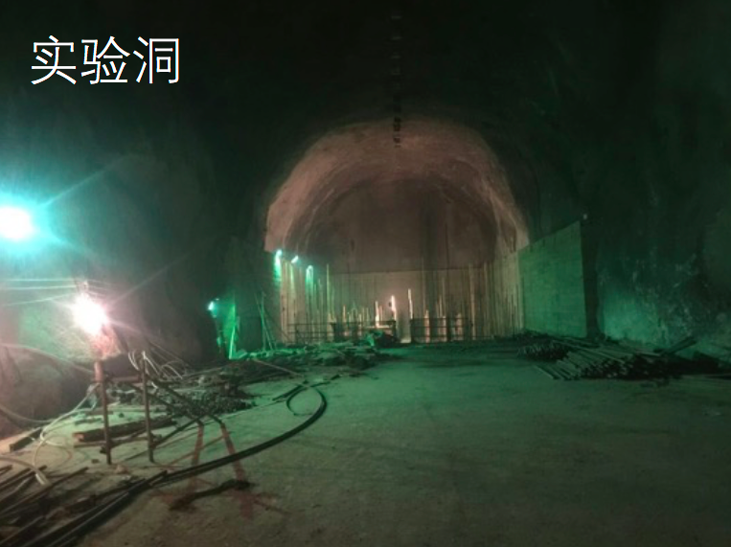
The New Exp. Hall, CJPL-II
The Water Pool
The Cave
13m

Slide 31
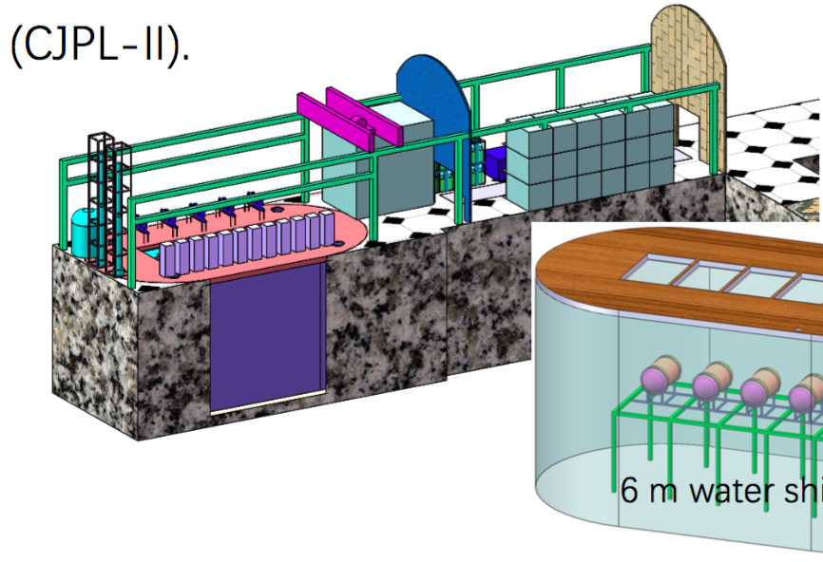
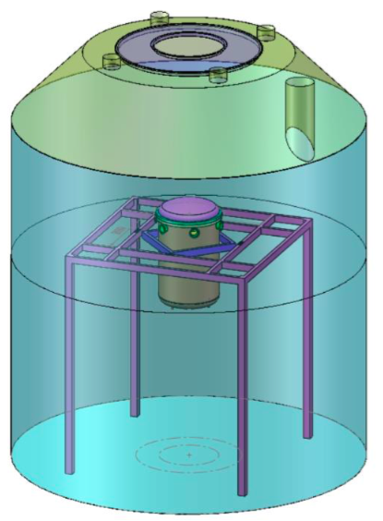
PandaX Upgrading
Water Shielding
5000Ton pure water
U/Th <10⁻¹⁴ g/g
Rn ctrl.
<1mBq/m³ in water;
~10Bq/m³ in the cave
Fresh air

Slide 32
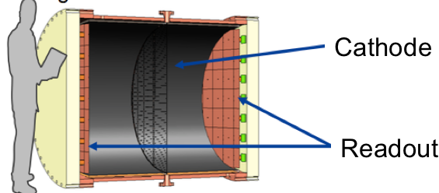
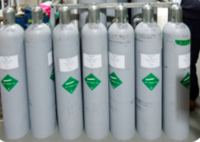
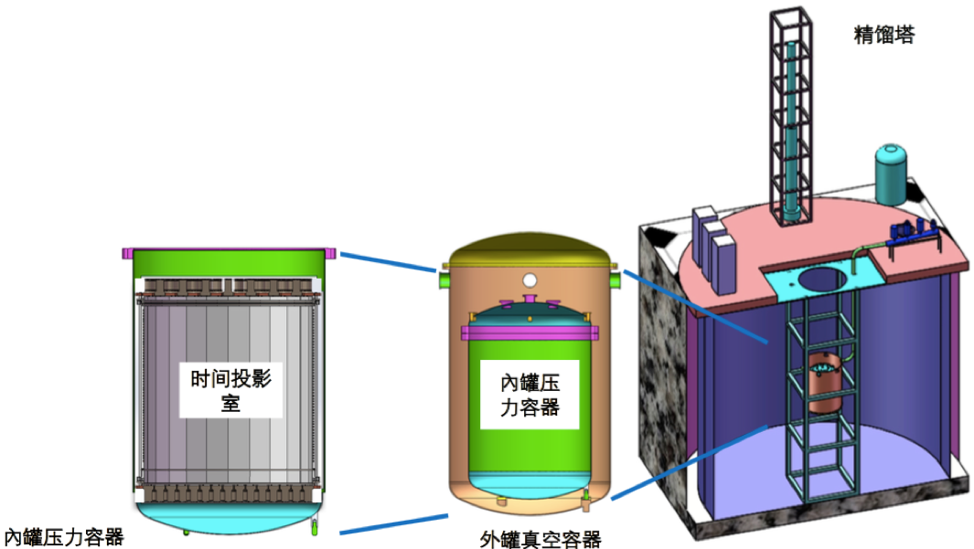
PandaX-III&IV Modules
PandaX-III(0vbb)
Better E Res. than liquid
Position Sensitive
150Kg ¹³⁶Xe (90%)
PandaX-4T
6ton total, 4ton sensitive target
2019—2020 on-site assembling

Slide 33
Summary
Using data from PandaX-II (500kg) 79.6+19.1 days data， ~33,000 kg-day exposure, No WIMP was found.
Limits on SD and SI WIMP-nucleon cross sections were obtained.
Using data from PandaX-II (500kg) 79.6 days data， ~27,000 kg-day exposure, No Solar or Galactic ALP was found.
For Solar Axion, we set constraints, including ⁵⁷Fe (preliminary).
For Galactic ALP, we set constraints in axion mass range about [1, 10]keV (preliminary).
We are under preparation to the future PandaX-4T program.
We are working on ¹³⁶Xe 0vbb.

Slide 34
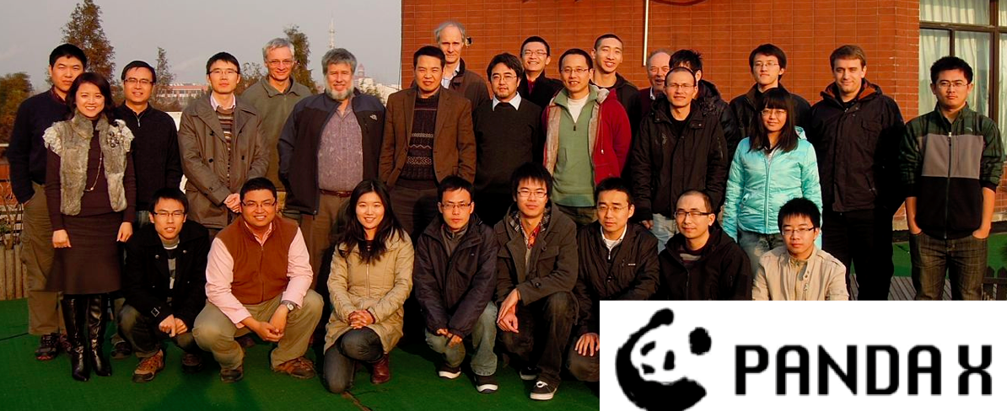
PandaX Collaboration
Shanghai Jiao Tong U (2009-)
Peking U (2009-)
Shandong U (2009-)
Shanghai Inst. App Phys, CAS (2009-)
U of Science & Tech. (2015-)
China Inst. of Atomic Energy (2015-)
Sun Yat-Sen U (2015-）
Yalong Hydropower (2009-)
U of Maryland (2009-)
U of Michigan (2011-2015)
Alt Eng. & Atom Eng. Comm. (2015-)
U of Zaragoza(2015-)
Suranaree U of Tech. (2015-)

Slide 36
Extracting Det. Parameters
W = 13.7 eV
PDE: Photon Det Eff.
EEE: Electron Extr. Eff.
SEG: Single Electron Gain.
SEG ➔ Determined by identifying Single Electron Events.
PDE/EEE ➔ One Eq.; Two Variables

Slide 37
PandaX Detector System
Online
Purify
Electronic
LowTemp
Vacuum
PandaX
Xe TPC
Pre-
Distillation
Radiation
Control

