Slide 1
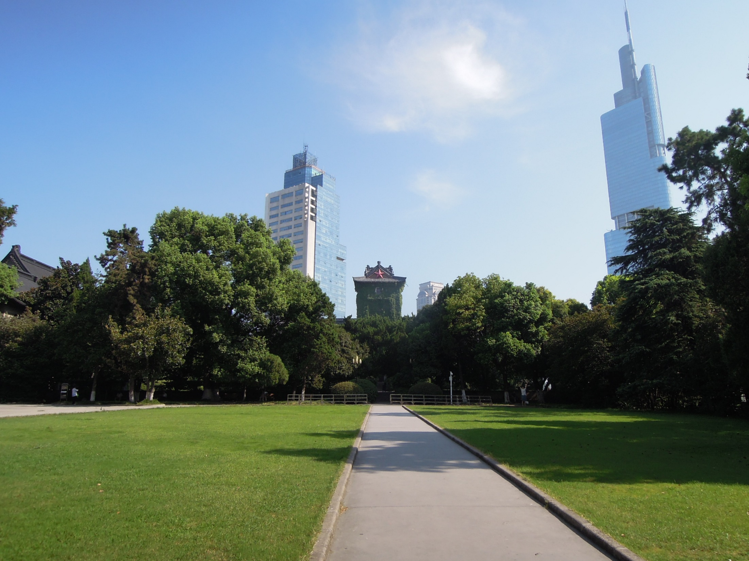


First transverse spin asymmetries measured in polarized Drell-Yan at COMPASS
9th Workshop on Hadron physics in China and Opportunities Worldwide
24-29 July 2017
Nanjing University, Nanjing, China
Wen-Chen Chang 章文箴
Institute of Physics, Academia Sinica
On behalf of COMPASS Collaboration

Slide 2
Outline
Transverse momentum dependent distributions (TMDs) and transverse single-spin asymmetries (TSAs)
Universality test of Sivers Functions: a predicted sign change between SIDIS and Drell-Yan processes
First measurement of TSAs from the 2015 polarized Drell-Yan runs of COMPASS
Summary

Slide 3
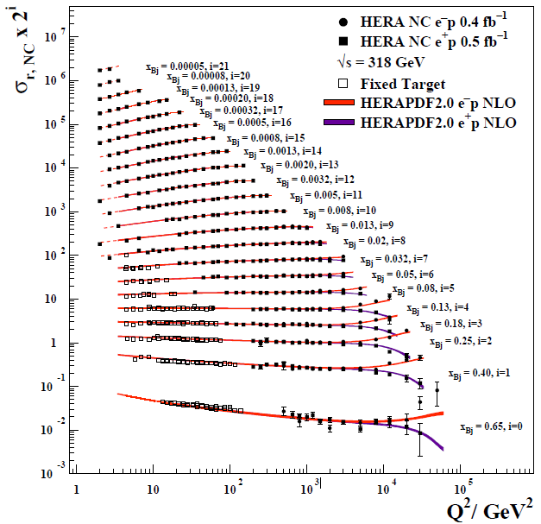
Factorization of Hard Processes
DIS
Drell-Yan
$$σ_{proton}\left(x,Q^{2}\right)=f_{parton}(x,Q^{2})⨂{\hat{σ}}_{parton}(Q^{2})$$

Slide 4
Universality of
Parton Density Functions (PDFs)
Sea quarks
Valence quarks
x: momentum fraction of partons

Slide 5
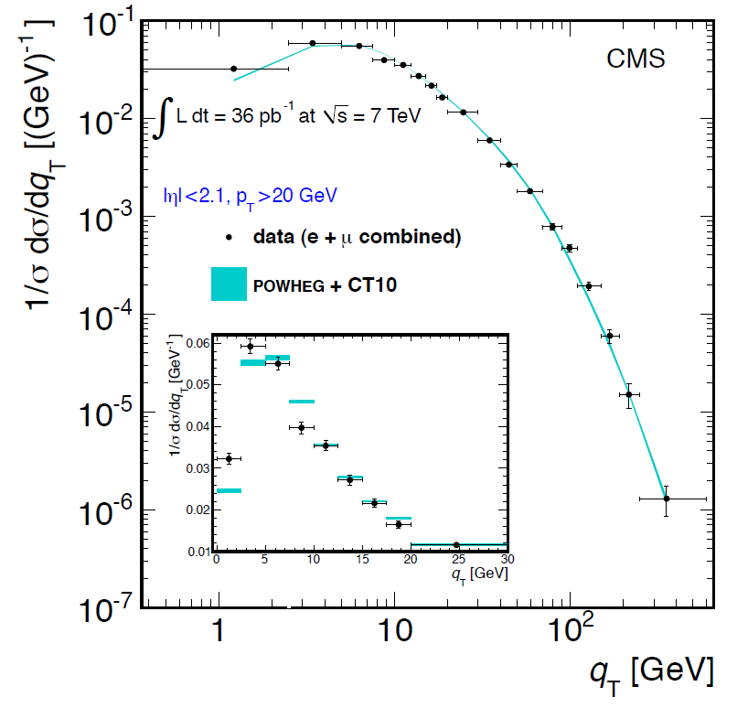
Why TMDs?
The Z-boson transverse momentum q_{T} spectrum in pp collisions at the LHC
PRD 85, 032002 (2012)
At large qT, the NNLO pQCD describes the data better than 10%.
For qT<10 GeV, pQCD calculation fails: multi-parton QCD radiation.
Angeles-Martinez et al., arXiv: 1507.05267
Notes:
The reason for this is that the physical behavior of the Z-boson spectrum near the peak region and below [2, 3] is controlled by multi-parton QCD radiation, which is not well approximated by truncating the QCD perturbation series
to any fixed order but rather requires methods to resum arbitrarily many parton emissions, viz., scattering
amplitudes with an infinite number of real and virtual insertions of soft gluons.
This can be accomplished in a systematic manner via a generalized form of QCD factorization [4{6] which
now involves quark distribution functions that, unlike the ordinary ones, explicitly depend on transverse
momentum and polarization (TMD pdfs). Such TMD pdfs obey evolution equations [6{8] which generalize
the ordinary renormalization-group evolution equations of collinear pdfs.

Slide 6
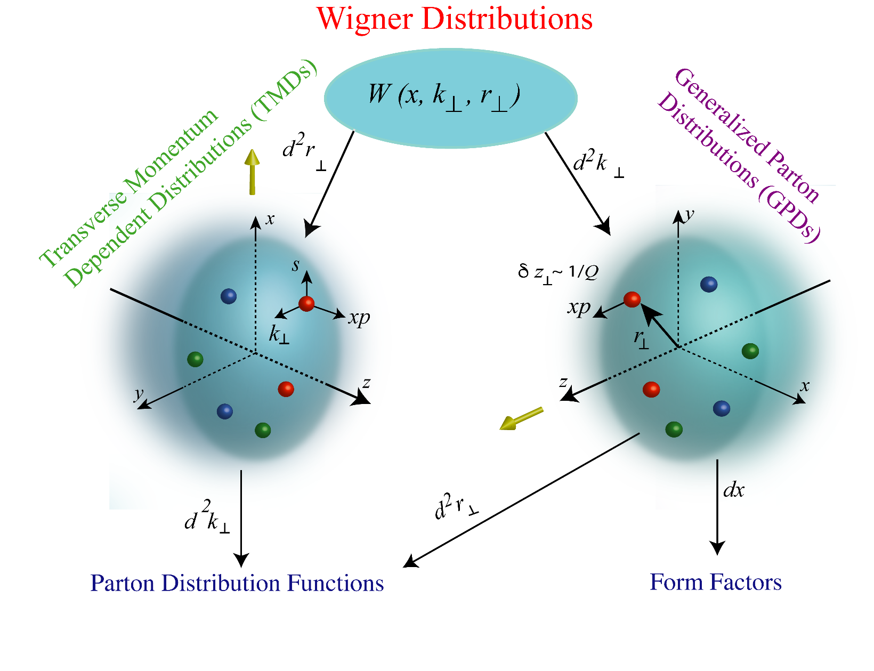
Multi-dimensional Partonic Structures
Beyond collinear approximation
Related to the orbital motion and spin-orbit effects.
http://www.int.washington.edu/PROGRAMS/17-3/

Slide 7

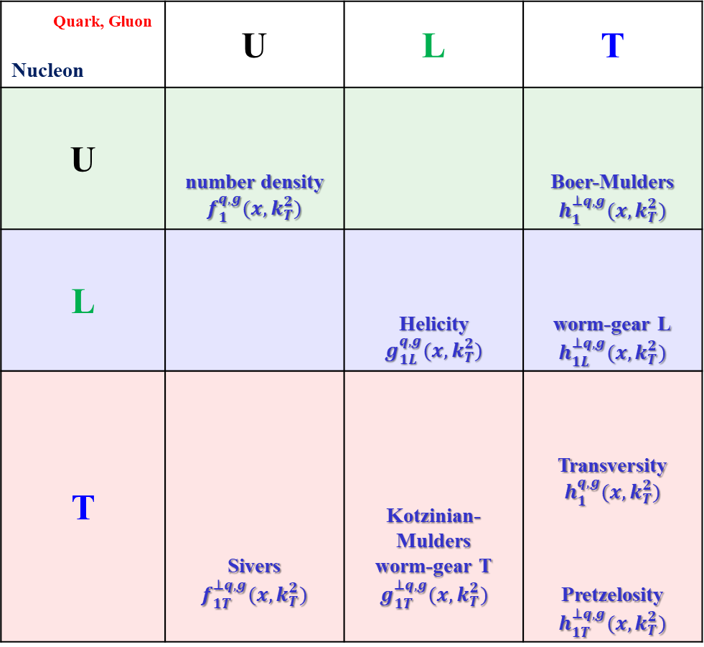

Leading-Twist Transverse-momentum Dependent Parton Density Function (TMDs)
Quark, Gluon Nucleon | U | L | T
U | number density $$f_{1}^{q,g}(x,k_{T}^{2})$$ |  | Boer-Mulders $$h_{1}^{⊥q,g}(x,k_{T}^{2})$$
L |  | Helicity $$g_{1L}^{q,g}(x,k_{T}^{2})$$ | worm-gear L $$h_{1L}^{⊥q,g}(x,k_{T}^{2})$$
T | Sivers $$f_{1T}^{⊥q,g}(x,k_{T}^{2})$$ | Kotzinian-Mulders worm-gear T $$g_{1T}^{⊥q,g}(x,k_{T}^{2})$$ | Transversity $$h_{1}^{q,g}(x,k_{T}^{2})$$ Pretzelosity $$h_{1T}^{⊥q,g}(x,k_{T}^{2})$$
spin of the nucleon
spin of the parton
$k_{T}$ of the parton
Notes:
According to the polarization of the whole nucleon and the individual partons inside, different TMDs could be sorted into this table.

Slide 8
Leading-Twist Transverse-momentum Dependent Fragmentation Function (TMDs)
Quark, Gluon Nucleon | U | L | T
U | unpolarized $$D_{1}^{q,g}(x,k_{T}^{2})$$ |  | Collins $$H_{1}^{⊥q,g}(x,k_{T}^{2})$$
L |  | $$G_{1L}^{q,g}(x,k_{T}^{2})$$ | $$H_{1L}^{⊥q,g}(x,k_{T}^{2})$$
T | $$D_{1T}^{⊥q,g}(x,k_{T}^{2})$$ | $$G_{1T}^{⊥q,g}(x,k_{T}^{2})$$ | $$H_{1}^{q,g}(x,k_{T}^{2})$$ $$H_{1T}^{⊥q,g}(x,k_{T}^{2})$$
spin of the nucleon
spin of the parton
$k_{T}$ of the parton

Slide 9
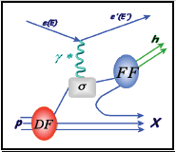


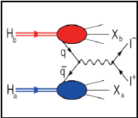


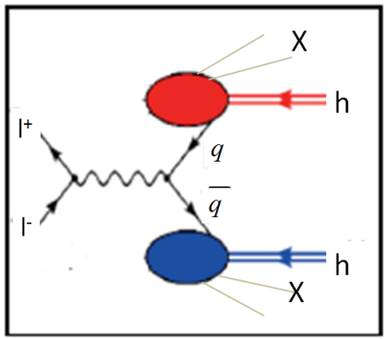


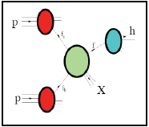


Accessing TMDs
SIDIS: ep → ehX
Drell-Yan: pp → e⁺e⁻X
Dihadron in e+e-: e⁺e⁻ →h₁ h₂ X
Hadron production in pp: pp → hX

Slide 10
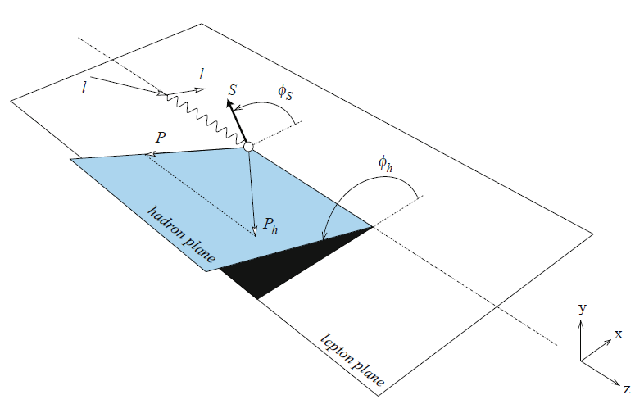
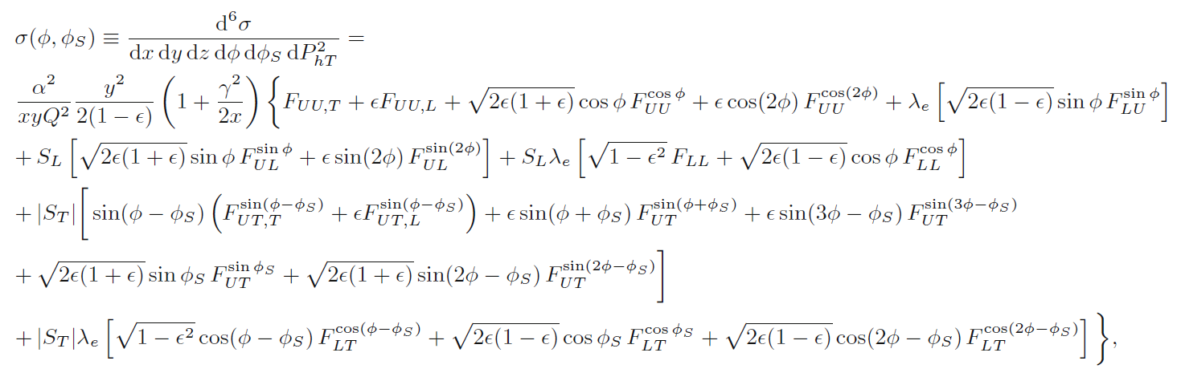
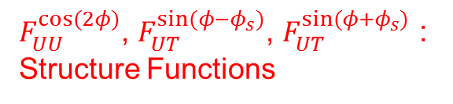
SIDIS cross-sections
$F_{UU}^{cos⁡(2φ)}$, $F_{UT}^{sin⁡(φ−φ_{s})}$, $F_{UT}^{sin⁡(φ+φ_{s})}$ : Structure Functions
Avakian et al., Eur. Phys.J. A52 (2016) 150

Slide 11
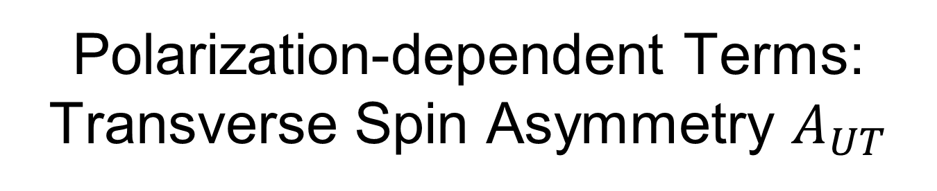

Polarization-dependent Terms:
Transverse Spin Asymmetry $A_{UT}$
$f$: dilution factor due to non-polarizable component of the target
$S_{T}$: polarization degree of transverse spin
Advantage: most of the systematics due to instrumental artifacts cancel.
Disadvantage: the unpolarized structure function $F_{UU}$ has to be well known.

Slide 12
SIDIS and single-polarized DY x-sections at twist-2 (LO)
SIDIS DY
SIDIS-DY
bridge
Boer-Mulders
Sivers
Transversity
Pretzelosity
Worm-gear L
Double polarized DY only
: FFs, further constrained by the e+e- process.

Slide 13
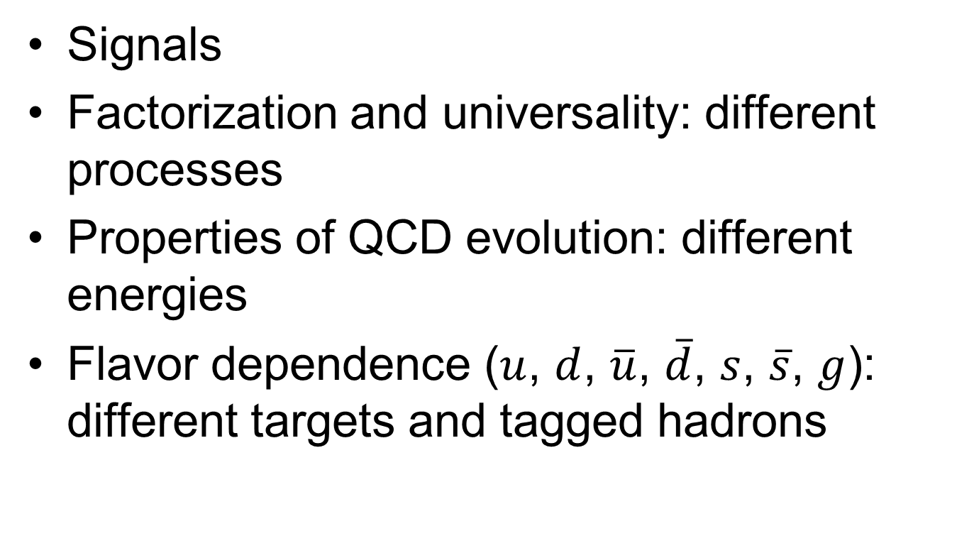
Key Issues of TMDs to be Answered/Tested by Experiments
Signals
Factorization and universality: different processes
Properties of QCD evolution: different energies
Flavor dependence ($u$, $d$, $\overline{u}$, $\overline{d}$, $s$, $\overline{s}$, $g$): different targets and tagged hadrons

Slide 14
Leading-Twist Transverse-momentum Dependent Parton Density Function (TMDs)
Quark, Gluon Nucleon | U | L | T
U | number density $$f_{1}^{q,g}(x,k_{T}^{2})$$ |  | Boer-Mulders $$h_{1}^{⊥q,g}(x,k_{T}^{2})$$
L |  | Helicity $$g_{1L}^{q,g}(x,k_{T}^{2})$$ | worm-gear L $$h_{1L}^{⊥q,g}(x,k_{T}^{2})$$
T | Sivers $$f_{1T}^{⊥q,g}(x,k_{T}^{2})$$ | Kotzinian-Mulders worm-gear T $$g_{1T}^{⊥q,g}(x,k_{T}^{2})$$ | Transversity $$h_{1}^{q,g}(x,k_{T}^{2})$$ Pretzelosity $$h_{1T}^{⊥q,g}(x,k_{T}^{2})$$
spin of the nucleon
spin of the parton
$k_{T}$ of the parton

Slide 15
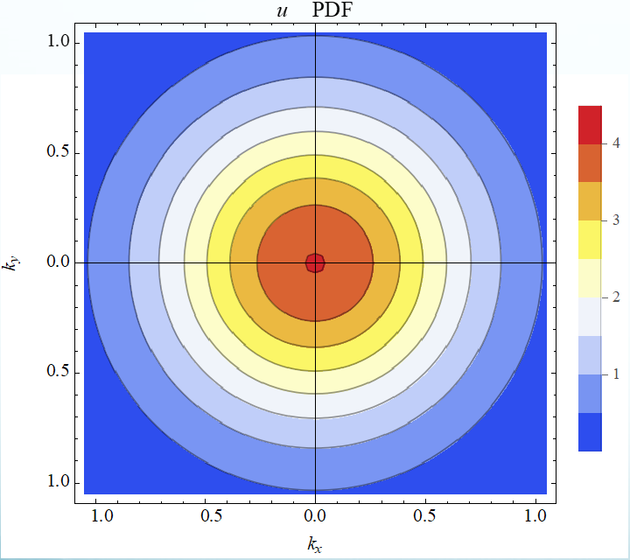
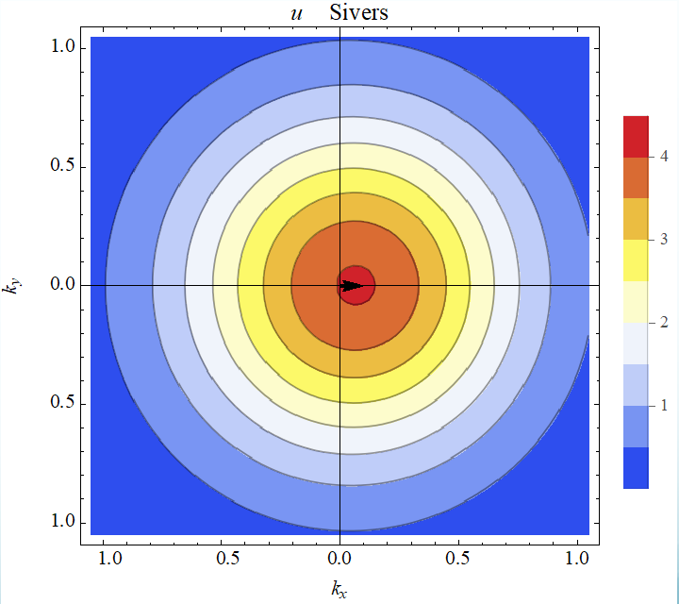




TMD Sivers Function
Unpolarized proton
Transversely-polarized proton
$$k_{y}$$
$$k_{y}$$
$$k_{x}$$
$$k_{x}$$
A nonzero Sivers function is considered to be strong evidence for the presence of quark orbital angular momentum.

Slide 16
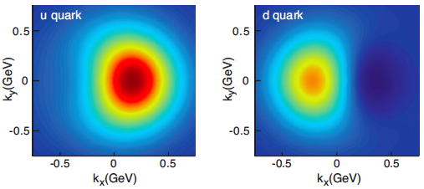
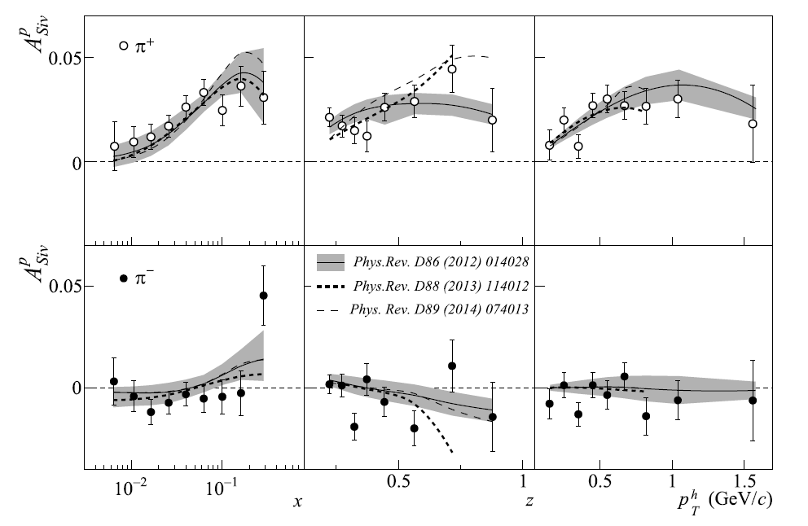
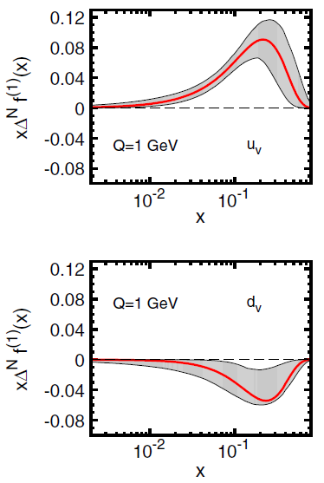
Nonzero Sivers Asymmetries from SIDIS
T. Iwata’s talk
COMPASS, PLB 744 (2015) 250
Sivers Functions
Signals of Sivers functions in SIDIS.
Flavor dependence.
PRD 86, 014028 (2012)
[arXiv:1204.1239]

Slide 17
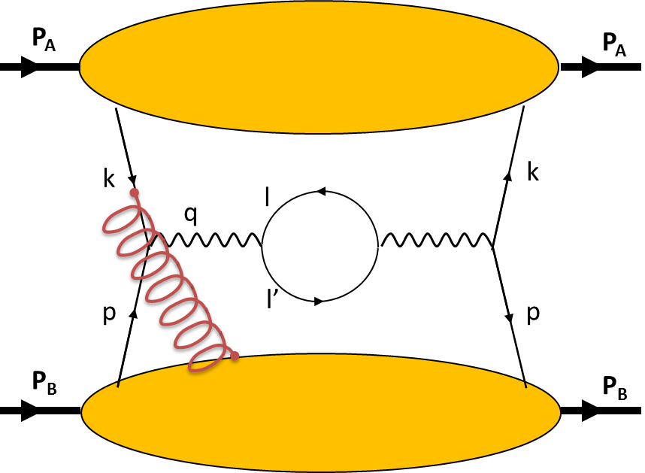
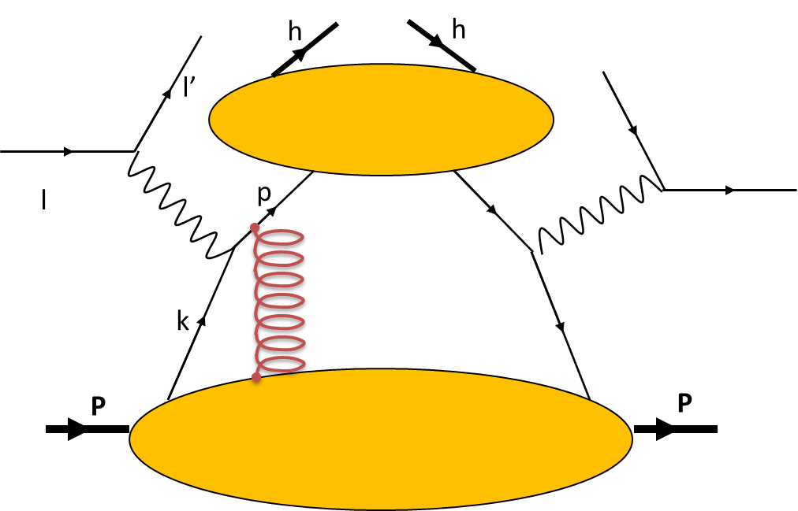
Universality of Sivers Functions
J.C. Collins, Phys. Lett. B 536 (2002) 43
A.V. Belitsky, X. Ji, F. Yuan, Nucl. Phys. B 656 (2003) 165
D. Boer, P.J. Mulders, F. Pijlman, Nucl. Phys. B 667 (2003) 201
Z.B. Kang, J.W. Qiu, Phys. Rev. Lett. 103 (2009) 172001
Drell-Yan
SIDIS
QCD gluon gauge link (Wilson line) in the initial state (DY) vs. final state interactions (SIDIS).
Fundamental predictions from TMD physics will be tested.

Slide 18
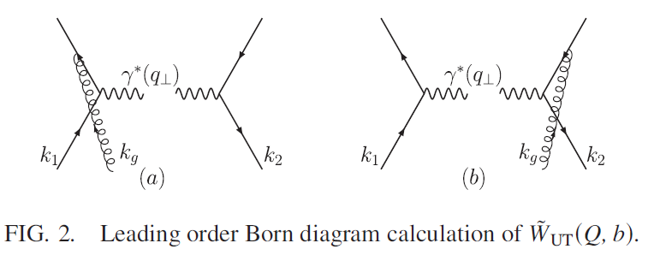
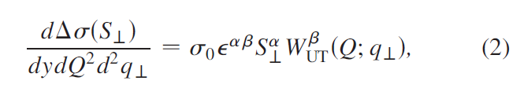
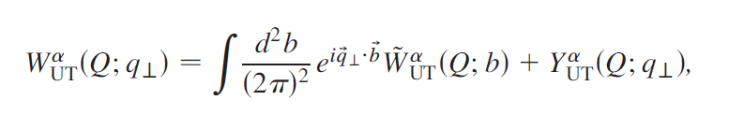
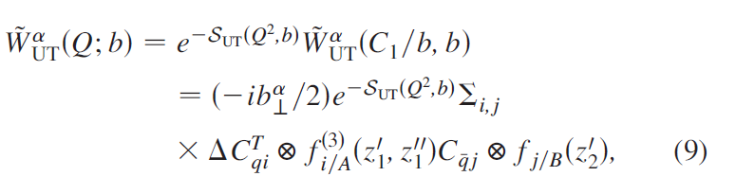
“Opposite Sign of SSA for SIDIS and DY” Preserved in NLO QCD
Z-B Kang, B-W Xiao and F. Yuan, PRL 107, 152002 (2011)
Ji-Ma-Yuan factorization
Collins-Soper-Sterman resummation

Slide 19
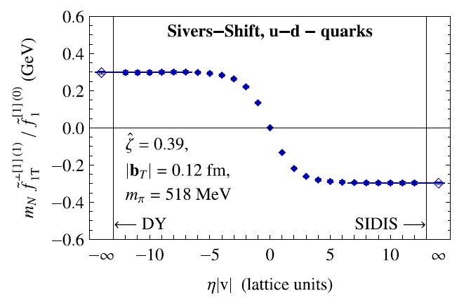
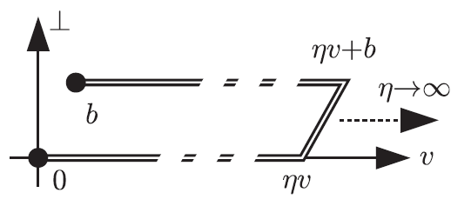
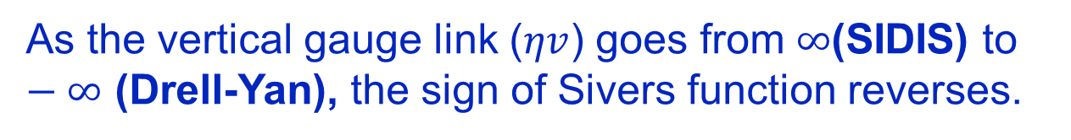
Sivers Function with Lattice QCD
B. U. Musch et al., PRD 85, 094510 (2012)
As the vertical gauge link ($ηv$) goes from $∞$(SIDIS) to $−∞$ (Drell-Yan), the sign of Sivers function reverses.

Slide 20

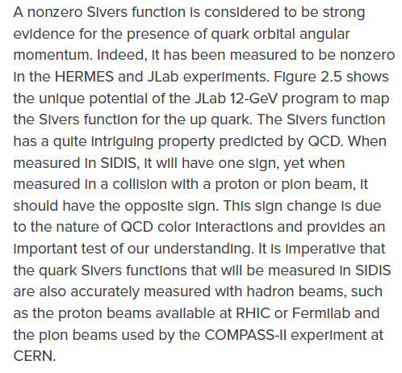
2015 U.S. Long Range Plan
https://science.energy.gov/~/media/np/nsac/pdf/2015LRP/2015_LRPNS_091815.pdf

Slide 21
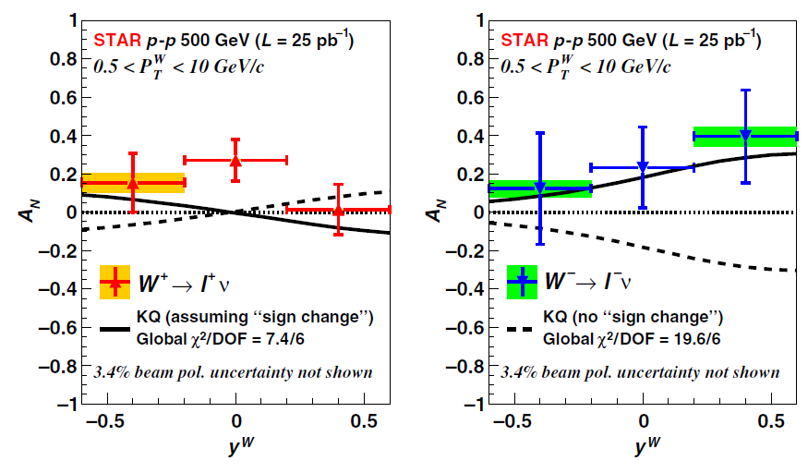

Transverse SSA of W in polarized pp collisions at RHIC
STAR, PRL 116 (2016) 132301

Slide 22




COMPASS Collaboration
(Common Muon and Proton Apparatus for Structure and Spectroscopy)
M.G. Perdekamp’s talk
24 institutions from 13 countries – nearly 250 physicists
Fixed-target experiment at SPS north area
Physics programs:
  Nucleon spin and partonic structures
  Hadron spectroscopy

Slide 23
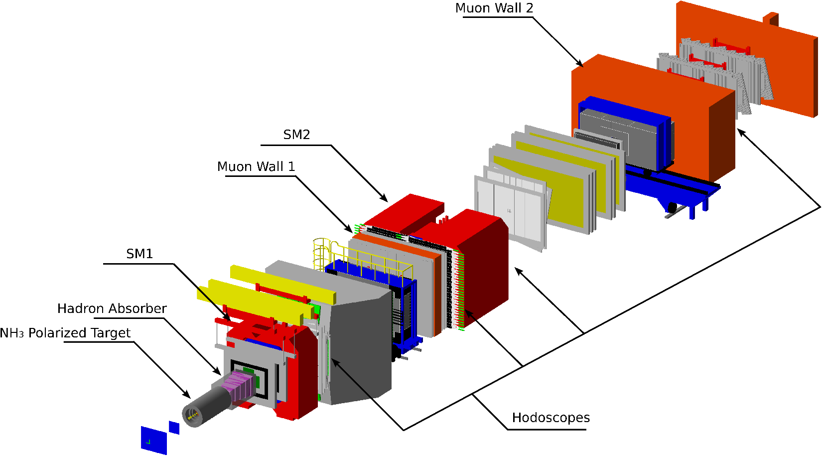
COMPASS Setup (Drell-Yan Runs)
Beam:
π⁻ 190 GeV/c
Target:
Polarized NH₃ target
Nuclear targets
Target Region
Small Angle Spectrometer
(SAS)
Large Angle Spectrometer (LAS)

Slide 24
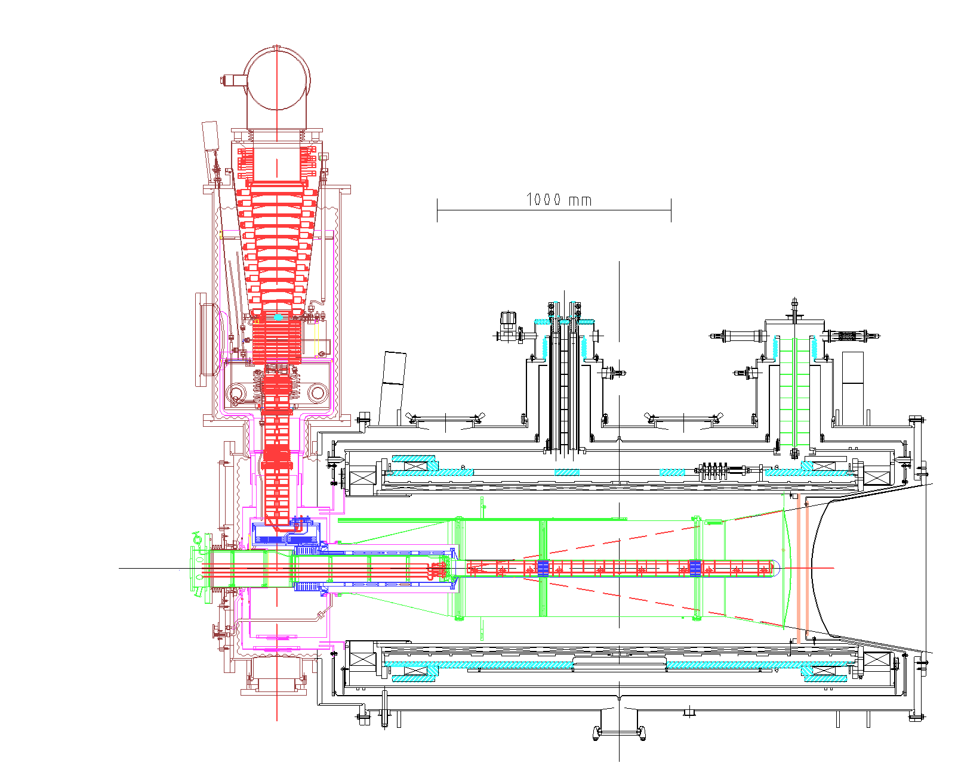
Polarized NH₃ Target
T. Iwata’s talk
Cryogenic
³He-4He dilution refrigerator
T~50mK
Magnet
Superconducting solenoid : 2.5 T
Dipole filed: 0.5 T
Target
Materials: p(NH₃)
Dilution factor: ~0.15
Polarization: >90%
Two 55 cm long target cells spaced by 20 cm
Notes:
Optical pumping, colling

Slide 25
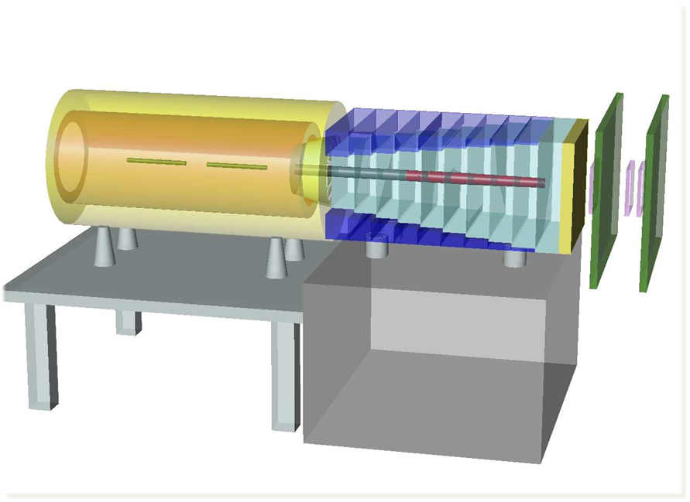
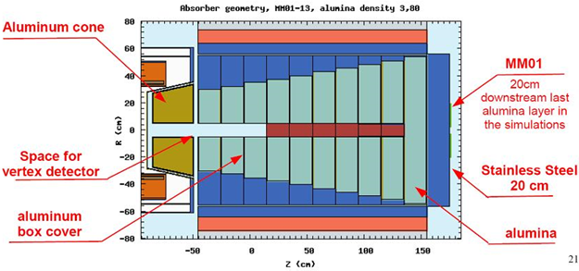
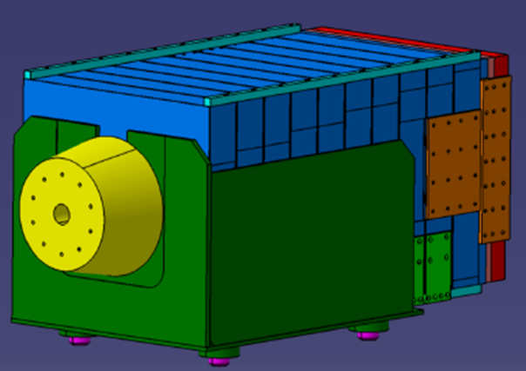
Hadron Absorber & Nuclear Targets
Absorber: 236 cm long, made of Al₂O₃.
Radiation lengths (multiple scattering for μ): x/X₀ = 33.53
Hadronic interaction lengths (stopping power for π): x/λ_{int} = 7.25
7 cm Al target
120 cm W beam dump
Al
W

Slide 26
Hadron Absorber & Nuclear Targets

Slide 27

COMPASS-II Transversely Polarized Drell-Yan Program
Schedules:
  2014 Oct – Dec: commission Drell-Yan runs
  2015: first year of transversely polarized Drell-Yan runs with 190 GeV $π^{−}$ beam

Slide 28
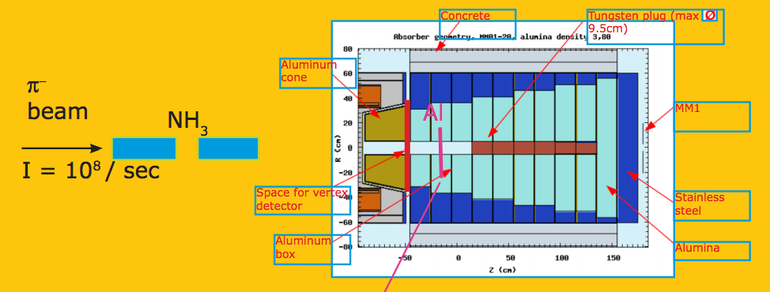
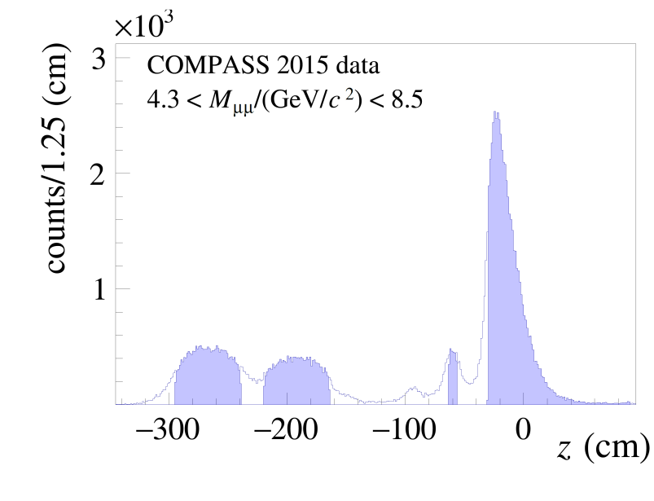
Dimuon Vertex Distributions (2015 Trans.-pol. Drell-Yan Runs)
Tungsten
beam plug
NH₃
Al
arXiv:1704.00488

Slide 29
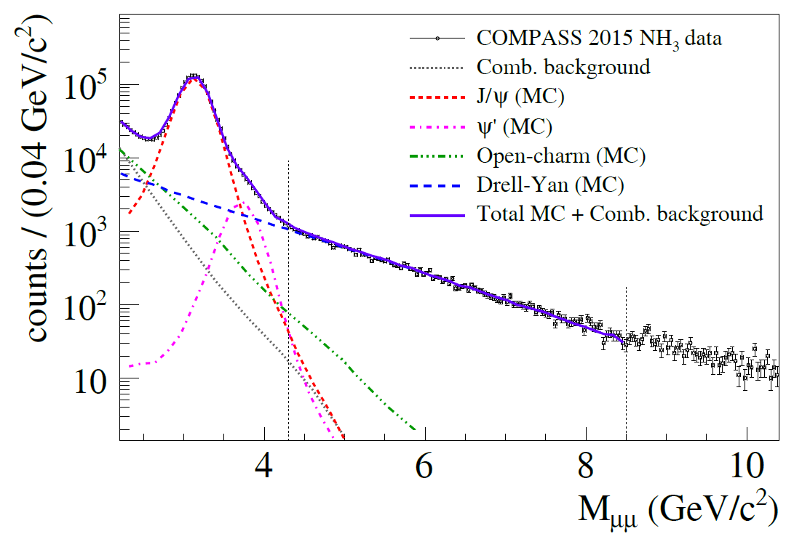
Dimuon Invariant-mass Distributions
(2015 Trans.-pol. Drell-Yan Runs)
arXiv:1704.00488

Slide 30
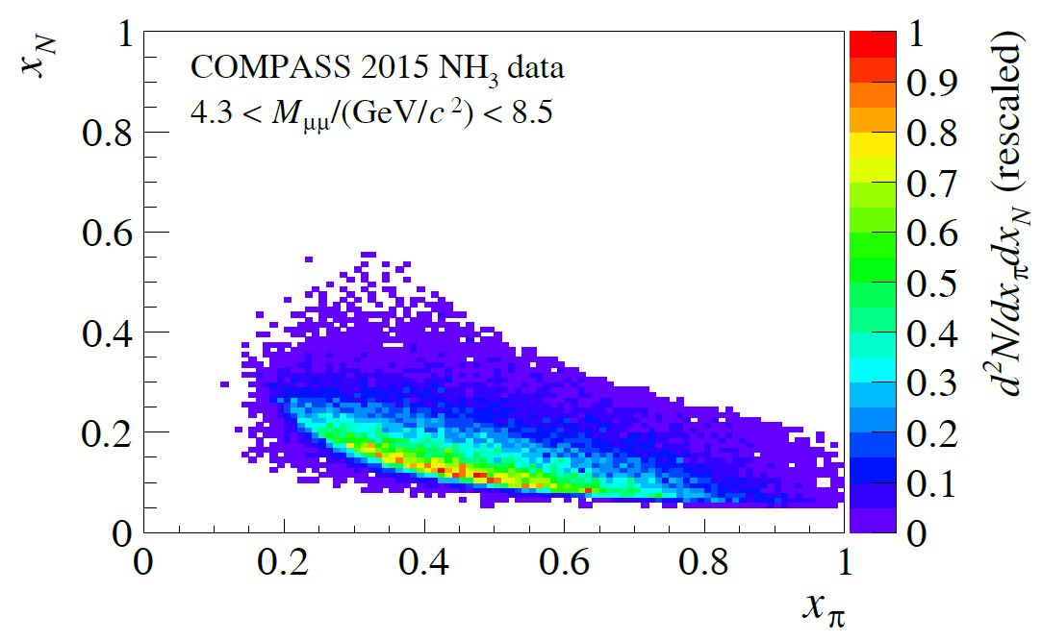
Kinematic Acceptance
(2015 Trans.-pol. Drell-Yan Runs)
arXiv:1704.00488

Slide 31
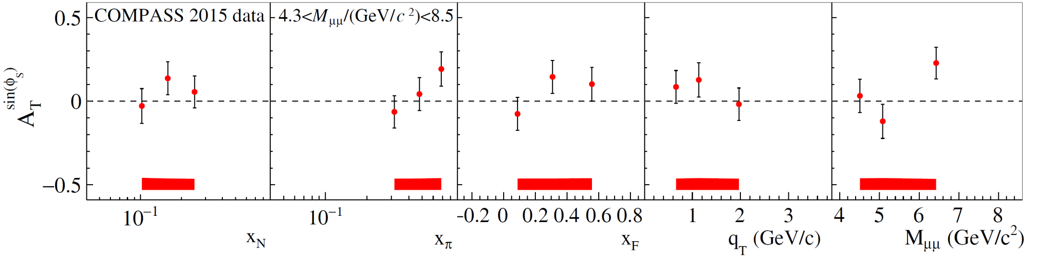
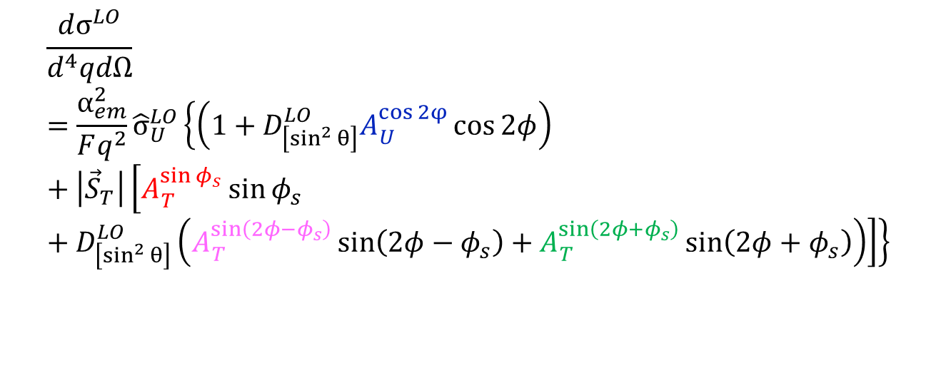
Transverse Spin Asymmetries in Trans.-pol. Drell-Yan: Sivers
$$\frac{dσ^{LO}}{d^{4}qdΩ}=\frac{α_{em}^{2}}{Fq^{2}}{\hat{σ}}_{U}^{LO}\left\{\left(1+D_{\left[\sin^{2}{θ}\right]}^{LO}A_{U}^{\cos{2φ}}\cos{2φ}\right)+\left|{\vec{S}}_{T}\right|\left[A_{T}^{\sin{φ_{s}}}\sin{φ_{s}}+D_{\left[\sin^{2}{θ}\right]}^{LO}\left({A_{T}^{\sin\left(2φ−φ_{s}\right)}\sin\left(2φ−φ_{s}\right)+A}_{T}^{\sin\left(2φ+φ_{s}\right)}\sin\left(2φ+φ_{s}\right)\right)\right]\right\}$$
arXiv:1704.00488

Slide 32
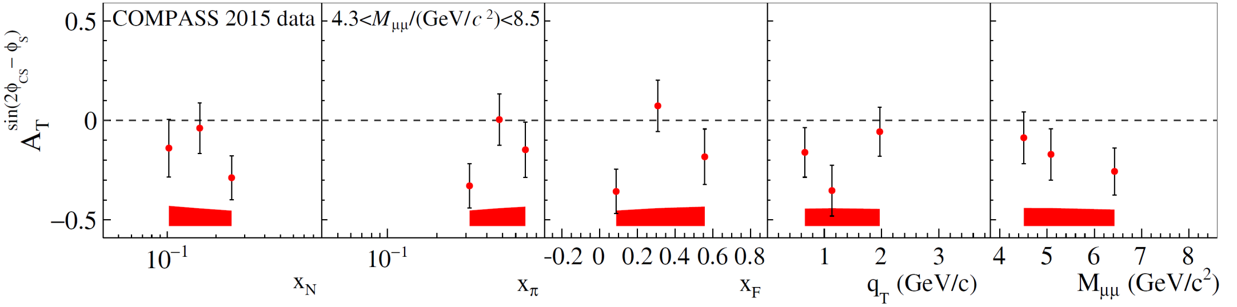
Transverse Spin Asymmetries in Trans.-pol. Drell-Yan: Transversity
$$\frac{dσ^{LO}}{d^{4}qdΩ}=\frac{α_{em}^{2}}{Fq^{2}}{\hat{σ}}_{U}^{LO}\left\{\left(1+D_{\left[\sin^{2}{θ}\right]}^{LO}A_{U}^{\cos{2φ}}\cos{2φ}\right)+\left|{\vec{S}}_{T}\right|\left[A_{T}^{\sin{φ_{s}}}\sin{φ_{s}}+D_{\left[\sin^{2}{θ}\right]}^{LO}\left({A_{T}^{\sin\left(2φ−φ_{s}\right)}\sin\left(2φ−φ_{s}\right)+A}_{T}^{\sin\left(2φ+φ_{s}\right)}\sin\left(2φ+φ_{s}\right)\right)\right]\right\}$$
arXiv:1704.00488

Slide 33
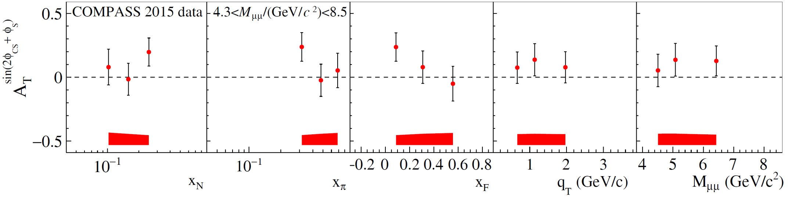
Transverse Spin Asymmetries in Trans.-pol. Drell-Yan: Pretzelosity
$$\frac{dσ^{LO}}{d^{4}qdΩ}=\frac{α_{em}^{2}}{Fq^{2}}{\hat{σ}}_{U}^{LO}\left\{\left(1+D_{\left[\sin^{2}{θ}\right]}^{LO}A_{U}^{\cos{2φ}}\cos{2φ}\right)+\left|{\vec{S}}_{T}\right|\left[A_{T}^{\sin{φ_{s}}}\sin{φ_{s}}+D_{\left[\sin^{2}{θ}\right]}^{LO}\left({A_{T}^{\sin\left(2φ−φ_{s}\right)}\sin\left(2φ−φ_{s}\right)+A}_{T}^{\sin\left(2φ+φ_{s}\right)}\sin\left(2φ+φ_{s}\right)\right)\right]\right\}$$
arXiv:1704.00488

Slide 34
SIDIS and single-polarized DY x-sections at twist-2 (LO)
SIDIS DY
SIDIS-DY
bridge
Boer-Mulders
Sivers
Transversity
Pretzelosity
Worm-gear L
Double polarized DY only
: FFs, further constrained by the e+e- process.

Slide 35
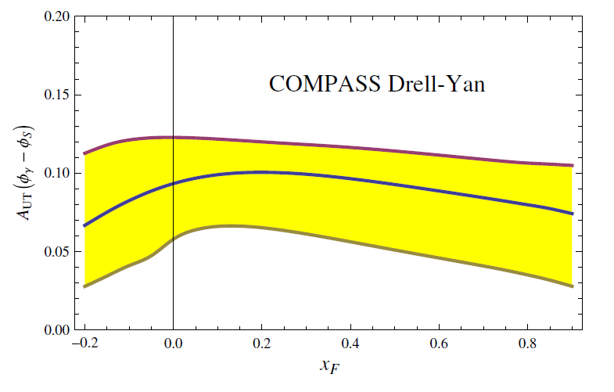
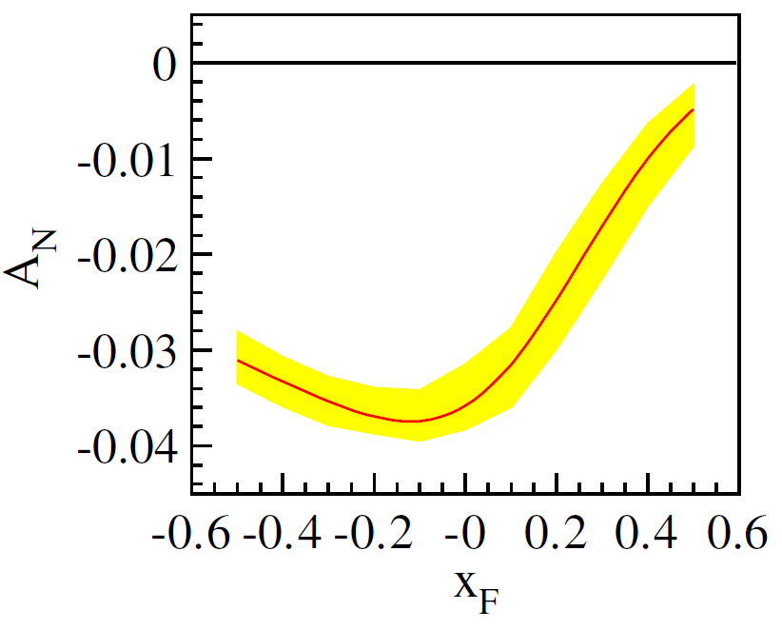
Predicted Sivers Asymmetries in COMPASS with QCD Evolution
Sun and Yuan,
PRD 88, 114012 (2013)
Echevarria, Idilbi, Kang and Vitev,
PRD 89, 074013 (2014)

Slide 36
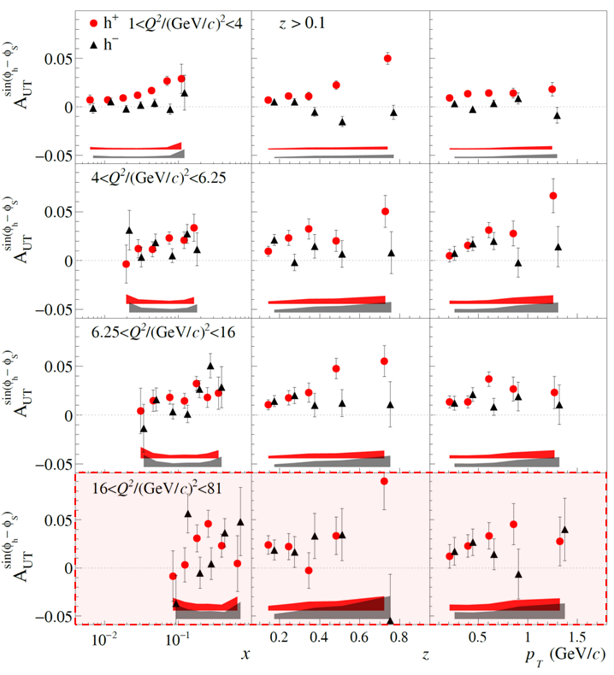
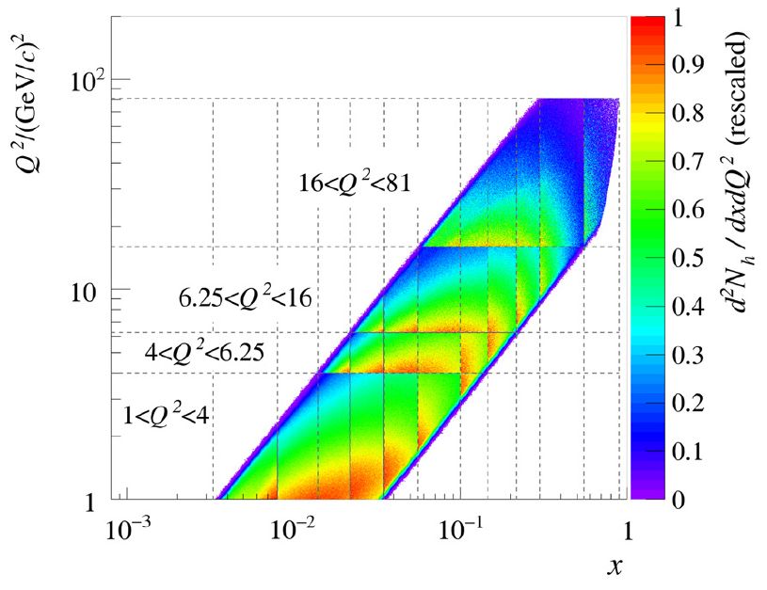
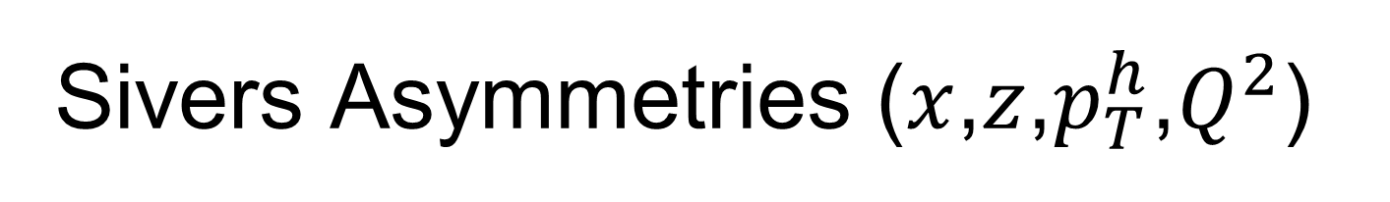
Sivers Asymmetries ($x$,$z$,$p_{T}^{h}$,$Q^{2}$)
Sivers asymmetry extracted in SIDIS at the hard scales of the
Drell–Yan process at COMPASS
COMPASS, PLB 770 (2017) 138

Slide 37
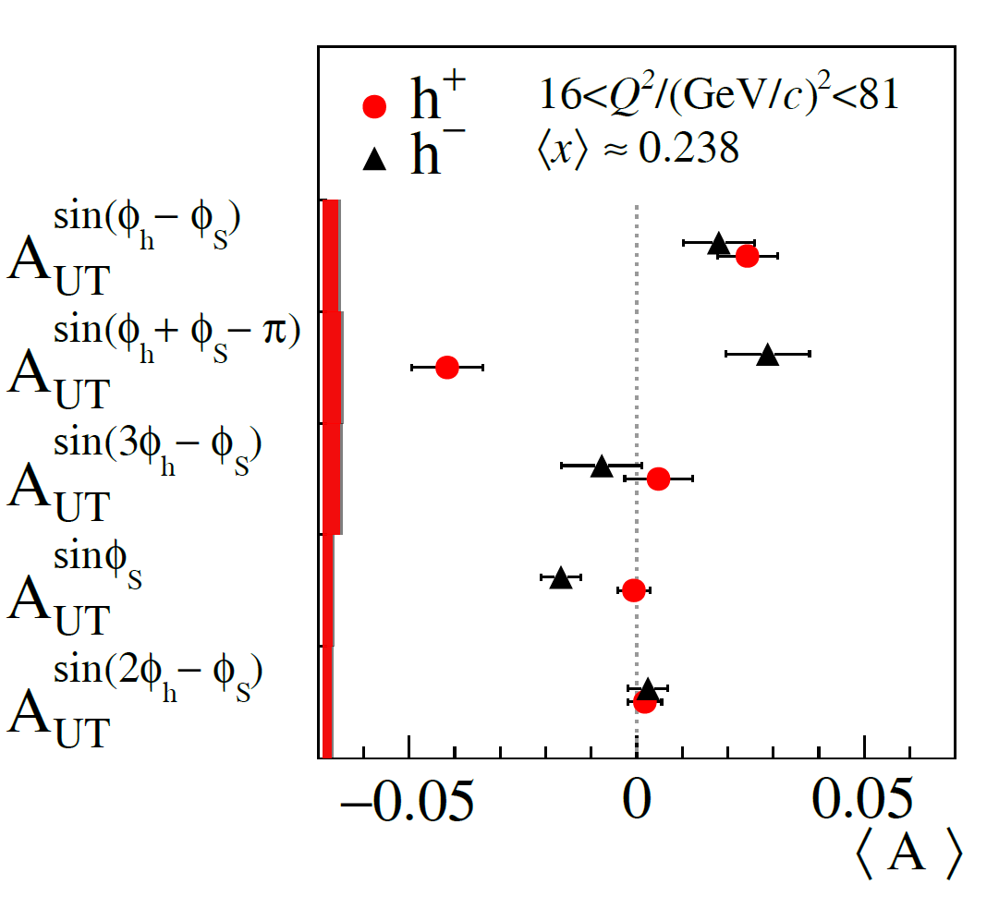

SIDIS and DY TSAs at COMPASS
COMPASS, arXiv:1704.00488
COMPASS, PLB 770 (2017) 138

Slide 38




Sivers Asymmetry in Drell-Yan:
Hint of Sign Change!
sign change
no sign change
arXiv:1704.00488, to appear in PRL.

Slide 39
COMPASS-II Programs
2014-2018:
  Commissioning of polarized Drell-Yan experiment started in mid-October 2014.
  2015: Polarized Drell-Yan program.
  2016-2017: DVCS program.
  2018: Polarized Drell-Yan program (improved statistics errors of Sivers asymmetries are expected).
2020-2024 (under planning) :
  Polarized ⁶LiD target: flavor separation of TMD SSAs.
  Long LH₂ and nuclei targets: un-polarized pion-induced DY.

Slide 40
Summary
In 2015 COMPASS has successfully collected first ever transversely polarized Drell-Yan data:
  Sivers asymmetry is found to be above zero at about 1 sigma.
  1st measurement of the DY Sivers asymmetry is consistent with the predicted change of sign for the Sivers function.
Other TMDs like transversity and pretzelosity as well as pion BMs are also accessed by TSAs of Drell-Yan process.
A second year of polarized DY data-taking will take place in 2018. Hopefully it will provide more stringent quantitative test of Sivers universality.

Slide 41
Backup slides

Slide 42

SIDIS x-section
A.Kotzinian, Nucl. Phys. B441, 234 (1995).
Bacchetta, Diehl, Goeke, Metz, Mulders and Schlegel JHEP 0702:093 (2007).
l'
l
h
γ*
P
X

Slide 43
SIDIS x-section and TMDs at twist-2
l'
l
h
γ*
FF
P
DF
X
Quark Nucleon | U | L | T
U | number density |  | Boer-Mulders
L |  | helicity | worm-gear L
T | Sivers | Kotzinian-Mulders worm-gear T | transversity pretzelosity

Slide 44
SIDIS x-section: transverse spin dependent part
Twist-2
Twist-3
Eight transverse-spin-dependent azimuthal asymmetries (TSA) appear in SIDIS x-section
Four “twist-2” TSAs
(Sivers, Collins, pretzelosity, Kotzinian-Mulders)
Four “higher-twist”

Slide 45




SIDIS and single-polarized DY x-sections
SIDIS DY

Slide 46

Predicted Sivers asymmetry A_{N}, assuming a sign change of the SIDIS Sivers functions
Anselmino et al., , JHEP04 (2017) 046 [arXiv:1612.06413]
Signals of Sivers functions in W production.
Hints of (non)universality.

