Slide 1
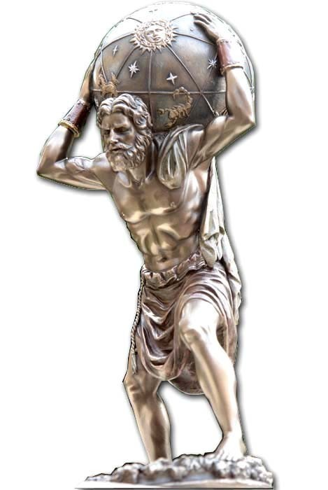
Strong QCD: Atlas for the Standard Model
Craig Roberts

Slide 2
Collaborators: 2014-Present
Students, Postdocs, Profs.
Jing CHEN (Peking U.)
Bo-Lin LI (Nanjing U.)
Ya LU (Nanjing U.)
Khépani RAYA (U Michoácan);
Chien-Yeah SENG (UM-Amherst) ;
Chen CHEN (UNESP - São Paulo, USTC & IIT);
Zhu-Fang CUI (Nanjing U.) ;
J. Javier COBOS-MARTINEZ (U Michoácan);
Minghui DING (Nankai U.) ;
Fei GAO (Peking U.) ;
L. Xiomara GUTIÉRREZ-GUERRERO (MCTP)
Cédric MEZRAG (ANL, Irfu Saclay) ;
Mario PITSCHMANN (Vienna);
Si-xue QIN (Chongqing, ANL, U. Frankfurt, PKU);
Eduardo ROJAS (Antioquia U.)
Jorge SEGOVIA (TU-Munich, ANL);
Chao SHI (ANL, Nanjing U.)
Shu-Sheng XU (Nanjing U.)
Adnan Bashir (U Michoácan);
Daniele Binosi (ECT*)
Stan Brodsky (SLAC);
Lei Chang (Nankai U. ) ;
Bruno El-Bennich (São Paulo);
Tanja Horn (Catholic U. America)
Yu-Xin Liu (PKU);
Hervé Moutarde (CEA, Saclay) ;
Joannis Papavassiliou (U.Valencia)
M. Ali Paracha (NUST, Islamabad)
Jose Rodriguez Qintero (U. Huelva) ;
Franck Sabatié (CEA, Saclay);
Sebastian Schmidt (IAS-FZJ & JARA);
Peter Tandy (KSU);
Shaolong WAN (USTC) ;
Hong-Shi ZONG (Nanjing U)
41% of this international collaboration is Chinese

Slide 3
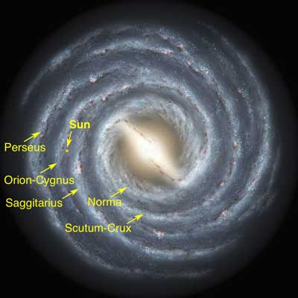
Emergent Phenomena in the Standard Model
Existence of the Universe as we know it depends critically on following empirical facts:
Proton is massive, i.e. the mass-scale for strong interactions is vastly different to that of electromagnetism
Proton is absolutely stable, despite being a composite object constituted from three valence quarks
Pion is unnaturally light (but not massless), despite being a strongly interacting composite object built from a valence-quark and valence antiquark
Emergence: low-level rules producing high-level phenomena, with enormous apparent complexity

Slide 4
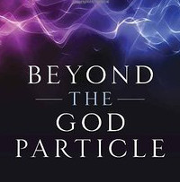
Overture
LHC has NOT found the “God Particle”
because the Higgs boson is NOT the origin of mass
Higgs-boson only produces a little bit of mass
Higgs-generated mass-scales explain neither the proton’s mass nor the pion’s (near-)masslessness
Hence LHC has, as yet, taught us very little about
Origin Nature Structure
of the nuclei whose existence support the Cosmos
Strong interaction sector of the Standard Model,
i.e. QCD, is the key to understanding the
origin, existence and properties
of (almost) all known matter
Answers are in sight
Theoretical tools are reaching point where sound QCD predictions can be made
New facilities – in operation or being planned – can validate those predictions

Slide 5
What & where is mass?

Slide 6
Strong Interactions in the Standard Model of Particle Physics
Perspective on the origin of hadron masses Craig D. Roberts, arXiv:1606.03909 [nucl-th]
Only apparent scale in chromodynamics is mass of the quark field
In connection with everyday matter, that mass is 1/250th of the natural (empirical) scale for strong interactions,
viz. more-than two orders-of-magnitude smaller
Quark mass is said to be generated by Higgs boson.
Plainly, however, that mass is very far removed from the natural scale for strongly-interacting matter
Nuclear physics mass-scale – 1 GeV – is an emergent feature of the Standard Model
No amount of staring at L_{QCD} can reveal that scale
Contrast with quantum electrodynamics, e.g. spectrum of hydrogen levels measured in units of m_{e}, which appears in L_{QED}

Slide 7
Whence Mass?
Classical chromodynamics … non-Abelian local gauge theory
Remove the current mass … there’s no energy scale left
No dynamics in a scale-invariant theory; only kinematics … the theory looks the same at all length-scales … there can be no clumps of anything … hence bound-states are impossible.
Our Universe can’t exist
Higgs boson doesn’t solve this problem … normal matter is constituted from light-quarks & the mass of protons and neutrons, the kernels of all visible matter, are 100-times larger than anything the Higgs can produce
Where did it all begin?
… becomes … Where did it all come from?

Slide 8
Whence Mass?
Poincaré invariance entails that the Energy-Momentum Tensor is divergence-free, i.e. it defines a conserved current:
Noether current associated with a global scale transformation:
x → e^{-σ} x
is the dilation current: D_{μν}=T_{μν} x_{ν}
In a scale invariant theory, the dilation current is conserved
Consequently, in a scale invariant theory
the energy-momentum tensor must be traceless: T_{μμ} ≡ 0
T_{μν} can always
be made symmetric

Slide 9
Trace Anomaly
Classical chromodynamics is meaningless … must be quantised
Regularisation and renormalisation of (ultraviolet) divergences introduces a mass-scale
… dimensional transmutation: mass-dimensionless quantities become dependent on a mass-scale, ζ
α → α(ζ) in QCD’s (massless) Lagrangian density, L(m=0)
Under a scale transformation ζ → e^{σ} ζ, then α → σ αβ(α)
L→ σ αβ(α) dL/dα
⇒ ∂_{μ}D_{μ} = δL/δσ = αβ(α) dL/dα = β(α) ¼G_{μν} G_{μν} = T_{ρρ} =: Θ₀
Straightforward, nonperturbative derivation, without need for diagrammatic analysis …
quantisation of renormalisable four-dimensional theory forces nonzero value for trace of energy-momentum tensor
QCD β function
Trace anomaly
Notes:
Alpha -> alpha(zeta) seems to be enough to generate M(zeta), which is large for zeta small.

Slide 10
Whence?
Classical chromodynamics … non-Abelian local gauge theory
Local gauge invariance; but there is no confinement without a mass-scale
Three quarks can still be colour-singlet
Colour rotations will keep them colour singlets
But they need have no proximity to one another
… proximity is meaningless in a scale-invariant theory
Whence mass … equivalent to whence a mass-scale … equivalent to whence a confinement scale
Understanding the origin of mass in QCD is quite likely inseparable from the task of understanding confinement.
Existence alone of a scale anomaly answers neither question

Slide 11
Where is the mass?

Slide 12
Trace Anomaly
Knowing that a trace anomaly exists does not deliver a great deal … indicates only that a mass-scale exists
Can one compute and/or understand the magnitude of that scale?
One can certainly measure the magnitude … consider proton:
In the chiral limit the entirety of the proton’s mass is produced by the trace anomaly, Θ₀
… In QCD, Θ₀ measures the strength of gluon self-interactions
… so, from one perspective, m_{p} is completely generated by glue.

Slide 13
On the other hand …

Slide 14
Trace Anomaly
In the chiral limit
⇒
Does this mean that the scale anomaly vanishes trivially in the pion state, i.e. gluons contribute nothing to the pion mass?
Difficult way to obtain “zero”!
Easier to imagine that “zero” owes to cancellations between different operator contributions to the expectation value of Θ₀.
Of course, such precise cancellation should not be an accident.
It could only arise naturally because of some symmetry and/or symmetry-breaking pattern.

Slide 15
Whence “1” and yet “0” ?
No statement of the question
“Whence the proton's mass?”
is complete without the additional clause
“Whence the absence of a pion mass?”
Natural nuclear-physics mass-scale must emerge simultaneously with apparent preservation of scale invariance in related systems
Expectation value of Θ₀ in pion is always zero, irrespective of the size of the natural mass-scale for strong interactions = m_{p}

Slide 16
A New Era for hadro-particle physics

Slide 17
A New Era
QCD is the first place that we fully experience the collisions and collusions between relativity and quantum mechanics.
In attempting to match QCD with Nature, we confront the innumerable complexities of nonperturbative, nonlinear dynamics in relativistic quantum field theory, e.g.
the loss of particle number conservation,
the frame and scale dependence of the explanations and interpretations of observable processes,
and the evolving character of the relevant degrees-of-freedom.
Origin and distribution of mass, momentum, spin within hadrons, e.g. where is the proton’s spin and how is the pion spinless?
Don’t forget the latter!
How do all the spin-1/2 quarks and spin-1 gluons combine to make a massless, J=0 composite mode?

Slide 18
Overarching Science Challenges for the coming decade
What is origin of mass in our Universe?
What is the nature of confinement in real (dynamical-quarks) QCD?
How are they connected?
How can any
answers,
conjectures
and/or conclusions
be empirically verified?
Physics is an
Empirical Science

Slide 19
Gluon Gap Equation
Pinch Technique: Theory and Applications
Daniele Binosi & Joannis Papavassiliou
Phys. Rept. 479 (2009) 1-152
24-29 July 2017, U. Nanjing: 9th Workshop
on Hadron physics in China (76p)

Slide 20
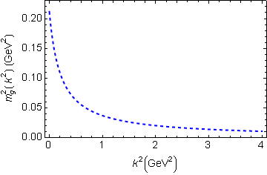
In QCD: Gluons become massive!
Bridging a gap between continuum-QCD and ab initio predictions of hadron observables, D. Binosi et al., arXiv:1412.4782 [nucl-th], Phys. Lett. B742 (2015) 183-188
Running gluon mass
Gluons are cannibals – a particle species whose members become massive by eating each other!
Expression of trace anomaly:
Massless glue becomes massive
gluon mass-squared function
Power-law suppressed in ultraviolet, so invisible in perturbation theory
5%
Interaction model for the gap equation, S.-x.Qin et al., arXiv:1108.0603 [nucl-th], Phys. Rev. C 84 (2011) 042202(R) [5 pages]
Class A: Combining DSE, lQCD and pQCD analyses of QCD’s gauge sector

Slide 21
Massive Gauge Bosons!
Gauge boson cannibalism
… a new physics frontier … within the Standard Model
Asymptotic freedom means
… ultraviolet behaviour of QCD is controllable
Dynamically generated masses for gluons and quarks means that QCD dynamically generates its own infrared cutoffs
Gluons and quarks with
wavelength λ > 2/mass ≈ 1 fm
decouple from the dynamics … Confinement?!
How does that affect observables?
It will have an impact in
any continuum study
Possibly (probably?) plays a role in gluon saturation ...
In fact, could be a harbinger of gluon saturation?

Slide 22
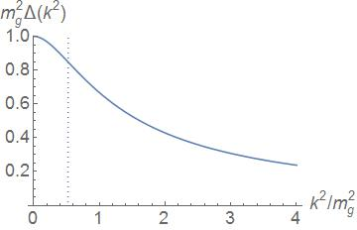
Confined particle
All QCD solutions for gluon & quark propagators exhibit an inflection point in k² … consequence of the running-mass function
Spectral function is NOT positive
Such states have negative norm (negative probability)
Negative norm states are not observable
This object is confined!
Sum of “probabilities”
Inflexion point
Corresponds to r_{C} ≈ 0.5 fm:
Parton-like behaviour at shorter distances; but propagation characteristics changed dramatically at larger distances.
m_{g} ≈ 0.5 GeV

Slide 23
Confinement is dynamical

Slide 24
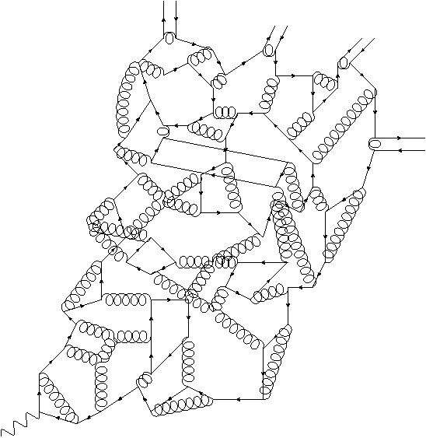
Quark Fragmentation
A quark begins to propagate
But after each “step” of length σ, on average, an interaction occurs, so that the quark loses its identity, sharing it with other partons
Finally, a cloud of partons is produced, which coalesces into colour-singlet final states
meson
meson
meson
meson
σ
Confinement is a dynamical phenomenon!

Slide 25
Quark Fragmentation
A quark begins to propagate
But after each “step” of length σ, on average, an interaction occurs, so that the quark loses its identity, sharing it with other partons
Finally, a cloud of partons is produced, which coalesces into colour-singlet final states
meson
meson
meson
Confinement in hadron physics is largely a dynamical phenomenon, intimately connected with the fragmentation effect.
It is unlikely to be comprehended without simultaneously understanding dynamical chiral symmetry breaking, which is the origin of a near-zero mass hadron (pion).
meson
σ
Confinement is a dynamical phenomenon!

Slide 26
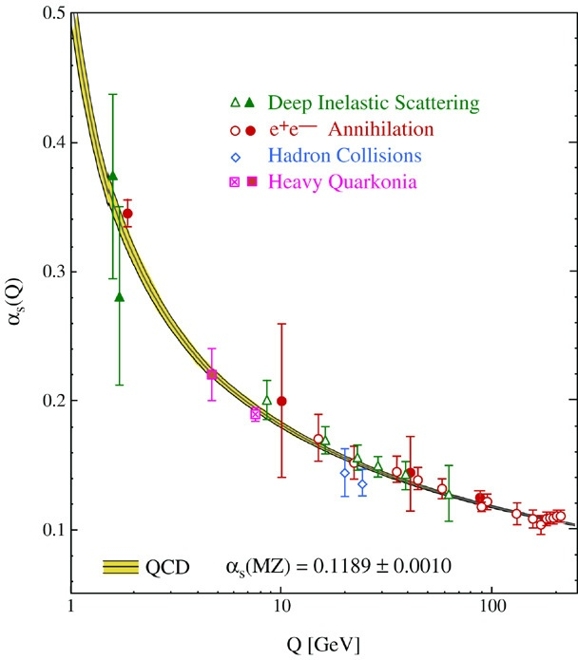
QCD’s Running Coupling
⇐
What’s happening
out here?!

Slide 27
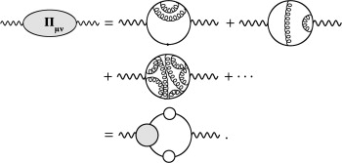
QED Running Coupling
Quantum gauge field theories in four spacetime dimensions,
Lagrangian couplings and masses come to depend on a mass scale
Can normally be related to the energy or momentum at which a given process occurs.
QED, owing to the Ward identity:
a single running coupling
measures strength of the
photon-charged-fermion vertex
can be obtained by summing the virtual
processes that dress the bare photon,
viz. by computing the photon vacuum polarisation.
QED's running coupling is known to great accuracy
and the running has been observed directly.

Slide 28
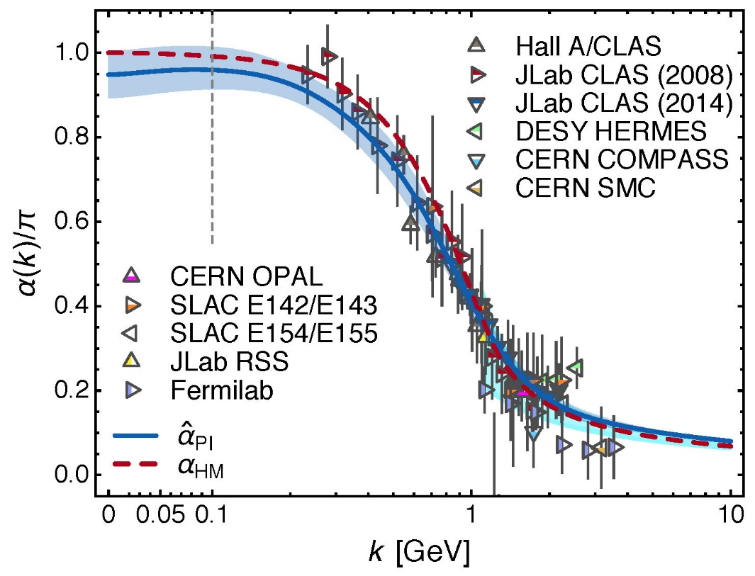
Process-independent effective-charge in QCD
Process independent strong running coupling
Binosi, Mezrag, Papavassiliou, Roberts, Rodriguez-Quintero
arXiv:1612.04835 [nucl-th]
Modern continuum & lattice methods for analysing gauge sector enable analogous quantity to be defined in QCD
Combined continuum and lattice analysis of QCD’s gauge sector yields a parameter-free prediction
N.B. Qualitative change in α̂_{PI}(k) at k ≈ ½ m_{p}

Slide 29
QCD Effective Charge
Process independent strong running coupling
Binosi, Mezrag, Papavassiliou, Roberts, Rodriguez-Quintero
arXiv:1612.04835 [nucl-th]
The QCD Running Coupling,
A. Deur, S. J. Brodsky and G. F. de Teramond,
Prog. Part. Nucl. Phys. 90 (2016) 1-74
Near precise agreement between process-independent α̂_{PI} and α_{g1}
and α̂_{PI} ≈ α_{HM}
Perturbative domain:
difference = (1/20) α_{M̅S̅}²
Parameter-free prediction:
curve completely determined by results obtained for gluon & ghost two-point functions using continuum and lattice-regularised QCD.
Data: process dependent effective charge: α_{g1} defined via Bjorken Sum Rule

Slide 30
QCD Effective Charge
α̂_{PI} is a new type of effective charge
direct analogue of the Gell-Mann–Low effective coupling in QED, i.e. completely determined by the gauge-boson two-point function.
Prediction for α̂_{PI} is parameter-free
Draws best from continuum & lattice results for QCD’s gauge sector
Prediction for α̂_{PI} smoothly unifies the nonperturbative and perturbative domains of the strong-interaction theory.
α̂_{PI} is
process-independent
appears in every one of QCD’s dynamical equations of motion
known to unify a vast array of observables
α̂_{PI} possesses an infrared-stable fixed-point
Nonperturbative analysis demonstrating absence of a Landau pole in QCD
QCD is IR finite, owing to dynamical generation of gluon mass-scale

Slide 31
QCD – A Paradigm for Extending the Standard Model?
How do quantum field theories fail?
Ultraviolet and infrared divergences
Asymptotic freedom ⇒ QCD is well-defined at UV momenta
Dynamical generation of gluon mass function, large on k² ≃ 0,
⇒ the infrared domain of QCD is self-regularizing
QCD is therefore unique amongst known four-dimensional quantum field theories
Potentially self-consistent
Defined & internally consistent at all momenta (e.g., no Landau pole)

Slide 32
QCD – a paradigm for extending the Standard Model?
How do quantum field theories fail?
Ultraviolet and infrared divergences
Asymptotic freedom ⇒ QCD is well-defined at UV momenta
Dynamical generation of gluon mass function, large on k² ≃ 0,
⇒ the infrared domain of QCD is self-regularizing
QCD is therefore unique amongst known four-dimensional quantum field theories
Potentially self-consistent
Defined & internally consistent at all momenta (e.g., no Landau pole)
If all this is true,
then QCD can serve as a basis
for theories that take physics
beyond the Standard Model

Slide 33
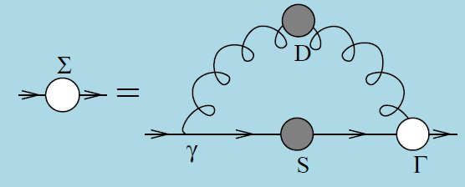
Quark Gap Equation

Slide 34
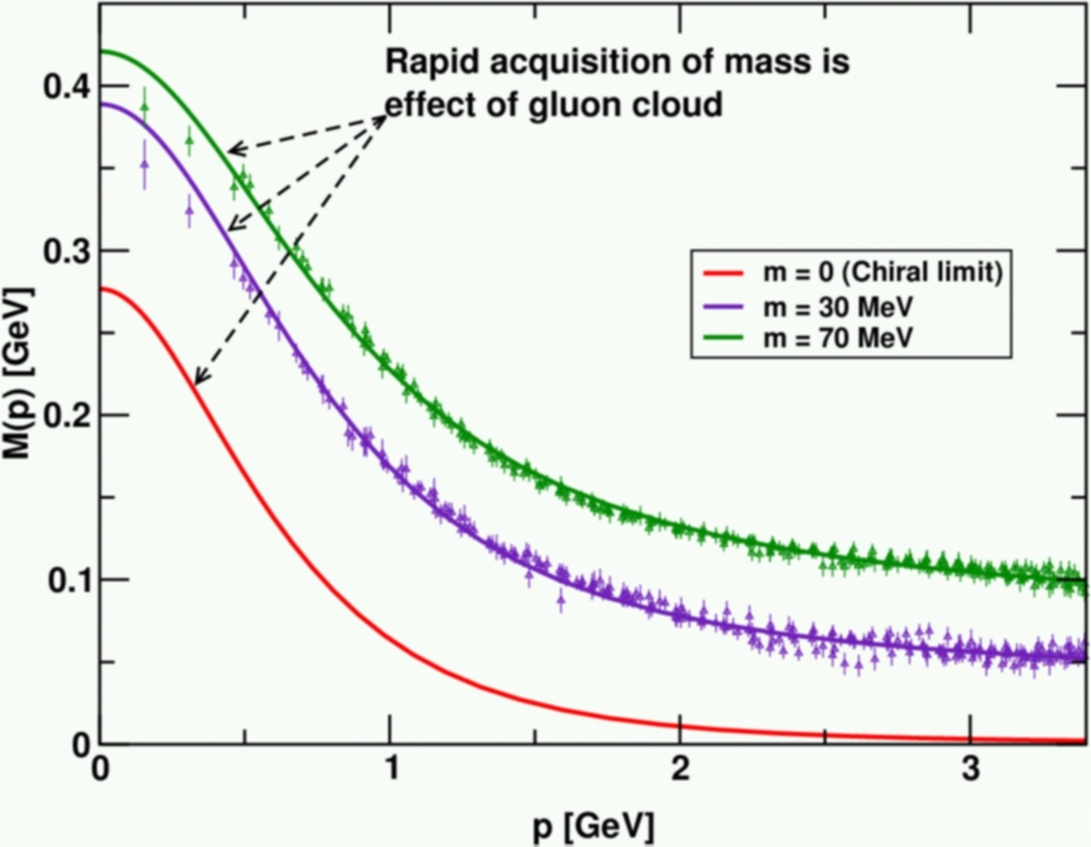
DCSB
Dynamical chiral symmetry breaking (DCSB) is
a key emergent phenomenon in QCD
Expressed in hadron wave functions not in vacuum condensates
Contemporary theory indicates that DCSB is responsible for more than 98% of the visible mass in the Universe; namely, given that classical massless-QCD is a conformally invariant theory, then DCSB is the origin of mass from nothing.
Dynamical, not spontaneous
Add nothing to QCD ,
No Higgs field, nothing!
Effect achieved purely
through quark+gluon
dynamics.
Trace anomaly: massless quarks
become massive
Combining DSE, lQCD and pQCD analyses of QCD’s gauge and matter sectors

Slide 35
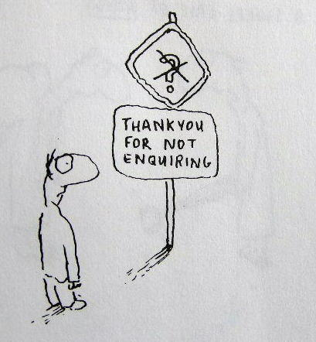
Enigma of Mass

Slide 36
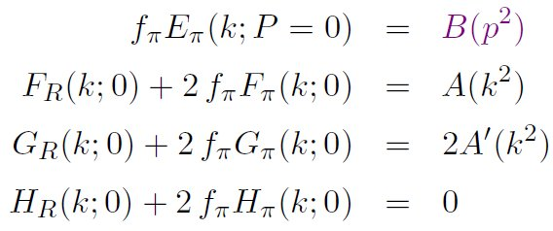
Pion’s Goldberger -Treiman relation
Maris, Roberts and Tandy
nucl-th/9707003, Phys.Lett. B420 (1998) 267-273
Pion’s Bethe-Salpeter amplitude
Solution of the Bethe-Salpeter equation
Dressed-quark propagator
Axial-vector Ward-Takahashi identity entails
B(k²)
Owing to DCSB
& Exact in
Chiral QCD
Miracle: two body problem solved, almost completely, once solution of one body problem is known

Slide 37
The most fundamental expression of Goldstone’s Theorem and DCSB
Rudimentary version of this relation is apparent in Nambu’s Nobel Prize work
Model independent
Gauge independent
Scheme independent
f_{π} E_{π}(p²) = B(p²)

Slide 38
Pion exists if, and only if, mass is dynamically generated
Rudimentary version of this relation is apparent in Nambu’s Nobel Prize work
Model independent
Gauge independent
Scheme independent
f_{π} E_{π}(p²)⇔ B(p²)

Slide 39
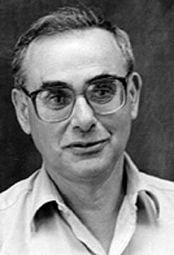
Enigma of mass
f_{π} E_{π}(p²) = B(p²)
This algebraic identity is why QCD’s pion is massless in the chiral limit
The quark level Goldberger-Treiman relation shows that DCSB has a very deep and far reaching impact on physics within the strong interaction sector of the Standard Model; viz.,
Goldstone's theorem is fundamentally an expression of equivalence between the one-body problem and the two-body problem in the pseudoscalar channel.
This emphasises that Goldstone's theorem has a pointwise expression in QCD
Hence, pion properties are an almost direct measure of
the dressed-quark mass function.
Thus, enigmatically, the properties of the massless pion
are the cleanest expression of the mechanism that is
responsible for almost all the visible mass in the universe.

Slide 40
Whence “0” ?

Slide 41
Whence “0” ?
The answer is algebraic

Slide 42
Pion masslessness
Munczek, H. J., Phys. Rev. D 52 (1995) pp. 4736-4740
Bender, A., Roberts, C.D. and von Smekal, L., Phys. Lett. B 380 (1996) pp. 7-12
Maris, P. , Roberts, C.D. and Tandy, P.C., Phys. Lett. B 420 (1998) pp. 267-273
Binosi, Chang, Papavassiliou, Qin, Roberts, Phys. Rev. D 93 (2016) 096010/1-7
Obtain a coupled set of gap- and Bethe-Salpeter equations
Bethe-Salpeter Kernel:
valence-quarks with a momentum-dependent running mass produced by self-interacting gluons, which have given themselves a running mass
Interactions of arbitrary but enumerable complexity involving these “basis vectors”
Chiral limit:
Algebraic proof
at any & each finite order in symmetry-preserving construction of kernels for
the gap (quark dressing)
and Bethe-Salpeter (bound-state) equations,
there is a precise cancellation between
mass-generating effect of dressing the valence-quarks
and attraction introduced by the scattering events
Cancellation guarantees that
simple system, which began massless,
becomes a complex system, with
a nontrivial bound-state wave function
attached to a pole in the scattering matrix, which remains at P²=0 …
Interacting, bound system remains massless!

Slide 43
Pion masslessness
Munczek, H. J., Phys. Rev. D 52 (1995) pp. 4736-4740
Bender, A., Roberts, C.D. and von Smekal, L., Phys. Lett. B 380 (1996) pp. 7-12
Maris, P. , Roberts, C.D. and Tandy, P.C., Phys. Lett. B 420 (1998) pp. 267-273
Binosi, Chang, Papavassiliou, Qin, Roberts, Phys. Rev. D 93 (2016) 096010/1-7
Obtain a coupled set of gap- and Bethe-Salpeter equations
Bethe-Salpeter Kernel:
valence-quarks with a momentum-dependent running mass produced by self-interacting gluons, which have given themselves a running mass
Interactions of arbitrary but enumerable complexity involving these “basis vectors”
Chiral limit:
Algebraic proof
at any & each finite order in symmetry-preserving construction of kernels for
the gap (quark dressing)
and Bethe-Salpeter (bound-state) equations,
there is a precise cancellation between
mass-generating effect of dressing the valence-quarks
and attraction introduced by the scattering events
Cancellation guarantees that
simple system, which began massless,
becomes a complex system, with
a nontrivial bound-state wave function
attached to a pole in the scattering matrix, which remains at P²=0 …
Interacting, bound system remains massless
Quantum field theory statement:
In the pseudsocalar channel, the dynamically generated mass of the two fermions is precisely cancelled by the attractive interactions between them – iff –
f_{π} E_{π}(p²) = B(p²)

Slide 44
Massless Pion
Chiral limit
⇒
“Zero” owes to cancellations between different operator-component contributions to the expectation value of Θ₀.
The cancellations are precise
Arising naturally because chiral symmetry – the apparent masslessness of the QCD action – is broken by strong dynamics in a very particular manner.
In the chiral limit, the pion is massless irrespective of the magnitude of any other hadron’s mass

Slide 45
Observing Mass

Slide 46
Confinement ⇔ DCSB
Signals for these (equivalent?) emergent phenomena are ubiquitous
Manifestations do not always appear the same in different systems
Studying a diverse array of systems and/or observables therefore exposes different aspects of the underlying mechanisms
Examples …
Spectrum of hadrons (level ordering, existence of exotics …)
Hadron (meson & baryon) elastic and transition form factors
Distribution amplitudes and functions, in all their guises
Origin of the nucleon-nucleon interaction and emergence of nuclei
Complete understanding of QCD – the toughest, most interesting part of the Standard Model – will only be found in a unified description of all these phenomena
All the basic subjects of hadro-particle physics

Slide 47
Observing Mass: Examples

Slide 48
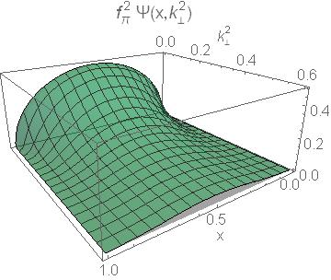
Pion’s Wave Function

Slide 49
Pion’s valence-quark Distribution Amplitude
Imaging dynamical chiral symmetry breaking: pion wave function on the light front, Lei Chang, et al., arXiv:1301.0324 [nucl-th], Phys. Rev. Lett. 110 (2013) 132001 (2013) [5 pages].
Methods have been developed that enable direct computation of the pion’s light-front wave function
φ_{π}(x) = twist-two parton distribution amplitude = projection of the pion’s Poincaré-covariant wave-function onto the light-front
Results have been obtained with the DCSB-improved DSE kernel, which unifies matter & gauge sectors
ϕ_{π}(x) ∝ x^{α} (1-x)^{α}, with α≈0.5

Slide 50
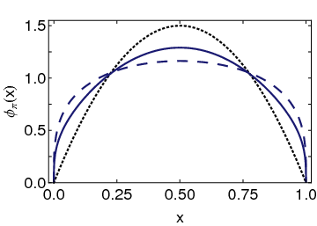
Pion’s valence-quark Distribution Amplitude
Imaging dynamical chiral symmetry breaking: pion wave function on the light front, Lei Chang, et al., arXiv:1301.0324 [nucl-th], Phys. Rev. Lett. 110 (2013) 132001 (2013) [5 pages].
Continuum-QCD prediction:
marked broadening of φ_{π}(x), which owes to DCSB
Conformal QCD
DB
RL
Real-world PDAs are squat and fat

Slide 51
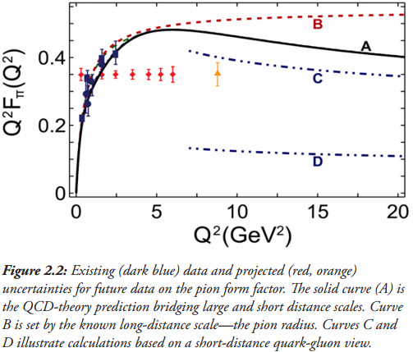
Pion’s electromagnetic form factor
Pion electromagnetic form factor at spacelike momenta L. Chang et al., arXiv:1307.0026 [nucl-th], Phys. Rev. Lett. 111, 141802 (2013)
A: Internally-consistent DSE prediction
PDA Broadening has enormous impact on understanding F_{π}(Q²)
C: Hard-scattering formula with broad PDA

Slide 52
Pion’s electromagnetic form factor
Pion electromagnetic form factor at spacelike momenta L. Chang et al., arXiv:1307.0026 [nucl-th], Phys. Rev. Lett. 111, 141802 (2013)
A: Internally-consistent DSE prediction
PDA Broadening has enormous impact on understanding F_{π}(Q²)
Appears that JLab12 is within reach of first verification of a QCD hard-scattering formula
C: Hard-scattering formula with broad PDA

Slide 53
Structure of Baryons

Slide 54
Baryon Structure
R.T. Cahill et al.,
Austral. J. Phys. 42 (1989) 129-145
Poincaré covariant Faddeev equation sums all possible exchanges and interactions that can take place between three dressed-quarks
Confinement and DCSB are readily expressed
Prediction: owing to DCSB in QCD, strong diquark correlations exist within baryons
Diquark correlations are not pointlike
Typically, r₀₊ ~ r_{π} & r₁₊ ~ r_{ρ} (actually 10% larger)
They have soft form factors

Slide 55
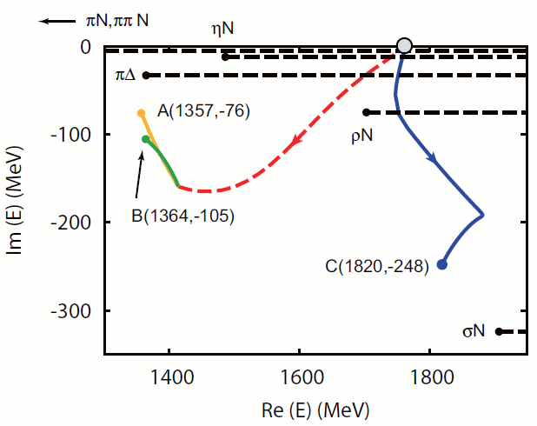
Roper Resonance

Slide 56
Roper Resonance
Completing the picture of the Roper resonance, Jorge Segovia et al.,, arXiv:1504.04386 [nucl-th], Phys. Rev. Lett. 115 (2015) 171801
Diquark content: Nucleon vs Roper
“Image”-nucleon = orthogonal solution of Faddeev equation at the Roper mass, with eigenvalue λ>1
Roper & Nucleon have same diquark content
Completely different to prediction of contact-interaction, wherein P_{J=0}≃0
With richer kernel, orthogonality of ground and excited states is achieved differently
 | Nucleon | Roper | Image-Nucleon
P_{J=0} | 62% | 62% | 30%
P_{J≠0×0} | 38% | 38% | 70%

Slide 57
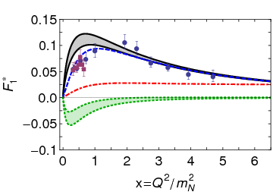
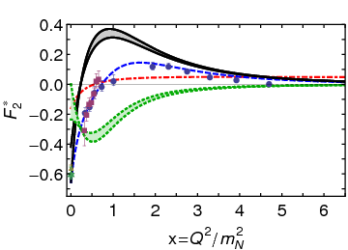
γ N → Roper
Completing the picture of the Roper resonance, Jorge Segovia et al.,, arXiv:1504.04386 [nucl-th], Phys. Rev. Lett. 115 (2015) 171801
Predicted transition form factors
Excellent agreement with data on x>2 (3)
Like γN → Δ, room for meson cloud on x<2 … appears likely that cloud
Is a negative contribution that depletes strength on 0<x<2
Has nothing to do with existence of zero; but is influential in shifting the zero in F₂* from x=¼ to x=1
Is irrelevant on x>2 (3)
Core dominance
Core dominance
DSE Contact
DSE Realistic
Inferred meson-cloud contribution
Anticipated complete result
M. Dugger et al., Phys. Rev. C79, 065206 (2009).
I. Aznauryan et al., Phys. Rev. C80, 055203 (2009).
I. G. Aznauryan et al., arXiv:1108.1125 [nucl-ex].
V. I. Mokeev et al., Phys. Rev. C86 (2012) 035203

Slide 58
γ N → Roper
Completing the picture of the Roper resonance, Jorge Segovia et al.,, arXiv:1504.04386 [nucl-th], Phys. Rev. Lett. 115 (2015) 171801
Predicted transition form factors
Excellent agreement with data on x>2 (3)
Like γN → Δ, room for meson cloud on x<2 … appears likely that cloud
Is a negative contribution that depletes strength on 0<x<2
Has nothing to do with existence of zero; but is influential in shifting the zero in F₂* from x=¼ to x=1
Is irrelevant on x>2 (3)
After 35 years, the Roper is now understood
First radial excitation of the nucleon’s dressed-quark core
But the core is accompanied by a meson cloud,
reduces the core’s mass by 20%
contributes measurably to transition form factors on x<2.
Roper emulates the pattern established by the Δ resonance
Core dominance
Core dominance
DSE Contact
DSE Realistic
Inferred meson-cloud contribution
Anticipated complete result
M. Dugger et al., Phys. Rev. C79, 065206 (2009).
I. Aznauryan et al., Phys. Rev. C80, 055203 (2009).
I. G. Aznauryan et al., arXiv:1108.1125 [nucl-ex].
V. I. Mokeev et al., Phys. Rev. C86 (2012) 035203

Slide 59
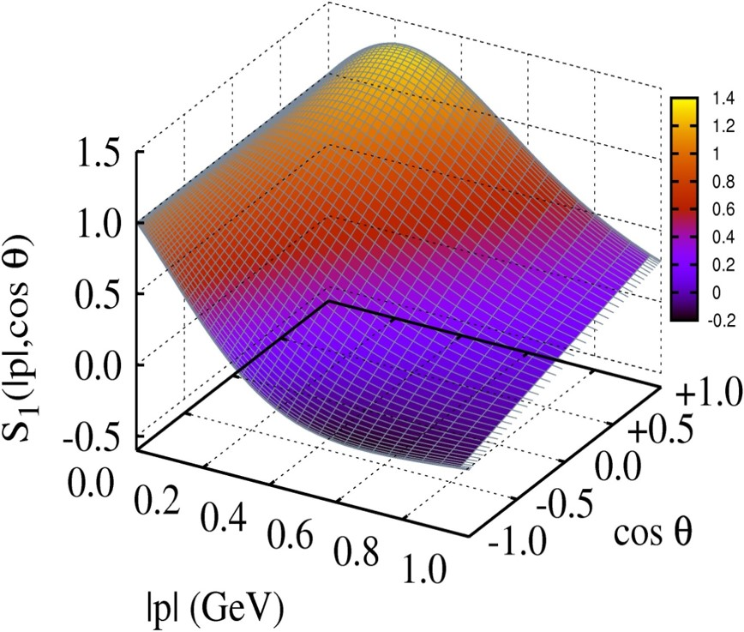
Baryon Wave Functions

Slide 60
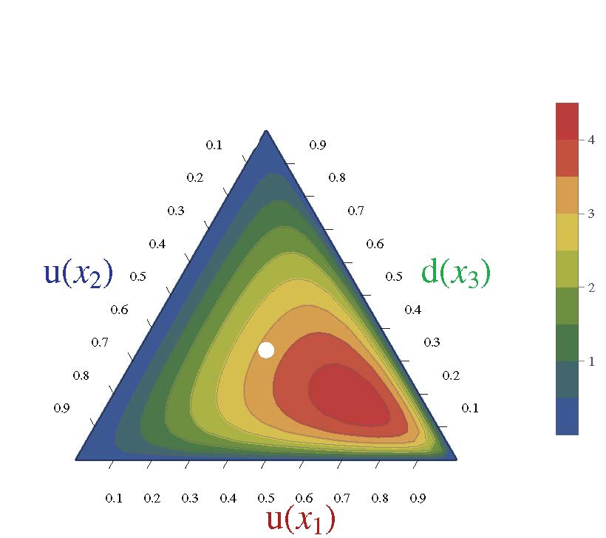
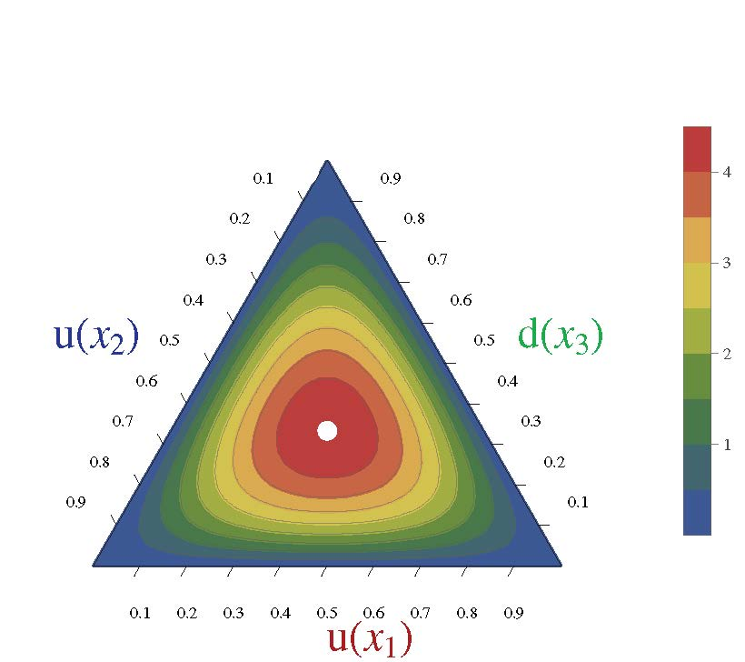
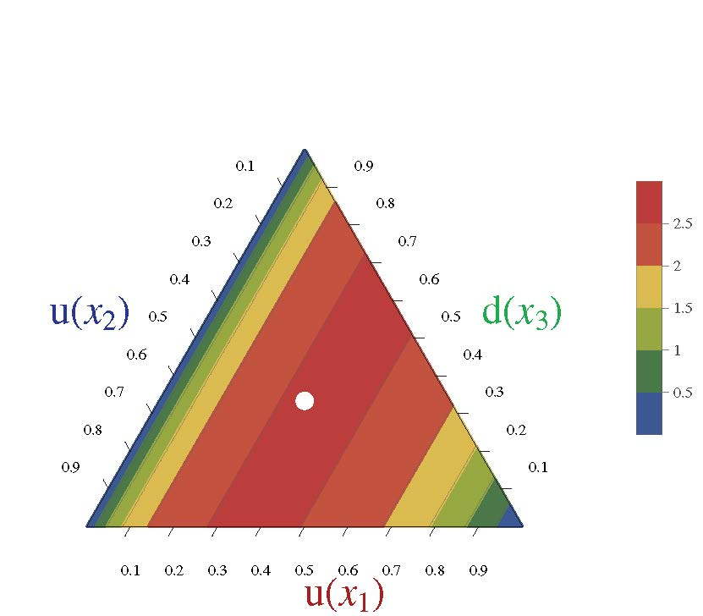
Nucleon Parton Distribution Amplitudes
C. Mezrag, C. D. Roberts and J. Segovia,
Near completion
Computations underway. First results available.
Realistic, finite size (0.7fm) 0⁺ diquark [u(x₂)d(x₃)]
Diquark clustering skews the distribution toward the dressed-quark bystander, which therefore carries more of the proton’s light-front momentum
(0.6,0.2,0.2)
conformal limit:
120 x₁x₂x₃
〈x_{i}〉=⅓ … peak of the distribution
Pointlike 0⁺ diquark [u(x₂)d(x₃)]

Slide 61
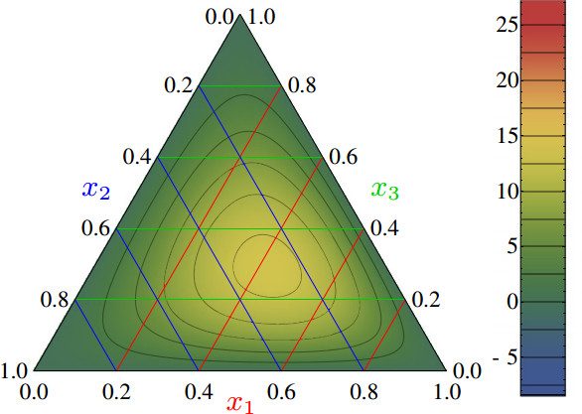
Nucleon PDAs & lQCD
Light-cone distribution amplitudes of the nucleon and negative parity nucleon resonances from lattice QCD
V. M. Braun et al., Phys. Rev. D 89 (2014) 094511
Light-cone distribution amplitudes of the baryon octet
G. S. Bali et al. JHEP 1602 (2016) 070
First lQCD results for n=0, 1 moments of the leading twist PDA of the nucleon are available
Used to constrain strength (a₁₁) of the leading-order term in a conformal expansion of the nucleon’s PDA:
Φ(x₁,x₂,x₃)
= 120 x₁ x₂ x₃ [ 1 + a₁₁ P₁₁(x₁,x₂,x₃) + … ]
Shift in location of central peak is consistent with existence of diquark correlations within the nucleon
(0.5,0.25,0.25)
Notes:
The calculation is done using Nf = 2 + 1 flavors of dynamical (clover) fermions on lattices of different volumes and pion masses down to 222 MeV. Significant SU(3) flavor symmetry violation effects in the shape of the distribution amplitudes are observed.

Slide 62
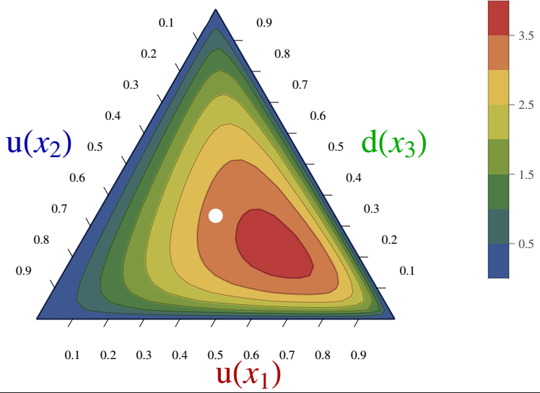
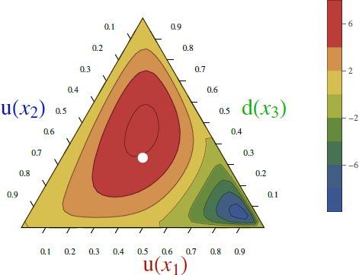
PDAs: Nucleon vs. Roper
Realistic N & R = 0⁺ (0.8) ⊕ 1⁺ (0.2) ⇒ 0⁺ (62%) ⊕ 0⁺ (38%)
Presence of diquark correlations has striking consequences
 | Conformal (uncorrelated) | Nucleon (qq 0⁺ only) | Nucleon | Roper (qq 0⁺ only) | Roper | R-N difference
〈 x₁ 〉 | 0.33 | 0.44 | 0.39 | -0.30 | 0.12 | -69%
〈 x₂ 〉 | 0.33 | 0.28 | 0.29 | 0.65 | 0.40 | +34%
〈 x₃ 〉 | 0.33 | 0.28 | 0.32 | 0.65 | 0.48 | +50%
Nucleon
Roper
Roper PDA has a line of zeros

Slide 63
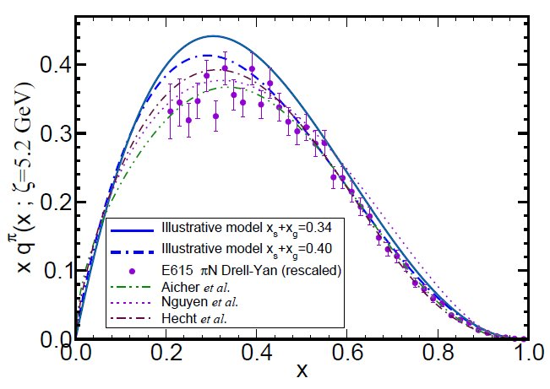
π & K Valence-quark Distribution Functions

Slide 64
π & K PDFs
Experimental data on π & K PDFs obtained in mesonic Drell-Yan scattering from nucleons in heavy nuclei; but it’s old: 1980-1989
Newer data would be welcome:
persistent doubts about the Bjorken-x ≃1 behaviour of the pion’s valence-quark PDF
single modest-quality measurement of u^{K}(x)/u^{π}(x) cannot be considered definitive.
Approved experiment, using tagged DIS at JLab 12, should contribute to a resolution of pion question; and a similar technique might also serve for the kaon.
Future:
new mesonic Drell-Yan measurements at modern facilities could yield valuable information on π and K PDFs,
as could two-jet experiments at the large hadron collider;
EIC would be capable of providing access to π and K PDFs through measurements of forward nucleon structure functions.
Gribov-Lipatov reciprocity (crossing symmetry) entails connection between PDFs and fragmentation functions on z ≃ 1 (z ≥ 0.75)
D_{H/q}(z) ≈ z q^{H}(z)
Reliable information on meson fragmentation functions is critical if the worldwide programme aimed at determining TMDs is to be successful

Slide 65
Valence-quark PDFs within mesons
Basic features of the pion valence-quark distribution function,
Lei Chang, Cédric Mezrag, et al.,
arXiv:1406:5450 [nucl-th], Phys. Lett. B 737 (2014)pp. 23–29
Valence-quark distribution functions in the kaon and pion,
Chen Chen, Lei Chang et al.
arXiv:1602.01502 [nucl-th], Phys. Rev. D93 (2016) 074021/1-11
Compute PDFs from imaginary part of virtual-photon – pion forward Compton scattering amplitude:
γ π → γ π
Handbag diagram is insufficient. Doesn’t even preserve global symmetries. Exists a class of leading-twist corrections that remedies this defect ⇒
Similar expressions for u_{V}^{K}(x), s_{V}^{K}(x)
Projection onto light-front
Partial derivative wrt relative momentum
Measurable quantities
Directly related to dynamically generated quark masses
& bound-state wave functions

Slide 66
Valence-quark PDFs within mesons
Basic features of the pion valence-quark distribution function,
Lei Chang, Cédric Mezrag, et al.,
arXiv:1406:5450 [nucl-th], Phys. Lett. B 737 (2014)pp. 23–29
Valence-quark distribution functions in the kaon and pion,
Chen Chen, Lei Chang et al.
arXiv:1602.01502 [nucl-th], Phys. Rev. D93 (2016) 074021/1-11
Formulae guarantee that valence-quark PDFs satisfy, independent of any and all structural details:
Algebraic proof that at an hadronic scale ζ ≈ 0.5 GeV
q_{V}^{M}(x ≃ 1) ∝ (1-x)^{2n}
in any theory with (1/k²)^{n} vector-boson exchange interaction

Slide 67
Realistic distributions
Pion distribution at ζ_{H}
DSE prediction, following from analysis of leptonic decay: π contains 5% sea
Assume GRV analysis of πN Drell-Yan is reliable, then 30% of π momentum carried by glue
Adopting standard PDF parametrisations, this additional information is sufficient to completely fix realistic u_{π}(x; ζ_{H}) = valence + sea + glue
Kaon distribution at ζ_{H}
Owing to heavier mass of intermediate states that can introduce sea-quarks, safe to assume sea-quark content of kaon is effectively zero
Treat momentum fraction carried by glue as a parameter to be used in understanding u^{K}(x)/u^{π}(x)
… owing to heavier mass of s-quark,
expect 〈x〉_{g}^{K} < 〈x〉_{g}^{π};
… but how much less?

Slide 68
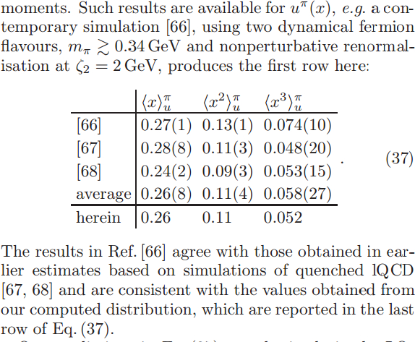
Pion: DSE comparison with lQCD moments
All lQCD studies agree with each other, within errors
[66]: Brommel et al. (2007)
[67]: Best et al. (1997)
[68]: Detmold et al. (2003)
DSE and lQCD agree, within errors; and DSE at level of 4% with lQCD-average
On light-front, just 52% of the pion’s momentum is carried by valence-quarks at ζ₂ = 2GeV, down from 65% at ζ_{H}= 0.51GeV

Slide 69
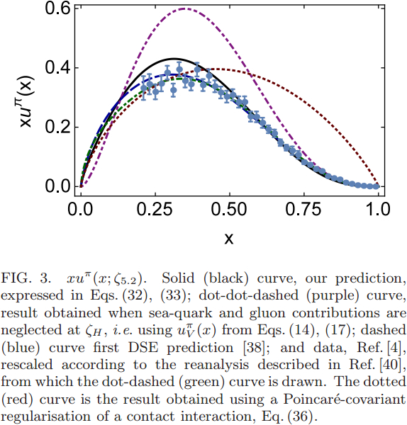
Pion PDF
DSE
2000 2016
Purple dot-dot-dash = prediction at ζ_{H}
Data = modern reappraisal of E615: NLO analysis plus soft-gluon resummation (ASV)
Solid black curve, prediction evolved to ζ=5.2GeV, the scale associated with the experiments
Blue dashed curve = first DSE prediction, in 2000 (ζ=5.2GeV)
Dotted red curve = result obtained with momentum-independent gluon exchange (contact interaction, ζ=5.2GeV)
CI: (1-x)^{1.0±0.1}
ζ=5.2GeV
DSE: (1-x)^{3.0±0.1}

Slide 70
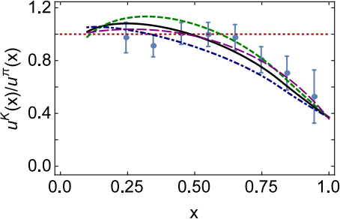
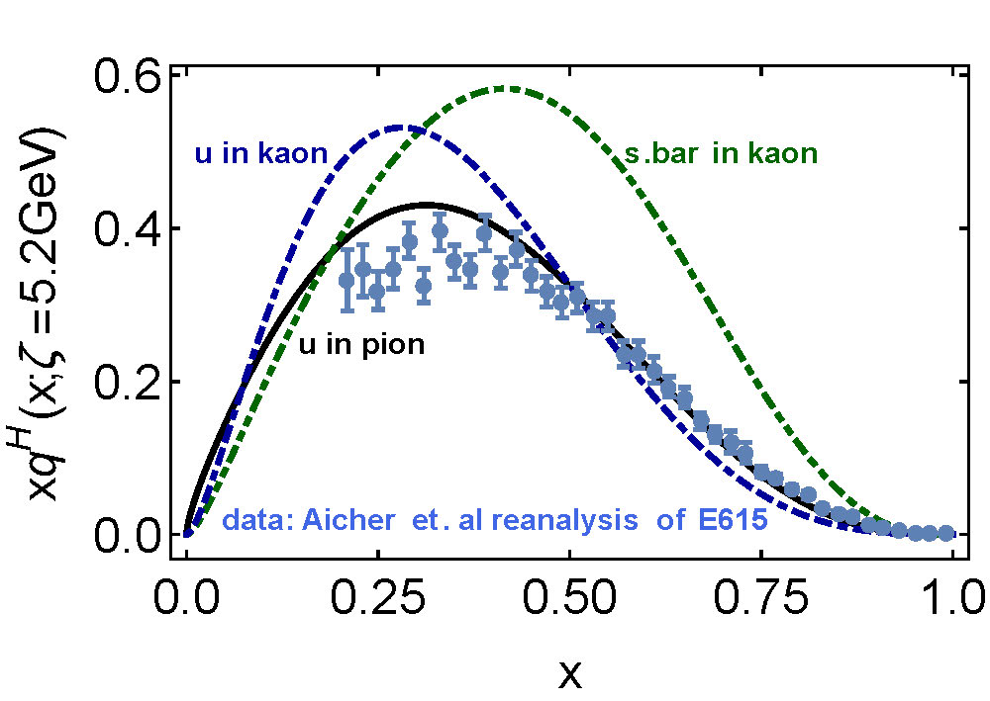
Kaon’s gluon content
0%
10%
〈x〉_{g}^{K}(ζ_{H}) = 0.05 ± 0.05
⇒ Valence quarks carry
95% of kaon’s
momentum at ζ_{H}
Evolved to ζ₂
Valence-quarks carry ⅔ of kaon’s light-front momentum
1st DSE analysis (Tandy et al., fully numerical DSE solutions)

Slide 71
π & K PDFs
Valence-quark distribution functions in the kaon and pion,
Chen Chen, Lei Chang et al.
arXiv:1602.01502 [nucl-th], Phys. Rev. D93 (2016) 074021/1-11
Marked differences between π & K gluon content
ζ_{H}:
Whilst $\frac{1}{3}$ of pion’s light-front momentum carried by glue
$Only \frac{1}{20}$ of the kaon’s light-front momentum lies with glue
ζ₂² = 4 GeV²
Glue carries $\frac{1}{2}$ of pion’s momentum and $\frac{2}{3}$ of kaon’s momentum
Evident in differences between large-x behaviour of valence-quark distributions in these two mesons
Signal of Nambu-Goldstone boson character of π
Nearly complete cancellation between
one-particle dressing and binding attraction
in this almost massless pseudoscalar system
2 M + U ≈ 0

Slide 72
π & K PDFs
Valence-quark distribution functions in the kaon and pion,
Chen Chen, Lei Chang et al.
arXiv:1602.01502 [nucl-th], Phys. Rev. D93 (2016) 074021/1-11
Existing textbook description of Goldstone’s theorem via pointlike modes is outdated and simplistic

Slide 73
π & K PDFs
Valence-quark distribution functions in the kaon and pion,
Chen Chen, Lei Chang et al.
arXiv:1602.01502 [nucl-th], Phys. Rev. D93 (2016) 074021/1-11
The appearance of Nambu-Goldstone modes in the Standard Model is far more interesting
Nambu-Goldstone modes are nonpointlike!
Intimately connected with origin of mass!
Quite probably inseparable from expression of confinement!
Difference between gluon content of π & K is measurable … using well-designed EIC
Write a definitive new chapter in future textbooks on the Standard Model

Slide 74
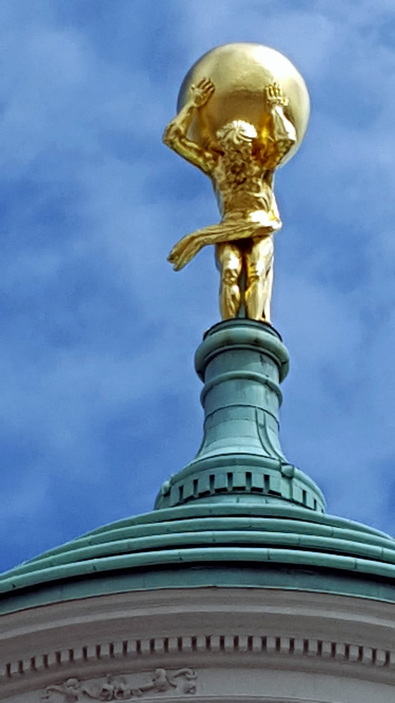
Epilogue

Slide 75
Epilogue
Challenge: Explain and Understand
the Origin of the vast bulk of Visible Mass
Current Paradigm: Quantum Chromodynamics
QCD is plausibly a mathematically well-defined quantum field theory,
The only one we’ve ever produced
Consequently, it is a worthwhile paradigm for developing Beyond-SM theories
Facing the Challenge: a Worldwide effort in Hadro-particle physics,
both Experiment and Theory
Reward: A Place in History
Think of the history of atomic structure, which is now understood, and all the applications to which it has led …
We must write the chapters that explain structure of nucleons and nuclei, and everything required to make it thus, so that the next generations can expose QCD’s wider implications and develop its practical applications

Slide 76
Now is the time.

Slide 77
Index
Pion’s Wave Function
Structure of Baryons
Roper Resonance
Baryon Wave Functions
π & K PDFs
“Measuring” Mass Function and Effective Charge

Slide 78
Observing the mass function
Importance ⇒ Is the dressed-quark mass function observable?
Goldberger-Treiman relations entail that on m≃0, dressed-quark mass function (almost) completely determines χ_{π} (wave function)
⇒ Thus, like a wave function in any field of physics,
the dressed-quark mass function is not strictly observable
On the other hand, no one can reasonably doubt the enormous value of possessing (nearly) complete knowledge of a bound-state's wave function
Moreover, χ_{π} can be projected onto the light-front
Object thus obtained is strictly a probability amplitude and the moments of a probability measure are truly observable.
Consequently, there is a mathematically strict sense in which moments of the dressed-quark mass function are observable.
One should note in addition that generalised parton distributions can rigorously be defined as an overlap of light-front wave functions

Slide 79
Observing the mass function
Practically, the dressed-quark mass function can be “measured” because
it influences and determines a vast array of experimental observables,
and there is at least one tractable framework, the DSEs, through which to relate those observables to QCD
In this sense, M(p²) is as readily observable as, e.g. parton distribution amplitudes and functions
Upgraded and planned facilities will provide data on hadron
elastic and transition form factors,
distribution functions and amplitudes, etc.,
all of which have-been/can-be unified via M(p²)
Agreement will be a clear validation of the fundamental character of M(p²) and its crucial role in determining observables
Moreover … M(p²) is an implicit measure of α̂_{PI}(k), as are so many other things, so modern experiment will provide the information necessary to chart the IR behaviour of QCD’s β-function
Access to IR is indirect, but truncation-dependence is being brought under control

Slide 81
Massless Pion
Recall that in the chiral limit
⇒
We now have enough information in hand to explain this result

Slide 82
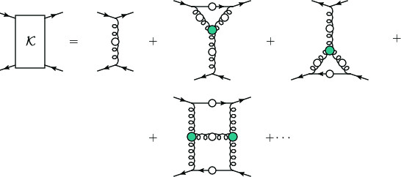
Pion masslessness
Pion’s Poincaré-invariant mass and Poincaré-covariant wave function are obtained by solving a Bethe-Salpeter equation.
This is a scattering problem
In chiral limit
two massless fermions interact via exchange of massless gluons … initial system is massless;
… and it remains massless at every order in perturbation theory
But, complete the calculation using an enumerable infinity of dressings and scatterings
Then …

Slide 84
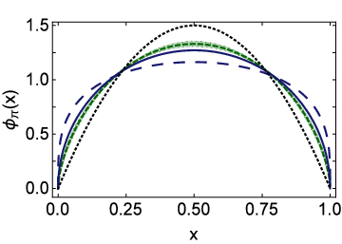
Lattice-QCD & Pion’s valence-quark PDA
Flavour symmetry breaking in the kaon parton distribution amplitude, Chao Shi et al., arXiv:1406:3353 [nucl-th], Phys. Lett. B 738 (2014) pp. 512–518
Isolated dotted curve = conformal QCD
Green curve & band = result inferred from the single pion moment computed in lattice-QCD
Blue solid curve = DSE prediction obtained with DB kernel
DSE & lQCD predictions are practically indistinguishable
See also … arXiv:1702.00008, Pion Distribution Amplitude from Lattice QCD
Jian-Hui Zhang, Jiunn-Wei Chen, Xiangdong Ji, Luchang Jin, Huey-Wen Lin

Slide 86
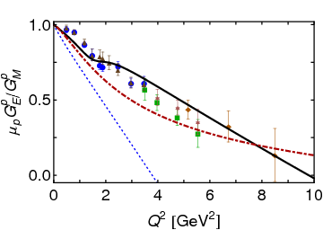
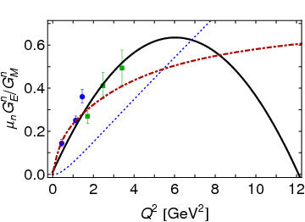
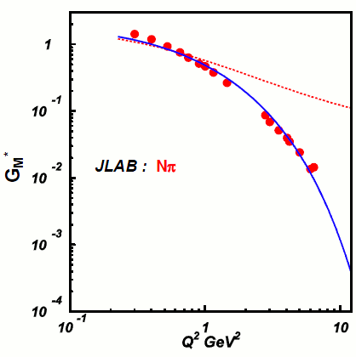
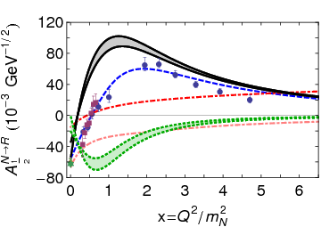
“Measuring” Mass Function and Effective Charge
2007 Empirical
Parametrisation
Relativistic quantum field theory
Fully consistent treatment of
Contact interaction: (1/k²)⁰
QCD interaction: (1/k²)¹
Interaction determines ALL:
Wave function
Mass function
Etc.
Observables!
QCD-kindred
QCD-kindred
contact
2007 Empirical
Parametrisation
contact
contact
QCD-kindred
contact
QCD-kindred

Slide 87
“Measuring” Mass Function and Effective Charge
Relativistic quantum field theory
Completely consistent treatment of
Contact interaction: (1/k²)⁰
QCD interaction: (1/k²)¹
Interaction determines ALL:
Wave function
Mass function
Etc.
Observables!
QCD-kindred
Much existing data supports 1/k² interaction
But … different effects for different targets
Higher Q² will take us out of meson cloud region for all systems
Provide unambiguous signal of k²-dependent mass
e.g. scaling behaviour of form factors depends CRUCIALLY on the nature of the underlying interaction
change interaction ⇒ change power-laws
Such outcomes are unavoidable consequence in QFT
Continued improvements in continuum theory then, potentially, experiment can provide tight constraints on running mass ⇔ effective charge
QCD-kindred
contact
contact
contact
QCD-kindred
contact
QCD-kindred

Slide 89
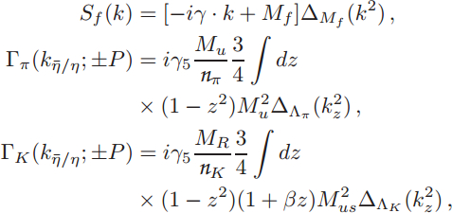
Valence-quark PDFs within mesons
Algebraic analysis
Δ_{f}(k²)=1/[k²+M_{f}²]
M_{R}=M_{us}²/[M_{u}+M_{s}]
M_{us}² = M_{u} M_{s}
M_{u} , M_{s} = dressed-quark mass-scales: M_{u}=0.4GeV and M_{s}=1.2M_{u} from most sophisticated DSE analyses
β = 1 is kaon asymmetry parameter, fixed to reproduce best DSE result for first moment of kaon PDA
Λ_{π,K} = widths of meson Bethe-Salpeter amplitudes: chosen to ensure f_{π,K} reproduce empirical values
Could use sophisticated DSE input, like Tandy et al. arXiv:1102.2448 [nucl-th]; but, as demonstrated in arXiv:1602.01502 [nucl-th], nothing material is gained
Predictions of algebraic framework are indistinguishable and provide additional, novel insights

Slide 90
E615 Controversy
q^{π}(x) ∼ (1-x)¹
Numerous “explanations”
Nambu – Jona-Lasinio model, translationally invariant regularisaion
q^{π}(x) ∼ (1-x)⁰,
which becomes ≈1 after evolving from a low resolution scale
NJL models with a hard cutoff & also some duality arguments:
q^{π}(x) ∼ (1-x)¹
Relativistic constituent quark models:
q^{π}(x) ∼ (1-x)^{0…2}
depending on the form
of model wave function
Instanton-based models
q^{π}(x) ∼ (1-x)^{1…2}
Any power you might like in models possessing no connection with QCD.
What can be learnt from this?
Is QCD threatened?

Slide 91
Pion’s Valence-Quark Distribution Function
One of the earliest predictions of the QCD parton model (1974,1975):
q^{π}(x) ∼ (1-x)²
Owing to the validity of factorisation in QCD,
q^{π}(x) is directly measurable in πN Drell-Yan experiments
E615 @ FNAL (Conway:1989fs): leading-order analysis of πN Drell-Yan
q^{π}(x) ∼ (1-x)¹
Apparent disagreement with QCD.
Nevertheless (often) used to produce “modern” PDF fits

Slide 92
Valence-quark PDFs within mesons
x=1 values of ratios of PDFs are invariant under DGLAP evolution
Consequently, they’re a scale invariant discriminator between competing pictures of hadron structure
On the other hand
Owes to inexorable growth in both mesons’ gluon and sea-quark content driven by pQCD splitting mechanisms.
Analogous to the convergence of all meson PDAs to conformal form as Λ_{QCD}/ζ → 0

Slide 93
π & K PDFs
Dressed-quark basis and symmetry-preserving (beyond-handbag) expressions used to analyse π & K valence-quark PDFs … guarantee that at hadronic scale
q_{V}(x;ζ_{H}) ∝ (1-x)² on x ≃ 1
Flavour-dependence of DCSB modulates the strength of SU(3)-flavour symmetry breaking in meson PDFs, as it does in every other nonperturbative quantity
At ζ_{H}:
PION: valence dressed-quarks carry roughly two-thirds light-front momentum, with the bulk of the remainder carried by glue … sea-quarks carry roughly 5%
KAON: contrast, valence dressed-quarks carry approximately 95% of the light-front momentum, with the remainder lying in the gluon distribution … sea-quarks carry ≃ 0 %
heavier s-quarks radiate soft gluons less readily than lighter quarks and momentum conservation subsequently constrains gluons associated with the kaon’s u-quark

Slide 94
π & K PDFs
Evolving distributions to scale characteristic of meson-nucleon Drell-Yan experiments, ζ=5.2 GeV
extant data reproduced
x ≃ 1: q(x) ∝ (1-x)^{3.0±0.1}
ratio u^{K}(x)/u^{π}(x) explained by vastly different gluon content of π & K
Distributions evolved to ζ₂ = 2 GeV, which is typically used in numerical simulations of lattice-regularised QCD:
Valence-quarks, light-front momentum
π ∼ 1/2 but K ∼ 2/3
Next steps
Do not anticipate any improvement over these results using continuum methods in QCD
Can lQCD say anything novel? (As yet, nothing from lattice on kaon PDF)
Empirical verification of the predictions is essential (equivalent to verifying hard-scattering formulae)
Extend analysis to GPDs, TMDs and Fragmentation Functions

