Slide 1
Nuclear and hadron physics opportunities with Shanghai electron and photon beams
Yu-Gang Ma
Shanghai Institute of Applied Physics (SINAP)，CAS
Nuclear physics Department， 201800
9th Workshop on Hadron physics in China and Opportunities Worldwide
24 July 2017 - 29 July 2017, Nanjing, China

Slide 2
outline
1. MeV LCS gamma beams at SINAP
2. GeV electron beam at SCLF (Shanghai Coherent Light Facility)
3. GeV gamma beam at SCLF (Proposed)
4. PW laser beams at SULF (Shanghai Super intense Ultra fast Laser Facility) and SCLF-SEL (Station of Extreme Light)
5. Nuclear physics and related researches
6. Summary

Slide 3
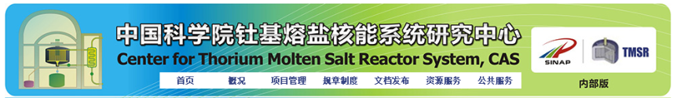
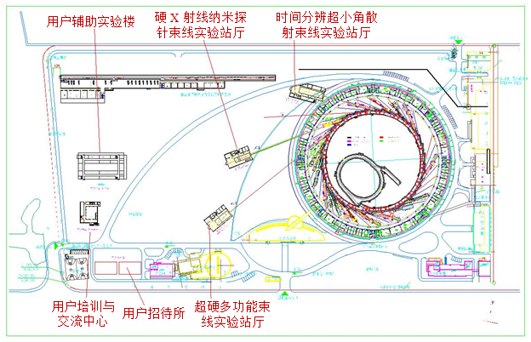
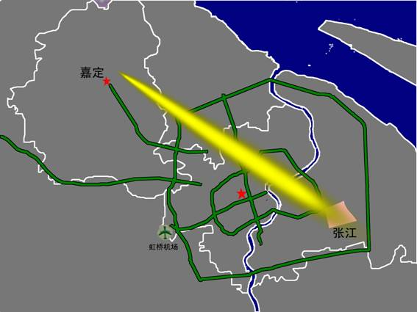

二、线站整体布局
SSRF/SXFEL/SCLF(HXFEL) @ SINAP
Shanghai zhangjiang High-tech park
★
SLEGS
Beam station
SINAP a national research institute for particle accelerator physics and engineering, nuclear science and technology, and interdisciplinary studies.
SSRF: Third generation synchrotron light sources based on 3.5GeV – the Shanghai Synchrotron Radiation Facility.
TMSR: It also conducts state-of-the-art R&D in Thorium Molten Salt Reactor.
Other key scientific endeavour includes Nuclear physics, Physical Biology and Water Science &Technology.
SXFEL is soft X ray free electron Laser, Electron enery 0.84GeV, and user facility will be update to 1.3GeV. Water window(X ray wave length 3.7nm)
SCLF (HXFEL) is hard X ray free electron Laser facility based on the electron energy 8GeV.
SULF & SEL is high intensity 10-100PW Laser
SLEGS as one of 16 new SSRF Phase II beamlines, was approved by central government in 2015 and expected to be completed in 2021. SLEGS is the first laser-Compton scattering based gamma-ray source in China, aiming at the frontier researches in nuclear structure physics, nuclear astrophysics, nuclear photonics, and etc. SLEGS will be opened for users in 2020.

Slide 4

X ray LCS gamma beam at SINAP
Two MeV LCS gamma beams at SINAP
GeV photon beam at SCLF
GeV electron beams at SCLF
10-100 PW laser beam at SCLF-SEL
1-10 PW laser beam at SULF

Slide 5
Part 1
MeV LCS gamma beam @ SINAP

Slide 6
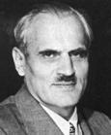
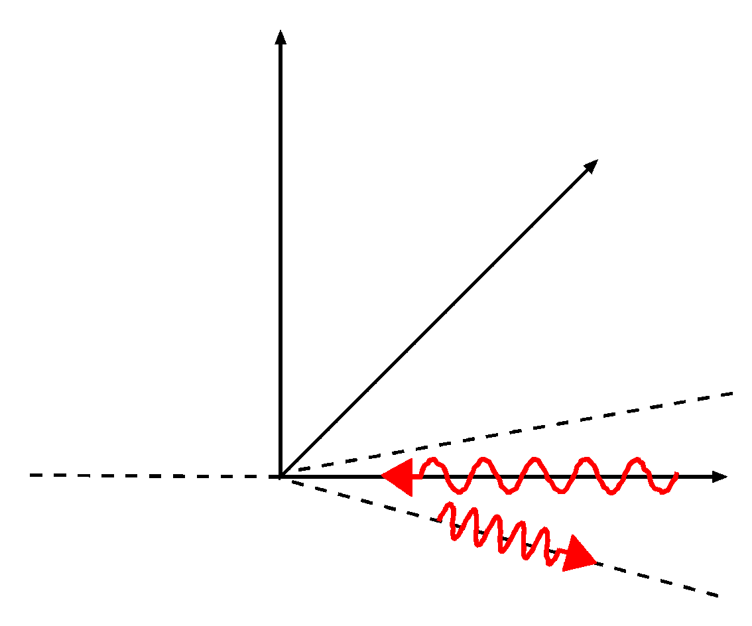
二、线站整体布局
MeV LCS gamma beam at SINAP
1.1 Laser Compton Scattering Gamma Source
Laser-Compton scattering
Bang!
Scattered electrons
Incident
Photons E_{l}
A. H. Compton
（1892-1962）
Incident electrons E_{e}
θ
Scattered photons
E_{γ}
Notes:
6
.

Slide 7
二、线站整体布局
MeV LCS gamma beam at SINAP
1.2 History of LCS Gamma Source
Project name | Ladon | Taladon | LEGS | LEGS-2 | Graal |  | ROKK-1M | LEPS |  | LEPS-2
Location | Frascati, Italy |  | Brookhaven, US |  | Grenoble, France |  | Novosibirsk,Russia | Harima, Japan
Storage ring | Adone | Adone | NSLS | NSLS | ESRF |  | VEPP-4M | SPring-8 |  | SPring-8
Scattering method | BCS | BCS | BCS | BCS | BCS |  | BCS | BCS |  | BCS
Energy defining method | Collimation | Internaltagging | Externaltagging | Externaltagging | Externaltagging |  | Collimation /Tagging | Internaltagging Tagging |  | Internaltagging Tagging
Electron energy (GeV) | 1.5 | 1.5 | 2.584 | 2.8 | 6.03 |  | 1.4- | 7.975 |  | 7.975
Electron current (A) | 0.1 | 0.1 | 0.3-0.35 | 0.3-0.35 | 0.2-0.5 |  | 0.1 | 0.1 |  | 0.1
Laser photon energy (eV) | 2.45 | 2.45 |  |  |  |  | 1.17-3.51
Laser Waveength(nm) |  |  | 333,351,364 | 302 | 514 | 333,351,364 |  | 355 | 266 | 355 | 266
Laser power(W) |  |  | 9 | 3 | 10 | 8 |  | 8 | 1 | 16 | 2
Gamma-ray energy (MeV) | 5-80 | 35-80 | 180-330 | 285-420 | 1100 | 1530 | 100-1600 | 1500-2400 | 1055-2900 | 1500-2400 | 1500-2900
Energy resolution (%) | 1.4-10 | 5 | 1.6 | 1.1 | 1.1 |  | 1-3 | 0.5 |  | 0.5
Energy spread (MeV) | 0.07-8 | 4-2 | 5 | 5 | 16
Gamma intensity (s⁻¹) | 10⁵ | 5*10⁵ | 4*10⁶ | 2*10⁶ | 2*10⁶ | 1-2*10⁶ | 2*10⁶ | 1-3*10⁶ | 1-3*10⁵ | >10⁷ | >10⁶
First year of operation | 1978-1993(closed) |  | 1987-2006(closed) |  | 1989-2008(closed) |  | 1993- | 1999- |  | 2013-
Project name |  |  |  | ETL-LCS |  |  |  |  |  |  |  | HIGS
Location | Harima, Japan |  |  | Japan |  |  |  |  |  | Japan |  | Durham, NC US
Storage ring | NewSUBARU |  |  | TERAS |  |  |  |  |  | UVAOR-II |  | Duke-SR
Scattering method | BCS |  |  | BCS |  |  |  |  |  | BCS | BCS | BCS
Energy defining method | Collimation |  |  | Collimation |  |  |  |  |  |  |  | Collimation
Electron energy (GeV) | 0.5-1.5 |  |  | 0.2-0.8 |  |  |  |  |  | 0.75 |  | 0.24-1.2
Electron current (A) | 0.3 |  |  | 0.4 |  |  |  |  |  | 0.35 |  | 0.01-0.1
Laser photon energy (eV) |  |  |  |  |  |  |  |  |  |  |  | 1.17-6.53
Laser Waveength(nm) | 1064 | 532 | 10540 | 1064 | 1053 | 532 | 527 | 551 | 263 |  | 800
Laser power(W) | 5 | 5 | 20 | 10 | 40 | 5 | 15 | 2 | 0.5 |  | 2
Gamma-ray energy (MeV) | 37.6 | 73 | 3.9 | 1.6-10 | 1.6-10 | 3-20 | 3-20 | 5-30 | 7-40 |  | 6.6 | 1-100(158)
Energy resolution (%) |  |  |  |  |  |  |  |  |  |  |  | 0.8-10
Energy spread (MeV) |  |  |  |  |  |  |  |  |  |  |  | 0.008-8.5
Gamma intensity (s⁻¹) | ~10⁶ | ~10⁶ | ~10⁶ | 10⁵ | 5*10⁵ | 5*10⁴ | 2*10⁵ | 10⁴ | 7*10³ |  | >10⁷ | 10⁶-3*10⁹
First year of operation | 2007- |  |  | 1985- |  |  |  |  |  | 2011- |  | 1996-
Typical LCS Gamma Source: storage ring + traditional Laser
New LCS Gamma Source: LINAC + High power laser (ELI-NP)
LINAC/ storage ring + FEL (HIγs-II)
Notes:
7
.

Slide 8
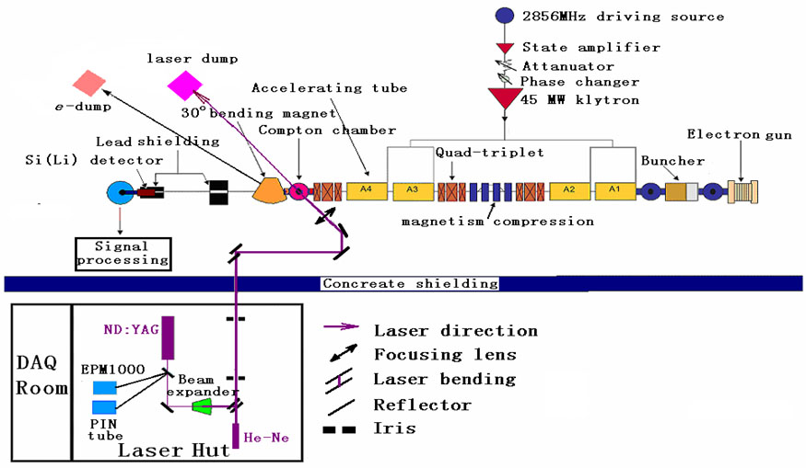
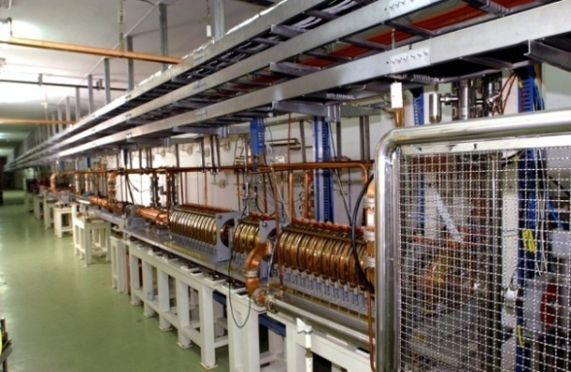
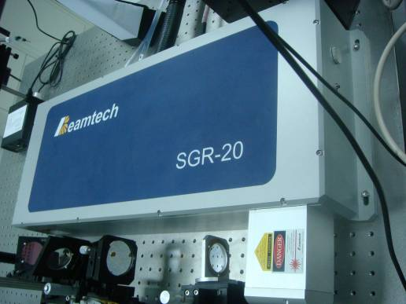
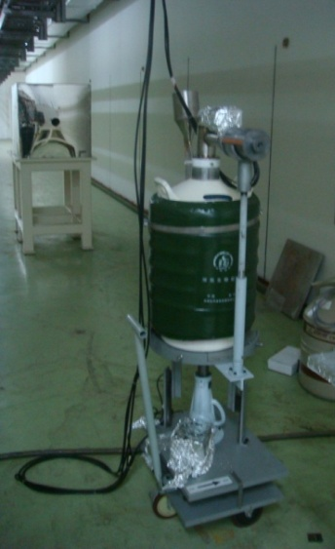
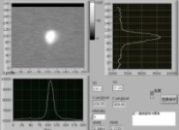
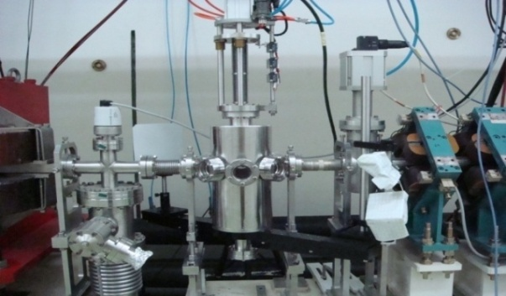
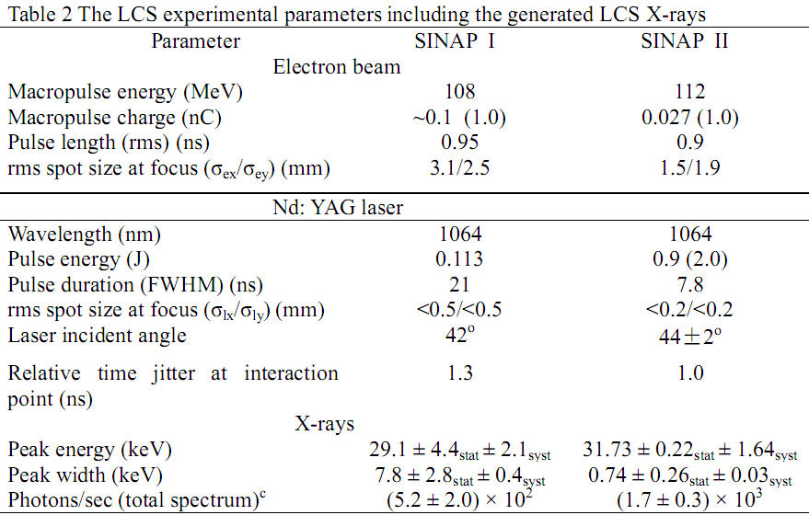
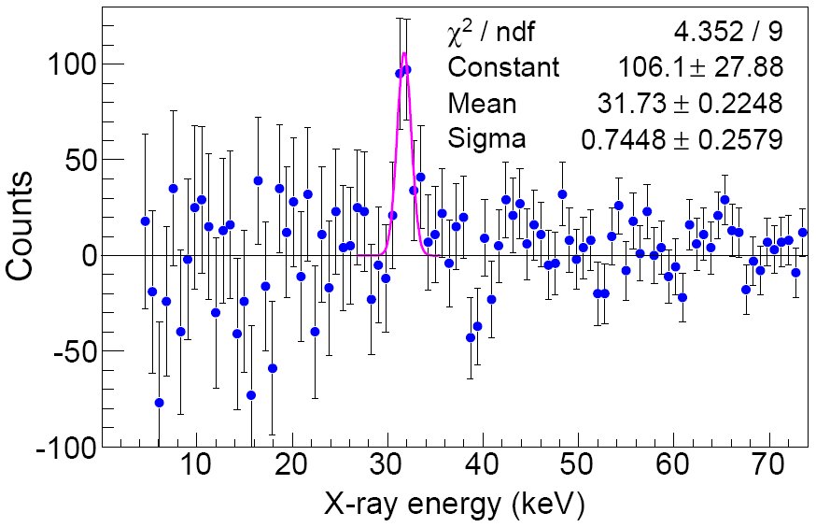
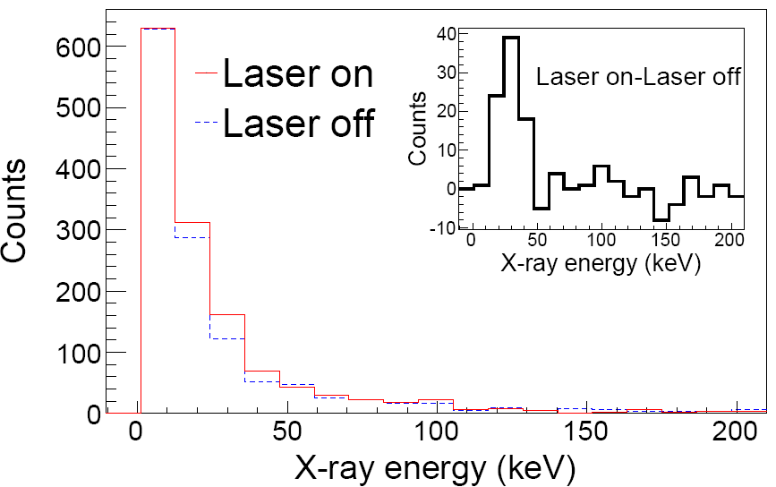
二、线站整体布局
LCS x-ray beam at SINAP
1.3 LCS x-ray Source @ Jiading Campus (Prototype for SLEGS)
[1] Nucl. Inst. And Meth. A, 624 (2010) 141；[2]Rev. of Sci. Inst., 81 (2010) 13304
Notes:
8
.

Slide 9
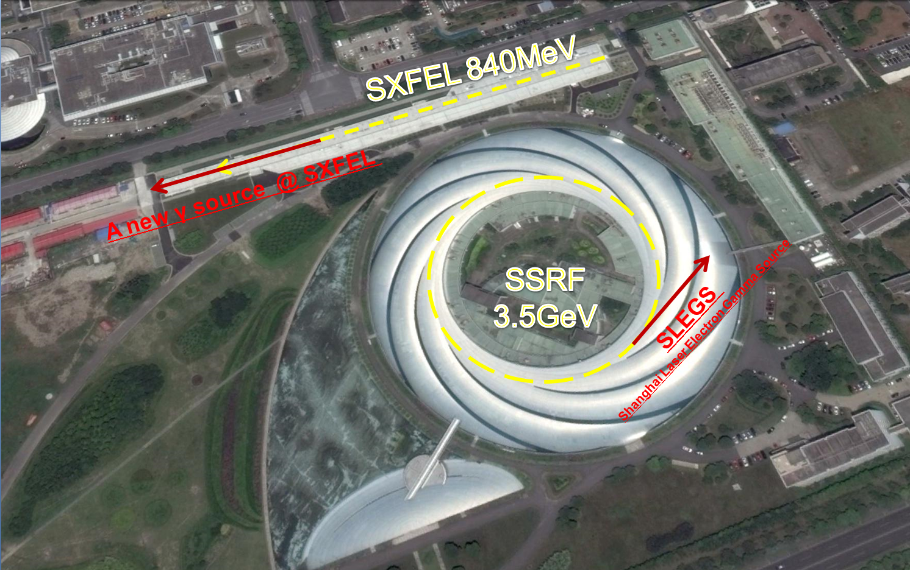
二、线站整体布局
MeV LCS gamma beam at SINAP
1.3 Two LCS Gamma Sources @ Zhangjiang Campus

Slide 10
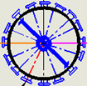



二、线站整体布局
SLEGS-Gamma source design
Operation modes
Gamma Source
Front End
Experiment Station
LCS Chamber
Dump
Mirror
Chanmber
Neutron Detector
BM
BM
Collimator
Target
Dump
n
Focusing Mirror
n
Charged particle
Detector
n
γ Detector
Electron Beam
Laser system &optical path
LCS Mode 1
Slanting Scattering
LCS Mode 2
Backward Scattering
Alternative mode
Reset
Notes:
10
10

Slide 11
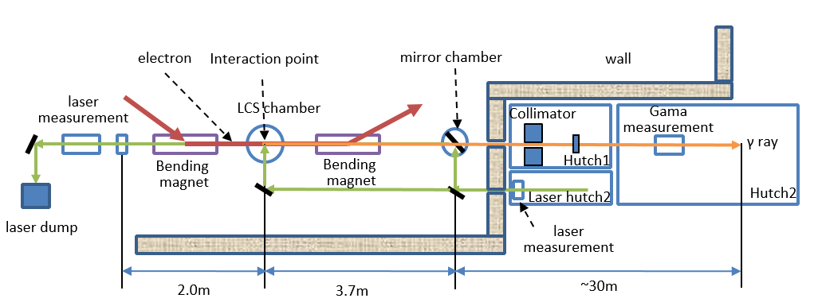
二、线站整体布局
SLEGS-Gamma source design
Layout
Light Source
Frant-End
Beamline
End station
(1) light source: Electron, Laser, LCS chamber (slanting mode), mirror chamber (back scattering).
(2) Front end of Beamline.
(3) Beamline:gamma collimator, absorber, bend magnet, gamma monitor, gamma dump.
(4) End station.

Slide 12
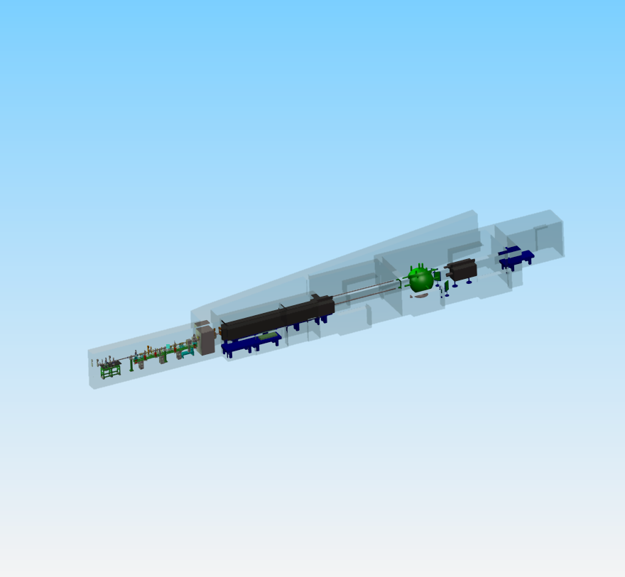
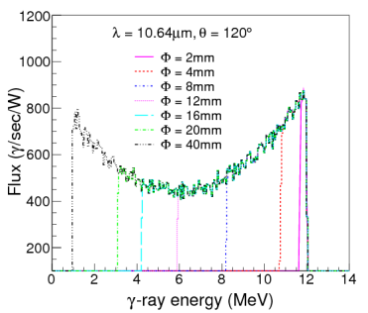
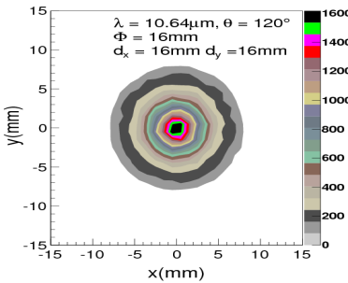
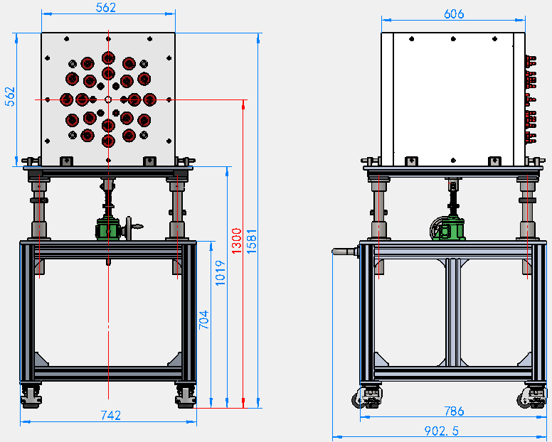
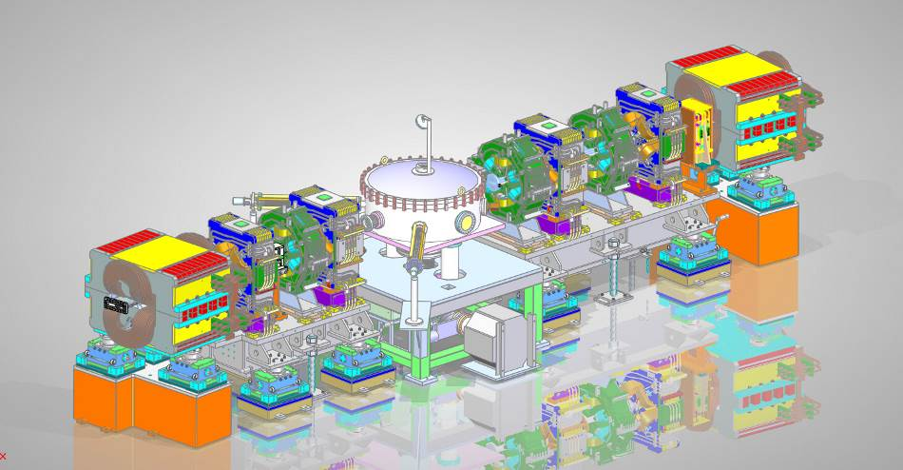
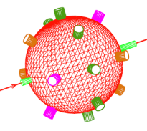
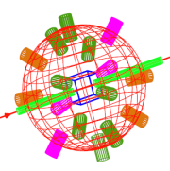
二、线站整体布局
MeV LCS gamma beams at SINAP
1.3 Shanghai Laser Electron Gamma Source @ SSRF (operates in 2021)
Energy range： 0.4-20.MeV; Energy resolution ：~5%; Divergence angle：0.5mrad;
Flux：10⁵ -10⁷ phs/s
End station
Beamline
Front-End
Light
Source
35m
4π Flat Coefficiency ³He propotional Tube Array
Laser
Interaction chamber
TPC and Neutron detector Array
Notes:
This schematic shows the layout of SLEGS
.The beam line consists of 3 subsystems: Gamma source at storage ring, Front end, and Beamline.

Slide 13
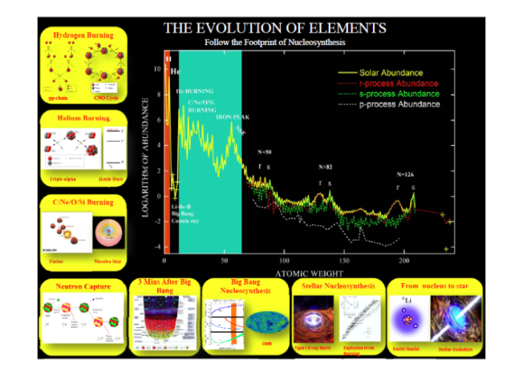
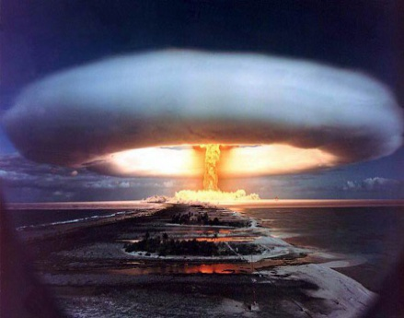
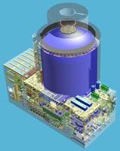
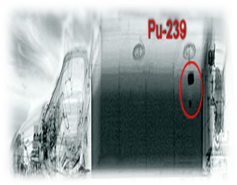
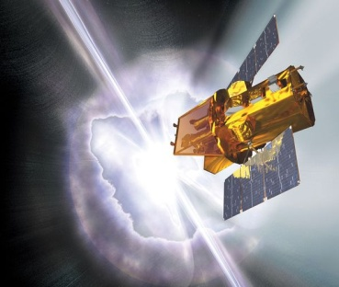
二、线站整体布局
MeV LCS gamma beams at SINAP
1.3 Shanghai Laser Electron Gamma Source @ SSRF (Operates in 2021)
Photo-nuclear physics:
  Nuclear Astrophysics：nuclear reactions which have a critical impact on stellar evolution and nucleosynthesis of elements
  Nuclear structure GDR and NRF, etc.
Research on the anti-γ radiation properties of aerospace device and
calibration for the X/γ detector equiped on aerospace device
Nuclear waste transmutation research and nuclear safety,
Gamma-ray imaging techniques (in particular: isotope imaging technology), etc.
Nuclear Astrophysics
光核物理（核天体物理）
Space (radiation hardened)
Nuclear technology and data
U-235
nuclear explosion
Nuclear reactor
Isotope Detection
[1] Design Report of SSRF Phase-II Beamlines-Shanghai Laser Electron Gamma Source(2016)

Slide 14
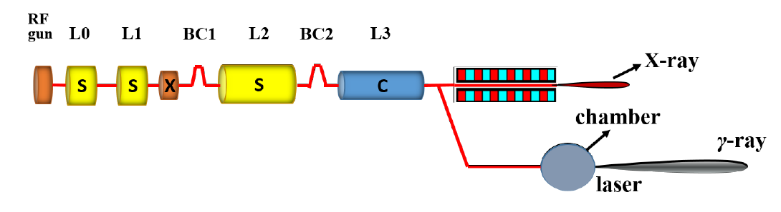
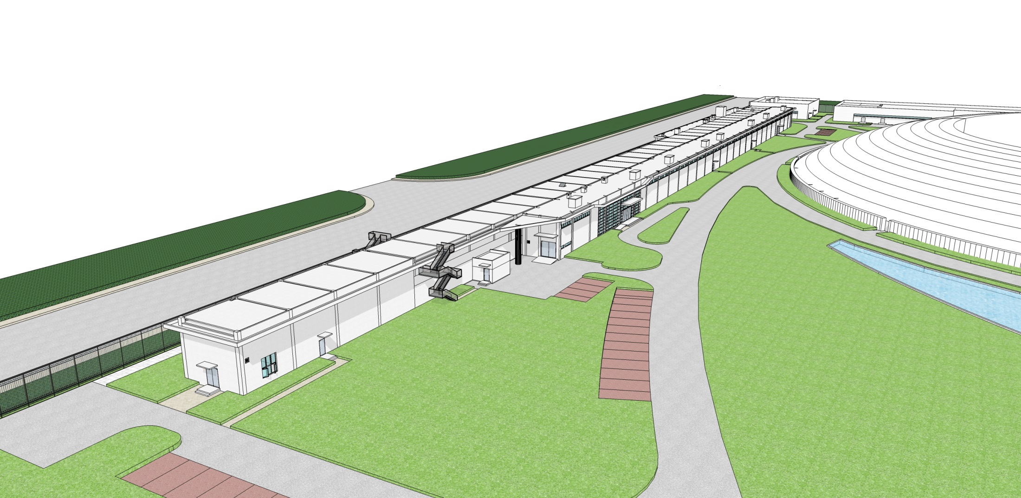
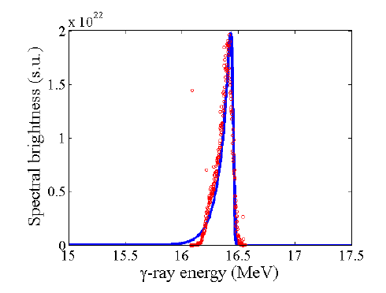
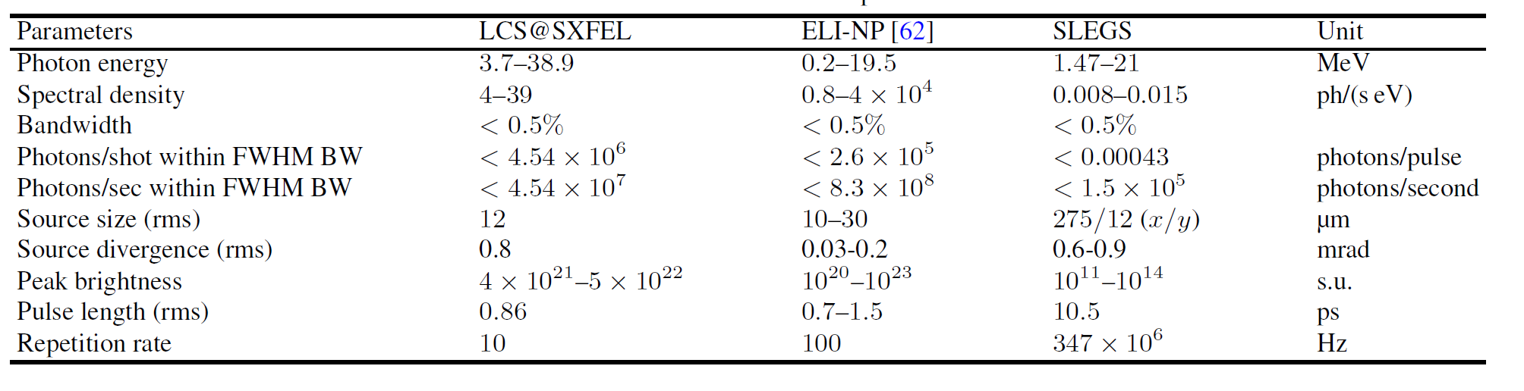
二、线站整体布局
MeV LCS gamma beams at SINAP
1.3 A new proposal for LCS Gamma Source similar to ELI-NP @ SXFEL
Schematic layout of the gamma source at SXFEL
Electron Energy：0.85GeV，Update to 1.3GeV
Laser ： 800 nm Ti: Sapphire
Gamma Energy： 3.7MeV ~ 38.9MeV
SSRF
SXFEL
Main parameters of the gamma source at SXFEL and ELI-NP
[1]Nuclear Science and Techniques, Vol.26(2015)050103

Slide 15
Part 2
GeV electron beam at SCLF

Slide 16
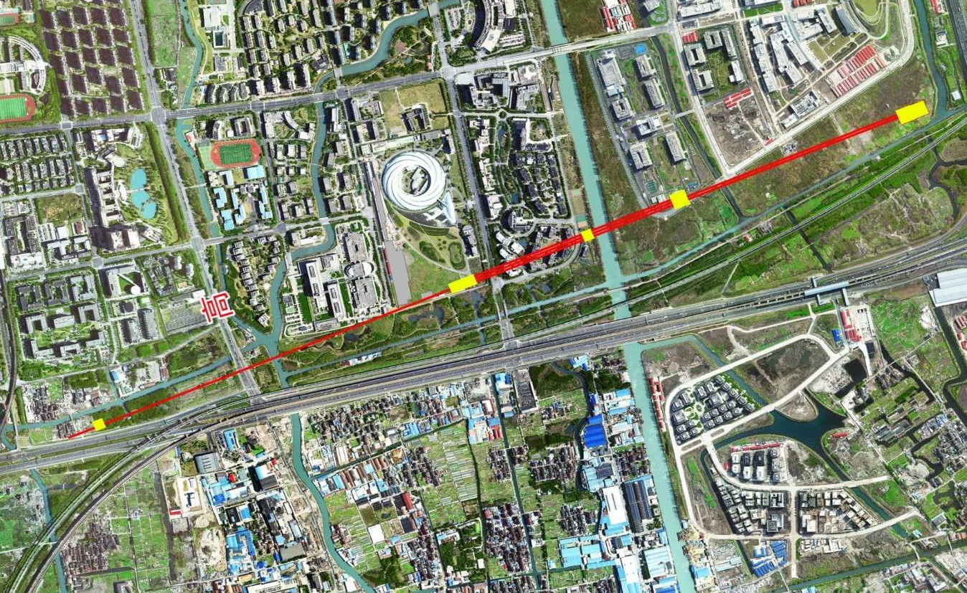
二、线站整体布局
GeV electron beam at SCLF
Layout of the SCLF
Length ~ 3.2km， Located underground 38m
Beam line
Experiment hall
Undulator and beam line
Main experiment hall
Injector
Main accelerator
E
N
S
W

Slide 17
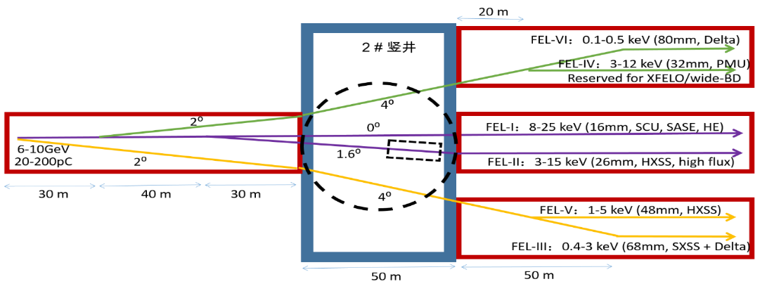
二、线站整体布局
GeV electron beam at SCLF
Layout of the SCLF
[1]Proposal of Shanghai Coherent Light Facility (SCLF- Hard X-ray FEL) ,2016.11

Slide 18
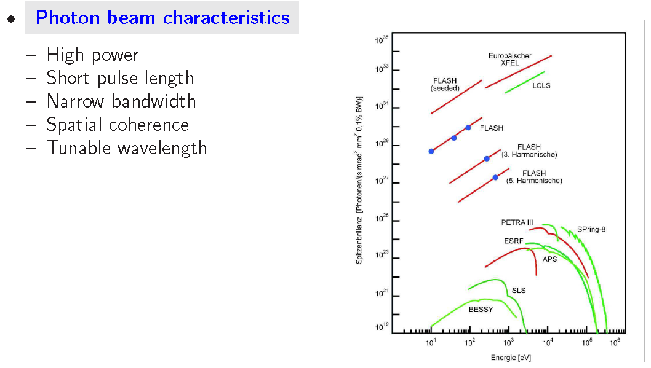
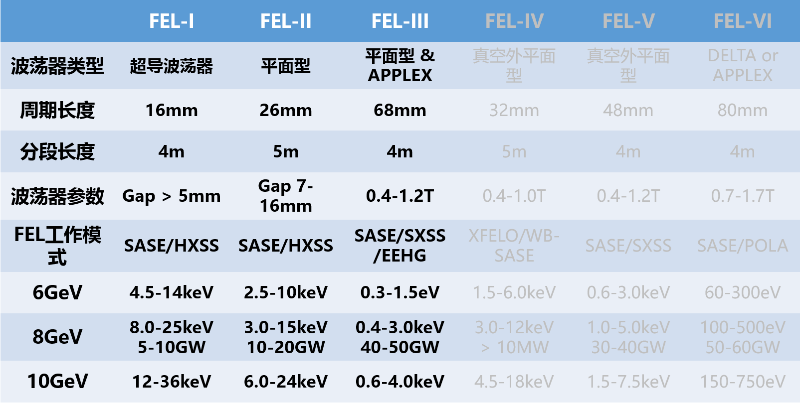
二、线站整体布局
GeV electron beam at SCLF
Characters of SCLF
[1] Proposal of Shanghai Coherent Light Facility (SCLF- Hard X-ray FEL) ,2016.11

Slide 19
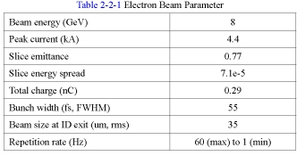
二、线站整体布局
GeV electron beam at SCLF
Electron beam parameters of SCLF
Parameter | Values
Electron Energy(GeV) | 8
charge per pulse(pC) | 20-200
Norlimalize Perpendicularslice eiitance (mm·mrad) | ≤0.4
Peak current(A) | ≥3000
Slice energy spread（rms） | <0.01%
Pulse duration（ps） | 0.7
Frequency (MHz) | 1
Beam bunch diameter (um) | 50
Energy dispersion | 0.01%
The last four parameters be used to Laser Compton Gamma source calculation based on the Monte Carlo Code developed by our group.
Compare with SACLA Japan
[1] Design Report of Shanghai Coherent Light Facility (SCLF- Hard X-ray FEL) ,2016.11.
[2] Nuclear Instruments and Methods in Physics Research A, Vol.726 (2013)67.

Slide 20
Part 3
GeV photon beam at SCLF (Proposed)

Slide 21
二、线站整体布局
GeV photon beam at SCLF
Calculation based on the Different Lasers
Laser wavelength um/nm | Type | Power /W | Duration fs/ps | Frequency /Hz | Single Pulse /J | Gamma Energy /MeV | Gamma flus photons/s/W
10.64um | CW | 1 |  |  |  | 112.7 | 7.59×10⁶
1.64um | CW | 1 |  |  |  | 999.8 | 9.49×10⁵
800nm | Pulse |  | 50fs | 10Hz | 5J | 1277.4 | 1.04×10¹⁰
355nm | CW | 1 |  |  |  | 2397.8 | 2.75×10⁵
266nm | CW | 1 |  |  |  | 2908.0 | 1.79×10⁵
0.1keV@FEL | FEL |  | 0.7ps | 1MHz |  | 7398.6 | 1.04×10⁸
1.0keV@FEL | FEL |  | 0.7ps | 1MHz |  | 7937.8 | 1.97×10⁷
CW： Continue Wave mode
Pul； Pulse beam
Preliminary calculation
（a）Use optical Laser，we can get 0.11-2.9GeV gamma ray，and gamma fluxs per Watt from 10⁵ ⁻ 10¹⁰ phs/s/W。
（b）Use X-ray FEL, we can get ~ 8GeV high energy Gamma ray，and integral gamma fluxs per pulse 10⁷ -10⁸ phs/s/pulse。

Slide 22
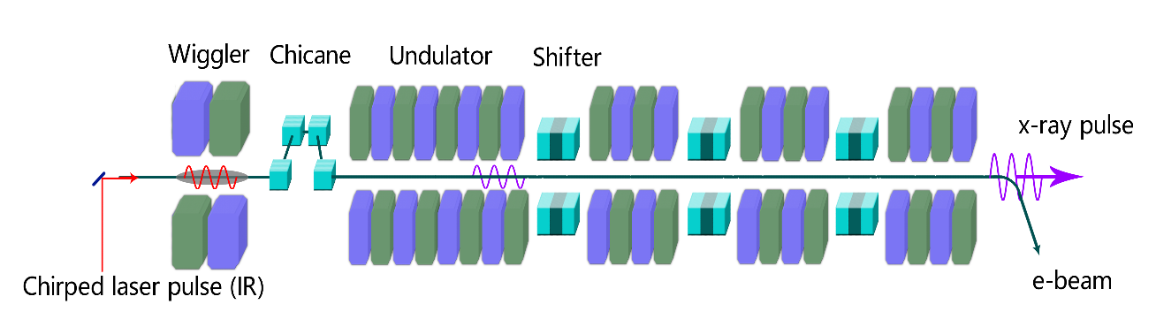
二、线站整体布局
GeV photon beam at SCLF
Mode I: External laser + Electron
External laser
Gamma ray
Laser wavelength um/nm | Type | Power /W | Duration fs/ps | Frequency /Hz | Single Pulse /J | Gamma Energy /MeV | Gamma flus photons/s/W
10.64um | CW | 1 |  |  |  | 112.7 | 7.59×10⁶
1.64um | CW | 1 |  |  |  | 999.8 | 9.49×10⁵
800nm | Pulse |  | 50fs | 10Hz | 5J | 1277.4 | 1.04×10¹⁰
355nm | CW | 1 |  |  |  | 2397.8 | 2.75×10⁵
266nm | CW | 1 |  |  |  | 2908.0 | 1.79×10⁵
0.1keV@FEL | FEL |  | 0.7ps | 1MHz |  | 7398.6 | 1.04×10⁸
1.0keV@FEL | FEL |  | 0.7ps | 1MHz |  | 7937.8 | 1.97×10⁷

Slide 23
二、线站整体布局
GeV photon beam at SCLF
Mode II: X-ray from SCLF + Electron
Gamma ray
Bragg Mirror
Laser wavelength um/nm | Type | Power /W | Duration fs/ps | Frequency /Hz | Single Pulse /J | Gamma Energy /MeV | Gamma flus photons/s/W
10.64um | CW | 1 |  |  |  | 112.7 | 7.59×10⁶
1.64um | CW | 1 |  |  |  | 999.8 | 9.49×10⁵
800nm | Puls |  | 50fs | 10Hz | 5J | 1277.4 | 1.04×10¹⁰
355nm | CW | 1 |  |  |  | 2397.8 | 2.75×10⁵
266nm | CW | 1 |  |  |  | 2908.0 | 1.79×10⁵
0.1keV@FEL | FEL |  | 0.7ps | 1MHz |  | 7398.6 | 1.04×10⁸
1.0keV@FEL | FEL |  | 0.7ps | 1MHz |  | 7937.8 | 1.97×10⁷

Slide 24
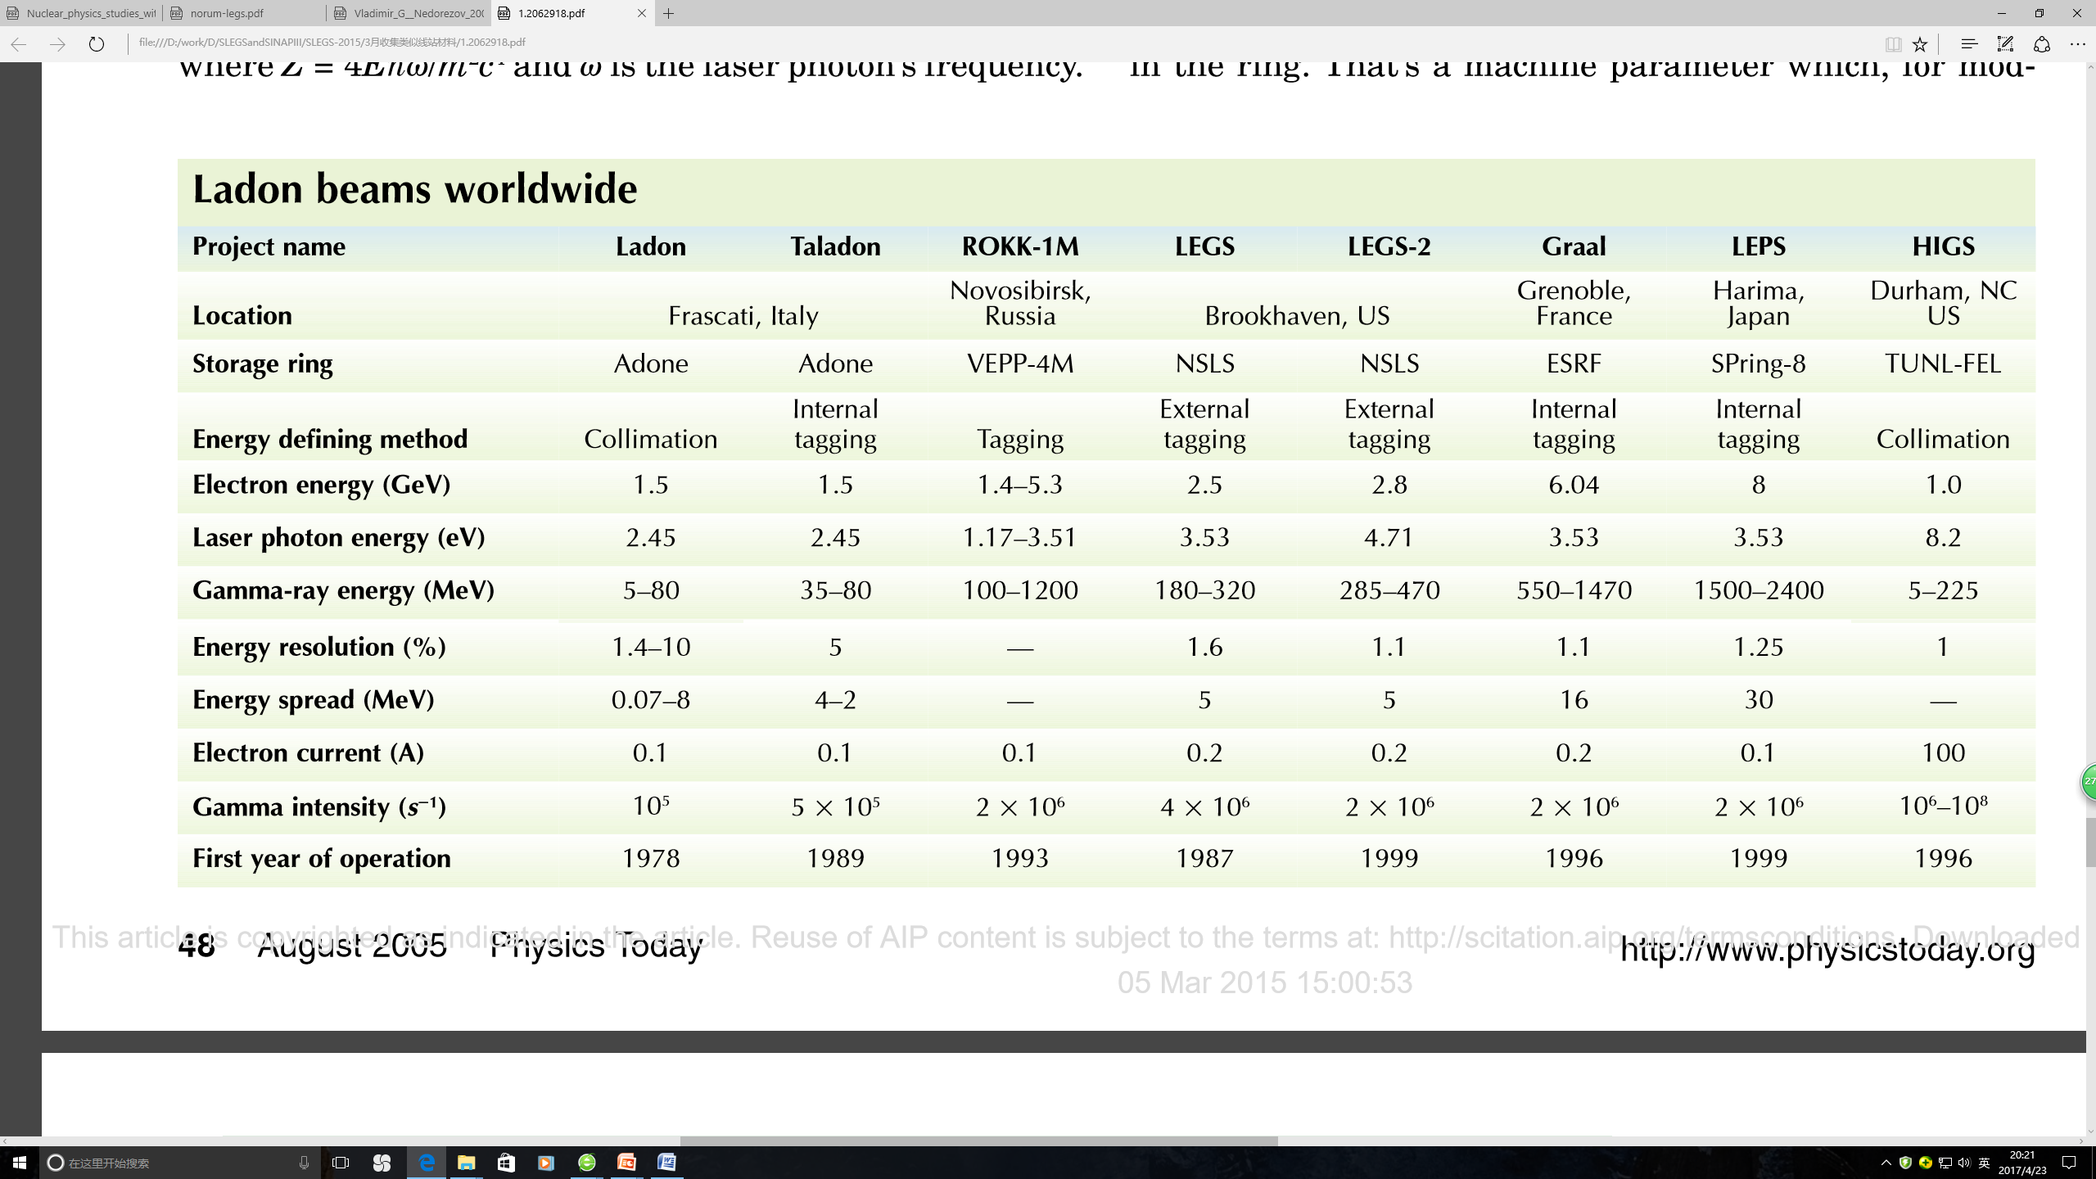
二、线站整体布局
GeV photon beam at SCLF
Reference GeV gamma sources
[1] Physics Today 58 (2005) 44

Slide 25
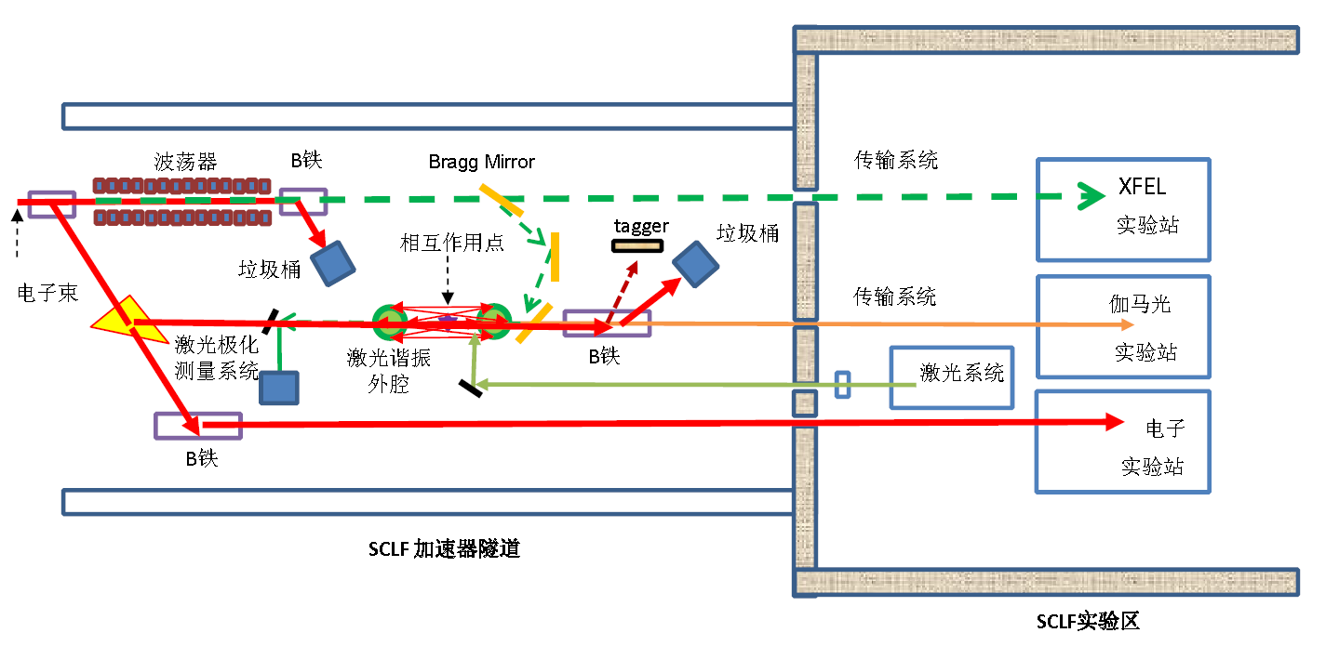
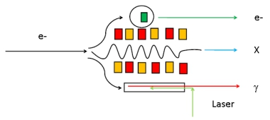
二、线站整体布局
GeV photon beam at SCLF
What can we use in SCLF station?
SCLF station can serve us the 8GeV electron and tunable max 25keV hard X-ray and 0.1-8 GeV Tunable Gamma Source.
Based on these beams, we can develop electron scattering， hard X-ray physics and photo-nuclear reaction research and many applied physics studies.
Fig1-2 The proposed beam station of SCLF (in Future)

Slide 26
Part 4
PW laser beams at SULF and SCLF-SEL

Slide 27
Shanghai Super intense Ultra fast Laser Facility (SULF)
Main Parameter：10PW, 30fs, 800nm；
Max intensity: 10²² w/cm²；
Frequency: (1-10Hz) 0.1PW & 1PW
Construction Time： 2016.1-2017.12
Particle Beam ：
Electron：<20MeV，10¹² e-/shot，<100ps
Proton：< 0.1GeV, 10¹⁰ proton/shot, < 100as, >1keV.
Gamma：> 0.5MeV，10¹⁰ gamma/shot, <100ps.
Neutron：< 20MeV，> 10⁹ neutron/shot
Positron：1MeV-50Mev，< 10⁶ e+/shot
Ruxin Li, Yuxin Leng et al., Recent Progress on the 10PW laser Project at SIOM,
IZEST 3 , LLNL, USA, 17-18 July 2013

Slide 28
Shanghai Coherent Light Facility-
Station of Extreme Light（SCLF-SEL）

Slide 29
Part 5
Nuclear Physics and Related Research

Slide 30
二、线站整体布局
Nuclear Physics and Related Research
High energy electron scattering experiment
Hard X-Ray physics
（2.1）High energy density plasma physics
（2.2）non-linear, undisturb QED
（2.3）Hard X-Ray Photonics
（2.4）Nuclear Excitation by Electron Transition/Capture (NEET/NEEC)
Physics based on Laser Compton Gamma Source
（3.1）Particle Physcis
（3.2）Nuclear Physis
（3.3）Nuclear Astrophysics
（3.4）Nuclear Photonics
New Gamma Source based on the Hard X-Ray
Laser Driven Nuclear Physcis on high-power Laser

Slide 31
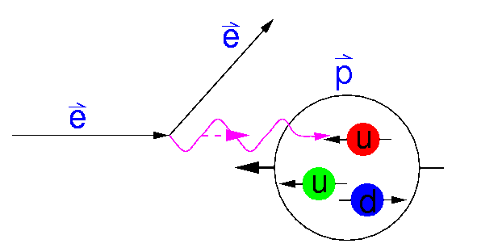
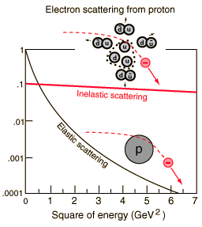
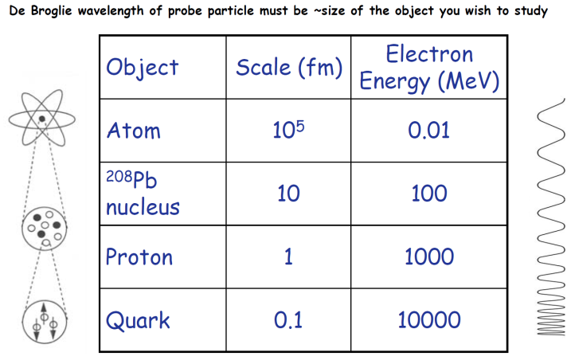
二、线站整体布局
Nuclear Physics and Related Research
High energy electron scattering experiment
The electron is a probe which is uniquely well suited to reveal many aspects of nuclear structure.
The general theory of its interaction with the constituents of the nucleus via the electromagnetic field is well understood.
Fig 1.1-1 Electron scater process in Proton
Surface modes: Giant resonances
Nuclear constituents: protons and neutrons – momentum distributions
Sub-nucleonic degrees of freedom: effective field theories
Nucleon substructure: quarks, gluons and QCD.
[1]Ingo Sick,Elastic electron scattering from light nuclei,arXiv:nucl-ex/0208009v1 14 Aug 2002
[2] Kyle Foster,Electron Scattering: Form Factors and Nuclear Shapes,November 16, 2011
[3] H.K,Nuclear Instruments and Methods in Physics Research A 507 (2003) 582–586
[4] A. Ringwald，Pair production from vacuum at the focus of an X-ray free electron laser，Physics Letters B 510 (2001) 107–116
[5] Daniel Watts, University of Edinburgh UK Nuclear Physics summer school Chester, September 2005

Slide 32
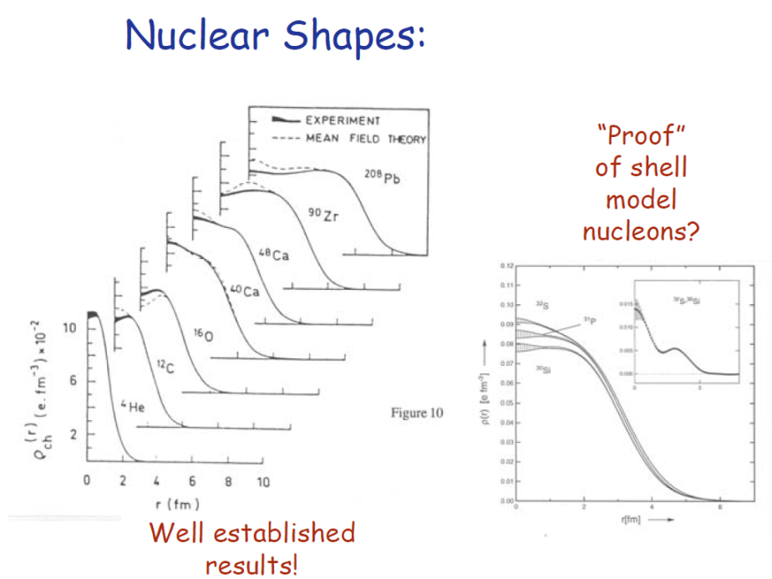
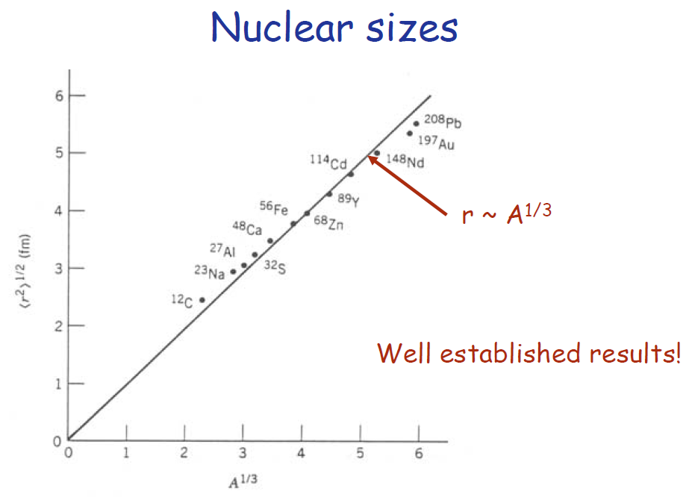
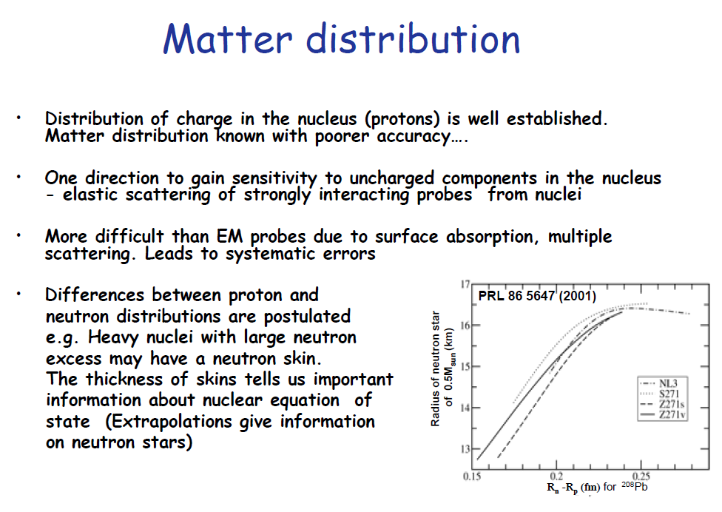
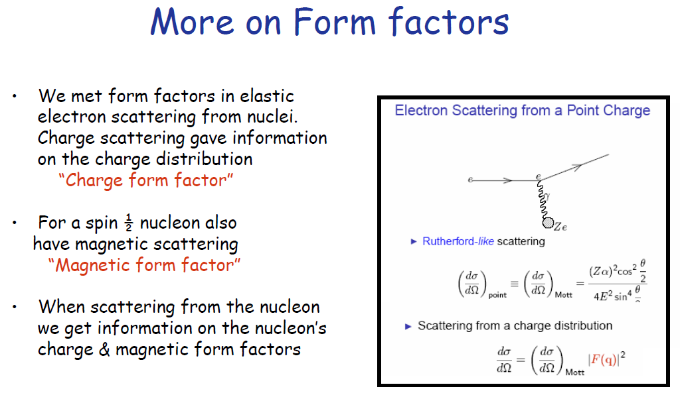
二、线站整体布局
Nuclear Physics and Related Research
High energy electron scattering experiment
[1] Daniel Watts, University of Edinburgh UK Nuclear Physics summer school Chester, September 2005

Slide 33
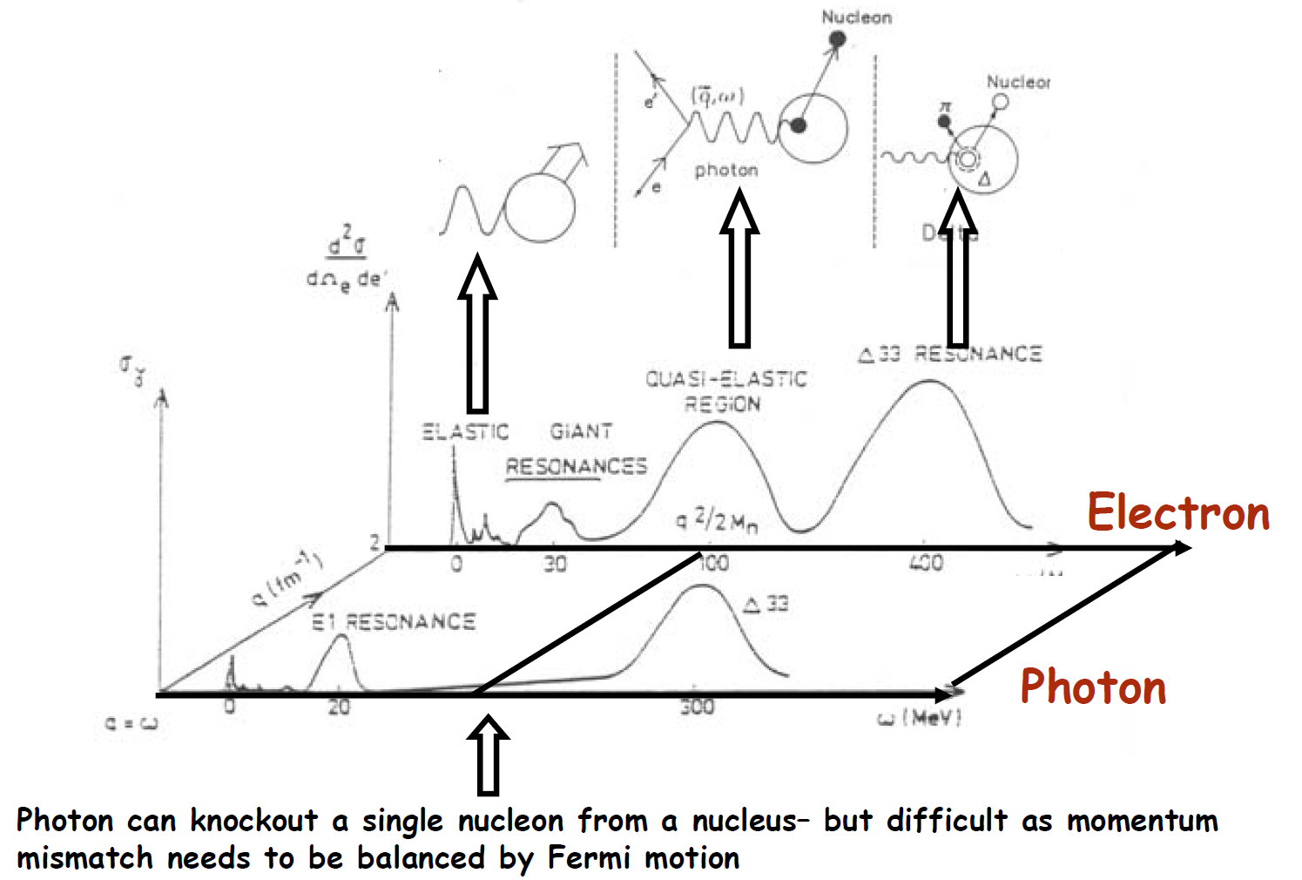
二、线站整体布局
Nuclear Physics and Related Research
Physics based Laser Compton Gamma Source
[1] Daniel Watts, University of Edinburgh UK Nuclear Physics summer school Chester, September 2005

Slide 34

二、线站整体布局
Nuclear Physics and Related Research
Physics based on Laser Compton Gamma Source
3.1 Particle Physics (several hundred MeV - GeV)
Fig 3.1-1 Pion production in particle Physics
Nucleon forces
Nucleon form factors, Missing resonances, magnetic moments of nucleon resonances
Nucleon substructure: quarks, gluons and QCD.
QCD exotica

Slide 35

二、线站整体布局
Nuclear Physics and Related Research
Physics based on Laser Compton Gamma Source
3.1 Particle Physcis-Nucleon forces
[1] Daniel Watts, University of Edinburgh UK Nuclear Physics summer school Chester, September 2005

Slide 36

二、线站整体布局
Nuclear Physics and Related Research
Physics based on Laser Compton Gamma Source
3.1 Particle Physcis-modification of particles by the nuclear medium
[1] Daniel Watts, University of Edinburgh UK Nuclear Physics summer school Chester, September 2005

Slide 37

二、线站整体布局
Nuclear Physics and Related Research
Physics based on Laser Compton Gamma Source
3.1 Particle Physcis-nucleon excited states
[1] Daniel Watts, University of Edinburgh UK Nuclear Physics summer school Chester, September 2005

Slide 38



3.2 Nuclear Physics (under several hundred MeV)
二、线站整体布局
Nuclear Physics and Related Research
Physics based on Laser Compton Gamma Source
Basic symmetry and properties of nuclei A ≤ 2;
Photodisintegration involving low-energy few-body (A≤ 4) nuclei
Photoreaction involving finite nuclei (mediate A, ~ 13~15)
Multi-body (large A,~ 206) nuclear systems research
PDR,GDR and nuclear cluster study

Slide 39





Slide 40


3-body decay: hyperangle,hyperradius

Slide 41





Slide 42






proton-proton momentum correlation
@16O(gamma,14C)pp decay
Preliminary results
pp HBT: (large) tetrahadron → Square → Kite → Chain (small) ++> source size becomes larger @ Chain 4-alpha structure!
pp HBT: (large) 70MeV → 80 → 90 → 100 → 110MeV (small) ++> > source size becomes larger @ higher E_gamma!

Slide 43






12C(gamma,10Be)p+p
Preliminary results
pp HBT: (large) triangle→ Chain (small) ++> source size becomes larger @ Chain 3-alpha structure!
pp HBT: (large) 80 → 90 → 100 → 110→120 MeV (small) ++> > source size becomes larger @ higher E_gamma!

Slide 44


3.3 Nuclear Astrophysics
二、线站整体布局
Nuclear Physics and Related Research
Physics based on Laser Compton Gamma Source
For example,p-nuclei and s-,r-,p-process...
The γ process scenario suffers from a strong underproduction of the most abundant p isotopes, ^{92,94}Mo and ^{96,98}Ru, due to lack of seed nuclei with A >90.
For these missing abundances, alternative processes and sites have been proposed, for example, νp process,rp process,ν process...
Using strong neutrino fluxes in the deepest ejected layers of a SNII (ν p process).
Rapid proton-captures in proton-rich, hot matter accreted on the surface of a neutron star (rp process).
A few p nuclides may also be produced by neutrino-induced reactions during the γ -process(ν process).
This ν process was additionally introduced because the γ process alone strongly underproduces the odd-odd isotopes ¹³⁸La and ^{180m}Ta.
While the reaction rate ^{A}X(γ,n)^{A-1}X can be determined by bremsstrahlung , the reaction ^{A+1}X(γ,n)^{A}X has to be measured via its inverse (n,γ) rate.
[1] Eur. Phys. J. A 27(2006)129-134

Slide 45

3.4 Nuclear Photonics
二、线站整体布局
Nuclear Physics and Related Research
Physics based on Laser Compton Gamma Source
Nuclear structure
• Modes of excitation below the GDR
Impact on nucleosynthesis
• Gamow window for photo–induced reactions in explosive stellar events
Understanding exotic nuclei
• E1 strength will be shifted to lower energies in neutron rich system
Potential NRF applications：
Detection of radioactive isotopes
Nondestructive assay of plutonium and minor actinide in spent fuel
Detecting clandestine material
Nuclear waste imaging and assay
[1] NIMA 621 (2010) 695-700; Applied Physics Express 2 (2009) 036502

Slide 46


二、线站整体布局
Nuclear Physics and Related Research
New Gamma Source based on the Hard X-Ray
Spring-8：
BCS using laser (infrared to ultra-violet) established with successful results, but extension of the maximum photon energy of γ-ray opens new fields of the photo production experiments of nuclear and particle physics
Proposed BCS using X-ray undulator radiation and Bragg reflection of single crystal to produce quasi-monochromatic GeV γ-ray.
[1] H. Ohkuma，Construction Experience of LEPS and LEPS2 and X-ray Compton Scattering at SPring-8,LCS@Saskatoon 2014.11, ppt report

Slide 47


二、线站整体布局
Nuclear Physics and Related Research
New Gamma Source based on the Hard X-Ray
Narrow-band GeV photons generated from an x-ray
free-electron laser oscillator (XFELO)
Proposed a narrow-band GeV photon source utilizing an XFEL oscillator.
Based on a 7-GeV electron beam operated at 3-MHz repetition, 7-GeV γ-ray photons are produced with extremely narrow bandwidth, ∼0.1%(FWHM), and a high spectral density, ∼10² ph/MeV/s.
The energy of γ-ray is tunable by varying the electron beam energy asfar as XFELO is lasing.
A circularly polarized γ-ray beam can be generated in XFELO-γ with a spin-polarized electron beam.
[1] Ryoichi Hajima, Status and perspectives of Compton sources, International Conference “Synchrotron and Free electron laser Radiation: generation andapplication”, SFR-2016, 4-8 July 2016, Novosibirsk, Russia,Physics Procedia 84 ( 2016) 35 – 39
[2] Ryoichi Hajima, Mamoru Fujiwara, Narrow-band GeV photons generated from an x-ray free-electron laser oscillator,PHYSICAL REVIEW ACCELERATORS AND BEAMS 19, 020702 (2016)

Slide 48





二、线站整体布局
Nuclear Physics and Related Research
Laser Driven Nuclear Physics Based On SULF & SCLF-SEL
Physics Case：
5.1 Nuclear fusion reactions from Laser-accelerated
fissile ion beams
5.2 Nuclear (De-)excitation induced by lasers
5.3 Nuclear reactions in Laser plasmas
5.4 Nuclear producction and other Applications
Daido H et al. Rep. Prog. Phys.，2012，75：056401
Romanian Reports in Physics, Vol. 68, Supplement, 2016

Slide 49
二、线站整体布局
Summary
Compton sources, photon sources based on Compton scattering, have been developed in the world to realize high-flux/high-brightness X-ray/gamma-ray sources and exploit applications with energy-tunable and narrow-bandwidth photon beams from these sources.
Recent progress of electron accelerator and laser technologies will open a new era in Compton sources. An electron beam of small emittance and high-average current contributes to improving spectral brightness of Compton scattered photons. Flux of generating photons is also increased by a high-power laser together with apparatus such as laser enhancement cavity.
New nuclear physics research opportunites based on the SCLF and Shanghai Ultra fast laser facility in Shanghai。
A new opportunity for a high energy, High flux and short pulse gamma source production, and new physics opportunites used High energy Electron and X-Ray based SCLF facility!
Electron Facility @SINAP | Laser be used | Gamma Energy | Physics | LCS Status
SSRF，3.5GeV | CO₂, 10.64um，CW | 0.4-20MeV | Nuclear Physics and Astrophysics, Medicine Application... | In construction
SXFEL， 0.85-1.6GeV | 100TW， 800nm，~50fs | 3.7-38.9MeV | Nuclear Physics and Astrophysics,Position production, Application... | Plan
HXFEL， 8GeV | Optical laser & FEL X-Ray | 100-8000MeV | Particle Physics, Nuclear physics and Astrophysics... | Proposal

Slide 50
Thanks for your attentation
Comments and Questions Welcome

