Slide 1

Progress of GEM R&D in Lanzhou University
Hui-Yin Wu(吴会寅)

Slide 2

Outline
Time properties of GEM-detector signal
Position correction
R&D of GEM-DAQ
Future plan
Jul. 27, 2017 Progress of GEM R&D in LZU 2

Slide 3
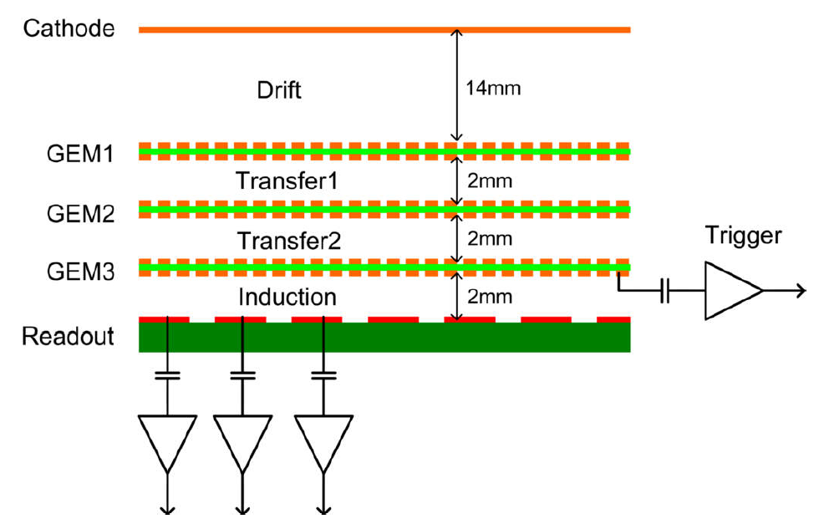
Time properties of GEM-detector signal
A typical GEM detector: Cathode; Drift region; GEM foils; Induction region; Readout PCB
Point of incidence
Cathode
+
+
+
+
+
+
Point of incidence
Center of gravity
+
+
+
+
+
Work Gas
+
+
+
α
+
+
+
+
Readout PCB
ΔX
Jul. 27, 2017 Progress of GEM R&D in LZU 3

Slide 4
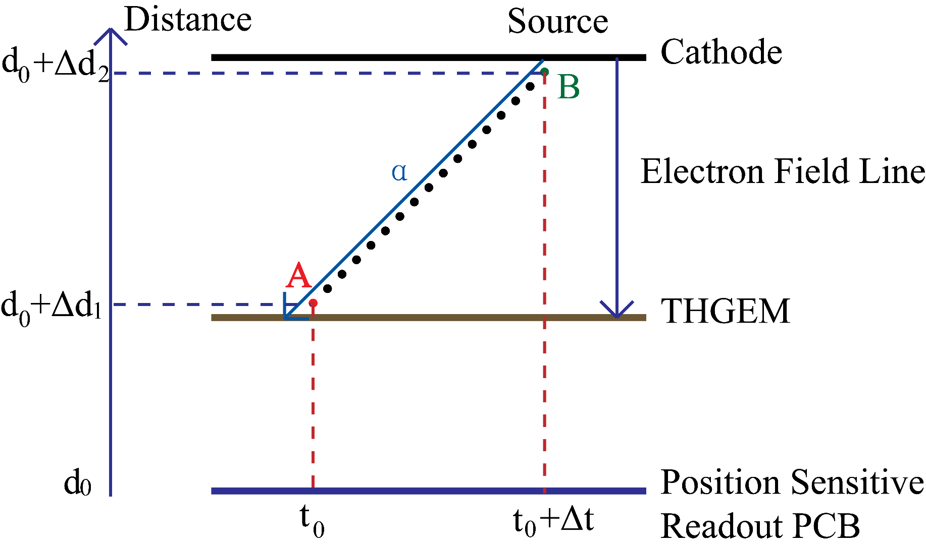
Time properties of GEM-detector signal
The velocity of Alpha (~7mm/ns) is much larger than the drift velocity of electron(~0.05mm/ns)
Jul. 27, 2017 Progress of GEM R&D in LZU 4

Slide 5
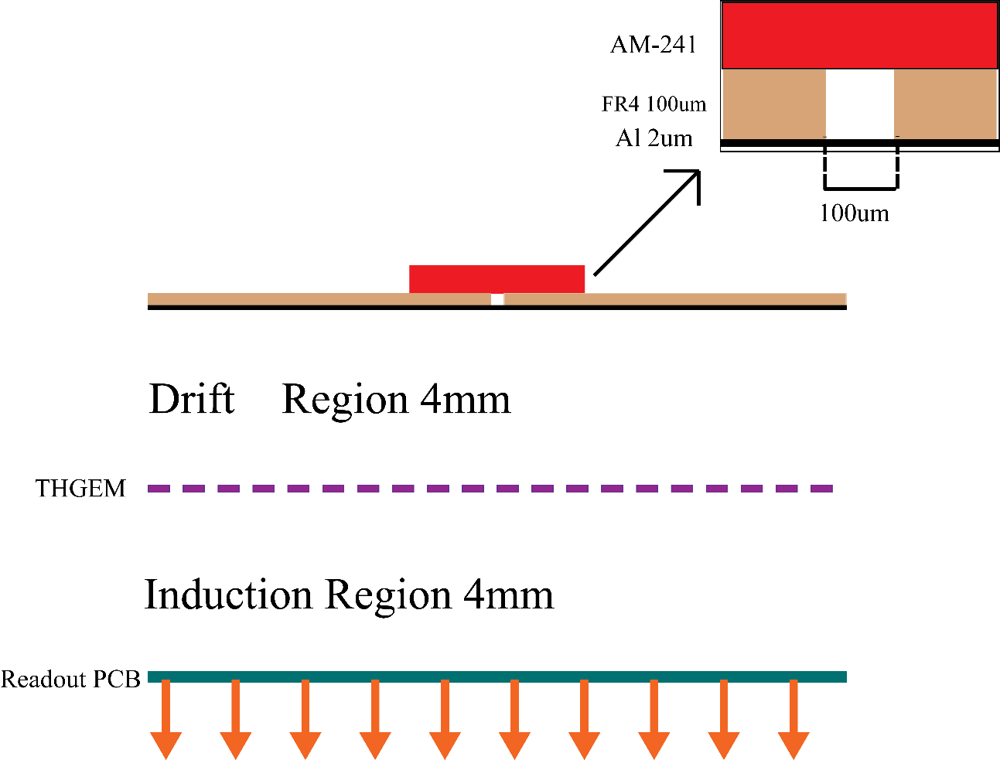
Position correction
45°
100um thick FR4 can completely block Alpha particle.
Alpha particle can incident at 45° at most.
Cathode is made of a 2um Aluminized Mylar foil reducing to block Alpha particle energy.
Jul. 27, 2017 Progress of GEM R&D in LZU 5

Slide 6
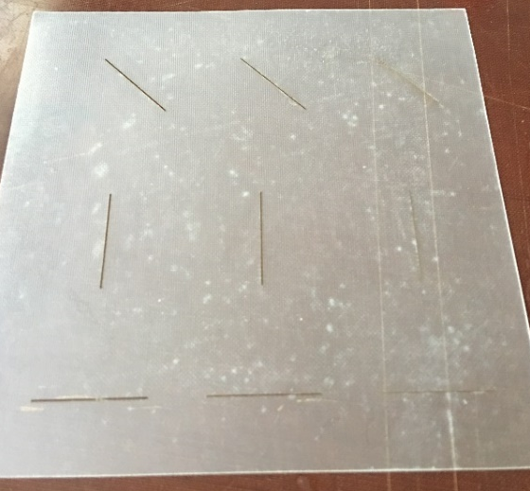
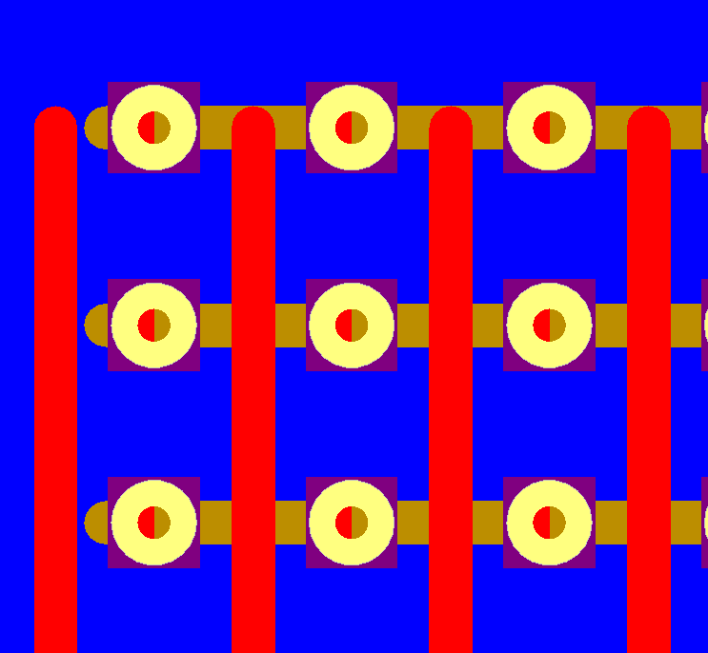
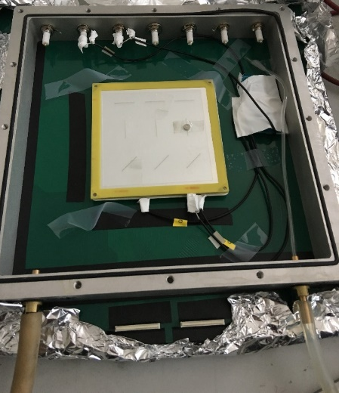
Position correction
APV25 chip with 25ns sample period
Slit
Strip readout with pitch of 600 um
Detector
THGEM foil: a thickness of 200 um, pitch of 600 um, a hole diameter of 200 um, and a rim of 80 um
Jul. 27, 2017 Progress of GEM R&D in LZU 6

Slide 7
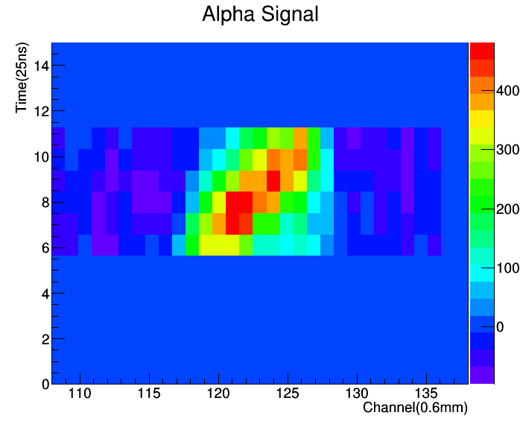
Position correction
A typical Alpha signal with 6 samples(maximum number of samples：MPD) The center of gravity shift to the right along with time increase.
Jul. 27, 2017 Progress of GEM R&D in LZU 7

Slide 8
Position correction
…
α
6th sample
5th sample
4th sample
3rd sample
+
+
2nd sample
+
+
1st sample
+
+
L₁/L₂=S₁/S₂=A
L₁
S₁
L₂
Similar triangle problem
S₂
Jul. 27, 2017 Progress of GEM R&D in LZU 8

Slide 9
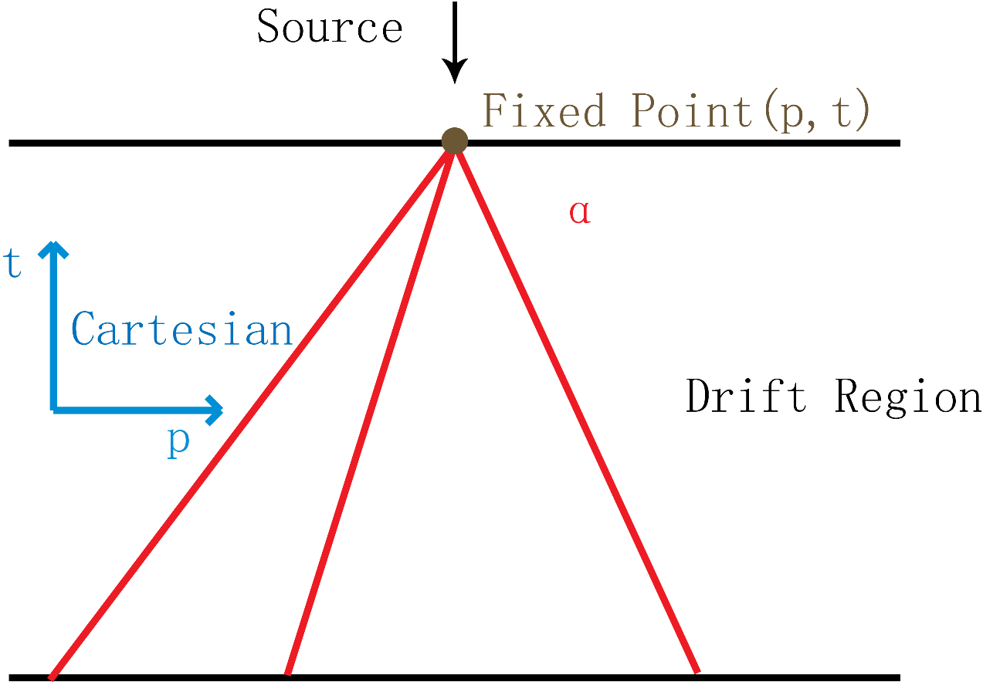
Position correction
Y=a*X+ b (1)
Each event go
through (p, t)
t=a*p + b (2)
a and b represent the linear fitting parameters for each track.
Jul. 27, 2017 Progress of GEM R&D in LZU 9

Slide 10
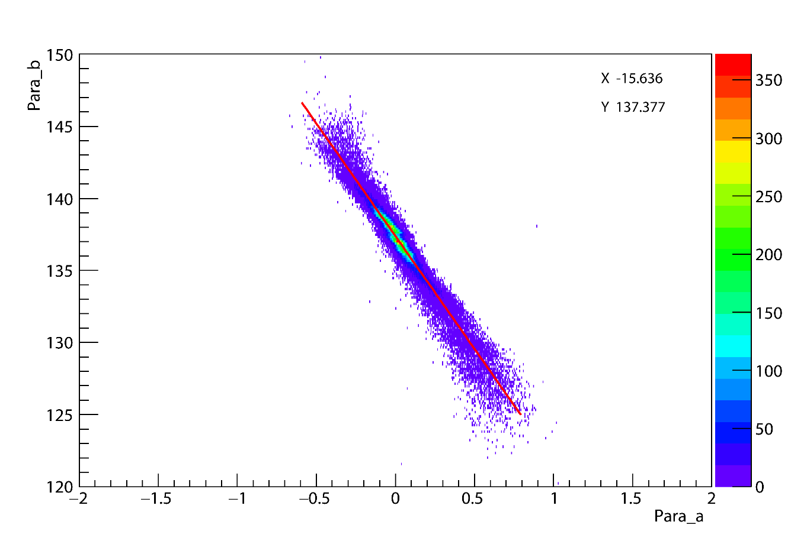
Position correction
Linear Fit gravity center of first three samples for each track and get the parameters a and b
Jul. 27, 2017 Progress of GEM R&D in LZU 10

Slide 11
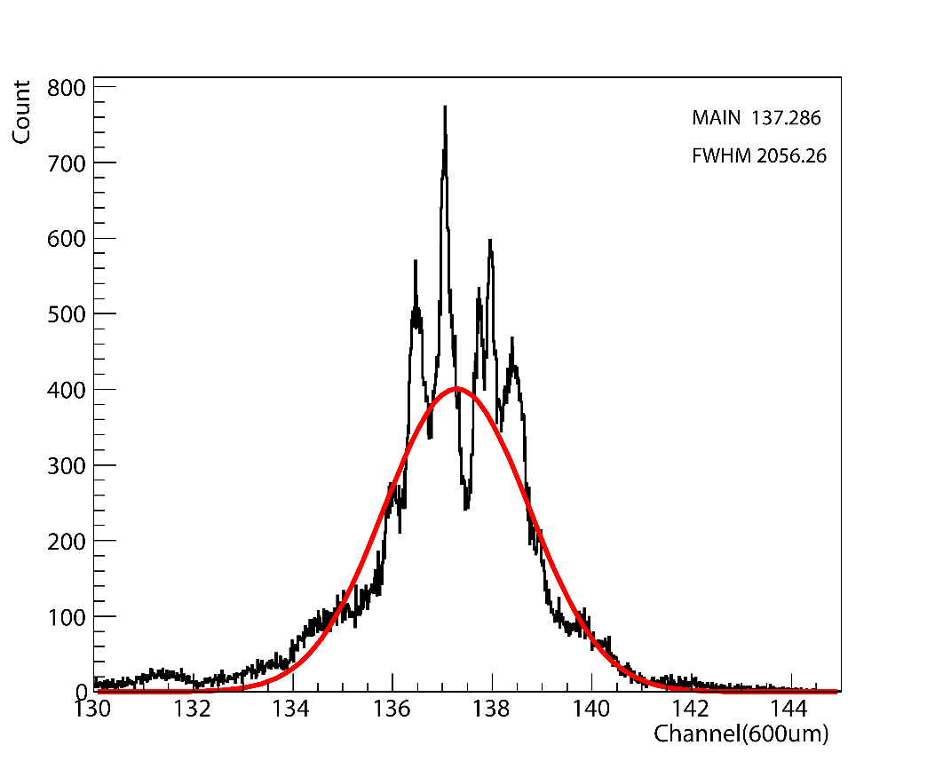
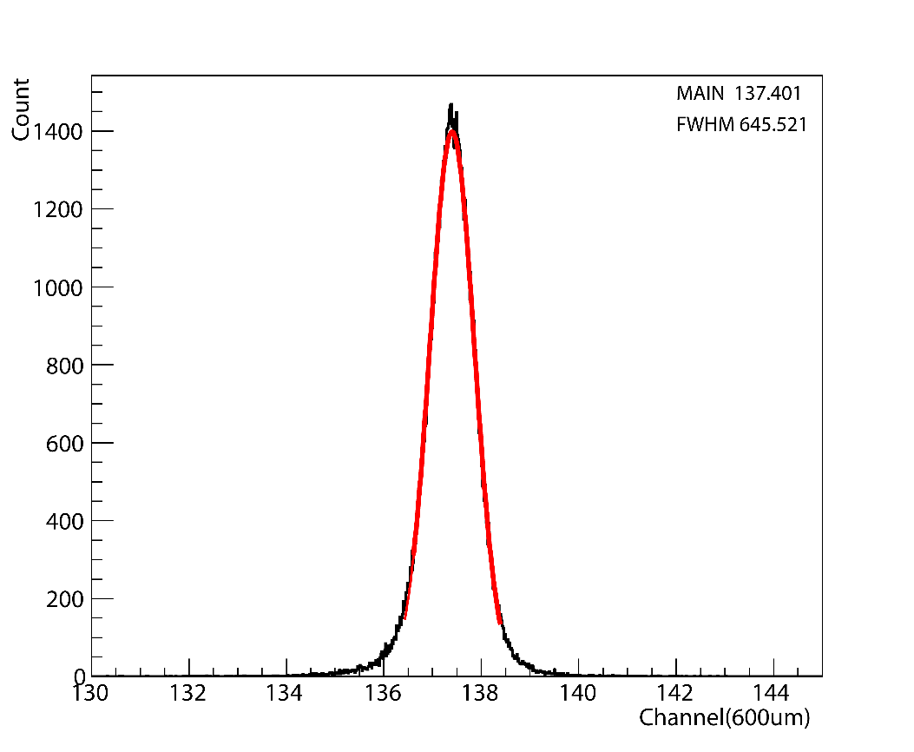
Position correction
Channel=b-x*a
a and b are linear fitting parameters for each track
x=-15.36.3
Before correction
FWHM
After correction
2056
645
137.28
137.40
MAIN
Jul. 27, 2017 Progress of GEM R&D in LZU 11

Slide 12
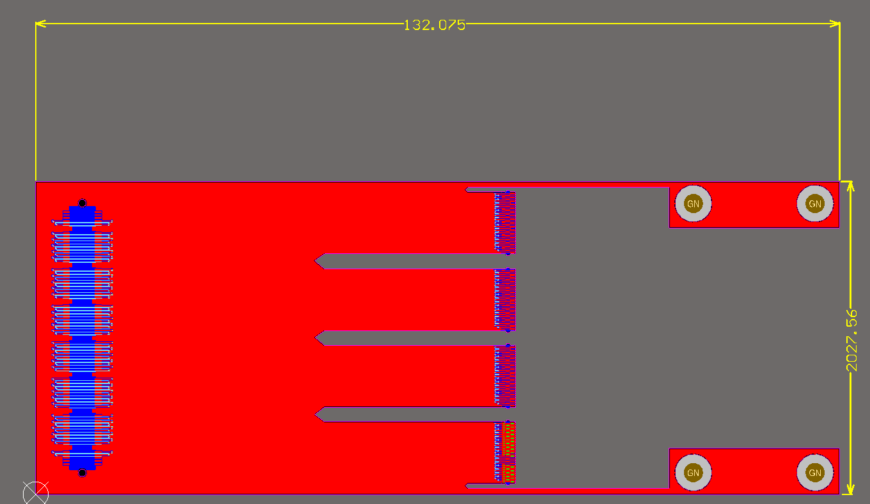
R&D of GEM-DAQ
Connect to Readout PCB: 140P signal + 18P Ground
Connect to APV25 Ground
4 layers PCB with
2 Ground layers
Connect to APV25 signal input
Jul. 27, 2017 Progress of GEM R&D in LZU 12

Slide 13
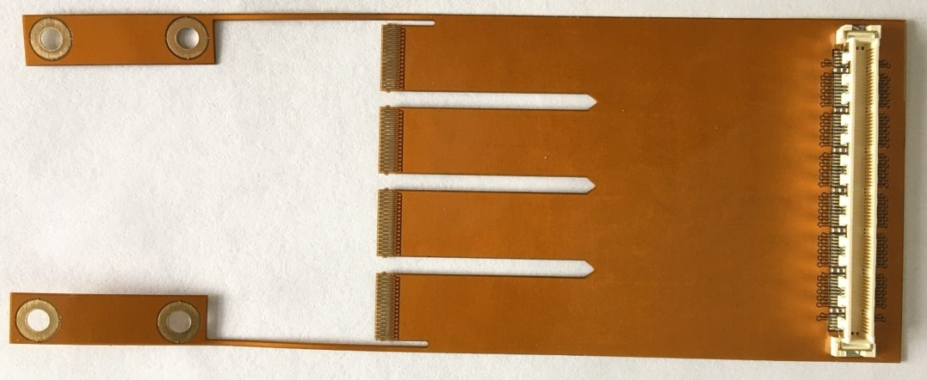
R&D of GEM-DAQ
Jul. 27, 2017 Progress of GEM R&D in LZU 13

Slide 14
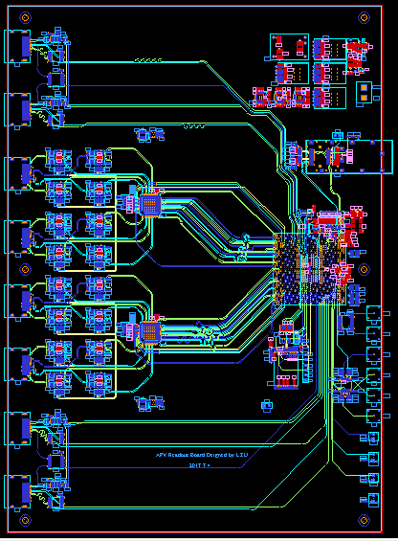
R&D of GEM-DAQ
New DAQ Unit
Control Output
HDMI A 19Pins
Ethernet Port
Signal Input
HDMI A19Pins
FPGA: Xilinx-V5
One unit can control 16 APV25 chips, total 2048 Channels.
30 samples per event
Trigger Input
LED
Jul. 27, 2017 Progress of GEM R&D in LZU 14

Slide 15
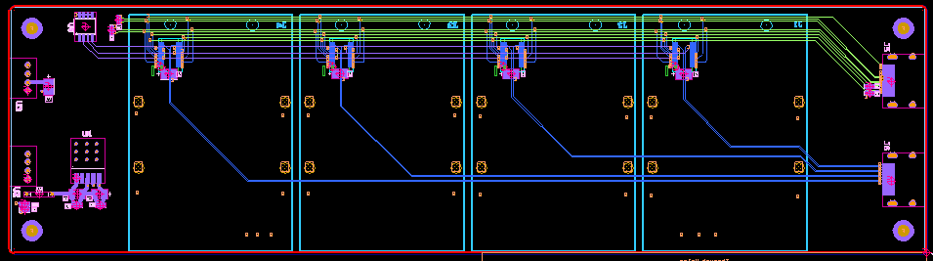
R&D of GEM-DAQ
New backplane
4 Apv25 chips per backplane
New
DAQ
HDMI A
1
2
3
4
Jul. 27, 2017 Progress of GEM R&D in LZU 15

Slide 16
Future plan
Develop the new DAQ system
Try to correct position in FPGA chip(online)
Jul. 27, 2017 Progress of GEM R&D in LZU 16

Slide 17
Thank you for your attention
Jul. 27, 2017 Progress of GEM R&D in LZU 17

Slide 18
