Slide 1
MPGD Detectors and Electronics at CIAE
Xinglong Li, Xiaomei Li, Shouyang Hu, Jing Zhou, etc.
China Institute of Atomic Energy
Notes:
Good aftertoon, Everyone. I am li xinglong, from china institute of atomic energy. I feel very lucky to have this chance as a presenter to show the recent work of our group. Thanks the origanizers and all supporters. The title is micro pattern gas detectors and electronics at CIAE.

Slide 2
Outline
MPGD detectors R&D
GEM foil
MicroMegas detector
APV25 digitization system
Test results
Upgrade
Summary
Notes:
There are two main parts in my presentation. One is the R&D of MPGD detectors, including GEM foil and MicroMegas. Another is APV25 digitization electronics. Some key test results and the upgrade of the hardware.

Slide 3
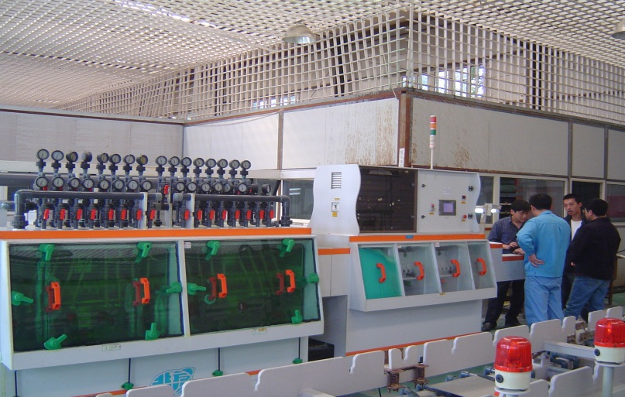
Collaborated Factory built some new facilities
Only for GEM foil and MicroMegas detector production.
Notes:
We did some R&D on GEM foils these years at our lab and clean room. Now we are collaborating with a factory on the manufacture of GEM foils. This picture shows that we helped the collaborated factory to build some new facilities which will be used only for GEM foil and MicroMegas detector production.

Slide 4
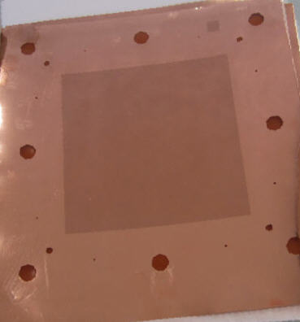
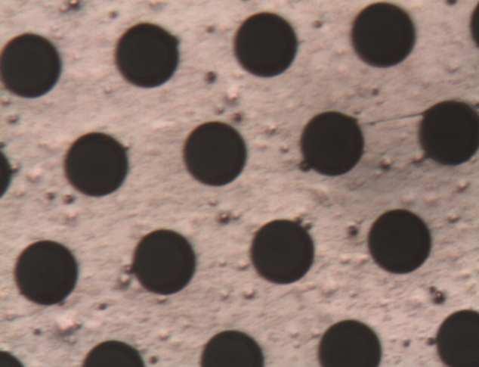
Some 10*10cm GEM foils Made
From prototype to real production step by step.
Notes:
These two photos are the GEM foils we made. Their effective area is 10*10 centimeters. These foils samples are in selection and test. Step by step, we are working on the way from prototype to real production.

Slide 5
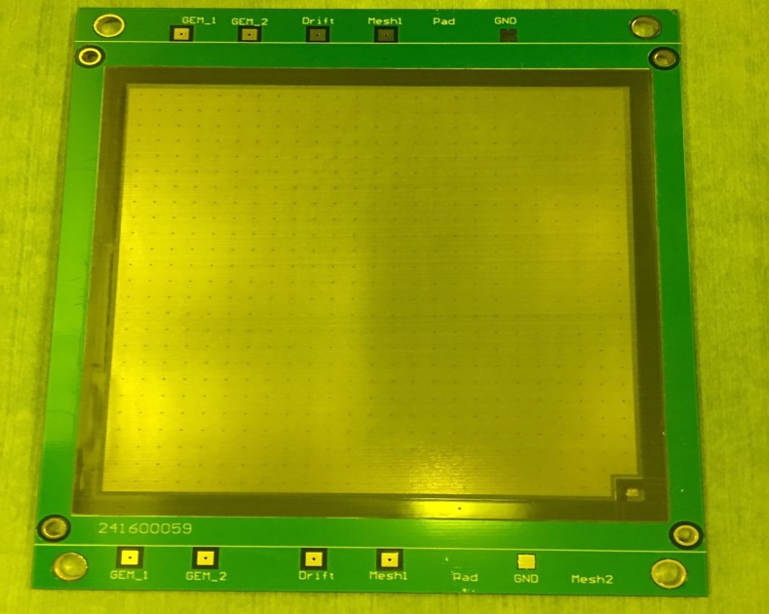
R&D of Bulk MicroMegas at CIAE
Resistance：450-500 GΩ
Notes:
MicroMegas is another popular kind of micro pattern gas detectors. Among several kinds of micromegas, Bulk micromegas is reliable, has good uniformity, and it is easy to be made to large area. Partially because it is made by photoetching technique with photosensitive film. Very clean environment and high technology are needed in the process. The temperature, etching time and other parameters must be controlled carefully.
We have made some 10*10 centimeters bulk micromegas recently. Their resistance between mesh and readout are more than 450 gig ohm by the measurement.
The black points array you may see in the picture is the pillar between mesh and readout.

Slide 6
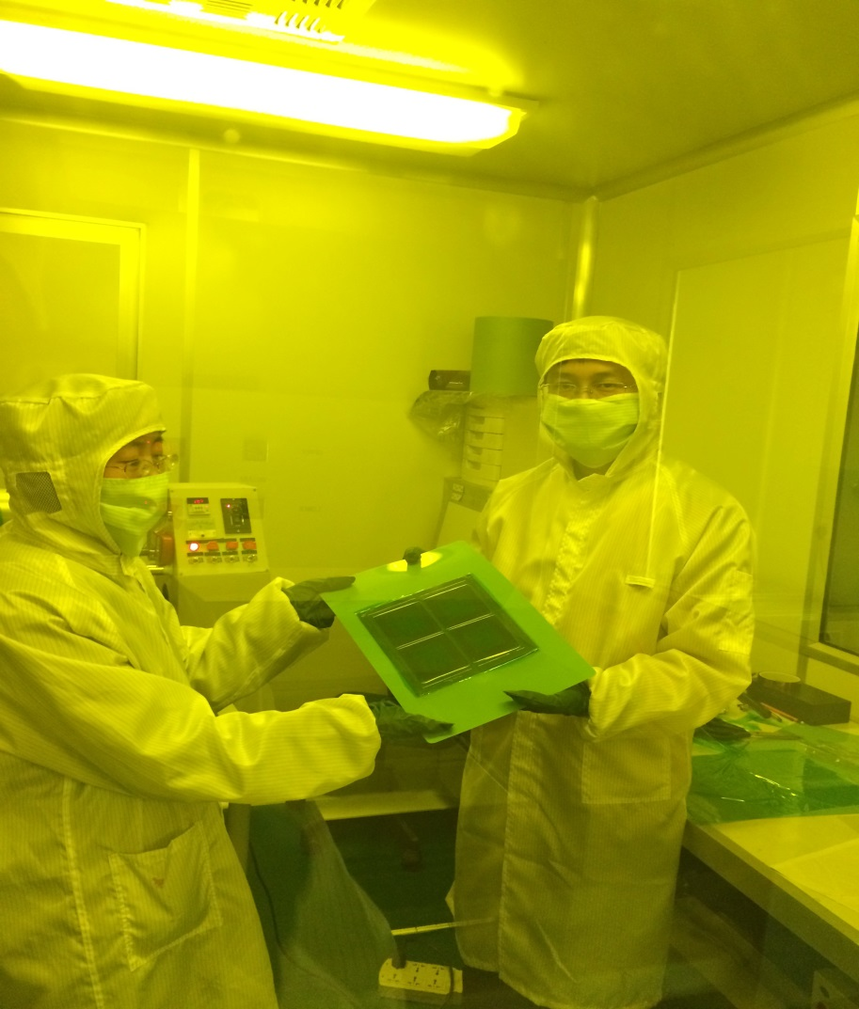
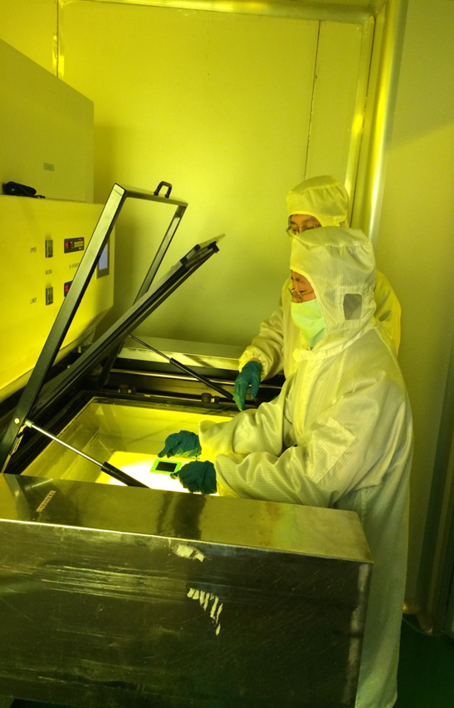
R&D of MicroMegas at CIAE
Notes:
These two pictures shows the scene when we are making bulk micromegas in our clean room at CIAE.

Slide 7
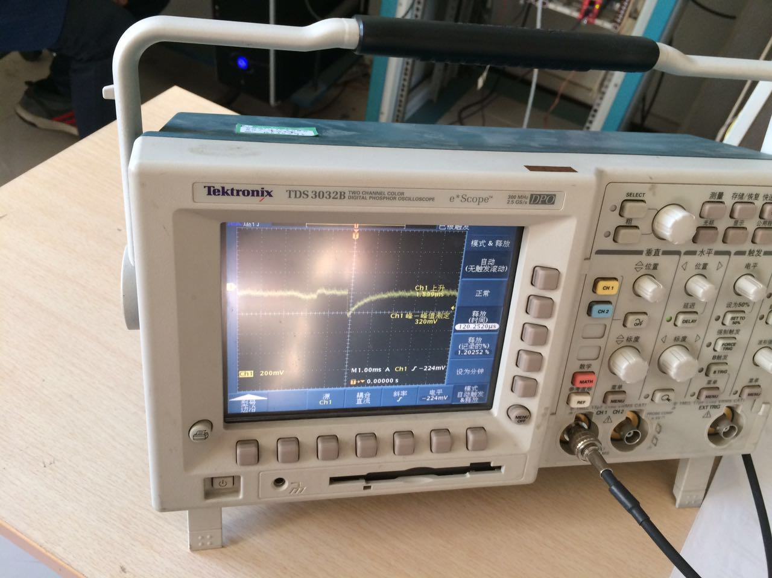
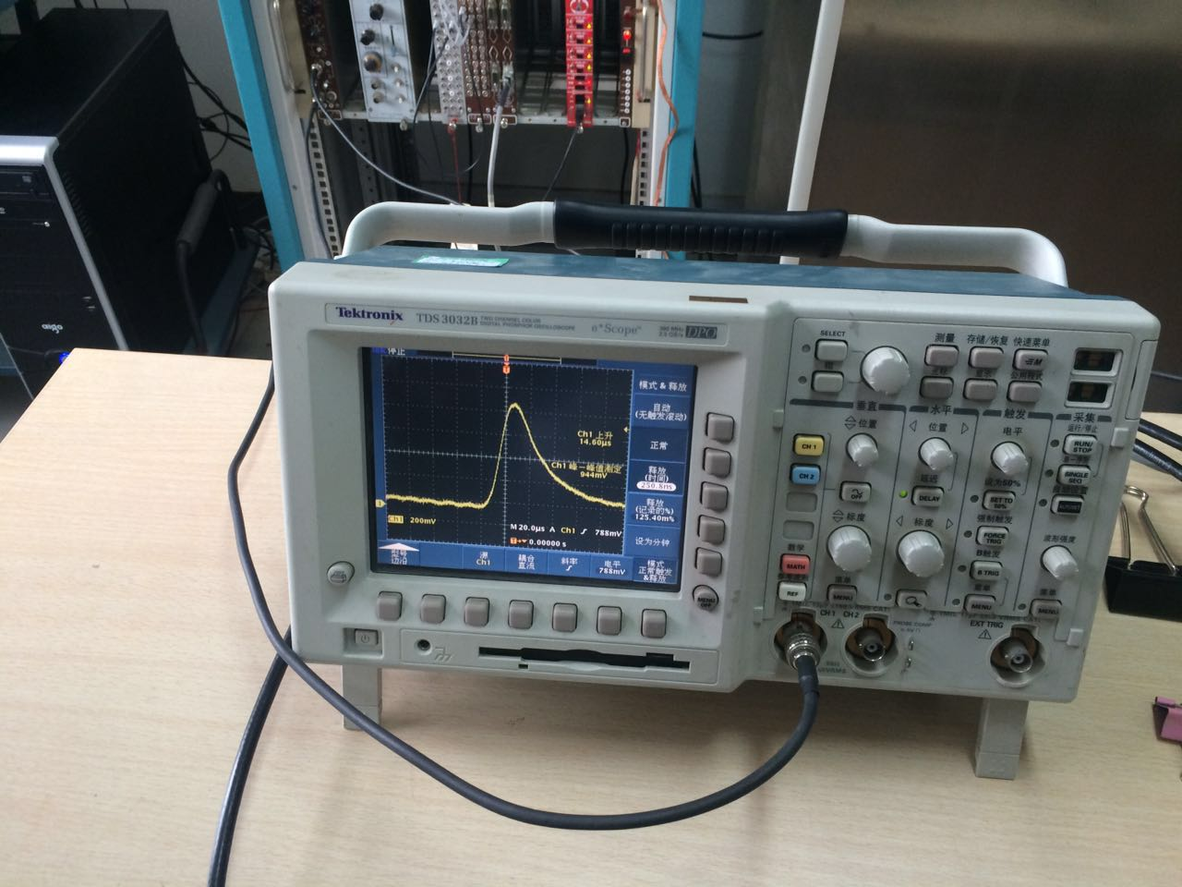
Test of MicroMegas at CIAE
Preamplifier signal
Signal after shaper
Ar: CO₂=70% : 30%
Alpha signals by ²⁴¹Am
Notes:
We made some preliminary tests on the micromegas we made with argon and CO2. An americium source is used. The energy of the alpha particle produced is about 5 MeV. The left picture shows the signal from the preamplifier and the other picture shows the signal after shaper and amplifier. This test shows that the bulk micromgegas works, although its energy resolution and space resolution need to be test in the next step.

Slide 8
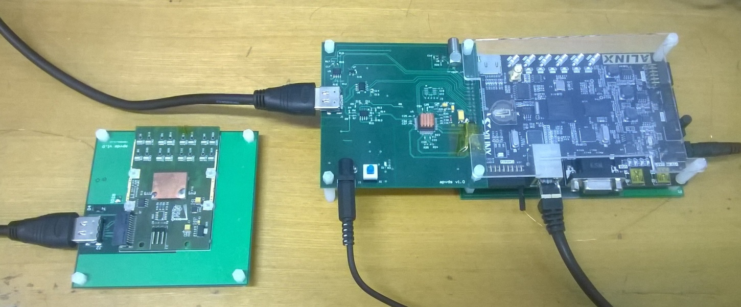
APVDS v1.0 system
Cumulative ACK and parity check are employed in UDP of GbE.
Full speed of APV25 (40MHz/140 sample rate) is achieved via Giga bit Ethernet.
HDMI
Spartan 6
power
GbE
ADS5242
power
APV25 backplane
Notes:
The next part is about APV25 electronics at CIAE. APV25 is a 128-channel preamplifier and can be used for MPGD.
The picture shows the version 1 APVDS system we made two years ago. It is composed of APV frond end card, backplane, ADC board and FGPA board. In its gigabit Ethernet communication, cumulative ACK and parity check are employed. Benefitted from the gigabit Ethernet, one APV25 can work at its maximum sample rate.
Then I will show the results of recent test of this system.

Slide 9
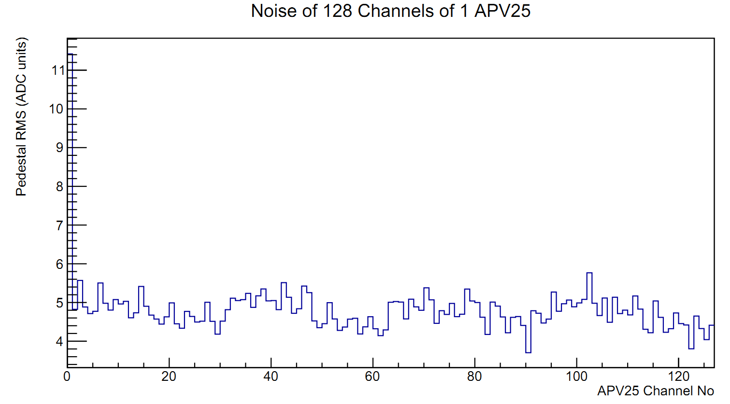
Noise test
Mean: 4.82ADC, ~811e⁻ .
Notes:
First, we measured the pedestal noise of APV without any input signals. The root mean squares of 128 channels of 1 APV are shown in this picture. Their mean value is about 5 ADC units, equal to about 800 electrons.

Slide 10
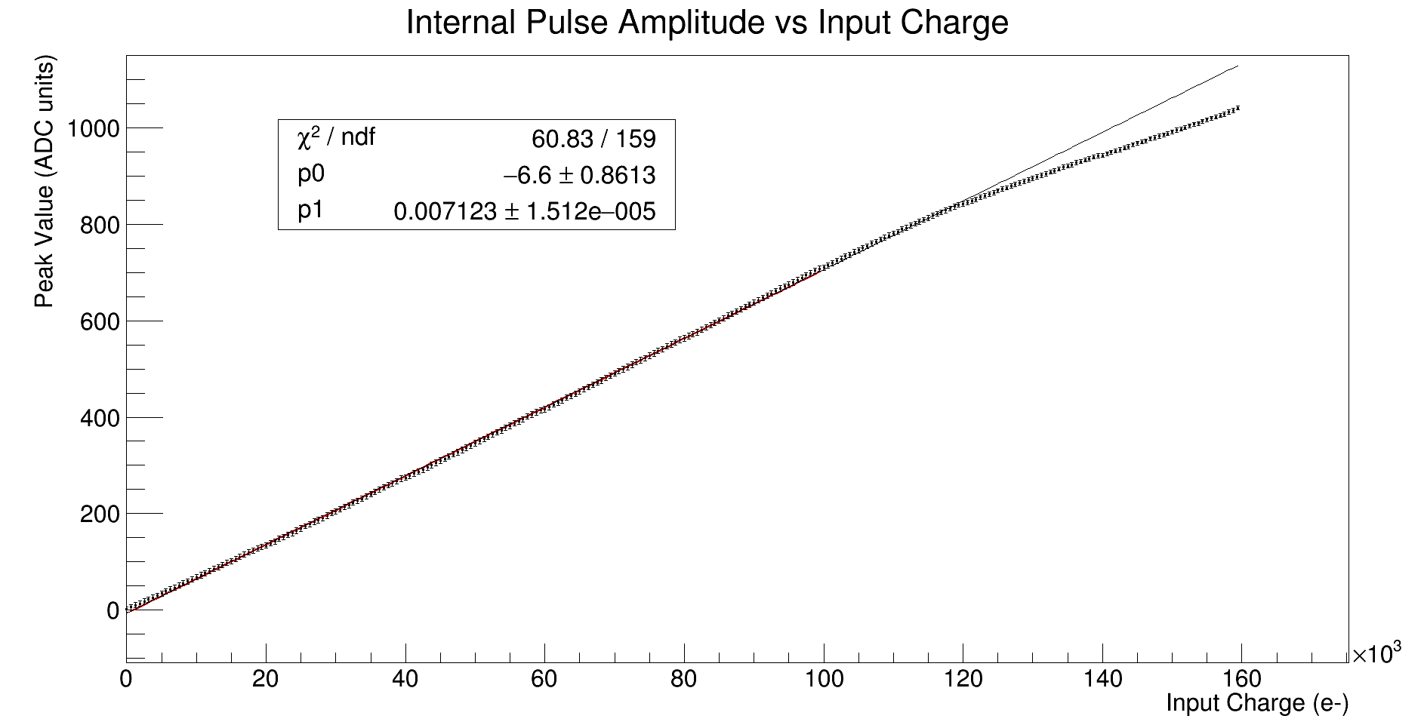
Internal pulse scan (1)
Non-inverting mode of APV25
Good linearity below 10⁵ e⁻ (16fC)
Notes:
There is a pulse generator inside the APV chip. It could be used to inject some charge into the input of the preamplifier. And the APV25 has an inverting circuit to adapt for both negative and positive signals. Non-inverting mode works for negative signals from detector, and the inverting mode works for positive signals.
This picture shows the pulse scan results in the non-inverting mode. As we can see, the linearity is good up to 100 000 electrons.

Slide 11
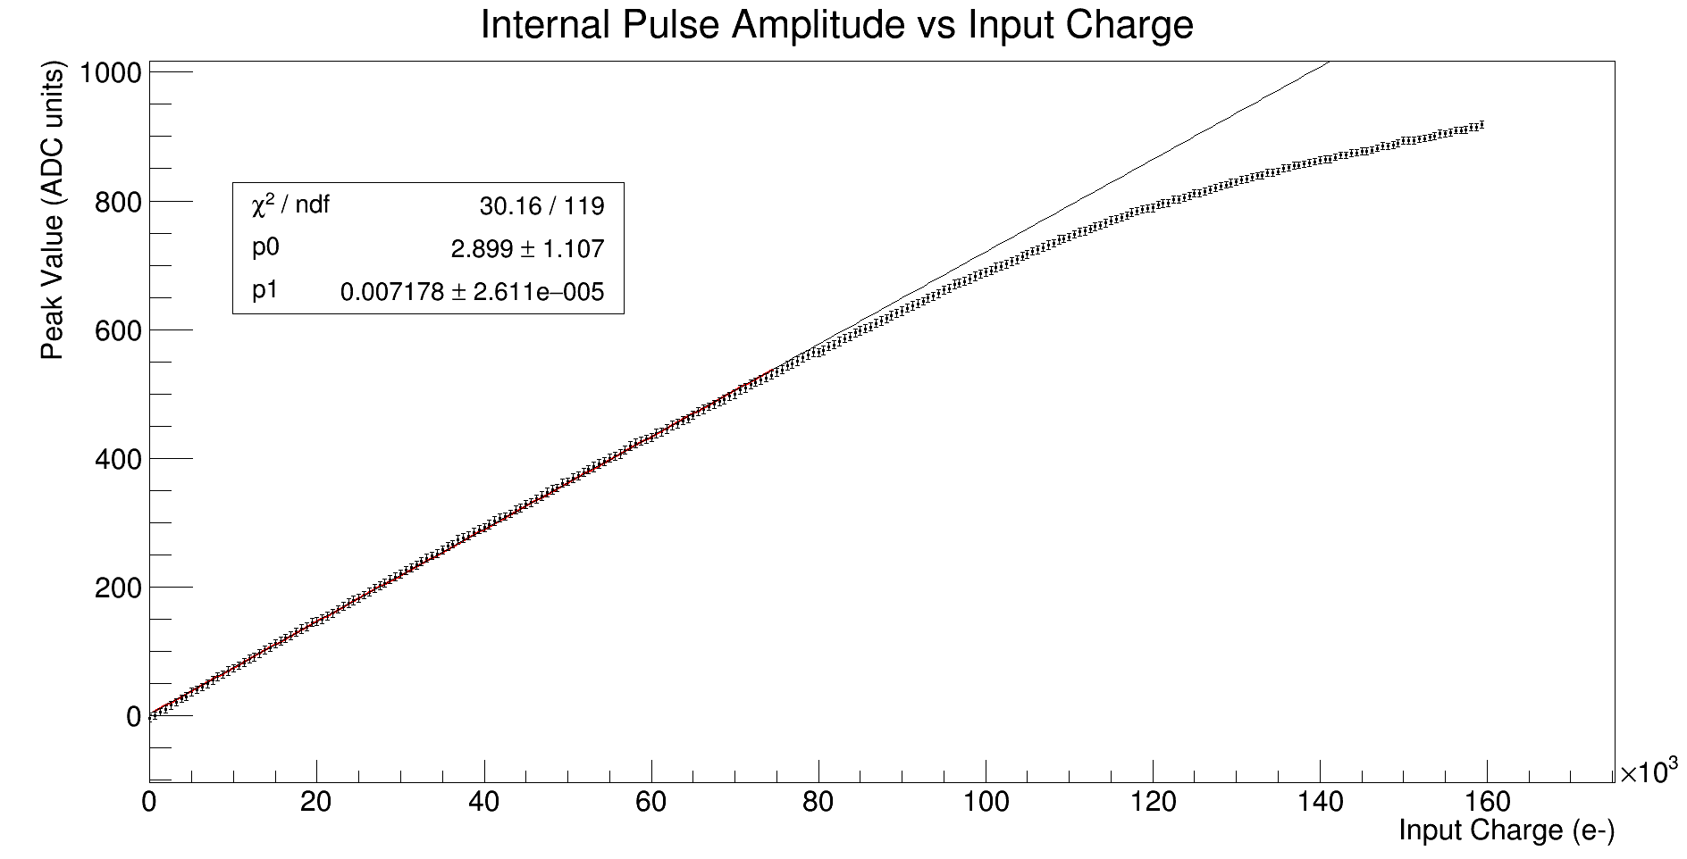
Internal pulse scan (2)
Inverting mode of APV25
Good linearity below 7.5*10⁴ e⁻ (12fC)
Notes:
As for the inverting mode, the linearity are slightly worse. It keeps linear till 75 000 electrons.
These two pulse scan results agree with the results of the manufacturer (The CMS Tracker APV25 0.25µm CMOS readout chip).

Slide 12
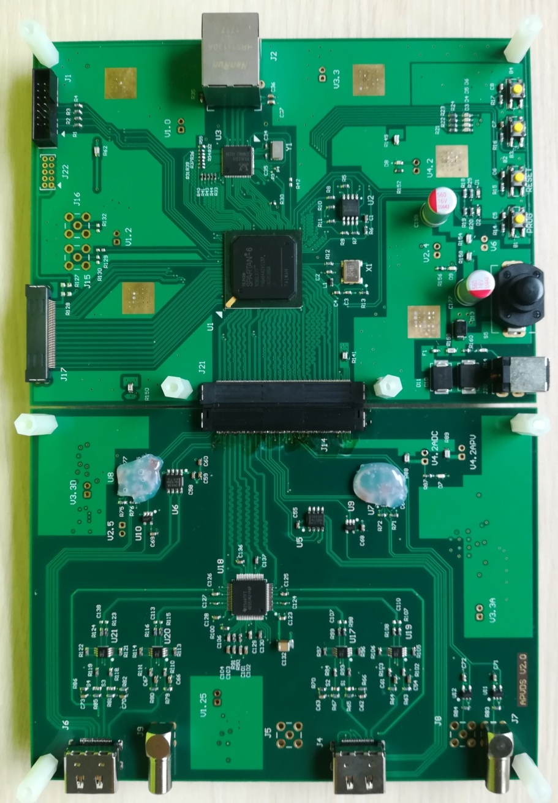
APVDS v2.0 system
4 APV25
XC6SLX75 FPGA
2 external signal ports
ADC and FPGA board are separated
GbE communication
Refer to MPD and SRS
Notes:
To fulfill the requirement of the detectors test at our lab, we developed a new APV digitization system. It can control up to 4 APV25. A more powerful Spartan FPGA is used. 2 external signal ports are reserved for the possible waveform sampling purpose. To maintain the flexibility of changing front end electronics, ADC board and FGPA board are separated. The communication interface with computer is still gigabit Ethernet. Thanks the developer of Multi Purpose Digitizer and Scalable Readout System for some of their good ideas.
Now we are working on the logic design and software of the new system.

Slide 13
Summary
GEM foil and MicroMegas detectors R&D is undergoing at Collaborated Factory and CIAE lab.
We just got 0.9 millions RMB fund to support the R&D of GEM foil. We are looking for more channels to support our work.
The test results of APVDS v1.0 system are good enough for MPGD.
APVDS v2.0 hardware is finished. The logic of FPGA and software are to be completed.
Next step is the combined test of Micromegas and APVDS.
Notes:
Better performance

Slide 14
Thanks for your attention!

Slide 15
backup

Slide 16
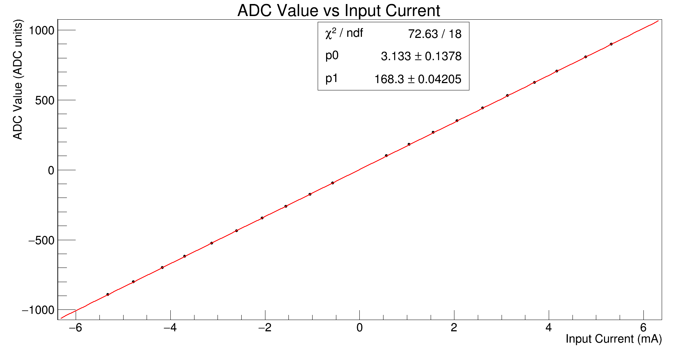
ADC Calibration
RMS < 0.65ADC, i.e. 97e⁻

Slide 17
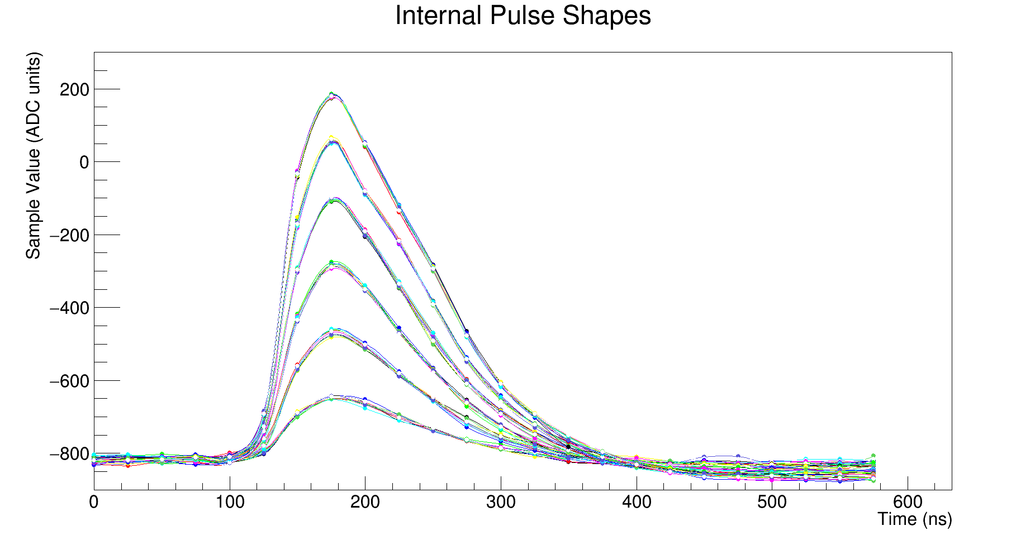
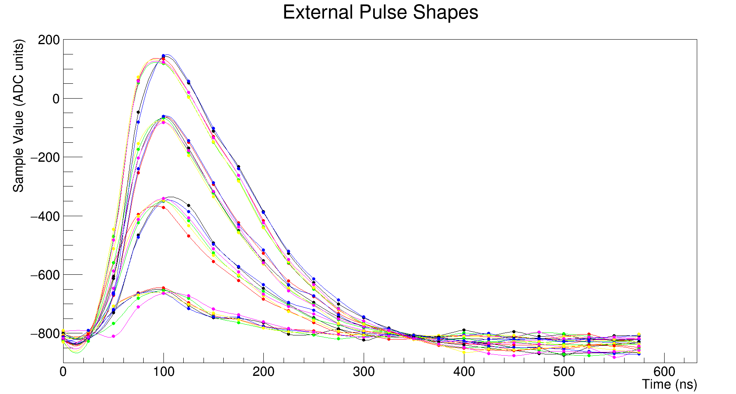
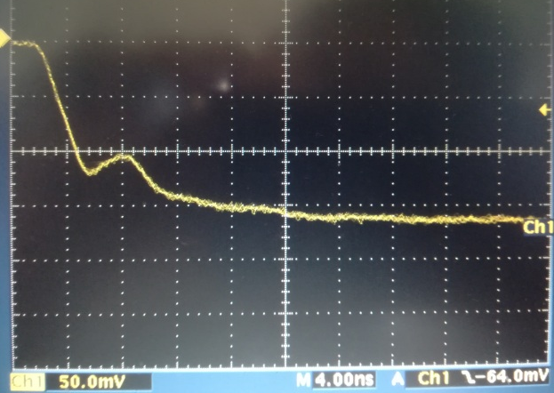
Pulse response
APV25 FEC
External pulse
10pF

Slide 18
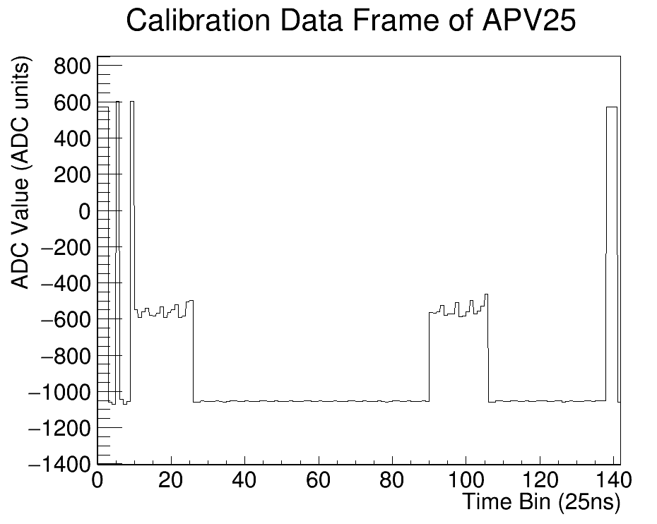
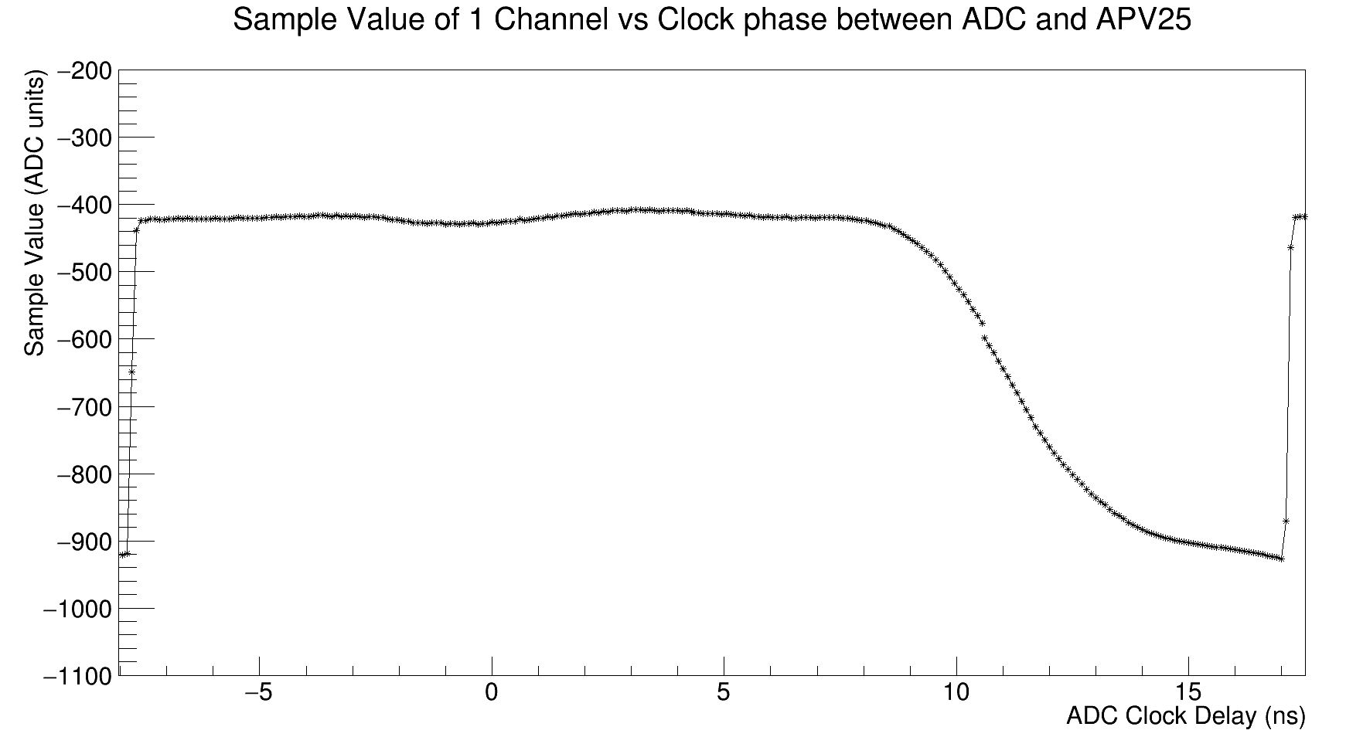
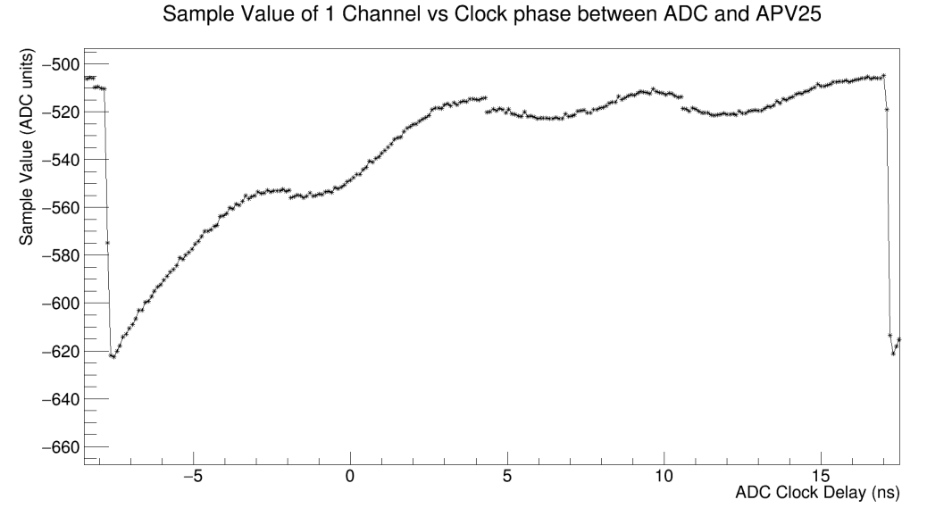
Clock phase determination
good
Combination of two edge condition,
proper ADC clock delay time: 3~7ns
good

Slide 19
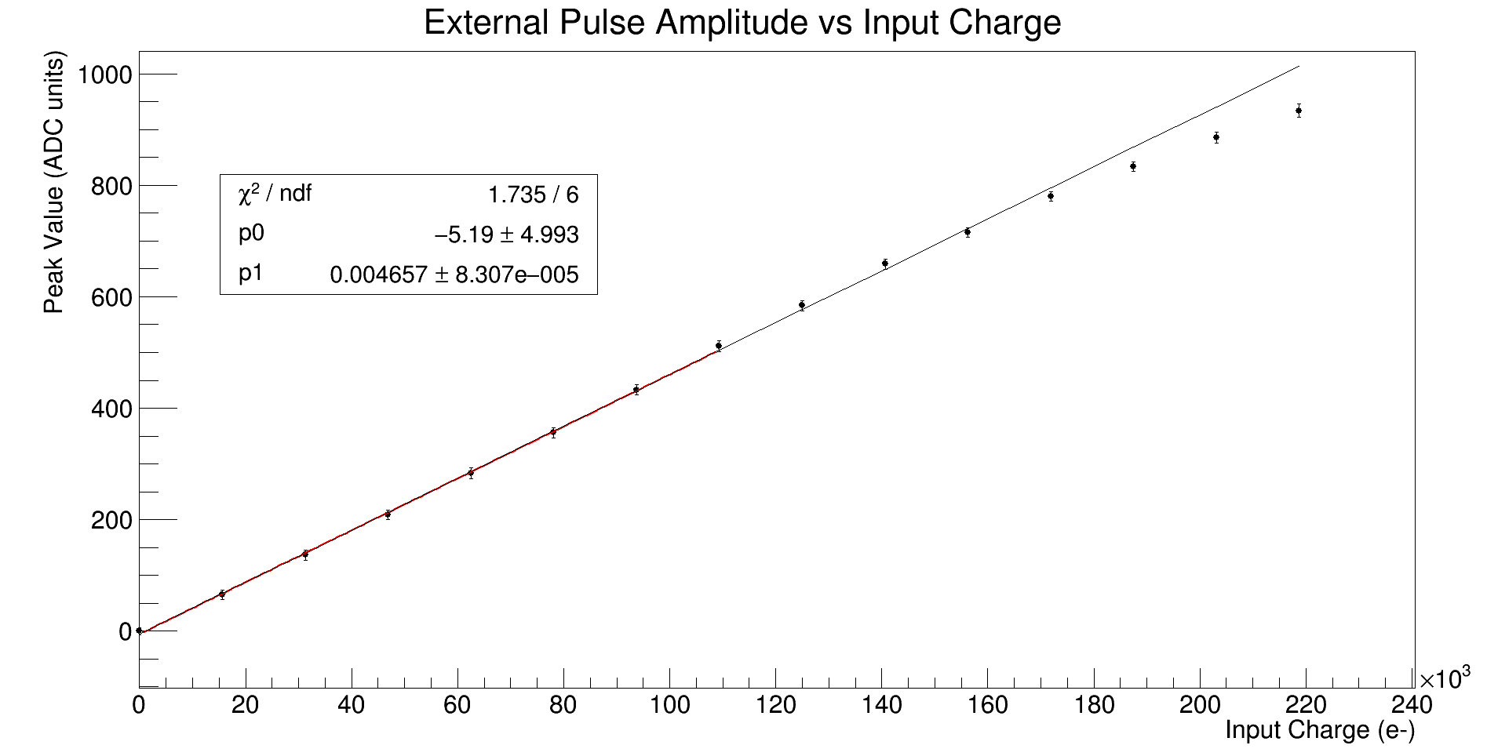
External pulse scan
Non-inverting. Input charge need calibration.

