Slide 1
GEM R&D at USTC
Wenhao You
Department of Modern Physics, University of Science and Technology of China
State Key Laboratory of Particle Detection and Electronics, USTC-IHEP, China
2017-07-27
9th Workshop on Hadron physics in china and Opportunities Worldwide, Nanjing University

Slide 2
Outline
Introduction
Progress of the 1m × 0.5m GEM
APV25 readout system and the spatial resolution of the 30cm×30cm GEM
Conclusion and future work

Slide 3

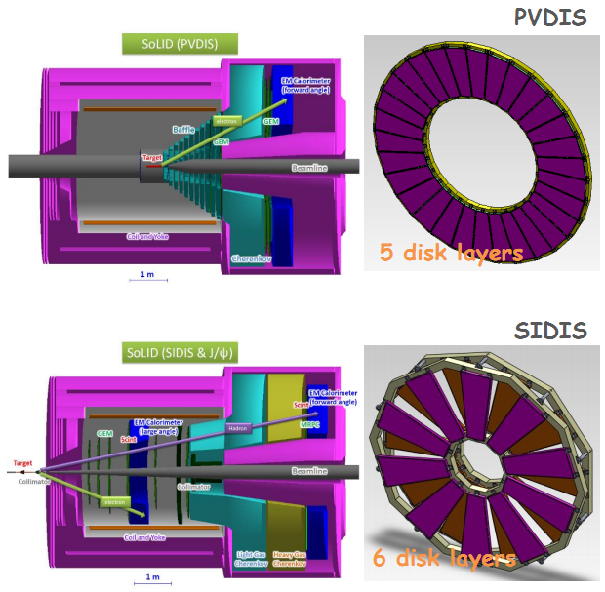
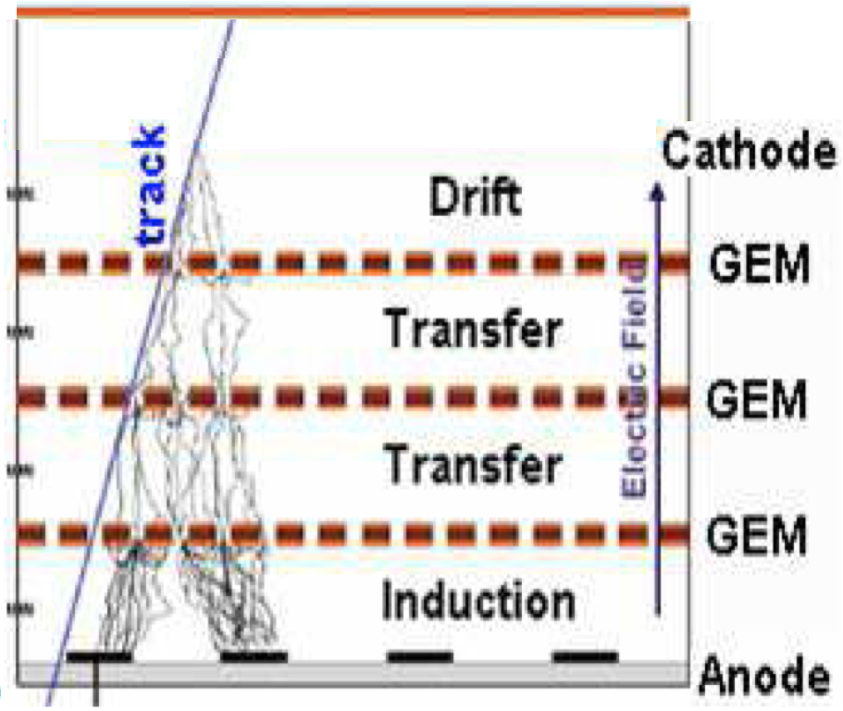
GEM detector
80um
GEM foil structure:
Cu: 5 µm
Kapton: 50 µm
Diameter: 60 µm
80 µm
Pitch: 140 µm
140um
60um
Characteristics:
Position resolution ~100um
High rate capability
Excellent radiation hardness
Flexibility in shape and design

Slide 4
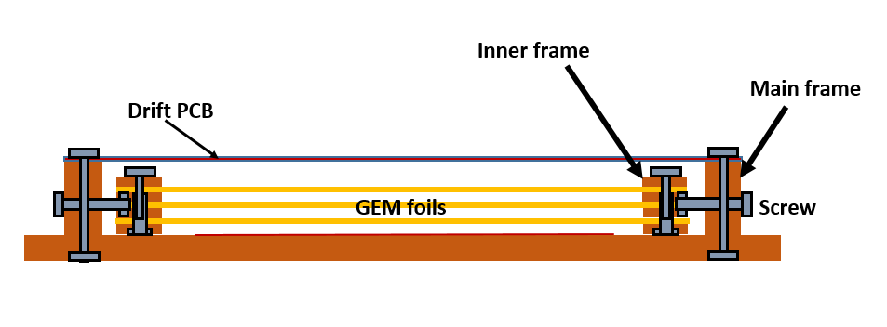
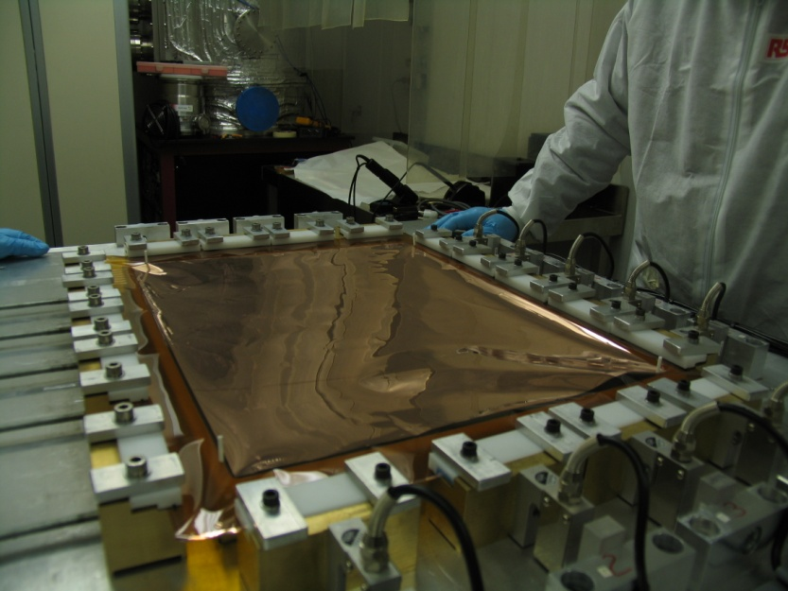
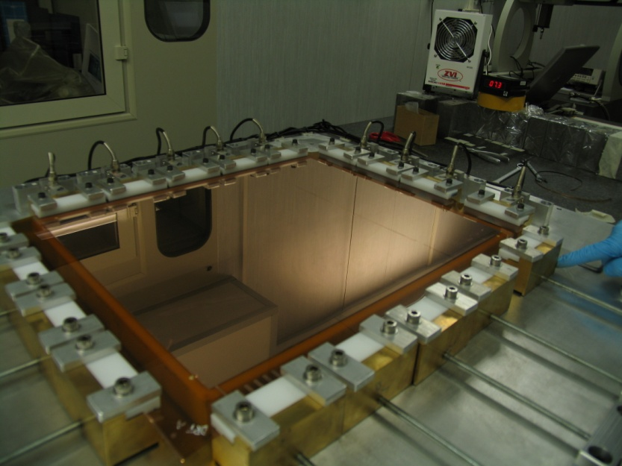
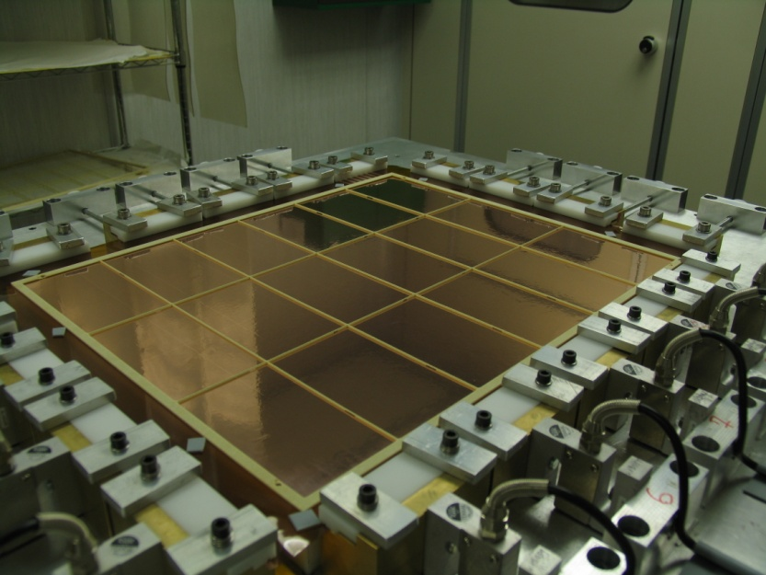
Assembly techniques for large-size GEM
Gluing technique
Self-stretching technique (from CERN)
stretching
Readout PCB
Advantages：
1. assembling process is easy and fast
2. no dead area inside the active area
3. uniform gas flow
4. detachable
Gluing inner spacer
We choose the self-stretching technique, and have gained many experience through the 30cm×30cm GEM detectors.

Slide 5
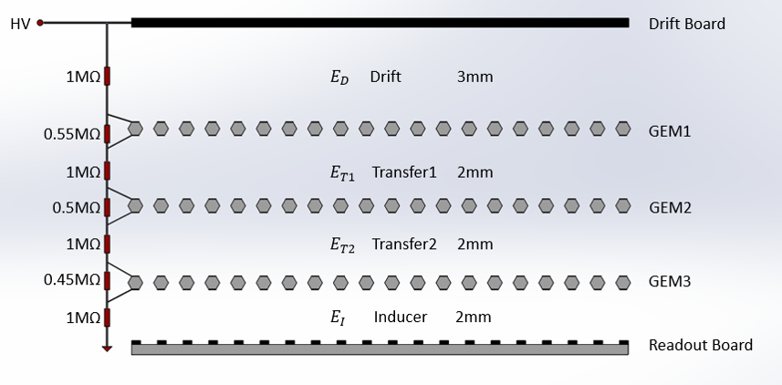
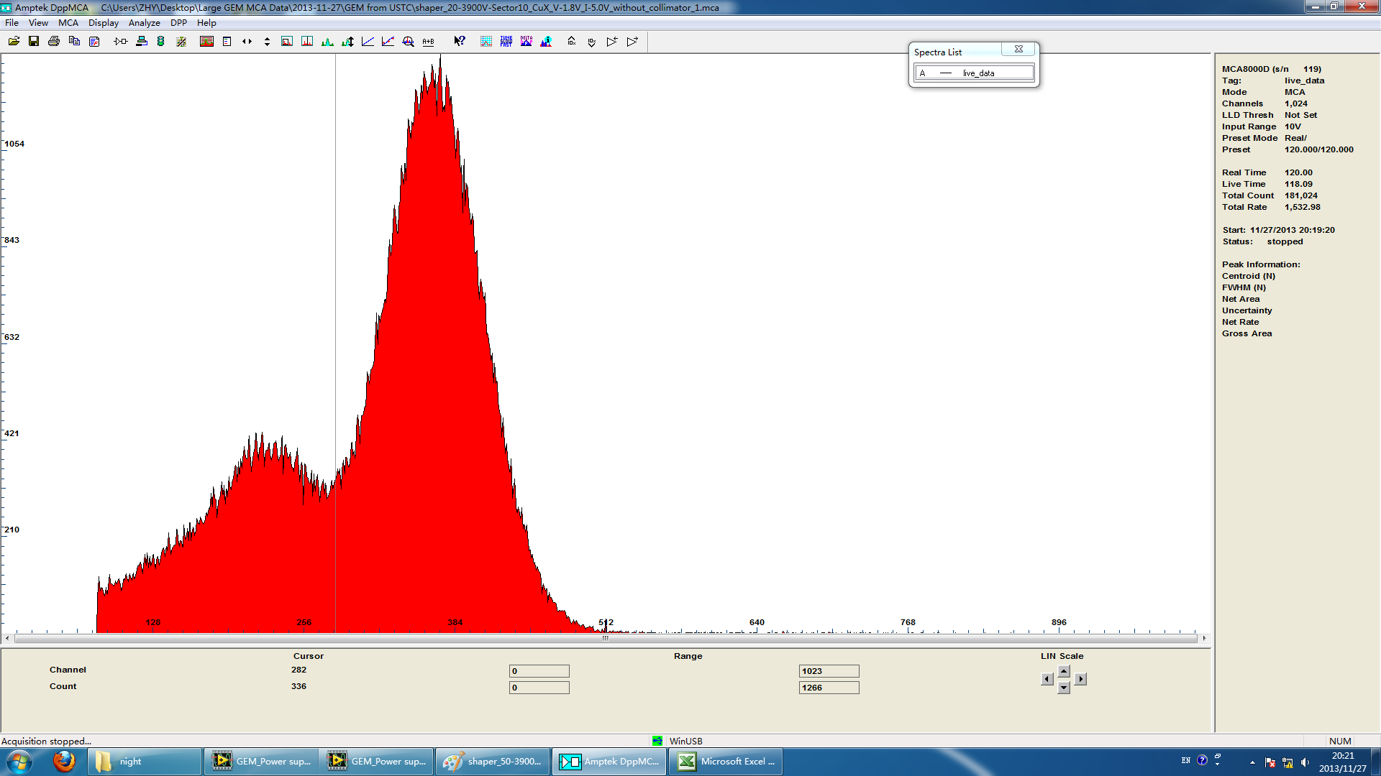
1m×0.5m GEM detector
Structure
Testing system
Copper X-ray
HV
1m×0.5m GEM
Pre-Amp
Triple-GEM
1m×0.5m
3mm-2mm-2mm-2mm
Shaper
MCA
The active area is divided into 200 sectors (5cmX5cm)

Slide 6
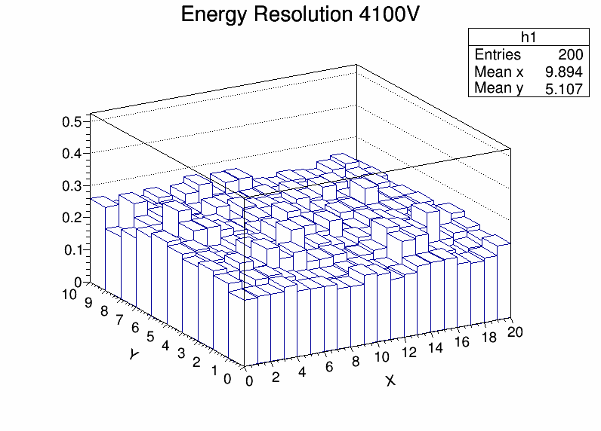
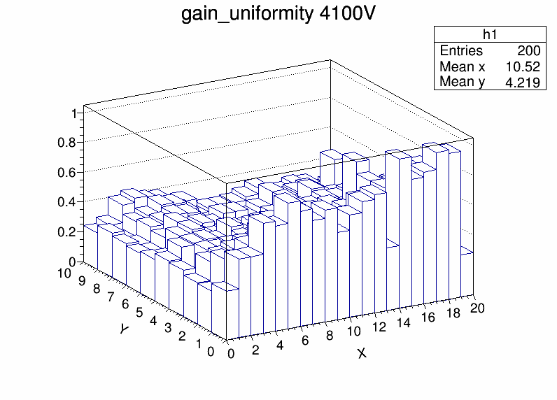
Uniformity result
Energy resolution= FWHM/Peak
Variation= σ/Mean
Energy resolution：mean~0.23
sigma~0.023
variation~10%
Relative Gain：mean~0.44
sigma~0.19
variation~43%
Gain uniformity still has room for improvement.

Slide 7
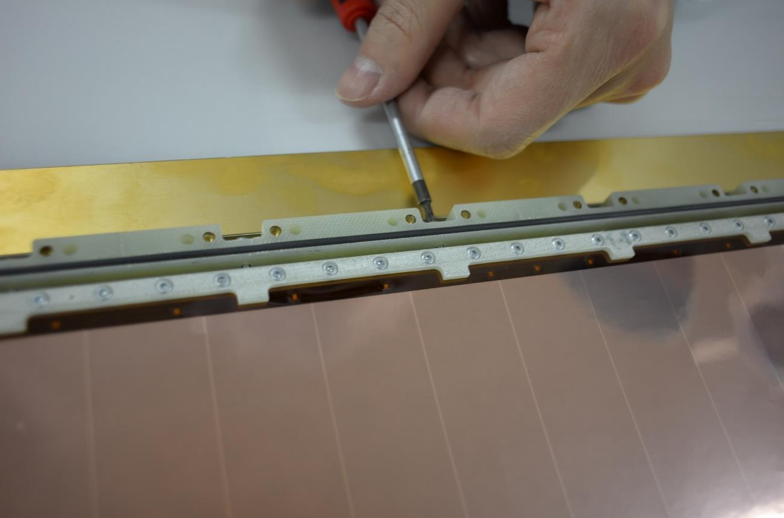
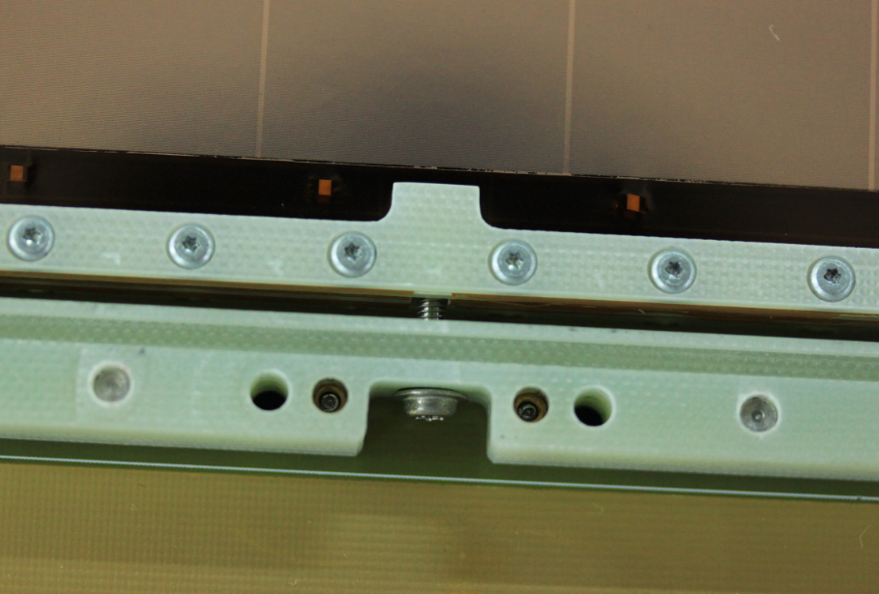
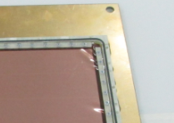
Problems of our original self-stretching design
The stretching screws will be blocked by the outside frame when it moves with the inner frame, and the tilted screws cause the gas leakage.
Screw and O-ring
Tension is non-uniform and small after stretching GEM foils
folds
These problems will finally influence the performance of the detector.

Slide 8
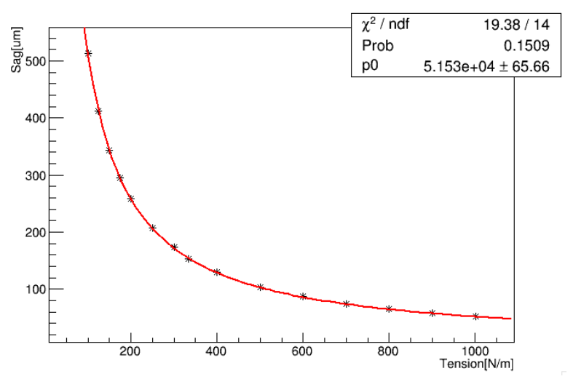
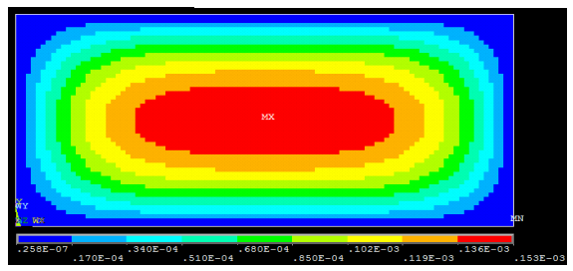
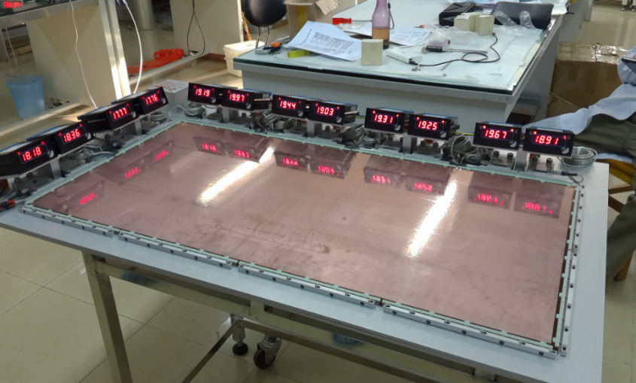
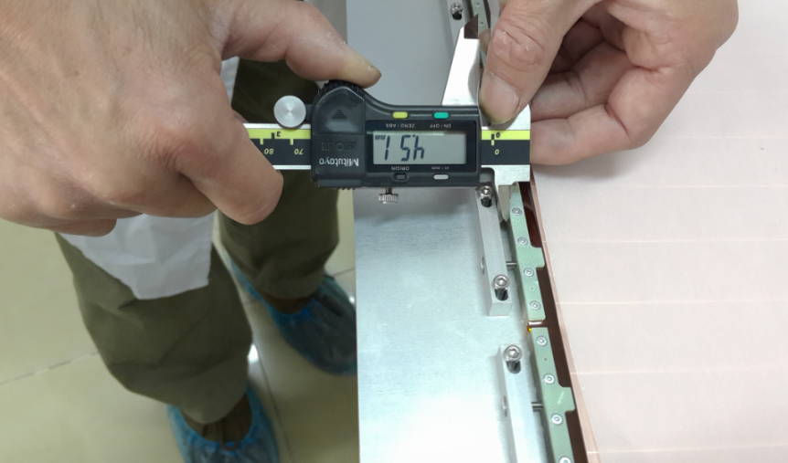
Tension simulation and test
Deformation at different place on single foil
Simulation condition:
1m×0.5m GEM;
Structure ： 3mm-2mm-2mm-2mm；
Working voltage: 4kV.
sag(um)
Maximum deformation ~100um at 500N/m, acceptable
tension(N/m)
Testing result:
Overall foil extension is about 2.5mm at 500N/m.
Tension sensor

Slide 9
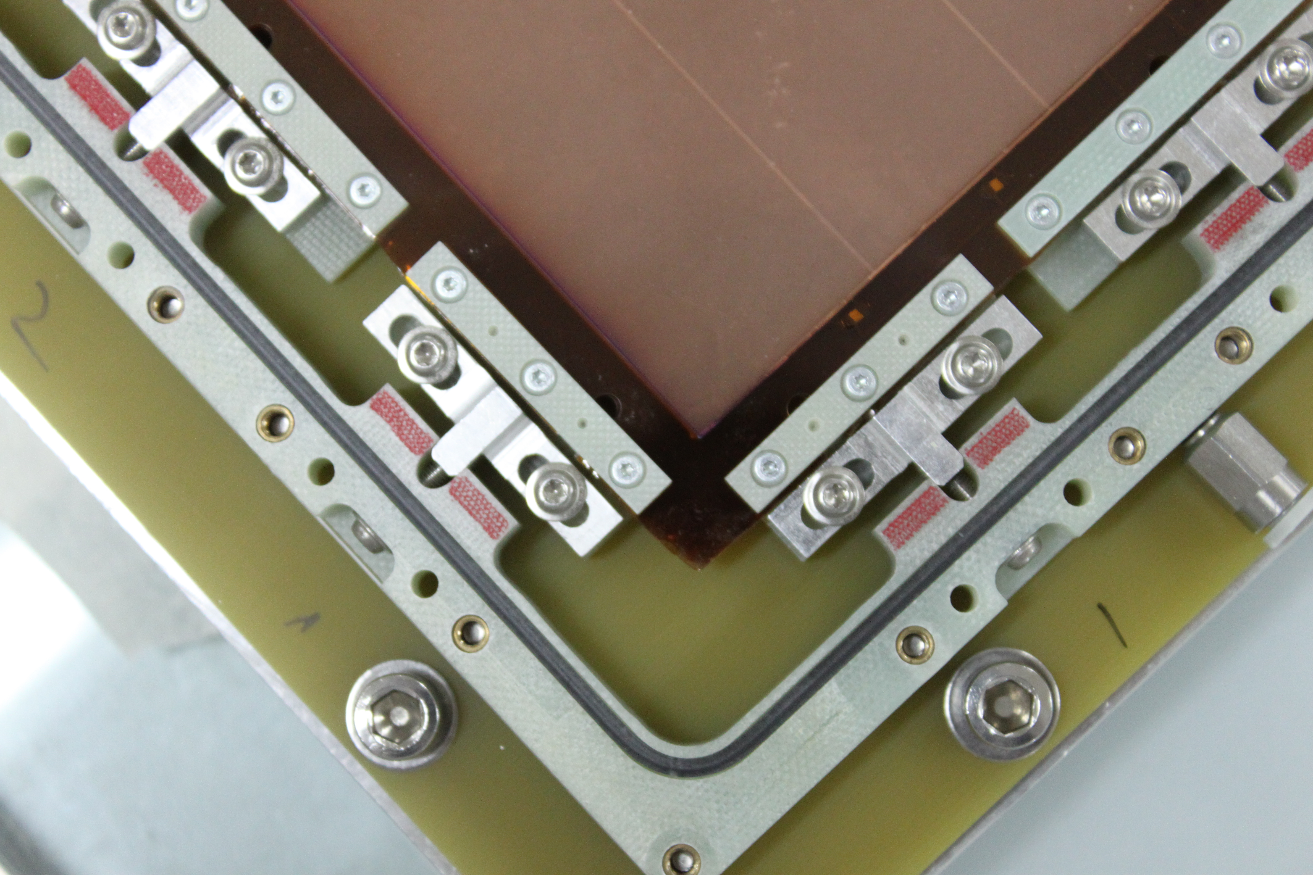
An improved GEM stretching method
Sliding self-stretching technique
GEM foils can move freely up to 5mm with respect to the main frame
Inner frame
Stretching screw
nut
Using this technique, a large-size GEM prototype (1m×0.5m) has been successfully built, and we’ve tested it.

Slide 10
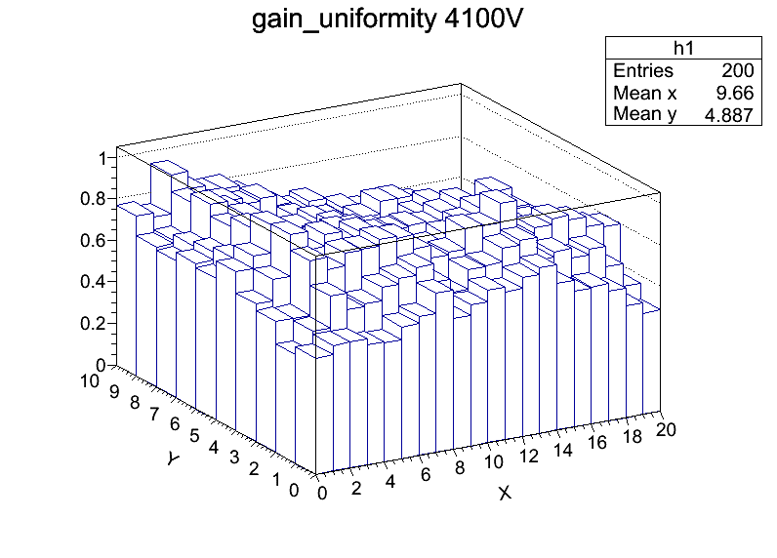
Test result of 1m×0.5m GEM with new technique
Original technique relative Gain：
mean~0.44
sigma~0.19
variation~43%
New technique relative Gain：
mean~0.73
sigma~0.12
variation~16%
Energy resolution is as well, the relative gain uniformity is much better;
The sliding self-stretching technique improves the performance of the GEM significantly.

Slide 11
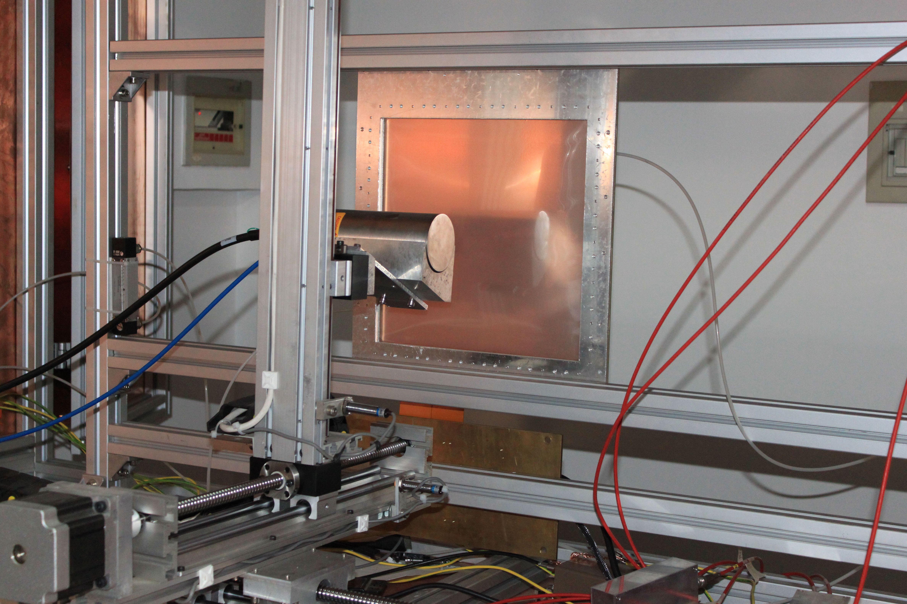
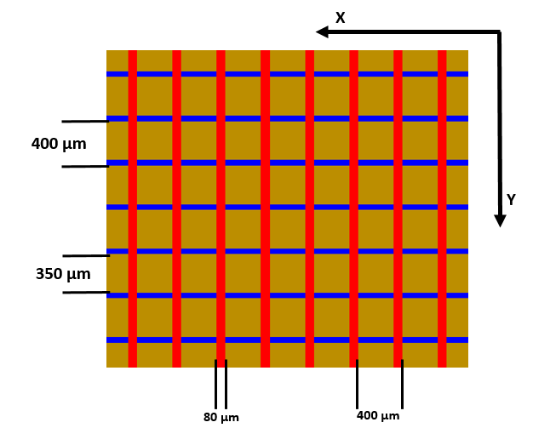
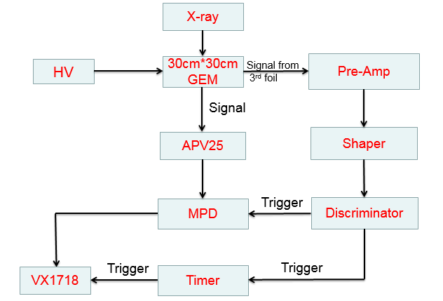
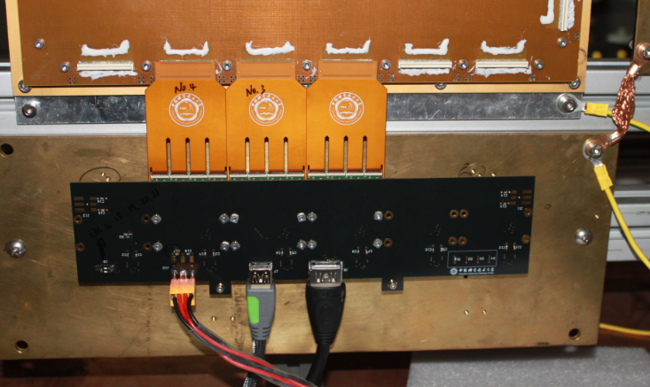
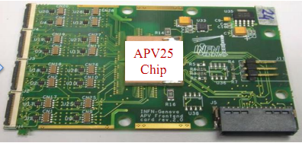
GEM readout system based on APV25
Position resolution testing system
Readout PCB
Double-GEM
50 um slit
Drift foil
Pitch: 400um;
Strip width:
x(80um),
y(350um)

Slide 12
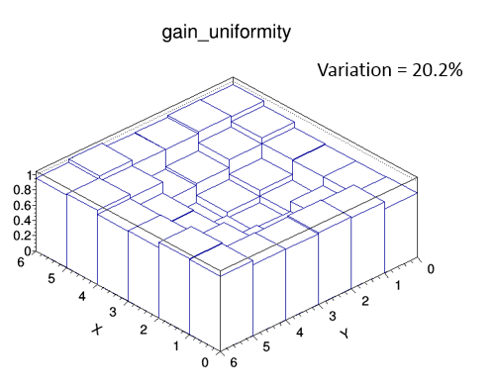
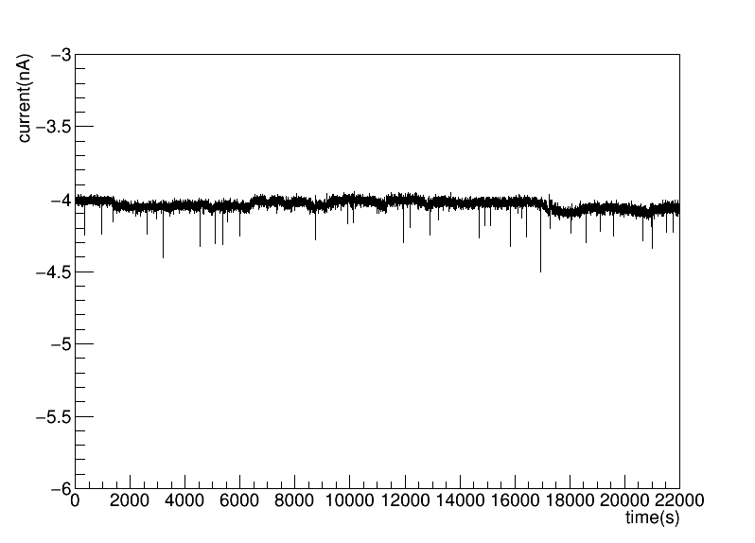
Gain and spark probability test
Variation= σ/Mean
Gain uniformity test
Spark probability test
Average = -4.04nA
Sigma = -0.031nA
Effective gain ~3199, 400V for each GEM foil；
Input charge: ~19 fC，linearity of APV25 is well.
Time: 6 hours;
Spark probability: 8.95E+7 signal per spark.

Slide 13
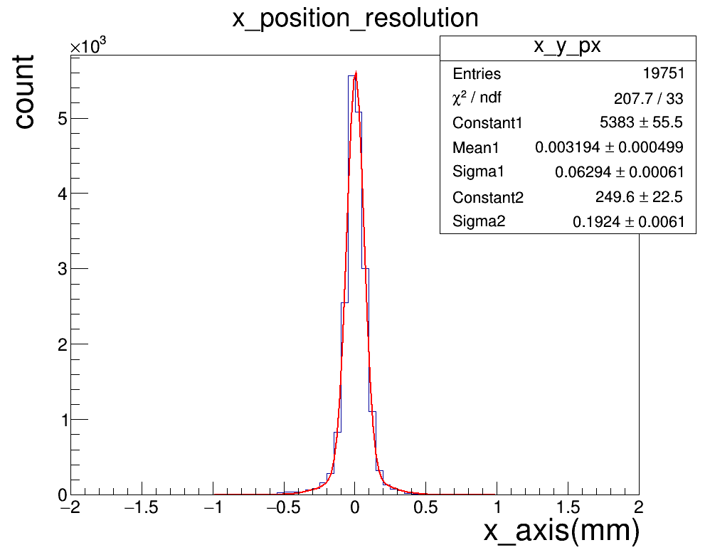
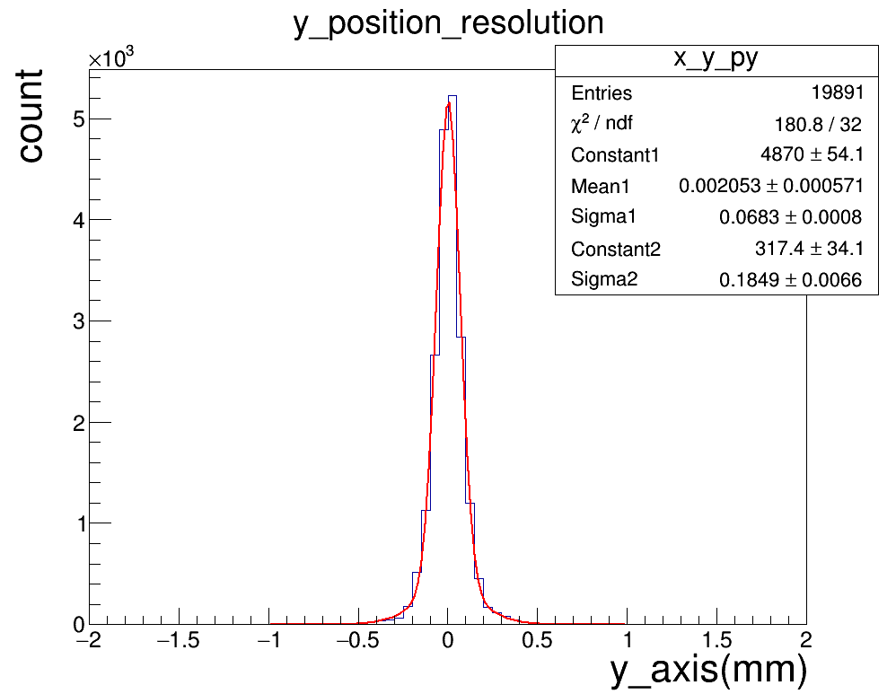
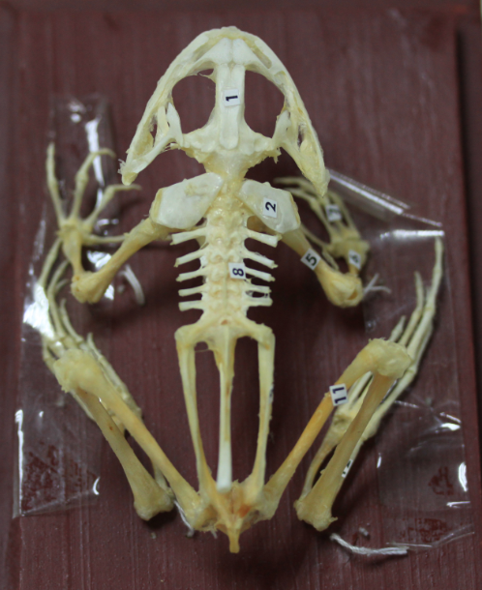
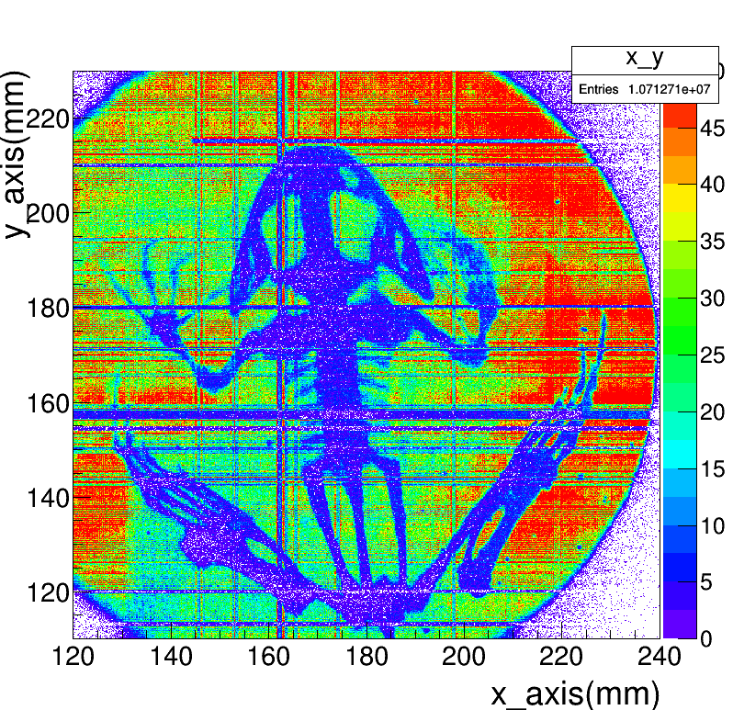
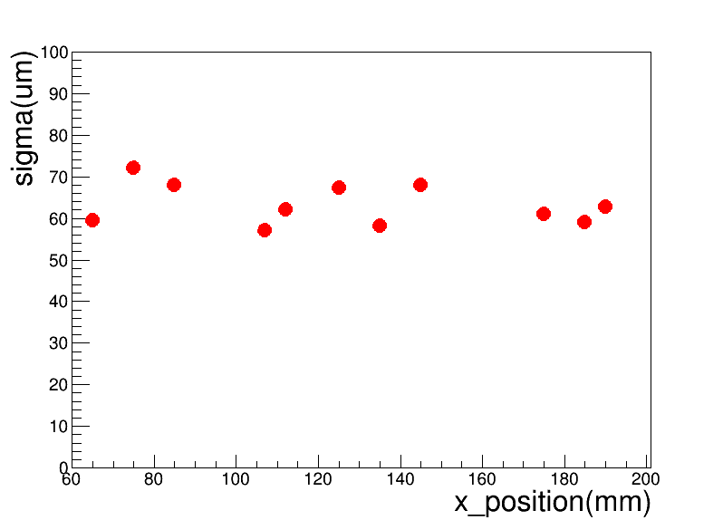
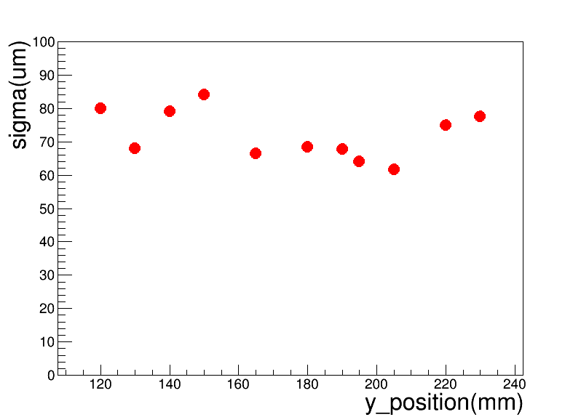
Spatial resolution result
2-D imaging
Frog bone
σ=63um
σ=68um
Typical spatial resolution： x~65um; y~70um

Slide 14
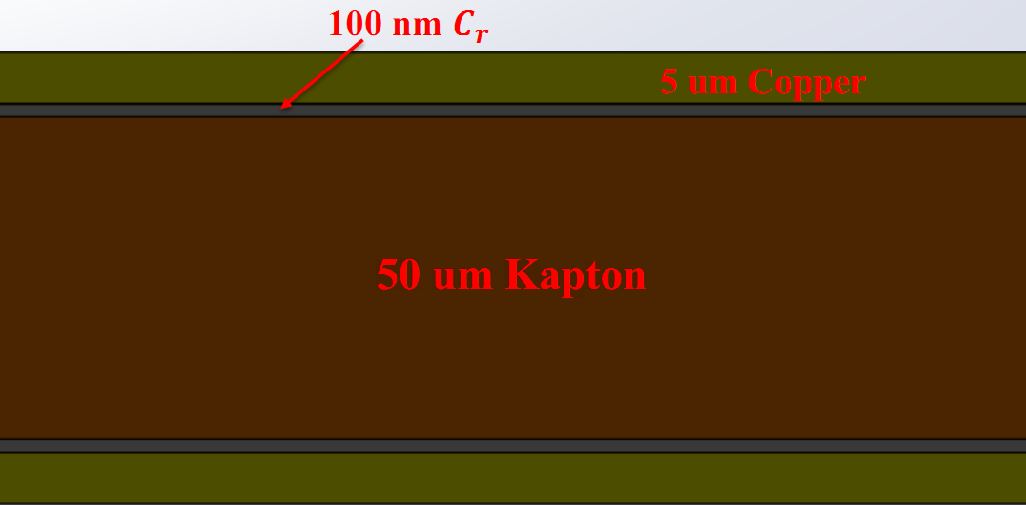
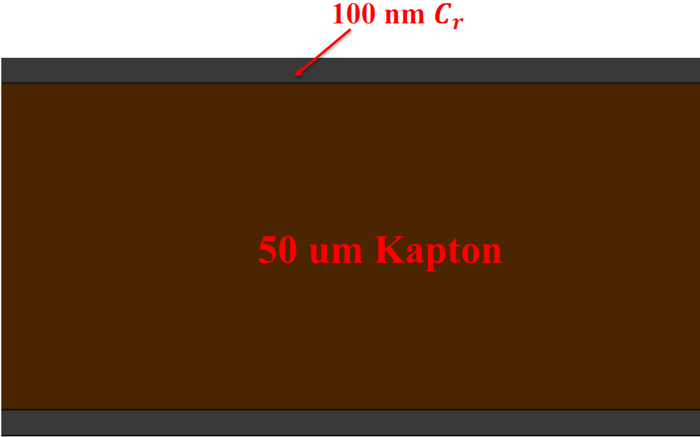
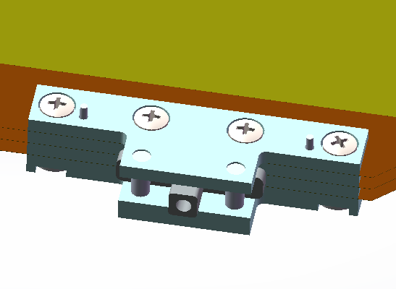
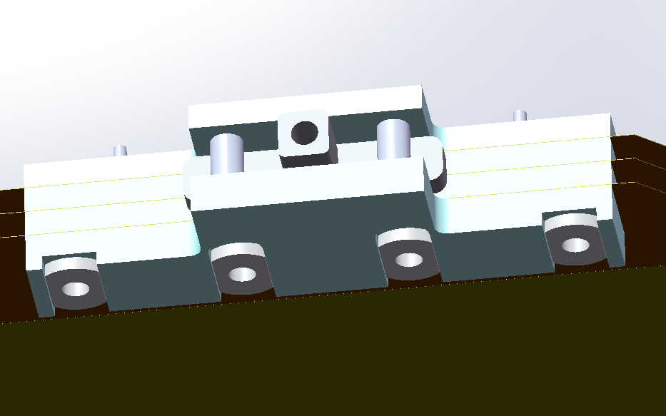
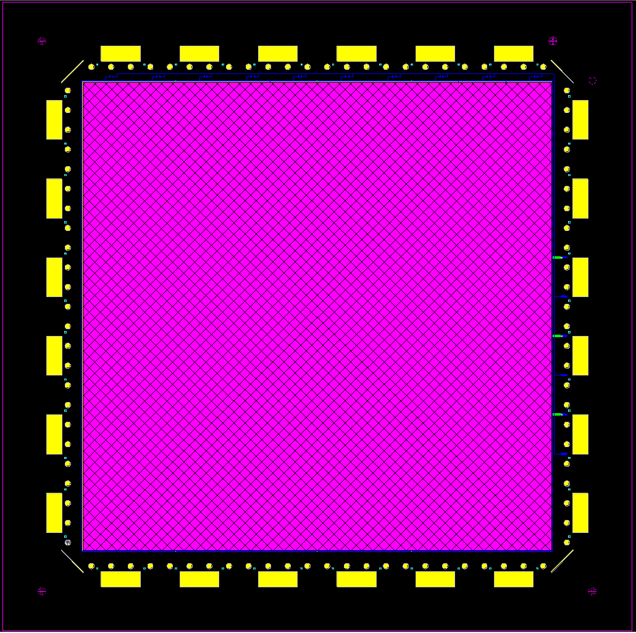
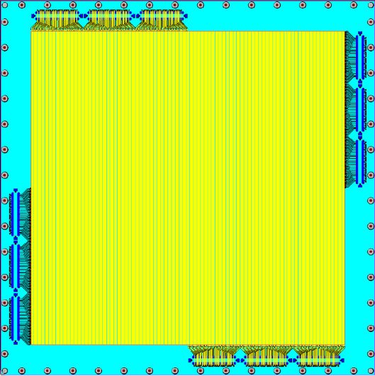
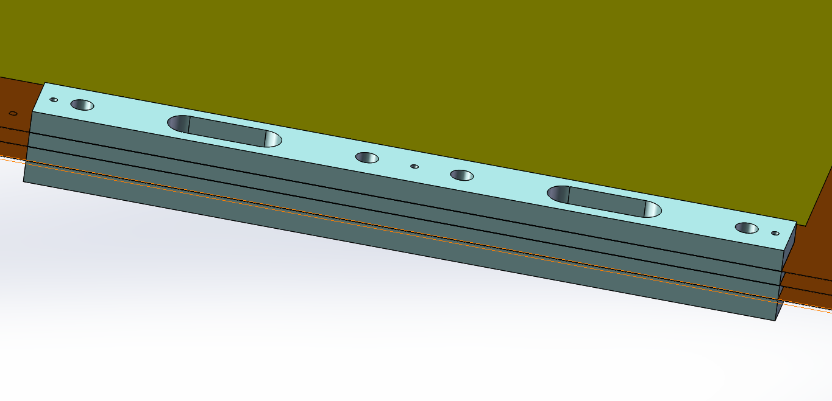
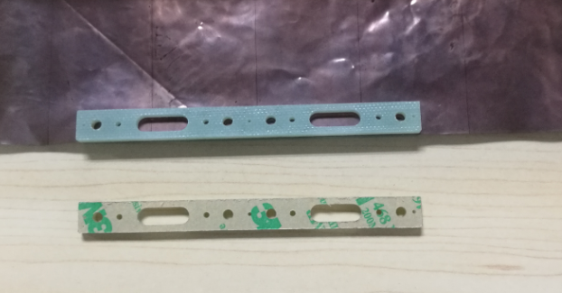
Future plan for low mass GEM
Copper-free
No inner screw
Metal screw
Standard GEM foil
Copper-free GEM foil
Double-sided adhesive
Copper Free Area
Light Material(Rohacell)
No metal screw
Thanks for R. De Oliveira’s help on Copper-free GEM

Slide 15
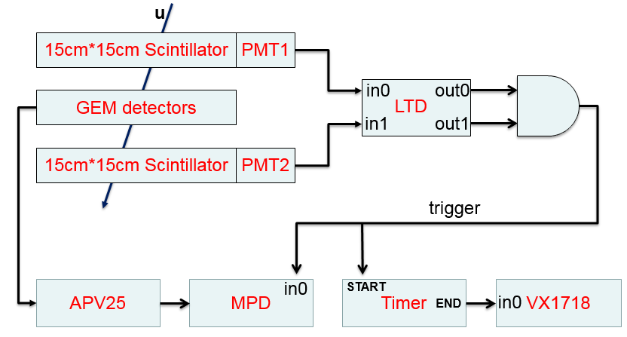
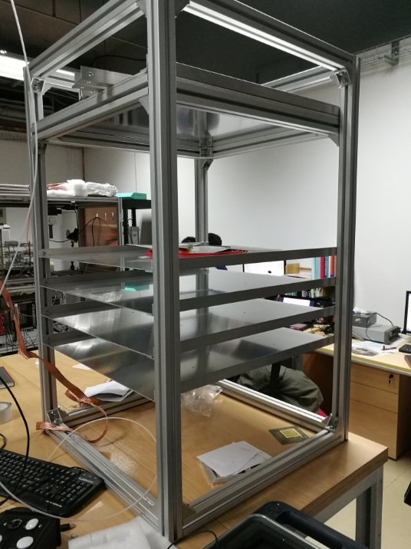
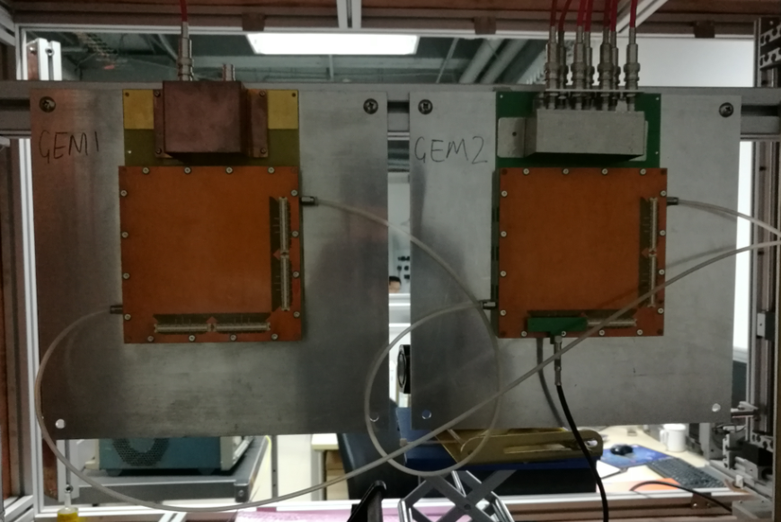
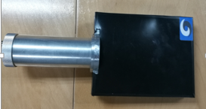
Future plan for cosmic ray system
System setup:
System platform;
Four 40cm×40cm GEM;
Two 15cm×15cm scintillator;
Two PMT;
readout system based on APV25.
10cm×10cm GEM
15cm×15cm scintillator
System platform
As the first step, we tried to use the 10cm×10cm to setup the cosmic ray system, then the larger GEM.

Slide 16
Conclusion and future work
We developed a new sliding self-stretching technique to assemble GEM detectors;
This new stretching technique improved the gain uniformity of 1m×0.5m GEM from 43% to 16%;
Typical spatial resolution of the 30cm×30cm double-GEM is about 65um(x-direction) and 70um(y-direction);
Spatial resolution of the 1m×0.5m GEM with the APV25 readout system will be tested;
We will work on the low mass GEM research;
We will finish the setup of the cosmic ray system.
Thanks

