Slide 1
Conceptual design of SoLID-TOF and aging test
  Wang Yi
Department of Engineering Physics, Tsinghua University
Outline:
  Conceptual design of SoLID-TOF
  Discussion of MRPC intrinsic resolution
  Aging test of glass
Aging test of MRPC
Conclusions

Slide 2
Motivation
JLab 6 GeV: precision measurements
high luminosity (10³⁹) but small acceptance (HRS/HMS: < 10 msr)
or large acceptance but low luminosity (CLAS6: 10³⁴)
JLab 12 GeV upgrade opens up a window of opportunities (DIS, SIDIS, Deep Exclusive Processes) to study valence quark (3-d) structure of the nucleon and other high impact physics (PVDIS, J/ψ, …)
High precision in multi-dimension or rare processes requires very high statistics → large acceptance and high luminosity
CLAS12: luminosity upgrade (one order of magnitude) to 10³⁵
To fully exploit the potential of 12 GeV, taking advantage of the latest technical (detectors, DAQ, simulations, …) development
→SoLID: large acceptance detector can handle 10³⁷ luminosity (no baffles)
10³⁹ with baffles

Slide 3
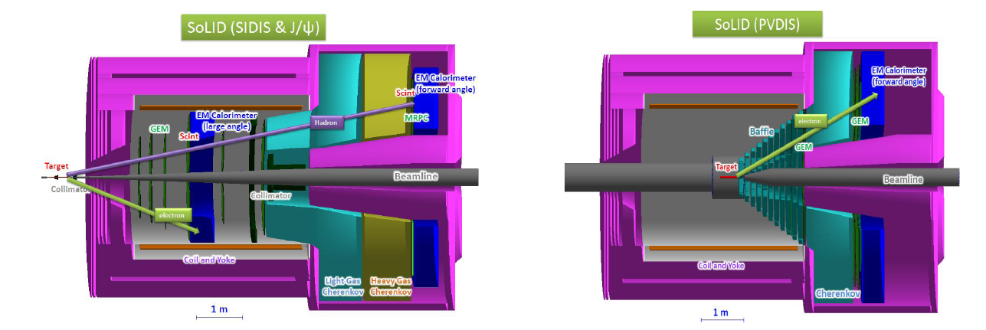
Overview of SoLID
Solenoidal Large Intensity Device
Full exploitation of JLab 12 GeV Upgrade
→ A Large Acceptance Detector AND Can Handle High Luminosity (10³⁷-10³⁹)
Take advantage of latest development in detectors , data acquisitions and simulations
Reach ultimate precision for SIDIS (TMDs), PVDIS in high-x region and threshold J/ψ
5 highly rated experiments approved (+3)
Three SIDIS experiments, one PVDIS, one J/ψ production (+ three run group experiments)
Strong collaboration (250+ collaborators from 70+ institutes, 13 countries)
Significant international contributions (Chinese collaboration)

Slide 4
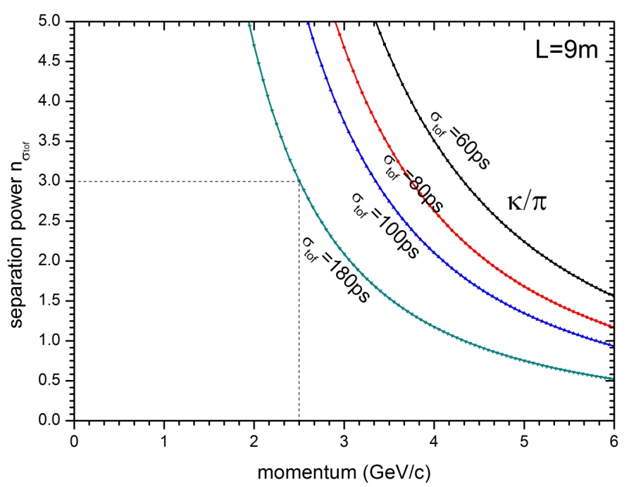
Main requirements for TOF
The MRPC is developed for the TOF of SoLID
Main Requirements for TOF:
  π/k separation up to 2.5GeV/c
  Time resolution < 100ps
  Rate capability > 10kHz/cm²
To separate very few K from π, we require the TOF time resolution as good as possible.
We have to improve the time resolution to about 20ps.

Slide 5
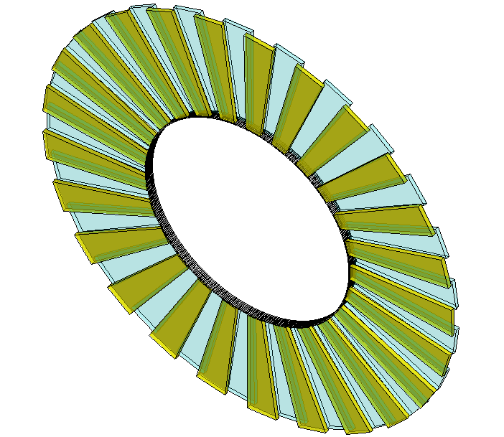
Conceptual design of SOLID-TOF
MRPC TOF wall we designed contain 150 MRPC modules in total, with 50 gas boxes and 3 counters in each box, covering the area of 10m².
MRPC3
28cm
MRPC2
16cmm
100cm
MRPC1
Total channel ~3600

Slide 6
Introduction of MRPC
MRPC is made of thin
glass, large area and cheap
The inner glasses are
floating, take and keep
correct voltage by
electrostatics. it is
transparent to fast signals
Thin gap->good timing
Multi-gap-> high efficiency
Read out
Insulator
Carbon
Resistive plate
Insulator
Read out
Standard parameters:
Resistivity of glass: ~10¹² Ω.cm
Time resolution <100ps
Efficiency >95%
Dark current: a few nA
Noise <1Hz/cm²
Application in nuclear physics experiments
Application in industry（Muon tomography)
Application in medicine（TOF-PET）
6
6

Slide 7
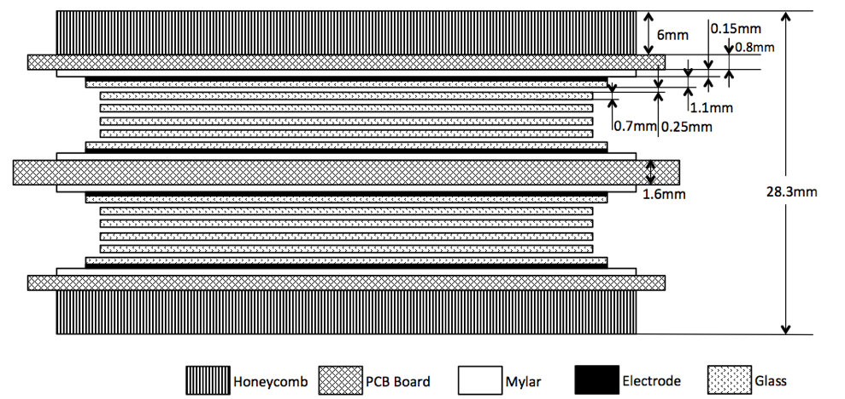
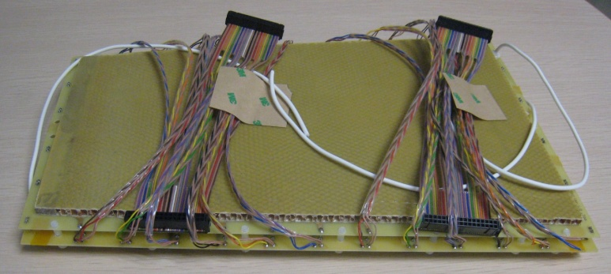
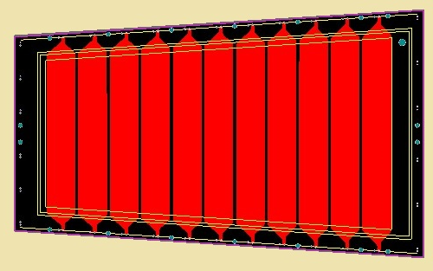
A MRPC prototype for SoLID-TOF
Volume resistivity: ~10¹⁰Ω.cm
25mm
Material dimensions
 | Length/mm | Width/mm | Thickness/mm
Gas gap | - | - | 0.25×10
Inner glass | 320 | 130-171 | 0.7
Outer glass | 330 | 138-182 | 1.1
Mylar | 335 | 153-198 | 0.18
Inner PCB | 350 | 182-228 | 1.6
Outer PCB | 350 | 172-218 | 0.8
Honeycomb | 330 | 153-198 | 6
171mm
219mm
363mm

Slide 8
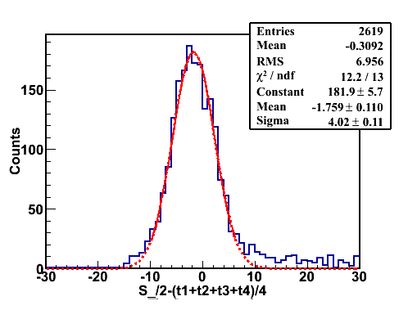
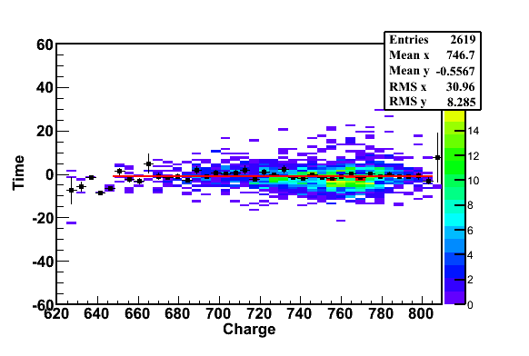
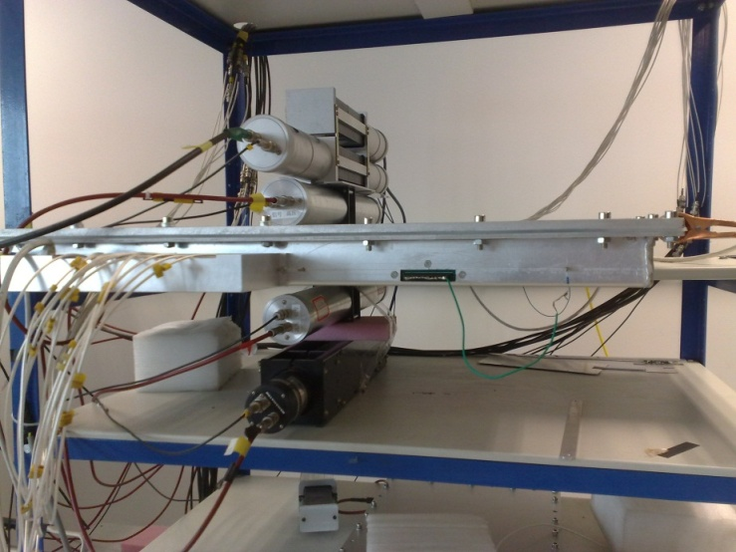
Cosmic test
Cosmic ray test@Tsinghua August, 2011
PMT0
PMT1
PMT2
MRPC
PMT3
PMT4
Cosmic Ray Muon
Efficiency > 95% @ 96kV/cm (6.0kV)
Time resolution: ~ 52ps

Slide 9
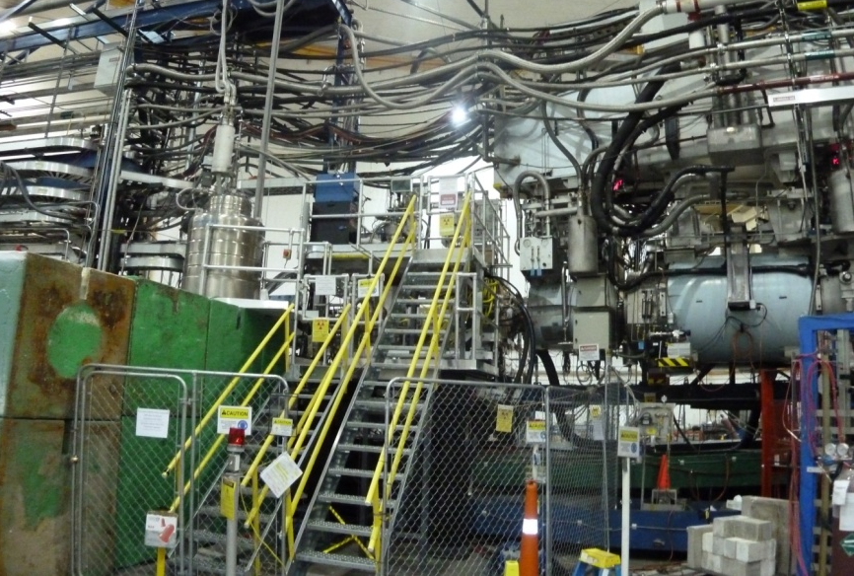
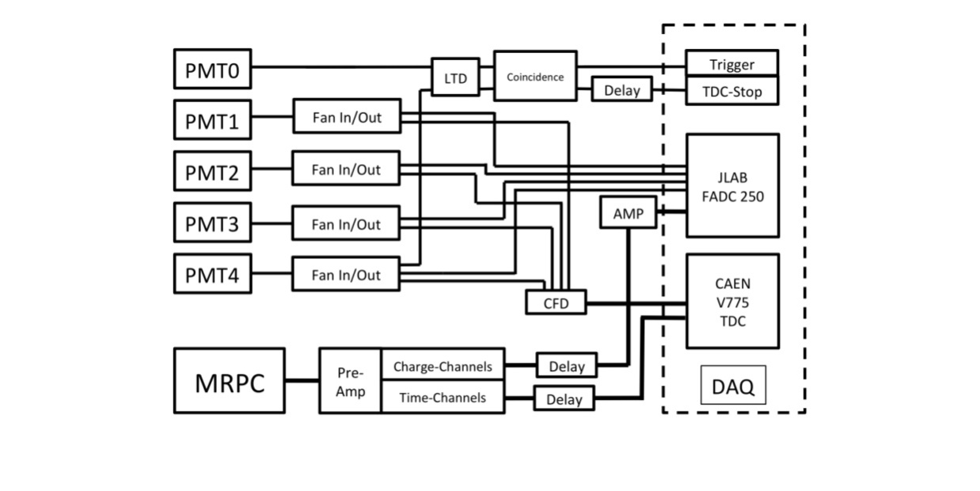
Beam test @ Hall A
High Energy e-
Shield
PMT1
PMT3
Target
PMT0
PMT2
PMT4
Top View
The diagram of DAQ system
Target
Test setup

Slide 10
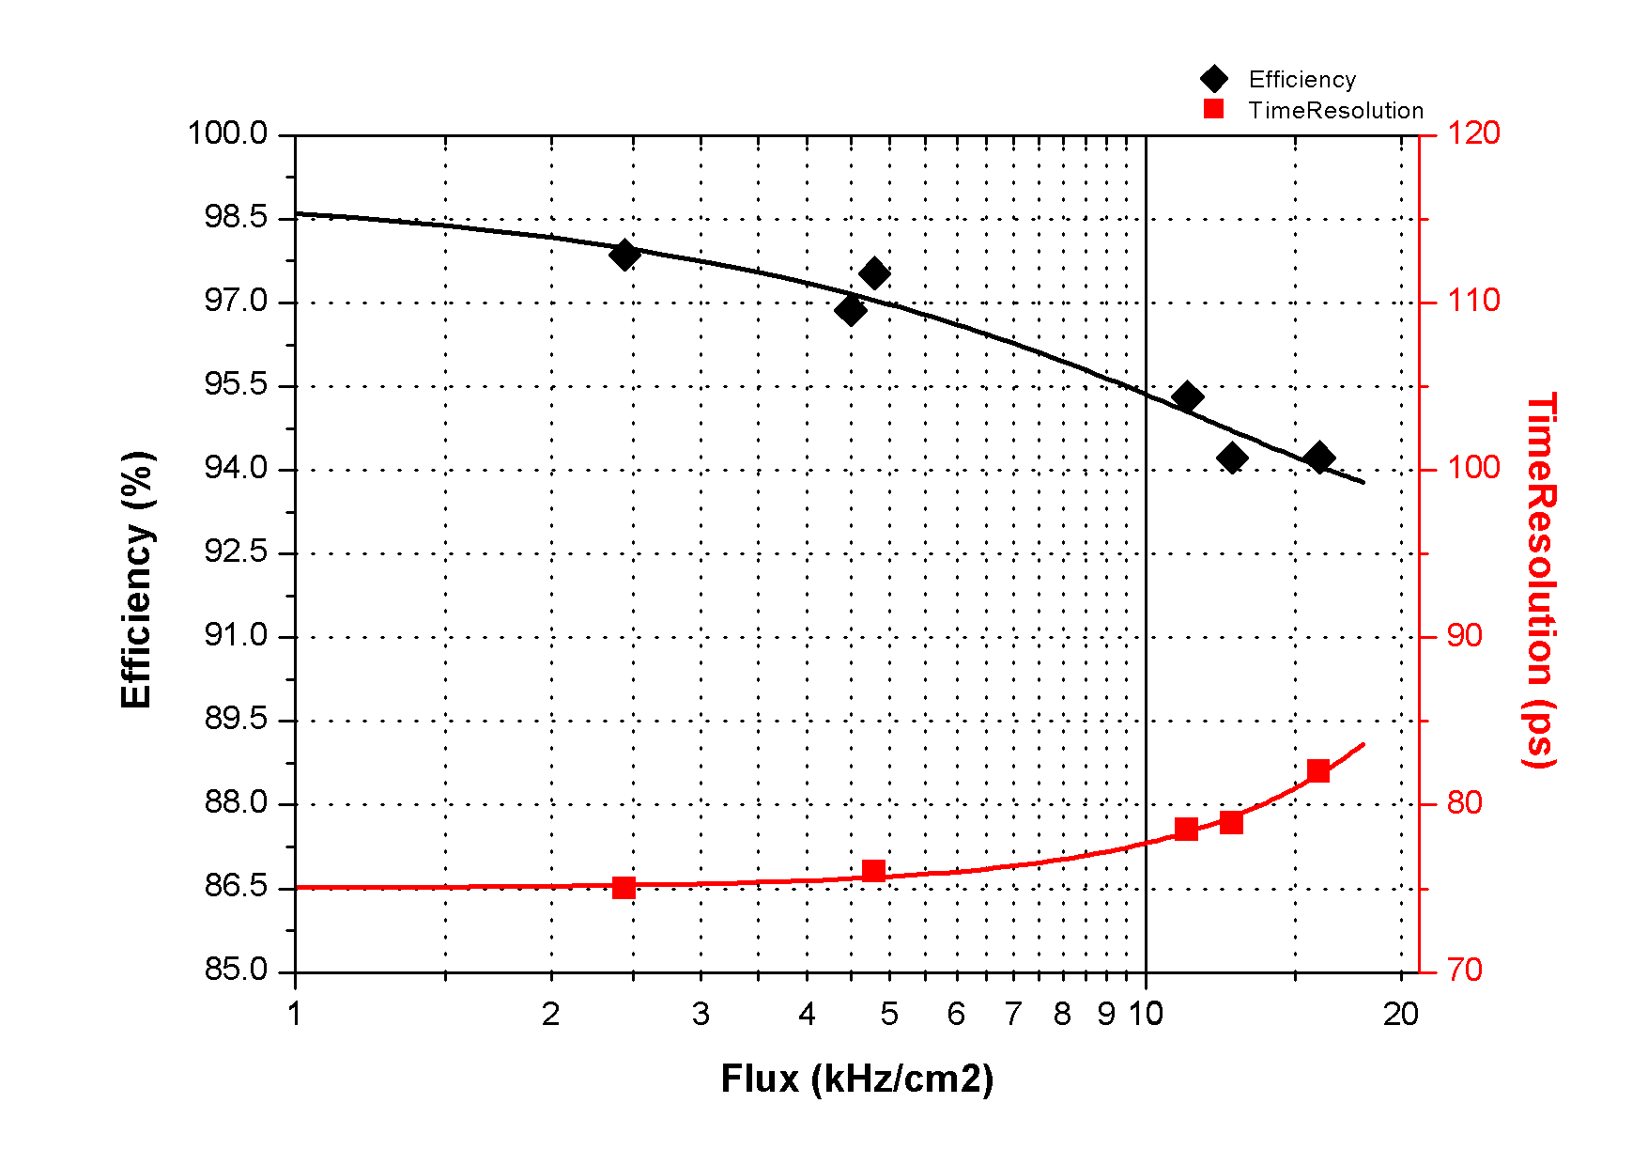
Rate Performance
Voltage: 6800V
Flux:11kHz/cm²
Efficiency:~95%
Time Resolution: 78ps
Flux:16kHz/cm²
Efficiency:~95%
Time Resolution: 82ps

Slide 11
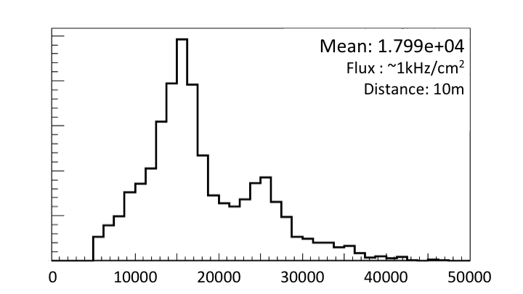
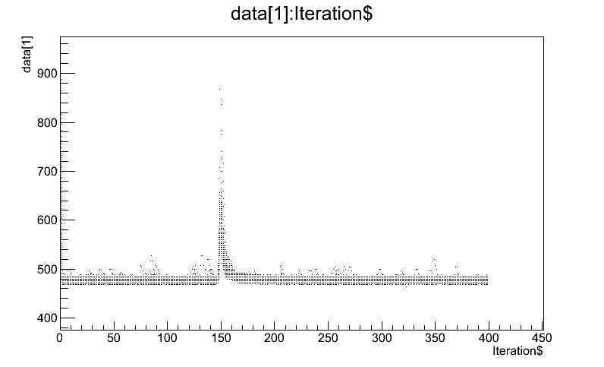
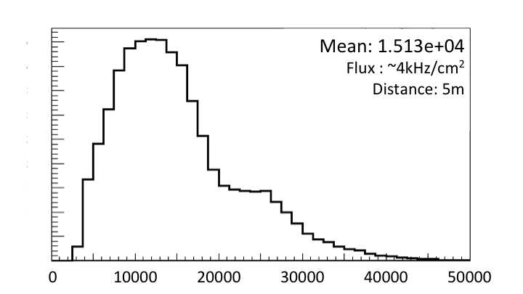
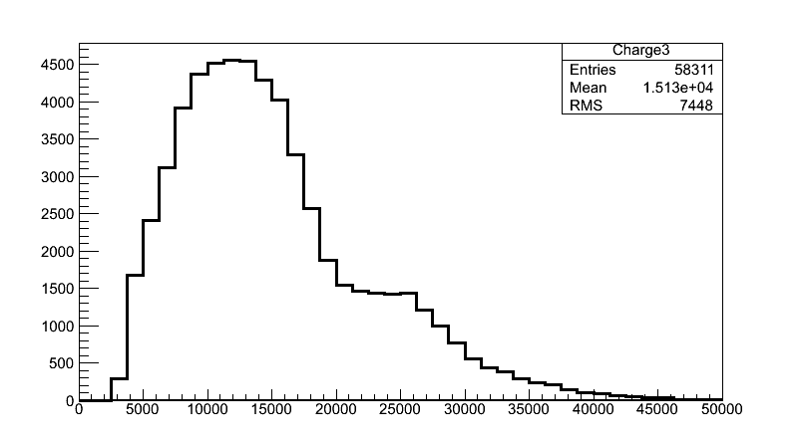
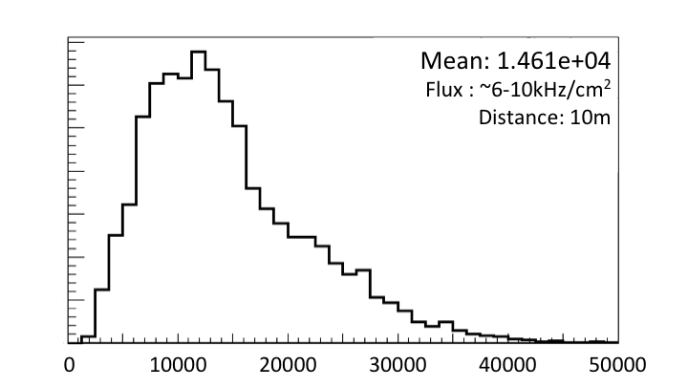
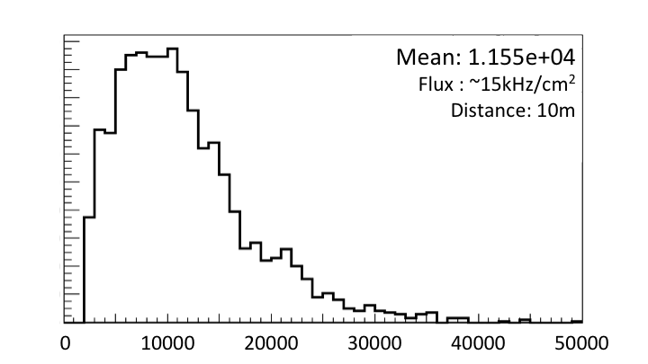
Charge Distribution
Signal
Base Line
Charge spectrum at different rate
Significant reduction of charge distribution can be seen as the background rate increases.
The reduction of electrical field is caused mainly by both background irradiation and electron beams.
Rate capability of the counter is higher than 16kHz/cm².

Slide 12
TOF electronics
Fast preamplifier：
Ninos (TOT) (ALICE)
Padi (TOT) (GSI)
CAD (TOT) (Tsinghua)
Low time jitter faster FEE
TDC
HPTDC (ALICE, 25ps/ch)
GET4 (GSI, 25ps/ch)
FPGA TDC (GSI and other)
Pulse wave form digitizer
DAQ

Slide 13
Intrinsic resolution of 10gap-MRPC
Time jitter of HPTDC 25ps
NINOs ASIC+Interface card 24ps
MRPC resolution tested 40ps
So the intrinsic resolution of MRPC is:

Slide 14
Resolution of 24 x140μm MRPC
Fast wave form digitizer 30-> 5ps
Low time jitter fast FEE 24-> 5ps
MRPC intrinsic 20-> 13ps
Time resolution of TOF:
14

Slide 15

TOF PID at the EIC
@ 1m distance | Distance | Pion-Kaon Separation | Kaon-Proton Separation
σ_{tot}=100 ps | 1m
σ_{tot}=10 ps | 1m
σ_{tot}=10 ps | 3m
Momentum reach of TOF PID reaches interesting levels if one can achieve ~ 10 ps
TOF Positives
Compact (10-15 cm of space needed), allowing more room for, e.g., RICH
More clean PID
Can contribute to e/h identification using TPC dE/dx
TOF Negatives
Start counter?

Slide 16
Configuration of eRD10 Prototype mRPC
PCB
glass
Crispin Williams
BNL&UIUC Prototype
4 x
4 x
Gas gap width : 160um
(16ps timing resolution)
Gas gap
Gas gap width : 105um
 | MRPC ( C. Williams et al. ) | MRPC ( UIUC & BNL)
Gas Gap Width | 160um (fishing line) | 105um (fishing line, and 165, 125, 75um)
# of Gas Gaps | 4 stack x 6 layers = 24 | 4 stack x 9 layers = 36
# of thin glass layers | 4 stacks x 5 layers = 20 (250um thick glass) | 4 stack x 8 layers = 32 (210um thick glass)
Preamplifier | Differential type, NINO chip | LMH6881 2.8-GHz + Evaluation Board
TDC and DAQ | Oscilloscope (10Gs) | DRS4-V5(5Gs) + PC
Time resolution | 20 ps published (16 ps private comm) | 18ps
16

Slide 17
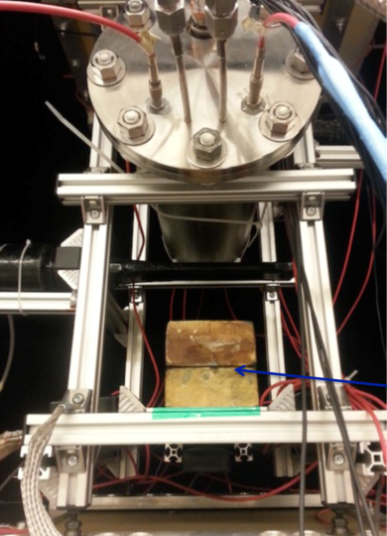
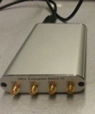
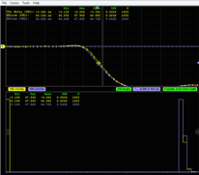
Time Resolution Measurement at UIUC
DC0,1,2
SC1
SC2
Muon trigger
Gas Cylinder
preamp
50 Ohm cable (<1m)
MRPC-A
ch2
DRS4-V5
(Wave form digitizer)
USB
PC
(DAQ)
MRPC-B
ch2
preamp
SC3
Pb Block
SC4
DC3,4
Gas Mixture : “Freon” (R134a) 90% : Iso 5% : SF6 5%
17

Slide 18
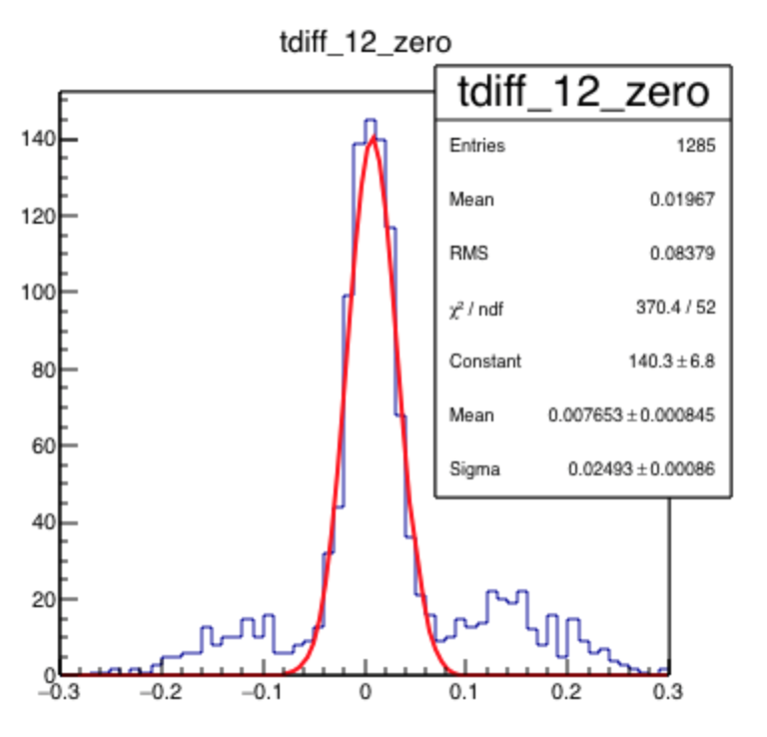
Time resolution
Difference between time of top and bottom mRPC, Δt = t₂ – t₁= 25 ps
  σ_{t} = Δt/√2 = 18 ps
  Used a “Leading Edge Discriminator technique” in software from waveform, slew corrected
  Difference in pathlength taken into account
  Wings possibly due to noise, cross-talk, streamers, or something else?
We believe best published result is 20 ps
  Nucl.Instrum.Meth. A594 (2008) 39-43
  Nucl.Instrum.Meth. A629 (2011) 106-110
18

Slide 19
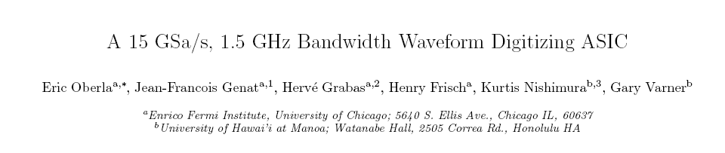
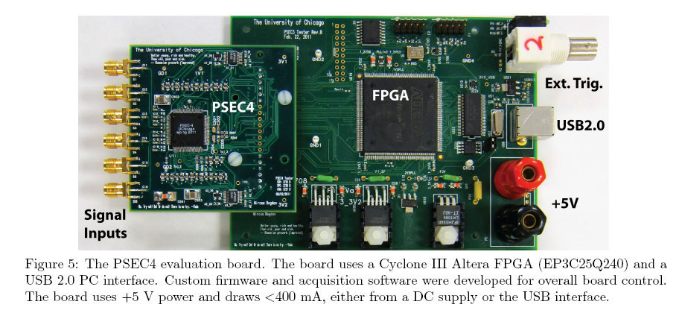
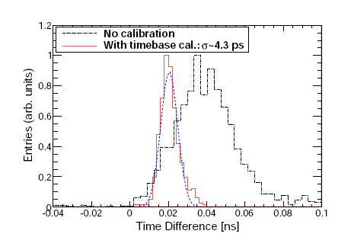
15Ghz wave form digitizer
19

Slide 20
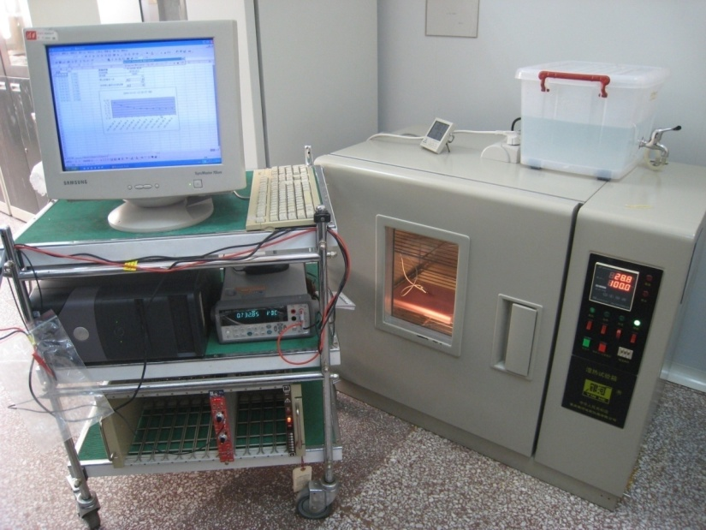
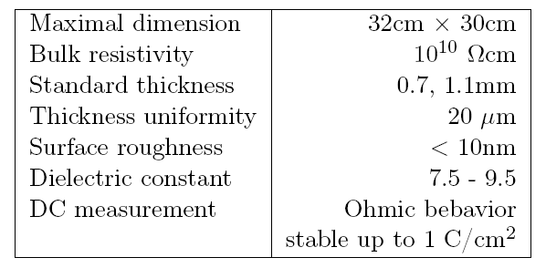
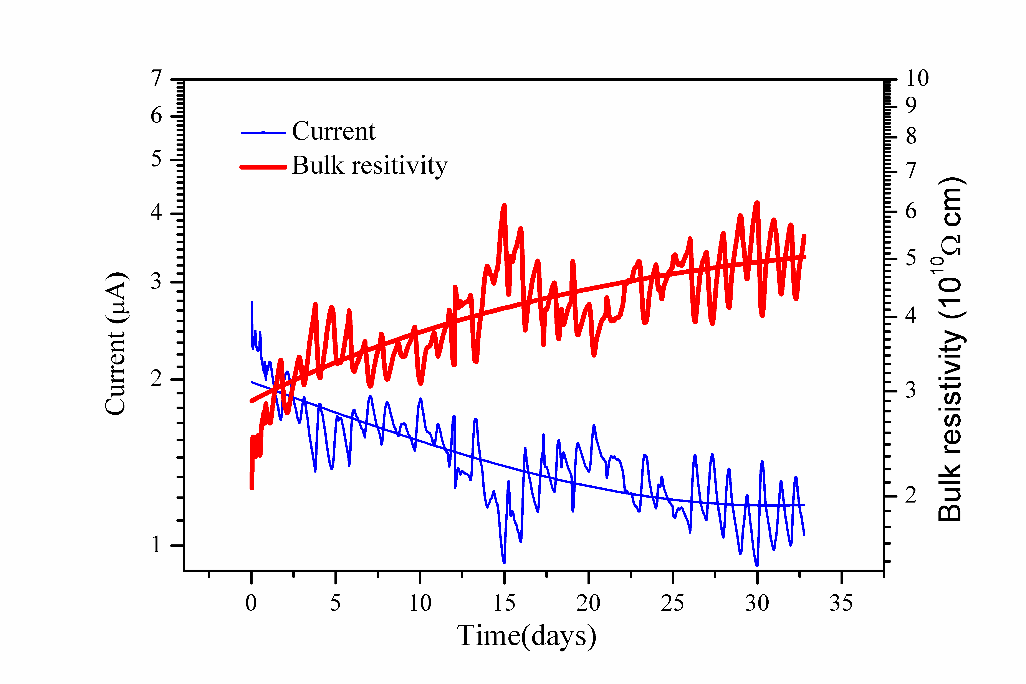
Aging test of low resistive glass
This glass was applied with 1000V for about 32days, integrated charge: 1 C/cm²
--roughly corresponding to the CBM life-time over 5 years operation at the maximum particle rate.
Glass specifications:

Slide 21
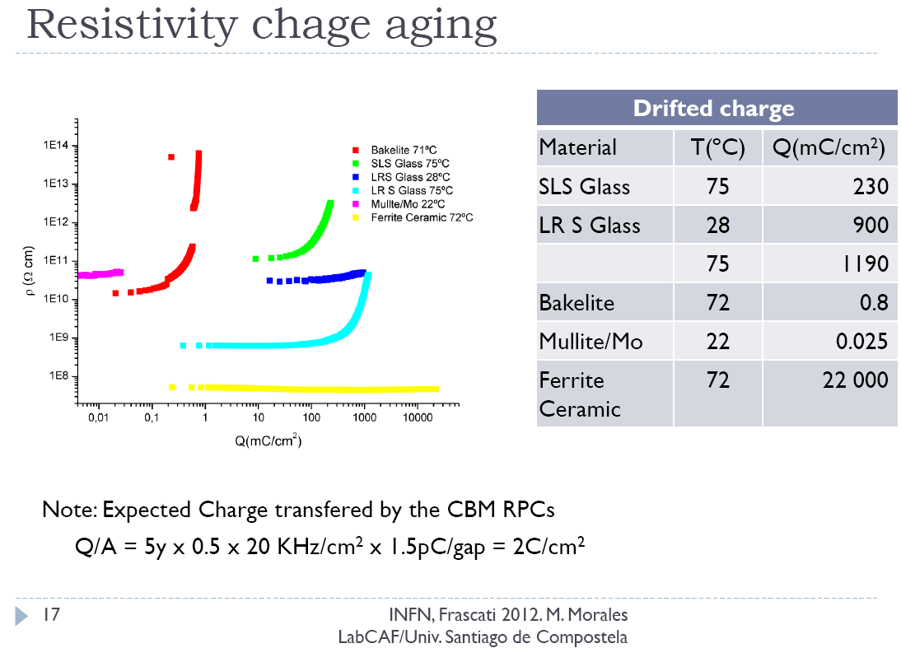
Comparasion with other material
Morales talk @RPC2012
21
21

Slide 22
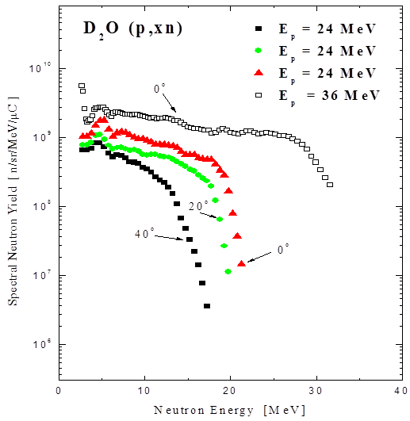
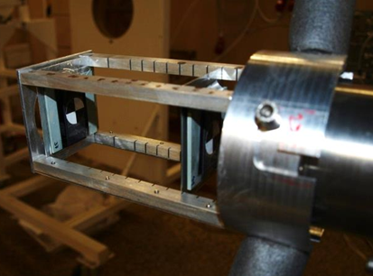
Neutron Test
Cyclotron U-120M (Řež)
Proton energy 36 MeV
Neutron production target Be
Neutron flux 10⁸ - 10¹⁰ n/cm²/s
Neutron energy spectra 1 – 36 MeV
Neutron energy spectrum
target support
Special thanks to A. Kugler and
O. Svoboda for their strong support.
22

Slide 23
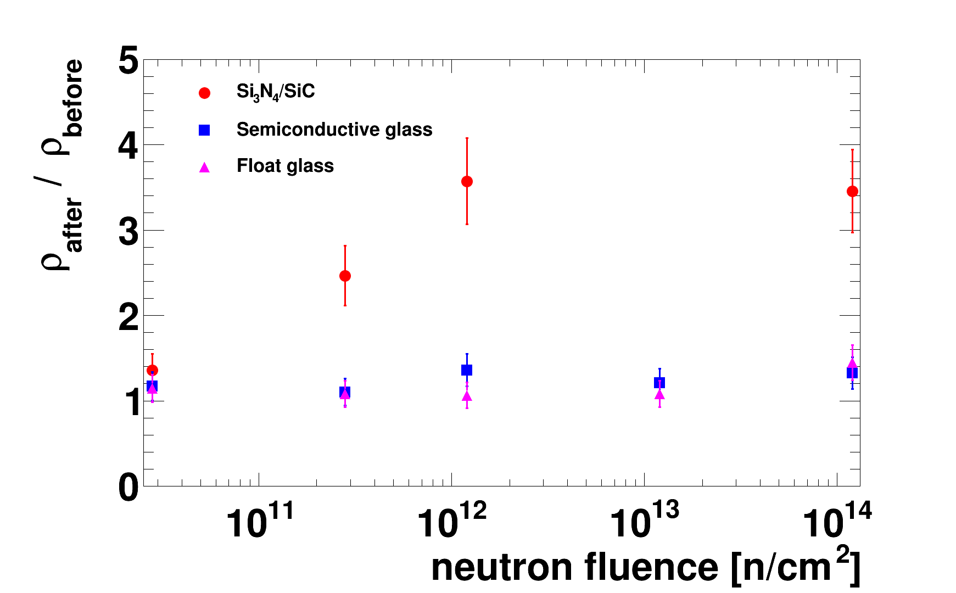
Test result

Slide 24
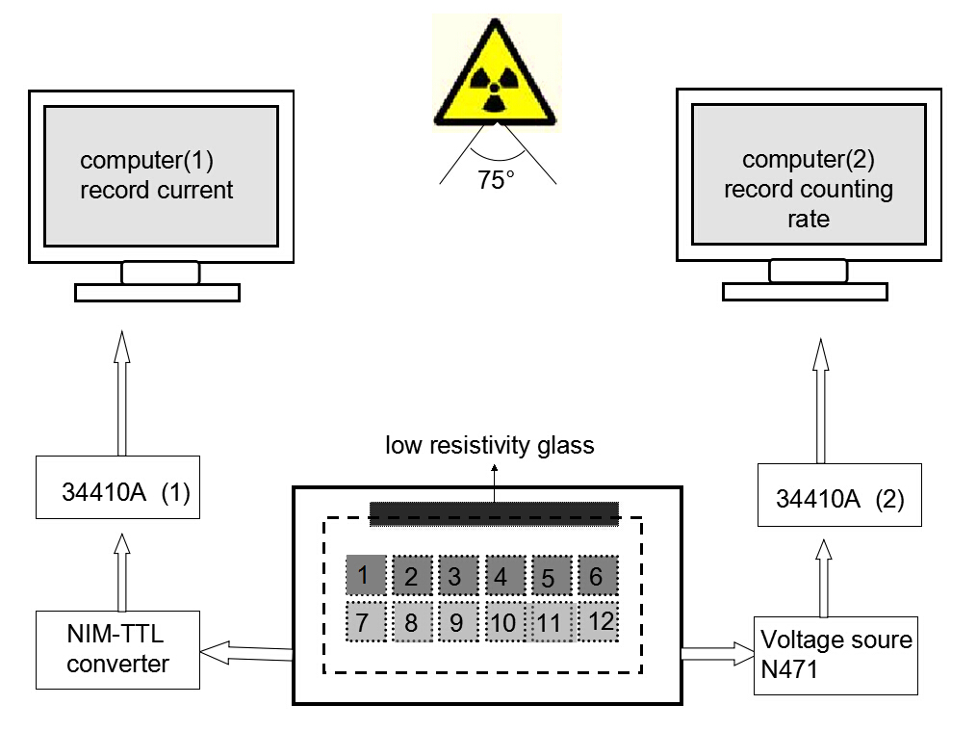
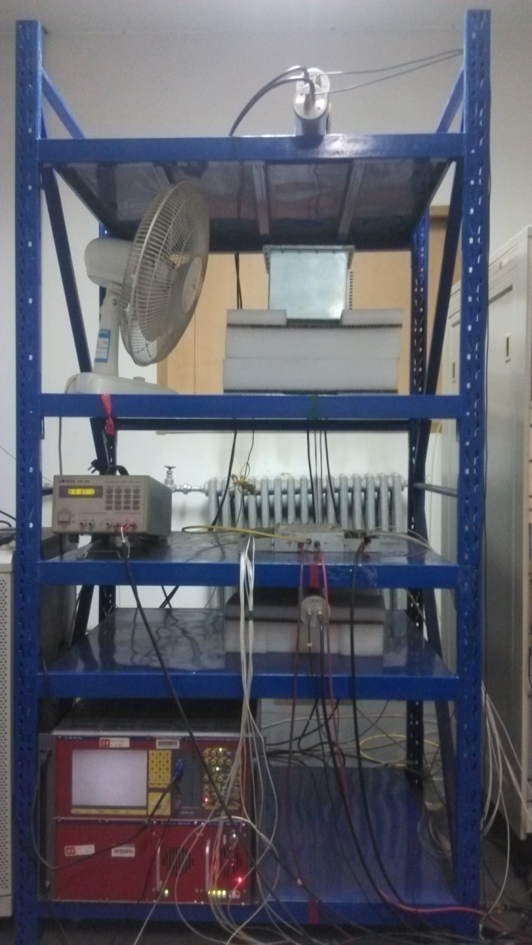
Online irradiation test
X-ray Generator
130cm
60cm
Hign rate MRPC
This is online test system. The efficiency and time resolution can be obtained by cosmic ray while irradiated by X-rays. 0.1C/cm² charge is accumulated in 35 days.

Slide 25
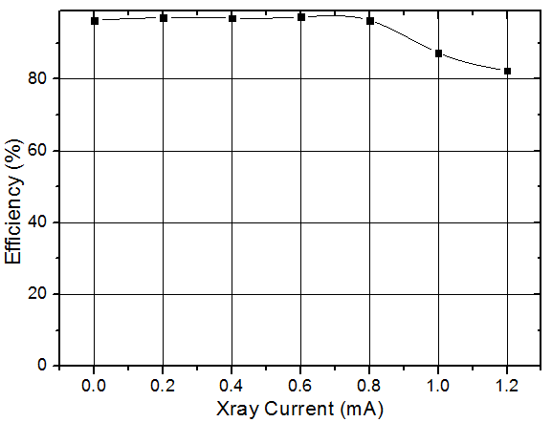
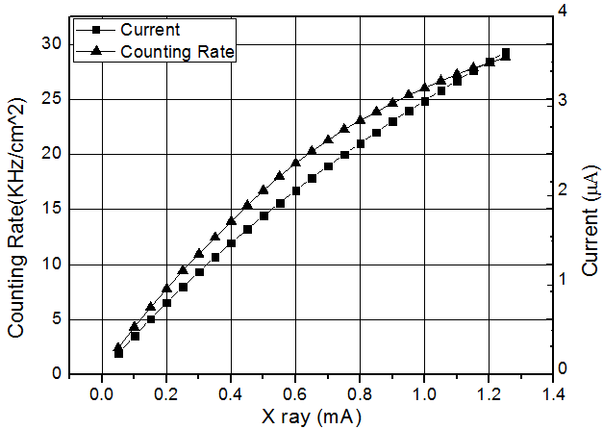
Determination of X ray strength
Current，counting rate and efficiency change with X ray strength

Slide 26
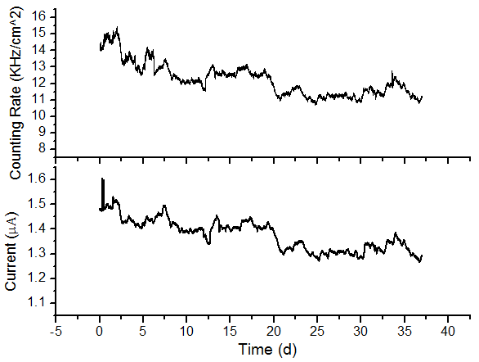
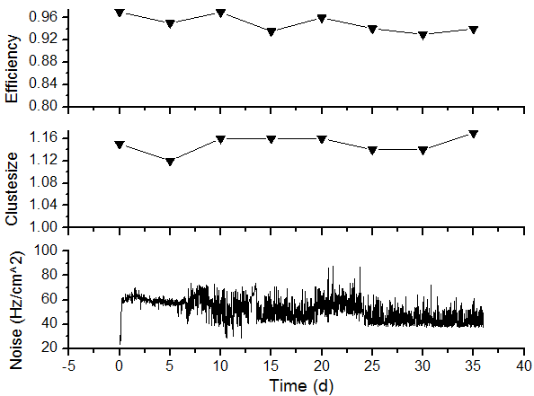
Performance Vs Dosage
By monitoring the performance on line, we can grasp the detector condition simultaneously.

Slide 27
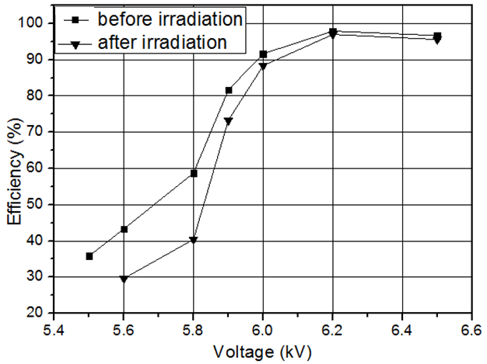
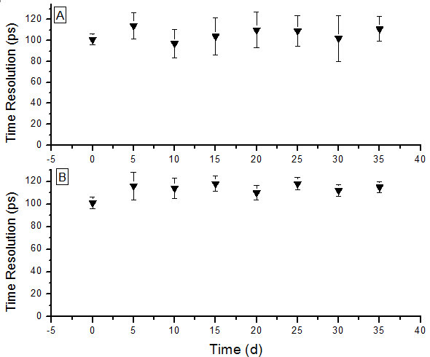
Performance Vs Dosage
~500 events/5days
More events ->Better statistics

Slide 28
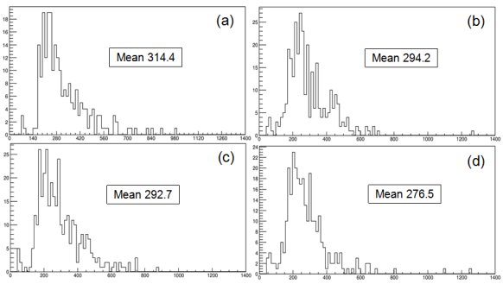
Charge spectrum
With the increase of dosage, the average charge decreased gradually, this is mainly from space charge effect.

Slide 29
Conclusions
A SoLID-TOF MRPC prototype is developed, its time resolution is 75ps, rate capability reach 16kHz/cm².
MRPC intrinsic resolution can reach 13ps. Fast FEE and high band width wave form digitizer has to be used to improve TOF resolution -> 15ps.
From high voltage and neutron radiation test, we did not find any aging problem for low resistive glass.
We also studied the long term stability of the MRPC. 0.1C/cm² charge is accumulated. No obvious performance degradation is observed.

Slide 30
Thanks for your attention !

