Slide 1

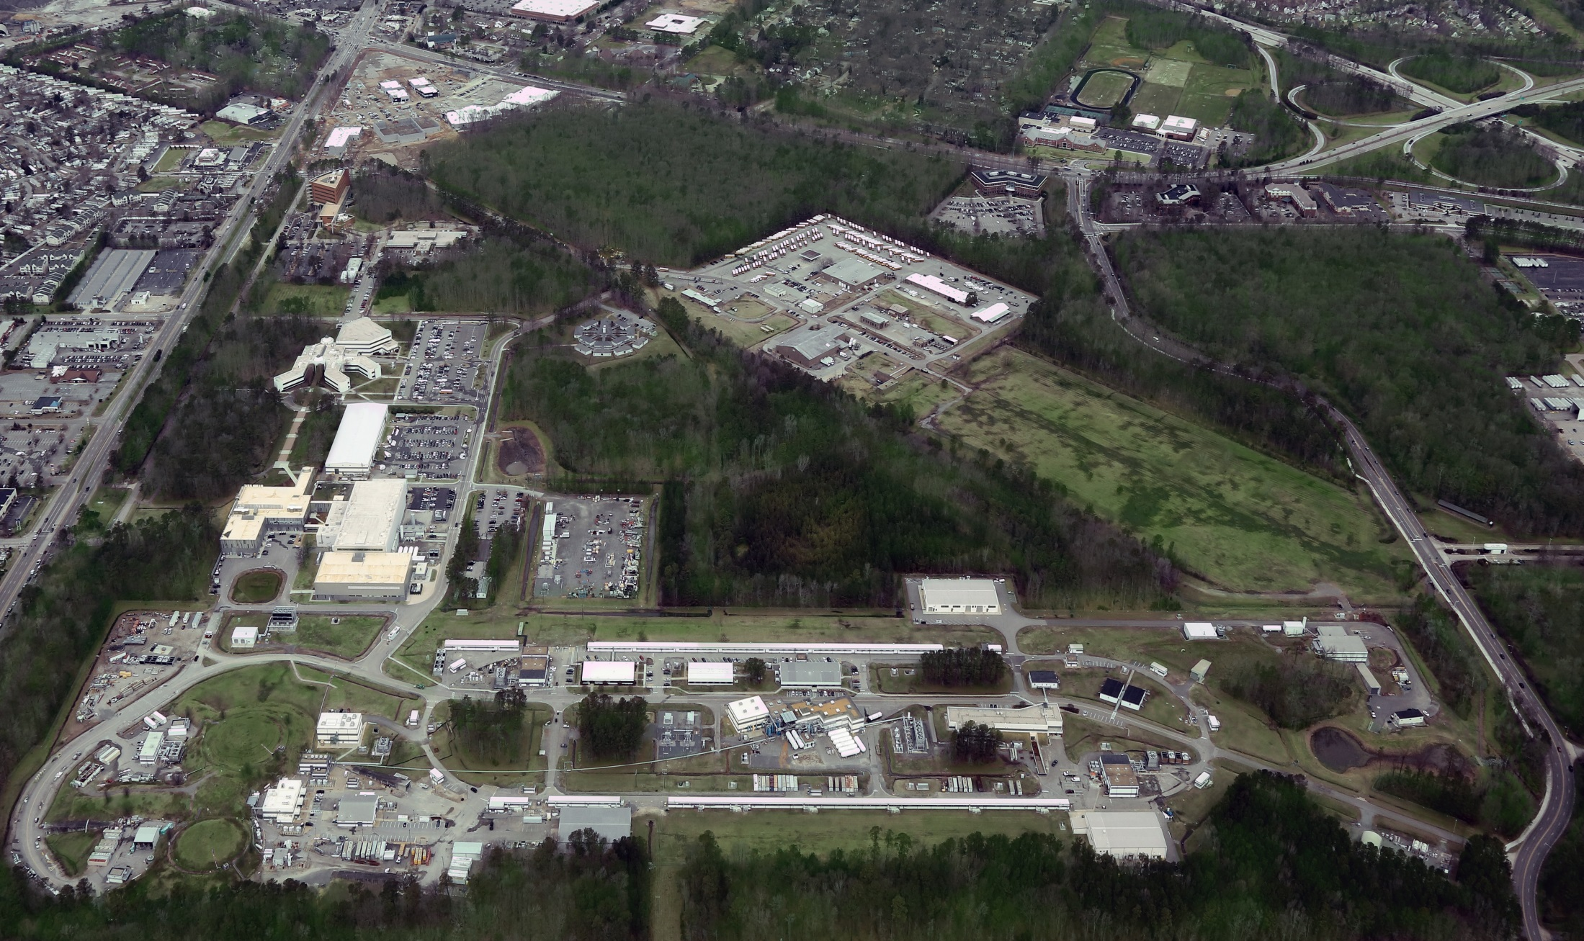
Jefferson Lab Overview
R. D. McKeown
August 3, 2015

Slide 2
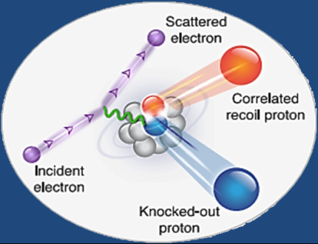
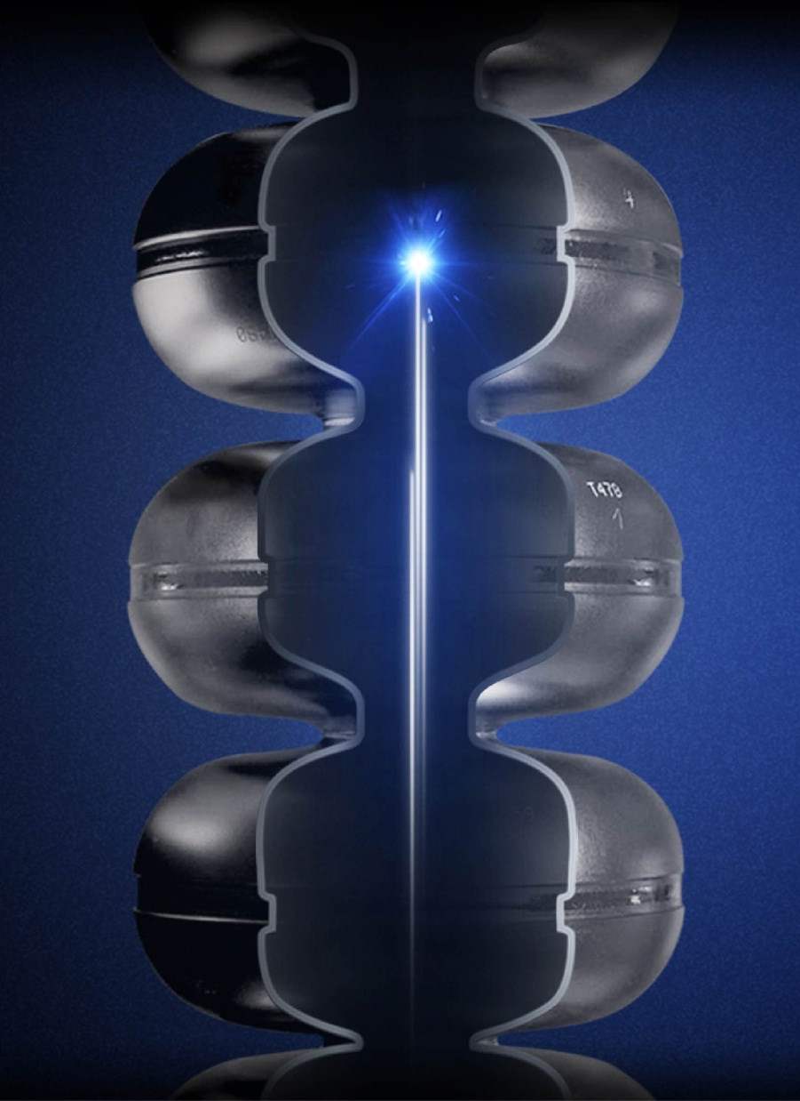
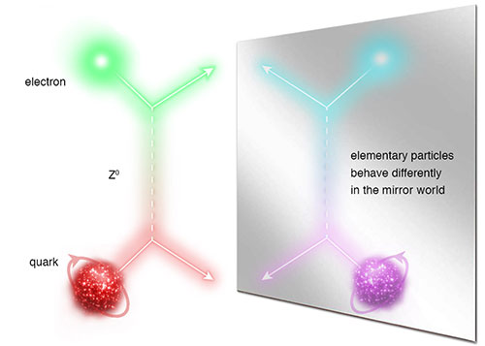
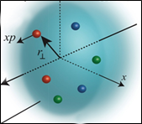
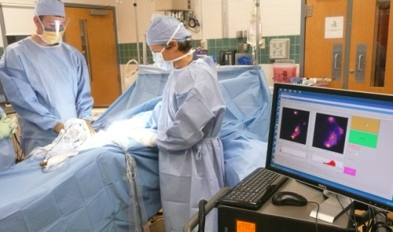
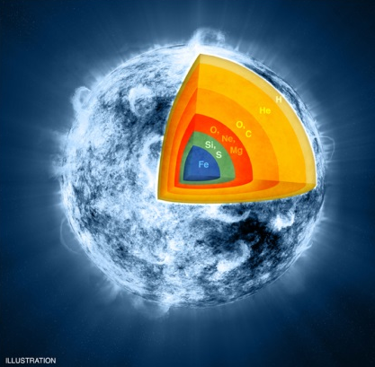
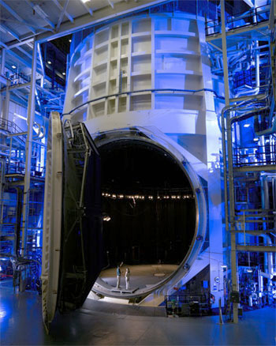
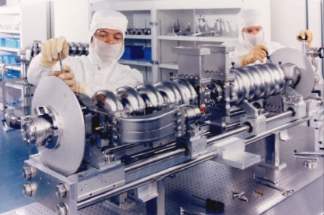

JLab: A Laboratory for Nuclear Science
Z⁰
Nuclear Structure
Fundamental
Forces & Symmetries
Structure of Hadrons
Medical Imaging
Nuclear Astrophysics
Accelerator S&T
Cryogenics
Theory & Computation

Slide 3
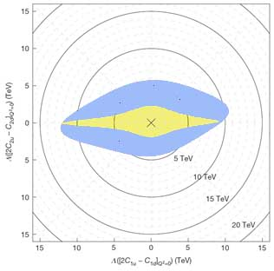
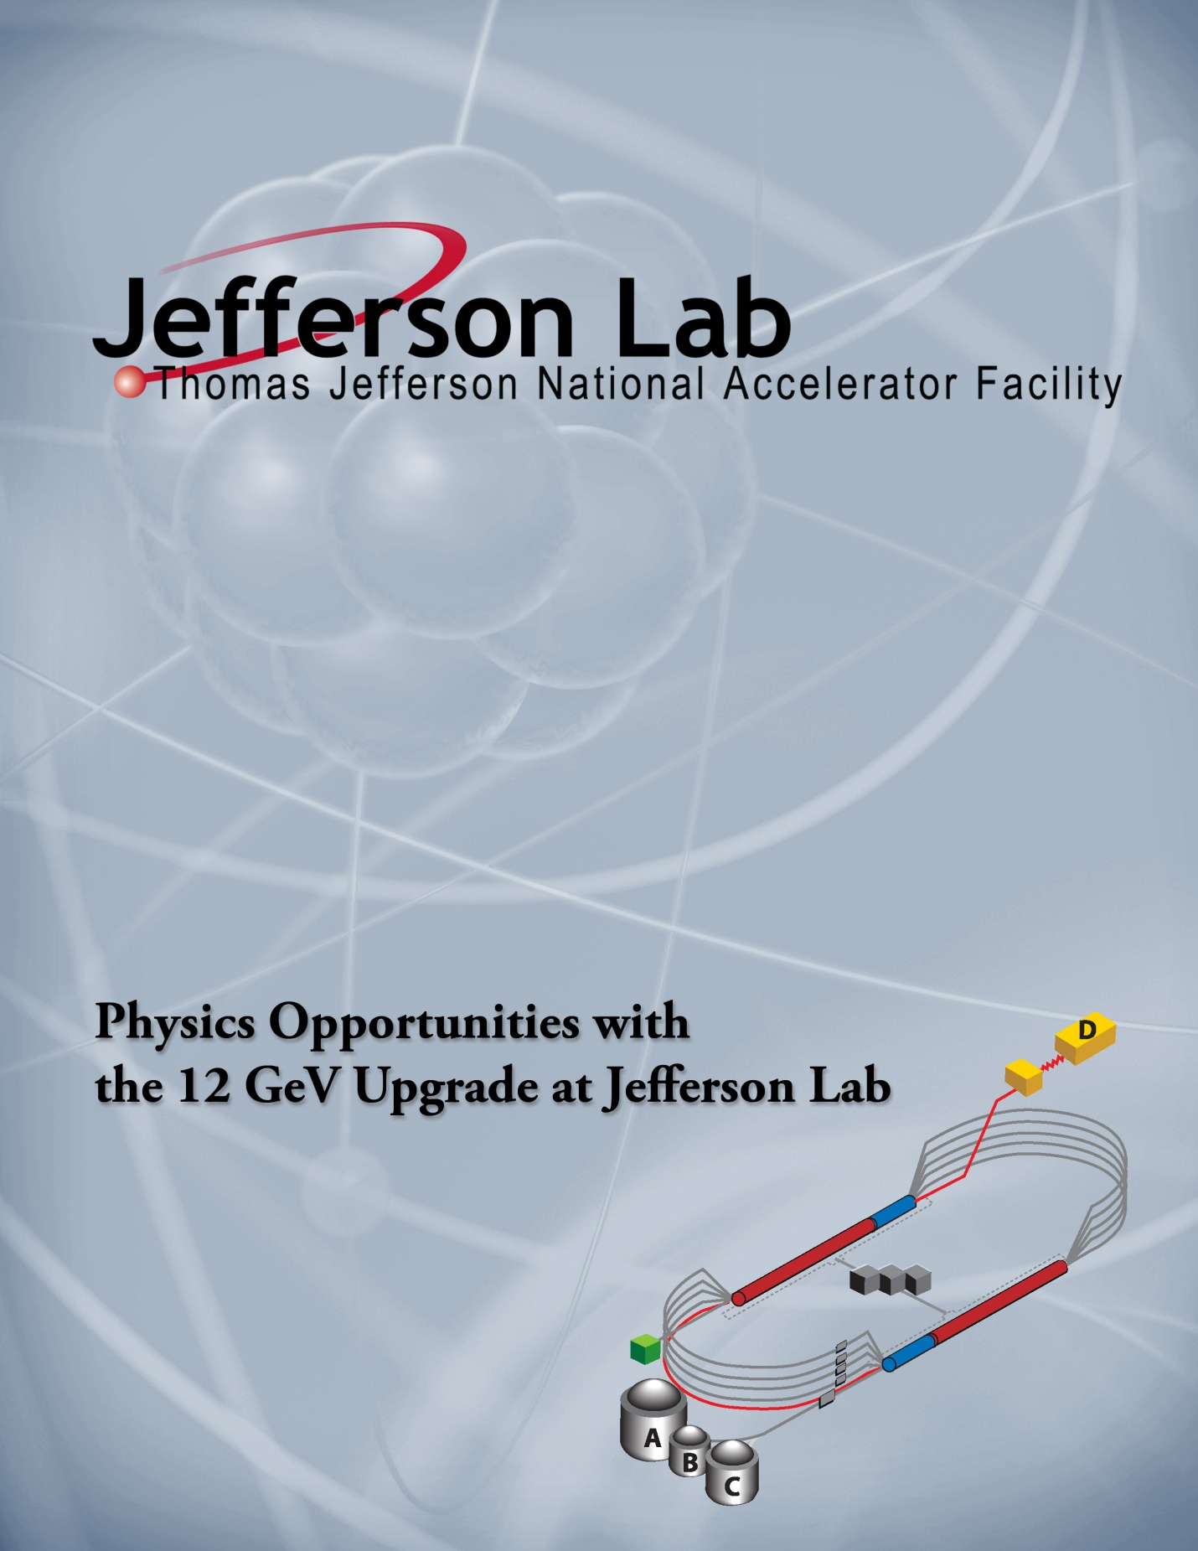
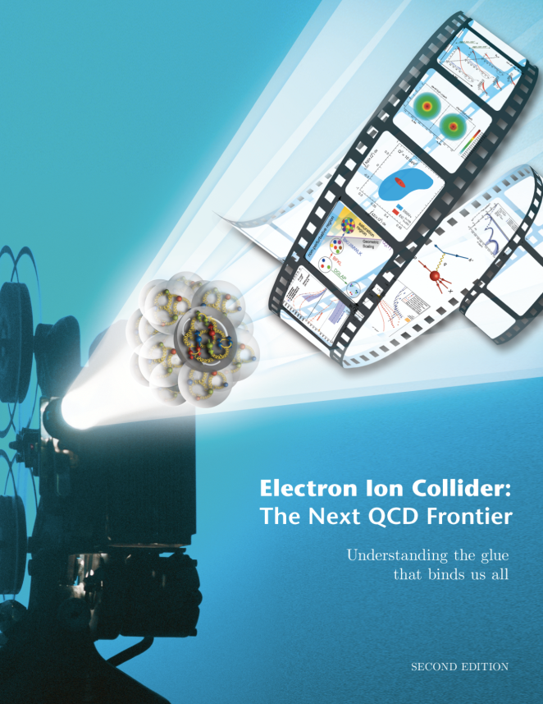
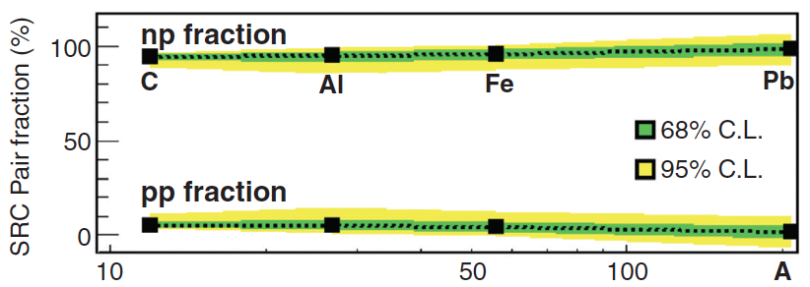
JLab 2014 Near-Future Future
Nature 506, 67 (6 February 2014)
Parity Violating DIS
Decade of Experiments Approved
Eager to Start 12 GeV Science!
Electron Ion Collider
The Next QCD Frontier
SLAC E122
JLab PVDIS
Science 346, 614 (October 2014)
Short Range NN Correlations
Confinement
Hadron Structure
Nuclear Structure
and Astrophysics
Fundamental Symmetries
Role of Gluons in Nucleon and Nuclear Structure
3
Notes:
Removed of “long” and sea quarks

Slide 4
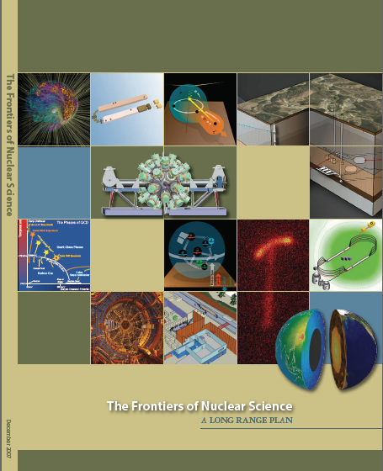
12 GeV Upgrade Project
Completion of the
12 GeV CEBAF Upgrade was ranked the highest priority in the 2007 NSAC Long Range Plan.
Upgrade is designed to build on existing facility: vast majority of accelerator and experimental equipment have continued use.
New Hall
Upgrade arc magnets
and supplies
Add 5 cryomodules
20 cryomodules
CHL upgrade
Add arc
20 cryomodules
TPC = $338M
ETC = ~$22M
Add 5 cryomodules
Project Scope (~94% complete):
Doubling the accelerator beam energy - DONE
New experimental Hall D and beam line - DONE
Civil construction including Utilities - ~98%
Upgrades to Experimental Halls B & C - ~85%
Enhanced capabilities
in existing Halls
Maintain capability to deliver lower pass beam energies: 2.2, 4.4, 6.6….
4

Slide 5
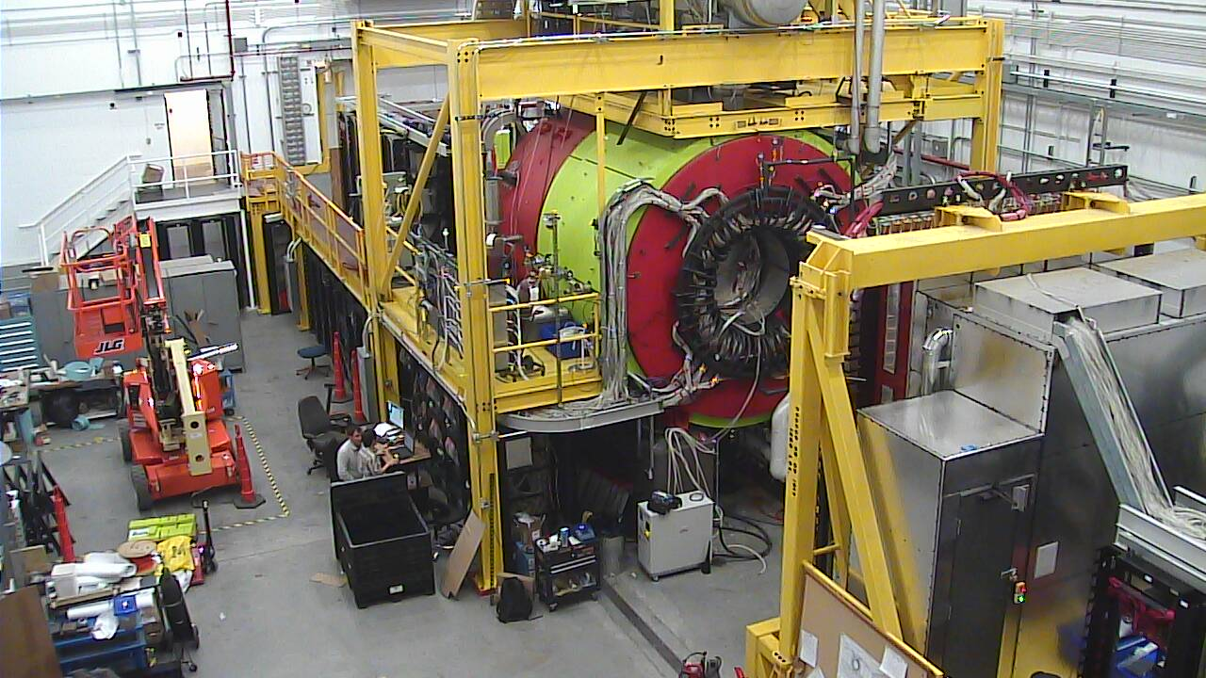
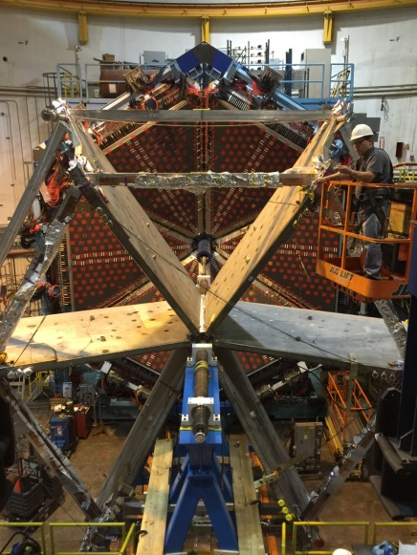
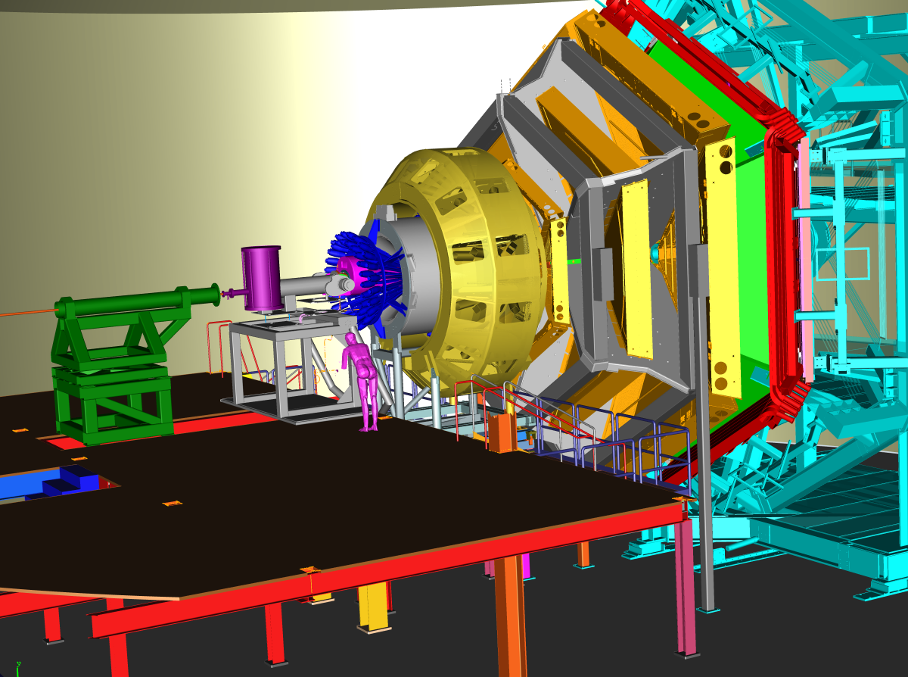
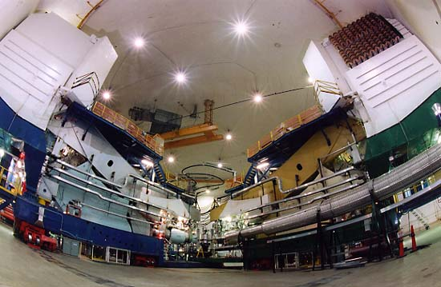
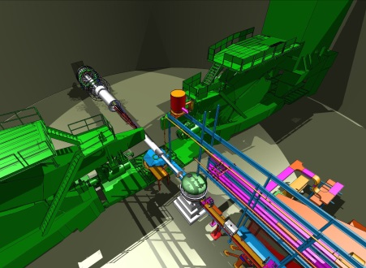
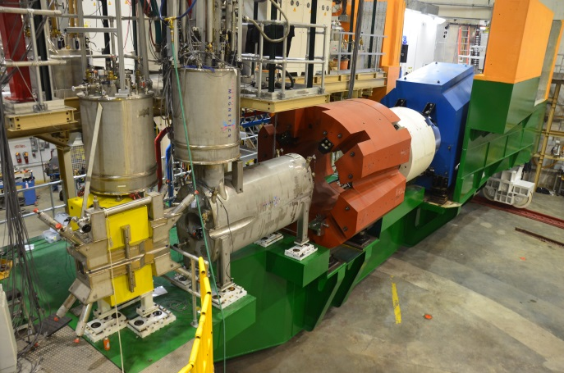
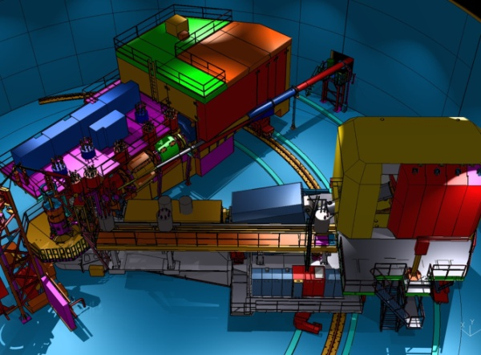
12 GeV Scientific Capabilities
Hall B – understanding nucleon structure via generalized parton distributions
Hall D – exploring origin of confinement by studying exotic mesons
Hall A – form factors, future new experiments (e.g., SoLID and MOLLER)
Hall C – precision determination of valence quark properties in nucleons/nuclei
Notes:
5
Note BSM not included in project

Slide 6
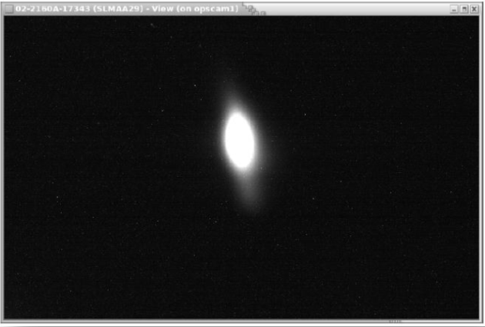
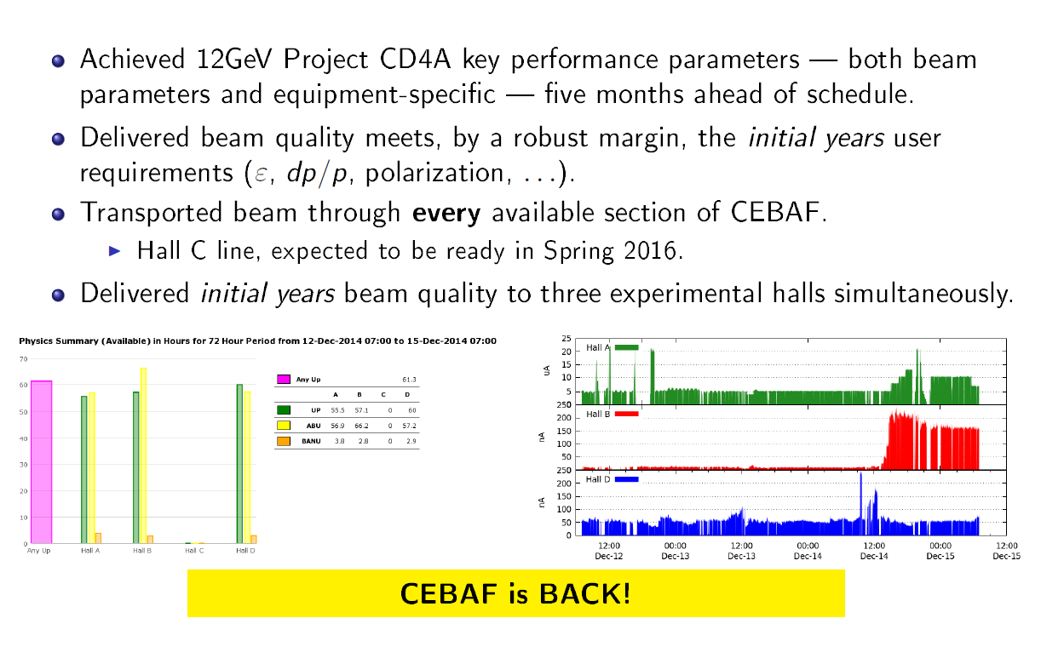
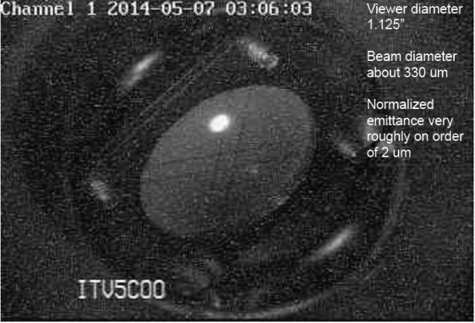
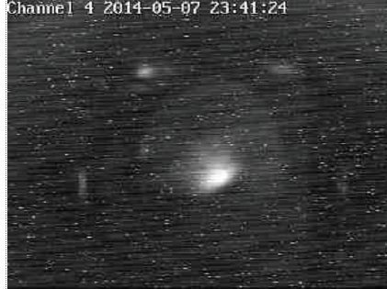
Upgraded CEBAF in Operation!
Hall A
Dec. 2014
Arc 10
CURRENT
Hall B
5.5 Pass
10.5 GeV
Hall D
February 2015: restored 5 pass beam
March 2015:
Commissioned 4-Hall separation system
Demonstrated 5.5 pass beam to Hall D
Demonstrated 5 pass beam to Hall A
Beam to Halls A, B, D for commissioning/physics
Hall D
Tagger
Notes:
Mont sent around Arne’s User talk for ideas…………….
Allison to provide photos and better graphic

Slide 7
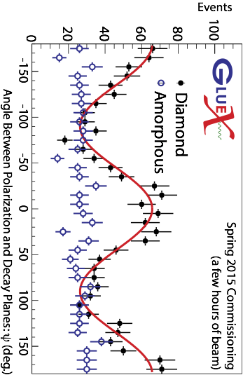

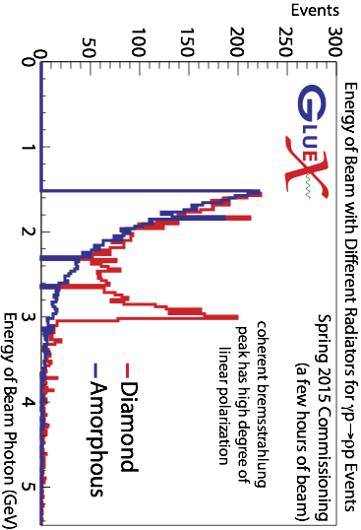
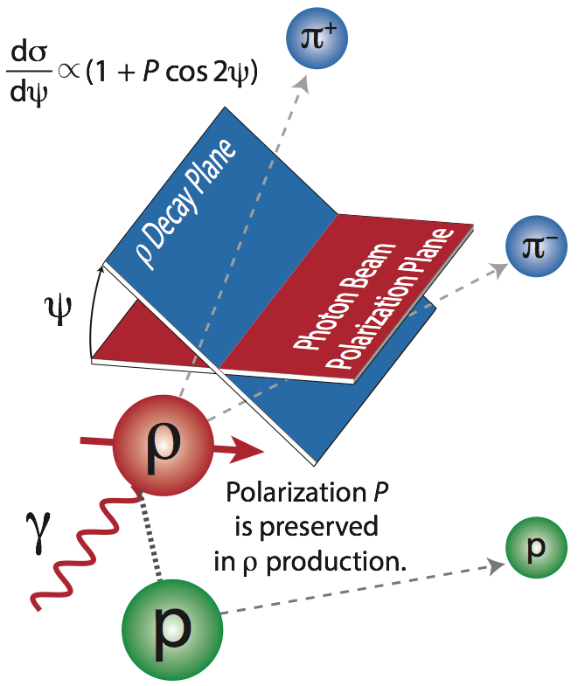
Early Physics in Hall D!
Polarized ρ Production with the Hall D Photon Beam
Aluminum
Aluminum
7
Notes:
Amorphous to Aluminum

Slide 8
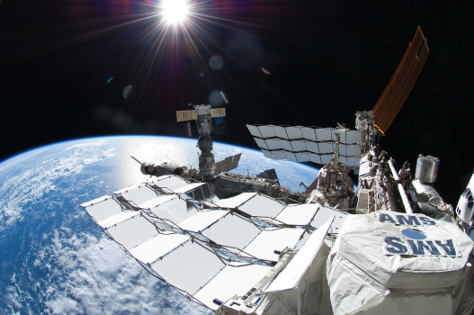
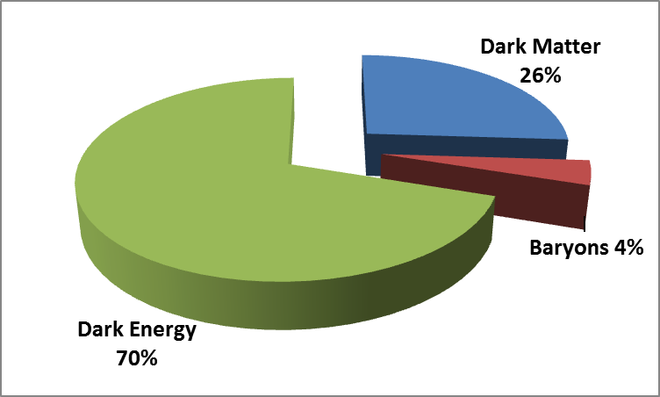
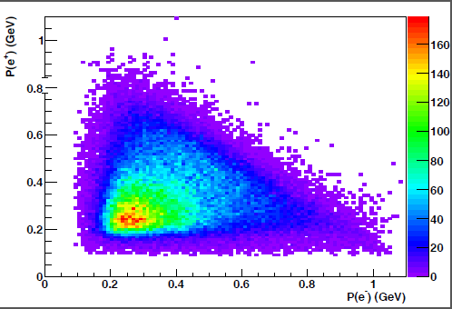
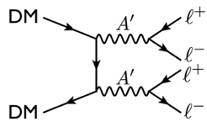
Early Physics in Hall B!
HPS tracked
pairs
Heavy Photon Search (HPS)
Funding from DOE-HEP
8
Notes:
Retitled to “Early physics “
Reconstructed pie chart
Animation removed

Slide 9
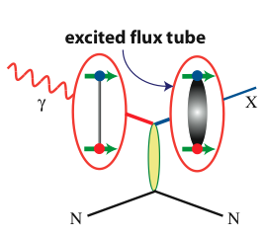
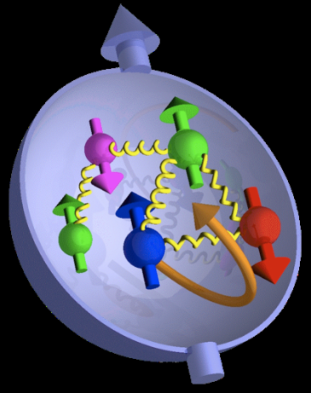

Jefferson Lab @ 12 GeV Science Questions
excited gluon field
What is the role of gluonic excitations in the spectroscopy of light mesons?
Where is the missing spin in the nucleon?
Role of orbital angular momentum?
Can we reveal a novel landscape of nucleon substructure through 3D imaging at the femtometer scale?
Can we discover evidence for physics
beyond the standard model
of particle physics?

Slide 10
12 GeV Approved Experiments by Physics Topics
Topic | Hall A | Hall B | Hall C | Hall D | Other | Total
The Hadron spectra as probes of QCD (GlueX and heavy baryon and meson spectroscopy) |  | 1 |  | 3 |  | 4
The transverse structure of the hadrons (Elastic and transition Form Factors) | 5 | 3 | 2 | 1 |  | 11
The longitudinal structure of the hadrons (Unpolarized and polarized parton distribution functions) | 2 | 3 | 6 |  |  | 11
The 3D structure of the hadrons (Generalized Parton Distributions and Transverse Momentum Distributions) | 5 | 9 | 7 |  |  | 21
Hadrons and cold nuclear matter (Medium modification of the nucleons, quark hadronization, N-N correlations, hypernuclear spectroscopy, few-body experiments) | 6 | 3 | 7 |  | 1 | 17
Low-energy tests of the Standard Model and Fundamental Symmetries | 3 | 1 |  | 1 | 1 | 6
TOTAL | 21 | 20 | 22 | 5 | 2 | 70

Slide 11
12 GeV Approved Experiments by PAC Days
Topic | Hall A | Hall B | Hall C | Hall D | Other | Total
The Hadron spectra as probes of QCD (GluEx and heavy baryon and meson spectroscopy) |  | 119 |  | 540 |  | 659
The transverse structure of the hadrons (Elastic and transition Form Factors) | 145.5 | 85 | 102 | 25 |  | 357.5
The longitudinal structure of the hadrons (Unpolarized and polarized parton distribution functions) | 65 | 230 | 165 |  |  | 460
The 3D structure of the hadrons (Generalized Parton Distributions and Transverse Momentum Distributions) | 409 | 872 | 212 |  |  | 1493
Hadrons and cold nuclear matter (Medium modification of the nucleons, quark hadronization, N-N correlations, hypernuclear spectroscopy, few-body experiments) | 180 | 175 | 201 |  | 14 | 570
Low-energy tests of the Standard Model and Fundamental Symmetries | 547 | 205 |  | 79 | 60 | 891
TOTAL | 1346.5 | 1686 | 680 | 644 | 74 | 4430.5
Total Approved Run Group Days | 1346.5 | 671 | 667 | 644 | 74 | 3402.5
A Decade of Experiments

Slide 12
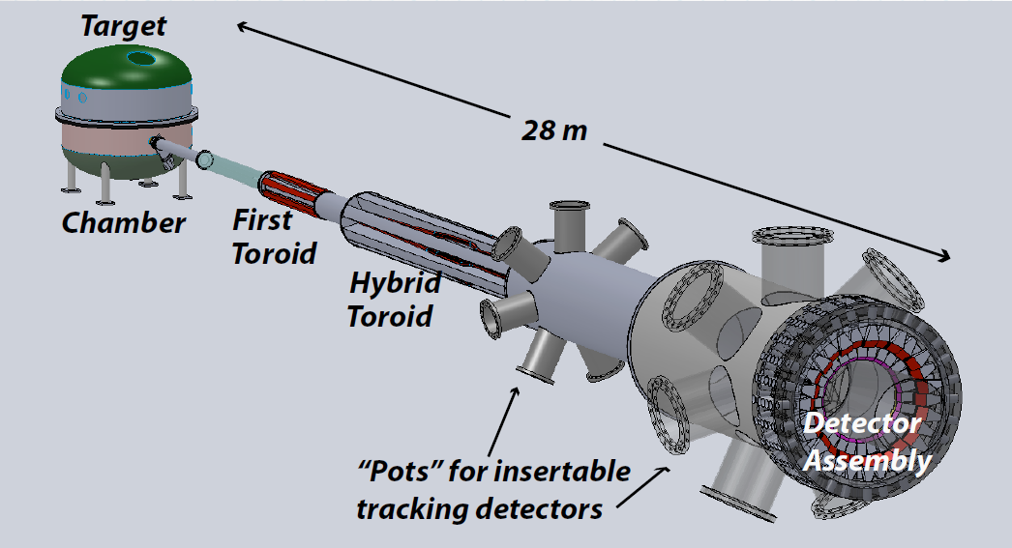

Future MIE Projects
MOLLER experiment
(Possible MIE – FY17-20)
– Precision Standard Model Test
– DOE science review (September 2014) – strong endorsement
– Technical, cost & schedule reviews?
SoLID (Future MIE)
– International collaboration
– CLEO Solenoid (from Cornell)
– Director’s review (Feb. 2015)
12

Slide 13
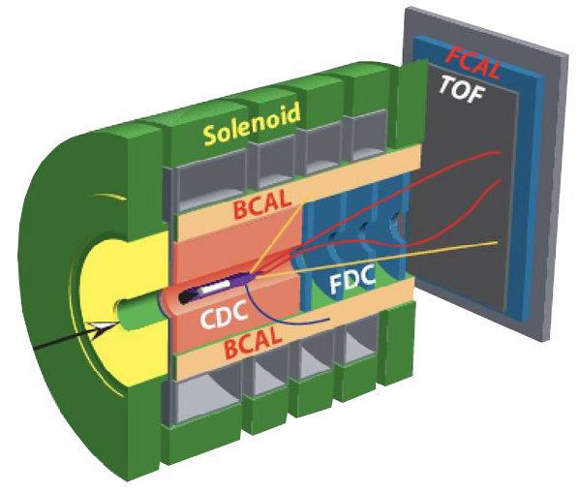

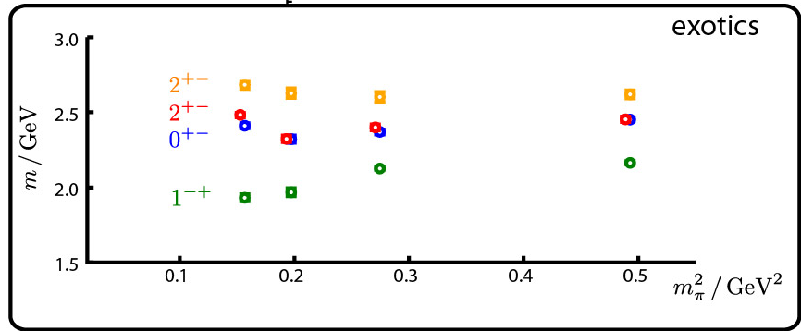
Gluonic Excitations and the mechanism for confinement
Excited Glue
Hall D@JLab
QCD predicts a rich spectrum of as yet to be discovered gluonic excitations - whose experimental verification is crucial for our understanding of QCD in the confinement regime.
Dudek et al.
States with Exotic Quantum Numbers

Slide 14
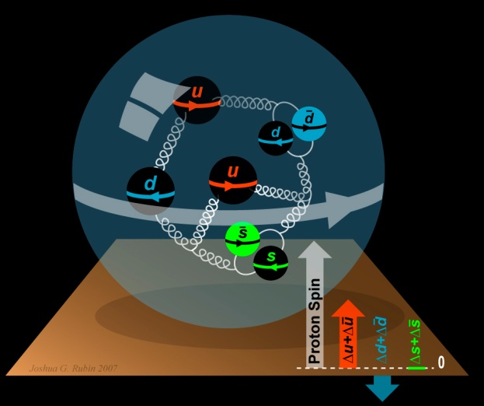
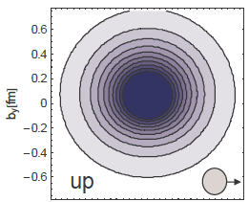
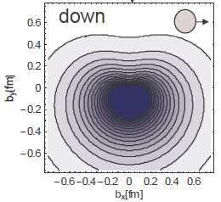
The Incomplete Nucleon: Spin Puzzle
1
1
ΔΣ
+
L_{q}
+
J_{g}
=
2
2
[X. Ji, 1997]
DIS → ΔΣ ≅ 0.25
RHIC + DIS → ΔG~0.2
→ L_{q}

Slide 15
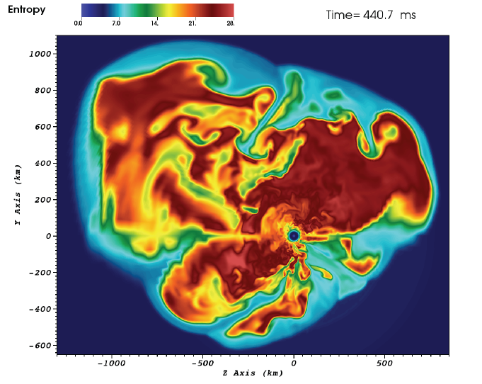
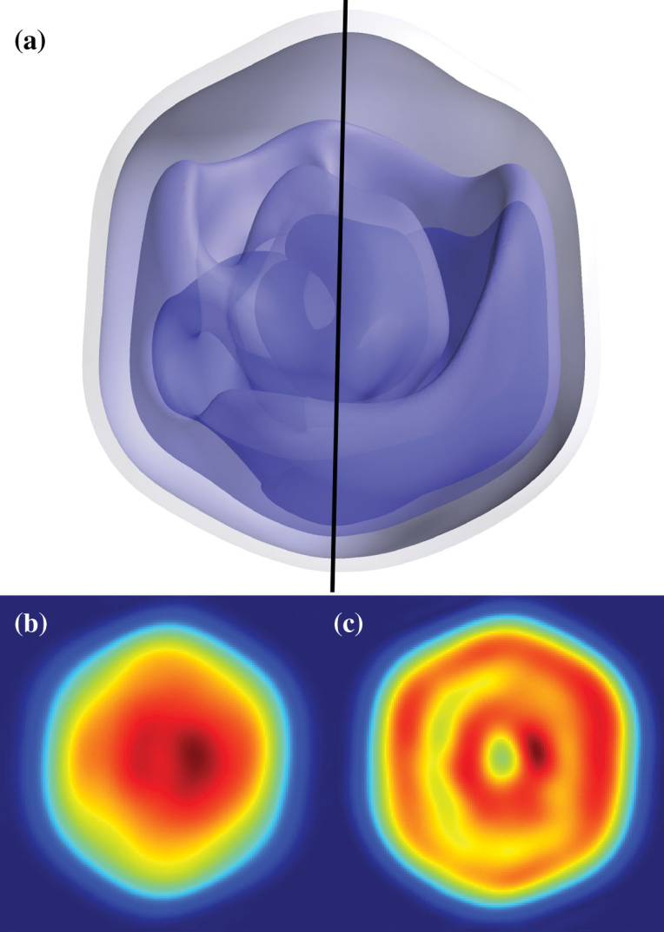
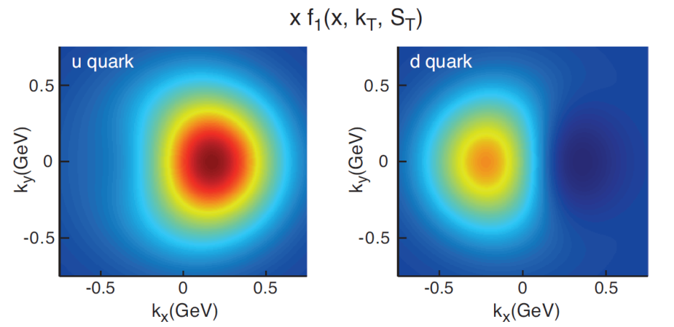
Science in 3-Dimensions
3D simulation of
15M supernova
(ORNL)
Predicted
quark
Transverse
Momentum
Distributions
for a
polarized
proton
(accessible with JLab @ 12 GeV)
Mimivirus imaged at LCLS
(SLAC)
15

Slide 16

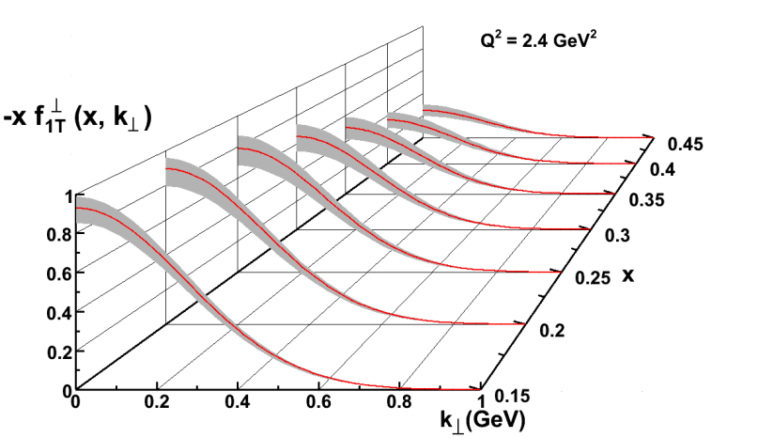
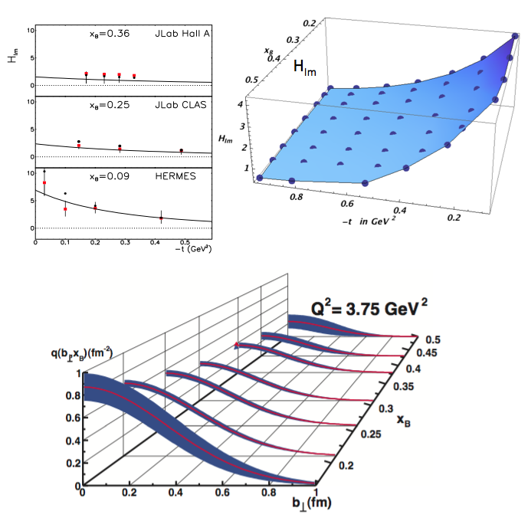
Imaging the Nucleon
5D
Transverse Momentum Dist. (TMD)
– Confined motion in a nucleon
(semi-inclusive DIS)
Generalized Parton Dist. (GPD)
– Spatial imaging
(exclusive DIS)
Requires
− High luminosity
− Polarized beams and targets
− Sophisticated detector systems
3D
Major new capability with JLab @ 12 GeV

Slide 17
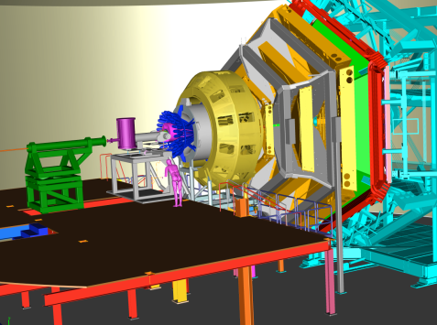
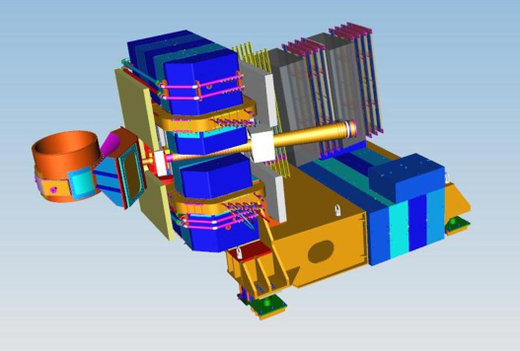
Imaging with JLab @ 12 GeV
Generalized Parton Distributions (GPDs)
CEBAF Large Acceptance Spectrometer
(CLAS12) in Hall B
Transverse Momentum Distributions (TMDs)
Super Bigbite Spectrometer (SBS) in Hall A
SHMS, High Momentum Spectrometer (HMS),
Neutral Particle Spectrometer (NPS) in Hall C
Future: Solenoidal Large Intensity Device
(SoLID) in Hall A
17
Notes:
Bob reworked

Slide 18
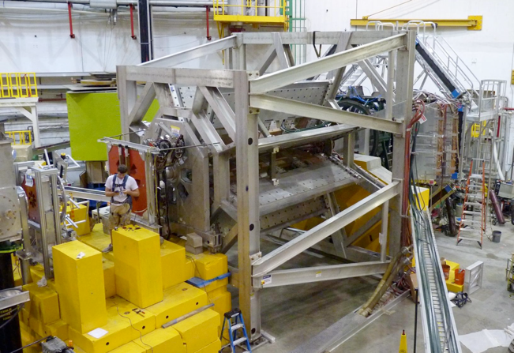
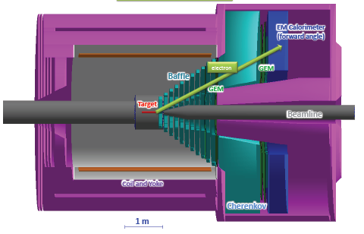
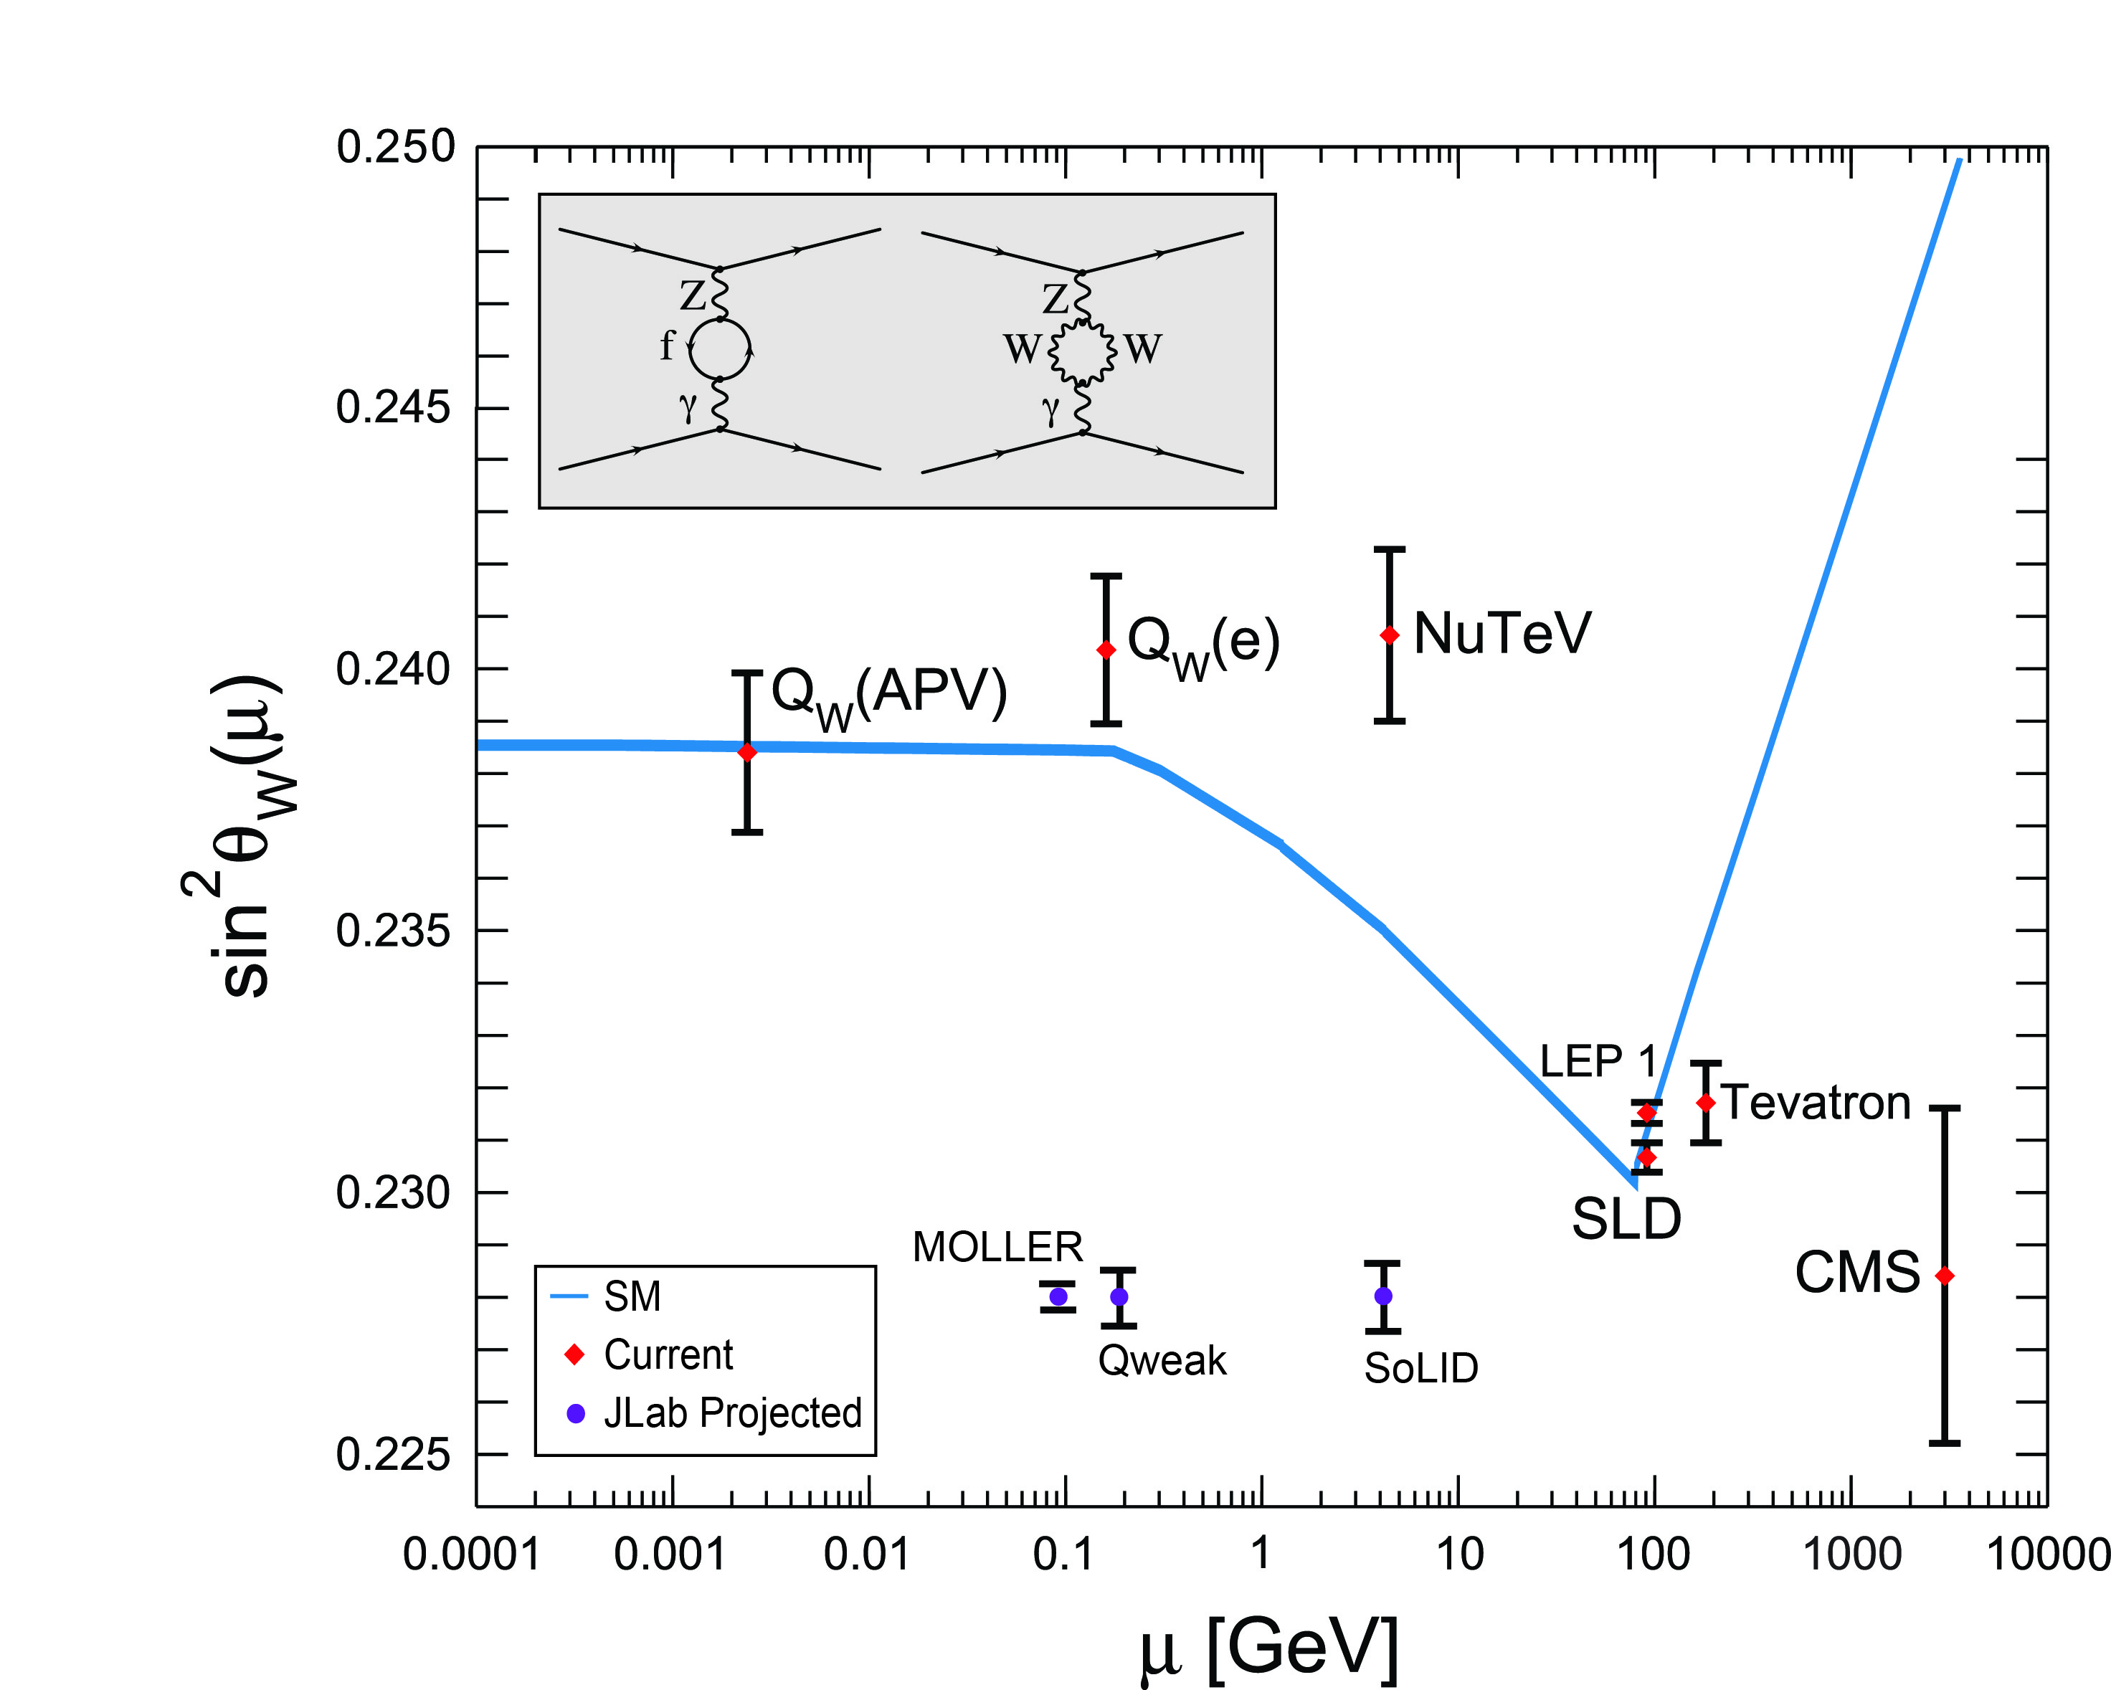
Testing the Standard Model at JLab
Standard Model
JLab
Data
Projected
JLab data:
(from PDG 2014)

Slide 19


New Opportunity: Search for A’ at Jefferson Lab
BNL “g-2” expt: Δa_{μ}(expt-thy) = (295±88) x 10⁻¹¹ (3.4 σ)
No evidence for SUSY at LHC (yet)
Another solution: A’, a massive neutral vector boson
3 Jefferson Lab proposals:
APEX test run (Hall A) – published
PRL 107, 191804 (2011)
HPS (Hall B) –initial FY15 run completed
DarkLight (LERF) – NSF-MRI funds

Slide 20

Electron Ion Collider
NSAC 2007 Long-Range Plan:
“An Electron-Ion Collider (EIC) with polarized beams has been embraced by the U.S. nuclear science community as embodying the vision for reaching the next QCD frontier. EIC would provide unique capabilities for the study of QCD well beyond those available at existing facilities worldwide and complementary to those planned for the next generation of accelerators in Europe and Asia.”
NSAC 2015 Long-Range Plan:
EIC unanimously endorsed by QCD Town Meetings
as next QCD frontier
Community has reached consensus on parameters
EIC Community White Paper arXiv:1212.1701v2
20
Notes:
Condensed bullets

Slide 21

The New Landscape Enabled by EIC
High Luminosity
◻ 10³⁴ cm⁻²s⁻¹
Low x regime
x ◻ 0.0001
High Polarization
◻ 70%
JLab
12
EIC
Luminosity cm.⁻² sec. ⁻¹
Discovery
Potential!
EMC
HERMES

Slide 22

EIC: Are the Gluons Polarized?
current data
A Polarized EIC:
Tremendous improvement on ΔG
Also improvement in ΔΣ
Spin Flavor decomposition of the Light Quark Sea
ΔG
w/ EIC data
ΔΣ

Slide 23


Spatial Imaging of Gluon Density at EIC
Exclusive vector meson production:
Q
J/Ψ, Φ, …
Fourier transform of the
momentum transfer t
Resolution ~ 1/Q or 1/M_{Q}
Gluon imaging from simulation:
Images of gluons
from exclusive
J/ψ production

Slide 24

Jefferson Lab Future: MEIC
JLab MEIC Figure 8 Concept
Initial configuration:
  3-10 GeV on 20-100 GeV ep/eA collider
  Optimized for high ion beam polarization:
    polarized deuterons
  Luminosity:
    up to few x 10³⁴ e-nucleons cm⁻² s⁻¹
    Low technical risk
    Upgradable to higher energies
    250 GeV protons on 20 GeV electrons
    Flexible timeframe for Construction
    consistent w/running 12 GeV CEBAF
    Thorough cost estimate completed
    presented to NSAC EIC Review
    Cost effective operations
    Fulfills White Paper Requirements
Current Activities
Site evaluation (VA funds)
Accelerator, detector R&D
Design optimization
Cost reduction
24
Notes:
Added new campus map 2025

Slide 25






Jefferson Lab: Today and Tomorrow
The Jefferson Lab electron accelerator is a unique world-leading facility for hadron and nuclear physics research
12 GeV upgrade ensures at least a decade of excellent opportunities for discovery
– New vistas in QCD
– Growing program Beyond the Standard Model
– Additional equipment: MOLLER, SoLID,
plus smaller projects
EIC moving forward:
– Strong science case, much builds on JLab 12 GeV program
– MEIC design well developed – time scale following 12 GeV program is “natural”
– Awaiting NSAC 2015 Long Range Plan

