Slide 1
Digitization System R&D for APV25
Xinglong Li
China Institute of Atomic Energy
(中国原子能科学研究院)

Slide 2
Outline
Introduction
System construction
Results
Next step

Slide 3
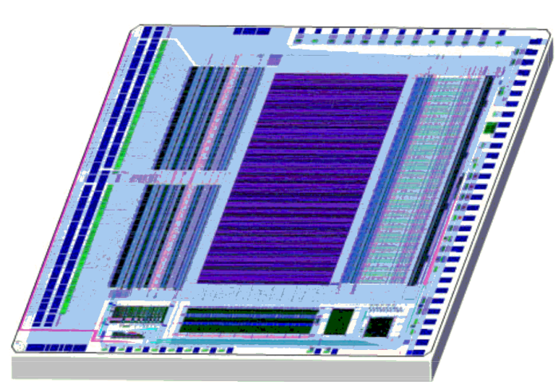
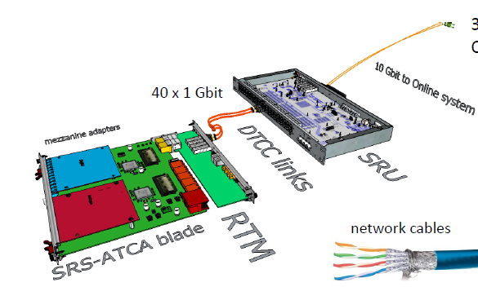
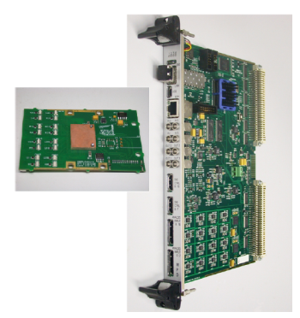
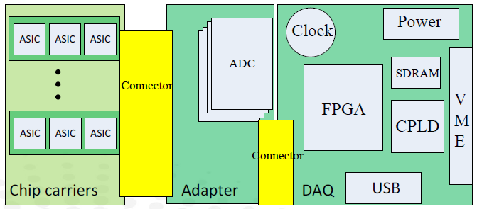
Introduction
-> APV25
· 128 channel pre-amplification
· 192 cell pipeline
· a single analogue differential output
-> Objective
Develop a system to control APV25 , digitize and save the APV25 output .
-> Similar system existing
· SRS (scalable readout system) @RD51 -developed
· MPD (Multi Purpose Digitizer) @INFN - developed
· MRS (Multiple-chip Readout System) @USTC -developing
· ...
MRS
SRS
MPD

Slide 4
Outline
Introduction
System construction
Results
Next step

Slide 5
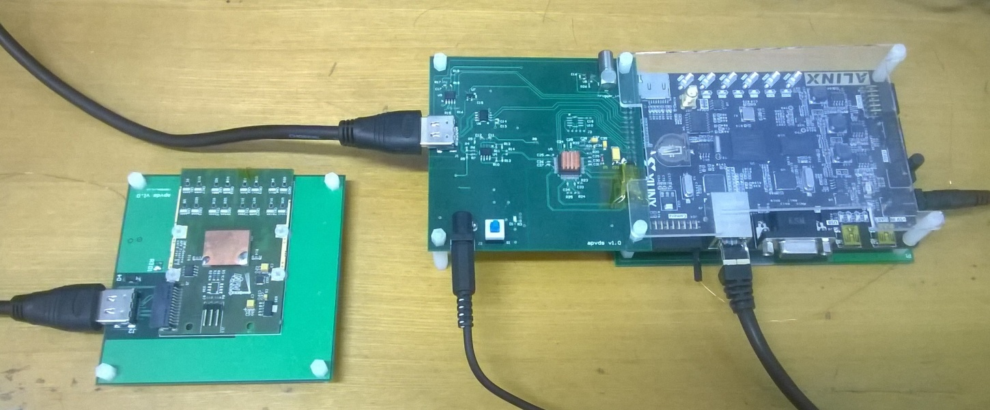
System construction
APV25
Analogue data
ADC
FPGA
Digital data
PC
HDMI
GbE
Clock, Trigger, Cmd
Parameters
HDMI
Spartan 6
power
GbE
ADS5242
power
APV25 backplane

Slide 6
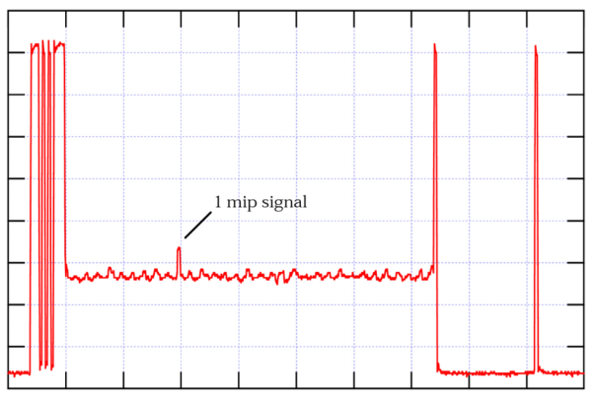
APV25 details
APV25
Analogue data
ADC
FPGA
Digital data
PC
HDMI
GbE
Clock, Trigger, Cmd
Parameters
Clock
Trigger
Command(I2C)
Channel
1
Preamplifier
Shaper
Buffer
APSP
Analogue data
2
Preamplifier
Shaper
Buffer
APSP
3
Preamplifier
Shaper
Buffer
APSP
. . . . . . .
. . . . . . .
128:1 Multiplexer
128
Preamplifier
Shaper
Buffer
APSP

Slide 7
ADC details
APV25
Analogue data
ADC
FPGA
Digital data
PC
HDMI
GbE
Clock, Trigger, Cmd
Parameters
Clock
Command
Analogue data
ADS5242
4-Channel
12-Bit
65MSPS
Analog-to-Digital Converter
Serial digital data

Slide 8
FPGA details
APV25
Analogue data
ADC
FPGA
Digital data
PC
HDMI
GbE
Clock, Trigger, Cmd
Parameters
ISERDES2
Serial to parallel
FIFO
Serial digital data
Clock
GbE MAC
(UDP)
Gigabit Ethernet cable
To ADC & APV25
RTL8211E
PHY
I2C
ADC Ctrl
Spartan 6
FPGA utilization: 50% BUFG, 22% IO, ≤ 10% others

Slide 9
PC details
APV25
Analogue data
ADC
FPGA
Digital data
PC
HDMI
GbE
Clock, Trigger, Cmd
Parameters
LabVIEW program
UDP send
Datagram
to data
Waveform
UDP receive
GbE
cable
C program based on SOCKET API
SOCKET sendto
binary file
SOCKET recvfrom

Slide 10
Outline
Introduction
System construction
Results
Next step

Slide 11
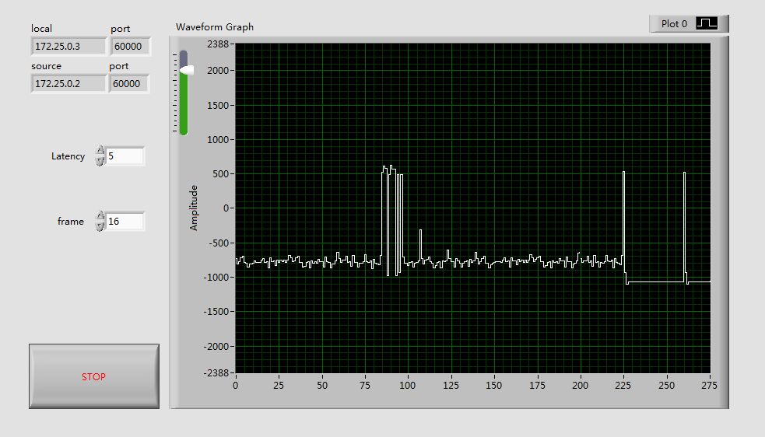
APV25 data received (LabVIEW)
header, addr, error
ticks
Signal injected
Signal of 1~128 channel
Jones, L. L., et al. "The APV25 deep submicron readout chip for CMS detectors." (1999).

Slide 12
Gigabit Ethernet speed test(SOCKET)
-> UDP protocol with Cumulative acknowledgment
(1 ACK every 10 datagram)
-> 731 second, 10⁸ datagrams, no lost, 40GB file (on SSD) ,
i.e. 460Mb/s
-> Time cost:
Send ACK | 14%
Receive datagram | 62%
Write to file | 24%
The UDP function of LabVIEW is slower…

Slide 13
Outline
Introduction
System construction
Results
Next step

Slide 14
Next step
FPGA
Add zero compression to reduce data rates to the computer.
Add Retransmission timeout to make the transmission more reliable.
LabVIEW program
Use SOCKET API or other similar API instead of the slow UDP function.
Improve data processing and save the results.
New version system
Design FPGA board instead of the development board.
Digitize 8 or 16 APV25 in 1 system.

Slide 15
Thank you!

