Slide 1
Orbital Angular Momentum, GPD, Nucleon Structure etc.
Xiangdong Ji
Shanghai Jiao Tong University/ University of Maryland
7th Workshop on Hadron Physics in China and Opportunities Worldwide
Aug. 4, 2015

Slide 2
Outline
The spin structure of the proton
GPDs and EIC
Theory meets experiment

Slide 3
The spin structure of the proton

Slide 4
The spin structure of the proton has been one of the central questions driving advances in hadron physics.
Experiments: new opportunities with 12 GeV upgrade and future EIC
Theory: Still some confusions among theorists, but significant progress made in the last 2-3 years.

Slide 5
Spin sum rule?
There have been many proposals. But the situation has been clarified considerably in the literature.
There are infinity possibilities theoretically if one allows non-local definitions.
  However, most of them are NOT experimentally relevant.
If one allows only local gauge-invariant contributions, there is only one sum rule.

Slide 6
Locality: the unique sum rule
Locality and gauge-invariance produce the unique result
½ = ½ ΔΣ + Lq+Jg
  Does not allow gluon spin term
  the individual contributions can be probed experiementally through twist-2 GPDs.
  Frame independence allows theoretical calculations done with the standard lattice method.

Slide 7
Non-local sum rule
There are infinite possibilities (Ji et al, Lorce et al)
They are frame dependent!
  It can easily be shown in perturbation theory by calculating in a state with fixed momentum.
The only one that’s physically (experimentally) relevant is the partonic sum rule in the finite momentum frame.

Slide 8
High-energy scattering and IMF
High-energy scattering probes the partonic content of a QCD bound state (nucleon and nucleus) (S. Brodsky…)
The probe is hard and relativistic, the nucleon is measured in the infinite momentum frame (light-cone correlations)
Note that the wave function is frame-dependent, the DIS naturally selects the IMF.
Structure and probe physics can be separated nicely (factorization)!

Slide 9
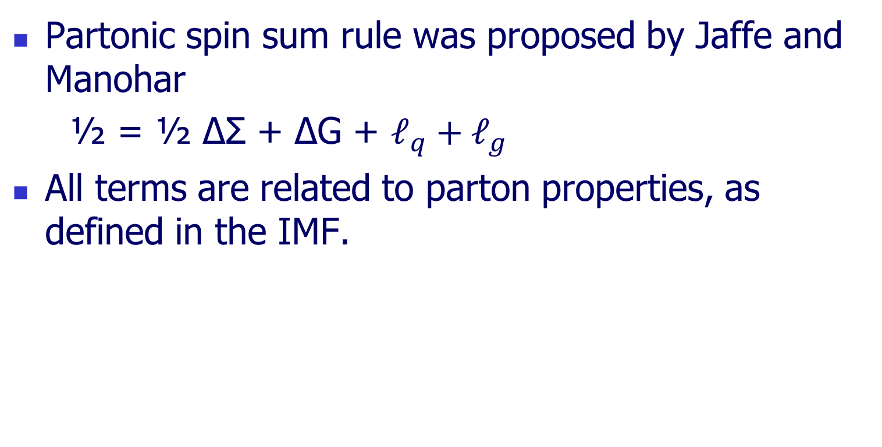
Partonic spin sum rule
Partonic spin sum rule was proposed by Jaffe and Manohar
½ = ½ ΔΣ + ΔG + $ℓ_{q}+ℓ_{g}$
All terms are related to parton properties, as defined in the IMF.

Slide 10
Universality class
Many of the frame-dependent and guage-dependent sum rules (universality class) collapse into the light-cone sum rule of Jaffe and Manohar in IMF.
Ji, Zhao, and Zhang, Phys.Rev.Lett. 111 (2013) 112002
Y.Hatta, Ji and Zhao, Phys.Rev. D89 (2014) 8, 085030
Zhao, Liu, Yang, arXiv: 1506.08832

Slide 11
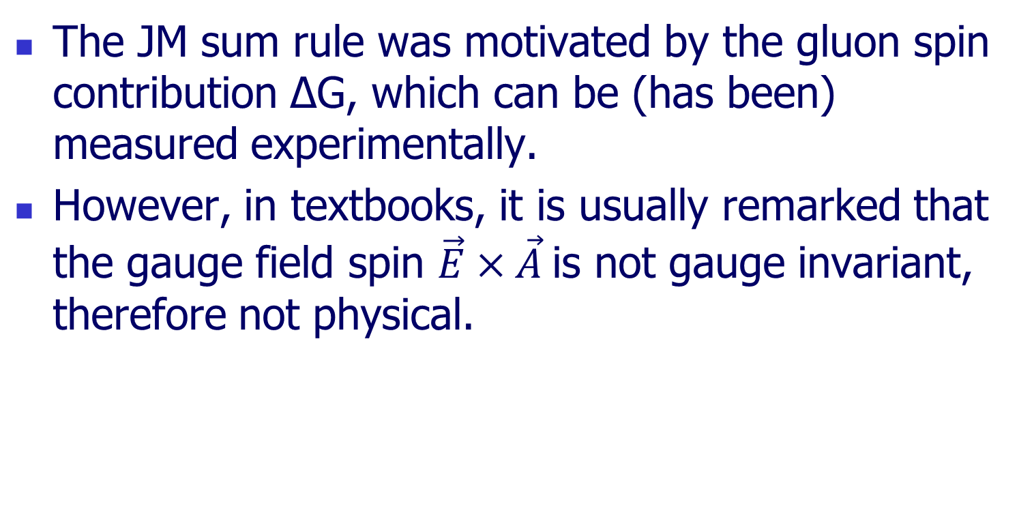
Gluon spin ΔG

Slide 12
How does gluon spin becomes physical？
There are two kinds of gluons inside the nucleon: Coulomb (confining, binding) gluons
Radiation gluons
Their roles can be separated in heavy-quark (non-relativistic) limit when we have a situation like H-atom.

Slide 13

Coulomb gluon
Consider a heavy quark at rest, it generates a gluonic Coulomb field, and the corresponding
potential depends on gauge choices.
This contribution to the gluon spin is gauge dependent.

Slide 14
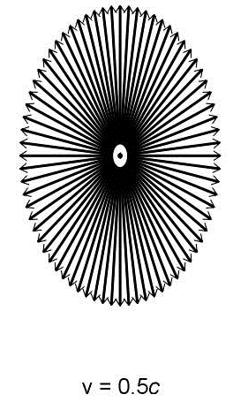
Radiation gluon
When the heavy quark moves, it also generates a radiation gluon field, which has non-zero B compoent.
Radiation gluon’s contribution to the gluon spin is gauge-invariant.

Slide 15
Frame dependence
The relative sizes of the two types of gluons are frame dependent.
In the IMF limit, the radiation gluon entirely dominates over the Coulomb gluon (Weizsacker-William’s picture) The contribution from the latter becomes very small.
Thus in the IMF, the gluon spin becomes a physical observable. This is exactly what high-energy scattering experiments measure!

Slide 16
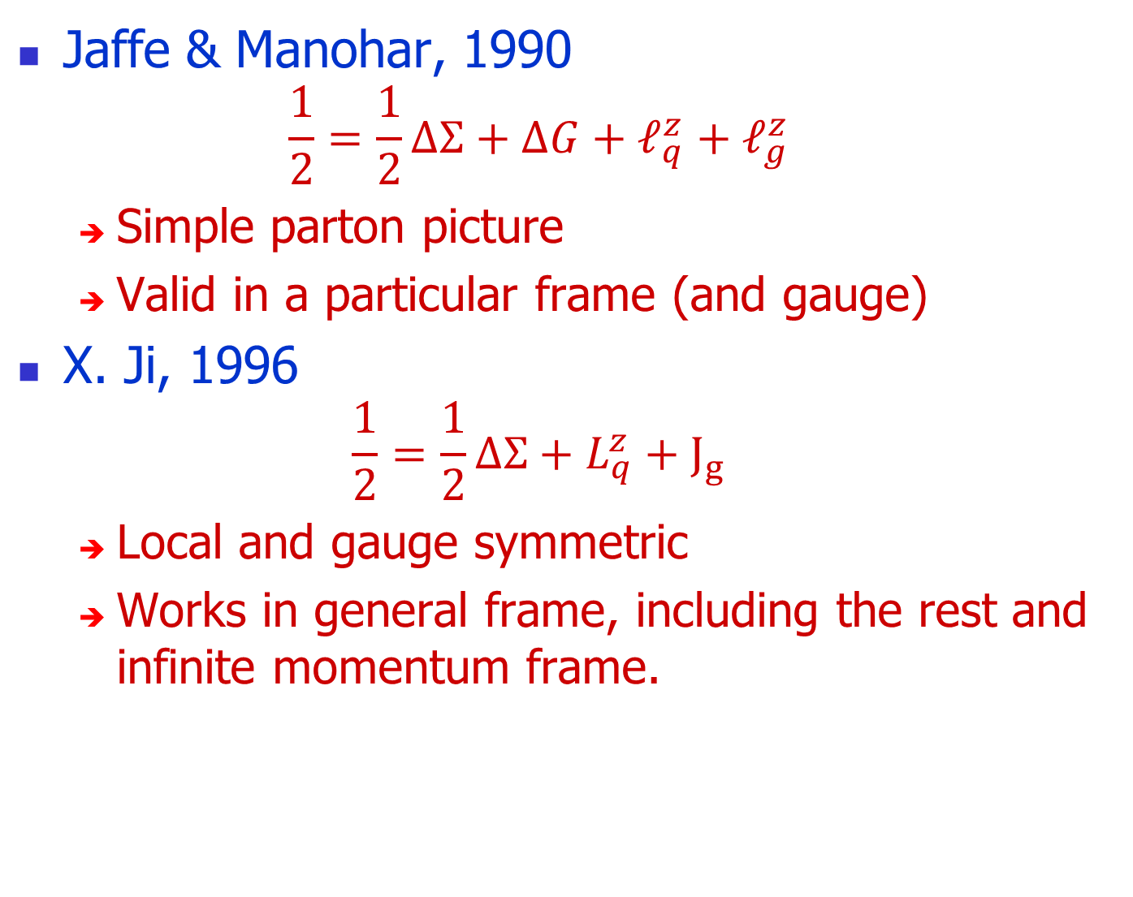
Partonic sum rule

Slide 17
GPD and EIC

Slide 18
GPD and orbital angular momentum
To study orbital angular momentum itself, one has to study GPDs.
To make precise measurement of GPDs is an important goal at Jlab 12 GeV upgrade and future EIC.
It is not an easy task but can be done!

Slide 19
Twist-2 vs Twist-3 GPDs
To study the frame-independent spin sum rule,
One needs to measure twist-2 GPDs
  Gluon GPDs through J/psi production or two jet production
To study partonic spin sum rule, one must measure twist-3 GPDs!
  Many have realized this, but no actual theoretical studies. Y. Zhao begins to look into this.

Slide 20
From spin structure to proton tomography
GPDs allow to make spatial images of proton in the IMF.
  This is much (infinitely) more than just form factors and parton distributions.
  Pushing the natural limit that what one can learn about the proton in the lab.
This is revolutionary in hadronic physics!
  Tomography has been a very important tool in biology, chemistry etc.

Slide 21
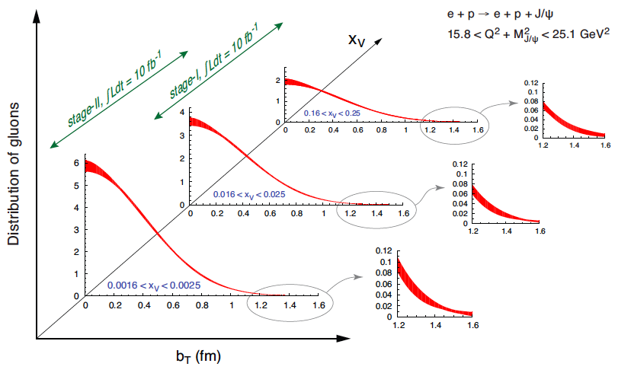
Gluon tomography at small x (GPDs)

Slide 22
EIC
An EIC is a dedicated
  probe of gluons in the nucleon
  tomographic machine for the nucleon.
It will be built and a fantastic opportunity in the horizon.

Slide 23
Theory meets experiment

Slide 24
Complementary principle
Good physics is learnt when experiments produce good data, and reliable theory either reproduces or predicts the results or finds a discrepancy.
A good investment in EIC must be accompanied by a good investment in theory, particularly lattice QCD!

Slide 25
Theory evolution
The fundamental QCD lagrangian is known.
Now it is time to produce the most reliable predictions from the fundamental theory!
Models:
NR quarks
Bags
Chiral quarks
Approximate QCD
QCD sum rules
Schwinger-Dyson
Lattice QCD

Slide 26
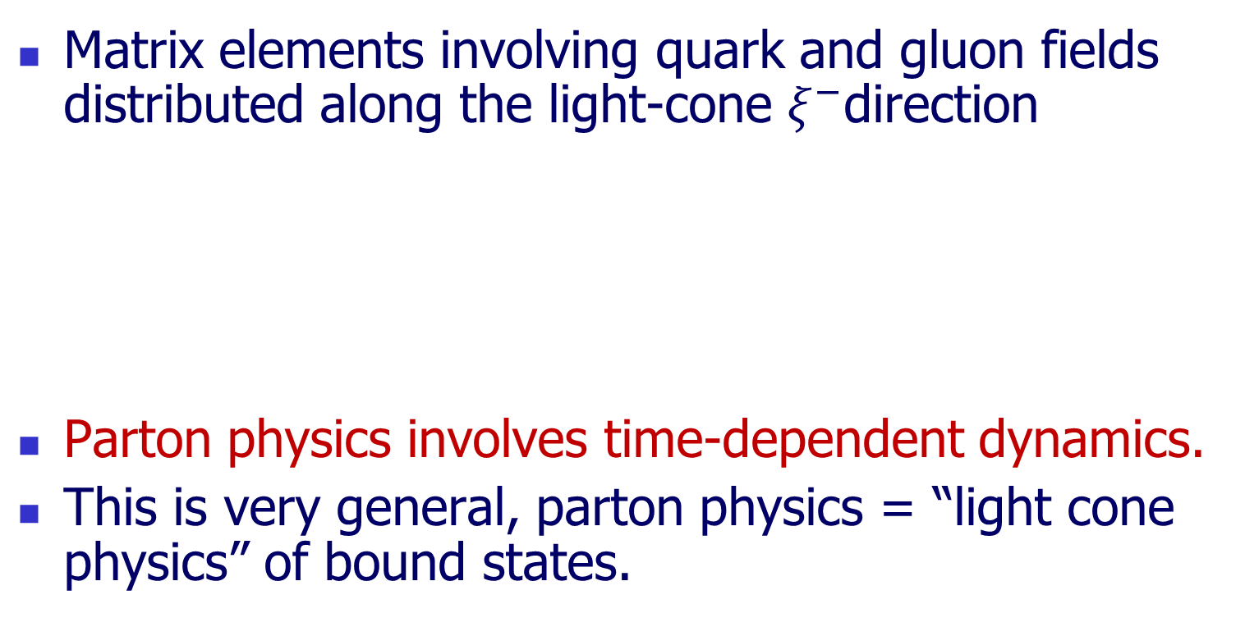
PDF’s are light-cone correlations
Matrix elements involving quark and gluon fields distributed along the light-cone $ξ^{−}$direction
Parton physics involves time-dependent dynamics.
This is very general, parton physics = “light cone physics” of bound states.
^{t}
𝜉⁻
𝜉⁺
^{z}

Slide 27
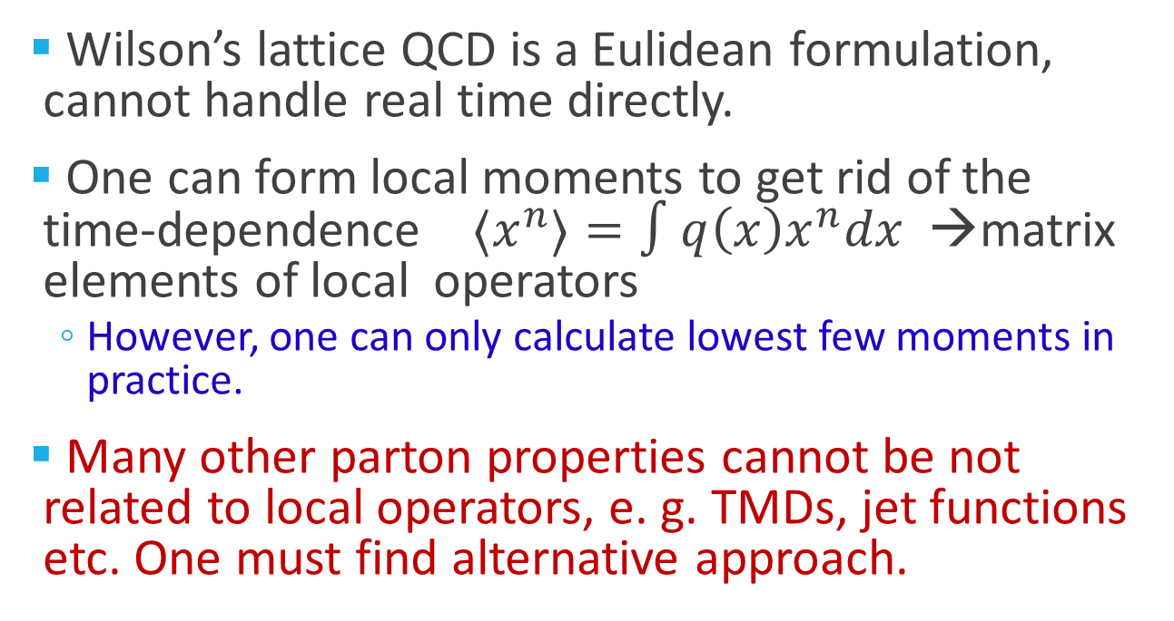
Parton physics on lattice?
Wilson’s lattice QCD is a Eulidean formulation, cannot handle real time directly.
One can form local moments to get rid of the time-dependence ${〈x}^{n}〉=∫q\left(x\right)x^{n}dx$ →matrix elements of local operators
  However, one can only calculate lowest few moments in practice.
Many other parton properties cannot be not related to local operators, e. g. TMDs, jet functions etc. One must find alternative approach.

Slide 28
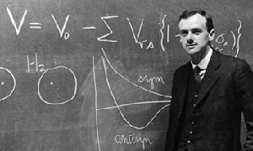

Light-cone quantization
P.A.M. Dirac (1949)
Choose a new system of coordinates with $ξ^{+}$ as the new “time” (light-cone time) and $ξ^{−}$ as the new “space” (light-cone space)
New “Space”
New “time”
t
𝜉⁻
𝜉⁺
z

Slide 29
LCQ and Partons
In LCQ, Light-cone correlation becomes “equal-time” correlation.
Parton physics is manifest through light-cone quantization (LCQ)

Slide 30
Wilson’s unsolved problem
In early 1990’s, Ken Wilson became a strong proponent for LCQ as a non-perturbative approach to solve QCD, and thus a way to calculate parton physics.

Slide 31
Solution of the problem?
Step 1: Light-cone correlations can be approximated by “off but near” light-cone “space-like” correlations
Step 2: Any space-like separation can be made simultaneous by suitably choosing the Lorentz frame.
t
𝜉⁻
𝜉⁺
Step1
Step2
x

Slide 32

A Euclidean quasi-distribution
Consider space correlation in a large momentum P in the z-direction.
  Quark fields separated along the z-direction
  The gauge-link along the z-direction
  The matrix element depends on the 3-momentum P.
  This distribution can be calculated using standard lattice method.
𝜉⁰
⁰
^{Z}
𝜉³

Slide 33
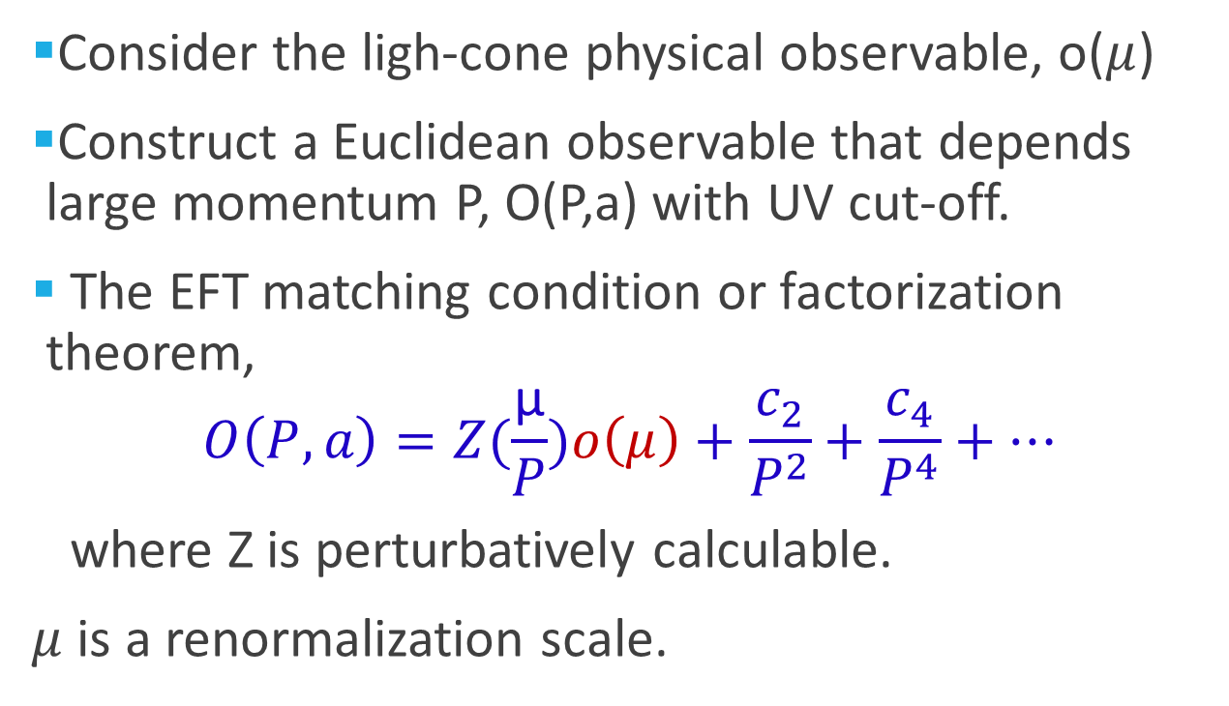
Effective field theory language
Consider the ligh-cone physical observable, o($μ$)
Construct a Euclidean observable that depends large momentum P, O(P,a) with UV cut-off.
The EFT matching condition or factorization theorem,
$$O\left(P,a\right)=Z(\frac{\text{μ}}{P})o\left(μ\right)+\frac{c_{2}}{P^{2}}+\frac{c_{4}}{P^{4}}+…$$
where Z is perturbatively calculable.
$μ$ is a renormalization scale.

Slide 34
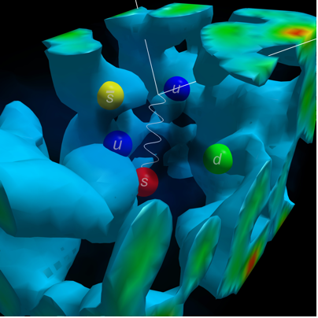
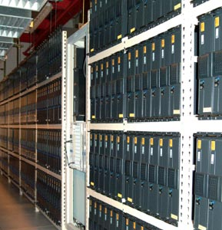
Theoretical progress：Lattice QCD
The only known rigorous framework for ab-initio calculation of the structure of protons and neutrons with controllable errors.
After decades of effort, one can finally calculate nucleon properties with dynamical fermions at physical pion mass!

Slide 35
Power of the approach
Gluon helicity distribution and total gluon spin
GPDs
TMDs
Light-cone wave functions
Higher twist observables
Etc.

Slide 36
Kentucky group

Slide 39
Summary
The era of hadron structure physics is yet to come, EIC and large scale lattice QCD
Tremendous opportunities for young people and for China.

