Slide 1
Nuclear Physics Researches on HIAF and CIADS facilities in China
Xurong Chen
(for Guoqing Xiao)
The Institute of Modern Physics
CAS, Lanzhou, China
2015.8.3

Slide 2
Outline
Introduction
HIAF
ADS
Summary

Slide 3
1. Introduction: Overview of IMP
The Institute of Modern Physics (IMP) was founded in 1957 in Lanzhou. As of 2014, there are 891 staffs and 296 postgraduate students studying for master or doctoral degree
IMP mainly conducts researches on and with ion accelerators. The major research fields cover heavy-ion physics, heavy-ion application, ion accelerator physics and technology, and nuclear technology related to the transmutation of nuclear waste
Through a half century of development, IMP has become a leading research center of heavy-ion science in China

Slide 4
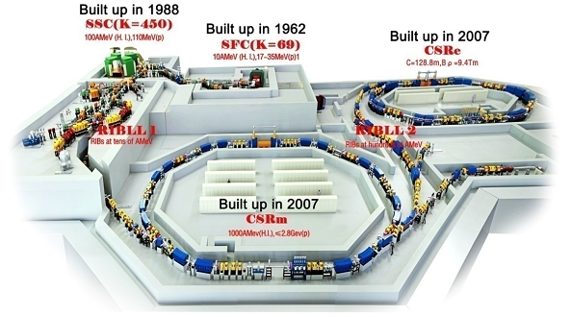
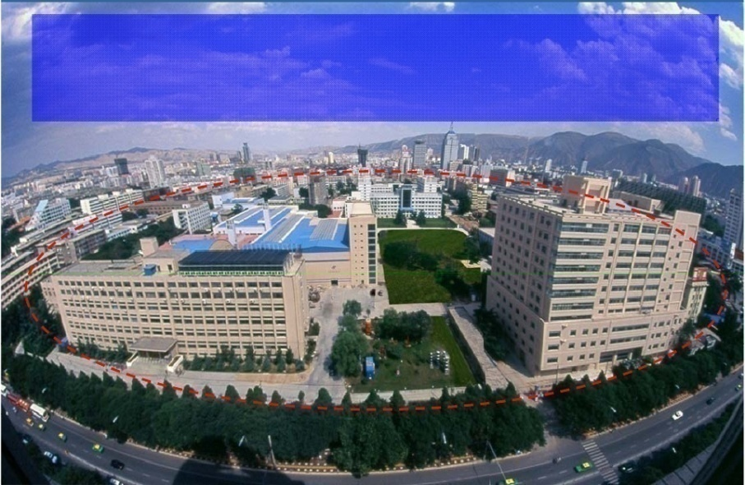
IMP operates the Heavy Ion Research Facility in Lanzhou (HIRFL), which consists of the Sector Focusing Cyclotron (SFC), the Separated Sector Cyclotron (SSC), the main and experimental Cooler Storage Ring (CSRm and CSRe), and a number of experimental installations.
The SFC was commissioned in 1962, and the SSC and CSR were adjoined successively in 1988 and 2007, boosting ion accelerations from 10% to 60% of the speed of light
HIRFL provides ion beams from proton through uranium, serving the local research groups and a largely growing national and international user community

Slide 5
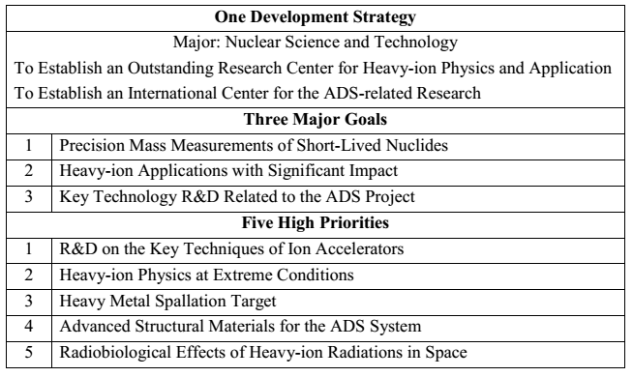
The “One-Three-Five” Strategic Development Planning in IMP

Slide 6
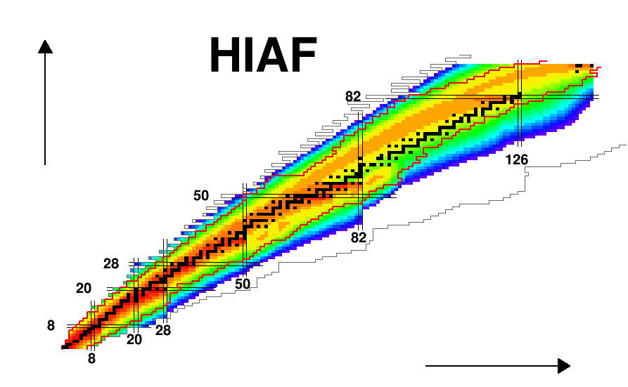
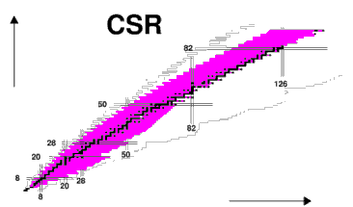
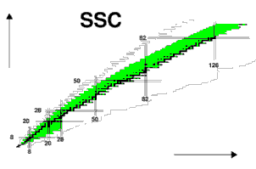
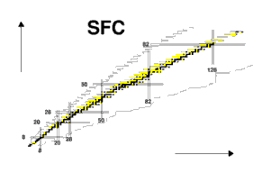
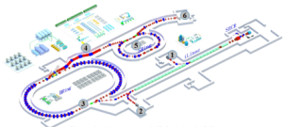
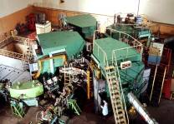
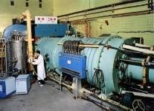
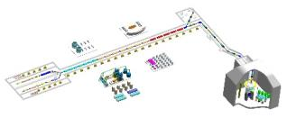
Summary
1958
1976
1996
2015
CIADS

Slide 7
2. HIAF
In 2010, the National Development and Reform Commission (NDRC) decided to build a batch of large-scale research facilities in order to boost basic science in China, and subsequently appealed for project proposals nationwide
The nuclear physics society in China had reached the consensus that heavy-ion accelerator complex of new generation should be built in our country, and hence proposed two projects. In 2011, a high-rank committee charged by NDRC evaluated all of the proposals in various research fields, and then recommended 16 top priority projects to NDRC. The High Intensity Heavy-ion Accelerator Facility (HIAF) proposed by IMP was selected
The committee identified several key science drivers for HIAF: the exotic nuclear structure, origin of heavy elements in the Universe, properties of high energy density matter, and heavy-ion application in space and material science
We IMP have optimized the facility design, carried out extensive R&D on the relevant techniques, and fabricated prototypes of key devices. All of these works have paved the way for the start-up of HIAF

Slide 8
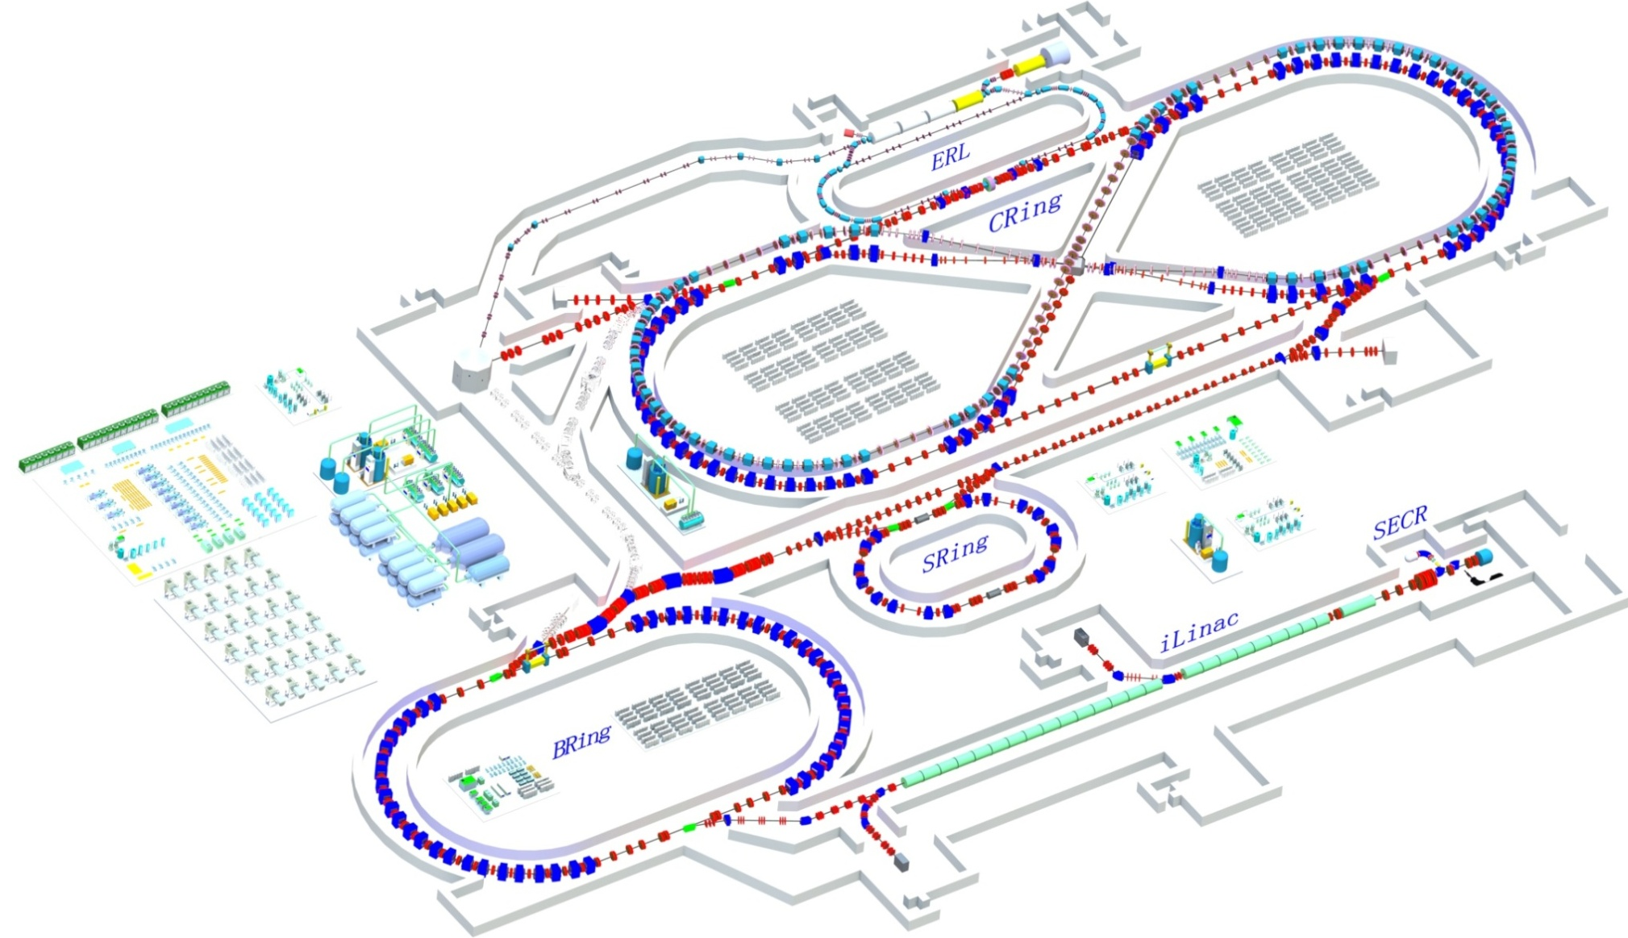
Overview of the HIAF Complex
HIAF II
3GeV
SRF Linac-ring
“8”electron 3GeV
“8” proton 12GeV
EIC
High energy density physics
HIAF II
HIAF I
SRing
iLinac: 25MeV/u(U³⁴⁺)
Notes:
8
8

Slide 9
3. The China ADS Program
Driven by the national demand for safe disposal of nuclear waste as well as the potentials for nuclear fuel breeding and advanced energy generation, CAS initiated the China Accelerator Driven Sub-critical System (ADS) program in 2011, which is incorporated into the program of “Advanced Fission Energy” under the frame of “Strategic Technology Pilot Project”
The ultimate goal for the China ADS program is to build an industrial demo facility for development of advanced fission energy, by integrating a high-power superconducting proton accelerator, a heavy metal spallation target and a sub-critical nuclear reactor
In the past few years, we have focused on the further understanding of the basic principle of ADS and R&Ds of the related key technologies on superconducting LINAC, spallation targets, sub-critical reactor, nuclear materials, nuclear data, transmutation chemistry, etc.

Slide 10
ADS Research Team
The CAS organized a core research team for the China ADS program in 2011, which is composed of the Institute of Modern Physics (IMP), Institute of High Energy Physics (IHEP), and Hefei Institutes of Physical Science (HIPS)
In addition, a number of institutions have participated in the program, including University of Science and Technology of China, Institute of Metal Research of CAS, Institute of Engineering Thermo-physics of CAS, State Nuclear Power Research Institute, etc.
As the leading institute for the China ADS program, IMP has established a dedicated research department, which consists of 125 permanent staffs and about 161 temporary staffs

Slide 11
ADS Research Aims
The ultimate goal of the ADS research in China is to establish an industrial-scale demo facility for nuclear waste transmutation through the following three phases:
✦ Phase 1: To resolve the key technology issues related to the accelerator, spallation target, and sub-critical core of ADS, and then start building a 10 MWt research system (CIADS)
Phase 2: To construct an experimental system of several hundreds of MWt around 2030.
✦ Phase 3: To construct a demo system around 2040.

Slide 12

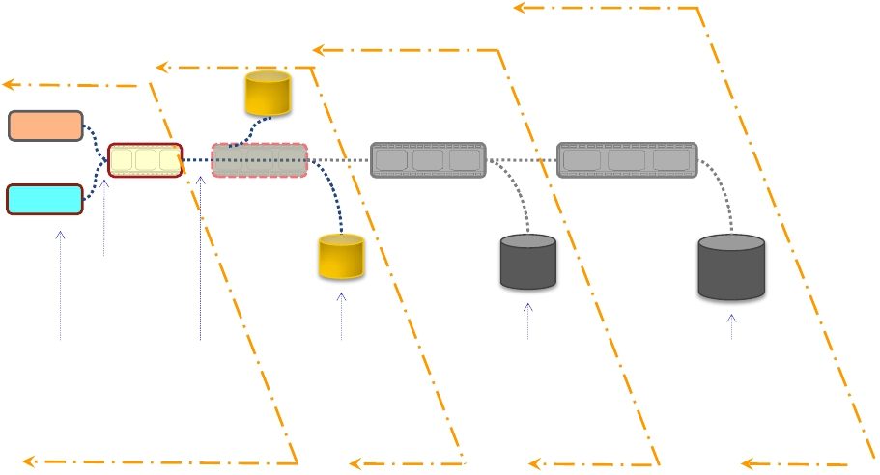
￥1.8 B
Phase IV
￥1.78 B
Phase II
Phase III
Phase I
2011--2016
Inject I
Inject II
2016--2022
<2021
~1MW Close
Fuel Recycle
10 MeV
>10 MWt
>600 MWt
~1 GWt
2014
~2.5 MeV
&10mA
2016
~25 MeV
&10mA
2022
>250 MeV
&10mA
<2030
1.0~2.0 GeV
&<15mA
~203x
1.0~2.0 GeV
&>15mA
Key Tech. R&D :Acc.,
Target, Blanket… Prototype
Initial Facility
Demo. Facility
Indust. Facility
37

Slide 13
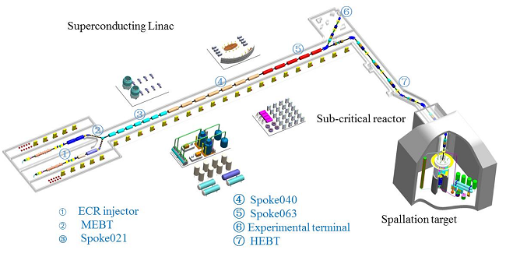
CIADS
The 250 MeV and 10mA (maximum beam current) CW mode superconducting proton LINAC.
For spallation target in this facility, the novel spallation target, i.e. granular flow spallation target, will be used in this research facility.
For the subcritical reactor, we will choose LBE coolant reactor in the ADS facility
By using this facility, we will demonstrate the principle of the ADS concept, and test key engineering technologies of this facility

Slide 14
ADS Perspectives
For the ADS program, the ultimate goal is to build an industrial demo ADS facility to destroy long-lived nuclear waste and protect the environment. As indicated in the China ADS development roadmap, in the next stage we will establish a research ADS facility by 2024
Thus, all of the research works now are developing around this goal.
After then, we will construct hundreds of MWt experimental system to demonstrate the reliability of this kind of technology.
In 2040s, we will build the first industry scale demo system to test the economy of this technology in long-lived nuclear waste transmutation

Slide 15
ADANES
In addition, based on the achievements obtained in the process of the ADS study, we have proposed a novel conceptual design of an ADS-based nuclear energy system, Accelerator Driven Advanced Nuclear Energy System (ADANES)
ADANES, which is integrating nuclear waste transmutation, nuclear fuel multiplication and nuclear safety production, is a kind of strategic energy capable of providing thousands of years' energy of secure with low emission and high cost performance
The ADANES has reached and partially surpassed the international requirements on sustainable development, security, economic competitiveness, nuclear nonproliferation of nuclear fission energy system, and has realized the ideal closed loop
operation of nuclear fission energy.

Slide 16
ADS: Outstanding Issues and Challenges
The ADS program faces great technical challenges as there is no prototype facility running in the whole world so far. Although we have made some important achievements, there are still a lot of problems needed to be solved.
The economy of the ADS system should be re-evaluated in the full loop of the fuel cycle. New conceptual nuclear system such as ADANES is worth being investigated.
As a driver of a nuclear reactor, the RAMI (Reliability, Availability, Maintainability and Inspectability) of the LINAC is a great challenge compared to the normal accelerator system.
The coupling of the target with accelerator and sub-critical reactor is also needed to pay special attention.

Slide 17
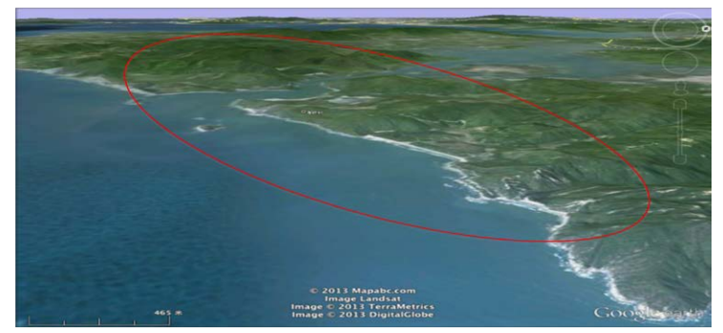
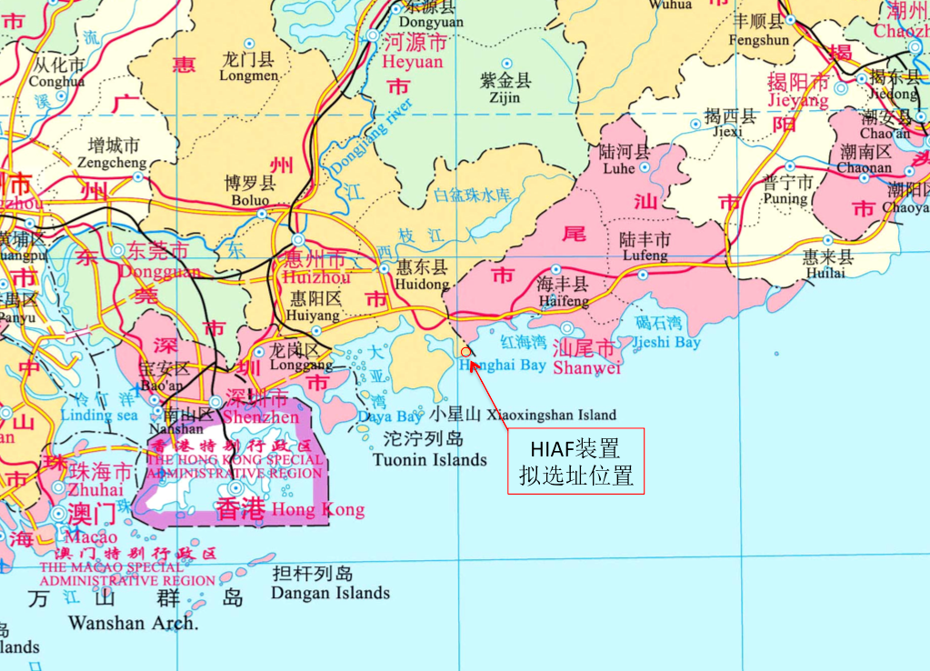
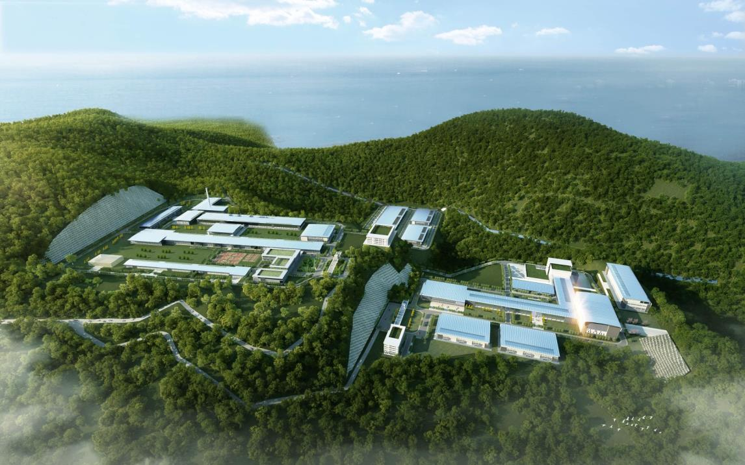
HIAF and CIADS Location
Both HIAF and CIADS will be in Huizhou, Guangdong Province.
HIAF
CIADS

Slide 18
ADS and HIAF Development in IMP
Lanzhou + Guangdong
Guangdong + Lanzhou
Lanzhou
2024-2030
2018-2023
HIRFL run
HIAF run
HIAF-EIC construct
HIAF-ISOL construct
Heavy Ion physics
Heavy ion beam applications
High energy density physics (fusion)
Neutrino
2015-2017
HIRFL run and upgrade
HIAF construct
HIAF-EIC R&D
Heavy Ion physics
Heavy ion beam applications
HIRFL run
HIRFL upgrade
HIAF R&D
Heavy Ion physics
Heavy ion beam applications

Slide 19
4. Summary
ADS: 1.8 B RMB ~ 300 M USD
HIAF: 1.5 B RMB ~ 250 M USD
Both ADS and HIAF will be approved in 1~2~3 months FINALLY!

Slide 20
Thanks you！

