Slide 1



Accessing Transverse Spin and Momentum Structure of the Nucleon in COMPASS
Hadron 2015
The 7th Workshop on Hadron Physics in China and Opportunities Worldwide
August 3-7, 2015, Kunshan, China
Wen-Chen Chang 章文箴
On behalf of the COMPASS Collaboration
Institute of Physics, Academia Sinica, Taiwan

Slide 2
Outline
Transverse single-spin asymmetry (SSA) and TMDs
Recent COMPASS TMD results of Collins and Sivers asymmetries in SIDIS
New measurement of Sivers functions in COMPASS polarized Drell-Yan process
Summary

Slide 3


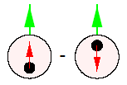
Quark Distribution Functions
At leading twist
Momentum Distribution
Helicity Distribution
Transversity Distribution
Positivity Bound
Soffer Bound

Slide 4
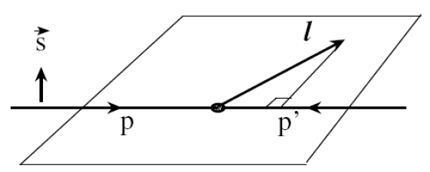
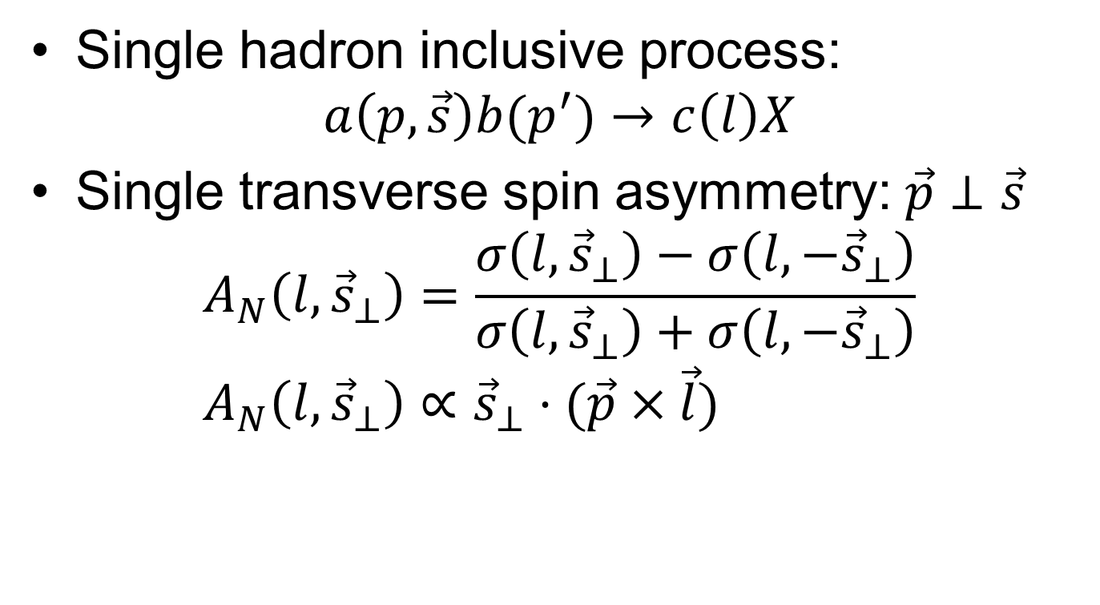
Transverse Single Spin Asymmetry
Single hadron inclusive process:
$a\left(p,\vec{s}\right)b(p^{′})→c\left(l\right)X$
Single transverse spin asymmetry:$\vec{p}⊥\vec{s}$
$$A_{N}\left(l, {\vec{s}}_{⊥}\right)=\frac{σ\left(l,{\vec{s}}_{⊥}\right)−σ\left(l,−{\vec{s}}_{⊥}\right)}{σ\left(l,{\vec{s}}_{⊥}\right)+σ\left(l,−{\vec{s}}_{⊥}\right)} \\ A_{N}\left(l,{\vec{s}}_{⊥}\right)∝{\vec{s}}_{⊥}⋅(\vec{p}×\vec{l})$$

Slide 5
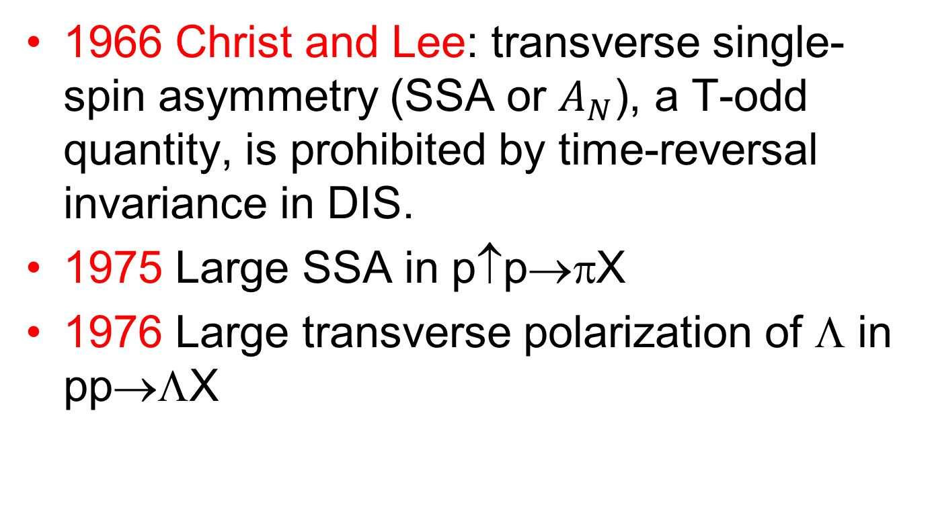
Prehistory of
Transverse Spin Effect
1966 Christ and Lee: transverse single-spin asymmetry (SSA or $A_{N}$), a T-odd quantity, is prohibited by time-reversal invariance in DIS.
1975 Large SSA in p↑p→πX
1976 Large transverse polarization of Λ in pp→ΛX

Slide 6
History of
Transverse Spin Effect
1978 Kane, Pumplin and Repko: SSAs shall vanish in the massless limit.
1990 Sivers: SSAs originating from the intrinsic motion of quarks in a transversely polarized hadron.
1993 Collins: a spin asymmetry in the fragmentation of transversely polarized quarks, correlating with k_{T}, into an unpolarized hadron, which enables the measurement of SSAs in SIDIS.

Slide 7
History of
Transverse Spin Effect
1993 Collins: Sivers function should vanish due to parity and time reversal invariance.
2002 Brodsky, Hwang and Schmidt: SSAs in SIDIS might be finite taking account of orbital motion of quarks and multiple gluon scattering.
2002 Collins: Sivers function could be non-zero due to the gauge link. The Sivers functions in SIDIS and Drell-Yan processes are of opposite sign.

Slide 8
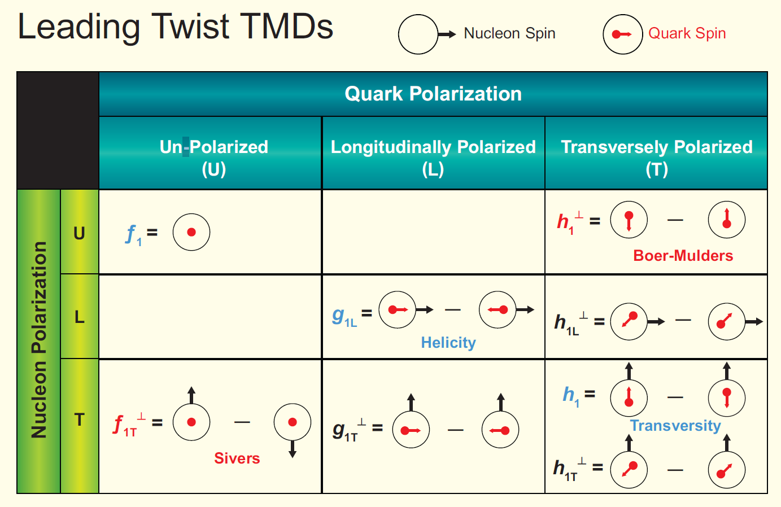
Transverse momentum dependent (TMD) PDFs
Boer-Mulders
function
correlation between the
transverse spin and the
transverse momentum
of the quark in unpolarized nucleons
Sivers function
correlation between the
transverse spin of the nucleon
and the transverse momentum
of the quark.
sensitive to orbital angular momentum
arXiv:1212.1701

Slide 9
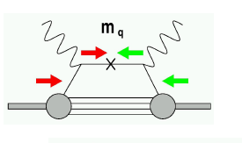
How to measure SSAs?
Chiral-odd → not accessible in DIS
Require another chiral-odd object
Semi-Inclusive DIS: ambiguity associated with fragmentation process
  Single-hadron (Collins fragmentation function, Sivers function)
  Two hadrons (Interference fragmentation function)
  Vector meson polarization
  Λ – polarization
Drell-Yan: small cross sections but free from fragmentation
Proton-proton collision: inclusive single-hadron, prompt jet, prompt photon production

Slide 10
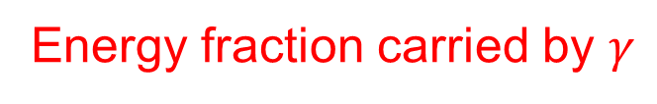
Semi-Inclusive DIS (SIDIS)
Bjorken scaling variable
Energy fraction carried by $γ$
P
Energy fraction carried by h

Slide 11
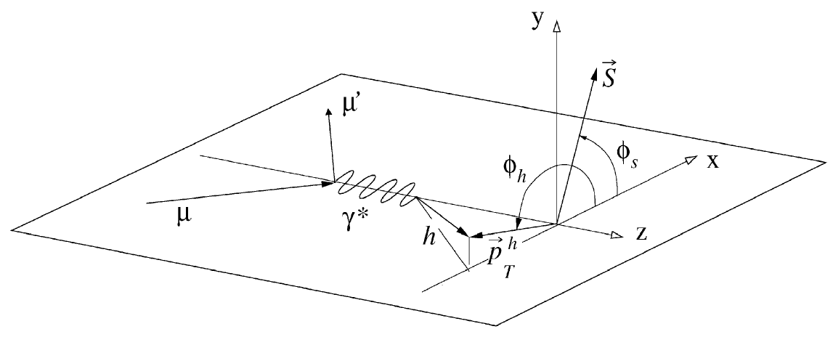
Collins and Sivers Azimuthal Asymmetries in SIDIS
Collins asymmetry
Sivers asymmetry

Slide 12




COMPASS Collaboration
(Common Muon and Proton Apparatus for Structure and Spectroscopy)
24 institutions from 13 countries – nearly 250 physicists
Fixed-target experiment at SPS north area
Physics programs:
  Nucleon spin and partonic structures
  Hadron spectroscopy

Slide 13
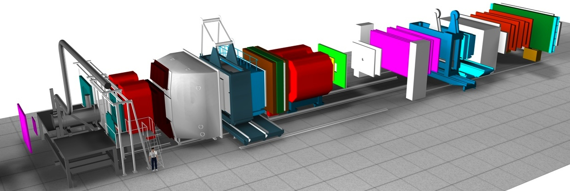
COMPASS Setup
Small Angle Spectrometer (SAS)
Large Angle Spectrometer (LAS)
Target Region
μ Filter
ECAL & HCAL
μ Filter
ECAL & HCAL
SM2
RICH
MWPC, MW2
SM1
straw
DC
Beam
MWPC, GEM, SciFi
MW1
50m
GEM, SciFi, DC, straw
Powerful tracking system : 350 planes
PID : μ-Walls, Calorimeters, RICH
MicroMega, DC, SciFi
Beam:
Polarized lepton beam : μ⁺, μ⁻ 50-280 GeV/c
Hadron beam : π⁺, π⁺, K⁺, K⁻, p
Target:
Polarized NH₃ and ⁶LiD target
Liquid hydrogen target
Notes:
Large angle spectrometers and small-angle spectrometer, important for two-track acceptance.

Slide 14
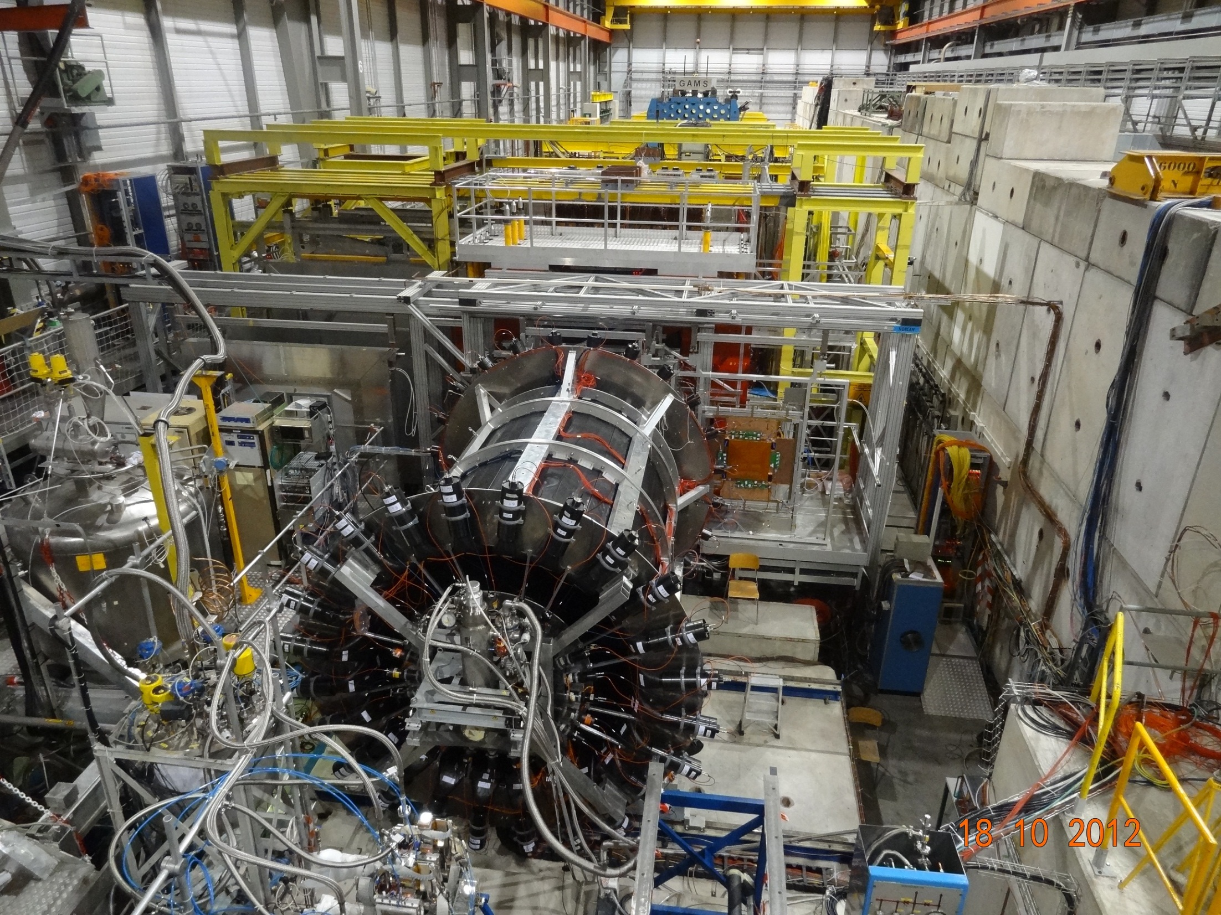
ECAL2
ECAL1
ECAL0
CAMERA recoil proton detector
surrounding the 2.5m long
LH2 target

Slide 15
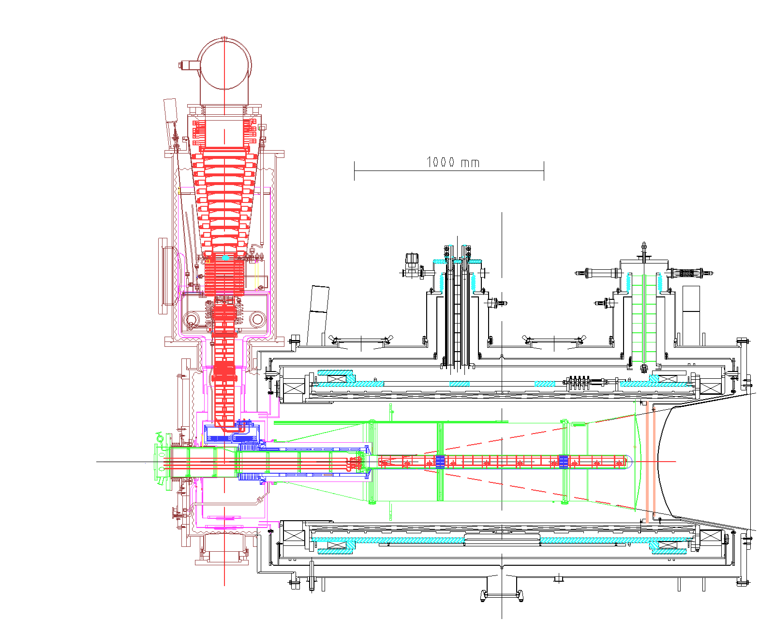
Polarized NH₃ Target
Cryogenic
³He-4He dilution refrigerator
T~50mK
Magnet
Superconducting solenoid : 2.5 T
Dipole filed: 0.5 T
Target
Materials: p(NH₃)
Dilution factor: 0.22
Polarization: >90%
Two 55 cm long target cells spaced by 20 cm
Notes:
Optical pumping, colling

Slide 16
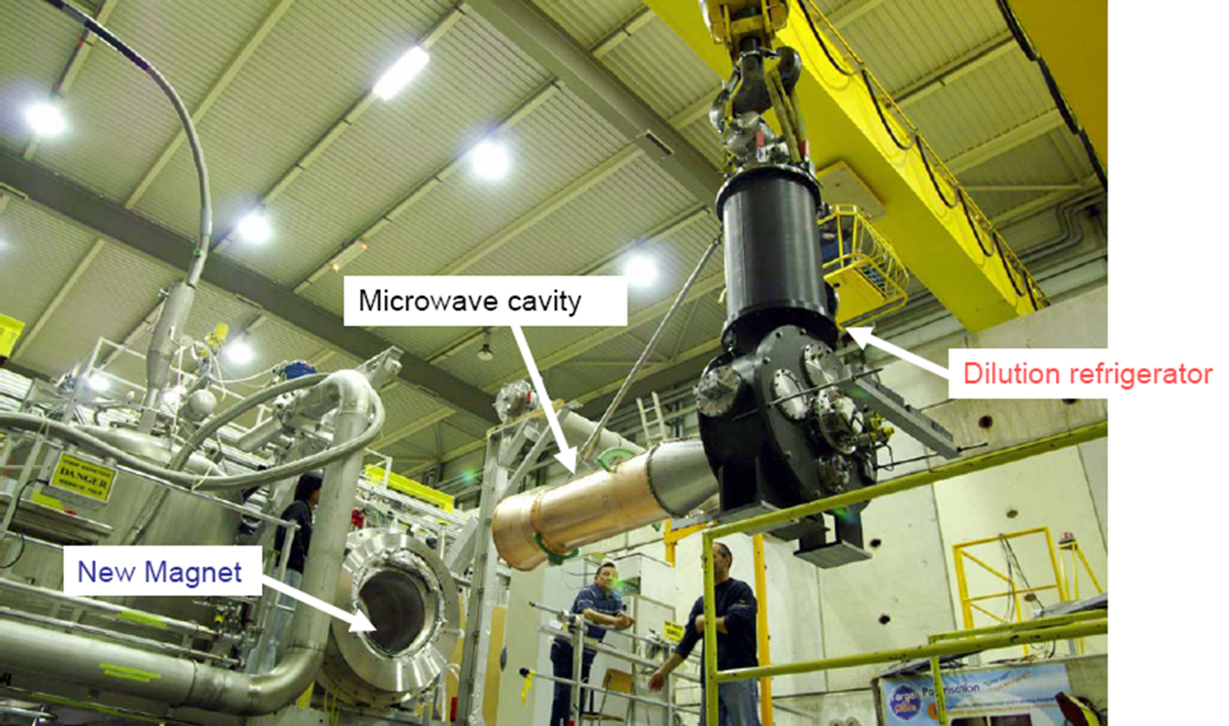
Polarized NH₃ Target
Magnet

Slide 17
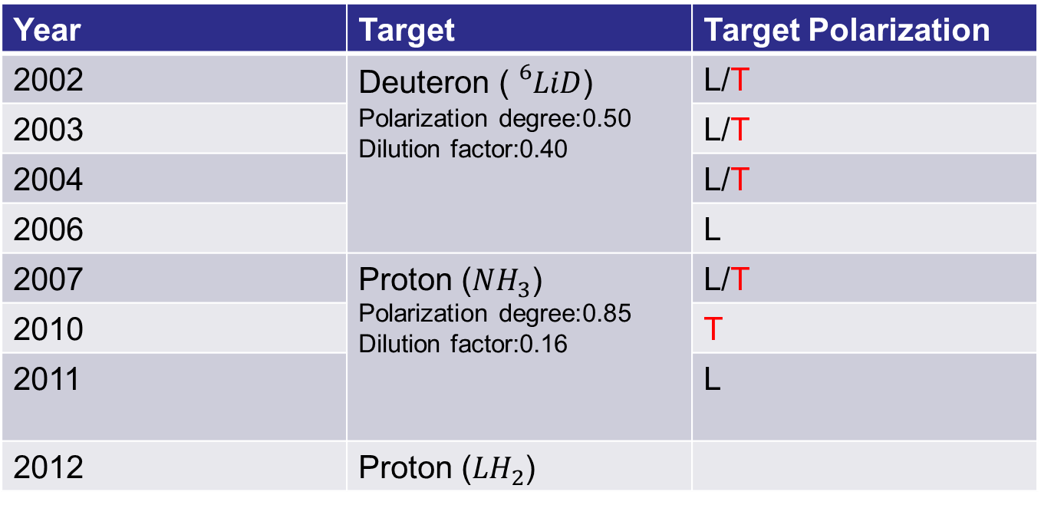
COMPASS Muon-Beam Runs
Year | Target | Target Polarization
2002 | Deuteron (${}_{}^{6}{LiD}$) Polarization degree:0.50 Dilution factor:0.40 | L/T
2003 |  | L/T
2004 |  | L/T
2006 |  | L
2007 | Proton (${NH}_{3}$) Polarization degree:0.85 Dilution factor:0.16 | L/T
2010 |  | T
2011 |  | L
2012 | Proton (${LH}_{2}$)
Beam momentum: 160 GeV/c
Beam intensity: ~4x10⁷/sec

Slide 18
COMPASS Publication of TMD Physics from SIDIS
Publication | Run/Target | Physics Results
Phys. Rev. Lett. 94 (2005) 202002 | 2002 /deuteron | Collins and Sivers asym. of charged hadrons
Nucl. Phys. B 765 (2007) 127 | 2002,2003,2004 /deuteron | Collins and Sivers asym. of charged hadrons
Phys. Lett. B 673 (2009) 127 | 2002,2003,2004 /deuteron | Collins and Sivers asym. of pions and kaons
Phys. Lett. B 692 (2010) 240 | 2007 /proton | Collins and Sivers asym. of charged hadrons
Phys. Lett. B 717 (2012) 376 | 2010 /proton | Collins asym. of charged hadrons
Phys. Lett. B 717 (2012) 383 | 2010 /proton | Sivers asym. of charged hadrons
Phys. Lett. B 736 (2014) 214 | 2010 /proton | Dihadron fragmen. asym. Of charged hadrons
Phys. Lett. B 744 (2015) 250 | 2007,2010 /proton | Collins and Sivers asym. of pions and kaons

Slide 19
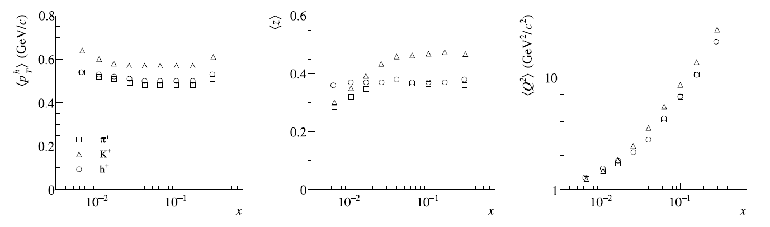
Kinematic Regions of
COMPASS SIDIS
COMPASS, PLB 744 (2015) 250

Slide 20
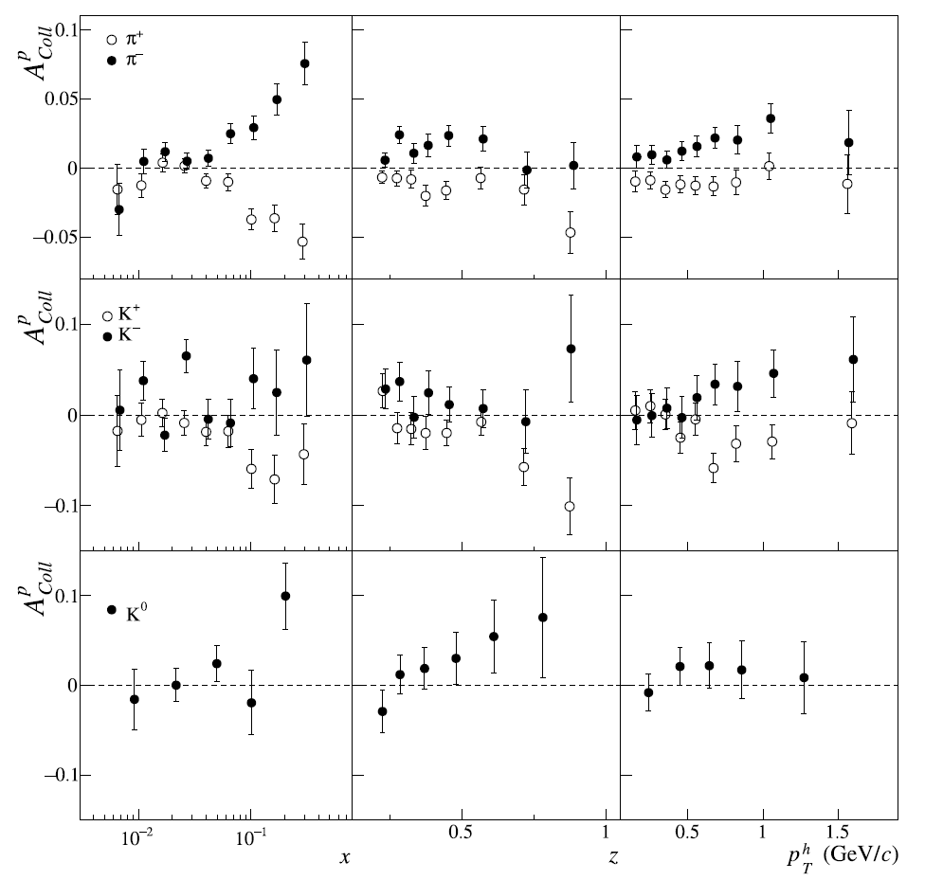
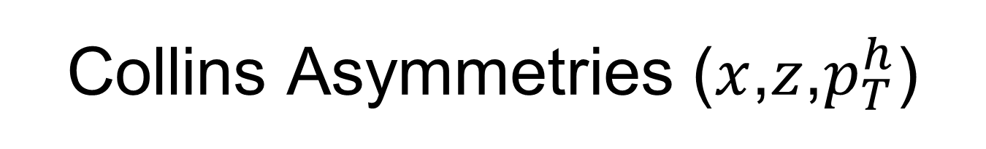
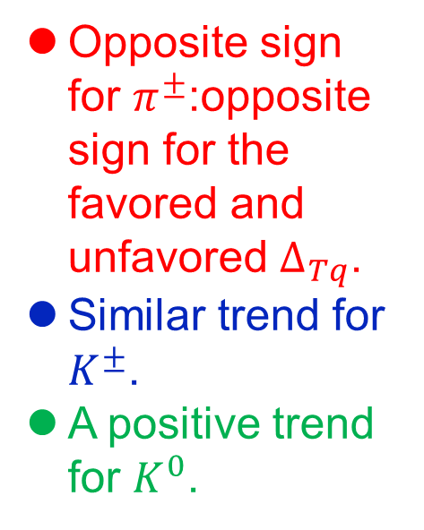
Collins Asymmetries ($x$,$z$,$p_{T}^{h}$)
Opposite sign for $π^{±}$:opposite sign for the favored and unfavored $∆_{Tq}$.
Similar trend for $K^{±}$.
A positive trend for $K^{0}$.
COMPASS, PLB 744 (2015) 250

Slide 21
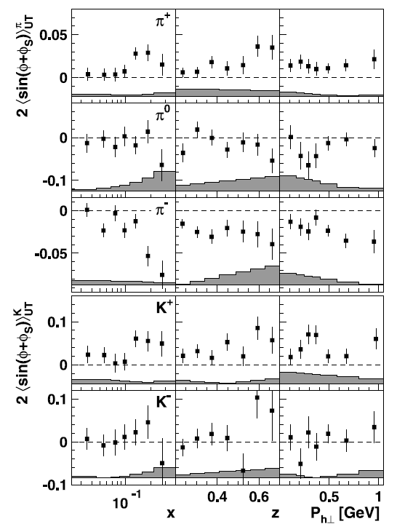
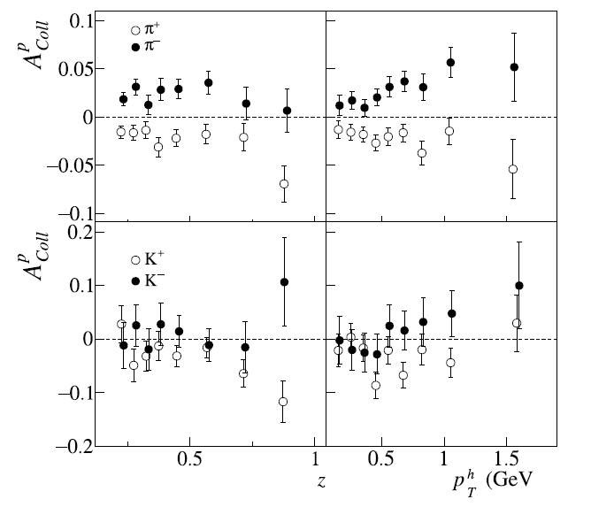
QCD-evolution of
Collins Asymmetries
COMPASS, PLB 744 (2015) 250
Good agreement of COMPASS and HERMES’s results suggests weak Q²-dependence of Collins asymmetry.
HERMES, PLB 693 (2010)11

Slide 22
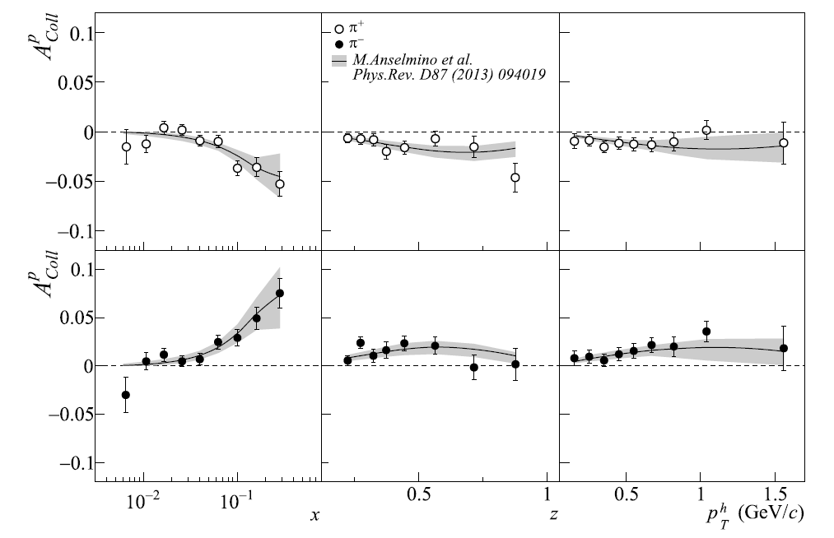
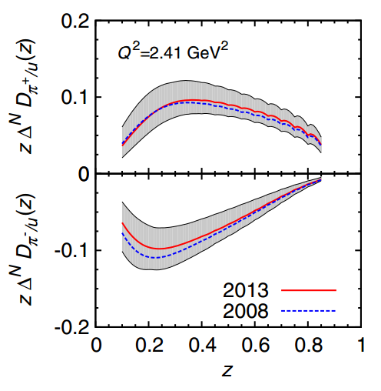
Global Analysis of
Collins Asymmetries
Collins Functions
favored
unfavored
PRD 87 (2013) 094019
COMPASS, PLB 744 (2015) 250

Slide 23
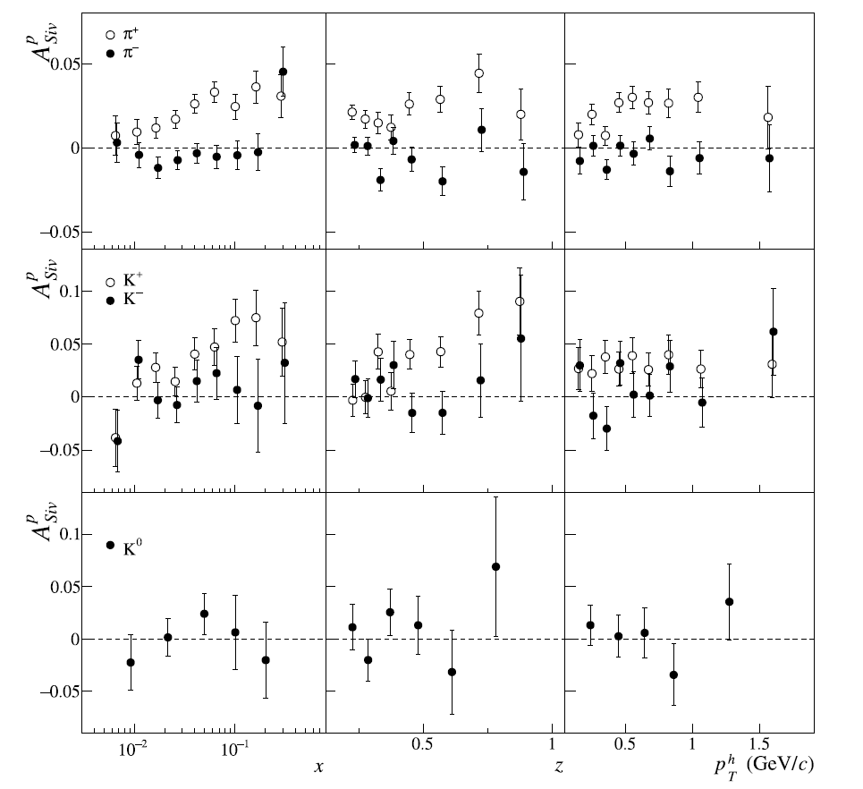
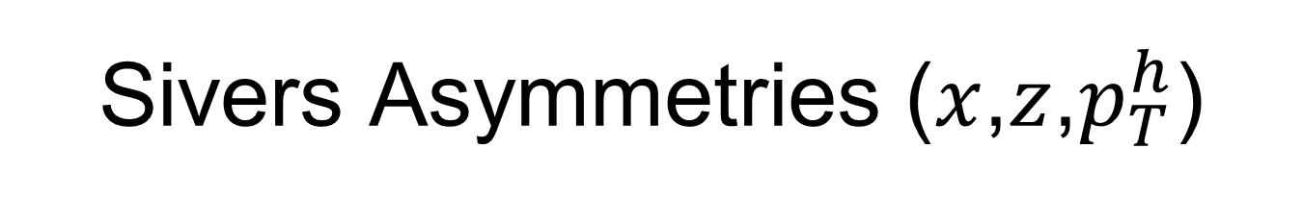
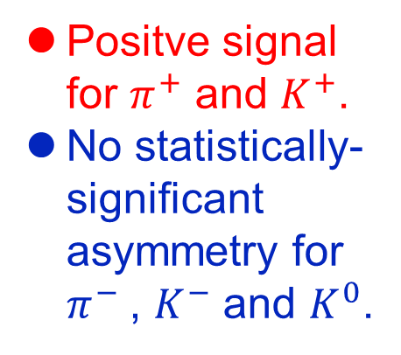
Sivers Asymmetries ($x$,$z$,$p_{T}^{h}$)
Positve signal for $π^{+}$ and $K^{+}$.
No statistically-significant asymmetry for $π^{−}$, $K^{−}$ and $K^{0}$.
COMPASS, PLB 744 (2015) 250

Slide 24
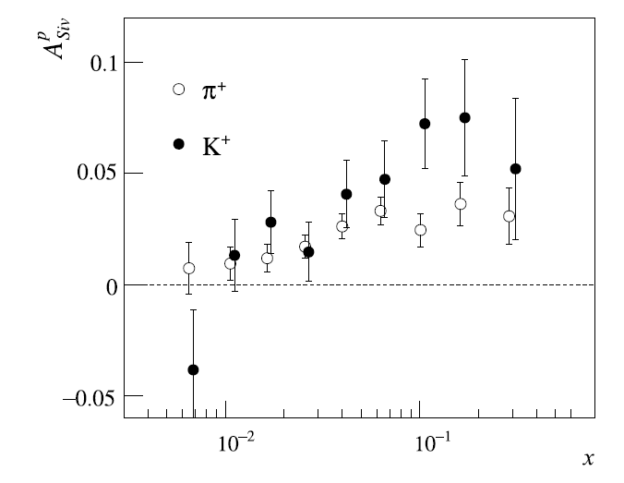
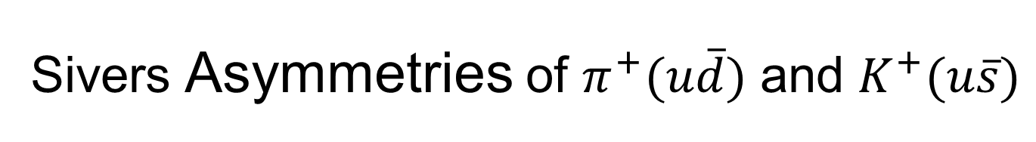
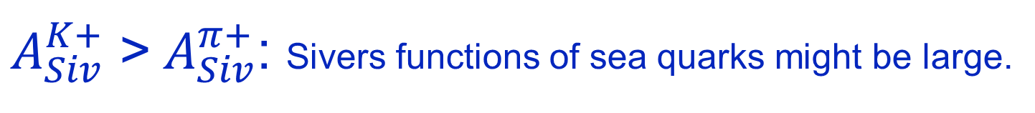
Sivers Asymmetries of $π^{+}(u\overline{d})$ and $K^{+}(u\overline{s})$
$A_{Siv}^{K+}$ >${ A}_{Siv}^{π+}$: Sivers functions of sea quarks might be large.
COMPASS, PLB 744 (2015) 250

Slide 25
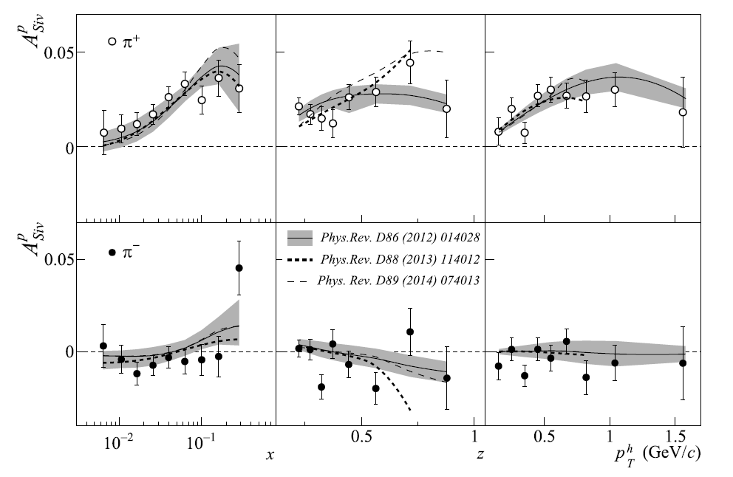
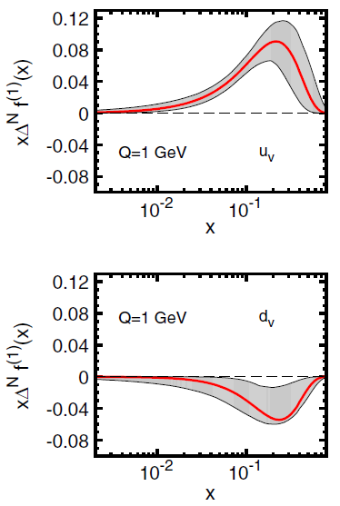
Global Analysis of
Sivers Asymmetries
COMPASS, PLB 744 (2015) 250
Sivers Functions
Clear signals of non-zero Sivers functions for the valance quarks of nucleons!
PRD 86 (2012) 014028

Slide 26
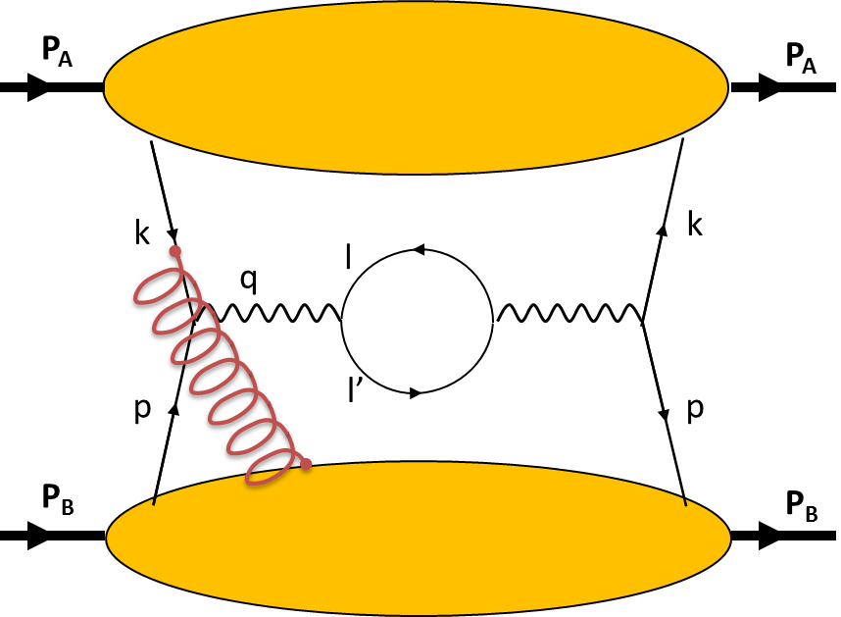
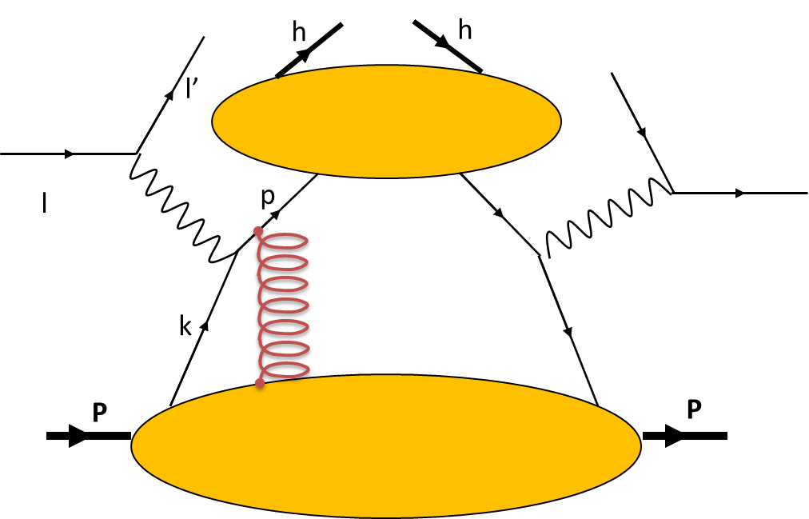
Sign Change of Sivers Functions
J.C. Collins, Phys. Lett. B 536 (2002) 43
A.V. Belitsky, X. Ji, F. Yuan, Nucl. Phys. B 656 (2003) 165
D. Boer, P.J. Mulders, F. Pijlman, Nucl. Phys. B 667 (2003) 201
Z.B. Kang, J.W. Qiu, Phys. Rev. Lett. 103 (2009) 172001
Drell-Yan
SIDIS
QCD gluon gauge link (Wilson line) in the initial state (DY) vs. final state interactions (SIDIS).
Fundamental predictions from perturbative QCD and TMD physics will be tested.

Slide 27
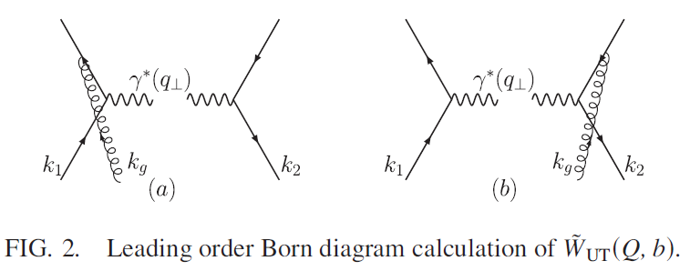
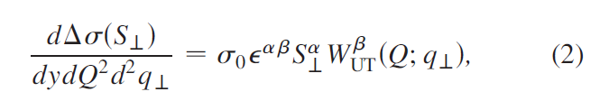
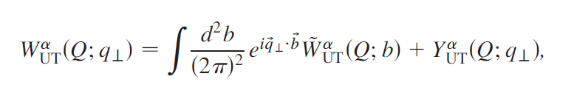
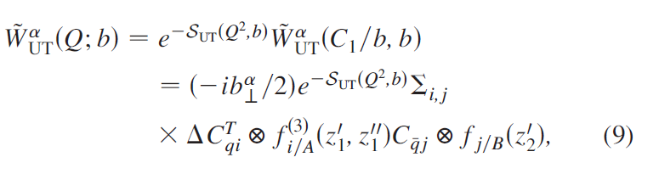
“Opposite Sign of SSA for SIDIS and DY” Preserved in NLO QCD
Z-B Kang, B-W Xiao and F. Yuan, PRL 107, 152002 (2011)
Ji-Ma-Yuan factorization
Collins-Soper-Sterman resummation

Slide 28
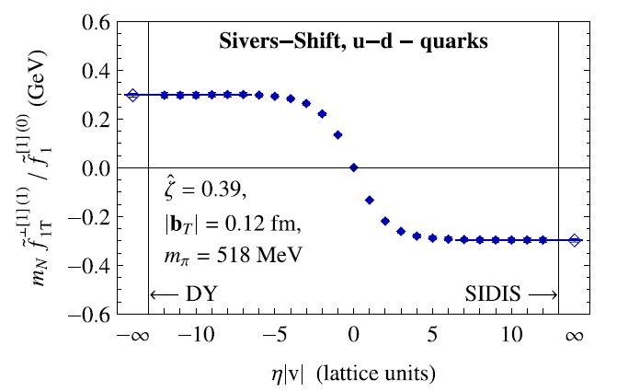
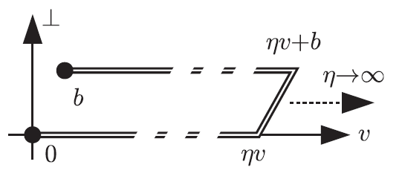
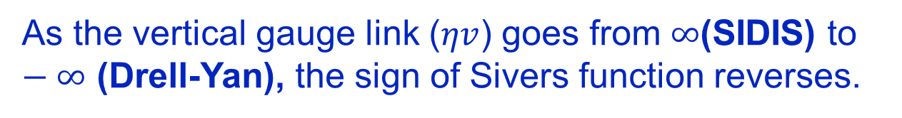
Sivers Function with Lattice QCD
B. U. Musch et al., PRD 85, 094510 (2012)
As the vertical gauge link ($ηv$) goes from $∞$(SIDIS) to $−∞$ (Drell-Yan), the sign of Sivers function reverses.

Slide 29
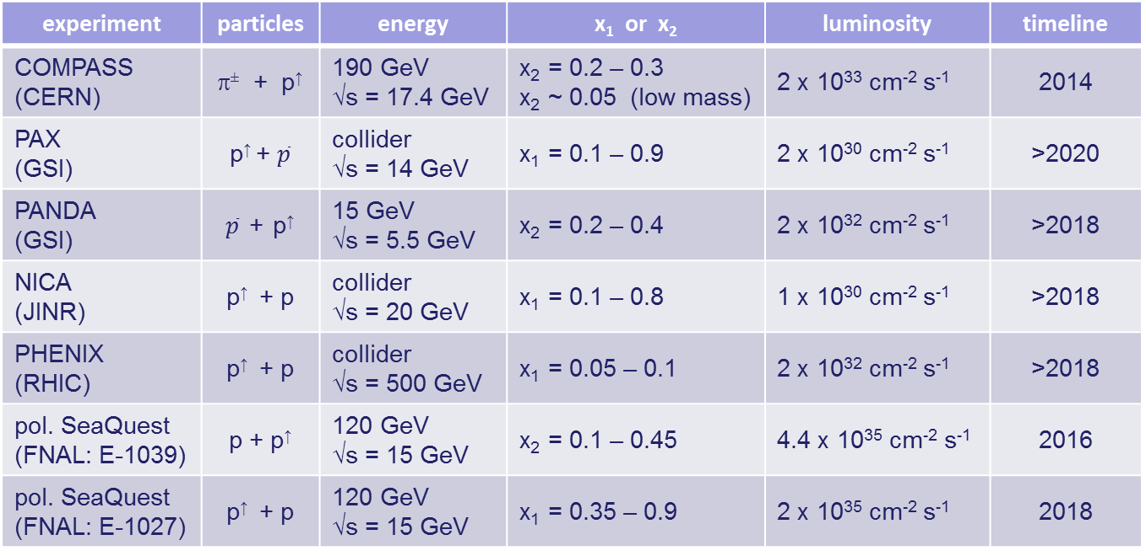
Planned Polarized Drell-Yan Experiments
experiment | particles | energy | x₁ or x₂ | luminosity | timeline
COMPASS (CERN) | π± + p↑ | 190 GeV √s = 17.4 GeV | x₂ = 0.2 – 0.3 x₂ ~ 0.05 (low mass) | 2 x 10³³ cm⁻² s⁻¹ | 2014
PAX (GSI) | p↑ + $\overline{p}$ | collider √s = 14 GeV | x₁ = 0.1 – 0.9 | 2 x 10³⁰ cm⁻² s⁻¹ | >2020
PANDA (GSI) | $\overline{p}$ + p↑ | 15 GeV √s = 5.5 GeV | x₂ = 0.2 – 0.4 | 2 x 10³² cm⁻² s⁻¹ | >2018
NICA (JINR) | p↑ + p | collider √s = 20 GeV | x₁ = 0.1 – 0.8 | 1 x 10³⁰ cm⁻² s⁻¹ | >2018
PHENIX (RHIC) | p↑ + p | collider √s = 500 GeV | x₁ = 0.05 – 0.1 | 2 x 10³² cm⁻² s⁻¹ | >2018
pol. SeaQuest (FNAL: E-1039) | p + p↑ | 120 GeV √s = 15 GeV | x₂ = 0.1 – 0.45 | 4.4 x 10³⁵ cm⁻² s⁻¹ | 2016
pol. SeaQuest (FNAL: E-1027) | p↑ + p | 120 GeV √s = 15 GeV | x₁ = 0.35 – 0.9 | 2 x 10³⁵ cm⁻² s⁻¹ | 2018
Wolfgang Lorenzon

Slide 30
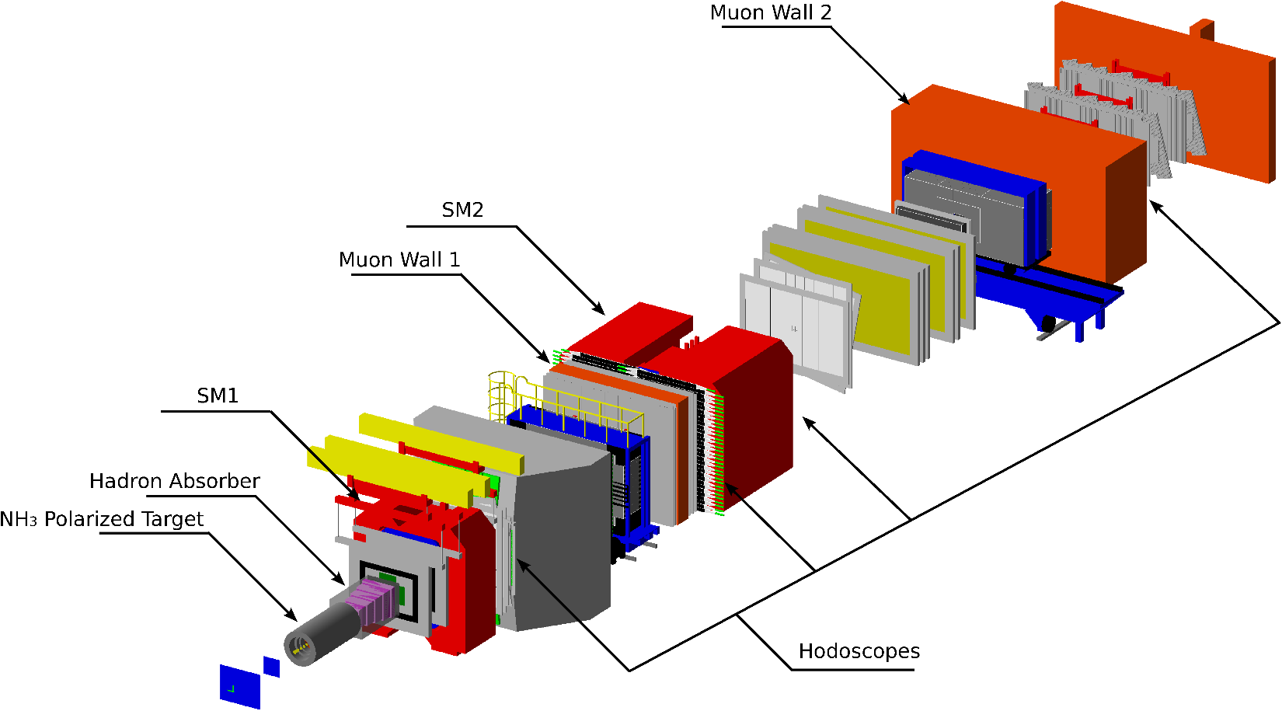
COMPASS Setup (Drell-Yan Runs)
Beam:
π⁻ 190 GeV/c
Target:
Polarized NH₃ target
Nuclear target
Target Region
Small Angle Spectrometer
(SAS)
Large Angle Spectrometer (LAS)

Slide 31
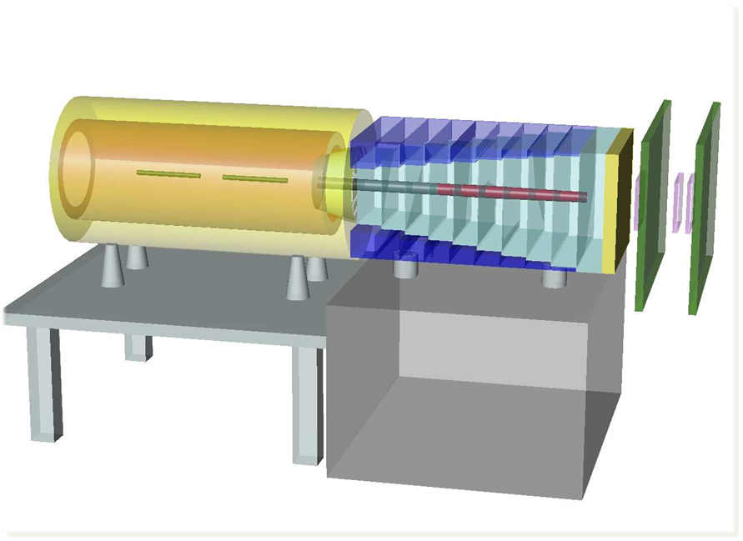
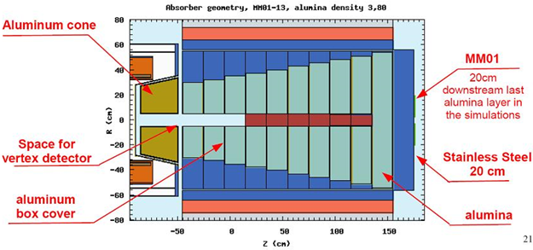
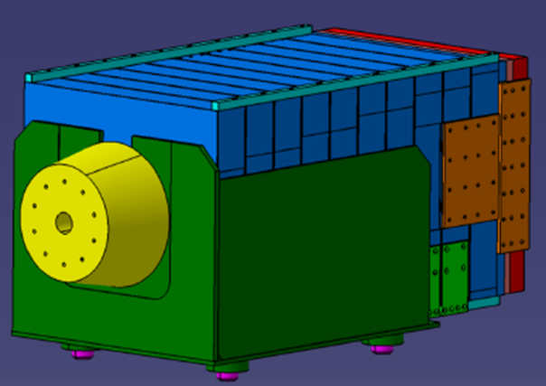
Hadron Absorber & Nuclear Targets
Absorber: 236 cm long, made of Al₂O₃.
Beam plug: 120 cm long, made of tungsten.
Radiation lengths (multiple scattering for μ): x/X₀ = 33.53
Hadronic interaction lengths (stopping power for π): x/λ_{int} = 7.25
7cm Al target
Al
W

Slide 32
Hadron Absorber & Nuclear Targets

Slide 33
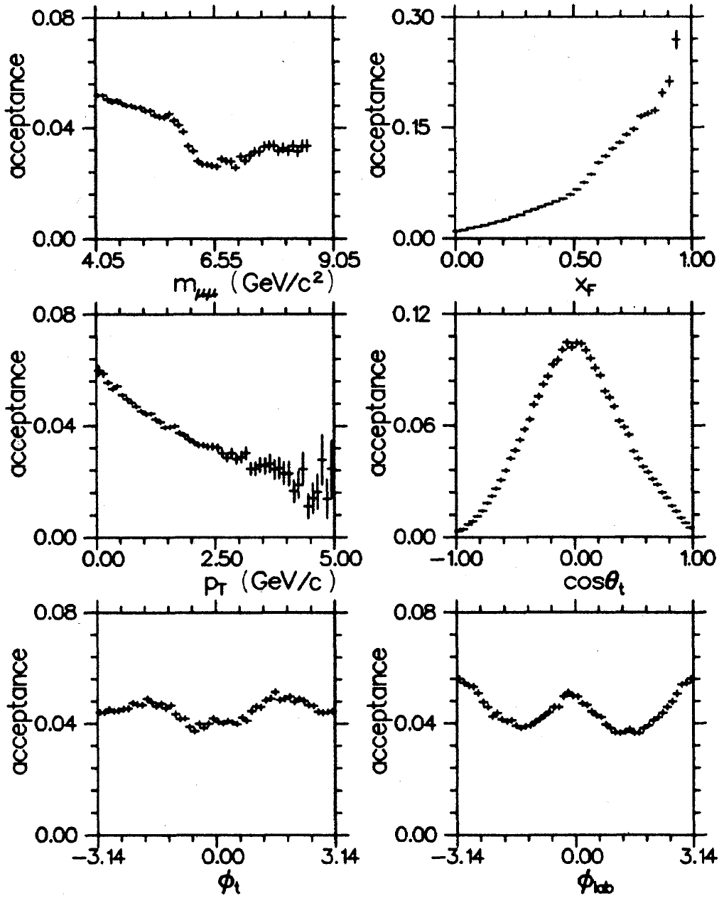
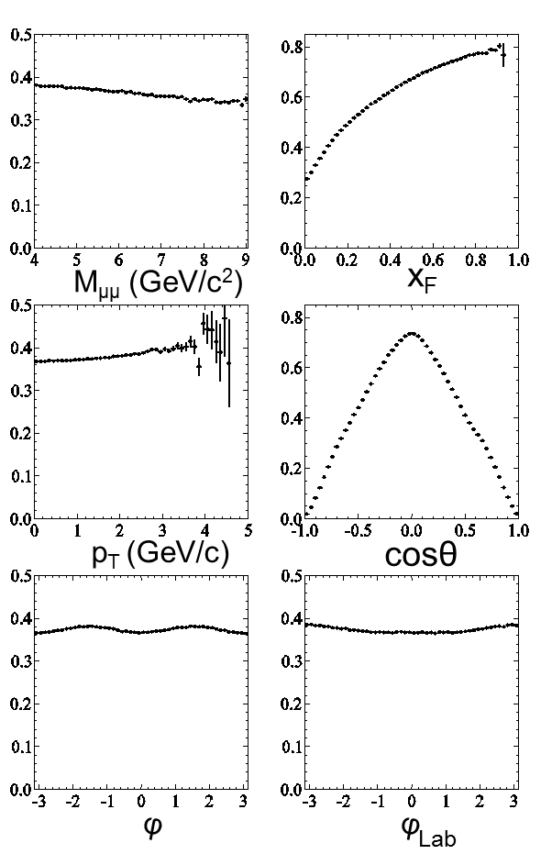
Dimuon Acceptance
E615 @ FNAL (1989)
COMPASS @ CERN (2014)
10x better

Slide 34
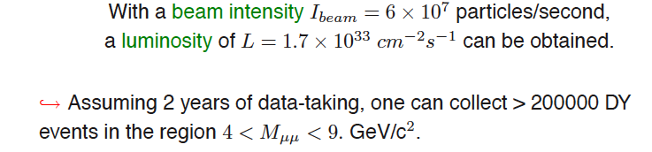
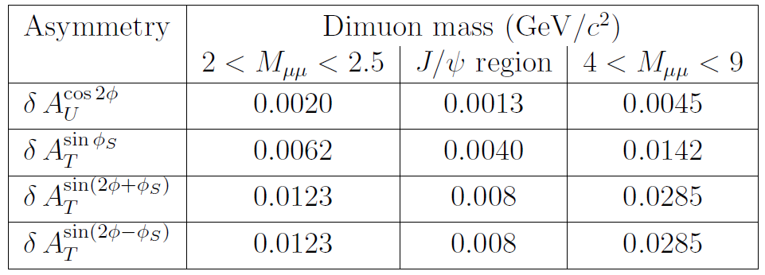
Expected Statistical Precision
Sivers
Asymmetries

Slide 35
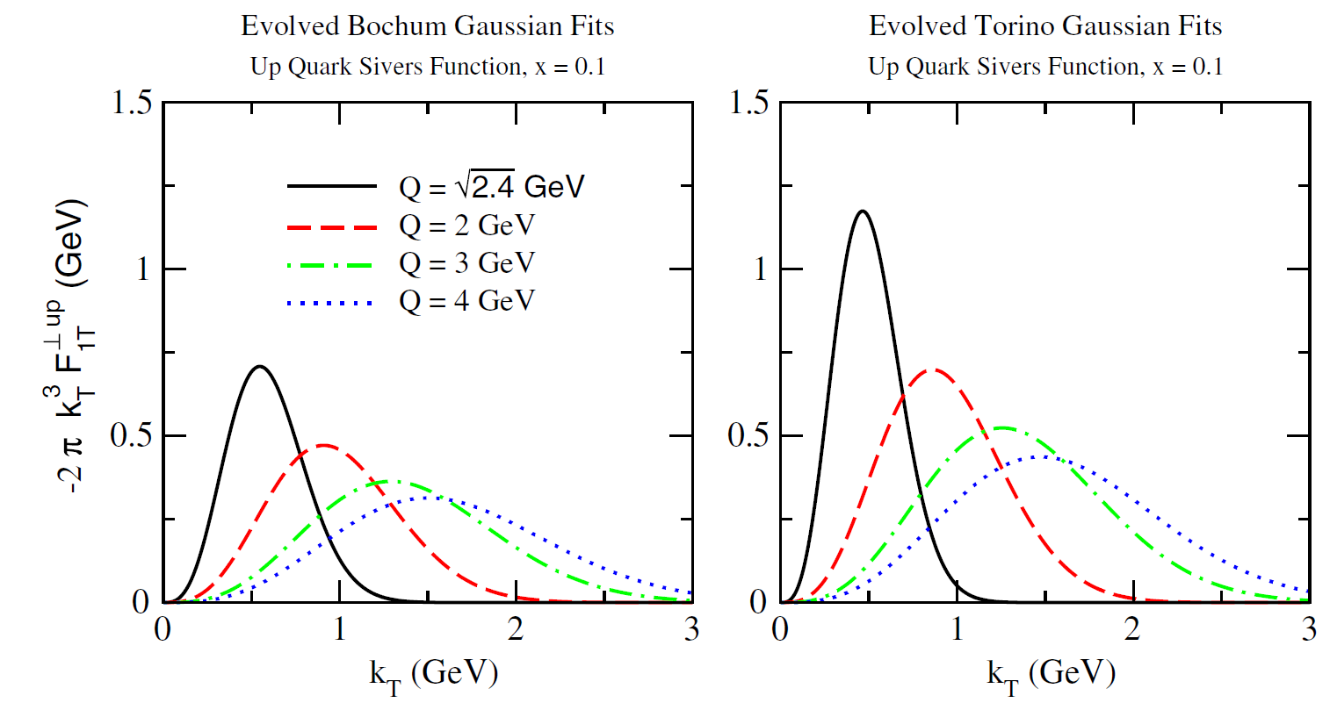
QCD Evolution of TMDs
Aybat, Collins, Qiu and Rogers, PRD 85, 034043 (2012)

Slide 36
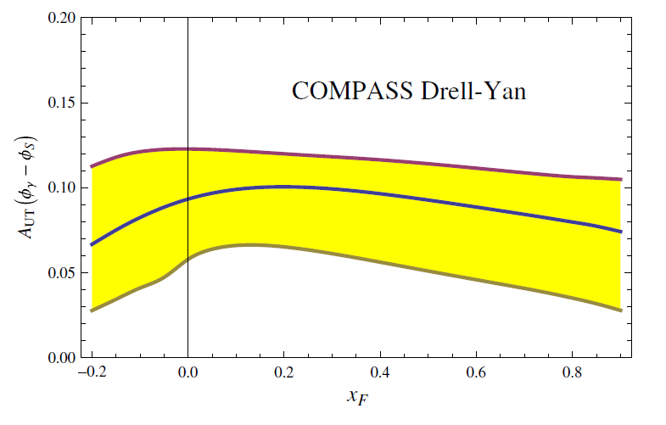
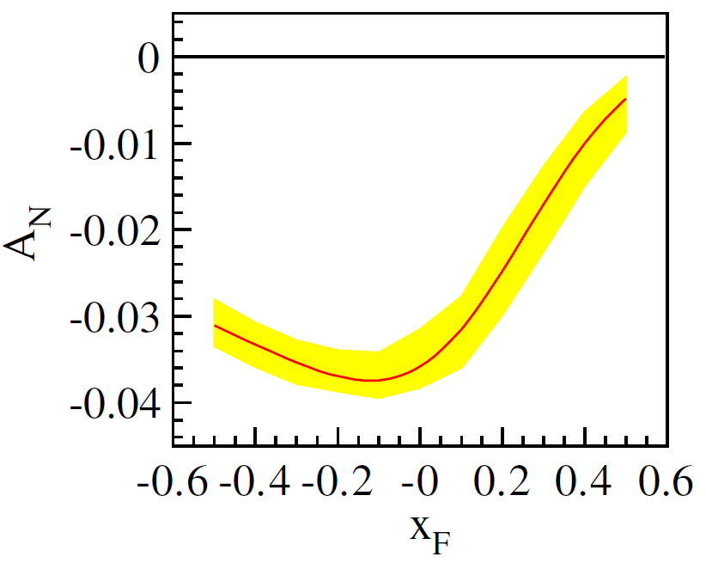
Predicted Sivers Asymmetries in COMPASS with QCD Evolution
Sun and Yuan,
PRD 88, 114012 (2013)
Echevarria, Idilbi, Kang and Vitev,
PRD 89, 074013 (2014)

Slide 37


Overlapping Kinematic Region
COMPASS has overlapping acceptance for SIDIS and DY.
Sivers asymmetry measured at the same [$x$,$Q^{2}$] without the ambiguity of QCD-evolution.

Slide 38


SIDIS at various $Q^{2}$ bins
Common acceptance for SIDIS and DY.
B. Parsymian (for the COMPASS Collaboration)
: Transversity 2014 and Spin 2014.

Slide 39


Sivers Asymmetries ($x$,$z$,$p_{T}^{h}$,$Q^{2}$)
Clear Sivers asymmetry for h⁺ at the common region ($Q^{2}>16 {GeV}^{2}$).

Slide 40
COMPASS DY Run Schedule
Oct – Dec 2014: commissioning run (completed).
May – Nov 2015: polarized Drell-Yan measurement. Physics data-taking started from this July and is under-going now!

Slide 41


Dimuon Vertex Distributions
(2014 DY)

Slide 42

Dimuon Invariant-mass Distributions
(2014 DY)

Slide 43


Dimuon x₁,x₂ and p_{T} Distributions
(2014 DY)

Slide 44
COMPASS Drell-Yan Program
2014-2018 short-term plan:
  Commissioning of polarized Drell-Yan experiment started in mid-October 2014.
  Physics data taking in year 2015.
  2016-2017: DVCS program. (A.Ferrero’s talk tomorrow)
  2018: Polarized Drell-Yan program (to be approved)
2020-2024 medium-term plan (under planning) :
  Polarized ⁶LiD target: flavor separation of TMD SSAs.
  Long LH₂ and nuclei targets: un-polarized pion-induced DY.
>2025 long-term plan (under planning) :
  Extracted high intensity RF separated antiproton/kaon beam: (un)polarized antiproton/kaon-induced DY.

Slide 45
Summary
Transverse single-spin effect has an interesting turnover and triggered the investigation of TMDs in SIDIS and DY processes.
Effects of Sivers and Collins fragmentation functions in SIDIS is clearly observed by COMPASS.
COMPASS is the first experiment to measure the polarized DY process and also the first experiment to measure TMD Sivers functions in both SIDIS and polarized DY processes.
Fundamental predictions of non-universal Sivers functions from perturbative QCD and TMD physics will be tested by the coming results from COMPASS polarized DY experiment.

Slide 47


Sivers Asymmetry ($x$,$z$,$p_{T}^{h}$)

Slide 48

Collins and Sivers Asymmetries

Slide 49

Collins Asymmetries
2007 vs. 2010

Slide 50

Sivers Asymmetries
2007 vs. 2010

Slide 51
Drell-Yan decay angular distributions
θ and φ are the decay polar and azimuthal angles of the μ⁺ in the dilepton rest-frame
Collins-Soper frame
Notes:
It is well-known that Drell-Yan process during hadron-hadron collisions is an effective approach of studying the partonic structure of hadrons, other than DIS. For hadrons like pion and kaon and antiproton, DY is probably the unique way. In the most naïve picture of DY process where quark anihlates with antiquark Electromagnetically into a virtual photon and then goes into dileption, the angular distributions of dilepton pairs could be expressed as. The virtual photon is fully transversely polarized. In 1978, Lam and Tung considered the LO QCD effect and construct the Lam-Tung relation. This servers a good check of QCD effect on DY process.

Slide 52

Angular Distributions of Drell-Yan Events
I.R. Kenyon, Rep. Prog. Phys. 45 (1982) 1261
pN
pN
πN
Notes:
At beginning, the observed decay angular distributions follow 1+costheta^2 well.

Slide 53

NA10 @ CERN: Violation of LT Relation
Z. Phys. 37 (1988) 545
π⁻+W 140 GeV
π⁻+W 194 GeV
π⁻+W 286 GeV
Notes:
In CERN NA10 pion-induced DY, it was the first time found that the LT relation was violated.

Slide 54


E615 @ FNAL: Violation of LT Relation
PRD 39, 92 (1989)
252-GeV π⁻+W
Notes:
The same observation was confirmed by FNAL E615 experiment. As you could see on the left-hand plot, there appears cos2\phi modulation at large pt region.

Slide 55

Angular Asymmetries Require Nontrivial Spin Correlation
The most general $q\overline{q}$ spin density matrix
Brandenburg, Nachtmann & Mirkes, ZPC 60 (1993) 697
Nonzero $κ$ requires the correlation of the spins of quark and antiquark.
What will be the mechanism?
Notes:
The most general qqbar spin density matrix and violation of LT can be expressed as the difference of H22 and H11. In the collinear case, quark and antiquark comes from two different hadrons, H11=H22 and thus nonzero k require an interference of spins of annilating quark and antiquark? What will be the mechanism for introducing the correlation between them?

Slide 56





D. Boer (PRD 60, 014012 (1999))
Hadronic Effect, Boer-Mulders Functions
Spin-orbit correlation of transversely polarized noncollinear partons inside an unpolarized hadron
Notes:
In 1999, D. Boer interpreted the violation of LT by the BM functions, which is the spin-orbit correlation of transversely polarized noncollinear partons inside an unpolarized hadron. The rise up of \nu as a function of pT of dimuon pair could be nicely described and this azimuthal asymmetry would vanish at large pT.

Slide 57


Pasquini and Schweitzer (PRD 90, 014050 (2014))
Boer-Mulders Functions of Pion and Proton in Light-Front Constituent Model
Notes:
In a recent work Pasgwini and shivitzer constructs BM function of valance quarks of pion and proton by LF constituent model and the
Nu parameters as a function of pt and x1 in NA10 and E615 can be nicely described.

Slide 58
Theoretical Interpretations of Lam-Tung Violation in pion-induced DY
 | Boer-Mulders Function | QCD chromo-magnetic effect | Glauber gluon
Origin of effect | Hadron | QCD vacuum | Pion specifically
Quark-flavor dependence | Yes | No | No
Hadron dependence | Yes | No | Yes
Large P_{T} limit | 0 | Nonzero | 0
Reference | PRD 60, 014012 (1999) | Z. Phy. C 60,697 (1993) | PLB 726, 262 (2013)
Notes:
Other than BM functions, there exists the other theoretical interpretations, e.g. QCD chromomagnetic effect or soft Glauber gluon surrounding pion. Each interpretation has its own prediction on the quark-flavor, hadron dependence and also large Pt limit. So measurement with different beams over wide kinematical range would help differentiating the true origin.

Slide 59

Azimuthal cos2φ Distribution in proton-induced DY
E866, PRL 99, 082301 (2007)
ν(π⁻W→µ⁺µ⁻X)~ [valence h₁┴(π)] * [valence h₁┴(p)]
ν(pd→µ+µ-X) ~ [valence h₁┴(p)] * [sea h₁┴(p)]
Sea-quark BM functions are much smaller than valence quarks
Notes:
As an example, there is no violation of LT relation seen in the proton induced DY. Some QCD vacuum effect is probably disfavored. We could account for the small \nu by small BM functions for sea quarks of proton in the case of proton-induced DY.

Slide 60
Transverse momentum dependent (TMD) PDF
Boer-Mulders
function
correlation between the transverse spin and the transverse momentum of the quark in the unpolarized nucleons
Sivers function
correlation between the
transverse spin of the nucleon
and the transverse momentum
of the quark.
sensitive to orbital angular momentum
arXiv:1212.1701
Notes:
Three distribution functions are necessary to describe the quark structure of the nucleon at LO in the collinear case.
Taking into account the quark intrinsic transverse momentum k_{T} , At leading order 8 PDFs are needed.

Slide 61

Fraction of Hadrons in M2-Hadron-beam at COMPASS target
http://www.staff.uni-mainz.de/jasinsk/index.htm
~2.5%
~97%
~1%
Beam momentum
Notes:
The secondary beam delivered to COMPASS are actually composed of several types of hadrons. For negatively-charged one, there are 97% pion-, 2.5 % kaon and 1% antiproton.

Slide 62



Beam PID & Nuclei Targets
CEDAR
(CErenkov Differential counter with Achromatic Ring focus)
50 m
Al (7cm) + W
Primary π⁻ Beam Flux
30 m
VTX
I₀
NH₃
h⁺ beam: p (75%) / π⁺ (24%)
h⁻ beam: π⁻ (97%) / K⁻ (2.5%) / $\overline{p}$ (1%)
1 x 10⁸ sec⁻¹
6.56 x 10⁷ sec⁻¹
Beam Particle Identification
5.72 x 10⁷ sec⁻¹
COMPASS could measure the beam- and target-dependence of Drell-Yan process.
Notes:
On the very upstream, we have Cerenkov different counter which could provide the function of beam identification to differentiate pion, kaon and proton. COMPASS could measure the beam- and target-dependence of Drell-Yan process.

Slide 63


Expected Statistics of
Unpolarized Drell-Yan Events
DY ( 4 < M_{μμ}< 9 GeV/c² )
140-day data taking
 | NH₃ | Al (7cm) | W
$π^{−}$ beam | 285,000 | 55,100 | 549,000
$K^{−}$ beam | 3,570 | 710 | 7,570
$\overline{p}$ beam | 2,570 | 450 | 3,640
NA3
E537
E615
21,220
27,977
700
387
COMPASS could improve the existing statistics of $π$, $K$ and $\overline{p}$-induced DY by more than one order of magnitude!

Slide 64




Expected Statistical Precision of Dimuon Angular Distributions
4 < M_{μμ}< 9 GeV/c²
NA10
COMPASS, DY on W target, 140-day data taking
$π^{−}$W
$K^{−}$W
$\overline{p}$ W
λ
λ
λ
μ
μ
μ
ν
ν
ν
p_{T} (GeV/c)
p_{T} (GeV/c)
p_{T} (GeV/c)
Notes:
On pT

Slide 65




Expected Statistical Precision of Dimuon Angular Distributions
4 < M_{μμ}< 9 GeV/c²
NA10
COMPASS, DY on W target, 140-day data taking
$π^{−}$W
$K^{−}$W
$\overline{p}$ W
λ
λ
λ
λ
μ
μ
μ
μ
ν
ν
ν
ν
x₁
x₁
x₁
Notes:
On x1

Slide 66

COMPASS Facility at CERN (SPS)
Appendix B5
Notes:
SPS as the injector to LHC, COMPASS is more or less located at the center of LHC.

Slide 67






Theoretical Predictions vs. Expected Precision
Sivers
Boer-Mulders
Sivers
Boer-Mulders
BM⊗Pretze.
BM⊗transv
BM⊗Pretze.
BM⊗transv
M. Anselmino et. Al, Eur.Phys.J.A39:89-100,2009.
V. Barone et al., Phys. Rept. 359 (2002) 1.
B. Zhang et al., Phys. Rev. D77 (2008) 054011,
Notes:
We have good enough sensitivity for the predicted Sivers function at low and high mass regions.

Slide 68

PRD 89, 074013 (2014)
Q2=2.4 GeV2

Slide 69


Slide 70

PRD 88, 114012 (2013)
Q2=2.4 GeV2

Slide 72

PRD 86, 014028 (2012)

Slide 73
PRD 85, 034043 (2012)

