Slide 1


Wasa-at-COSY
Search for
d*(2380) dibaryon
Mikhail Bashkanov

Slide 2
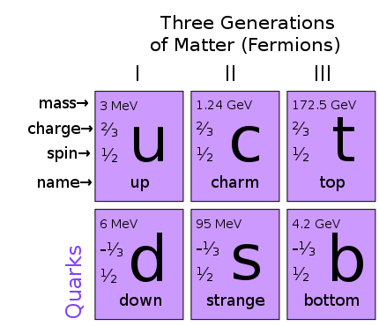
Types of particles/resonances
Meson
Baryon
white
color
anticolor

Slide 3
Possible particles
Tetraquark
Meson-Meson molecule
Hexaquark
Baryon-Baryon molecule
Pentaquark
Meson-Baryon molecule

Slide 4
Deuteron to Deltaron
I(J^{p}) = 0(1⁺)
I(J^{p}) = 0(3⁺)
u
u
u
d
d
d
u
u
u
d
d
d
Threshold
2.2 MeV
p
n
80 MeV
Δ
Δ
deuteron
d*

Slide 5
d*(2380)
The Discovery

Slide 6
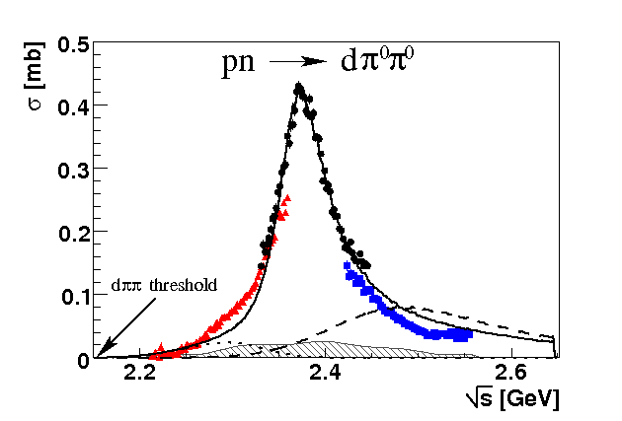
Total cross section pn → dπ⁰π⁰
“d* resonance”
Γ∼70 MeV
ΔΔ
NN*(1440)
P. Adlarson et. al Phys. Rev. Lett. 106:242302, 2011

Slide 7
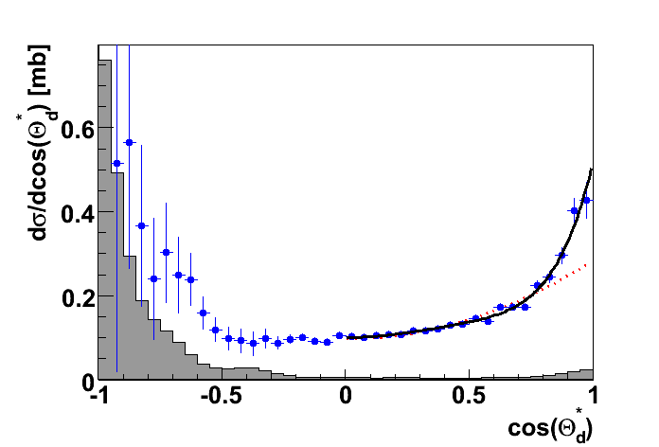
Angular distribution in the peak
J=3
J=1
P. Adlarson et. al Phys. Rev. Lett. 106:242302, 2011

Slide 8
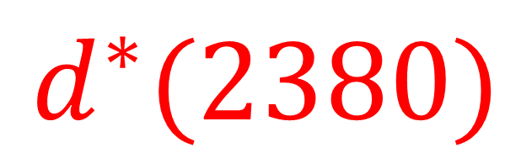
The extracted properties of the new particle
$$d^{∗}(2380)$$
pn → dibaryon → ΔΔ → dπ⁰π⁰
p
Δ
π
d
n
Δ
π
I(J^{p}) = 0(3⁺)
$$M_{d^{∗}}=2.38 GeV≈2M_{Δ}−80 MeV$$
$$Γ_{d^{∗}}=70 MeV≪Γ_{ΔΔ}=240 MeV$$

Slide 9

Only ${dπ}^{0}π^{0}$?

Slide 10
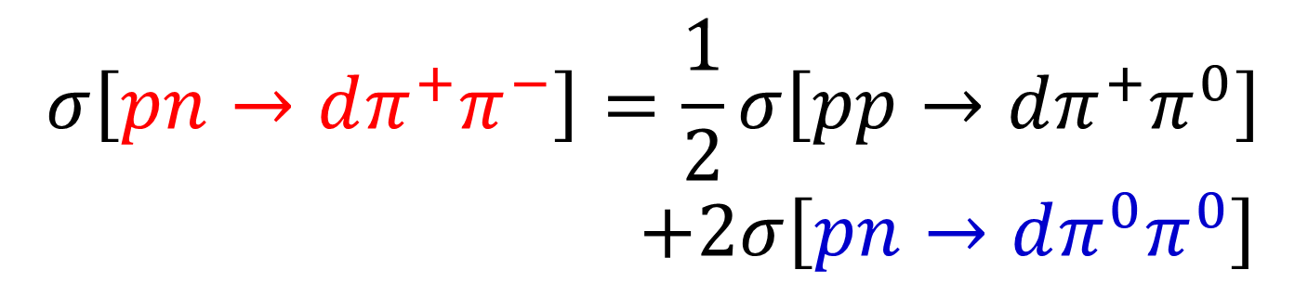
Isospin relations
I=1
I=0

Slide 11



Total cross section pN → dππ
$$dπ^{+}π^{−}$$
$$\frac{1}{2}∙dπ^{+}π^{0}$$
$$2∙dπ^{0}π^{0}$$
P. Adlarson et. al Phys. Lett. B721 (2013) 229

Slide 12
Only with deuteron?

Slide 13
From fusion to free case
pn → d* → ΔΔ → dππ
pn → d* → ΔΔ → NNππ
π
p
Δ
π
Δ
p
N
d
n
Δ
π
n
N
Δ
π
Fäldt & Wilkin, PLB 701 (2011) 619
Albaladejo & Oset, Phys.Rev. C88 (2013) 014006

Slide 14


pn → pnπ⁰π⁰
Conventional process +d*
d*
d*
Conventional process
$$\sqrt{s} [GeV]$$
$$\sqrt{s} [GeV]$$
P. Adlarson et al., Phys.Lett. B743 (2015) 325-332

Slide 15
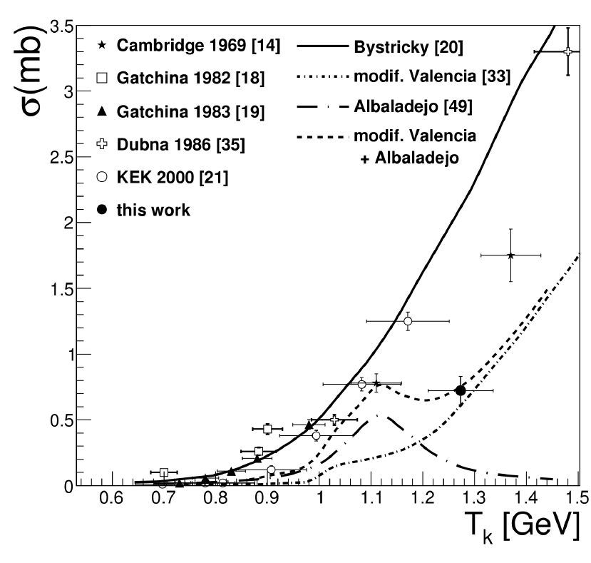
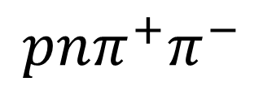
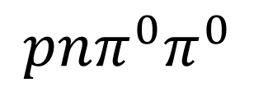
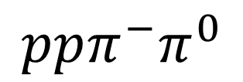
Dibaryon non-fusion decays
$$ppπ^{−}π^{0}$$
$$pnπ^{0}π^{0}$$
$$pnπ^{+}π^{−}$$
d*
d*
PRC 88 (2013) 055208
PLB 743 (2015) 325
HADES
arXiv:1503.04013

Slide 16
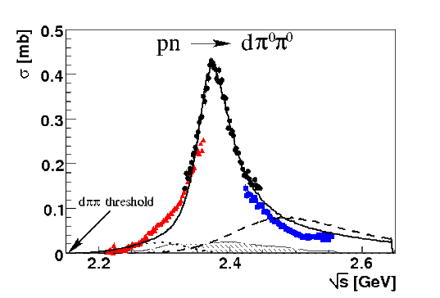
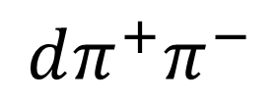
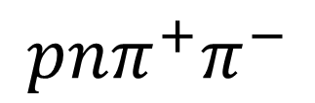
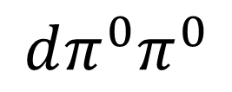
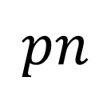
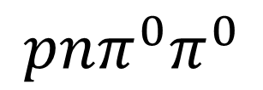
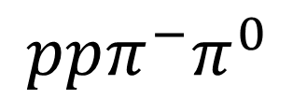
Dibaryon hadronic decays
PRL 106 (2011) 242302
PLB 721 (2013) 229
WASA data
$$dπ^{0}π^{0}$$
$$dπ^{+}π^{−}$$
pn → d*(2380)
$$pn$$
$$ppπ^{−}π^{0}$$
$$pnπ^{0}π^{0}$$
$$pnπ^{+}π^{−}$$
PRL 112 (2014) 202301
PRC 90, (2014) 035204
d*
d*
PRC 88 (2013) 055208
PLB 743 (2015) 325
d*

Slide 17
The decay modes of the dibaryon
Channel | Publications
d π⁰π⁰ | M. Bashkanov et. al Phys.Rev.Lett. 102 (2009) 052301 P. Adlarson et. al Phys. Rev. Lett. 106:242302, 2011 P. Adlarson et. al Phys.Lett. B721 (2013) 229-236
d π⁺π⁻ | P. Adlarson et. al Phys.Lett. B721 (2013) 229-236
ppπ⁰π⁻ | P. Adlarson et. al Phys. Rev. C 88, 055208
npπ⁰π⁰ | P. Adlarson et. al Phys.Lett. B743 (2015) 325
np | A. Pricking, M. Bashkanov, H. Clement. arXiv:1310.5532 P. Adlarson et al. Phys. Rev. Lett. 112, 202301, (2014) P. Adlarson et al. Phys. Rev. C 90, 035204 , (2014)
pn e⁺e⁻ | M. Bashkanov, H. Clement, Eur.Phys.J. A50 (2014) 107
³He ππ | M. Bashkanov et. al Phys.Lett. B637 (2006) 223-228 P. Adlarson et. al Phys. Rev. C 91 (2015) 1, 015201
⁴He ππ | P. Adlarson et. al Phys.Rev. C86 (2012) 032201
+ activities from other groups
M. Bashkanov, Stanley J. Brodsky, H. Clement Phys.Lett. B727 (2013) 438-442

Slide 18
Only with two pions?

Slide 19

From $ΔΔ$ to pn decay
pn → d* → ΔΔ → dππ
pn → d* → ΔΔ → NNππ
π
p
Δ
π
Δ
p
N
d
n
Δ
π
n
N
Δ
π
pn → d* → pn
p
p
n
n

Slide 20
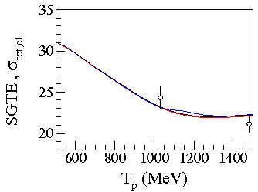
Expectations
p
p
n
n
SAID with resonance
SAID
A. Pricking, M. Bashkanov, H. Clement: arXiv:1310.5532

Slide 21
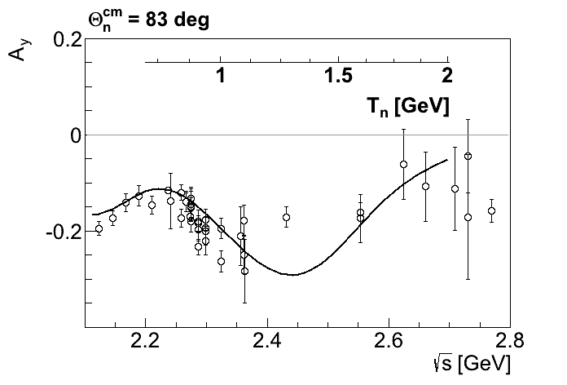

$A_{y}$ energy dependence at $83°$
p
p
n
n
SAID
A. Pricking, M. Bashkanov, H. Clement: arXiv:1310.5532

Slide 22
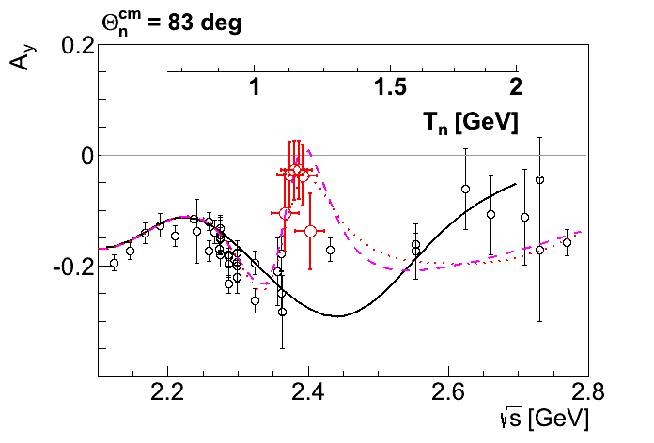
$A_{y}$ energy dependence at $83°$
p
p
n
n
SAID
New SAID
solutions
P. Adlarson et al. Phys. Rev. Lett. 112, 202301, (2014)

Slide 23
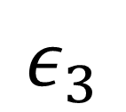
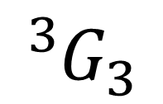

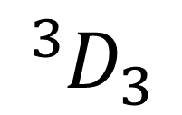
Dimensionless partial wave amplitudes
Pole at $(2380±10)−i(40±5) MeV$
Dimensionless partial wave amplitudes
Im
SP14
SP07
Re
$${}_{}^{3}{D_{3}}$$
$$ε_{3}$$
$${}_{}^{3}{G_{3}}$$
Resonance in the pn system
P. Adlarson et al. Phys. Rev. Lett. 112, 202301, (2014)

Slide 24
Argand plot
P. Adlarson et al. Phys. Rev. Lett. 112, 202301, (2014)
P. Adlarson et al. Phys. Rev. C 90, 035204 , (2014)

Slide 25
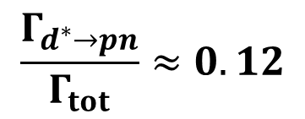


Argand plots
P. Adlarson et al. Phys. Rev. Lett. 112, 202301, (2014)
P. Adlarson et al. Phys. Rev. C 90, 035204 , (2014)
$$\frac{Γ_{d^{∗}→pn}}{Γ_{tot}}≈0.12$$
$$Γ_{d^{∗}→pn({}_{}^{3}{D_{3}})}≈10 MeV$$
$$Γ_{d^{∗}→pn({}_{}^{3}{G_{3}})}≈1 MeV$$

Slide 26
Molecule vs Hexaquark

Slide 27
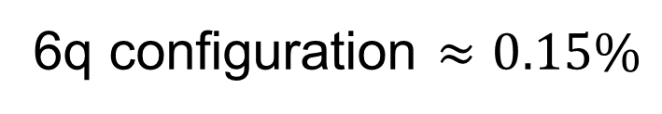

Deuteron
L=0
n
p
n
p
L=2
0.9 fm
4 fm
$$≈5\%$$
6q configuration $≈0.15\%$

Slide 28
d*(2380) internal structure and the ABC effect
L=0
Δ
Δ
Δ
Δ
L=2
M. Bashkanov et al, arXiv:1502.07500

Slide 29



Deltaron vs Hexaquark
L=0
$$≈33\%$$
Δ
Δ
0.9 fm
0.9 fm
0.7 fm
$$≈66\%$$
1.2 fm
Δ
Δ
L=2
$$?$$
F. Huang et al, Chin.Phys. C39 (2015) 7, 071001

Slide 30
The family of dibaryons

Slide 31
Mirror dibaryon
d*
I(J^{p}) = 0(3⁺)
I(J^{p}) = 3(0⁺)
Δ
Δ
Δ
Δ
u
u
u
d
d
d
u
u
u
u
u
u
Freeman J. Dyson, Nguyen-Hue Xuong Phys. Rev. Lett. 13(1964) 815
Avraham Gal, Humberto Garcilazo Nucl. Phys. A928, (2014), 73

Slide 32
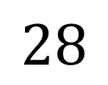
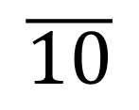


How many ways can you combine 6q?
Isospin
$$J^{P}=3^{+}$$
$$J^{P}=0^{+}$$
Strangeness
$$\overline{10}$$
$$28$$
Δ⁻Δ⁻
Δ⁺⁺Δ⁺⁺
d*
ΔΔ
ΔΣ*
Σ*Σ*+ΔΞ*
Ξ*Σ*+ΔΩ
Ξ*Ξ*+Σ*Ω
Ξ*Ω
ΩΩ

Slide 33
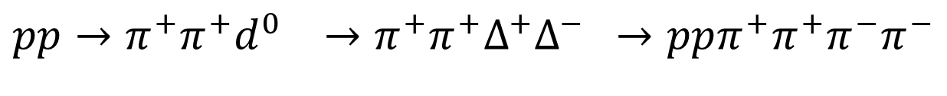

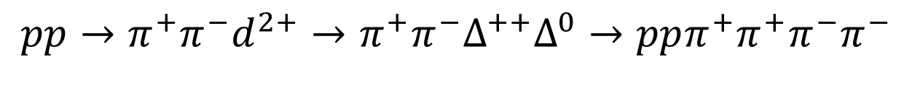

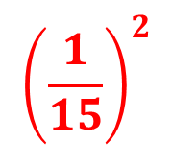

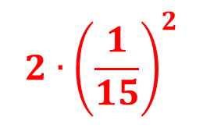


Z=+4 dibaryon isospin coefficients
$$π$$
$$π$$
p
p
p
p
$$π$$
I
$$π$$
$${pp→π^{−}π^{−}d}^{4+}→π^{−}π^{−}Δ^{++}Δ^{++}→ppπ^{+}π^{+}π^{−}π^{−}$$
$$1$$
$$2∙{\left(\frac{1}{15}\right)}^{2}$$
$${pp→π^{+}π^{−}d}^{2+}→π^{+}π^{−}Δ^{++}Δ^{0}→ppπ^{+}π^{+}π^{−}π^{−}$$
$${\left(\frac{1}{15}\right)}^{2}$$
$${pp→π^{+}π^{+}d}^{0} →π^{+}π^{+}Δ^{+}Δ^{−} →ppπ^{+}π^{+}π^{−}π^{−}$$

Slide 34
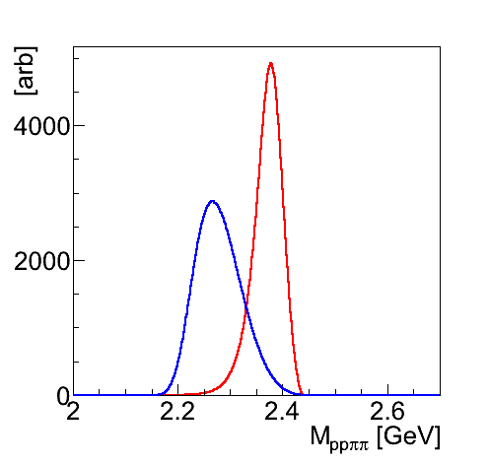
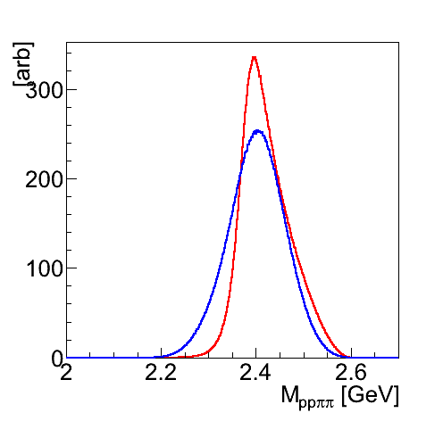
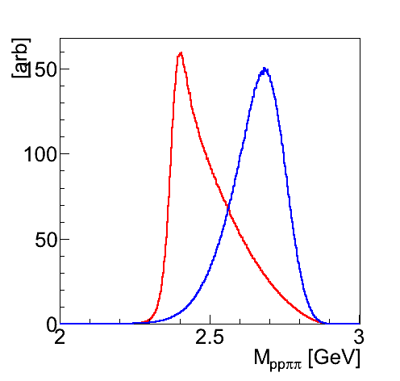
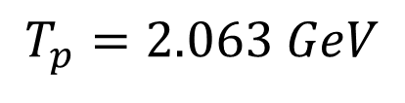
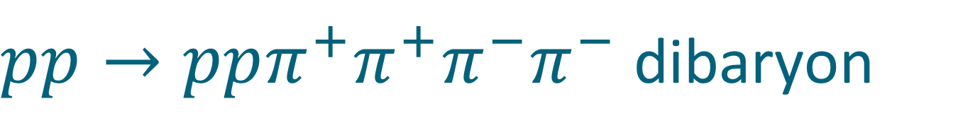
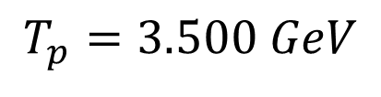
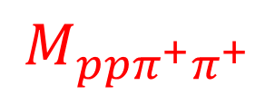
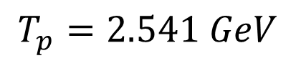
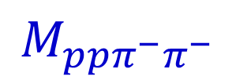
$pp→ppπ^{+}π^{+}π^{−}π^{−}$dibaryon
$$T_{p}=2.063 GeV$$
$$T_{p}=2.541 GeV$$
$$T_{p}=3.500 GeV$$
$$M_{ppπ^{−}π^{−}}$$
$$M_{ppπ^{+}π^{+}}$$

Slide 35
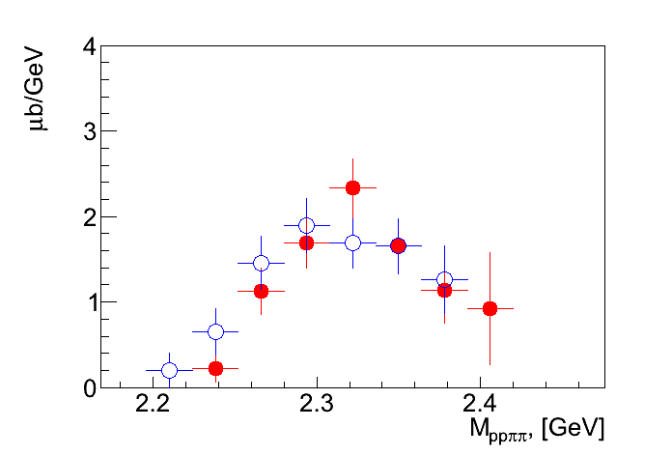
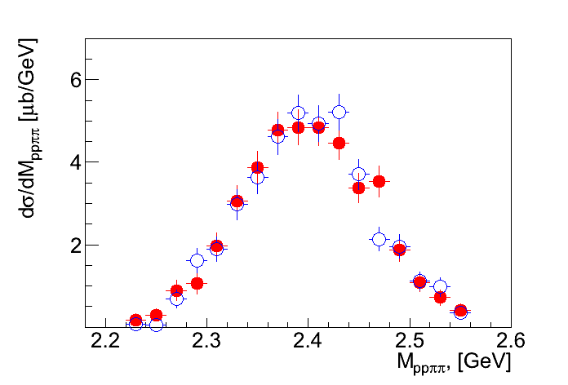
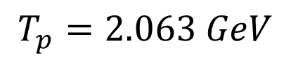
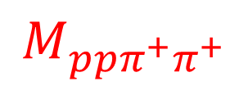
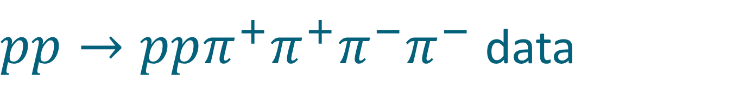

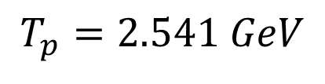
$pp→ppπ^{+}π^{+}π^{−}π^{−}$data
$$T_{p}=2.063 GeV$$
$$T_{p}=2.541 GeV$$
Preliminary
$$M_{ppπ^{+}π^{+}}$$
$$M_{ppπ^{−}π^{−}}$$

Slide 36
















$$pp→ppπ^{+}π^{+}π^{−}π^{−}$$
$background$+resonance
$$π^{−}$$
$$π^{−}$$
$$π^{+}$$
$$π^{+}$$
$$N^{∗}$$
$$N^{∗}$$
Δ
p
p
p
p
p
p
p
p
Δ
$$N^{∗}$$
$$N^{∗}$$
$$π^{+}$$
$$π^{+}$$
$$π^{−}$$
$$π^{−}$$
$$π^{−}$$
$$π^{+}$$
p
p
p
p
$$π^{+}$$
$$π^{−}$$

Slide 37
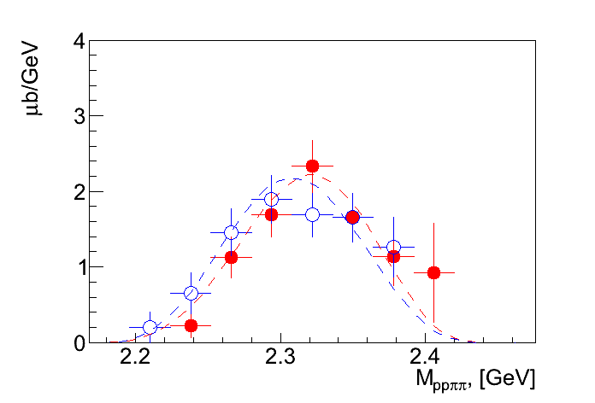


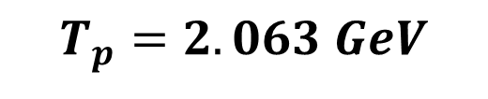
$pp→ppπ^{+}π^{+}π^{−}π^{−}$data
$$T_{p}=2.063 GeV$$
$$M_{ppπ^{+}π^{+}}$$
$$M_{ppπ^{−}π^{−}}$$
Preliminary
Double-Roper

Slide 38
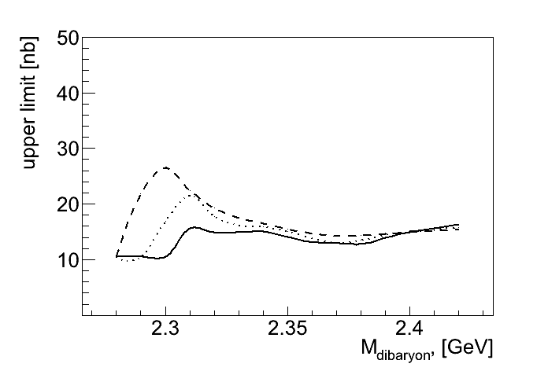






Charge Z=+4 dibaryon upper limit
$$T_{p}=2.063 GeV$$
$$T_{p}=2.541 GeV$$
$$Γ=150 MeV$$
$$Γ=100 MeV$$
$$Γ=50 MeV$$
Preliminary

Slide 39


$pp→pp{2π}^{+}2π^{−}$ total X-section
Preliminary

Slide 40

NN vs ΔΔ
$${}_{}^{1}{S_{0}}$$
Z=+4
p
n
Δ
Δ
66 keV
Threshold
?
2.2 MeV
p
n
80 MeV
Δ
Δ
deuteron
d*

Slide 41
How many ways can you combine 6q?
Isospin
$$J^{P}=3^{+}$$
$$J^{P}=0^{+}$$
Strangeness
$$\overline{10}$$
$$28$$
Δ⁻Δ⁻
Δ⁺⁺Δ⁺⁺
d*
ΔΔ
ΔΣ*
Σ*Σ*+ΔΞ*
Ξ*Σ*+ΔΩ
Ξ*Ξ*+Σ*Ω
Ξ*Ω
ΩΩ

Slide 42




d*(2380) SU(3) multiplet
J^{p} = 3⁺
ΔΔ
$$d^{∗}(2380)$$
$$M_{d^{∗}}−M_{Δ}+M_{Σ^{∗}}<M_{d_{s}^{∗}}≤M_{Δ}+M_{Σ^{∗}}$$
ΔΣ*
$$d_{s}^{∗}(2.53−2.60)$$
ΔΞ*
$$d_{ss}^{∗}(2.68−2.76)$$
ΔΩ
$$d_{sss}^{∗}(2.82−2.90)$$

Slide 43







Strange Dibaryon
Isospin
$$pn$$
$$\overline{10}$$
$d^{∗}$(2380)
Strangeness
d*
ΔΔ
ΔΣ*
$$ΔΔ→NNππ$$
Σ*Σ*+ΔΞ*
Ξ*Σ*+ΔΩ
$$NΛ$$
$d_{s}^{∗}$(2530-2600)
$$ΔΣ^{∗}→(Nπ)(Λπ)→NNπππ$$

Slide 44


d*(2380) in photoproduction?
R. Gilman and F. Gross nucl-th/0111015 (2001)
d*
γ
p
T. Kamae, T. Fujita Phys. Rev. Lett. 38, Feb 1977, 471
d
n
H. Ikeda et al., Phys. Rev. Lett. 42, May 1979, 1321
I(J^{p}) = 0(3⁺)
$$M=2.38 GeV$$

Slide 45

The benchmark measurement
Newly installed
Edinburgh polarimeter
γ
p
d*
d
n
Measure polarization of both
proton and neutron !
M.H. Sikora, D.P. Watts et al, Phys.Rev.Lett. 112 (2014) 022501

Slide 46
Conclusion
The very first dibaryon d*(2380) is established
  Mass
  Width
  Quantum numbers
  Main decay branches
  Structure: Hexaquark vs Molecule?
No convincing signs for the mirror dibaryon (charge Z=+4) so far
  Size and shape of the conventional background?
  Mirror multiplet (28-plet) is likely to be unbound

Slide 47
Thank you

Slide 48

Z=+4 dibaryon
$$d^{4+}→Δ^{++}Δ^{++}→ppπ^{+}π^{+}$$
π
Δ
N
N
Δ
π
$$π^{−}$$
$$π^{+}$$
p
p
p
p
$$π^{+}$$
$$π^{−}$$
$${pp→π^{−}π^{−}d}^{4+}→π^{−}π^{−}Δ^{++}Δ^{++}→ppπ^{+}π^{+}π^{−}π^{−}$$
WASA, HADES

Slide 49





$pp→ppπ^{+}π^{+}π^{−}π^{−}$dibaryon
$$T_{p}=2.063 GeV$$
$$T_{p}=2.541 GeV$$
$$T_{p}=3.500 GeV$$
$$M_{ppπ^{−}π^{−}}$$
$$M_{ppπ^{+}π^{+}}$$

Slide 50


Model calculations of the $d^{∗}$and $d^{4+}$
M(GeV) | 1 | 2 | 3 | 4 | 5 | exp
$$d^{∗}$$ | 2.35 | 2.361 | 2.45 | 2.38 | 2.38 | 2.38
$$d^{4+ }$$ | 2.35 | 2.833 | unbound | 2.69 | 2.40 | ⎯
Dyson-Xuong, PRL 13 (1964) 815
Mulders-Aerts-de Swart, PRD 21 (1980) 2653
Oka-Yazaki, PLB 90 (1980) 41.
Mulders-Thomas, JPG 9 (1983) 1159.
A. Gal, H. Garcilazo Nucl.Phys. A928 (2014) 73-88

Slide 51
d*(2380) begins

Slide 52

Celsius WASA

Slide 53

pd→³Heππ, T_{p}=0.89 GeV
(I=0)
M.Bashkanov et. al,
Phys. Lett. B637 (2006) 223-228
The ABC-effect ==ΔΔ-FSI effect?

Slide 54

WASA 4π Detector
$$pn→dibaryon→dπ^{0}π^{0}$$
π
γ
γ
p
d
n
γ
γ
π

Slide 55


First hints on d*(2380) at CELSIUS
CELSIUS/WASA
Phys.Rev.Lett.102, 052301 (2009)

Slide 56
CELSIUS to COSY
The Discovery

