Slide 1

MPGD activities at Lanzhou University
Xiaodong Wang (王晓冬)
School of Nuclear Science and Technology Lanzhou University, Lanzhou, China
July 5, 2013

Slide 2

Outline
Development of FEC for GASSIPLEX 0.7-3 chip
BulkMicromegas R&D base on T2K electronics
Simulations
The status of GEM detector base on APV 25 chip

Slide 3
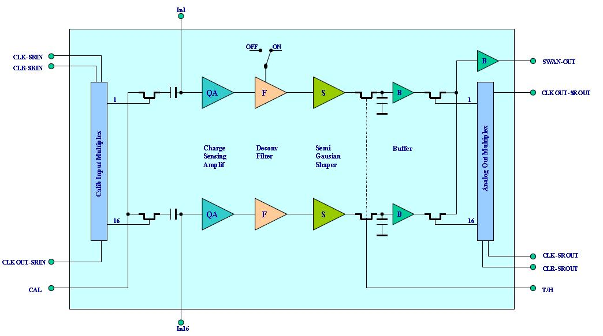
GASSIPLEX 0.7-3 chip introduction
Gassiplex chip is used the 0.7 micron of CMOS technology. Peak forming time : 1.2us
The linear dynamic range is up to 560fC.
Four components: charge sensitive amplifier, de-convolution filter, the shaper, track and hold circuit, 12 channels.

Slide 4

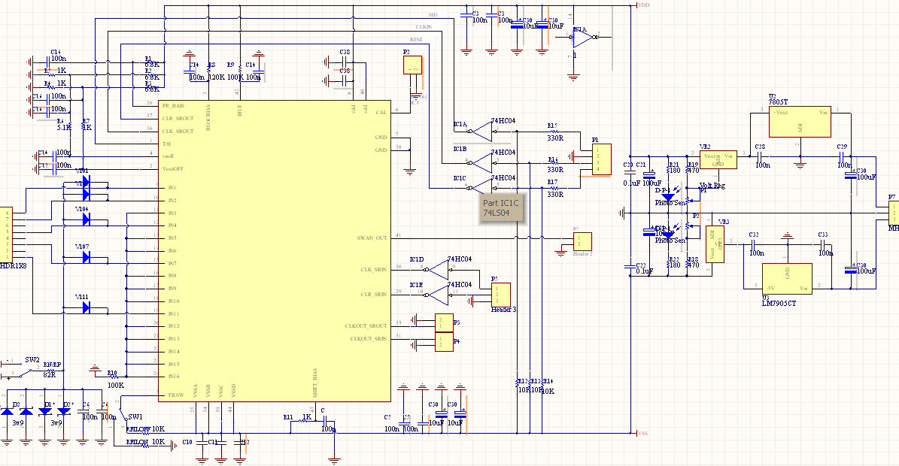
Peripheral analog circuit schematic of Gassipilex chip

Slide 5

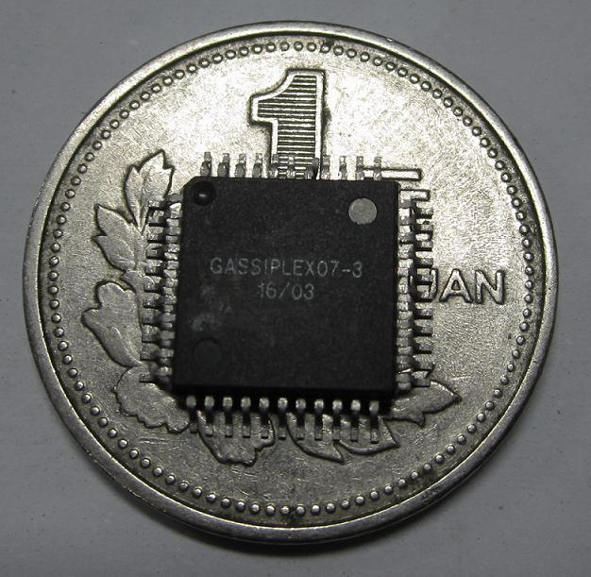
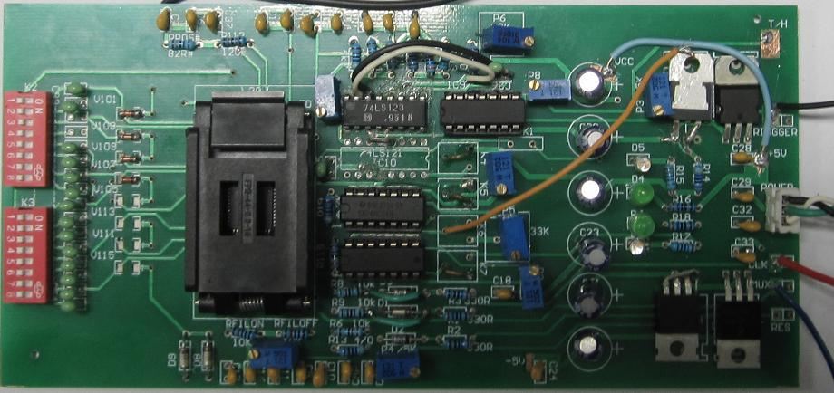
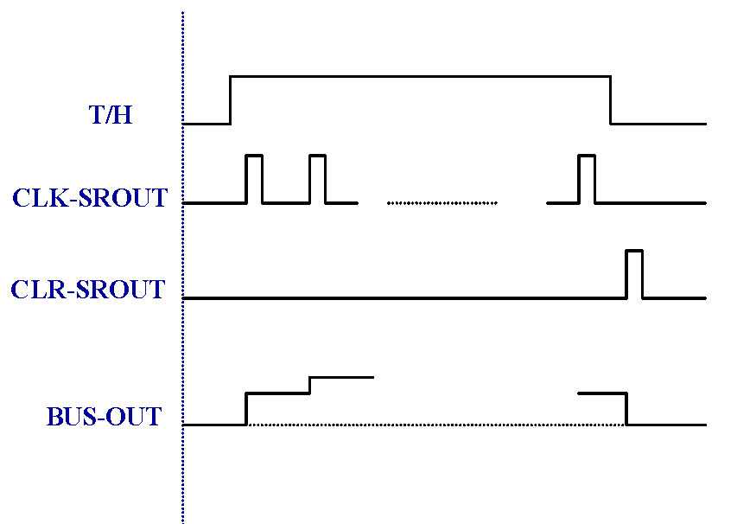
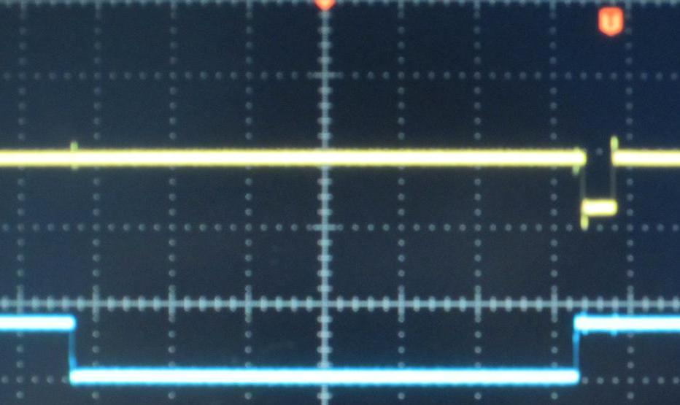
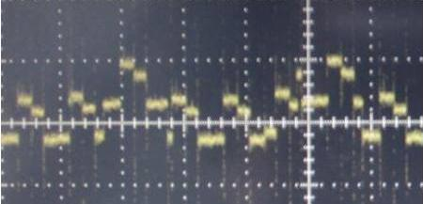
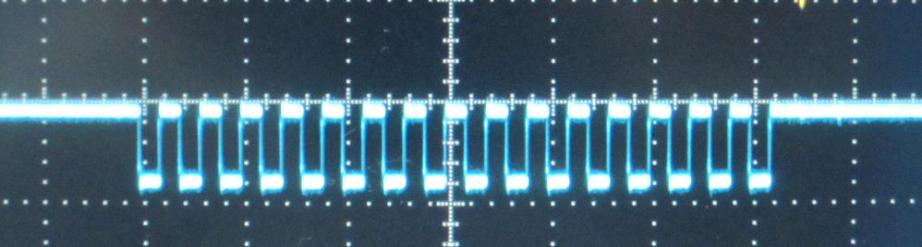
Development of FEC for GASSIPLEX 0.7-3 chip
Version-1
Main control signals come from FPGA
Test result

Slide 6
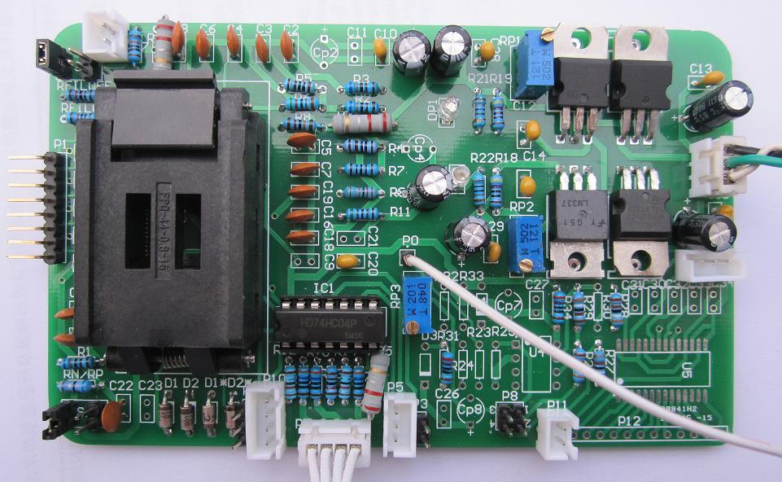
Version-2
We got the basic conditions of the chip working status, such as the requirement of control signal, each pin circuit etc….
To reduce the volume and power consumption , all of the elements will be replace by piece components in next version.

Slide 7

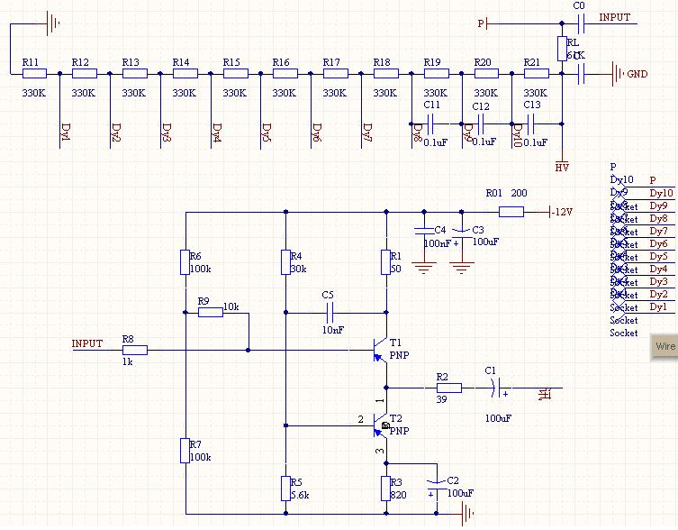
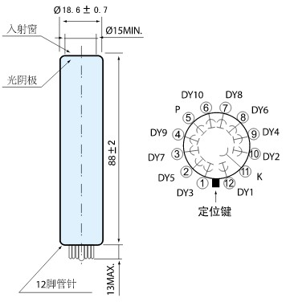
Trigger system :plastic scintillation detector
Schematic diagram
Resistor divider circuit
Emitter follower
PMT: CR115 of hamamatsu. Spectral response range :300-600 nm.
peak value: 420nm, rise time : 2.2 ns

Slide 8

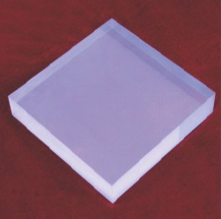
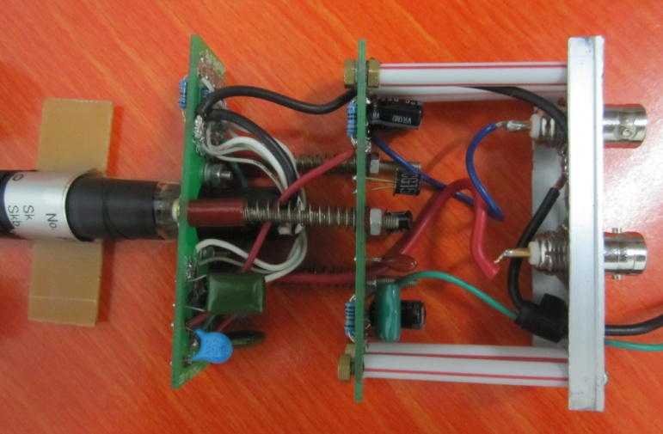
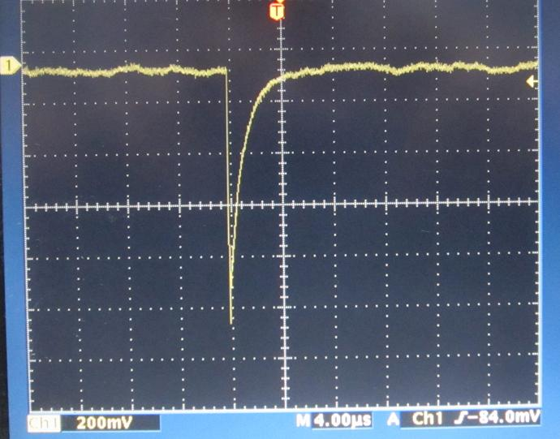
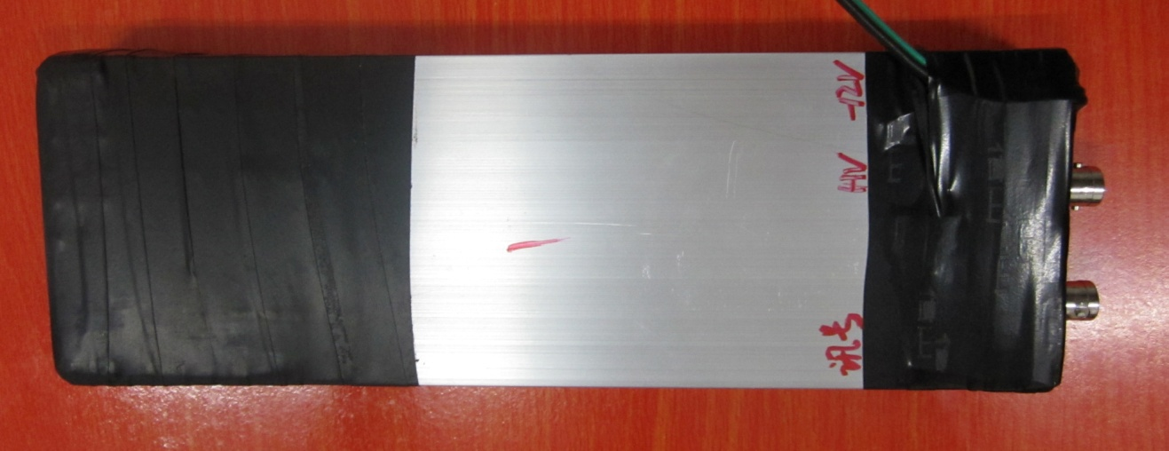
Assembly and test
Source :cosmic rays
Voltage, 750 V
Load, 61 ohm
Amplitude, 1V
Fall Time ,30 ns。

Slide 9
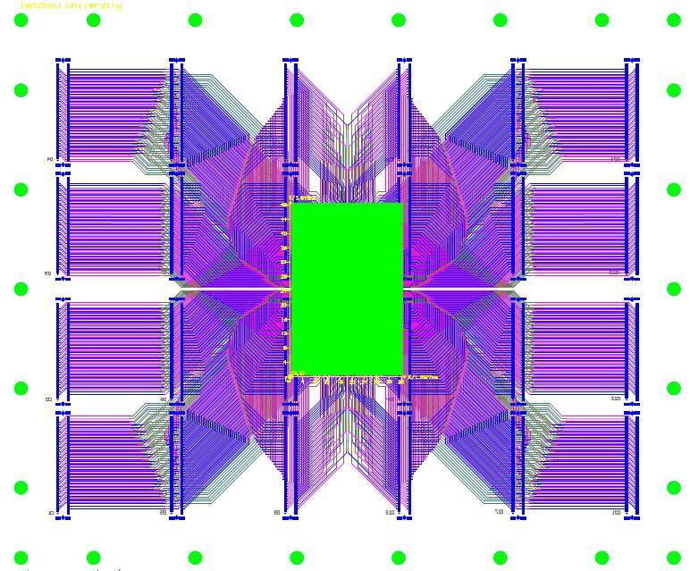
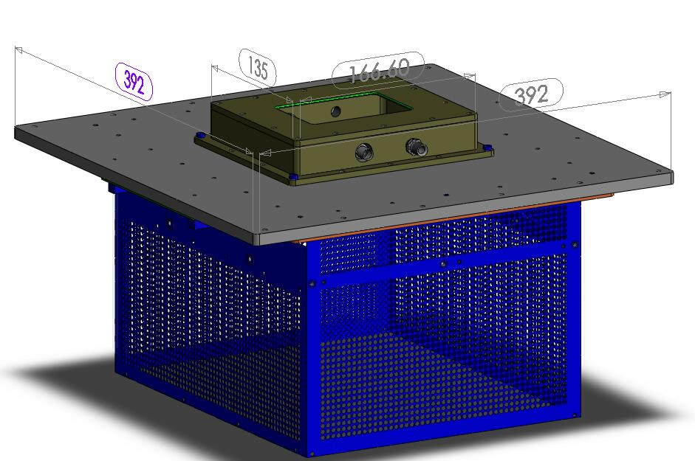
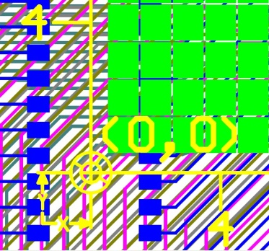
Fast neutron imaging exploiting BulkMicromegas base T2K electronics
n
Drift electrode
-HV1
Aluminum polyethylene
p
15mm
Ar+5% Isobutane
Micromesh
Pads
Substrate
-HV2
0.128mm
0
365.5mm
88.6mm
57.4mm
PCB: 365.5mm × 306.0mm
Sensitive area: 88.6mm ×57.4mm
Readout layout: 1728 pads
Each of 1.75mm × 1.50mm
306.0mm
http://mpgd.lzu.edu.cn/research.html

Slide 10

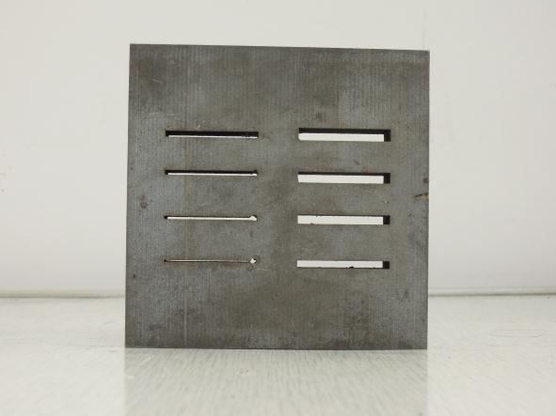
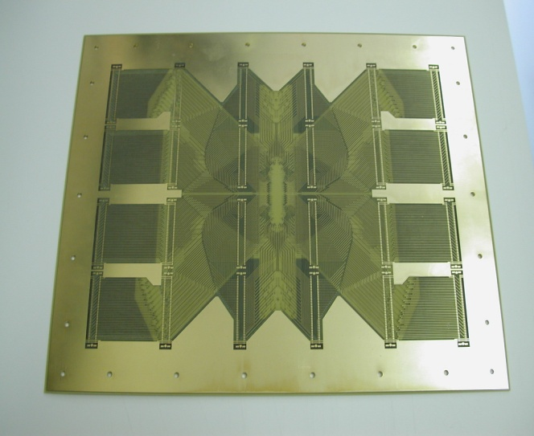
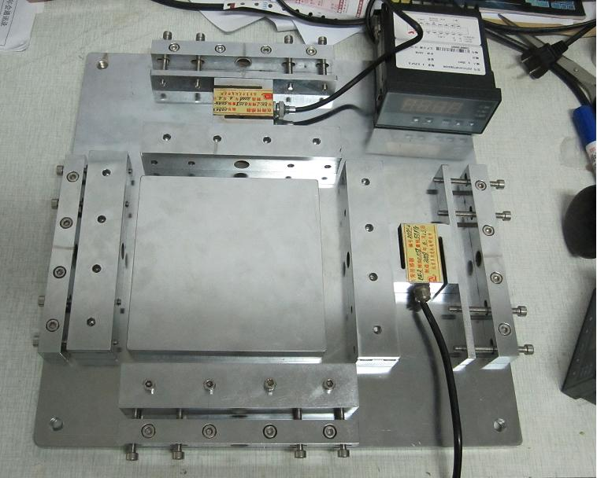
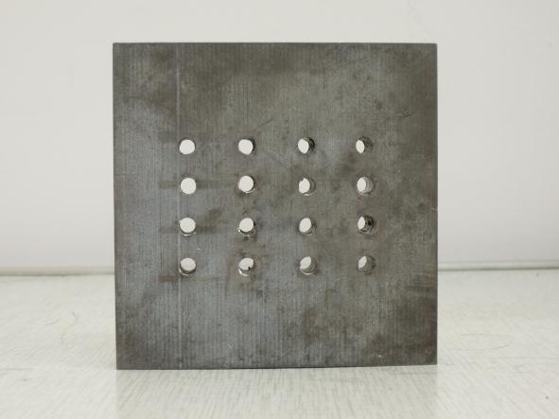
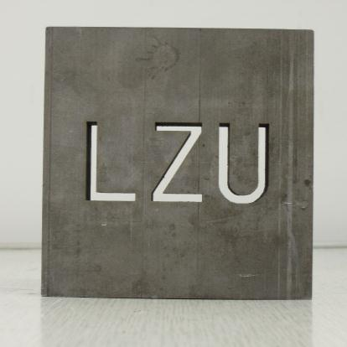
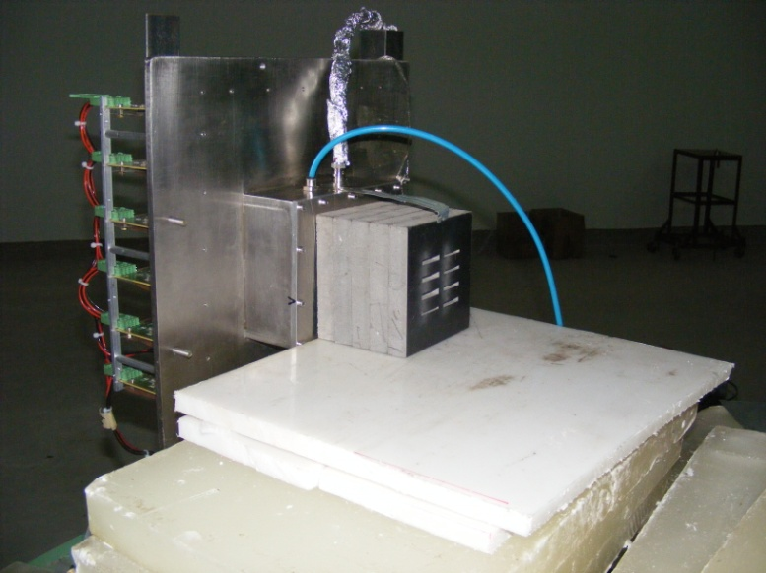
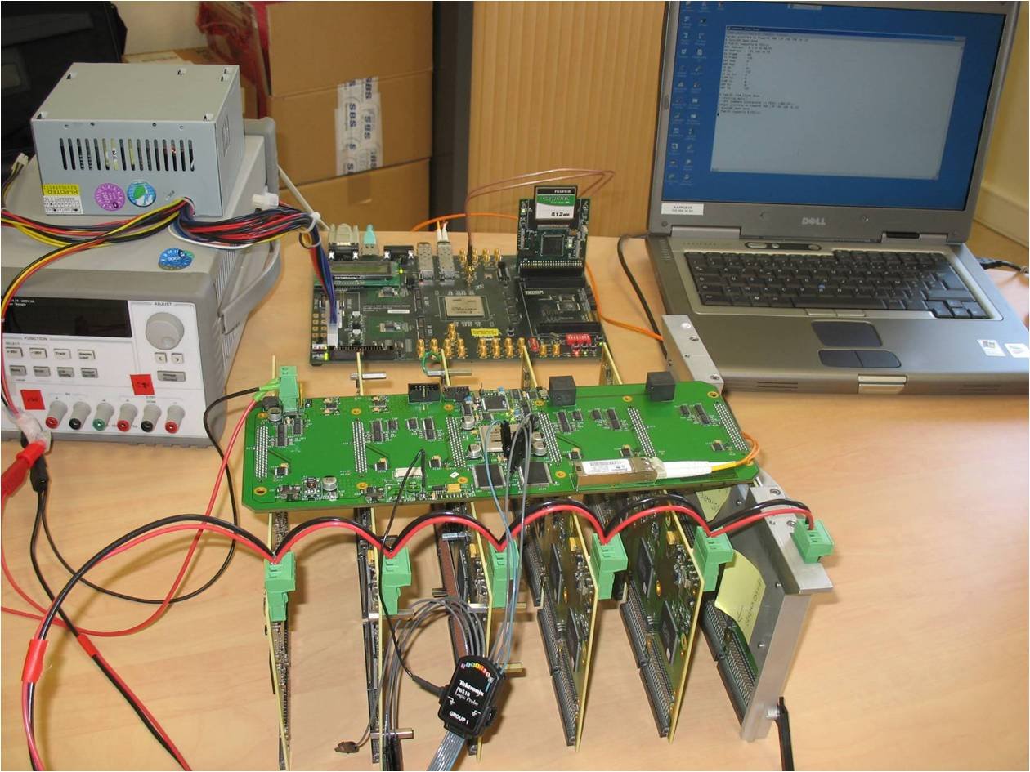
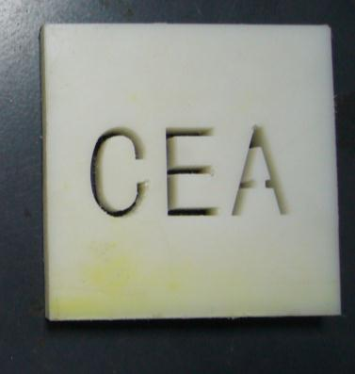
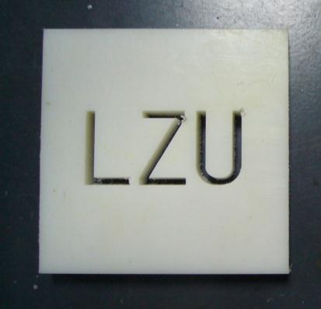
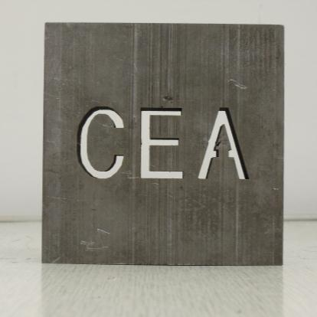
Experiment setup and target masks

Slide 11

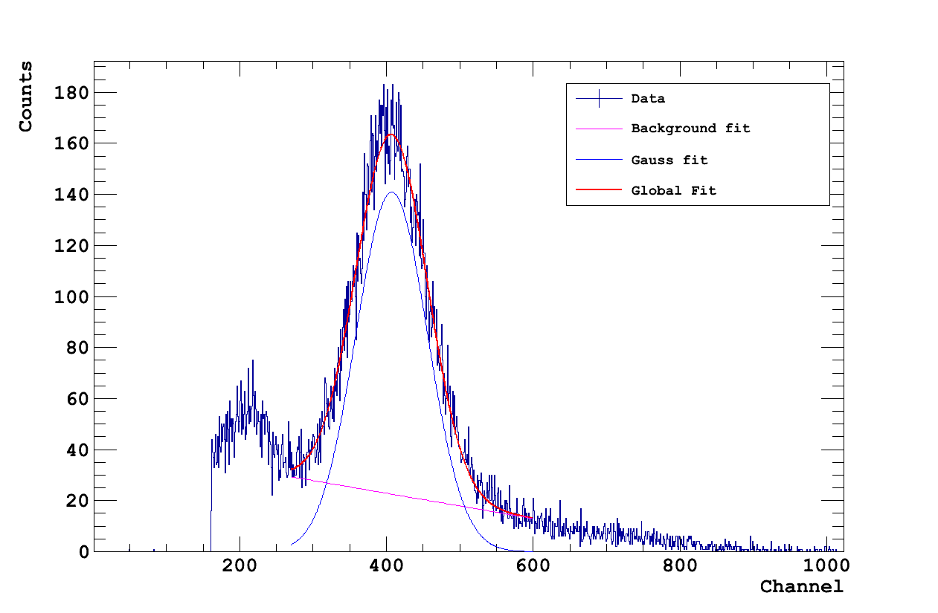
Detector energy resolution
Energy resolution calibration is irradiated with Fe-55.
Energy resolution ~25%（FWHM）
Vmesh ：350V，Vdrift：530V，Gain：5000
Notes:
111

Slide 12

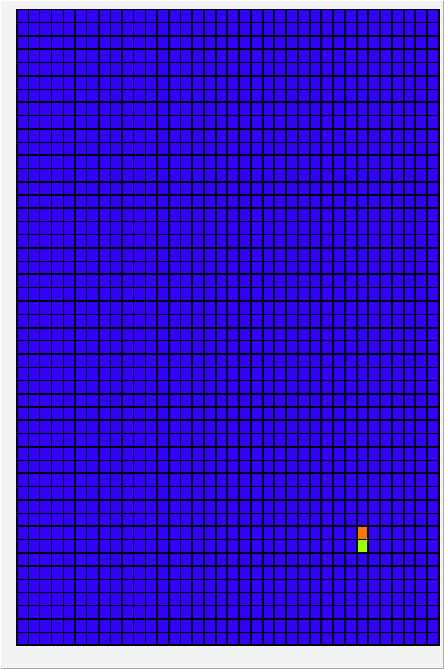
The criterion of real signal and true track selection

Slide 13

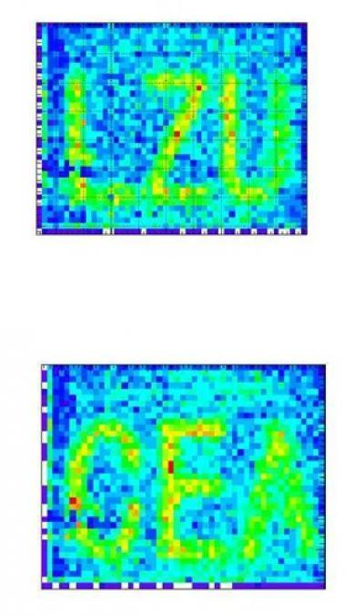
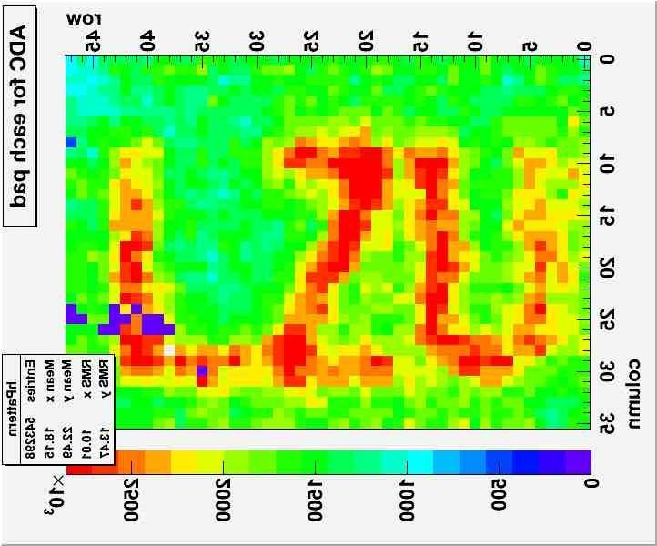
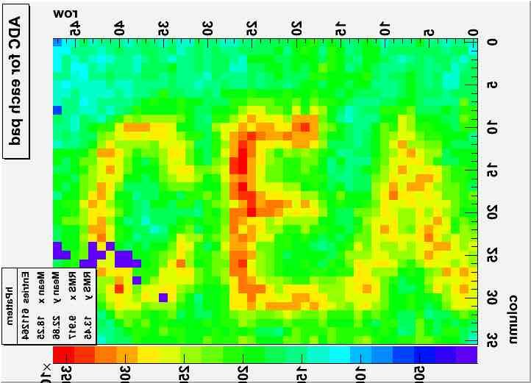
Images of the test mask of LZU and CEA
Time cut
Time cut
Images of boron-loaded polyethylene masks: LZU and CEA with Am-Be neutrons.

Slide 14
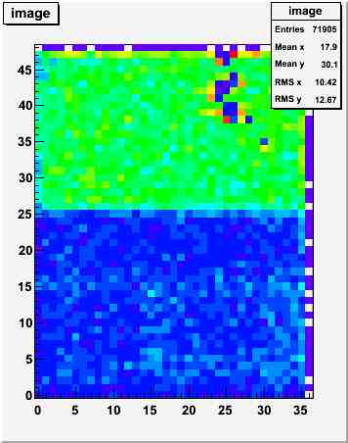
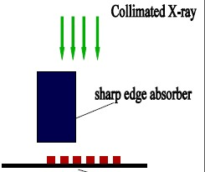
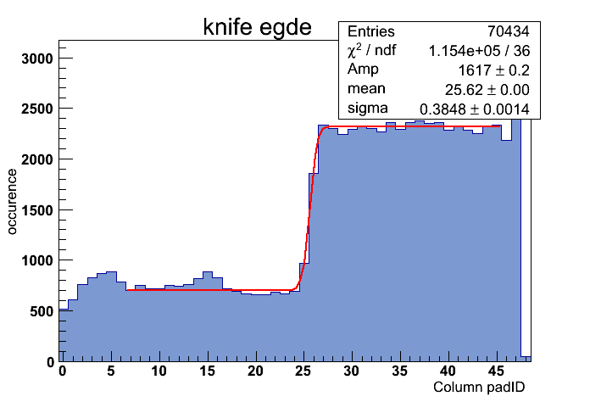
Conversion efficiency and spatial resolution
Method I: Sharp Edge
Am-Be Neutron beam
Knife edge absorber
CH2
Readout pads
According to the Edge Spread Function, we got the spatial resolution, 1.55mm in X direction and 0.71 mm in Y direction.
Experiment detection efficiency :0.07% is lower than the simulation result 0.08% .

Slide 15
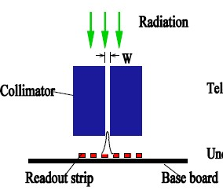

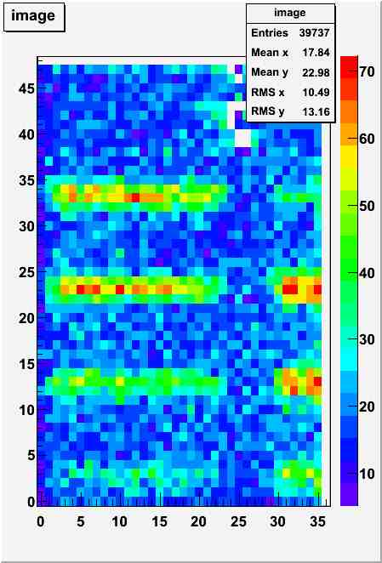
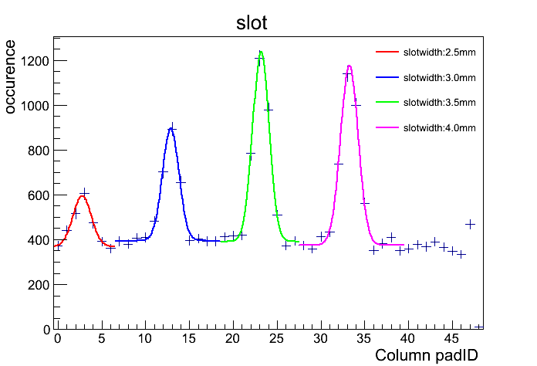
Spatial resolution II
Method II: Collimator
Am-Be neutron beam
Spatial resolution 2.04mm

Slide 16

Simulations
New ideas:
Novel neutron-to-proton converter structures, base on Micromegas.
A new concept of neutron detector based on GEM technology is a novel multi-layer High Density PolyEthylene (HDPE) as neutron-to-proton converter.

Slide 17
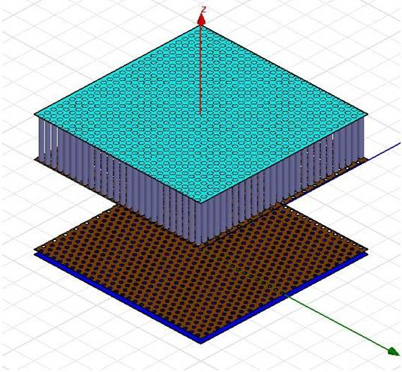
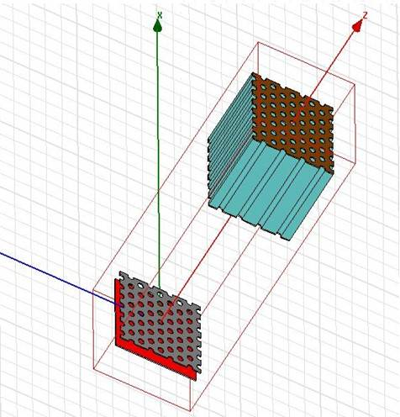
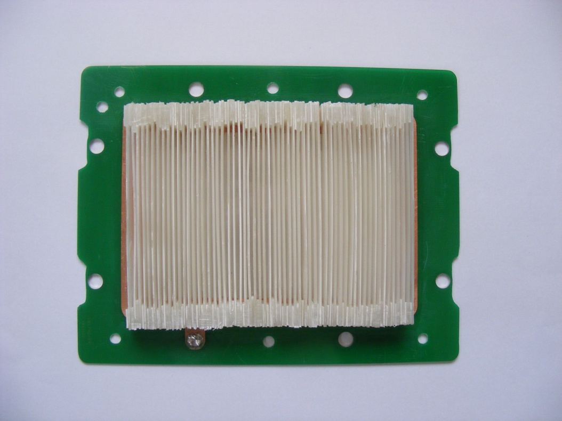
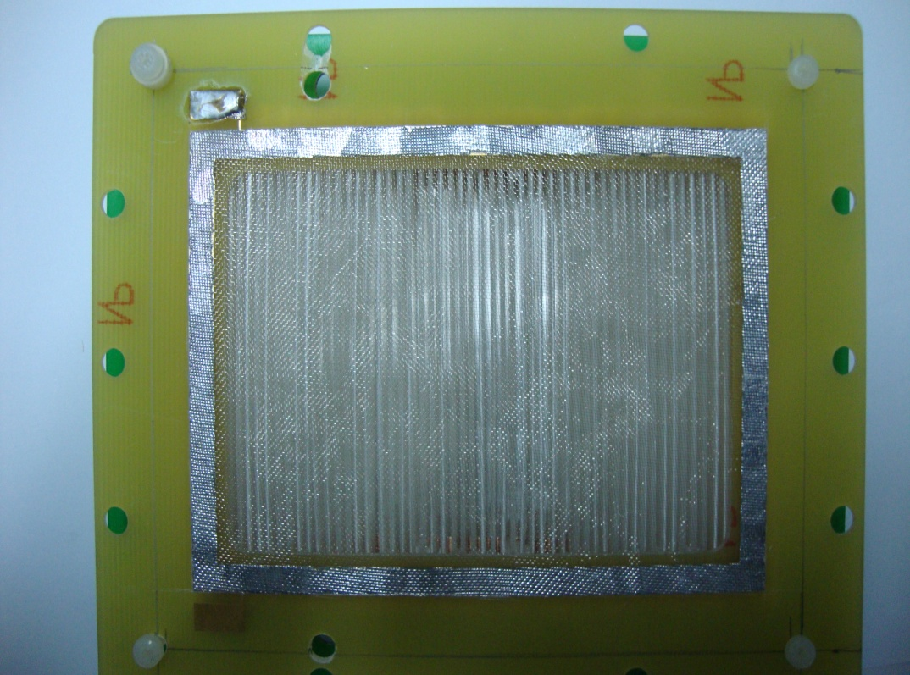
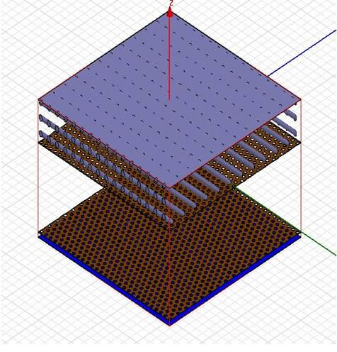
Monte Carlo simulation of BulkMicromegas-based for fast neutron detector
Micro-channel plate
Parallel micro-pillar 2D array
 | PE film |  | Micro-hole | Parallel-pillar | 45º inclined parallel-pillar
Am-Be Neutrons |  | 0.12% | 0.152%+0.119% 0.271% | 0.147%+0.096% 0.243% | 0.310%+0.114% 0.424%
14MeV Neutrons |  | 0.35% | 0.445%+0.376% 0.621% | 0.403%+0.279% 0.662% | 0.685%+0.330% 1.015%
Oblique micro-pillar 2D array
SCI CHINA: Tech. Sci. 2013, 43（3）315-319

Slide 18
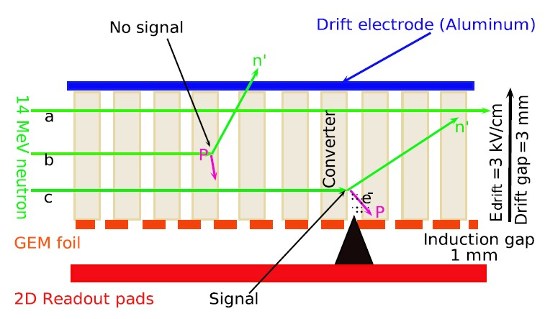
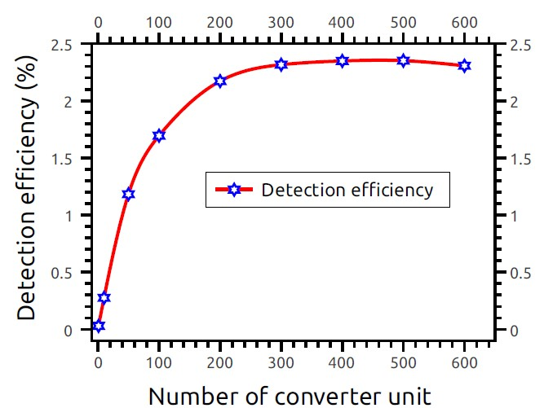
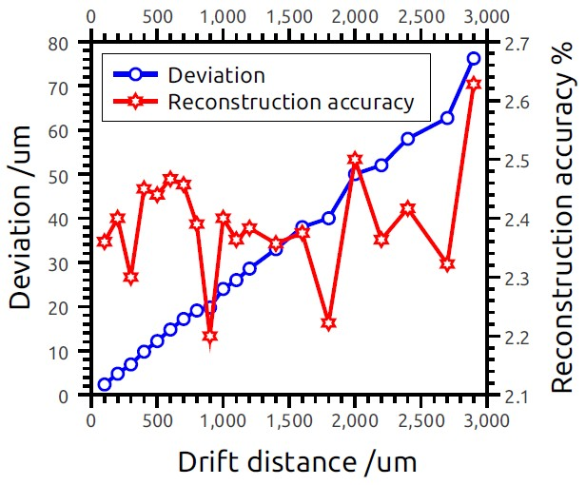
Monte Carlo simulation of GEM-based for 14 MeV neutron detector
Detection efficiency of the detector with 400 converter units is higher than 2.3%.
Reconstruction accuracy of the incident neutron position is better than 2.6%.
WANG Xiaodong，et al, SCIENCE CHINA Physics, Mechanics & Astronomy (2013) doi: 10.1007/s11433-013-5162-x

Slide 19

The current status and future work
April, we have received the APV25 chip, MPD,HDMI and FEC from ESS.
Eight piece of standard GEM foils (10*10cm2) have brought from CERN.
At present , we have contacted supplier and ordered VME64X device and some components.
The next step is the transition from Micromegas to GEM detector and test its basic performances ,including energy resolution, the plate curve, the spatial resolution and gain etc..
Ongoing work, we design a new 2D PCB to match the APV connector and test 128 or 256 channels, respectively.
THANK YOU FOR YOUR ATTENDTION

