Slide 1



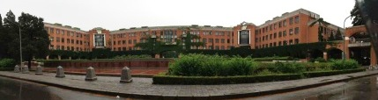

5th workshop on hadron physics in China and the opportunities in US
July 2-6, Huang-Shan College, China
The GEM activities at Tsinghua University
Zhigang Xiao¹, Yan Huang¹, Rensheng Wang¹, Haiyan Gao^{1,2}
1 Department of Physics, Tsinghua University
2 Dept. of Physics and Triangle Universities Nuclear Laboratory, Duke University
Li Min Duan³
3 Institute of Modern Physics, Chinese Academy of Science
物 理 系

Slide 2

Content
1 Small GEM detector test
1.1 Performance test
2 Large GEM detector test
2.1 Electronics
2.2 DAQ test
2.3 Large GEM assembling
3 Near Future Plan
4 Summary and Outlook
Mainly focusing on the performance test and simulation

Slide 3
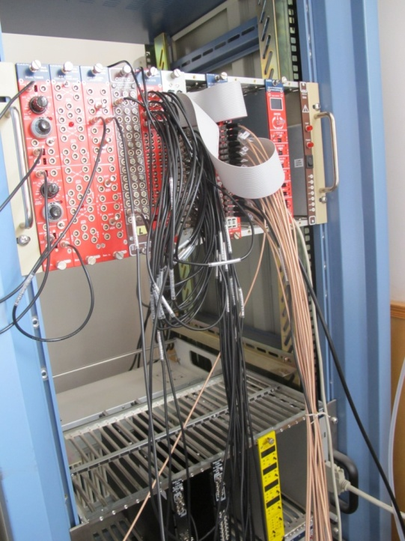
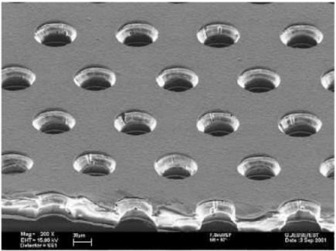
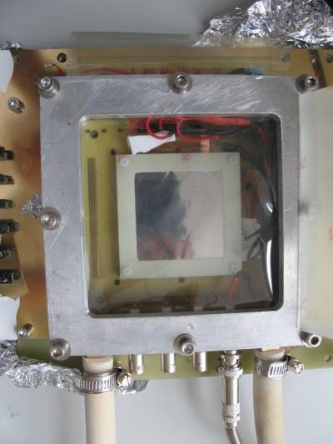
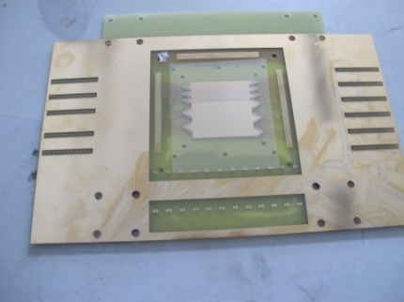
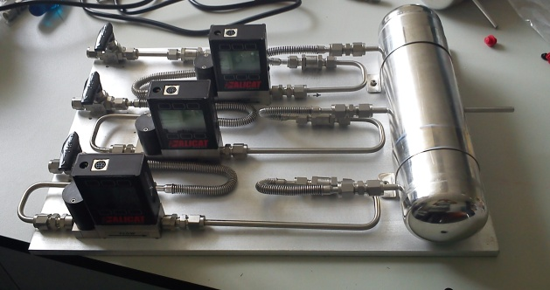
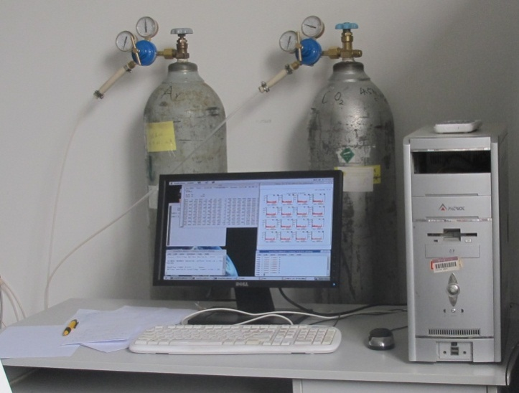
The set up of test
1 Small GEM prototype test
GEM foil (CERN):
50mm*50mm
300um
400um
100um
200um

Slide 4
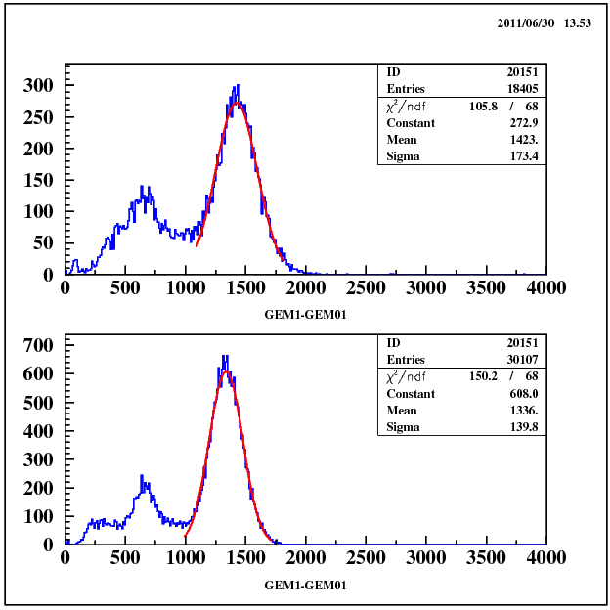
Energy Resolution
Fe55
… …
… …
Homemade
Charge Amplifier

Slide 5
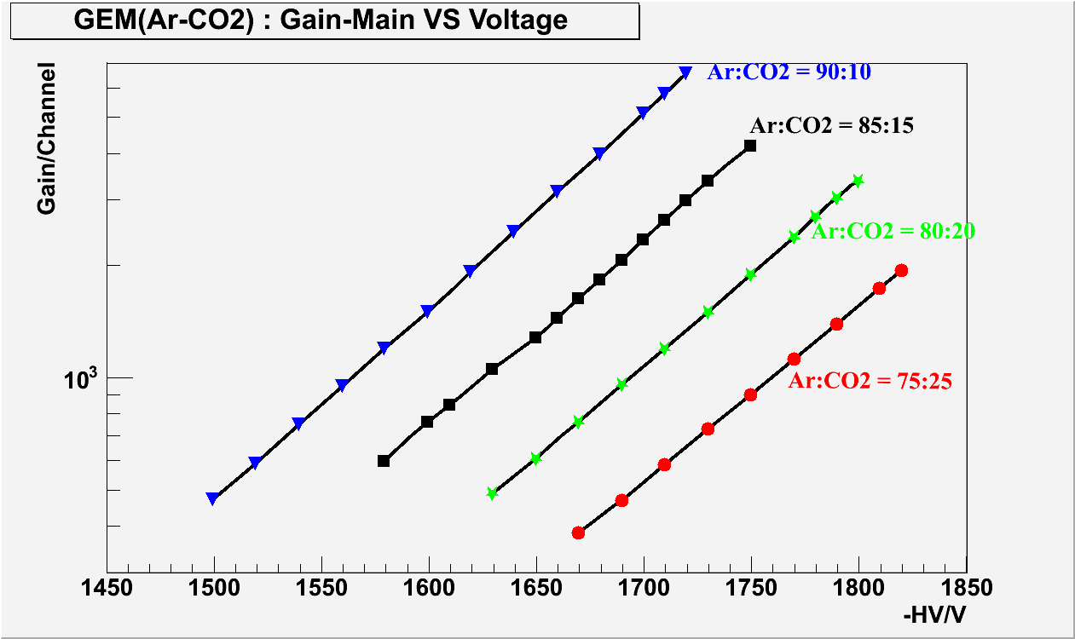
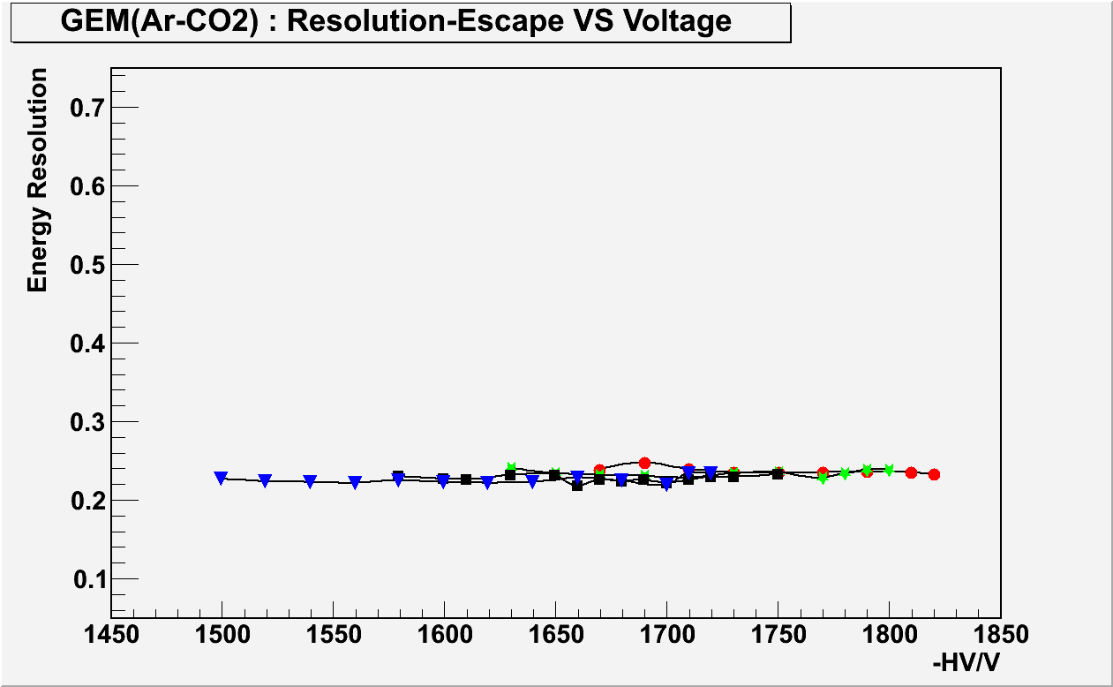
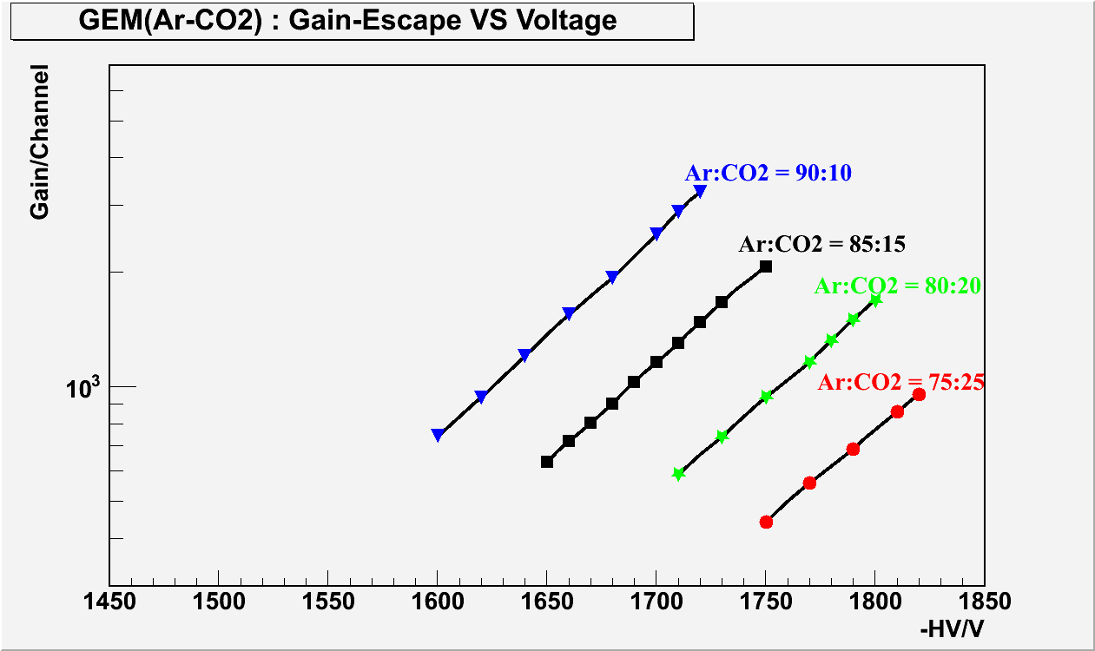
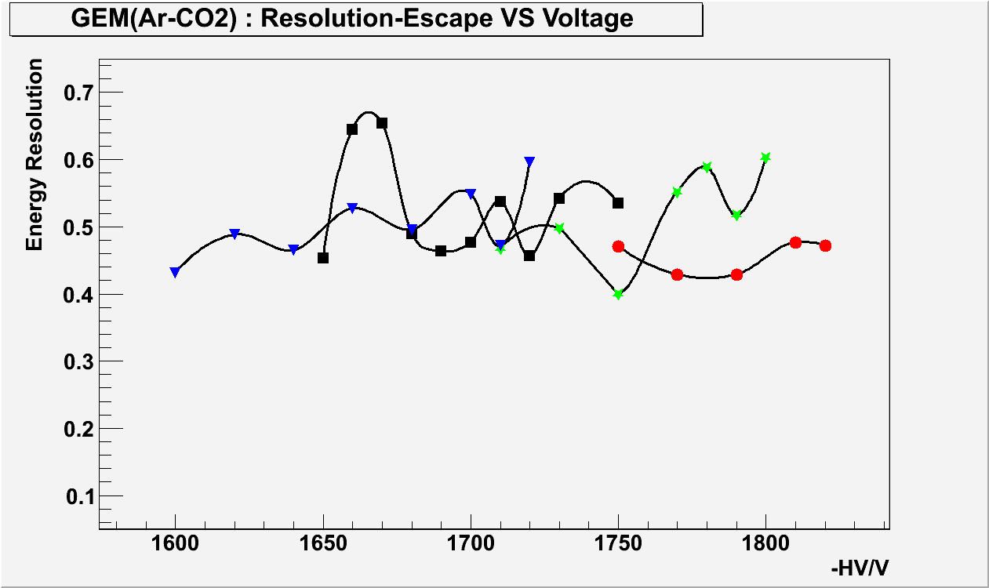
Gain studies

Slide 6
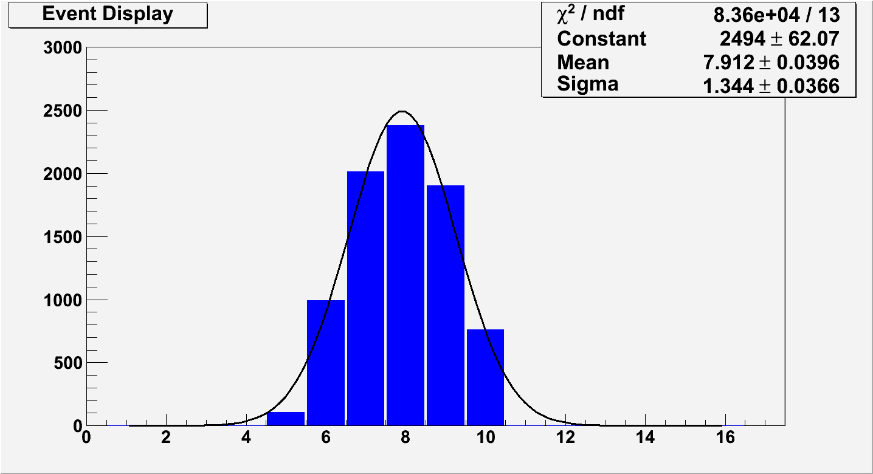
Cluster Size Analysis
Therein:
is the position of fired strip;
is the amplitude of signal;
is the position, calculated from centroid;

Slide 7
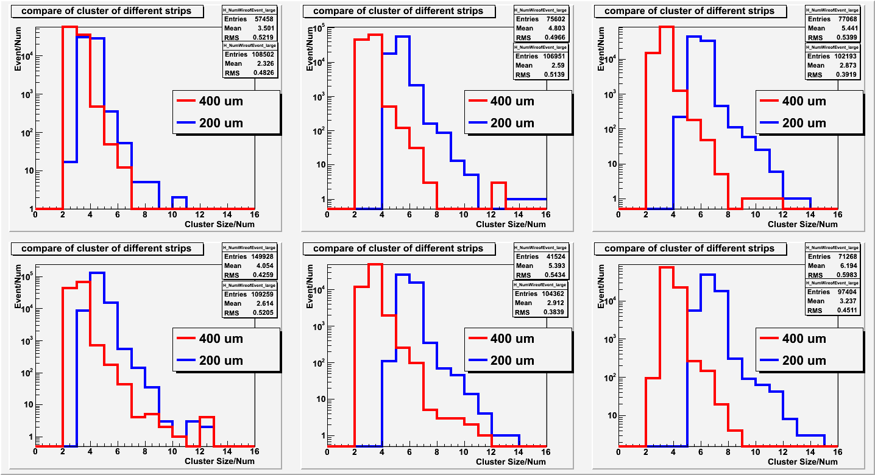
Cluster Size studies
Cluster size of signal of main peak
-HV
1710
1750
Ar | 75 | 80 | 85

Slide 8
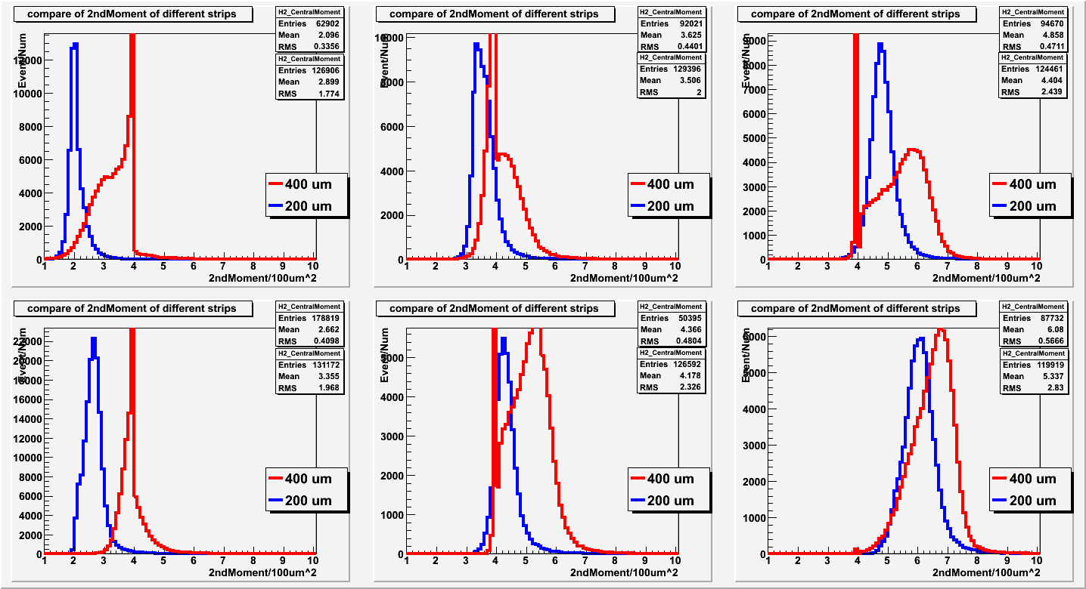
Cluster Size studies
Second central moment/Variance
-HV
1710
1750
Ar | 75 | 80 | 85

Slide 9
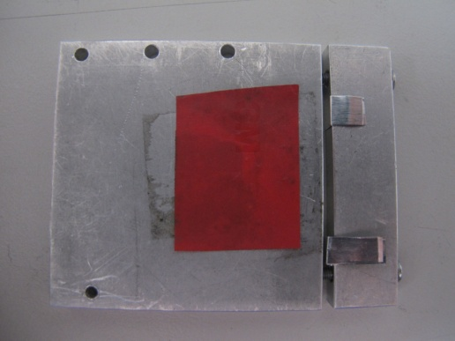
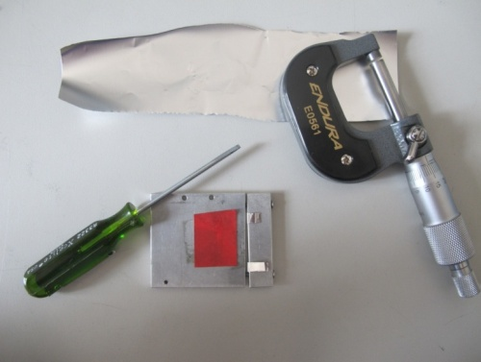
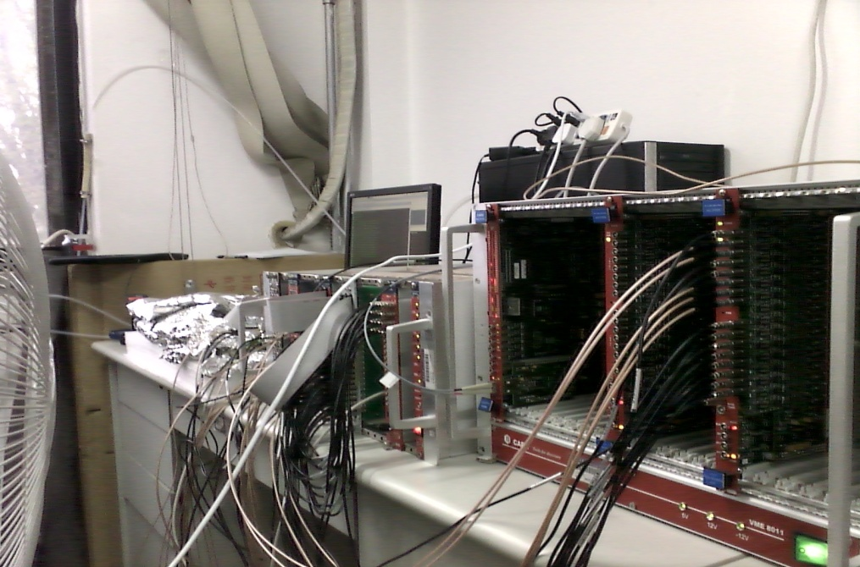
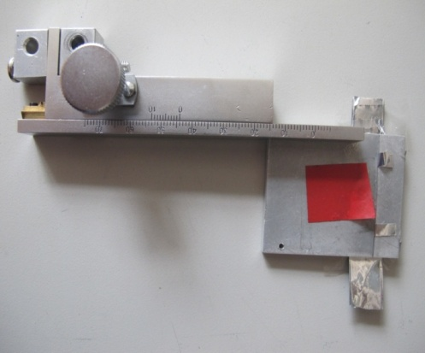
Spatial Resolution studies

Slide 10
Method Description
⁵⁵Fe(Surface source)

Slide 11
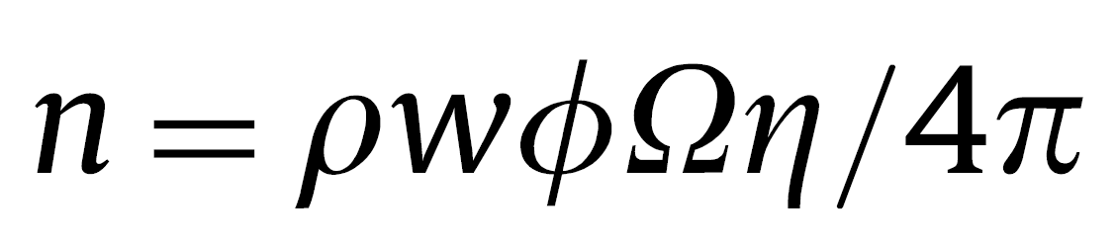
Use the counting rate in place of the slit width
⁵⁵Fe(Surface source)
n∝w²
n is counting rate

Slide 12
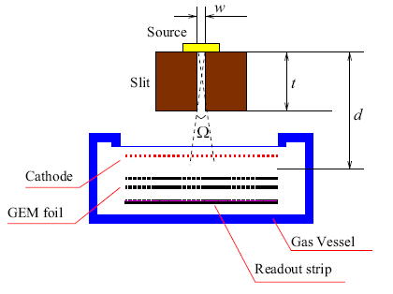
Simulation test
条件：
Initial GEM Resolution (μm)：70；
Slit Thickness(μm)：3, 4, 5, 6, 7;
Slit Width(μm):20,30… 100;
Angle Uncertainty：1.0, 0.5, 0.25, 0.125;
Total resolution linearly depends on w²

Slide 13
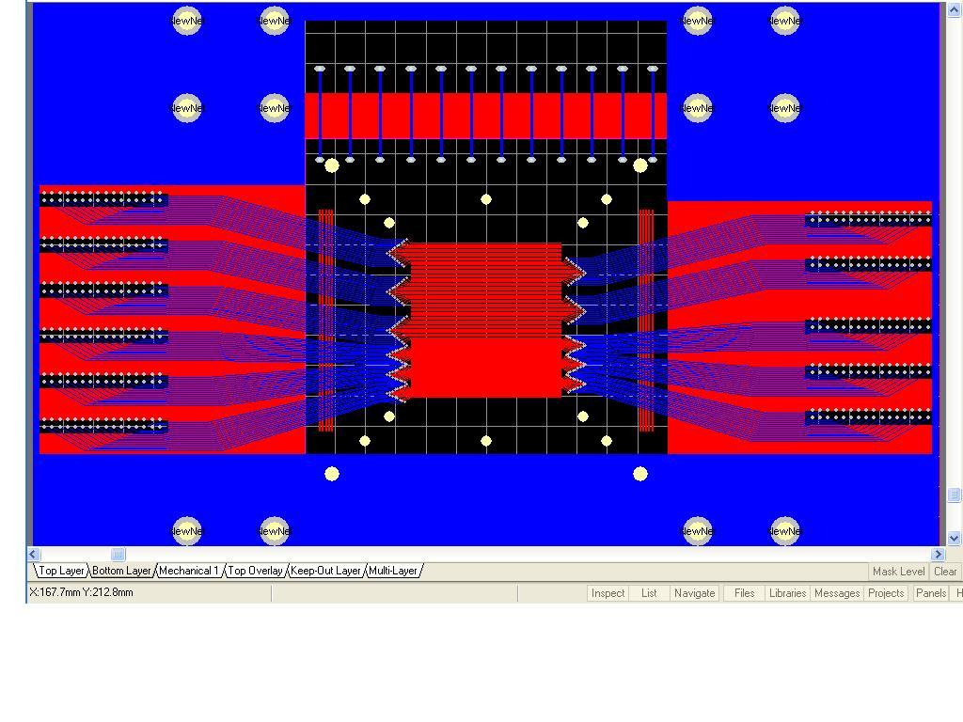
Experimental test
1 dimensional readout；
Inter stripe : D=200um， 400um；
gas：Ar(85%)+CO₂ (15%)

Slide 14
When W≈40μm:
1, (a): Fitting the main peak to get the events in (mean ±3σ) range
2, (b): Gaussian fit to the selected events to get the position spectrum after background subtraction;
3，Repeat at different w。

Slide 15
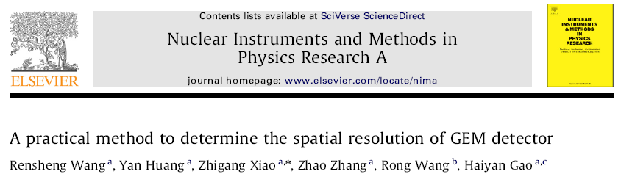
Results(1-D, 200μ inter strip distance)
σ_{GEM}=56 ±15μm

Slide 16
2 Large Area GEM detector
2.1 Electronics
2.2 DAQ test
2.3 Large GEM assembling

Slide 17
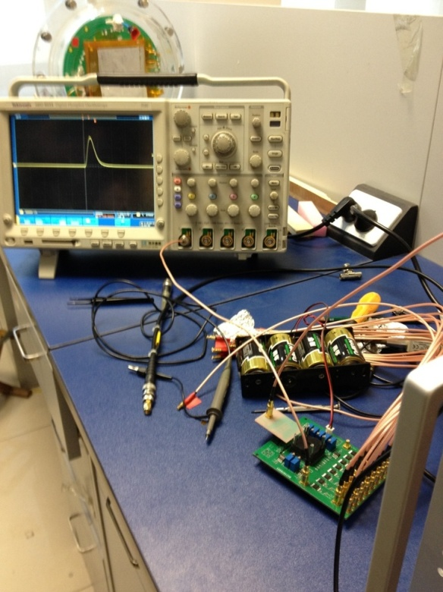
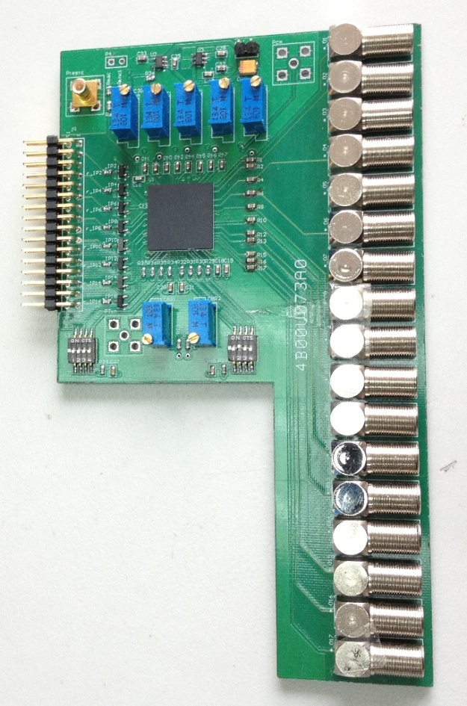
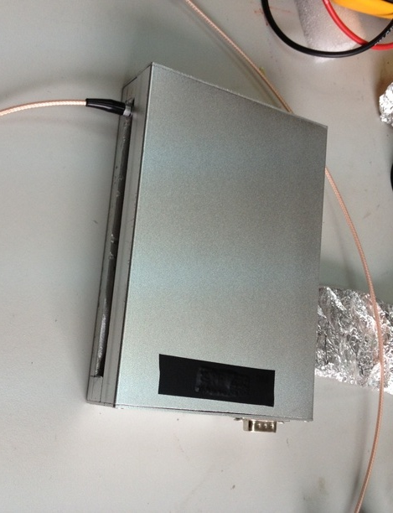
Electronics
APV or CASAGEM ?
Charge Amplifier and Shaping Amplifier for GEM
Function: 16 channels for each, Amplification + Shaping
Developed by Prof. Zhi Deng from the Dept. Engin. Phys., THU

Slide 18
CASAGEM Parameters
Gain | 2~40mV/fC
Dynamic Range | 0~1000fC
Shaping time | 20~80ns
INL | <1%
Power | 10mW/ch (Anode channel), 11mW/ch (Cathode channel )
ENC | <2000e (Anode channel, Input Cap: 50pF), <3000e (Cathode channel, Input Cap: 100pF)

Slide 19
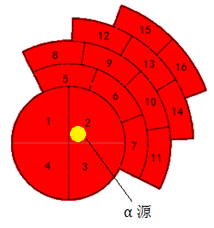
CASAGEM Parameters

Slide 20
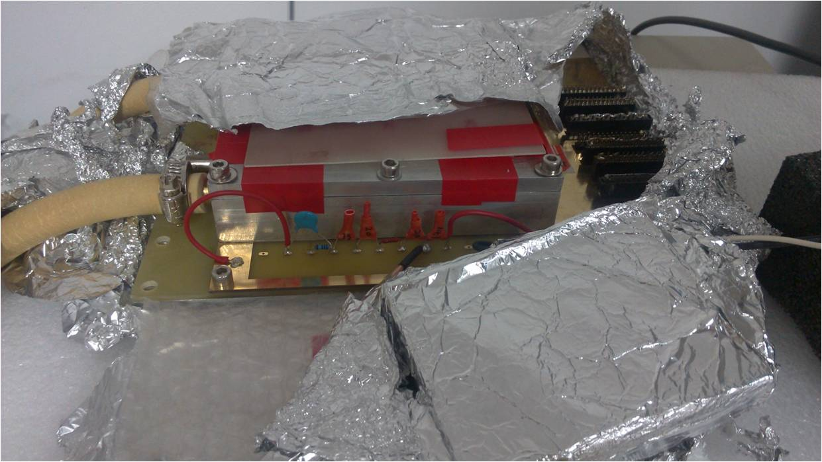

Trigger Signal ?
-HV(1300V-1900V)
1MΩ
Cathode
Trigger is the first problem we encounter if we are using the CASAGEM card.
13MΩ
2.625mm
Drift /Sensitive
20MΩ
GEM1
22MΩ
2.25mm
Transfer
20MΩ
GEM2
1.625mm
Induction
16MΩ
Anode/Readout strip

Slide 21
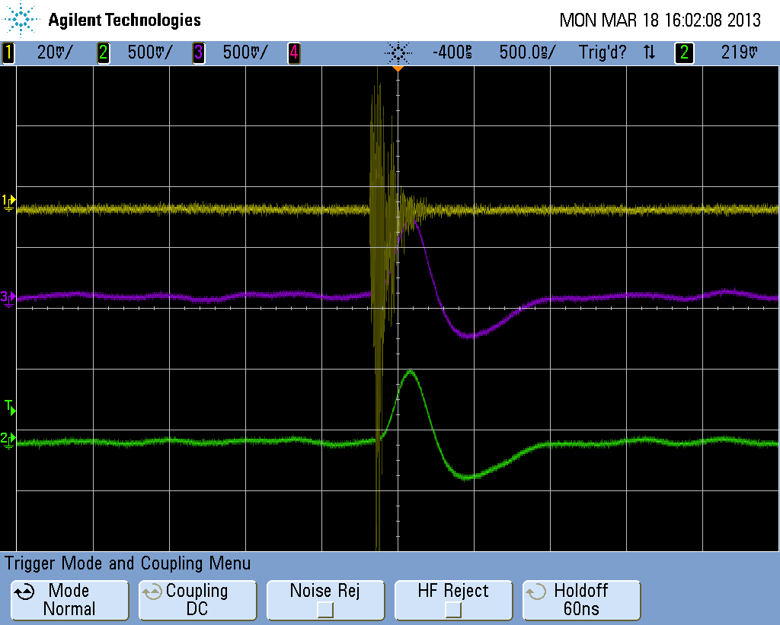
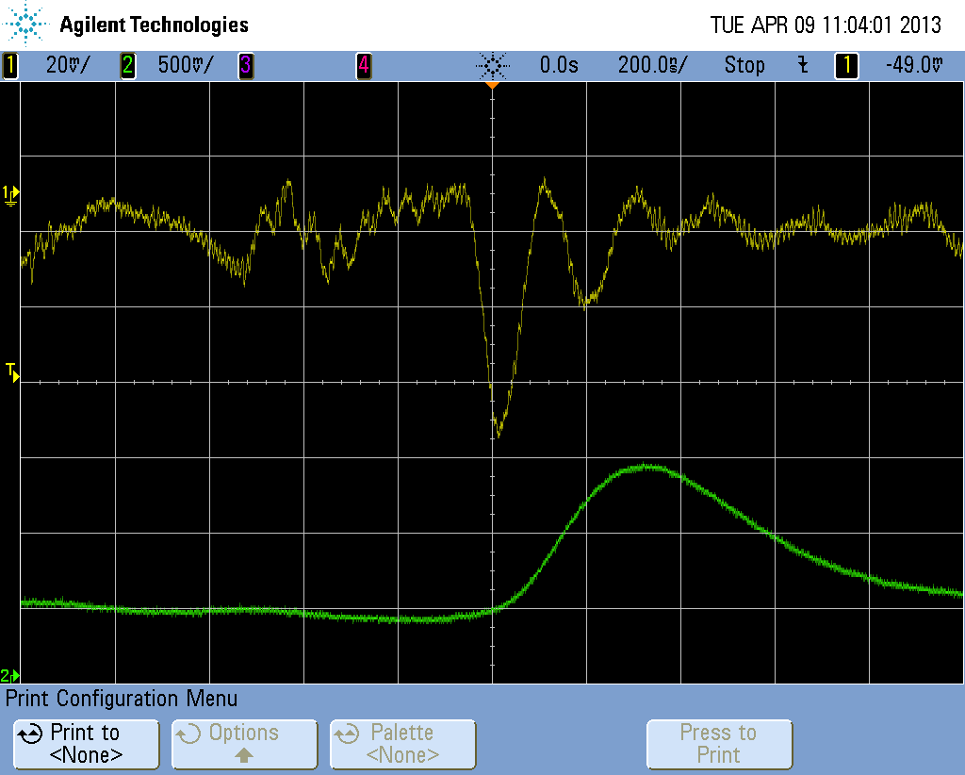
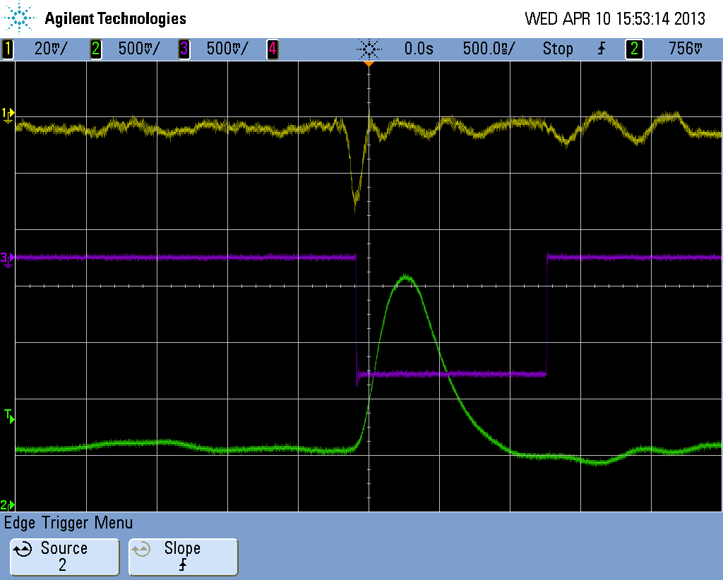
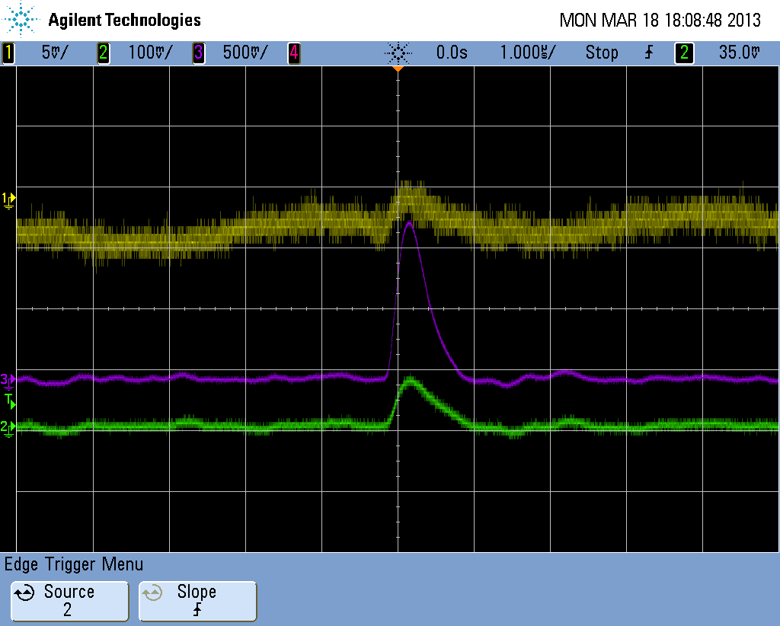
Always Fighting
…against the noise
That’s it！
…against the false signal

Slide 22
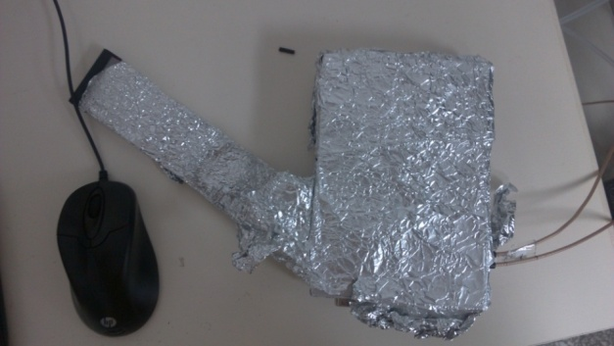
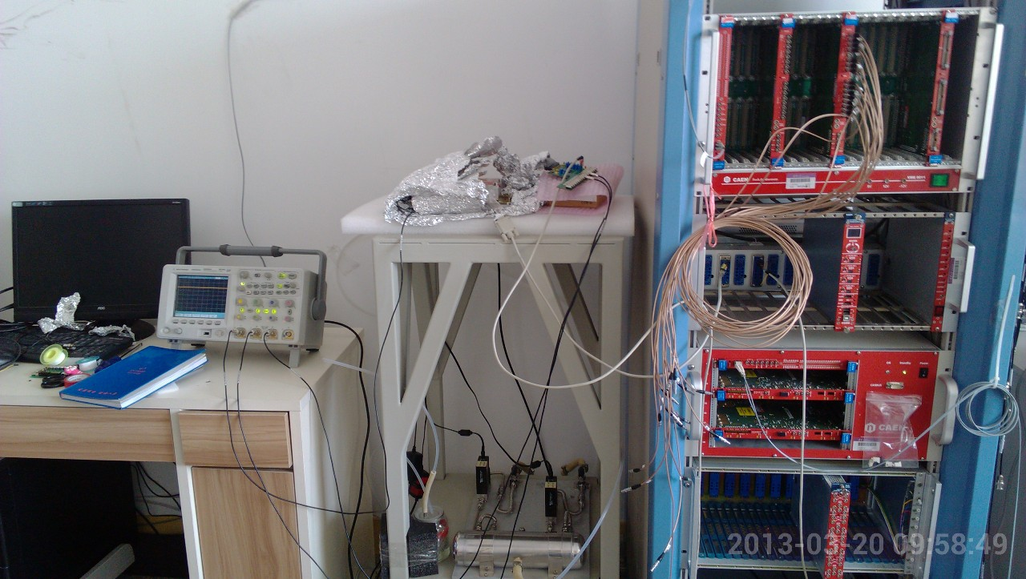
Performance test

Slide 23
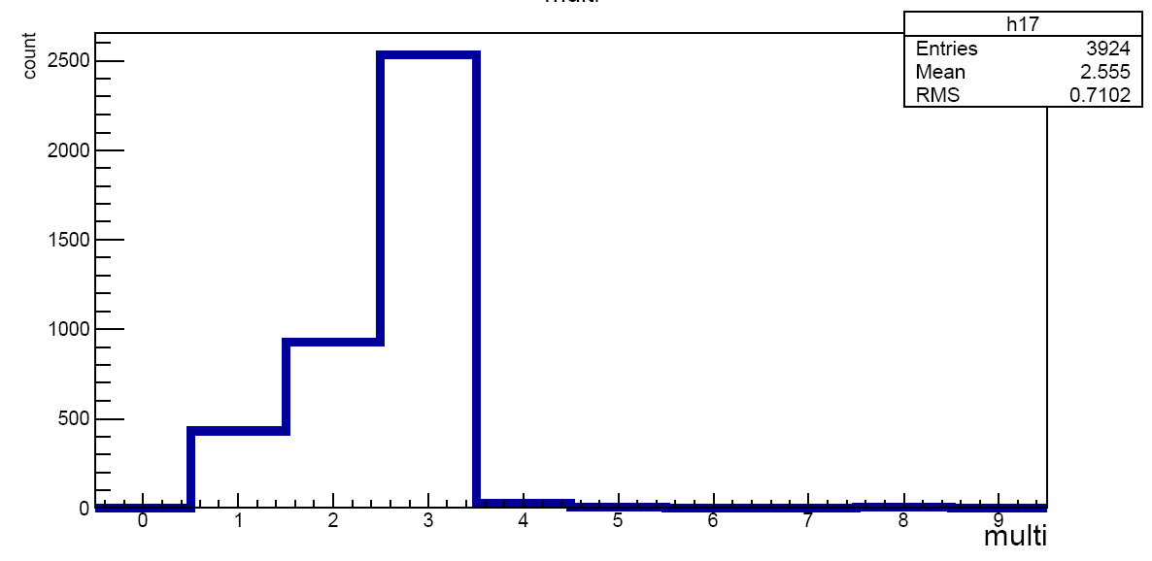
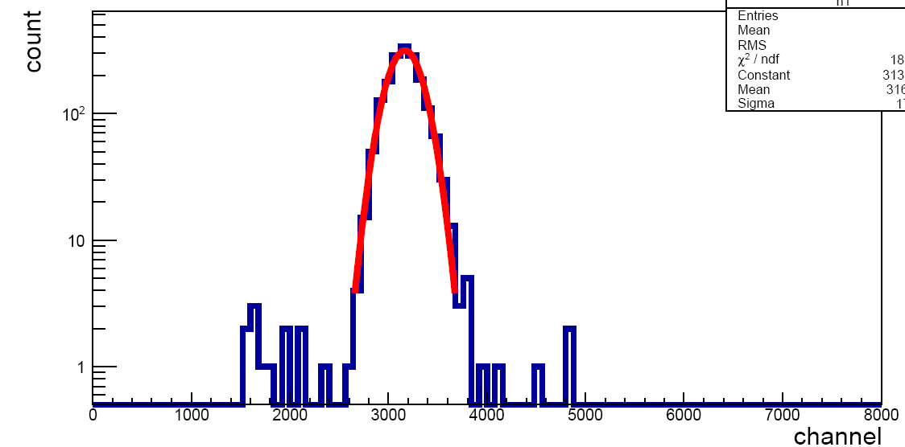
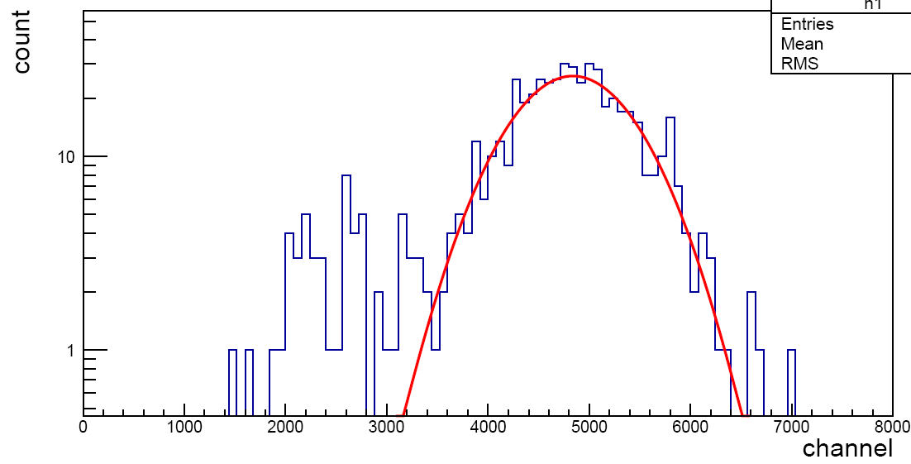
Test with Fe-55
Why the escape peak is so suppressed?
Why the main peak is narrower?

Slide 24
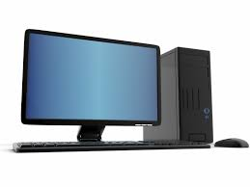
Test of DAQ with multi ADC modules
Purpose:
1 Extendable to multi-ADCs?
2 If the ADCs are synchronized?
PMT
N625
N568b
ADC1
1
2
3
ADC2
ADC3
Trigger

Slide 25
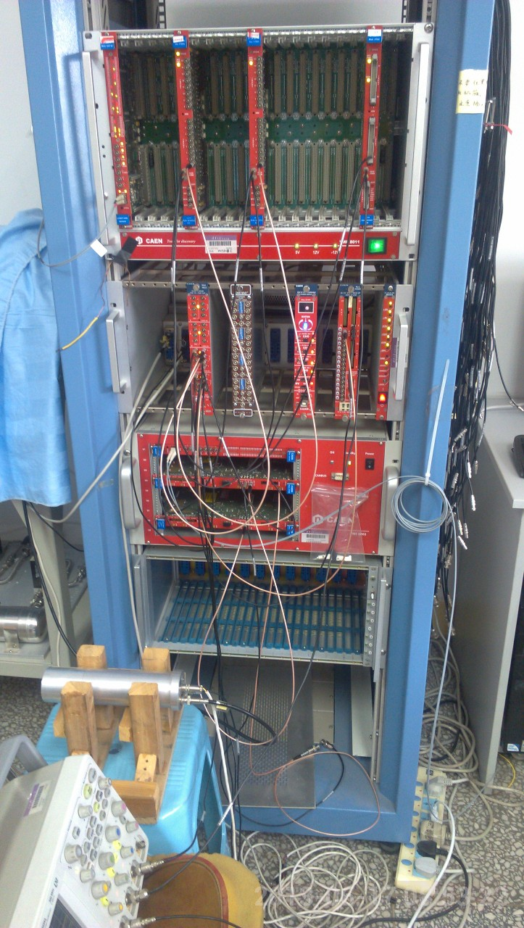
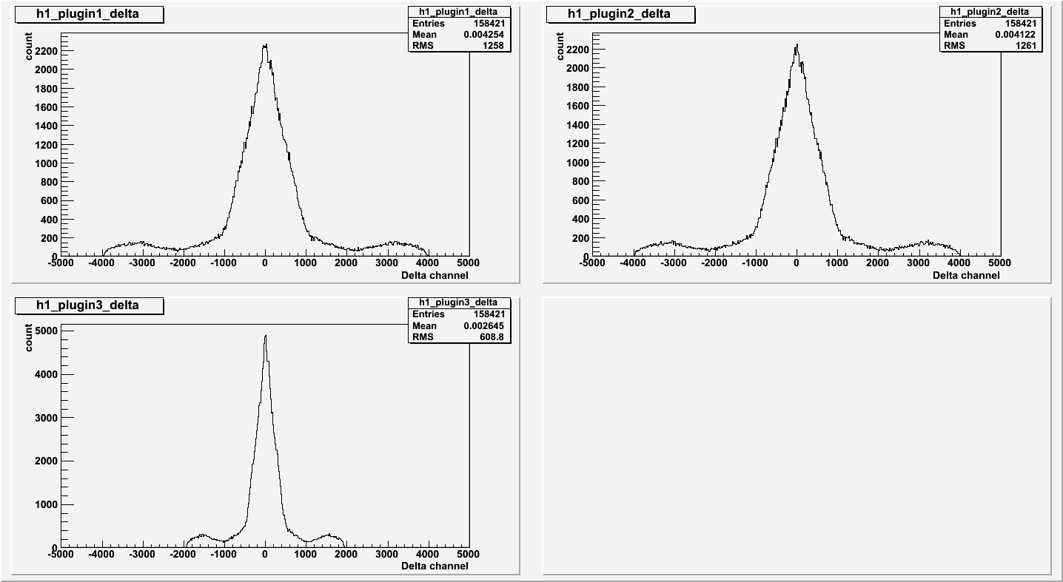
Idea and Setup
A same random signal (from scintillator) are fanned out to different modules, check the coincidence between every two.

Slide 26
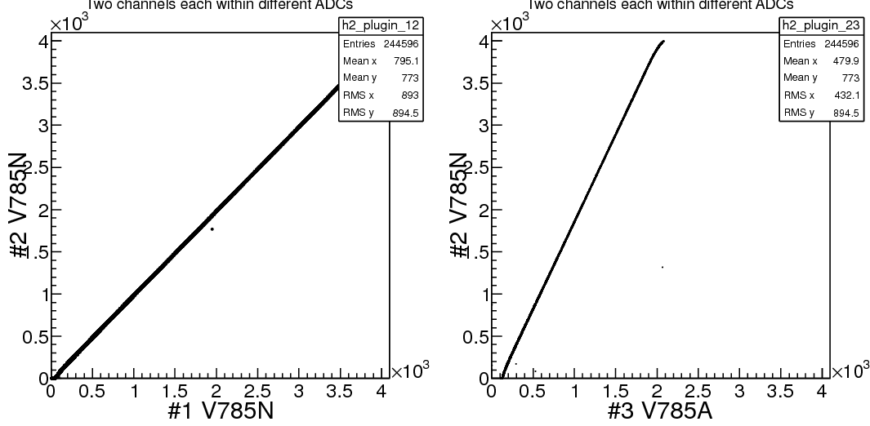
BEAR V1.10.4
Correlation is kept for 4⁺ days

Slide 27
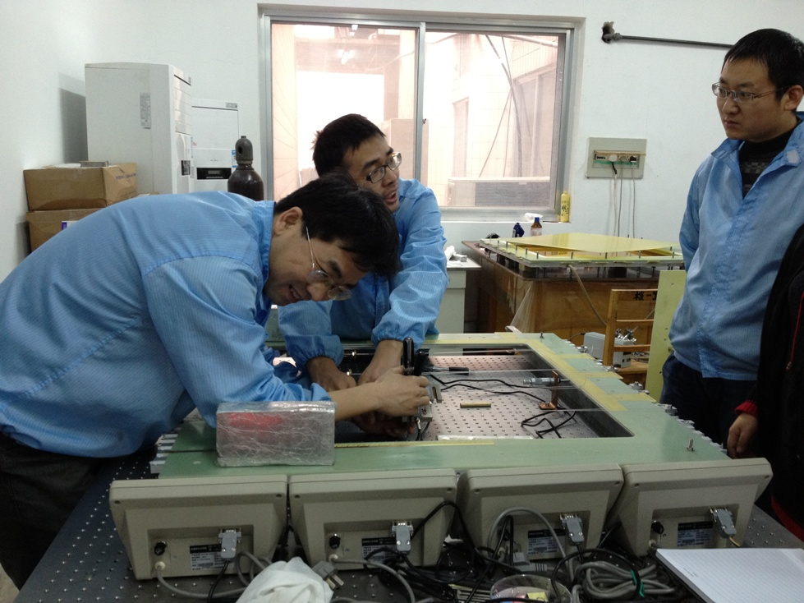
Large GEM detector assembling
Prof. Limin Duan
By Gas Detector Group, Institute Of Modern Physics

Slide 28
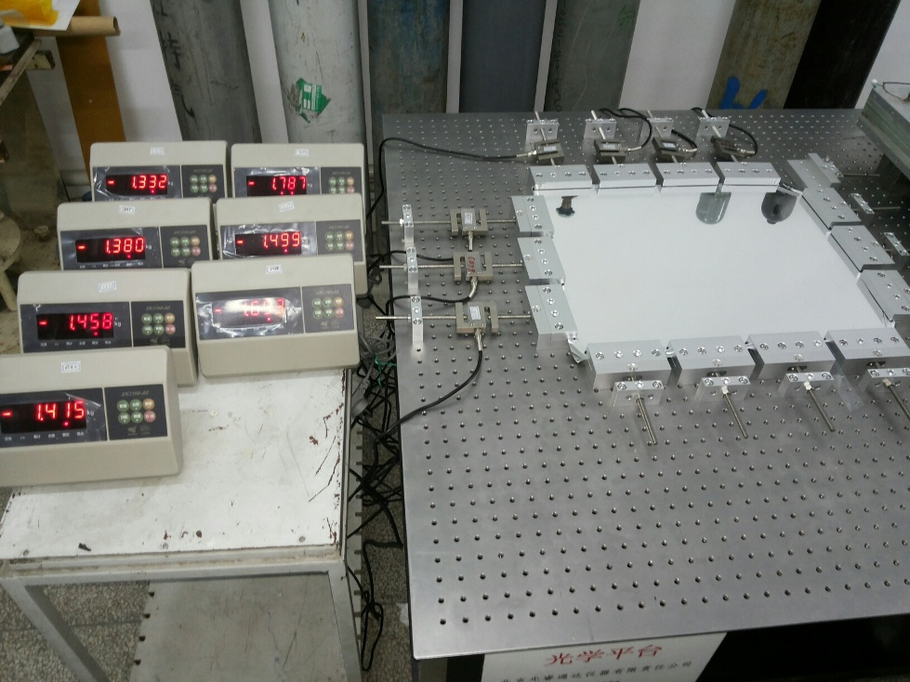
Foil extending

Slide 29
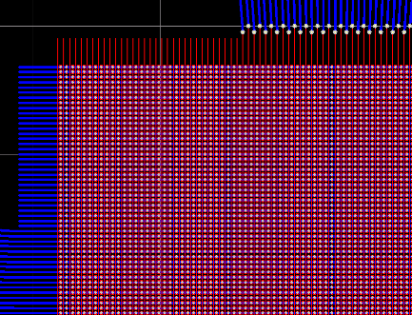
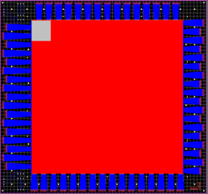
Readout strip design
~300+200 um
10⁶ holes
Rate and multiplicity is lower in lab test. So we use strip readout.

Slide 30
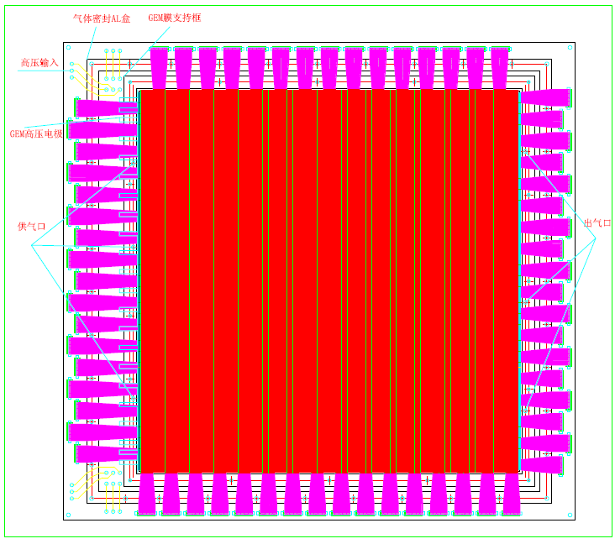
Mechanical Design

Slide 31
Near Future Work I
Ensure the CASAGEM is working properly with GEM detector.
Next: inter foil distance effect
For large foil, the inter-foil distance is hard to be completely homogeneous, particularly when it is running with high current in B field.
-HV
Cathode
GEM1
d1
d2
GEM2
Anode/Readout strip
Make d2>d1 to see the effect.

Slide 32
Near Future Work II
When the large GEM detector is ready:
0 To see correct signals
1What is the performance in cosmic ray test?
2What is the performance in beam test?
3What is the performance in a perpendicular B field?

Slide 33
Summary and Outlook
A small GEM prototype (5*5) has been used in the R&D studies, performance (gain, energy resolution and position resolution) is good.
Towards the test of a large GEM prototype: large GEM foil arrived and a prototype is in assembling. CASAGEM FEE will be adopted in the coming test.
VME-base multi ADC DAQ system is developed and tested.
While we are looking forward to having the large GEM prototype assembled, we plan to see a priori the effects of changing the inter-foil and the inter-strip distance, which are all of relevance to the performance of a larger GEM detector.
Thank you for your attention!

