Slide 1
Symmetry Tests of SM via Light Meson Decays
Liping Gan
University of North Carolina Wilmington
Physics Motivation
  Why the η is unique for symmetry tests
  ChPT, C-violating and P-conserving new physics, CP violation
Proposed experiment in Hall D
Summary
Outline

Slide 2
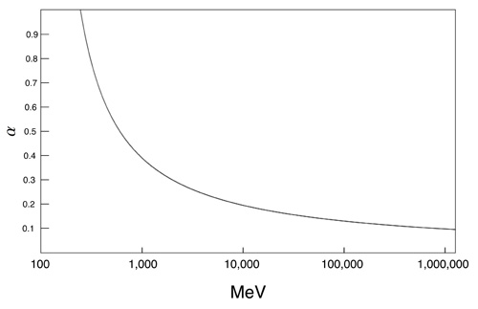
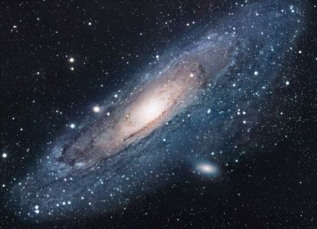
  Challenges in Physics
Confinement QCD
  Chiral perturbation theory (ChPT)
  Lattice QCD
QCD at different energies
New physics beyond the Standard Model (SM)
  New sources of symmetry violation
  Dark matter
  Dark energy
“As far as I see, all a priori statements in physics have their origin in symmetry”. By H. Weyl

Slide 3
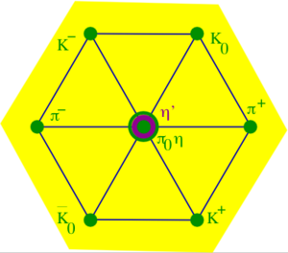

Why η is a unique probe
A Goldstone boson due to spontaneous breaking of
QCD chiral symmetry
η is one of key mesons bridging our
understanding of low-energy hadron dynamics
and underlying QCD
η decay width Γ_{η} =1.3KeV is narrow (relative to Γ_{ω}=8.5 MeV)
    The lowest orders of η decays are filtered out, enhancing the contributions from higher orders by a factor of ~7,000 compared to ω decays.
Eigenstate of P, C, CP, and G:
Study violations of discrete symmetries
The η decays are flavor-conserving reactions effectively free of
SM backgrounds for new physics search.

Slide 4
η Neutral Decays
Mode | Branching Ratio (PDG) | Physics Highlight
π⁰ 2γ | ( 2.7 ± 0.5 ) × 10 ⁻ ⁴ | χPTh @ Ο(p⁶)
3γ | <1.6 × 10 ⁻ ⁵ | C
2π⁰ | <3.5 × 10 ⁻⁴ | CP, P
4γ | <2.8 × 10 ⁻⁴ | Suppressed (<10⁻¹¹)
2π⁰ γ | <5 × 10 ⁻ ⁴ | C
π⁰ γ | <9 × 10 ⁻ ⁵ | C, L, gauge inv.
3π⁰ γ | <6 × 10 ⁻ ⁵ | C
4π⁰ | <6.9 × 10 ⁻ ⁷ | CP, P
3π⁰ | (32.57±0.23)% | Quark mass m_{d}-m_{u}
2γ | (39.31±0.20)% | Anomaly, η−η’ mixing

Slide 5
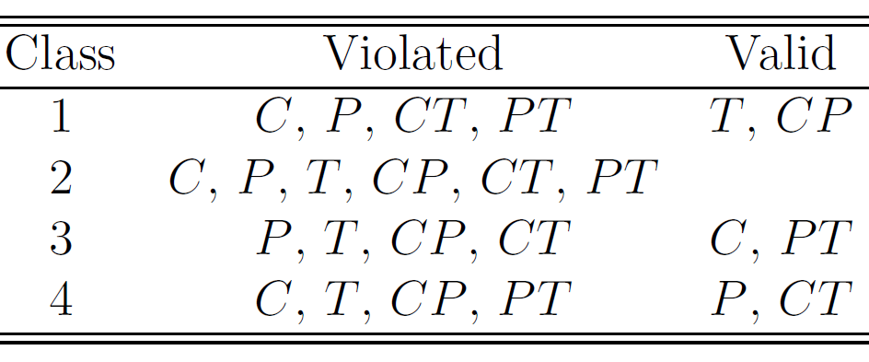
The Four Classes of C, P, and T Violations
Assuming CPT Invariance
B. Nefkens and J. Price, Phys. Scrip., T99, 114 (2002)
Experimental tests
P-violating exp.,
β-decays,
K-, B-, D-meson decays
EDM, η→even π’s
tests involving η, η’, π, ω, J/ψ decays
For class 4:
few tests available
not well tested experimentally for EM and strong interactions
The current constraint: Λ≥ 1 GeV
EDMs place no constraint on the new T-violating and P-conserving
physics; “new TVPC physics could arise at scales as light as a few GeV” .
(A. Kurylov, G. Mclaughlin and M. Ramsey-Musolf, phys. Rev., D63, 076007 (2001) )

Slide 6
C Invariance
Maximally violated in the weak interaction and is well tested.
Assumed in SM for both the electromagnetic (EM) and strong interactions, but it is not experimentally well tested.
C-violating η decays will provide unambiguous, direct constraints on new C-violating and P-conserving physics.
Testing C-invariance will provide a better understanding of
  origin of CP violation
  asymmetry in SM:
  left handed doublets and right-handed singlets.
C Violating η neutral decays
Final State | Branching Ratio (upper limit) | Gammas in Final State
3γ | < 1.6•10⁻⁵ | 3
π⁰γ | < 9•10⁻⁵
2π⁰γ | < 5•10⁻⁴ | 5
3γπ⁰ | Nothing published
3π⁰γ | < 6•10⁻⁵ | 7
3γ2π⁰ | Nothing published

Slide 7
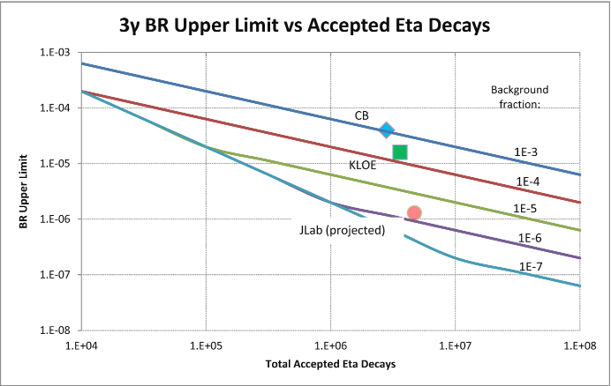
Experimental Improvement on η→3γ
SM contribution:
BR(η→3γ) <10⁻¹⁹ via P-violating
weak interaction.
A new C- and T-violating, and
P-conserving interaction was
proposed by Bernstein, Feinberg
and Lee
(Phys. Rev.,B139,1650).
A calculation due to such new
physics by Tarasov suggests:
BR(η→3γ)< 10⁻²
(Sov.J.Nucl.Phys.,5,445)
Improve BR upper limit by one
order of magnitude to tighten
the constraint on C-violating,
P-conserving new physics
Proj. JEF
The upper limit for the branching ratio at ~90% CL is estimated by:

Slide 8
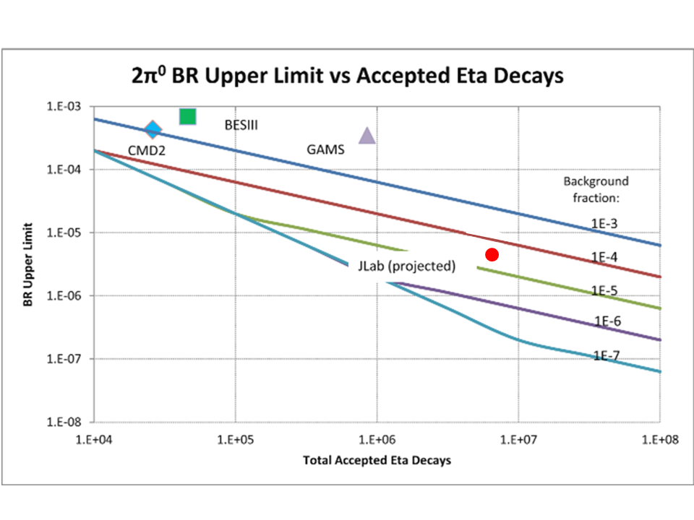
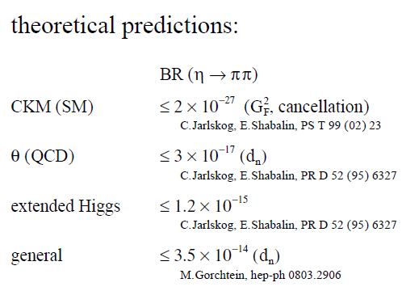
P and CP Violating η→π⁰ π⁰
Proj. JEF
The nEDM measurements access the static property of the particle. A non-
zero nEDM violates P and T directly, and indirectly violates CP under the
assumption of CPT conservation.
The η →2π⁰ decay is related to a dynamic process and it violates P and CP
directly.
η →2π⁰ is flavor-conserving counterpart of the corresponding
flavor-changing CP-violating K_{L} →2π⁰.

Slide 9
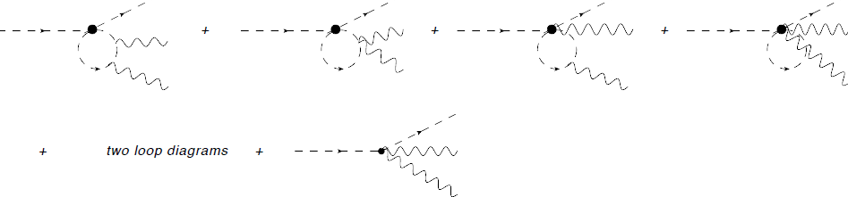
Allowed Rare Decay η→π⁰γγ
ChPT is highly developed and well-tested in the domain of pionic and kaonic
reactions. η →π⁰γγ is one of a few important channels to benchmark the success
of ChPT in the η-sector.
The major contributions to η →π⁰γγ are two O(p⁶) counter-terms in
the chiral Lagrangian a rare window for the high order ChPT contributions.
L. Ametller, J. Bijnens et. al., Phys. Lett., B276, 185
O(p⁶)
counter-term
Precision measurements of both the branching ratio and the Dalitz distribution
of η →π⁰γγ are critical to model-independently determine two Low Energy
Constants (LEC’s) of the O(p⁶) counter-terms in the chiral Lagrangian.

Slide 10


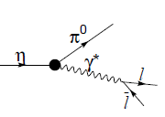
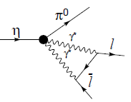
η→π⁰γγ and Other Rare Decays
η →π⁰γγ is an important “door-way” channel for interpretation of other rare
decays searching for new sources of C- or CP-violation
K_{L} Sector: CP violation search K_{L} →π⁰l⁺l⁻
CP conserving background
η
L.M. Sehgal, Phys. Rev., D38, 808 (1988)
K_{L} →π⁰ 2γ was recently measured by KTeV to estimate the CP conserving contributions
η Sector: C and CP search η →π⁰l⁺l⁻
C and CP violating
C and CP conserving background
J.N. Ng, et al., Phys. Rev., D46, 5034 (1992)
A cross-check of LEC's with different processes
test the foundations of ChPT.

Slide 11
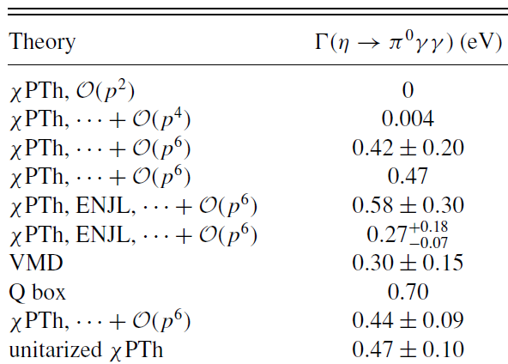
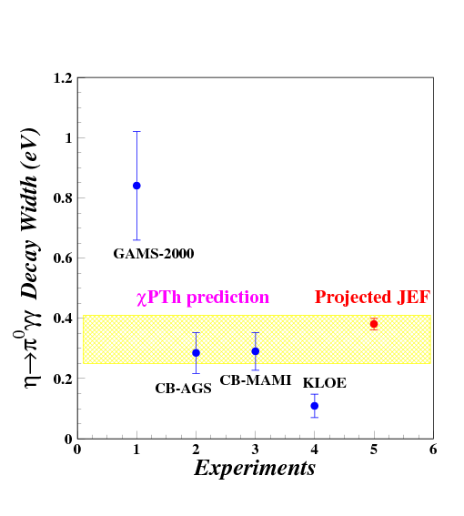

Status of η→π⁰γγ: Partial Decay Width
There have been about 20 experiments since 1966.
Experiments After 1980
Average ~0.44 eV
χPTh by Oset et al., Phys. Rev. D77, 07300 (2008)

Slide 12
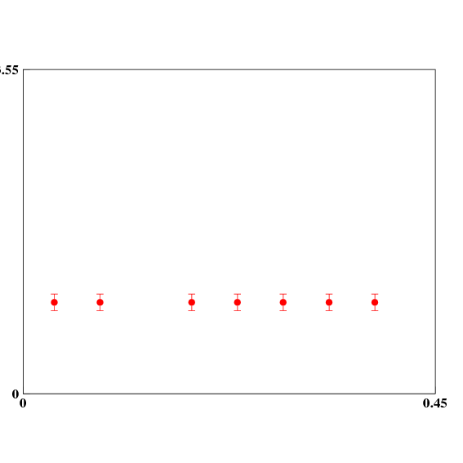
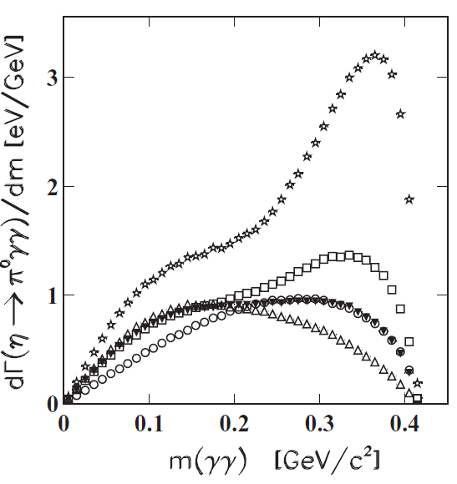
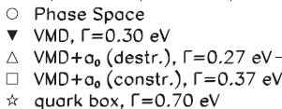
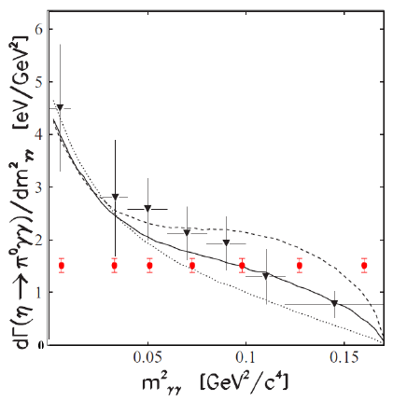
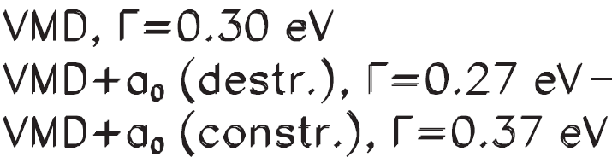
Status of η→π⁰γγ: Dalitz Distribution
Prakhov et al., Phys. Rev. C78, 015206 (2008)
CB-AGS
Projected JEF
Combined BR and Dalitz measurement
model-independent determination of two LEC’s of the O(p⁶)
counter- terms in the chiral Lagrangian

Slide 13
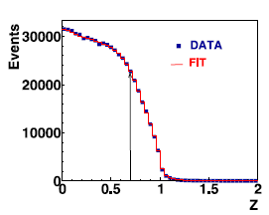
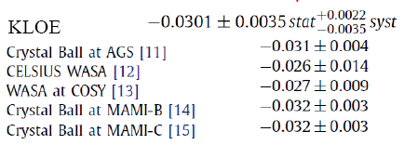
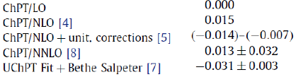
Measurement of η→3π⁰
Phys. Lett., B694, 16 (2010)
η →3π⁰ is the most promising channel
to determine an accurate light quark
mass ratio.
Existing data are from the low energy
η-production facilities and more
sensitive to the threshold effect in
the γ-detection.
Proposed measurement at high
energy will be comparable to existing
data in statistics but different
systematics.
Offers an independent experimental
verification.
Exp.
Slope α
Theory

Slide 14
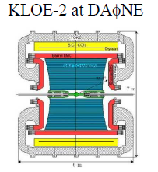
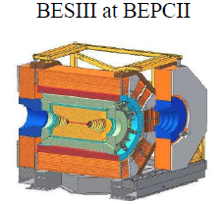
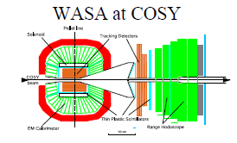
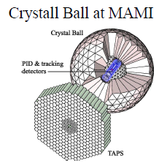
World Competition in η Decays
e⁺e⁻
Collider
Low energy
η-facilities
High energy η-facility
Fixed-target
hadroproduction
CBELSA/TAPS at ELSA
JEF at Jlab
photoproduction

Slide 15
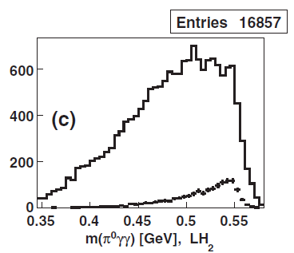
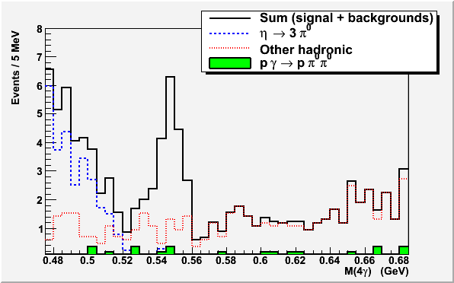
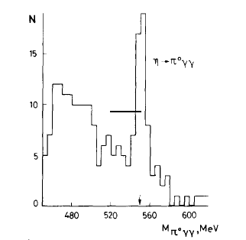
Filter Background with η Energy Boost (η→π⁰γγ)
CB-AGS Experiment
π⁻p→η p (E_{π}=730 MeV)
Jlab: γp→ηp (E_{γ} = 9-11.7 GeV)
η →π⁰π⁰π⁰
GAMS Experiment
π⁻p→η p ( E_{π}= 30 GeV )
Major Background
η →π⁰π⁰π⁰→6γ
π⁻p→ π⁰π⁰ + neutron

Slide 16
Proposed Experiment in Hall D
FCAL-II
Simultaneously measure η neutral decays: η→π⁰γγ, η→3γ, and …
η produced on LH₂ target with 9-11.7 GeV tagged photon beam:
γ+p → η+p
Reduce non-coplanar backgrounds by detecting recoil p’s with GlueX detector
Upgraded Forward Calorimeter with High resolution, high granularity
PbWO₄ (FCAL-II) to detect multi-photons from the η decays
16

Slide 17
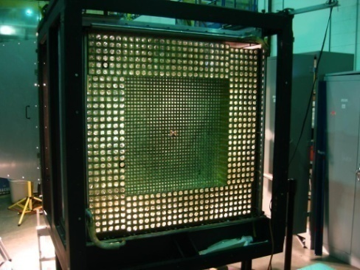
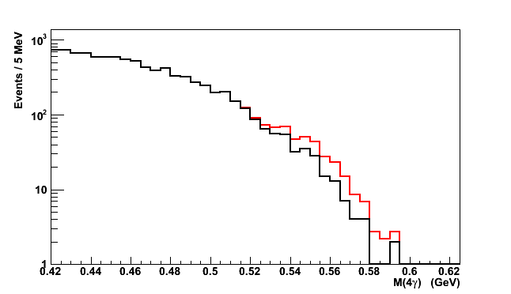
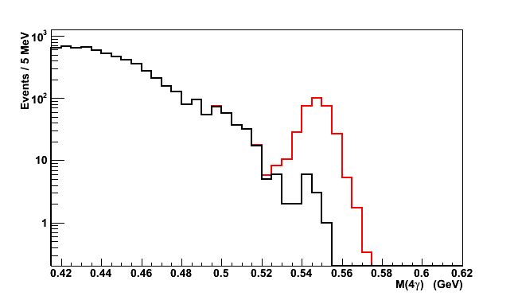
New Equipment: FCAL-II
PrimEx HyCal
FCAL-II:
118x118 cm² in Size (3445 PbWO₄)
2cm x 2cm x 18cm per module
S/N Ratio vs. Calorimeter Types
signal: , background:
FCAL (Pb glass)
FCAL-II (PbWO₄) vs. FCAL (Pb glass)
S/N=0.1:1
Property | Improvement factor
Energy σ | 2
Position σ | 2
Granularity | 4
Radiation-resistance | 10
FCAL-II (PbWO₄)
S/N=10:1

Slide 18
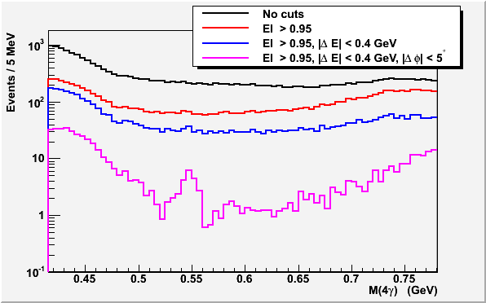
Hadronic Backgrounds Reduction in 4γ States
Event Selection
Elasticity is
EL=ΣE_{γ}/ E_{tagged-γ}
Energy conservation
for γ+p → η+p reaction:
ΔE=E(η)+E(p)-E(beam)-M(p)
Co-planarity Δφ= φ(η)- φ(p)
Note:
Statistics is normalized to
1 beam day.
BG will be further reduced
by requiring that only one
pair of γ’s have the π⁰
invariant mass.
Signal: η→π⁰γγ

Slide 19
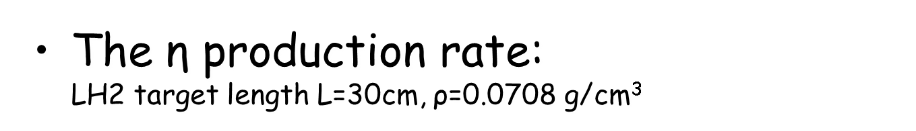
Rate Estimation
The γ+p→η+p cross section ~70 nb (J.M. Laget , Phys.Rev. , C72, 022202 (2005) and A. Sibirtsev et al. Eur.Phys.J., A44, 169 (2010))
Photon beam intensity N_{γ}~4x10⁷ Hz (for E_{γ}~9-11.7 GeV)
Jlab Eta Factory (JEF)
The η→π⁰γγ detection rate:
  BR(η→π⁰γγ )~2.7x10⁻⁴
  Average geometrical acceptance is ~20% (118x118 cm² FCAL-II)
  Event selection efficiency ~70%

Slide 20
Beam Time Requirement
Run type | Beam Time (days)
LH₂ Production | 100
Empty target and target out | 7
Tagger efficiency, TAC runs | 3
FCAL-II commissioning, Calibration | 12
Luminosity optimization | 14
Total | 136

Slide 21
Summary
12 GeV tagged photon beam with GlueX setup will provide a great opportunity for precise measurements. It offers two orders of magnitude reduction of the backgrounds of neutral rare η decays compared to other facilities in the world.
Perform a simultaneous measurement of η decays to all neutral final states:
  η→π⁰γγ model-independently determines two LEC’s of the O(p⁶) counter-terms in the chiral Lagrangian.
  η →3γ and other C-violating neutral channels offer the best window for C-violating and P-conserving new physics.
  η →π⁰π⁰ is a direct P- and CP-violation test, and a flavor-conserving counterpart of the corresponding flavor-changing P- and CP-violating K_{L} →2π⁰ .
  η →3π⁰ is potentially the best way to determine the light quark mass ratio.

Slide 22
The End
Thanks you!

Slide 23
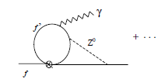
EDM Indirect Constraints on New TV, PC Interactions
(equivalent to CV, PC under CPT)
EDMs should be produced by new TVPC interactions plus the SM weak interaction, potentially indirectly constraining the existence of new TVPC forces.
An Effective Field Theory evaluation finds the constraints depends on the scenario:
Kurylov, McLaughlin, and Ramsey-Musolf,
PRD 63, 076007
 | Scenario A: Λ_{TVPC} Λ_{PV} (parity symmetry restored) | Scenario B: Λ_{PV} (parity symmetry remains broken) Λ_{TVPC}
EDM expression in Effective Field Theory (Unknown short distance physics is in Ci’s. β’s are calculable.) | d ~ β₇C₇ M²/Λ³_{TVPC} | d ~ β₅C₅ /Λ_{TVPC} + β₆C₆ M/Λ²_{TVPC} + β₇C₇ M²/Λ³_{TVPC}
In A, EDMs would tightly constrain new TVPC interactions at loop level in the C7 coefficient.
In B, it’s ambiguous. EDMs arise from a combination of potential TVPV and TVPC operators.
Loop corrections could be as large as tree level.
η rare decays will provide unambiguous, direct
constraints on new TVPC interactions.

Slide 24
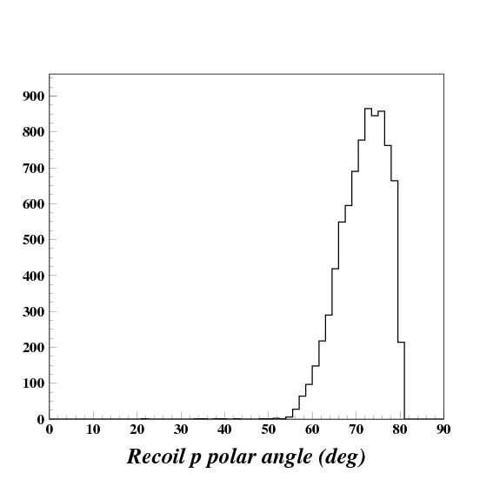
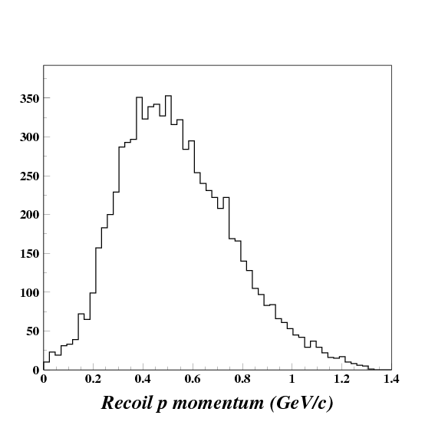
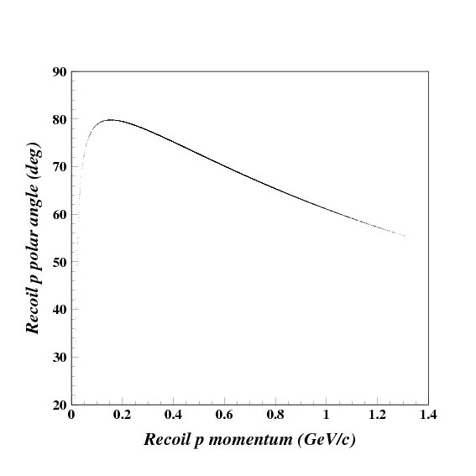
Detection of Recoil Proton with GlueX
Recoil proton kinematics
Polar angle ~55º-80º
Momentum ~200-1200 MeV/c

Slide 25
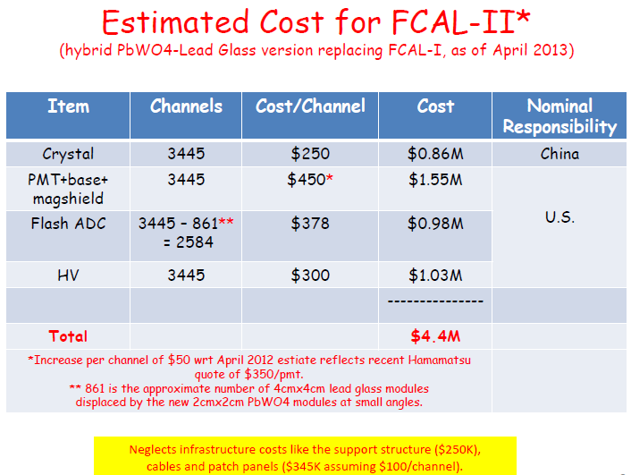

Slide 26
Determination of O(p⁶) Low Energy Constants
The total amplitude for the decay η(P) → π⁰(p) + γ(q1) + γ(q1) is
where A,B are two kinematically different amplitudes, and the a,b are the coefficients for tree level, π loops, and k loops contributions.
Expanding as O(p²) + O(p⁴) + O(p⁶) … many terms vanish or are very small:
M = (a₄^{π} + a₄^{k})A + a₆^{tree} A + b₆^{tree} B + suppressed O(p⁶) loops + HOT
small,known dominant, unknown
The dominant coefficients a₆^{tree} and b₆^{tree} depend on two low energy constants d₁, d₂:
Hence a precise η→π⁰2γ measurement provides a unique window into
O(p⁶) of ХPT, determining the low energy constants d₁,d₂ model independently.

Slide 27
Comparison of different crystals
(From R. Y. Zhu)

Slide 28
Probability of two-cluster separation vs. distance between hits
Study done by using PrimEx-II snake scan data
First cluster: “permanent” with energy 5 GeV
Second cluster: “moving” with energy 1-5 GeV
Artificially split events are counted as
missing
Reconstruction efficiency (100%)
PWO
Pb glass
Reconstruction efficiency (100%)
Separation distance (cm)
Separation distance (cm)

Slide 29
Can we use existing FCAL located at 10 m?
Z=6 m
PWO
σ=6.7 MeV
Pb glass
σ=14.5 MeV
Invariant Mass of 4γ (GeV)
Z=6 m
Pb glass
Invariant Mass of 4γ (GeV)
σ=16.2 MeV
Invariant Mass of 4γ (GeV)

Slide 30
Invariant Mass and Elasticity Resolutions
PWO
σ=3.2 MeV
σ=6.9 MeV
σ=0.0121
Mγγ
Mγγπ⁰
Elasticity
Pb glass
σ=15 MeV
σ=6.6 MeV
Mγγπ⁰
σ=0.0257
Mγγ
Elasticity

Slide 31
Figure of Merit
150x150 cm² PWO Cal.
Signal is η→π⁰γγ
Background is η→3π⁰
Signal window is ±3σ
118x118 cm² PWO Cal.

Slide 32
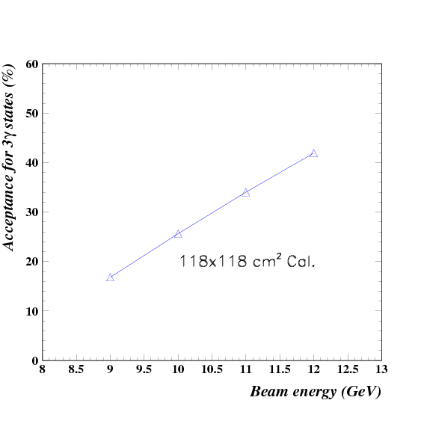
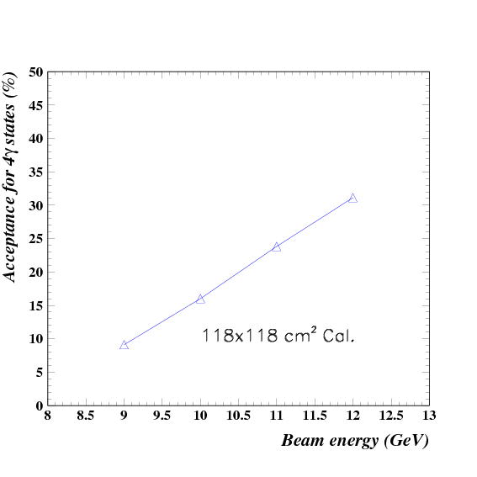
Acceptance of FCAL-II
3γ final state
4γ final state
~30%
~20%

Slide 33
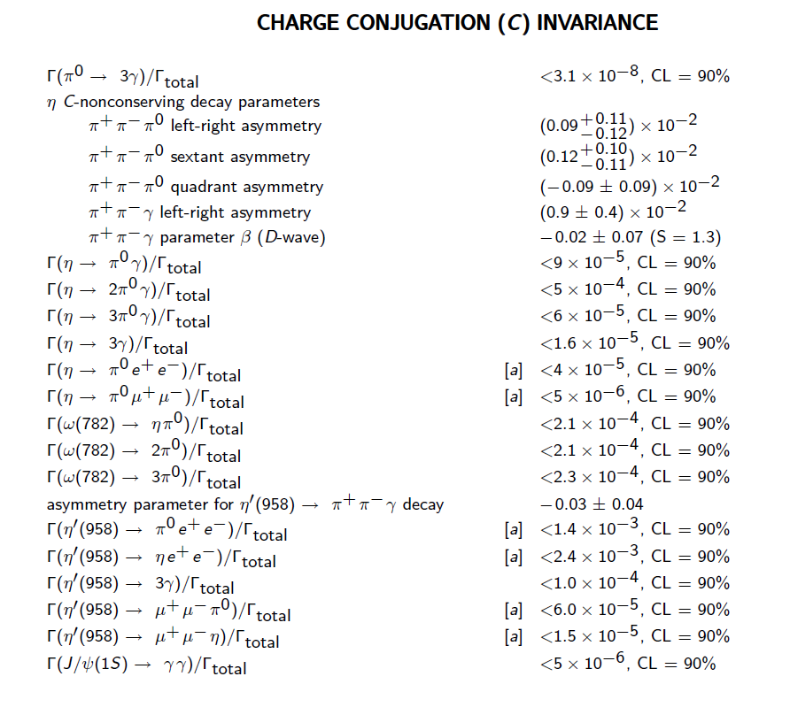
Tests of C Violation
C-violating η decays are among the few opportunities nature has
provided to directly test C invariance in the P conserving EM
interaction (class #4).
PDG 2012
η decays
Γ_{tot}(η)=1.3 KeV
Γ_{tot}(ω)=8.5 MeV
Γ_{tot}(η’)=194 KeV
Γ_{tot}(J/ψ)=93 KeV

Slide 34
S/N Ratio vs. Calorimeter Types signal: , background:
FCAL-II
FCAL-I
S/N=10:1
S/N=0.1:1
Major improvement:
Granularity
Energy and position resolutions.
PWO
FCAL-II
Pb Glass
FCAL-I
Elasticity
Event selection
Elasticity=ΣE_{γ}/E_{tag-γ}
Invariant mass.
Elasticity
Invariant Mass of 4γ (GeV)
Invariant Mass of 4γ (GeV)

