Slide 1

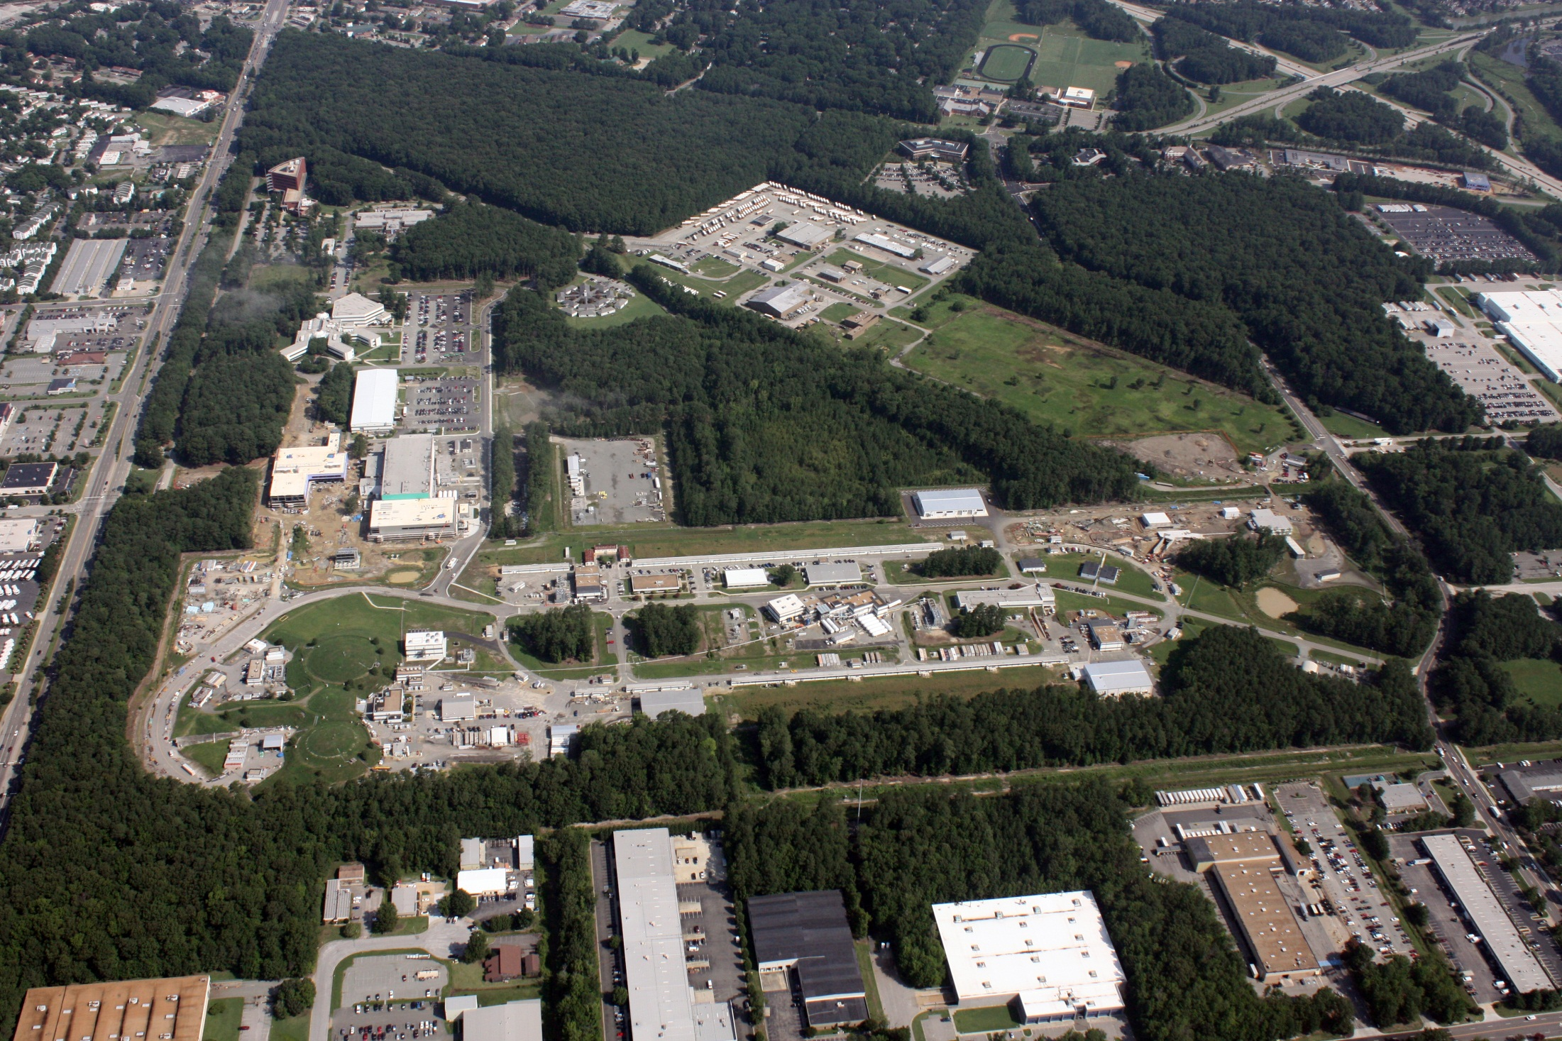
MEIC:
A Medium Energy Electron Ion Collider
at Jefferson Lab
R. D. McKeown
Jefferson Lab
College of William and Mary
Hadron Workshop, Huangshan
July 2, 2013

Slide 2
Outline
Motivation for Electron Ion Collider
- Science goals
- Requirements and specifications
MEIC design

Slide 3
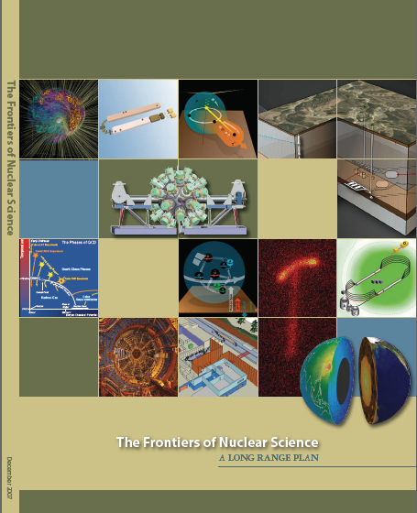
Electron Ion Collider
NSAC 2007 Long-Range Plan:
“An Electron-Ion Collider (EIC) with polarized beams has been embraced by the U.S. nuclear science community as embodying the vision for reaching the next QCD frontier. EIC would provide unique capabilities for the study of QCD well beyond those available at existing facilities worldwide and complementary to those planned for the next generation of accelerators in Europe and Asia.”
Jefferson Lab and BNL developing facility designs
Joint community efforts to develop science case ◻ white paper (2013)

Slide 4
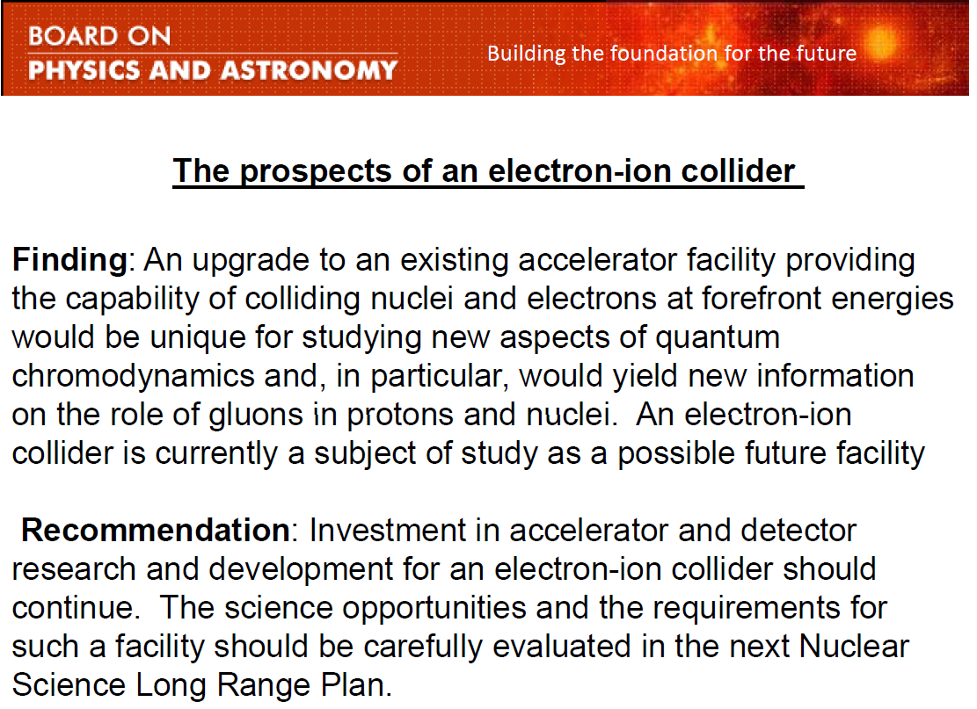

2010 NRC Decadal Study

Slide 5
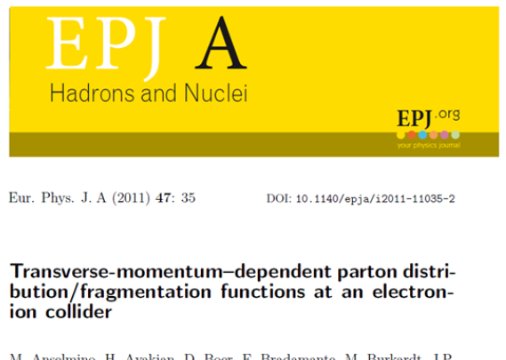
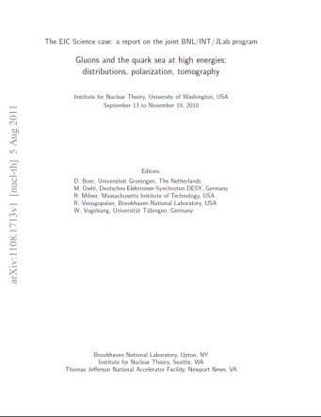
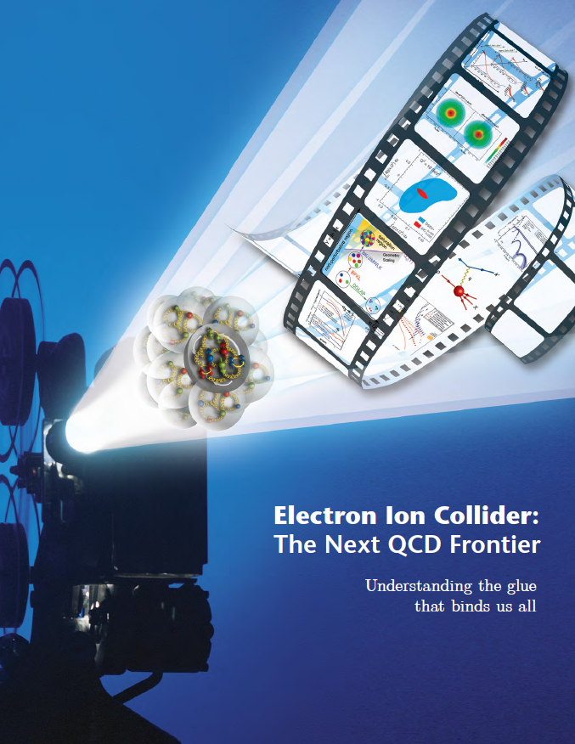
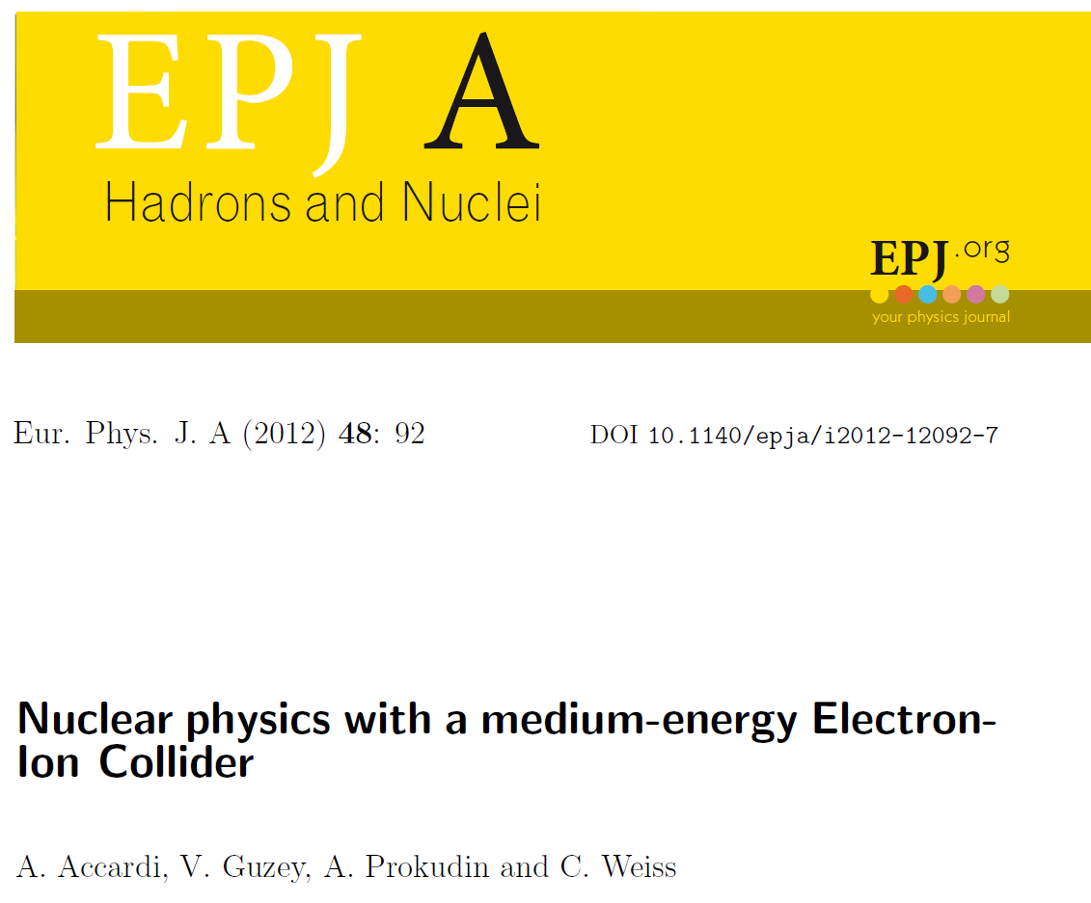
Recent Documents

Slide 6

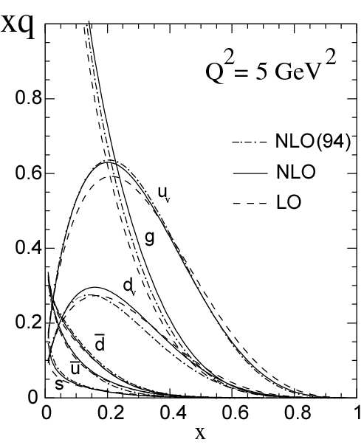
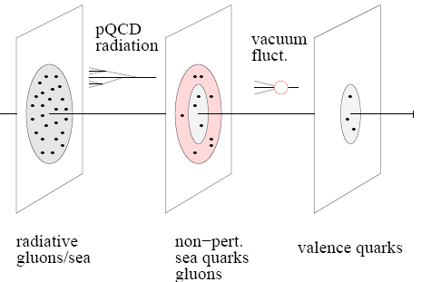
The Landscape of EIC
An EIC aims to study gluon dominated matter.
With 12 GeV we study mostly the valence quark component
mEIC
EIC
12 GeV

Slide 7
EIC Science (I)
EIC will complete our knowledge of the nucleon through exploration of the gluon-dominated regime at low x.
How much spin is carried by gluons?
Does orbital motion of sea quarks contribute to spin?
- Generalized parton distributions (GPD)
- Transverse momentum dependent (TMD) distributions
What do the parton distributions reveal in transverse momentum and coordinate space?

Slide 8
EIC Science (II)
Map the gluon field in nuclei
What is the distribution of glue in nuclei?
Are there modifications as for quarks?
Can we observe gluon saturation effects?
Study spacetime evolution of color charges in nuclei
How do color charges evolve in space and time?
How do partons propagate in nuclear matter?
Can nuclei help reveal the dynamics of fragmentation?
Search for physics beyond the standard model

Slide 9
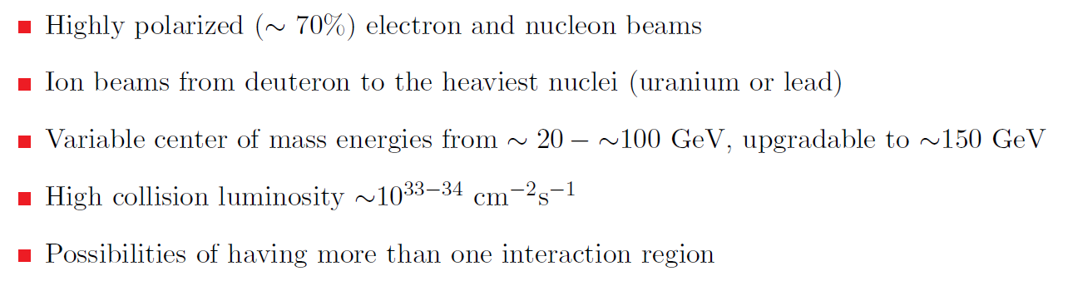
EIC Requirements
From the 2013 EIC White Paper:

Slide 10
The Reach of EIC
High Luminosity
◻ 10³⁴cm⁻²s⁻¹
Low x regime
x ◻ 0.0001
High Polarization
◻ 70%
Jlab
12
EIC
Discovery
Potential!
EMC
HERMES

Slide 11
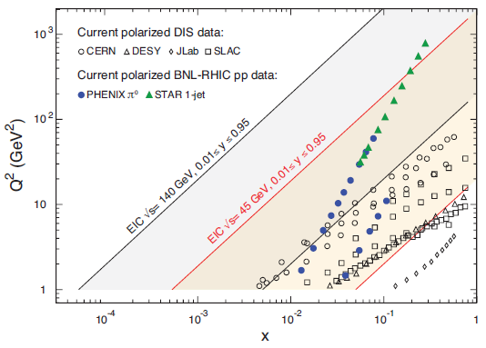
Polarized Luminosity
(x,Q²) phase space directly correlated with s (=4E_{e}E_{p}) :
@ Q² = 1 lowest x scales like s⁻¹
@ Q² = 10 lowest x scales as 10s⁻¹
x = Q²/ys

Slide 12
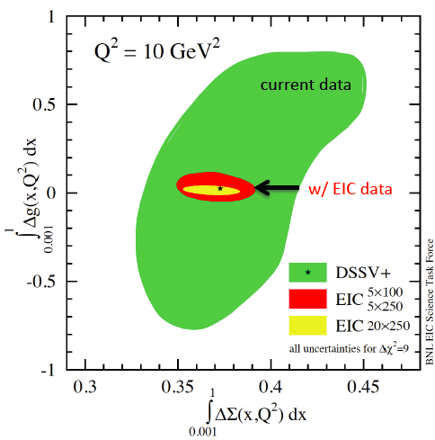
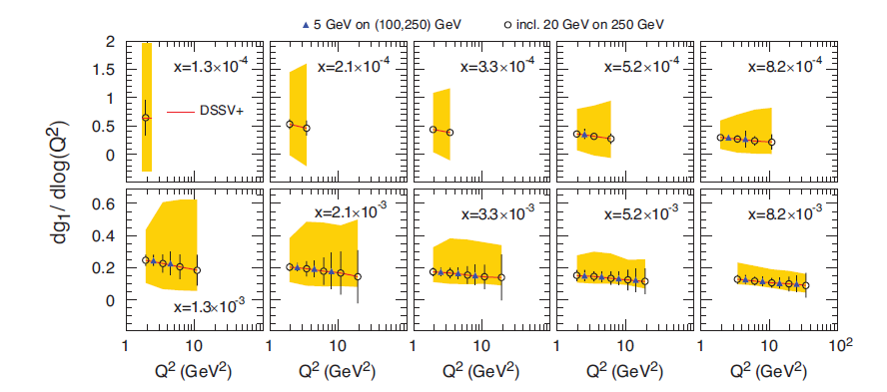
Gluon Contribution to Proton Spin
Study DGLAP evolution of g₁(x)
We need to measure all possible contributions to the nucleon spin
Reach of EIC is required to pin down the gluon contribution
(from EIC White Paper)

Slide 13
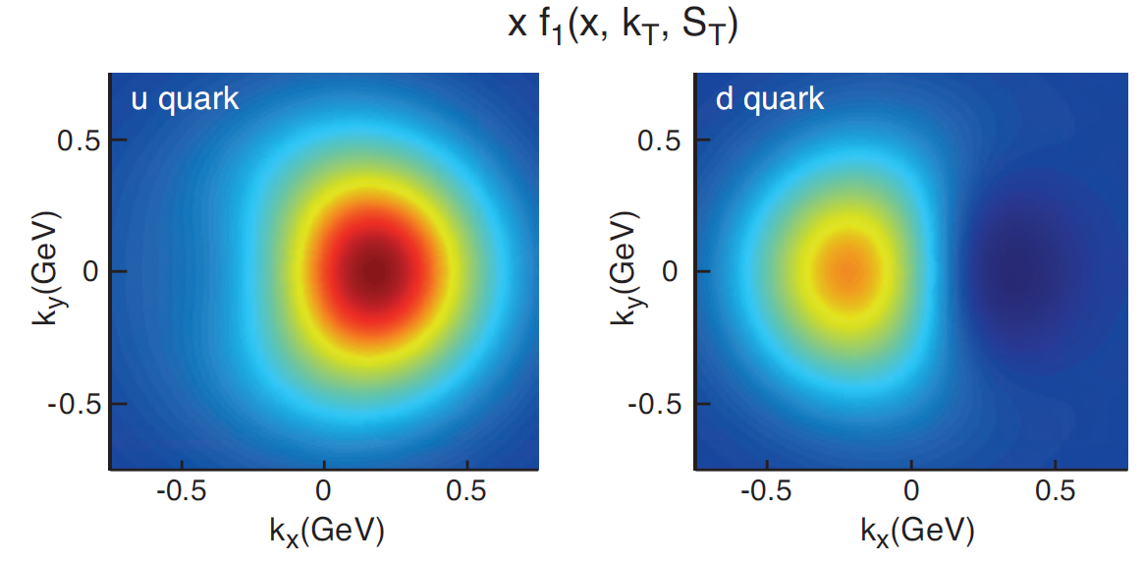
TMD studies at EIC
X=0.1
Nucleon polarized in y direction
(from EIC White Paper)

Slide 14
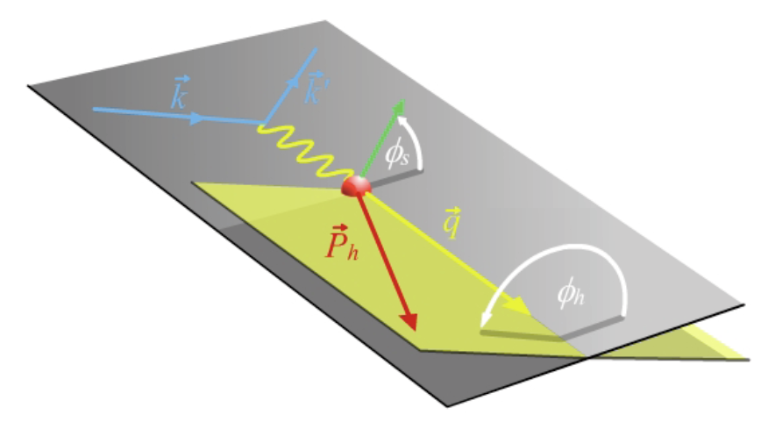
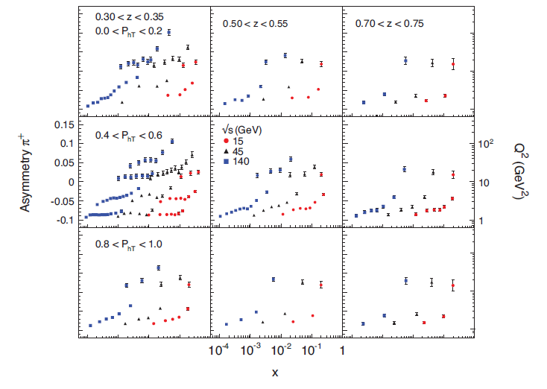
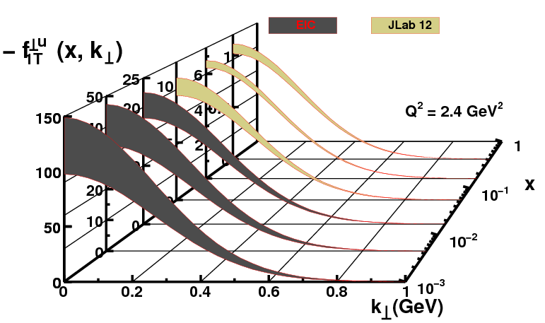
Sivers Tomography
A. Prokudin
10 fb⁻¹ @ each s

Slide 15
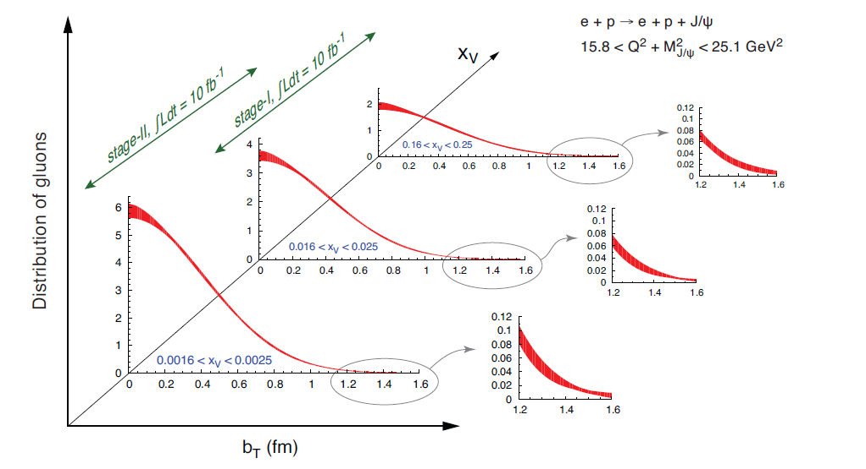
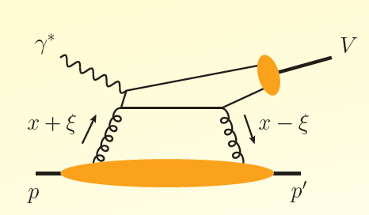
Gluon Tomography
DV J/Ψ Production (from EIC White Paper)

Slide 16
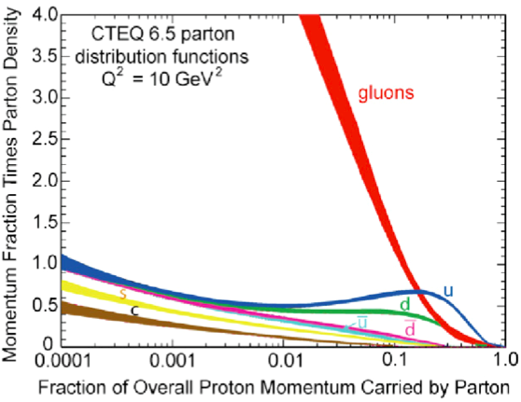
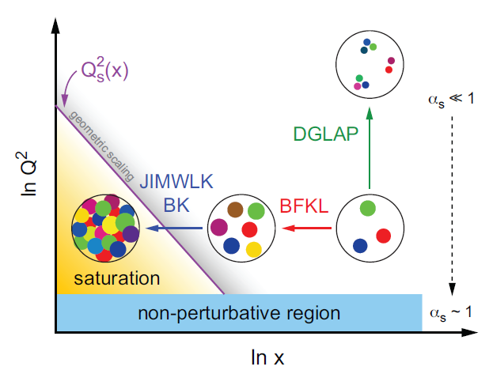
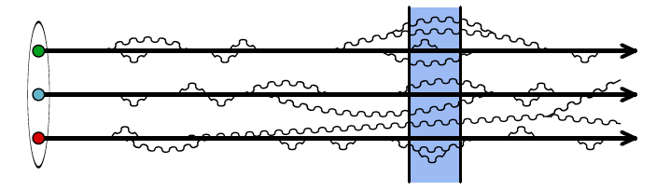
Gluon Saturation
HERA’s discovery: proliferation of soft gluons:
How does the unitarity bound of
the hadronic cross section survive
if soft gluons in a proton or nucleus continue to grow in numbers?
QCD: Dynamical balance between
radiation and recombination
Gluon saturation

Slide 17

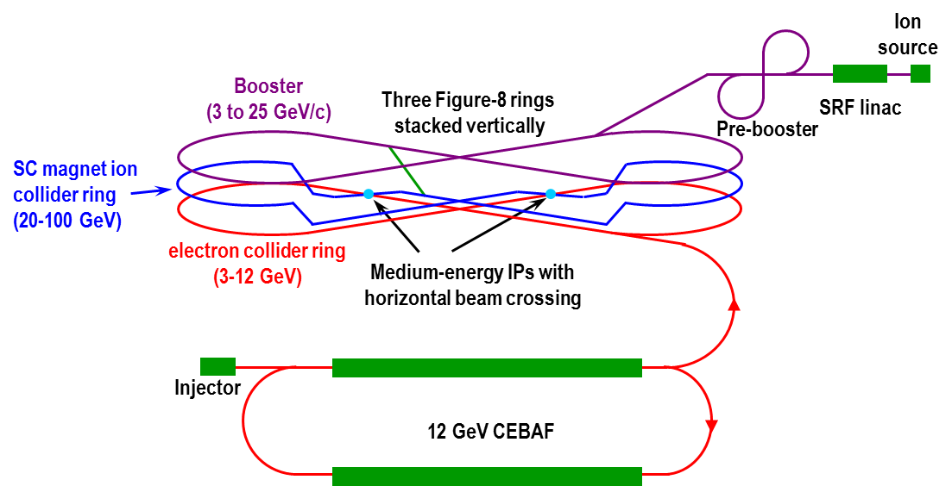
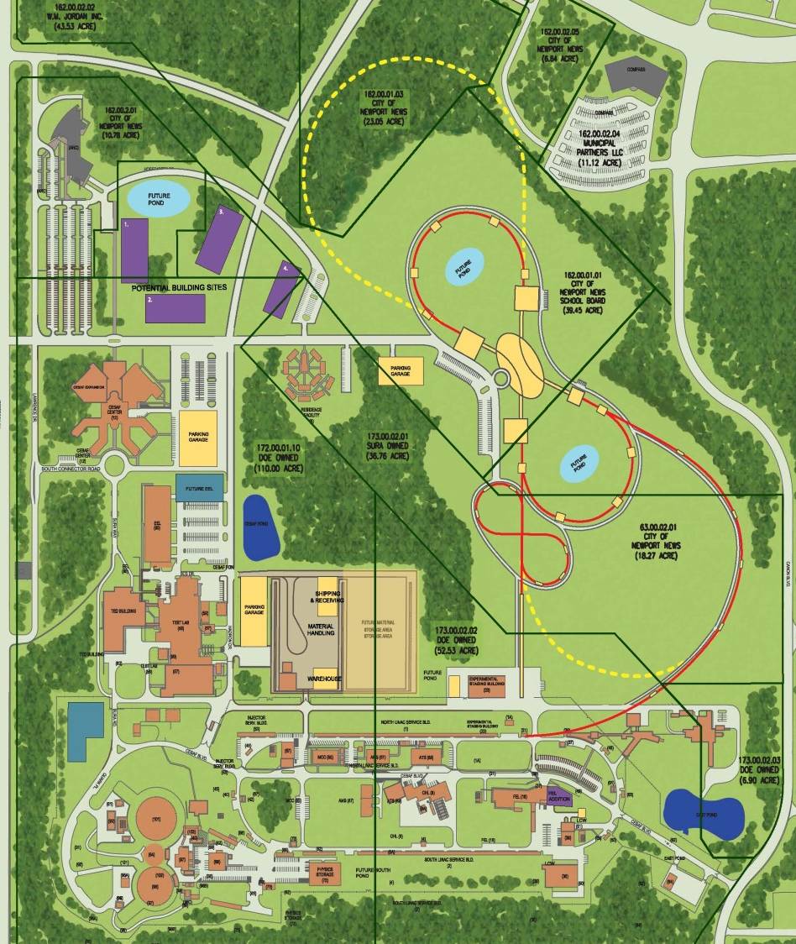
Medium Energy EIC@JLab
JLab Concept
Initial configuration (MEIC):
  3-12 GeV on 20-100 GeV ep/eA collider
  Fully-polarized, longitudinal and transverse
  Luminosity: up to few x 10³⁴ e-nucleons cm⁻² s⁻¹
    Upgradable to higher energies
    250 GeV protons + 20 GeV electrons

Slide 18
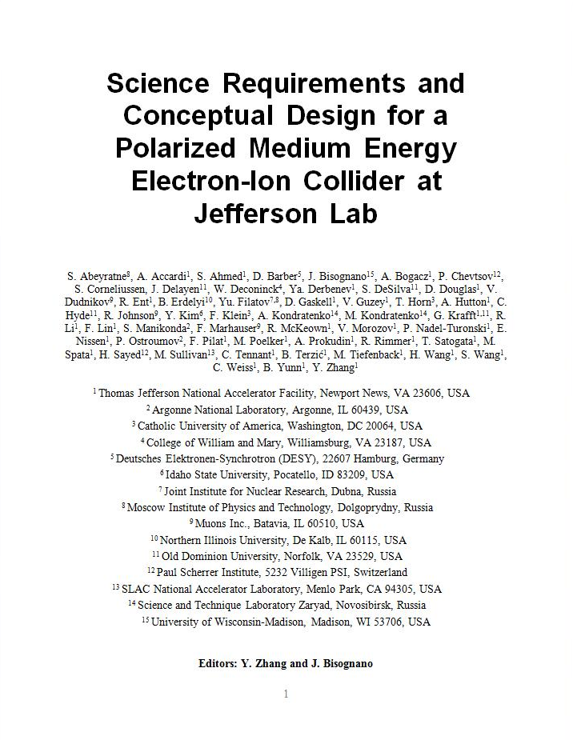
MEIC Design Report
ArXiv: 1209.0757
Stable design for 3 years

Slide 19

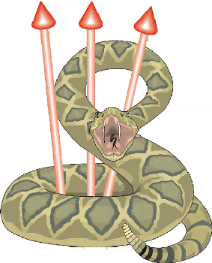

Design Features: High Polarization
All ion rings (two boosters, collider) have a figure-8 shape
  Spin precession in the left & right parts of the ring are exactly cancelled
  Net spin precession (spin tune) is zero, thus energy independent
  Ensures spin preservation and ease of spin manipulation
  Avoids energy-dependent spin sensitivity for ion all species
  The only practical way to accommodate medium energy polarized deuterons
  which allows for “clean” neutron measurements
  This design feature permits a high polarization for all light ion beams
(The electron ring has a similar shape since it shares a tunnel with the ion ring)
Use Siberian Snakes/solenoids to arrange polarization at IPs
Proton or Helium-3 beams
Deuteron beam
Longitudinal polarization at both IPs
Transverse polarization at both IPs
Longitudinal polarization at one IP
Transverse polarization at one IP
Vertical axis
Solenoid
Insertion
longitudinal axis
Slide 19

Slide 20
Design Features: High Luminosity
Follow a proven concept: KEK-B @ 2x10³⁴ /cm²/s
  Based on high bunch repetition rate CW colliding beams
  Uses crab crossing
MEIC aims to replicate this concept in colliders w/ hadron beams
  The CEBAF electron beam already possesses a high bunch repetition rate
  Add ion beams from a new ion complex to match the CEBAF electron beam
 |  | KEK-B | MEIC
Repetition rate | MHz | 509 | 748.5
Particles per bunch (e⁻/e⁺) or (p/e⁻) | 10¹⁰ | 3.3 / 1.4 | 0.42 / 2.5
Beam current | A | 1.2 / 1.8 | 0.5 / 3
Bunch length | cm | 0.6 | 1 / 0.75
Horizontal & vertical β* | cm | 56 / 0.56 | 10/2 to 4/0.8
Beam energy (e⁻/e⁺) or (p/e⁻) | GeV | 8 / 3.5 | 60 / 5
Luminosity per IP, 10³⁴ | cm⁻²s⁻¹ | 2 | 0.56 ~ 1.4
high bunch repetition rate
small bunch charge
short bunch length (σ_{z} )
small β* ( β* ~ σ_{z} )

Slide 21
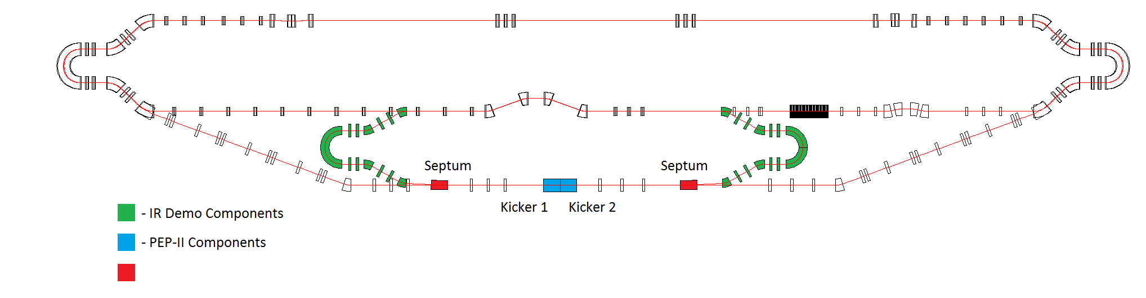
MEIC Accelerator R&D: Electron Cooling
Electron Cooling in Collider – proof of principle of concept & techniques
  Cooling simulations are in progress (collaboration with Tech-X established through an SBIR grant)
  ERL circulator cooler (linear optics and ERL) design has been completed
  Fast RF kicker concept has been developed, plan to test with two kickers from SLAC
  Test of beam-beam kicker concept at FNAL/ASTA facility and collaboration are in planning
  Optics design of a cooler test facility based on JLab FEL ERL has been completed
MEIC Electron cooler
(in center of figure-8)
A technology demonstration
possible using JLab FEL facility
Solenoid (15 m)
e-Cooler Test Facility @ FEL
injector
SRF
dumper
eliminating a long return path
could double the cooling rate
Dechirper
Rechirper
Required R&D: demonstrate ERL-based cooler concept by 2016 (at FEL/ERL conditions)

Slide 22
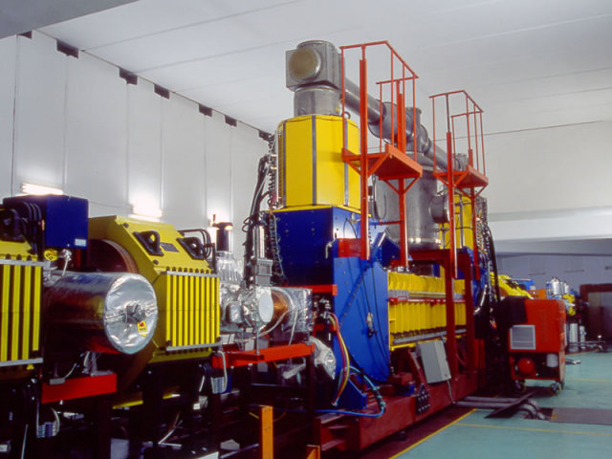
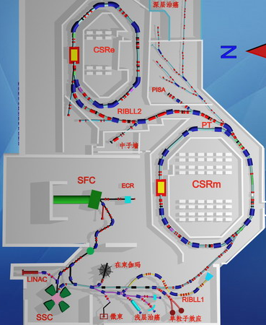
Proposed Cooling Experiments at IMP
DC cooler
Idea: pulse the beam from the existing thermionic gun using the grid (Hongwei Zhao)
Non-invasive experiment to a user facility
Proposed experiments
Demonstrate cooling of a DC ion beam by a bunched electron cooling (Hutton)
Demonstrate a new phenomena: longitudinal bunching of a bunched electron cooling (Hutton)
(Next phase) Demonstrate cooling of bunched ion beams by a bunched electron beam (need an RF cavity for bunching the ion beams)
Two storage rings for Heavy ion coasting beam

Slide 23
Further ongoing MEIC Accelerator R&D
Space Charge Dominated Ion Beam in the Pre-booster
  Simulation study is in progress by Argonne-NIU collaborators
Beam Synchronization
  A scheme has been developed; SRF cavity frequency tunability study is in progress
Beam-Beam Interaction
  Phase 1 simulation study was completed
Interaction Region, Chromaticity Compensation and Dynamic Aperture
  Detector integration with IR design has been completed, offering excellent acceptance
  Correction scheme has been developed, and incorporated into the IR design
  Tracking simulations show excellent momentum acceptance; dynamic aperture is increased
  Further optimization in progress (e.g., all magnet spaces/sizes defined for IR +/- 100 m)
Beam Polarization
  Electron spin matching and tracking simulations are in progress, achieving acceptable equilibrium polarization and lifetime (collaboration with DESY)
  New ion polarization scheme and spin rotators have been developed (collaboration with Russian group) – numerical demonstration of figure-8 concept with misalignments ongoing
Electron Cloud in Ion Ring
Ion Sources (Polarized and Universal)

Slide 24
MEIC: Full Acceptance Detector
7 meters
solenoid
detectors
ion dipole w/ detectors
ion FFQs
0 mrad
IP
ions
50 mrad
electron FFQs
electrons
2+3 m
2 m
2 m
Central detector
Three-stage detection
TOF
Detect particles with angles down to 0.5º before ion FFQs.
Need 1-2 Tm dipole.
Detect particles with angles below 0.5º beyond ion FFQs and in arcs.
Need 4 m machine element free region
Solenoid yoke + Muon Detector
RICH or DIRC/LTCC
EM Calorimeter
Tracking
RICH
4-5m
HTCC
Muon Detector
Hadron Calorimeter
EM Calorimeter
Very-forward detector
Large dipole bend @ 20 meter from IP (to correct the 50 mr ion horizontal crossing angle) allows for very-small angle detection (<0.3º).
Need 20 m machine element free region
Solenoid yoke + Hadronic Calorimeter
2m
3m
2m
Notes:
24
24

Slide 25
MEIC Point Design Parameters
Detector type |  | Full acceptance |  | high luminosity & Large Acceptance
 |  | Proton | Electron | Proton | Electron
Beam energy | GeV | 60 | 5 | 60 | 5
Collision frequency | MHz | 750 | 750 | 750 | 750
Particles per bunch | 10¹⁰ | 0.416 | 2.5 | 0.416 | 2.5
Beam Current | A | 0.5 | 3 | 0.5 | 3
Polarization | % | > 70 | ~ 80 | > 70 | ~ 80
Energy spread | 10⁻⁴ | ~ 3 | 7.1 | ~ 3 | 7.1
RMS bunch length | mm | 10 | 7.5 | 10 | 7.5
Horizontal emittance, normalized | µm rad | 0.35 | 54 | 0.35 | 54
Vertical emittance, normalized | µm rad | 0.07 | 11 | 0.07 | 11
Horizontal and vertical β* | cm | 10 and 2 | 10 and 2 | 4 and 0.8 | 4 and 0.8
Vertical beam-beam tune shift |  | 0.014 | 0.03 | 0.014 | 0.03
Laslett tune shift |  | 0.06 | Very small | 0.06 | Very small
Distance from IP to 1st FF quad | m | 7 | 3.5 | 4.5 | 3.5
Luminosity per IP, 10³³ | cm⁻²s⁻¹ | 5.6 |  | 14.2
Notes:
25

Slide 26
EIC Realization Imagined
Activity Name | 2010 | 2011 | 2012 | 2013 | 2014 | 2015 | 2016 | 2017 | 2018 | 2019 | 2020 | 2021 | 2022 | 2023 | 2024 | 2025
12 GeV Upgrade
FRIB
EIC Physics Case
NSAC LRP
EIC CD0
EIC Machine Design/R&D
EIC CD1/Downsel
EIC CD2/CD3
EIC Construction
Assumes endorsement for an EIC at the next NSAC Long Range Plan
Assumes relevant accelerator R&D for down-select process done around 2016

Slide 27
Summary
There has been excellent progress on developing the EIC science case over the last 2 years, with important contributions from both the BNL and JLab communities. White paper now available.
We anticipate an NSAC Long Range Plan in the next 2-3 years – need to realize a recommendation for EIC construction.
MEIC design is stable and mature. R&D planning in progress, with good opportunities for collaboration.
We are hopeful that an international collaboration can develop to advance the science and technology of electron ion colliders.

