Slide 1
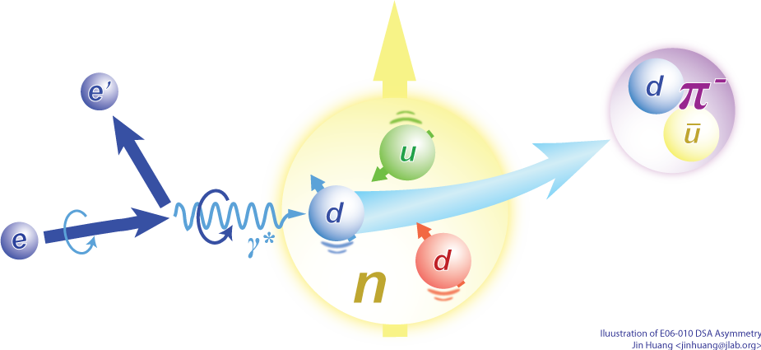
TMD program at Hall A
6GeV results and
plan on SoLID
Jin Huang
Los Alamos National Lab
Notes:
Extraction …
Higher twist …

Slide 2

Transverse Momentum Dependent (TMD) Parton Distributions
Go 3D!
TMD PDFs link
  Intrinsic motion of partons
  Parton spin
  Spin of the nucleon
Multi-Dimension structure
  3D motion of the quark in nucleon
  Probes orbital motion of quarks
A new phase of study, fast developing field
  Great advance in theories (factorization, models, Lattice ...)
  Experimentally, not systematically studied until recent years
  Recent experiments in HERMES, COMPASS, CEBAF, RHIC, …
Notes:
! Read experiment names
A crucial innovation in this new phase of investigation of the fundamental structure of matter is looking at, and studying, physical observables which are sensitive to the transverse structure of the nucleon. This information is encoded in the so-called Transverse Momentum Dependent partonic Distributions or TMDs, which link the intrinsic motion of partons to their spin and the spin of the parent nucleon.
TMDs can be used to construct a three-dimensional picture of partons inside hadrons in momentum space and may be related to the orbital angular momentum of partons. Here is a naïve picture why OAM and TMD are correlated: in DIS, since the momentum transfer is large, nucleon contracts into a pancake. However, on the transverse plane, which is perpendicular to that of virtual photon momentum transfer, transverse motion of the quark is conserved. Therefore if quark carries OAM in side this polarized nucleon, transverse momentum will be non-zero.
Therefore TMD opened a new phase of study. There was few studies of TMD until a decade ago. But this field are fast developing in both theory and experimental ways ...

Slide 3




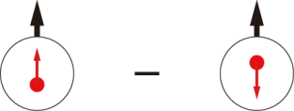
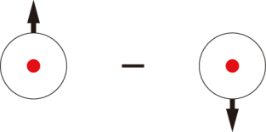
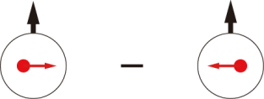
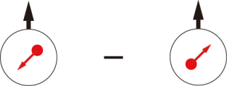
Leading-Twist TMD PDFs
Nucleon Spin
Quark Spin
 |  | Quark polarization
 |  | Unpolarized (U) | Longitudinally Polarized (L) | Transversely Polarized (T)
Nucleon Polarization | U
 | L
 | T
f₁ =
h₁⊥ =
Boer-Mulders
h_{1L}⊥ =
g₁ =
Worm Gear
(Kotzinian-Mulders)
Helicity
h₁ =
f _{1T}⊥ =
Transversity
g_{1T} =
Sivers
Worm Gear
(trans-helicity)
h_{1T}⊥ =
Pretzelosity
: Survive trans. momentum integration
Notes:
! relate g1, f1 -> collinear w/ pT dep.
Say: Noval new information on structure of nucleon, spin-orbital cor and multi-parton cor.

Slide 4











Access TMDs through Hard Processes
FNAL
JPARC
EIC
lepton
lepton
hadron
lepton
proton
pion
proton
antilepton
SIDIS
Hadron-Hadron (DY, Jet, IFF, etc.)
Partonic scattering amplitude
electron
pion
Fragmentation amplitude
Distribution amplitude
positron
pion
e–e⁺ to hadrons

Slide 5
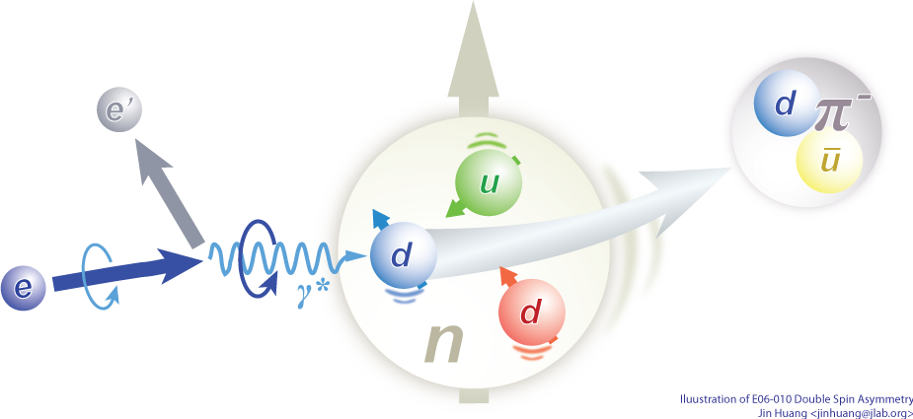
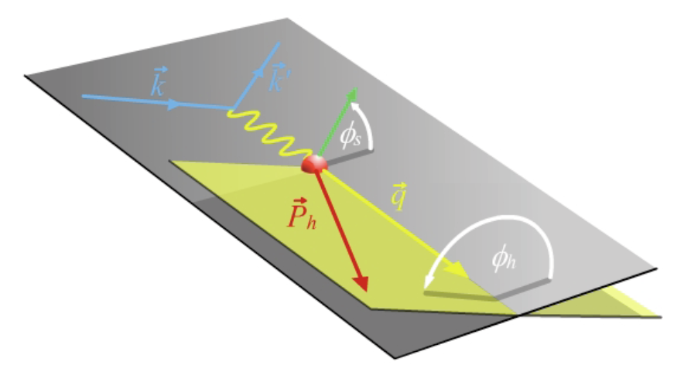
Tool: Semi-inclusive DIS (SIDIS)
Gold mine for TMDs
Access all eight leading-twist TMDs through spin-comb. & azimuthal-modulations
Tagging quark flavor/kinematics
Scattering Plane
Notes:
! SIDIS -> conv. PDF & FF
Introduction to DIS and its variables
Introduction to azimuthal angle
Factorized at Q^2>>p_T>>QCD scale

Slide 6
TMDs in SIDIS Cross Section
f₁ =
Boer-Mulder
h₁⊥ =
Worm Gear
g_{1T} =
Helicity
g₁ =
Worm Gear
h_{1L}⊥ =
Transversity
h_{1T} =
Sivers
f _{1T}⊥ =
Pretzelosity
h_{1T}⊥ =
S_{L}, S_{T}: Target Polarization; λ_{e}: Beam Polarization
Notes:
TMDs could be accessed through cross sections of SIDIS. Each TMD is related with a term of characteristic target-beam spin combinations and angular modulation.
TO BE simplified

Slide 7
Accessing TMD through SIDIS e.g. experimental study of g_{1T}
Double Beam-Target Spin Asymmetry (DSA) in SIDIS with transversely polarized target: A_{LT}
Scattering Plane
Technically, azimuthal amplitude in asymmetry extracted through methods considering acceptance and luminosity corrections, including
  azimuthal asymmetry fits
  Maximum likelihood analysis

Slide 8
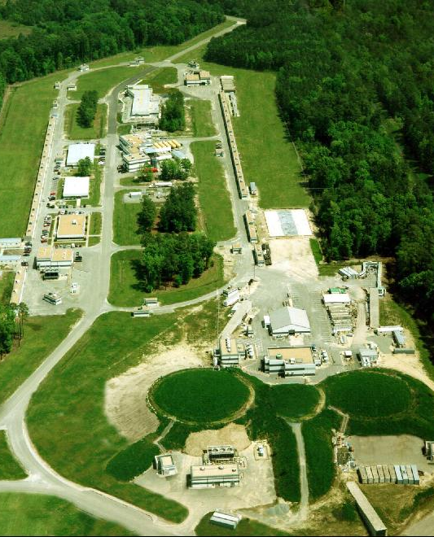
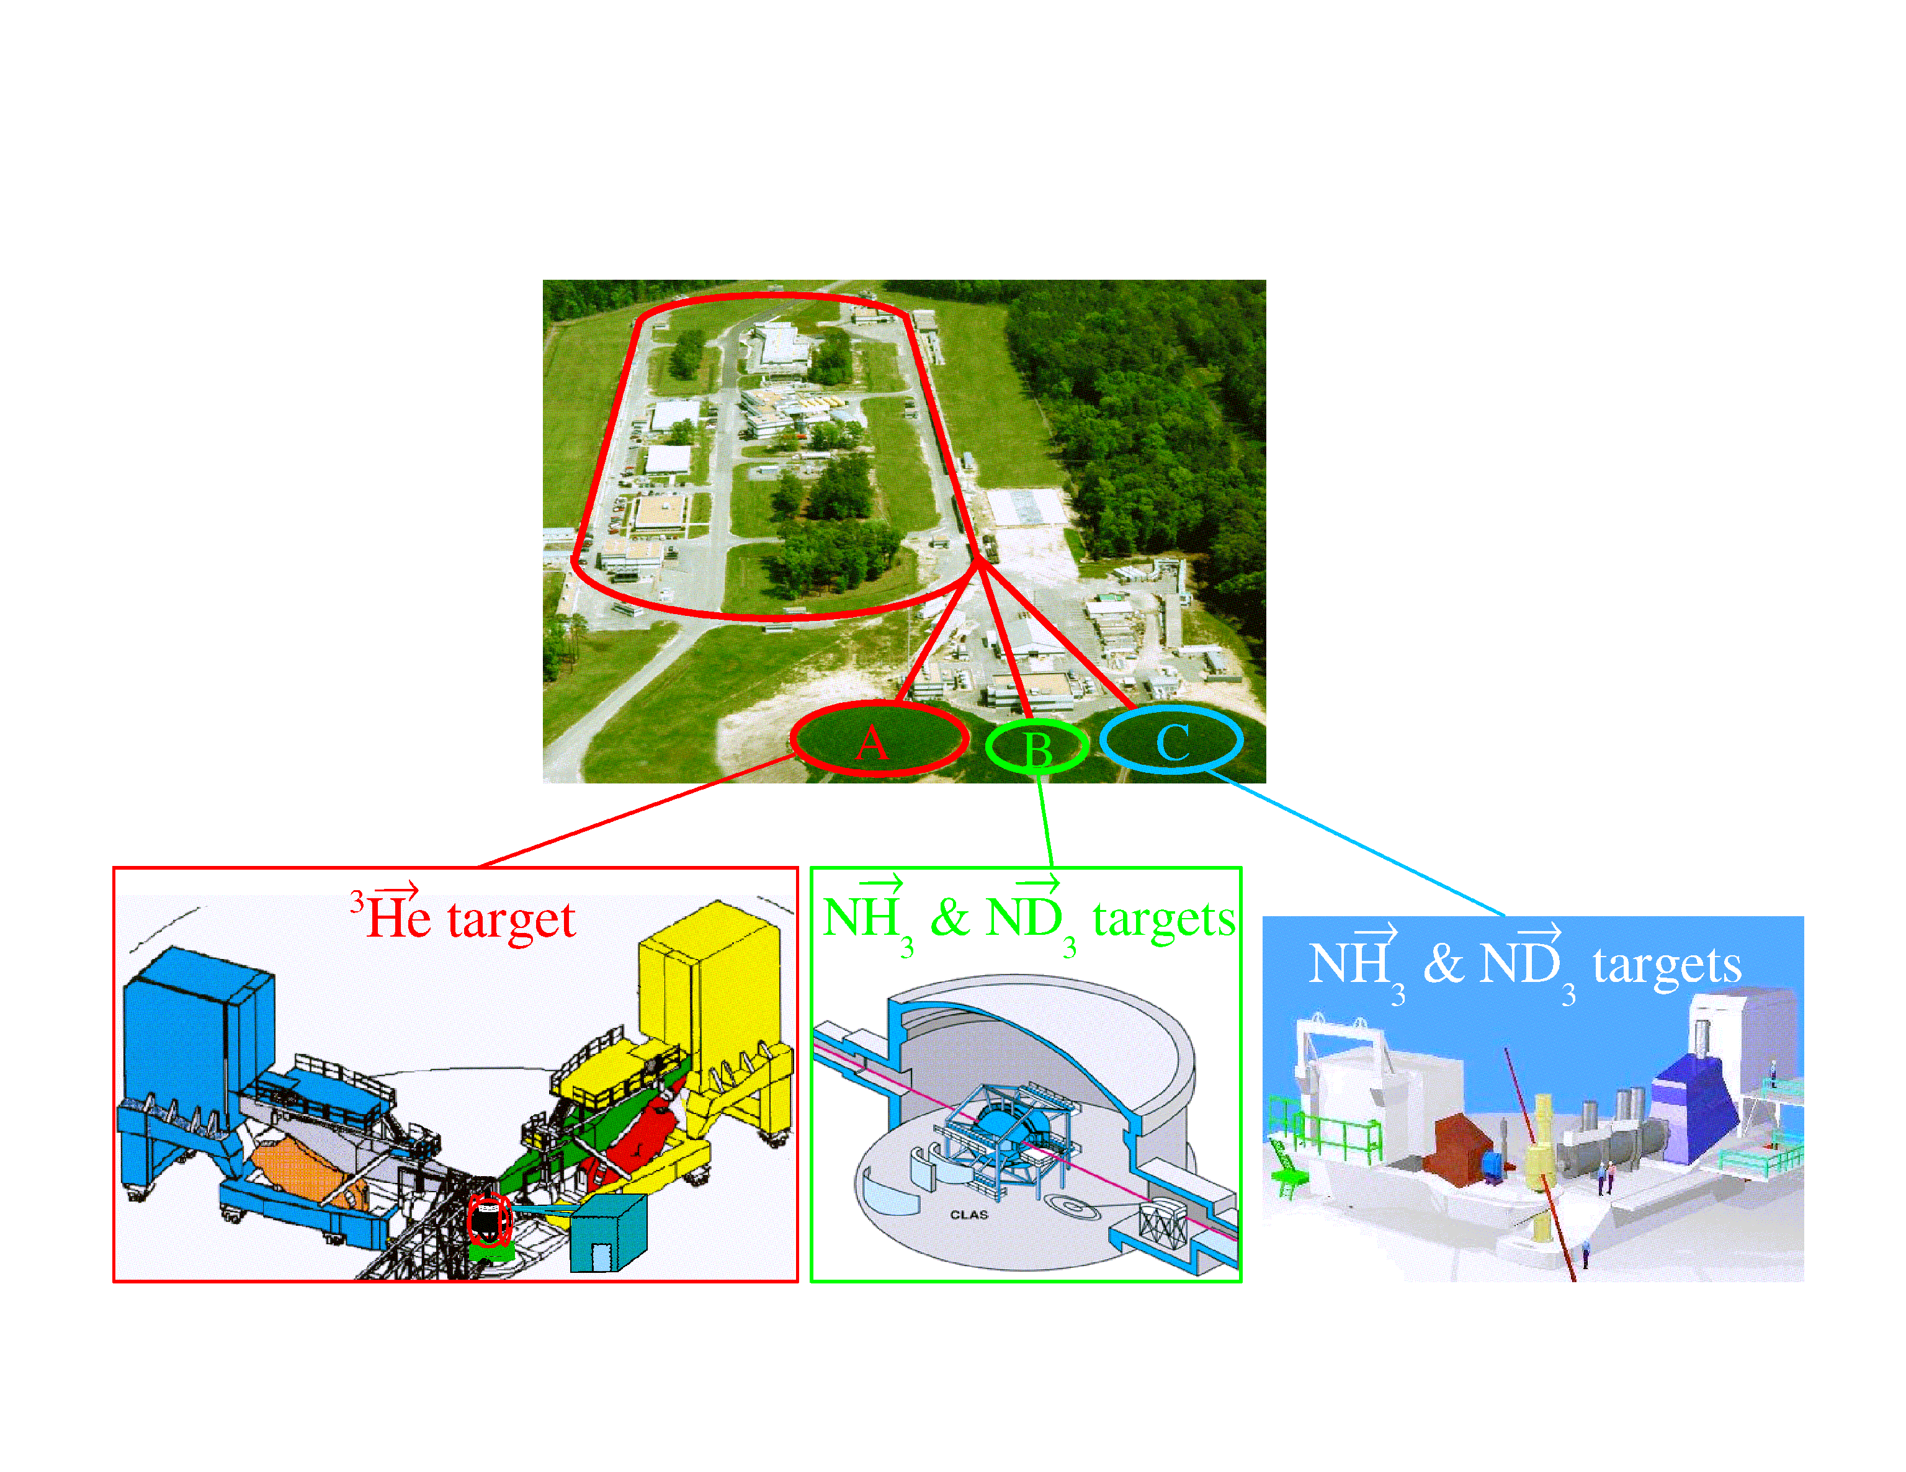
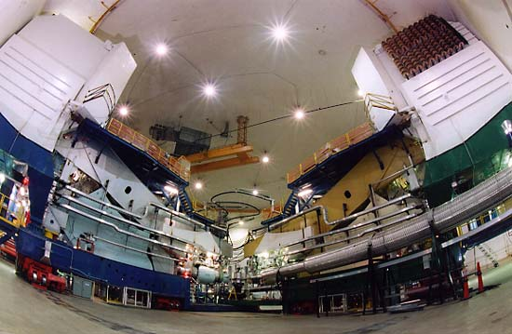
Jefferson Lab – 6 GeV CEBAF
Newport News, Virginia
Linear accelerator provides continuous polarized electron beam
  E_{beam} = 6 GeV
  P_{beam} = 85%
3 experimental halls
A, B and C
e⁻
A
B
C
Notes:
Jlab, blah...

Slide 9
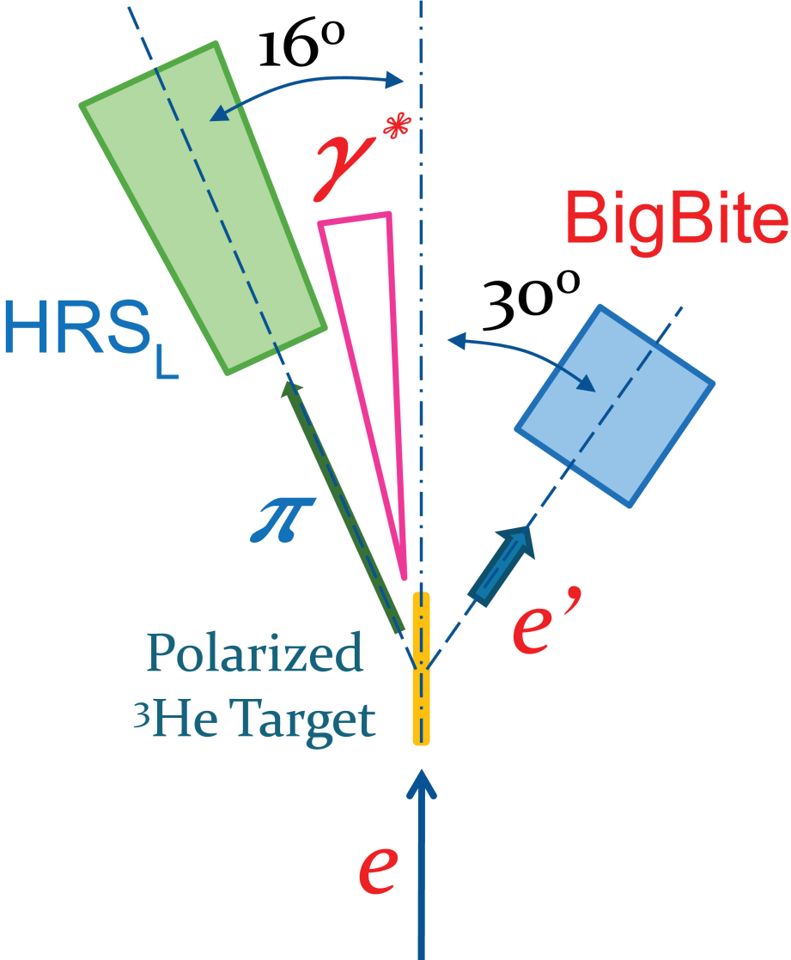
First exploring of TMD using polarized He-3 Target
Hall A E06‑010: 6-GeV Transversity Experiment
Successful data taking 2008-09
First results published
  Single spin: Qian PRL 107 072003 (2011)
  Double spin: Huang, PRL. 108, 052001 (2012)
Polarized electron beam
  With 30 Hz helicity reversal
Polarized ³He target
BigBite at 30º detect electron
  Dipole magnet, P_{e} = 0.6 ~ 2.2 GeV/c
  MWDC/shower-preshow/scitillator
  See talk: Yuxiang Zhao
HRS_{L} at 16º detect hadron
  QQDQ config, P_{h} = 2.35 GeV/c
  Scintillator/drift chamber/Cherenkov
  See talk: Yuxiang Zhao
Pion SIDIS result discussed in this talk. More results also see talk of Yuxiang Zhao
Luminosity
Monitor
Beam Polarimetry
(Møller + Compton)
Notes:
What’s new:
Neutron Target
Helicity Flip -> Cancel drift/cancel false asym.
Beam charge feed back -> PPM level Charge Asym

Slide 10
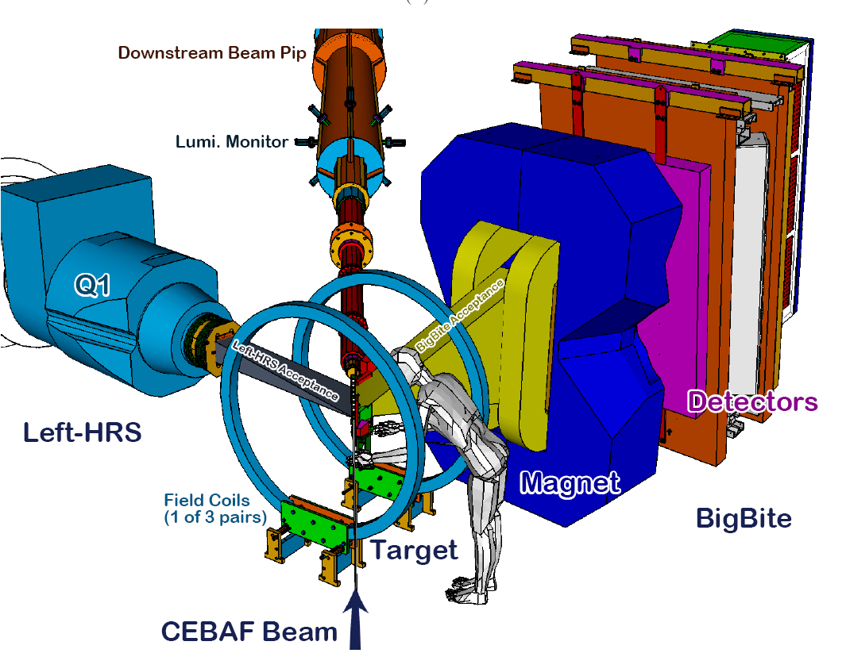
Experiment Setup
Rest of
Left-HRS
~25 m
Only Small Part of Left-HRS and He-3 Target is Shown

Slide 11
E06-010 (6-GeV Transversity) Collaboration
Institutions (38)
Univ. Kentucky, W&M, Duke Univ., CalTech, UIUC, Lanzhou Univ, California State Univ, Univ. Glasgow, MIT, CMU, JLab, ODU, UVa, Hampton Univ, INFN, Mississippi State Univ, Rutgers, Kharkov Inst. of Phys. and Tech., Los Alamos National Lab, Longwood Univ, Cairo Univ, Kyungpook National Univ, China Inst. of Atomic Energy, Kent State Univ, Univ. of Sci. & Tech. of China, Florida International Univ., Univ. Massachusettes, Temple Univ, Univ. Blaise Pascal, Univ. of New Hampshire, Syracuse Univ., Yerevan Physics Inst., Univ. Ljubljana, Seoul National Univ.
Collaboration members (115)
K. Allada, K. Aniol, J. R. M. Annand, T. Averett, F. Benmokhtar, W. Bertozzi, P. C. Bradshaw,
P. Bosted, A. Camsonne, M. Canan, G. D. Cates, C. Chen, J.-P. Chen, W. Chen, K. Chirapatpimol,
E. Chudakov, E. Cisbani, J. C. Cornejo, F. Cusanno, M. M. Dalton, W. Deconinck, C.W. de Jager,
R. De Leo, X. Deng, A. Deur, H. Ding, P. A. M. Dolph, C. Dutta, D. Dutta, L. El Fassi, S. Frullani ,
J. Huang, H. Gao, F. Garibaldi, D. Gaskell, S. Gilad, R. Gilman, O. Glamazdin, S. Golge, L. Guo,
D. Hamilton, O. Hansen, D.W. Higinbotham, T. Holmstrom, M. Huang, H. F. Ibrahim, M. Iodice,
X. Jiang, G. Jin, M. K. Jones , J. Katich, A. Kelleher, W. Kim, A. Kolarkar, W. Korsch, J. J. LeRose,
X. Li, Y. Li, R. Lindgren, N. Liyanage, E. Long, H.-J. Lu, D. J. Margaziotis, P. Markowitz, S. Marrone, D. McNulty, Z.-E. Meziani, R. Michaels, B. Moffit, C. Munoz Camacho, S. Nanda, A. Narayan,
V. Nelyubin, B. Norum, Y. Oh, M. Osipenko, D. Parno, J. C. Peng, S. K. Phillips, M. Posik,
A. J. R. Puckett , X. Qian, Y. Qiang, A. Rakhman, R. D. Ransome, S. Riordan, A. Saha, B. Sawatzky,
E. Schulte, A. Shahinyan, M. H. Shabestari, S. Sirca, S. Stepanyan, R. Subedi, V. Sulkosky, L.-G. Tang, A. Tobias, G. M. Urciuoli, I. Vilardi, K.Wang, Y. Wang, B.Wojtsekhowski, X. Yan, X.F. Yan, H. Yao, Y. Ye, Z. Ye, L. Yuan, X. Zhan, Y. Zhang, Y.-W. Zhang, B. Zhao, Y. X. Zhao, X. Zheng, L. Zhu, X. Zhu, and X. Zong
Co-spokesperson , Graduate student, Leading Postdoc
Notes:
36 institutes, 115 collaboration members around world, including co spokes person, graduate student and leading PD
We also received excellent theory supports from leading theorist in this field, especially from the theory center at Jefferson Lab, including Dr. A. Prokudin, Dr. A. Bacchetta, Dr. B. Musch.

Slide 12
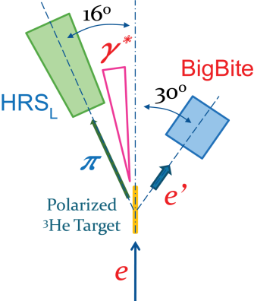
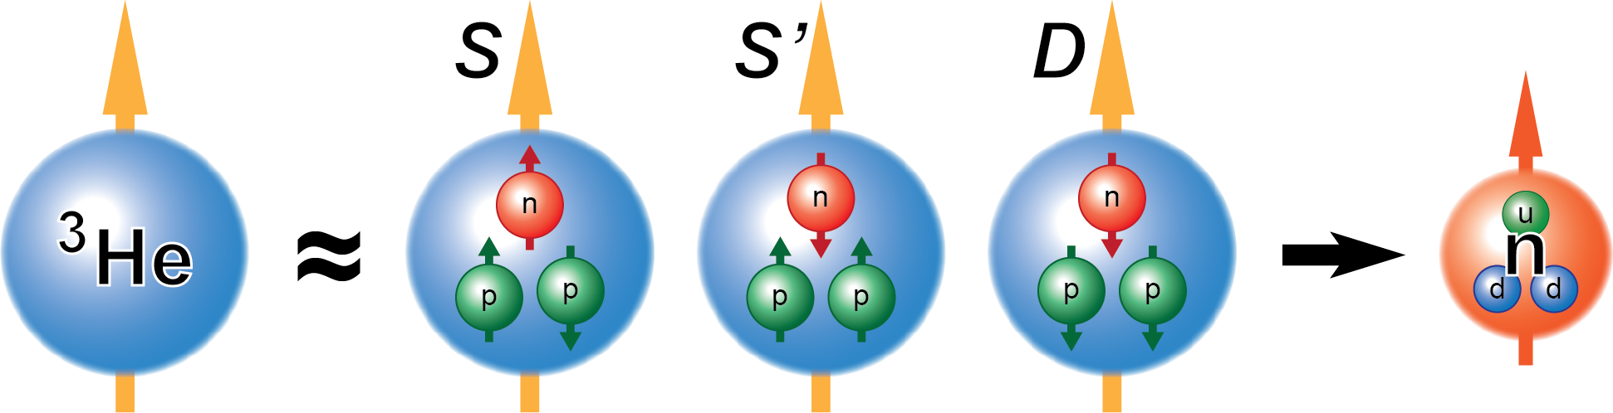
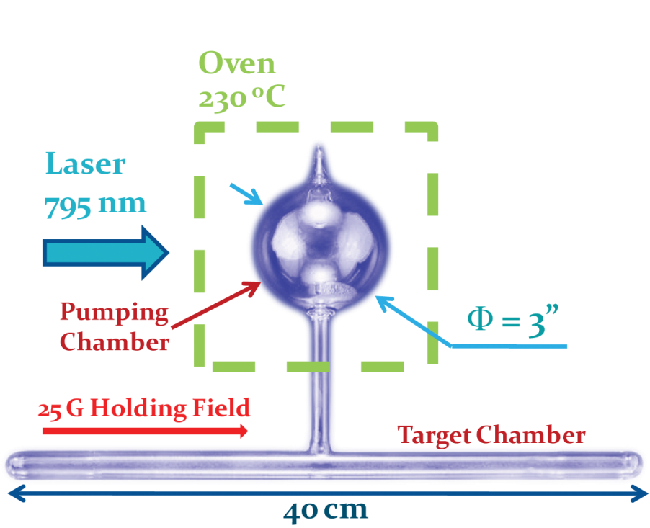
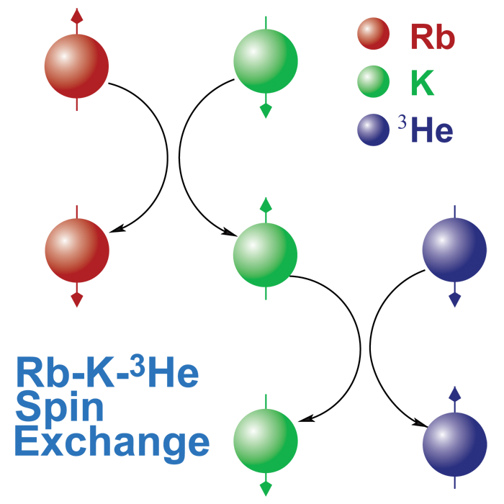
Polarized ³He Target
Luminosity
Monitor
High Luminosity polarize target: L(n) = 10³⁶ cm⁻² s⁻¹(achieved), 10³⁷ cm⁻² s⁻¹ (R&D)
Compact size: No cryogenic support needed
Proton dilution measured experimentally
Beam
Polarimetry
~90% ~1.5% ~8%
³He
Cell
Beam
Notes:
Technical break through 1: hybrid cell

Slide 13
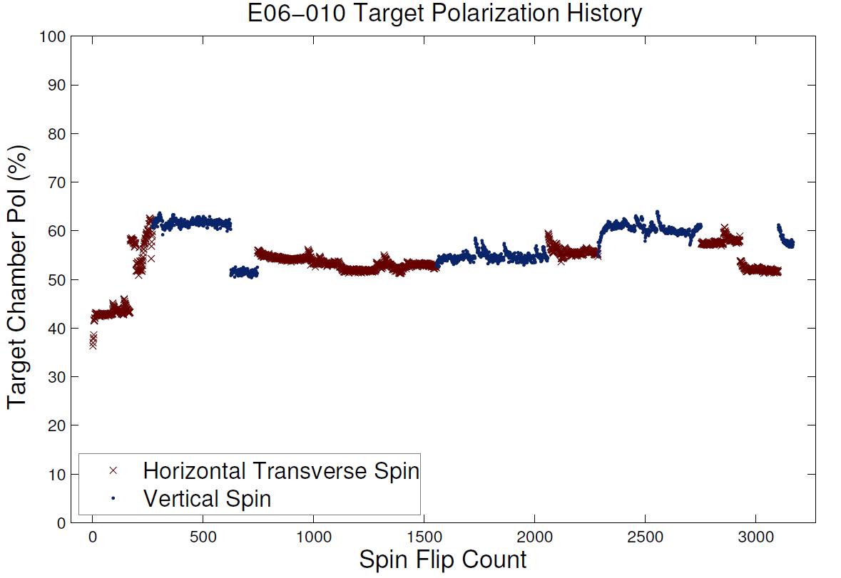
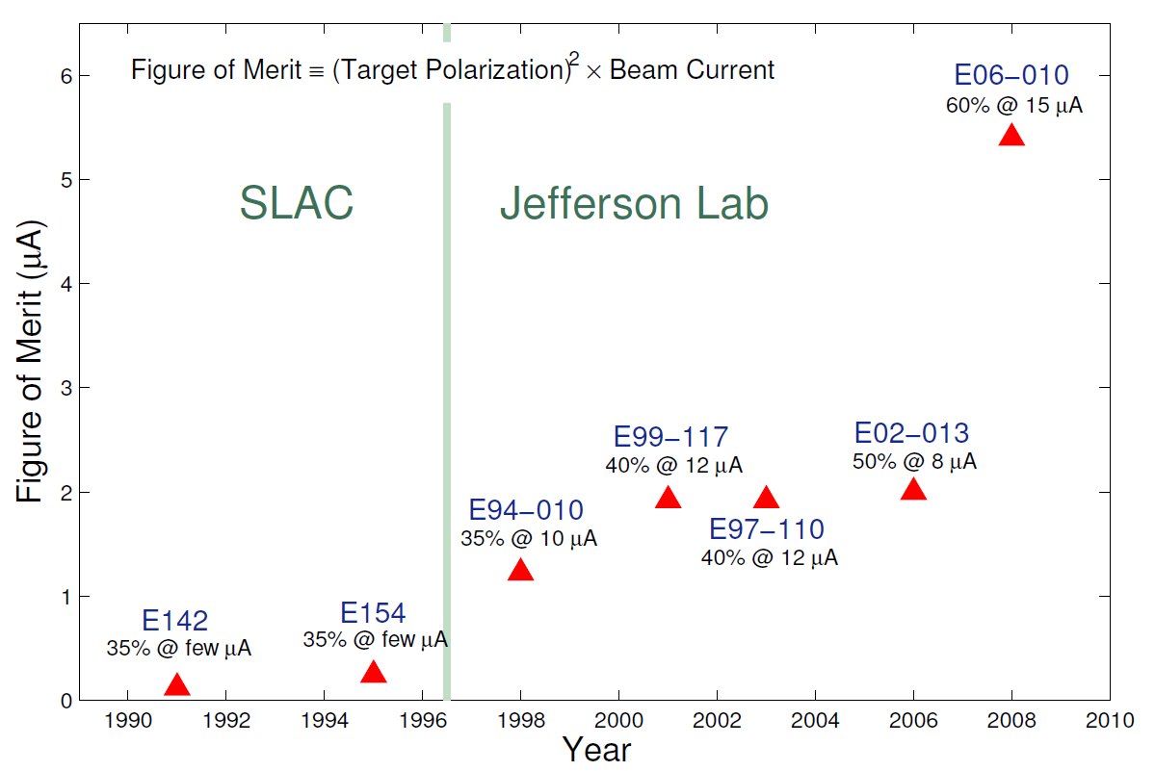
Performance of ³He Target
Luminosity
Monitor
High luminosity: L(n) = 10³⁶ cm⁻² s⁻¹
Record high 50-65% polarization in beam with automatic spin flip / 20min
<P> = 55.4% ± 0.4% (stat. per spin state) ± 2.7 % (sys.)
Beam
Polarimetry

Slide 14
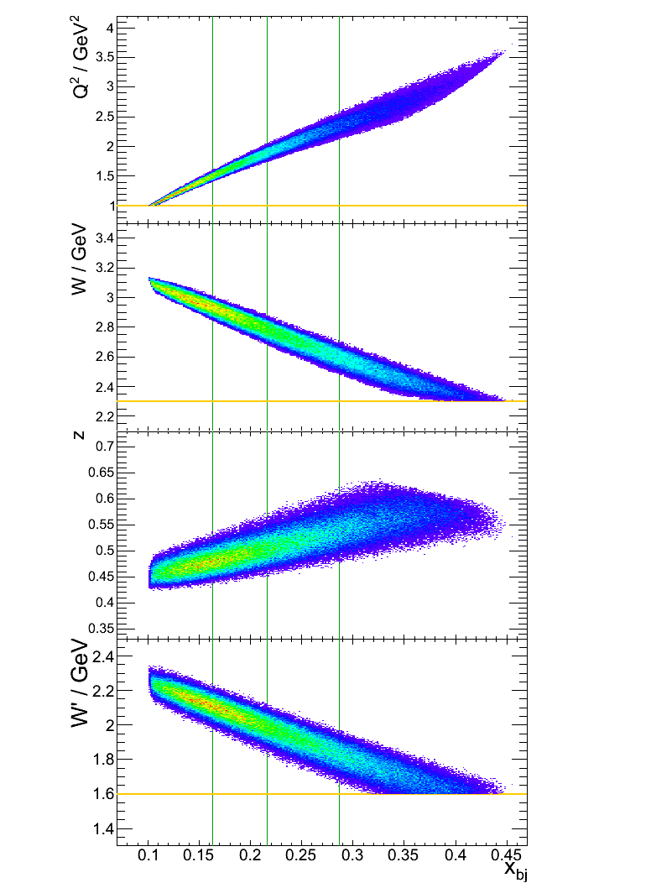
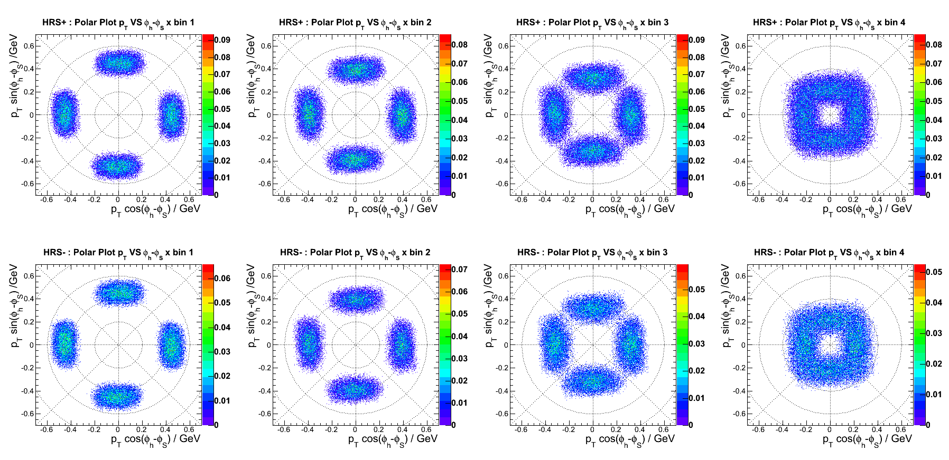
x bin 1
2
3
4
Scattering Plane
Q²>1GeV²
x bin 1
x bin 2
W>2.3GeV
Two team cross check on asymmetry analysis
Independent code and method
Red team: one step MLE
Blue team: bin-by-bin asymmetry in local spin pairs, azimuthal fit
Cross check result for both SSA and DSA
x bin 3
x bin 4
z=0.4~0.6
W’>1.6GeV
Kinematics coverage
p_{T} & ϕ_{h}- ϕ_{S} coverage
Notes:
Finite Acceptance, But w/ Spin Flip -> Larger one

Slide 15
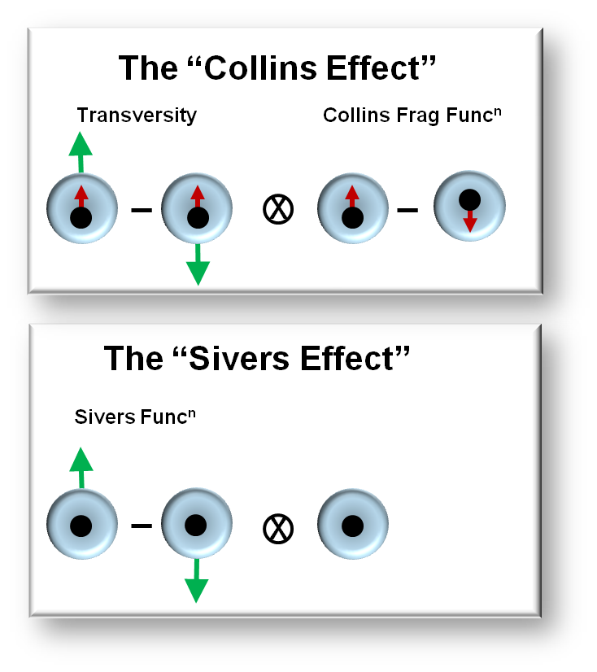
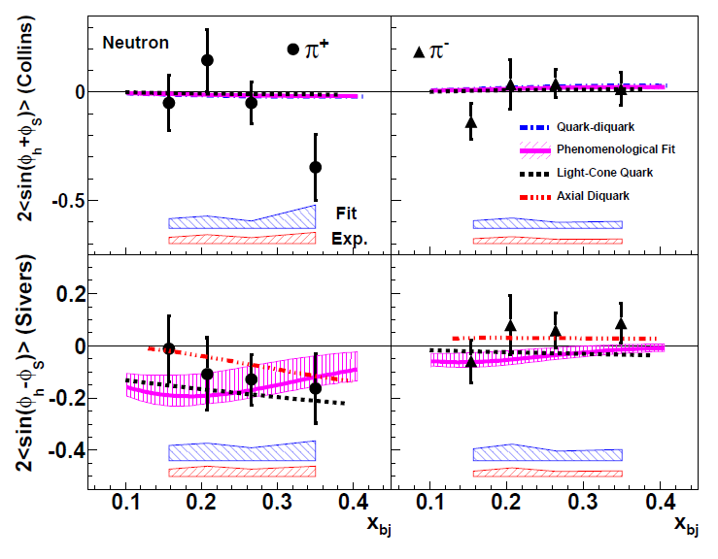
SSA Results on Neutron
X. Qian PRL 107 072003 (2011)
Sizable Collins π⁺ asymmetries at x=0.34?
  Sign of violation of Soffer’s inequality?
  Data are limited by stat. Needs more precise data!
Negative Sivers π⁺ Asymmetry
  Consistent with HERMES/COMPASS
  Independent demonstration of negative d quark Sivers function.
Model (fitting) uncertainties shown in blue band.

Slide 16
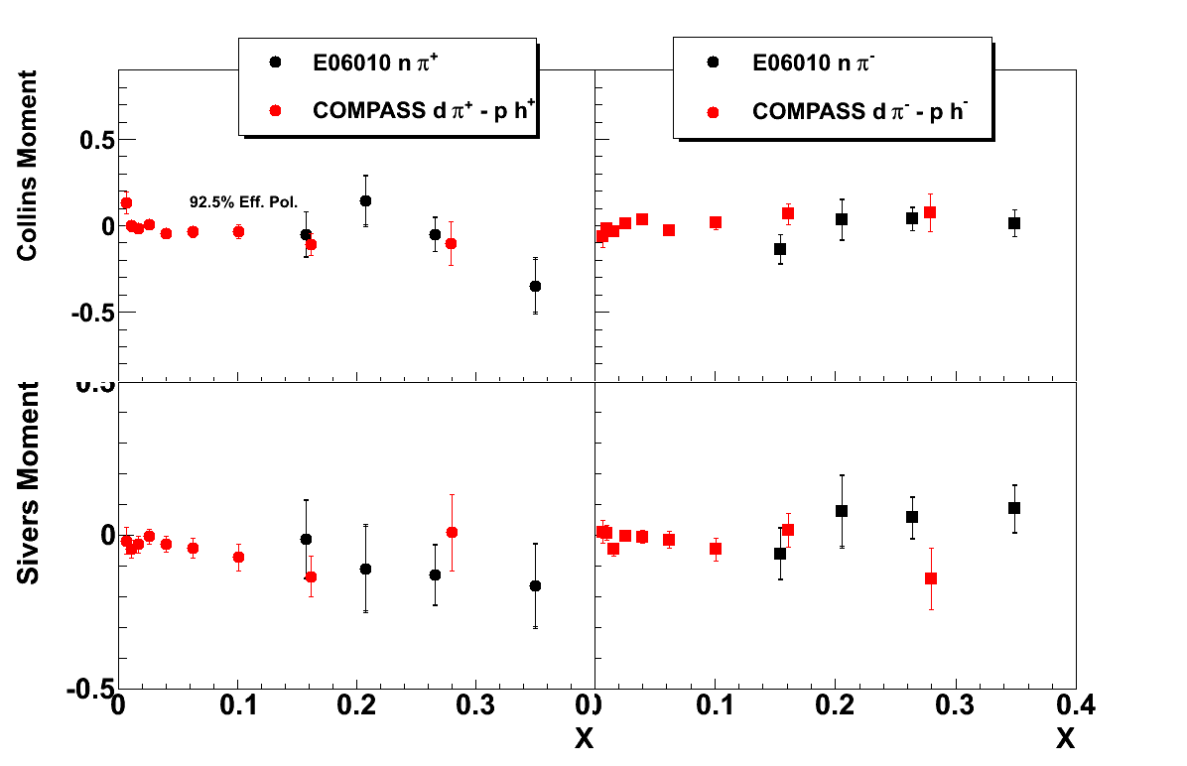
Best Measurements on Neutron at High x

Slide 17
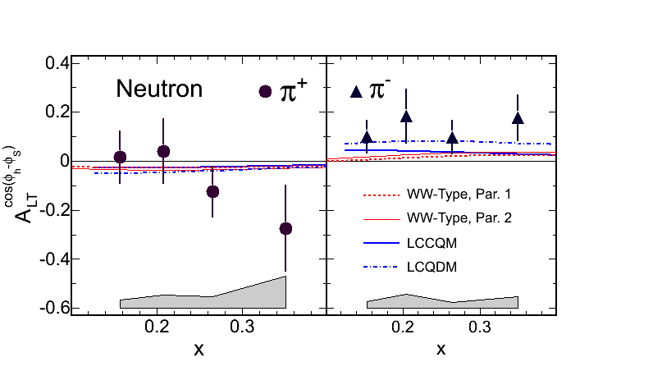
Neutron A_{LT} and Trans-Helicity g_{1T}
Huang, et. al. PRL. 108, 052001 (2012)
Access
Dominated by real part of interference between
L=0 (S) and L=1 (P) states
  Imaginary part -> Sivers effect
No GPD correspondence
Measured by COMPASS and HERMES on p and D targets
g_{1T} =
E06-010 - First data on effectively neutron target
Consistent with models in signs
Suggest larger asymmetry, possible interpretations:
  Larger quark spin-orbital interference
  different P_{T} dependence
  larger subleading-twist effects
Notes:
Thank theorist for supports

Slide 18
Next on-target : 12 GeV Upgrade Project
Upgrade is designed to build on existing facility: vast majority of accelerator and experimental equipment have continued use
New Hall
Add 5 cryomodules
Upgrade arc magnets
and supplies
CHL upgrade
Maintain capability to deliver lower pass beam energies:
2.2, 4.4, 6.6….
20 cryomodules
Add arc
20 cryomodules
Add 5 cryomodules
Scope of the project includes:
Doubling the accelerator beam energy
New experimental Hall and beamline
Upgrades to existing Experimental Halls
Beam in 2014
Enhanced capabilities
in existing Halls

Slide 19
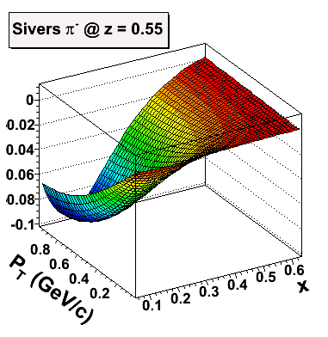
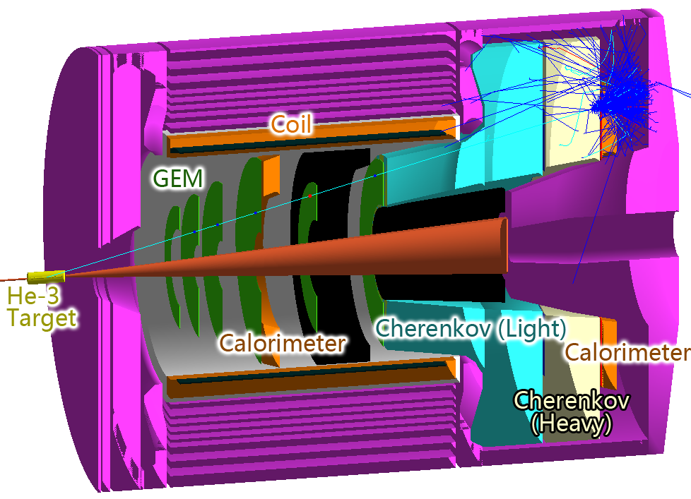
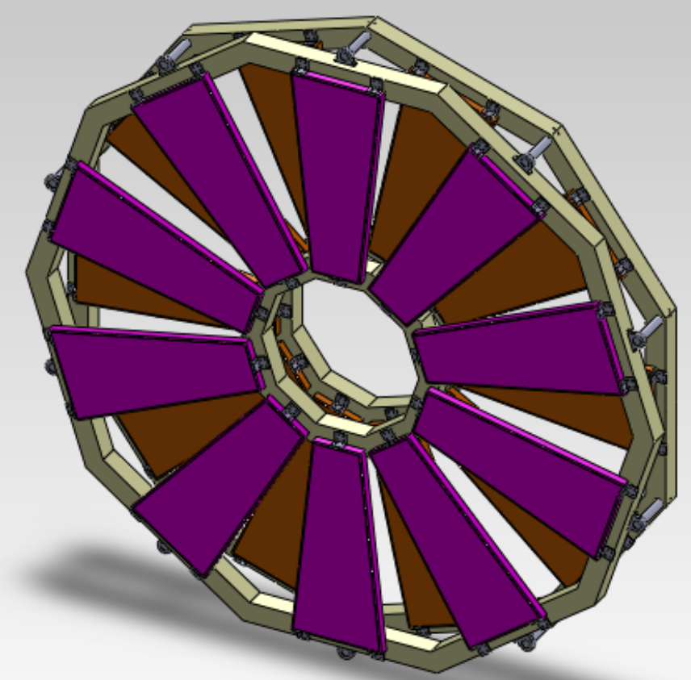
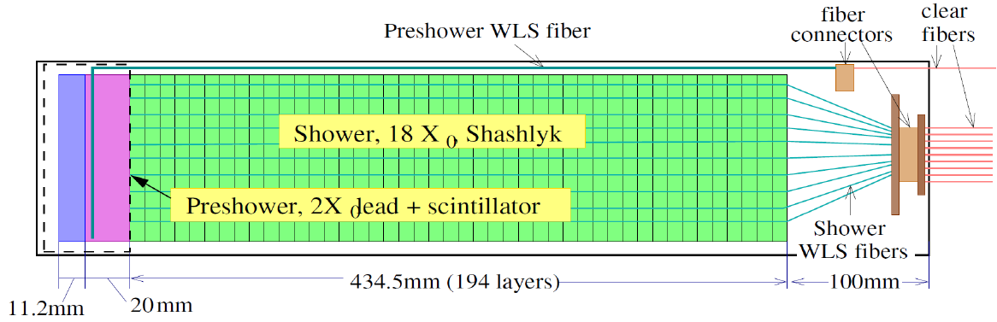
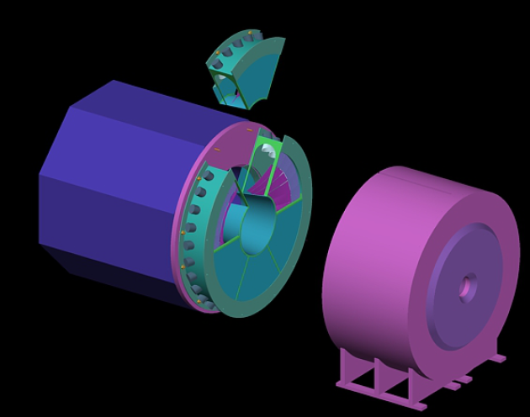
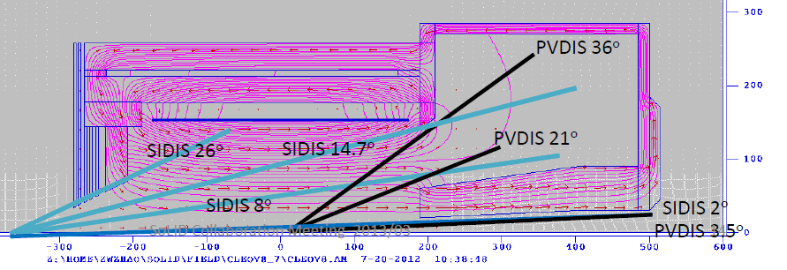
Key Device for High-Precision SIDIS measurement
The SoLID Spectrometer proposed for Hall A
Key device to achieve high-precision mapping and minimizing systematics
Strong Chinese collaboration in hardware interest and theory inputs
High Luminosity target and upgraded beam energy -> 12 GeV
Large acceptance: enable 4D-mapping of asymmetries, minimize systematics
Coherent physics program with three SIDIS experiment, a parity-violation DIS exp. and more experiment coming
  See talk: Jianping Chen, Zhiwen Zhao
Two readout layer
12 stereo angle
0.4-0.6 mm pitch
courtesy: N. Liyanage (UVa)
/proton
Calorimeter module design
E12-10-006: 90 day
Single Spin Asymmetry on Transverse ³He
E12-11-007: 30 day
Single and Double Spin Asymmetry on ³He
E12-11-108: 120 day
Single and Double Spin Asymmetries on Transverse Proton
Field simulation – CLEO II magnet
courtesy: Z. Zhao (UVa)
Tank and support design for
Light gas Cerenkov detector
π/e sep. to 3GeV/c
courtesy: M. Paolone (Temple)
Notes:
! Similar as PVDIS, outside target, forward angle, Pion PID
! Forward, electron + hadron ID

Slide 20
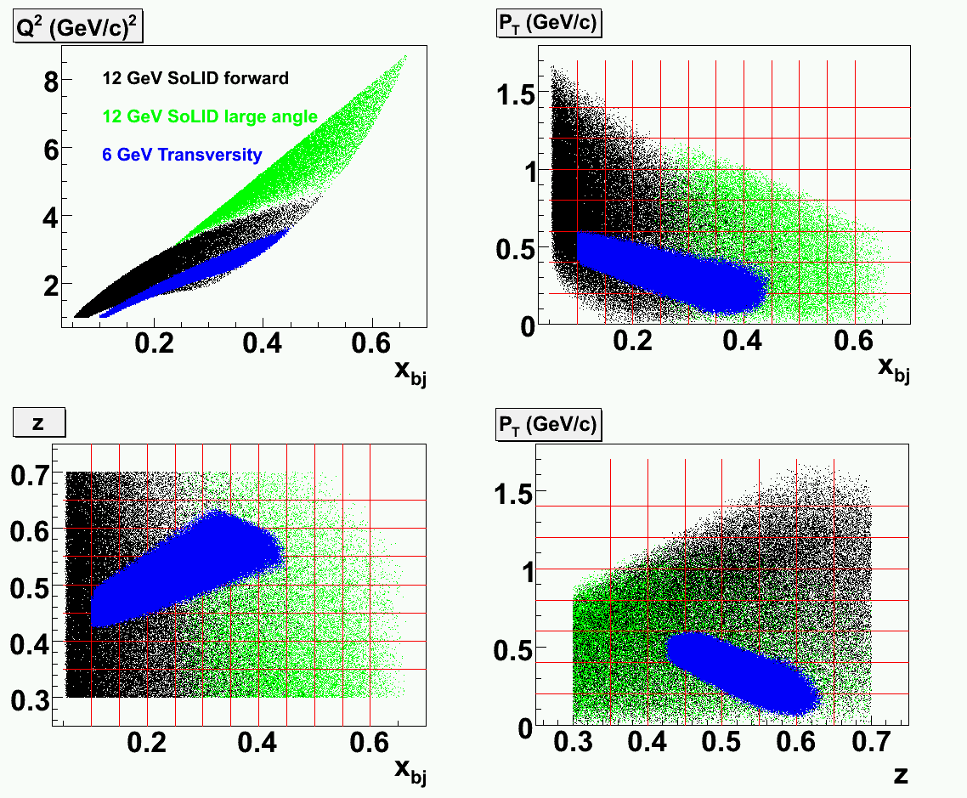
Phase space coverage
Natural Extension of E06-010
Much wider phase space
  Also data at low and high z value to access target frag. and exclusive channels.
Both transverse and longitudinal polarized target: 6/7 polarized leading twist TMDs Studied

Slide 21
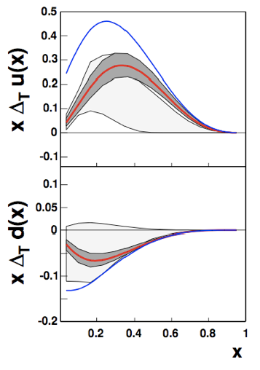
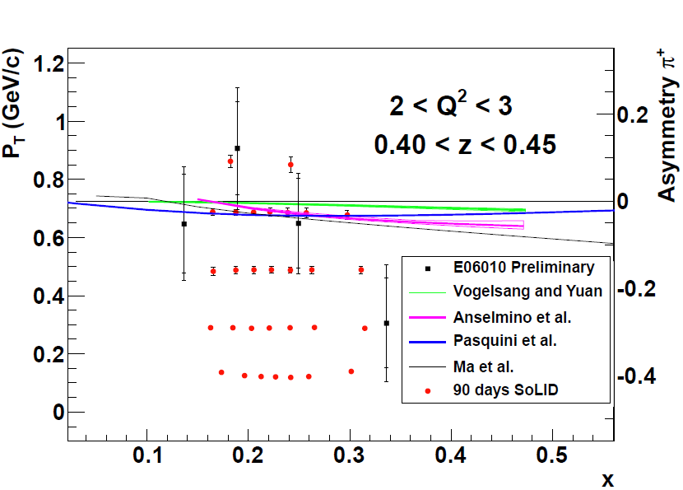
Transversity
h_{1T} =
The third PDFs in addition to f₁ and g_{1L}
10% quark tensor charge (both u and d!) from both SSA data
  Fundamental property, benchmark test of Lattice QCD
Neutron Projections, 1/48 z-Q^2 bins
6 GeV Data
PRL. 107 (2011) 072003
Test bond
violations
Proton data also planned

Slide 22
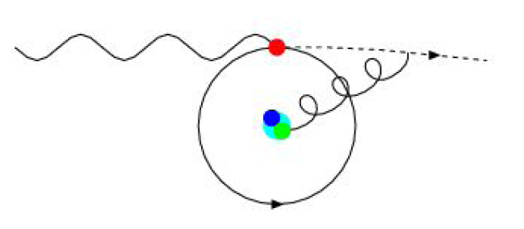
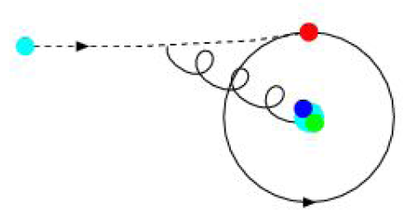
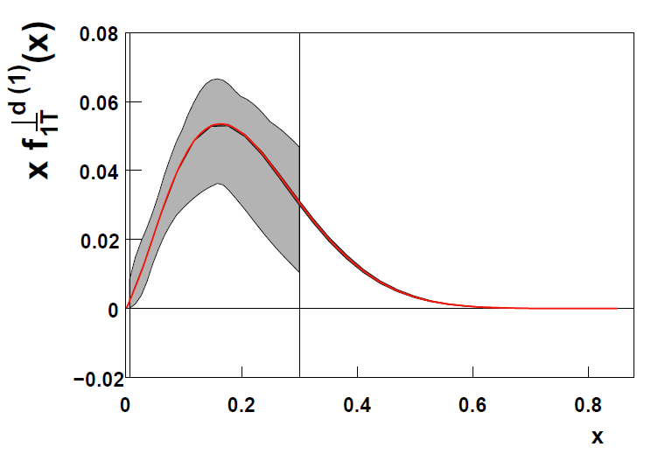
Sivers Effect
Correlation between nucleon spin with quark angular momentum
Naïve T-odd final state interaction -> Target SSA
Important test for TMD factorization
Relation with twist-3 quark-gluon corr. and RHIC measurements
Courtesy to M. Burkardt
Neutron Projection , 1/48 z-Q^2 bins
6 GeV Data
PRL. 107 (2011) 072003
x
More than precision :
Also study shape in muti-D kine space
Proton data also planned

Slide 23
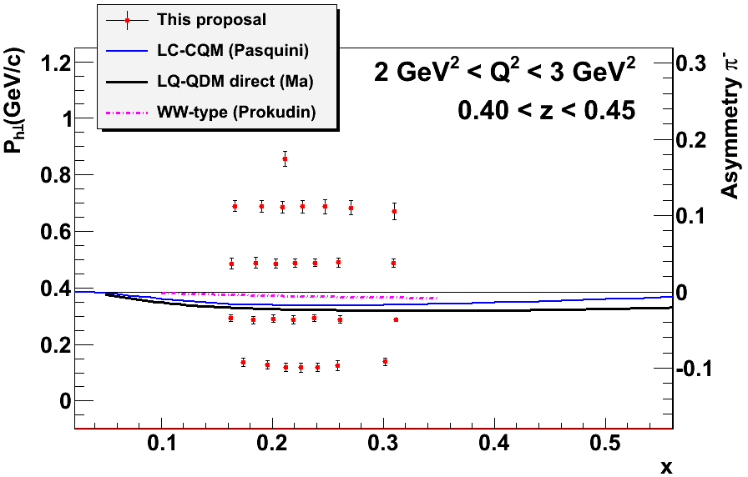
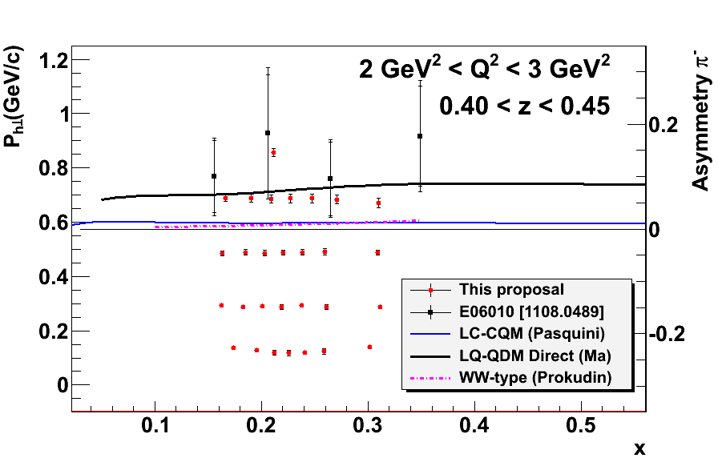
Worm-gear functions
h_{1L}⊥ =
g_{1T} =
h_{1L}^{⊥(1)}
Dominated by real part of interference
between L=0 (S) and L=1 (P) states
No GPD correspondence
Lattice QCD -> Moments of worm-gear TMDs
Model Calculations -> h_{1L}⊥ =? -g_{1T}
Connections with Collinear PDFs through WW approx. and LIR.
P-D int.
S-P int.
Neutron Projections, 1/48 z-Q^2 bins
6 GeV Data
arXiv:1108.0489
First Neutron Data !!

Slide 24
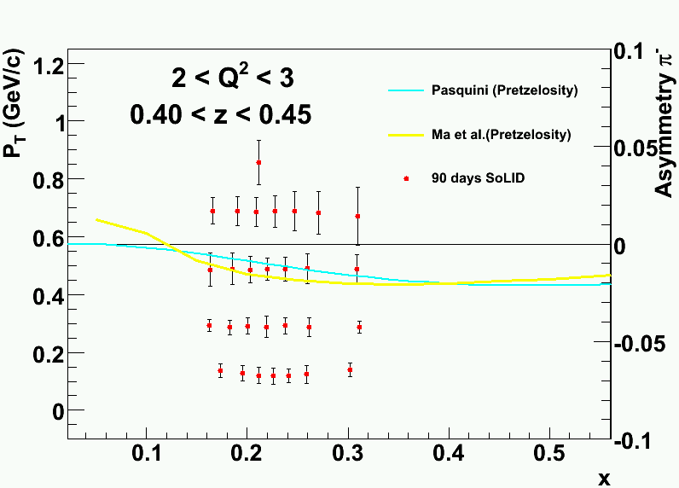
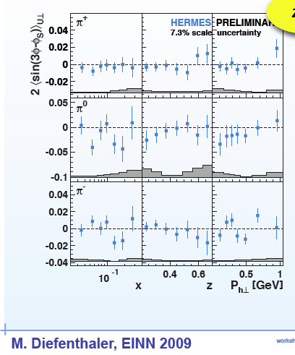
Pretzlosity:
h_{1T}⊥ =
Relativistic effect of quark , PRD 78, 114024 (2008)
(in models) direct measurement of OAM, PRD 58, 096008 (1998)
Expect first non-zero Pretzelosity asymmetries
Neutron Projection, 1/48 z-Q^2 bins
Proton data also planned

Slide 25
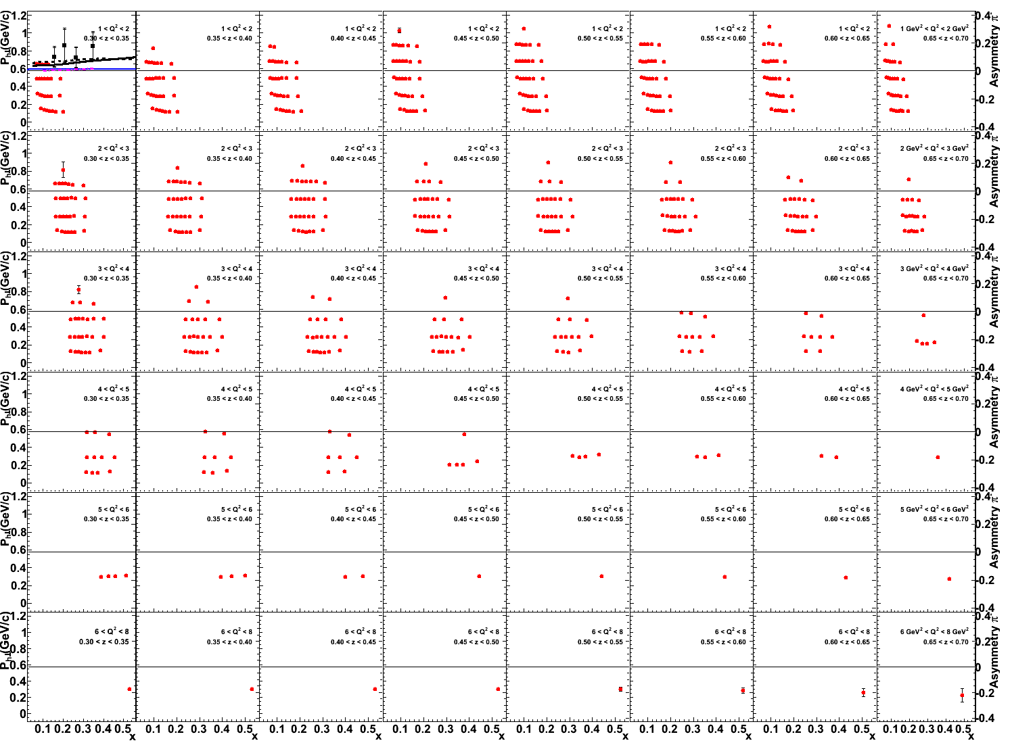
E12-11-007 Full projection, neutron A_{LT}
Satisfying the multi-D natural of this study
z= 0.3~0.7
x_{bj}
data point: Projection for neutron A_{LT} of π⁻
P_{h⊥} (GeV/c)
Q² = 1~8 GeV²

Slide 26
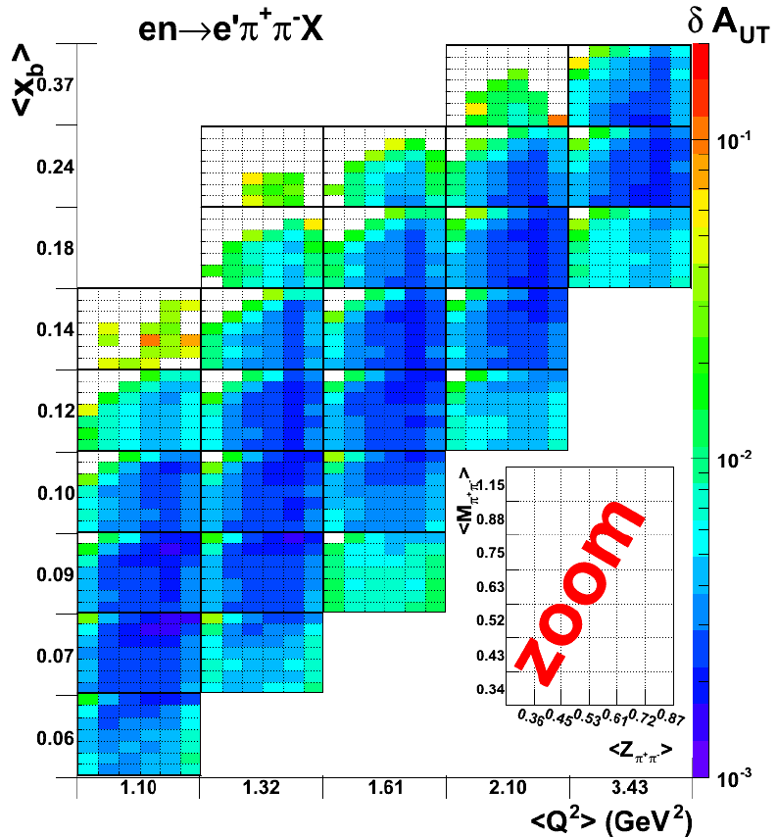
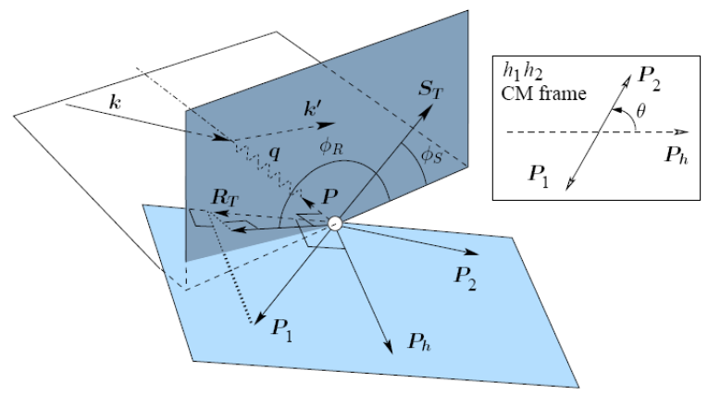
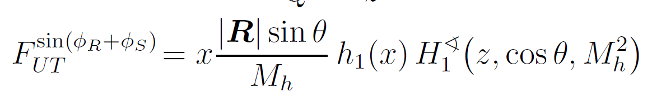
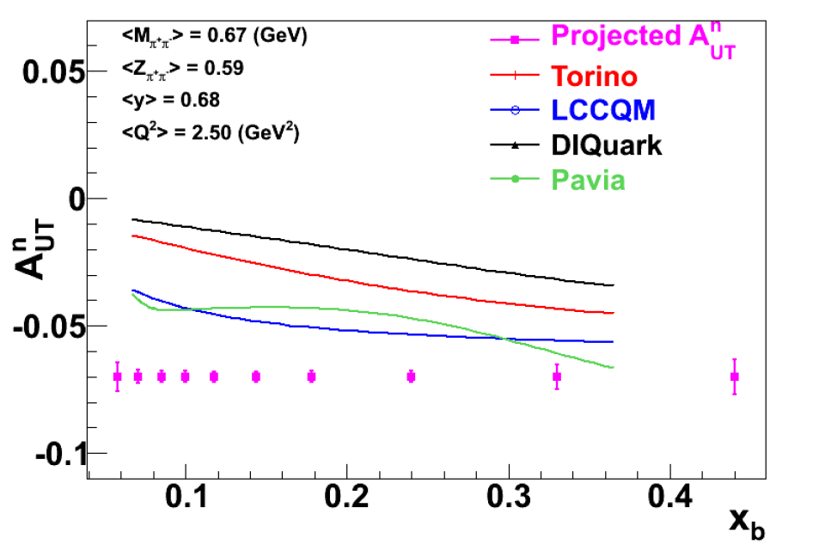
New : LOI – Dihadron in DIS on ³He
Access transversity in transversely polarized neutron target through π⁺ π⁻ di-hadron production
Run simultaneously with SIDIS ³He (e,e’π±)X
Systematical check of two approaches to access h₁
Asymmetry projection for one M-z bin

Slide 27
Summary
First polarized SIDIS results from ³He published
  World best polarized ³He target, as effective polarized neutron target
  Single spin asymmetry probe Sivers and Transversity
    Best constraint on high-x world data on neutron
  Double spin asymmetry probes Trans-helicity
    Suggest non-zero effect and Re[(L=0)_{q} × (L=1)_{q}]
Next generation program with 12GeV CEBAF and SoLID
  SoLID: a key device for high precision mapping of of SIDIS asymmetry
  Access six out of eight leading twist TMD fuctions
  Comprehensive study of spin-orbital correlations
Sivers
Transversity
Trans-helicity

