Slide 1
EIC Update / BNL Perspective
Steve Vigdor
EICAC Meeting
April 10, 2011
EIC-related developments at BNL since last EICAC meeting
New eRHIC design
EIC detector R&D program
Timeline of preparations for next LRP
Response to recommendations from last EICAC meeting
Charge for this EICAC

Slide 2
EIC Developments Since November 2009 EICAC Meeting
Revised eRHIC staging design in response to user demand for additional order of magnitude in luminosity, and DOE feedback to keep Total Project Cost to ~$500M (⇒ reuse existing detector infrastructure)
Launched targeted LDRD program to advance S&T planning for eRHIC
Attracted initial (~$1.5M) ONP funds for dedicated EIC accelerator R&D – for Coherent electron Cooling demo, jointly with JLab and Tech-X
Organized a number of conference sessions and workshops, culminating with 2-month Institute for Nuclear Theory program in Fall 2010
Launched generic EIC detector R&D program with RHIC funding, to engage more of experimental user communities – 1st proposals by April 4
Got consideration of eSTAR, ePHENIX upgrades in new (Fall 2010) Decadal Plans, and organized March 2011 eRHIC detector coordination workshop
Notes:
2

Slide 3
eRHIC Design Under Active Consideration
RHIC: 325 GeV p or 130 GeV/u Au with DX magnets removed
Vis-à-vis earlier MeRHIC design, this allows for:
more IP’s
reduced cost
reusing infrastructure + det. components for STAR, PHENIX
easier upgrade path from 5 GeV eRHIC-I
minimal environmental impact concerns
IR design to reach 10³⁴ luminosity

Slide 4
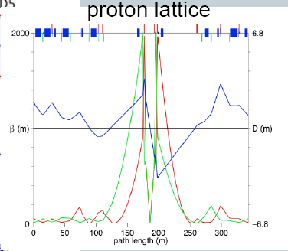
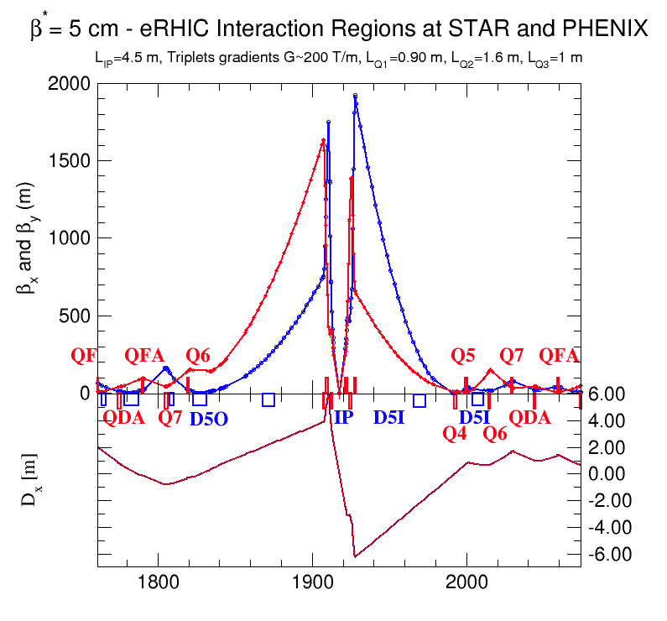
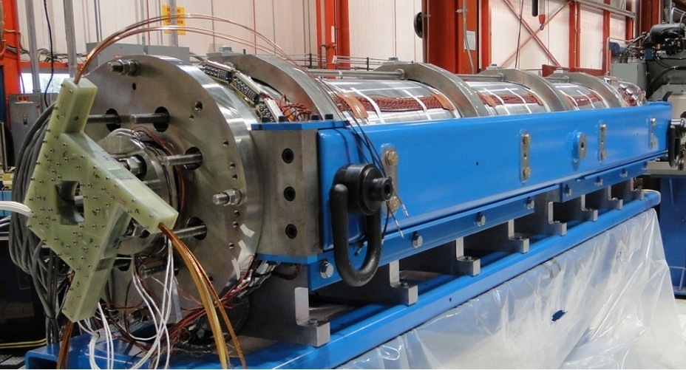
eRHIC IRs, β*=5cm, l*=4.5 m
Integrated with “new” detector design. Field-free electron pass thru hadron triplet magnets ⇒ minimal SR background.
Star detector
©Dejan Trbojevic
IR combined function magnet design
325 GeV p beam
0.45 m
10 mrad, with crab crossing
Up to 30 GeV e⁻ beam
90.m
Spin-Rotator
Nb₃Sn
325 GeV p beam
200 T/m
Exploit LARP development of Nb₃Sn SC quads with 200 T/m gradient
L=1.4x10³⁴cm⁻²s⁻¹, 200 T/m gradient
Notes:
We took advantage of recent achievement by LARP researches demonstrated SC quads with 200 T/m gradient and designed IR with 5 cm beta* for eRHIC. To avoid SR problem, we do not bend electrons before the detector an have 10 mrad crab-crossing. Bret Parker has preliminary design of such quad with pass of electron beam through its yoke
Note that we blew transverse dim x100 fold to make it visible
4

Slide 5
Strong BNL LDRD+PD Support for eRHIC Programs
Activity/Project (Blue=Accel. + Det. R&D; Red=EIC Science Case) | Total Cost | FY10 | FY11 est. | FY12 est. | FY13 est.
EIC Polarized Electron “Gatling” Gun | $810K (LDRD) | $128K | $382K | $300K
Laser System for Polarized Electron Source Photocathode | $430K (LDRD) | $225K | $205K
FEL-Based Coherent Electron Cooling | $414K (LDRD) | $95K | $319K
Study of FEL Options for eRHIC | $384K (LDRD) |  | $205K | $179K
Upgrade of IP2 Cryosystem for Coherent Electron Cooling Test | $2152K (Prog. Dev.) |  | $648K | $817K | $687K
CMOS Pixel Vertex Detector for EIC | $607K (LDRD) |  | $199K | $202K | $206K
Getting to Know Your Constituents: Studies of Partonic Matter at EIC | $413K (LDRD) | $167K
Realization of e+A Physics Event Generator for the EIC | $384K (LDRD) | $158K | $137K | $89K
Signatures of Saturation and Uni-versality in e+A Collisions at eRHIC | $423K (LDRD) | $79K | $191K | $153K
Electroweak Physics with an Electron-Ion Collider | $369K (LDRD) | $203K | $166K
Exploring the Role of Glue in Hadron Structure by an EIC | $597K (LDRD) |  | $191K | $202K | $204K

Slide 6
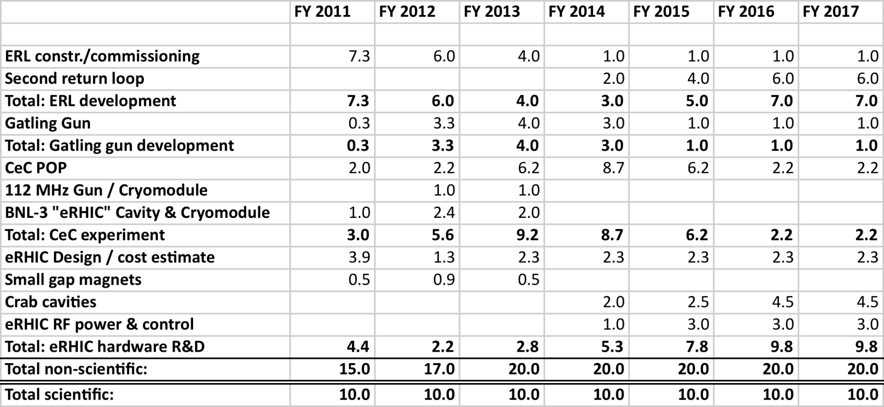
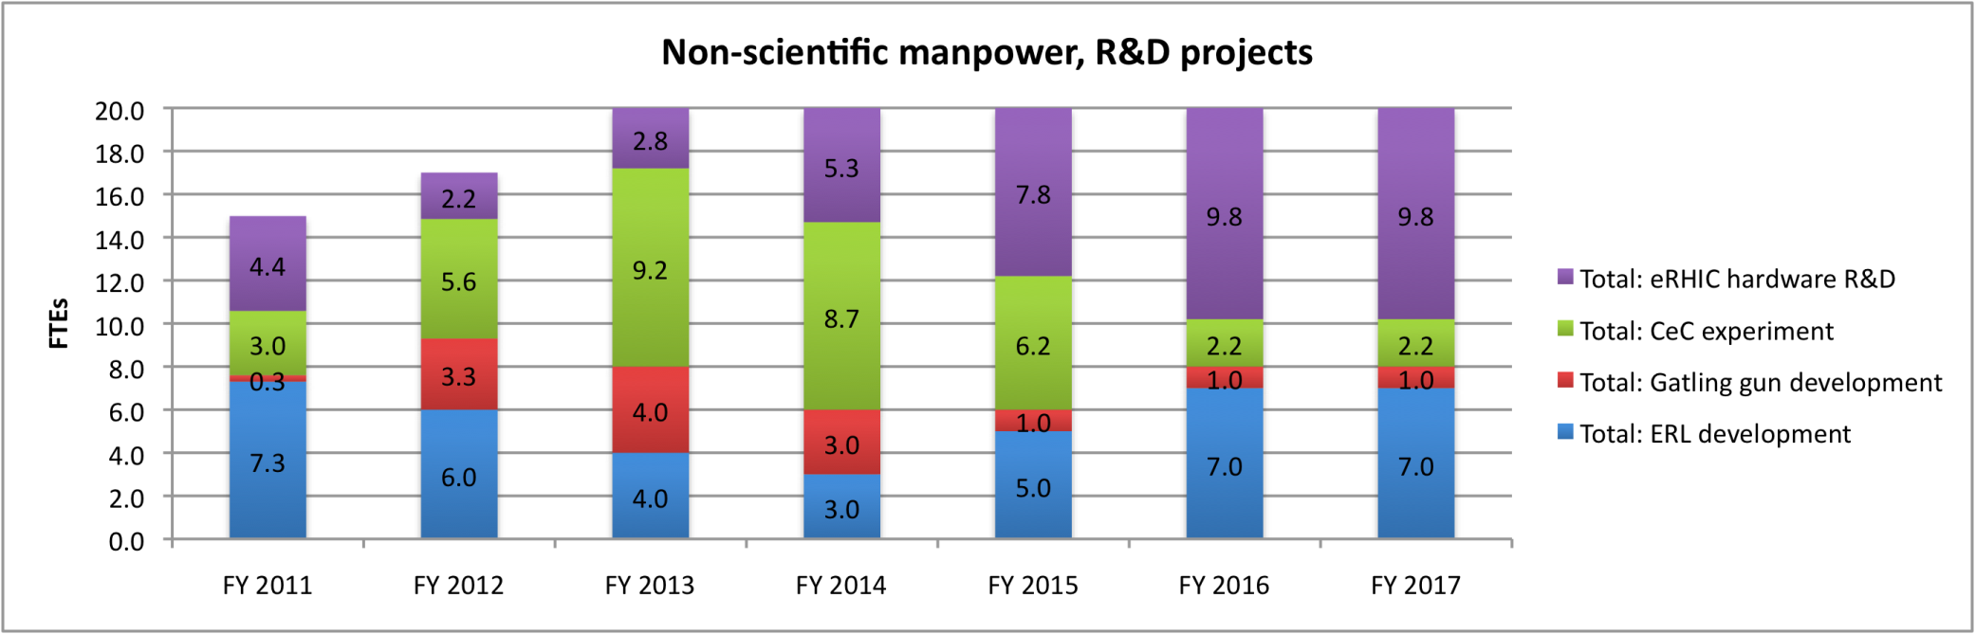
EIC Accelerator R&D Requires a Major Long-Term Commitment
4 major EIC R&D projects @ BNL require ~ 30 FTE to be ready for CD-2 by ~2017
Notes:
6

Slide 7
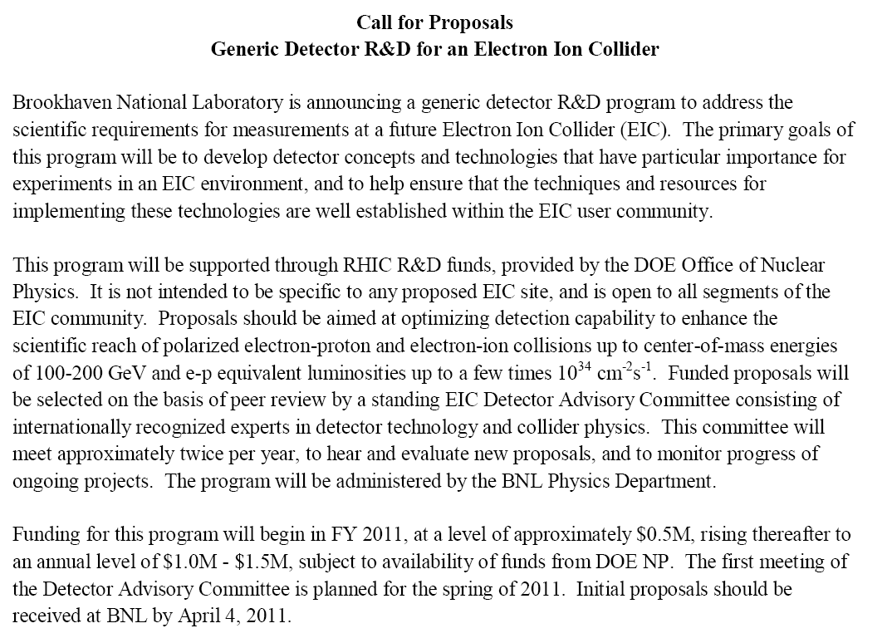

Slide 8
EIC Detector R&D Advisory Committee
Ian Shipsey, Purdue, Chair
Marcel Demarteau, ANL
Robert Klanner, DESY
Rick Van Berg, U. Penn.
Jerry Va’vra, SLAC
Howard Weiman, LBNL
Glenn Young, JLab
5 proposals + 1 Letter of Intent received so far for 1st meeting:
Development of a new detector technology for fiber sampling calorimeters for EIC and STAR
PI: H. Huang Institutes: UCLA, Texas A&M, Penn State Univ.
Front end readout module for detector data acquisition and trigger system
PI: C. Cuevas Institutes: Jefferson Lab.
DIRC-based PID for the EIC Central Detector
PI: T. Horn, C. Hyde, P. Nadel-Turonski, J. Schwiening
Catholic University of America, Old Dominion University, Jefferson Lab, GSI
Liquid scintillator calorimetry for the Electron Ion Collider
PI: J. Frantz Institutes: Ohio University
Proposal to test improved radiation tolerant silicon photomultipliers
PI: C. Zorn Institutes: Jefferson Lab.
Letter of Intent for detector R&D towards an EIC detector
PI: K. Dehmelt Institutes: BNL, Florida Inst. Of Technology, Iowa State U, LBNL, LANL, MIT, Riken BNL Res. Cntr., Stony Brook U, U. Virginia, Yale U

Slide 9
Fall 2010 INT Workshop Made Good Progress in Defining “Golden” EIC Experiments – Example for e+A Program:
Notes:
9

Slide 10
Upcoming Milestones for EIC Planning
April 10, 2011: 3rd EIC International Advisory Committee meeting before start of DIS 2011 Conference in Newport News
May 9-10, 2011: Detector Advisory Committee review of first round of submitted EIC detector R&D proposals
June 6-8, 2011: PAC review of PHENIX & STAR Decadal Plans
June 21-24, 2011: RHIC user workshop to develop optimal RHIC strategy going into LRP
Summer 2011: eRHIC technical design review
Late Fall 2011: EIC science White Paper (BNL, JLab, EICC have agreed on candidate Steering Comm. Members); eRHIC cost review
Fall 2012 (??): Town Meetings for next Nuclear Physics Long Range Plan? ⇒ Need clear formulation of RHIC long-range strategy by Summer 2012, presumably by time of August 2012 Quark Matter in Washington, D.C.
Notes:
10

Slide 11
Working Toward a Community-Wide EIC Science White Paper
2010 INT Workshop “yellow book” – anticipated ~500 pages, available Spring 2011 – should serve as starting point, but…
White Paper should be ~100 pages, aimed at non-experts, useful for “champions” within DOE, suitable for rest of NP community
Needs ~5-page general intro (“elevator speech” amplified) to lay out goals, importance and uniqueness, answer basic questions raised at last Long Range Plan (see next page) in clear, concise, compelling fashion
~10-page science sections to flesh out “golden experiment matrices” for several areas, with simulated “money plots,” light on technical detail
Envision Steering Committee comprising experimentalist / theorist pairs, broadly representative of interested institutions, in following specific scientific focus areas:
Gluon saturation in e+A
Nucleon spin structure (mostly inclusive polarized e+N)
GPD’s and exclusive reactions
TMD’s and hadronization (~SIDIS)
Electroweak physics
+2 senior NP leaders to add oversight, focus, constructive skepticism
~10-15 pages on basic machine parameters, design options, challenges + ~10 pages on detector design features and challenges

Slide 12
EIC ⇒ High-Resolution, Ultra-Fast Imaging of Gluon-Dominated Matter
Probing the momentum-dependence of gluon densities and the onset of saturation in nucleons and nuclei
Mapping the transverse spatial and spin distributions of quarks and gluons in the gluon-dominated regime
Twin central themes:
Why should we care about gluon-dominated matter? How do goals connect to other physics goals? Why are they of interest to nuclear physicists?
Is an electron machine necessary? Why not just p+A @ RHIC, LHC?
What will EIC do that HERA couldn’t?
If we haven’t solved the nucleon spin puzzle yet, why do we need a new expensive facility to pursue it further?
Real questions from Galveston LRP 2007:
In White Paper and at next LRP, we need to answer these questions crisply!
Notes:
12

Slide 13
Some BNL Responses to Recommendations from Nov. 2009 EICAC Meeting
Have made good progress toward meeting following recommendations:
The [Fall 2010] INT Program should be used to articulate the theoretical motivation, but also to compare those goals with reality by examining the sensitivities of simulated experiments. An outcome should be the science / machine matrix discussed earlier. At the conclusion of the INT program, we can anticipate some follow-up event(s) in 2011 where the joint community agrees on the theme of a final White Paper.
  but “science/machine matrix” is still a work in progress…
  In terms of strategy…the EICAC feels that the proponents might consider aiming for the EIC facility from the beginning, with a medium-range performance scope and future upgrade opportunities.
    this is the basic approach, but timeline to future upgrades may be substantial…
    It may…be wise to consider the possibility of more than one interaction region to satisfy these different [science and detector] requirements. This would also provide a natural way for different physics communities to group themselves.
      new BNL design meets this goal, but fitting full new detector into cost cap and/or integrating communities with existing RHIC collaborations will be challenging…

Slide 14
Some BNL Responses to Recommendations from Nov. 2009 EICAC Meeting (cont.)
Also have gotten good start on most of the high accelerator R&D priorities identified by EICAC, but just getting going on detector R&D.
Convergence of machine performance parameters for 2 designs has simplified comparisons of simulations, though different energy asymmetry for early stages is built centrally into the designs.
Have not yet met the following recommendations:
It is the growing view of several members of EICAC that as soon as possible a “down select” should be made…there is much R&D that needs to be done…addressing all the challenges of both [designs] is expensive and perhaps unwarranted. The highest priority on the facility side is to develop the JLAB design to a stage similar to where the BNL design is at present.
  Jlab design advancing, but down-select prior to LRP is not “natural”…
  To progress further, some assurance from lab managements would be useful, stating that, which ever facility scheme will be chosen in the end of the evaluation process, both laboratories are committed to making it a success together.
    No formal statements yet. I think both labs would work on accelerator design & fabrication at either lab, but users will need assurance of getting to their science goals…

Slide 15
Requested Feedback from This Meeting:
Are the machine designs maturing to a stage at which useful cost and reach comparisons and technical feasibility assessments can be made?
  If so, is progress sufficiently rapid for 2013 LRP?
  If not, what is missing or misguided?
Are accelerator R&D projects on a useful path, timeline?
Is the science plan and program coalescing sufficiently to garner community and DOE support?
What can JLab, BNL and EICC do to foster still better user community coalescence around a common science program and facility design?
Are considerations of detector design, cost, capability and R&D maturing sufficiently rapidly for the envisioned funding timeline?
Should the strategy for preparing for the next LRP be modified?

Slide 16
Summary
Last ~18 months have seen quite significant advances in machine designs and convergence toward common performance parameters.
Series of science workshops has expanded community of engaged theorists and experimentalists, and solidified the theoretical and simulation basis for at least some programs.
Significant accelerator and detector R&D funding has started, but it will be challenging to make sufficient technical progress on some fronts to demonstrate feasibility clearly by 2013.
Funding timeline for an EIC is heavily constrained by federal budget realities and existing NP commitments ⇒ EIC realization will be in mid-2020’s at best.
JLab and BNL have found some constructive ways to work together, but do not currently envision a down-select of technologies preceding the next LRP.
Anticipate many additional milestones during rest of 2011 ⇒ useful to have next EICAC toward end of calendar year.

Slide 17
Backup Slides

Slide 18
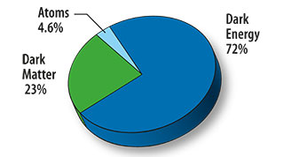
How Do EIC Goals Connect to Other Forefronts in Nuclear, Particle and Astrophysics?
The unfolding mysteries of the energy budget in our universe:
72% comes not from matter but from dark energy of unknown origin and mysterious magnitude (⇒ cosmological probes)
23% comes from dark matter of unknown composition (⇒ DM exp’ts & supersymmetry searches at LHC)
4.6% comes from “mass without mass”[ive constituents] of known baryonic matter (⇒ EIC to probe critical gluon role)
<<1% comes from Standard Model mass generation for quarks and leptons, attributed to as yet undiscovered particle (⇒ Higgs searches @ LHC and Tevatron, ν mass exp’ts)
Notes:
18

Slide 19
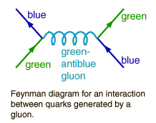
Why Should We Care About Gluon-Dominated Matter? Gluons and Mass Without Mass…
F. Wilczek, in “The Origin of Mass”:
“Its enhanced coupling to soft radiation…means that…a ‘bare’ color charge, inserted into empty space, will start to surround itself with a cloud of virtual color gluons. These color gluon fields themselves carry color charge, so they are sources of additional soft radiation. The result is a self-catalyzing enhancement that leads to runaway growth. A small color charge, in isolation, builds up a big color thundercloud… theoretically the energy for a quark in isolation is infinite… Having only a finite amount of energy to work with, Nature always finds a way to short-circuit the ultimate thundercloud.”
Confinement of color-coordinated quarks inside hadrons cancels the “thundercloud” at long distances from the hadron. But the short-circuit mechanism also needs saturation of gluon densities (via gg → g recombination) to limit the growth of gluon fields inside the hadron.
⇒ Need to probe gluons in non-linear QCD regime of high gluon density ⇒ Need high energies for “soft” glue, but can use heavy nuclei to boost reach, lower cost, probe onset of gluon saturation inside nuclear matter
Notes:
19

Slide 20
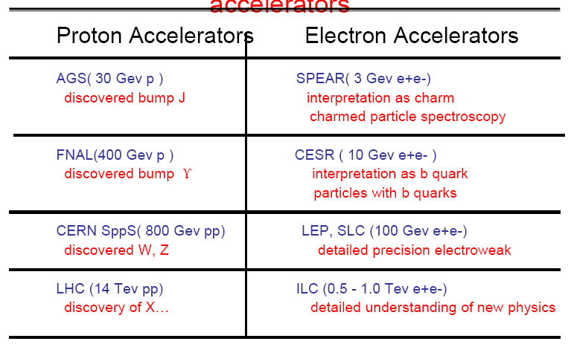
Why An Electron Machine?
Electron accelerators have traditionally been used for quantitative characterization of phenomena discovered at hadron machines:
Example table from C. Baltay talk at June 2010 NUFO Meeting
Proton Accelerators
RHIC, LHC may ⇒ hints of gluon saturation, but need eA to probe quanti-tatively, despite primary EM sensitivity to quarks, rather than gluons. Electron Deep Inelastic Scattering (DIS) is the best demonstrated method to provide time-dilated “freeze-frame” imaging of partons in matter.
Notes:
20

Slide 21
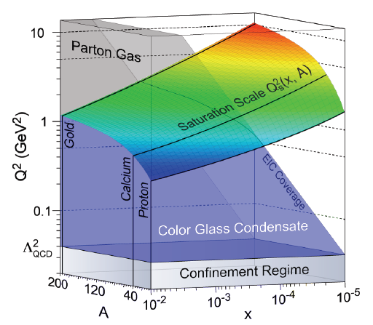
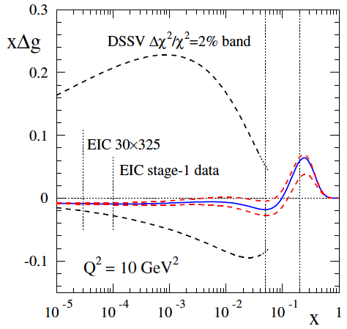
What Will EIC Have That HERA Didn’t?
Heavy-ion beams to take advantage of coherent contributions of many nucleons to gluon density, provide more cost-effective reach into gluon saturation regime when QCD coupling is still weak.
nuclear “oomph”
Constraints from RHIC spin data to date
Polarized proton and ³He (for neutron), as well as electron, beams to pursue search for gluon contributions to nucleon spin down to very soft gluons, and map spin-momentum correlations of quarks and gluons inside nucleons.
Constraints from projected EIC data
Notes:
21

Slide 22
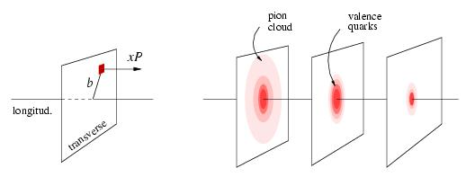
What Will EIC Have That HERA Didn’t?
Proton tomography via exclusive reactions
x < 0.1
x ~ 0.3
x ~ 0.8
3 orders of magnitude higher collision luminosity to facilitate exclusive reaction studies yielding 2+1- dim’l maps of internal nucleon wave function, and symmetry violation studies of fundamental electroweak interaction properties.
Parity-violating DIS to map “running” of the electroweak coupling
Notes:
22

Slide 23
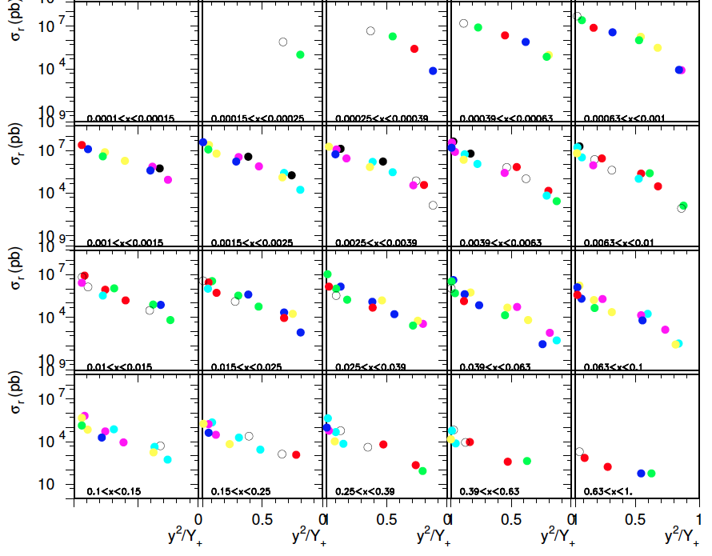



What Will EIC Have That HERA Didn’t?
4) Wide varia-bility in both electron and hadron energy, permitting separation of longitudinal from trans-verse structure functions.
F_{L} “slopes”
(examples)
5x50 - 5x325
ep running
F_{L} gives direct inform-ation on gluon dens-ity, determined from slope of y²/Y₊ for dif-ferent S at fixed x,Q²

Slide 24
Agenda for Users’ Workshop on RHIC Future Strategy (June 21-24, 2011)
Session I: Long-Term Options and Near-Term Plans
Session II: The Role of Heavy Ion Collisions at RHIC Beyond ~2017
Session III: PHENIX and STAR Decadal Plans
Session IV: eRHIC S&T
Session V: Panel and Community Discussion Toward Developing a RHIC Strategy to Present at Next Long Range Plan
Among the critical questions to be discussed:
Since LHC HI results very similar to RHIC’s, are both facilities needed?
Will 2-3 year cessation of RHIC ops. be essential to fund eRHIC? If so, what is optimal timing?
Is it crucial to maintain AA & pp capability into eRHIC era? If so, can we reconfigure IR’s annually, or do we separate HI from eA in different IR’s?
What eRHIC science is realizable within $500M total project cost limit?
What is optimal path for detectors and collaborations to evolve from RHIC to eRHIC?
Notes:
24

Slide 25




Science Deliverable | Basic Measurement | Uniqueness and Feasibility | Requirements
spin structure at small x contribution of Δg, ΔΣ to spin sum rule | inclusive DIS | ✔ | minimal large x,Q² coverage about 10fb⁻¹
full flavor separation in large x,Q² range strangeness, s(x)-s(x) | semi-inclusive DIS | ✔ | very similar to DIS particle ID improved FFs (Belle,LHC)
electroweak probes of proton structure flavor separation electroweak parameters | inclusive DIS at high Q² | ✔ some unp. results from HERA | 20x250 to 30x325 positron beam polarized ³He beam
treatment of heavy flavors in pQCD | DIS (g₁, F₂, and F_{L}) with tagged charm | ✔ some results from HERA | large x,Q² coverage charm tag
(un)polarized γ PDFs relevant for γγ physics at an ILC | photoproduction of inclusive hadrons, charm, jets | ✔ unp. not completely unknown | tag low Q² events about 10 fb⁻¹
Notes:
25

Slide 26


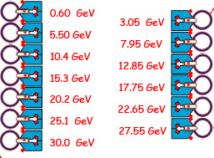


27.55 GeV
New
detector
Linac
2.45 GeV
Linac
2.45 GeV
Beam
dump
Coherent e-cooler
3.05 GeV
5.50 GeV
0.6 GeV
7.95 GeV
10.4 GeV
Polarized
e-gun
12.85 GeV
15.3 GeV
17.75 GeV
20.2 GeV
22.65 GeV
25.1 GeV
27.55 GeV
30 GeV
30.0 GeV
ePHENIX
eSTAR
30 GeV

