Slide 1
MEIC
A Polarized Medium Energy Electron-Ion Collider at Jefferson Lab
Yuhong Zhang
for
Jefferson Lab EIC Study Group
Electron-Ion Collider International Advisory Committee Review
Jefferson Lab, April 10, 2011

Slide 2
Outline
Introduction
MEIC Baseline Design
Design Details
Accelerator R&D
Outlook and Summary

Slide 3
1. Introduction

Slide 4
EIC: JLab’s Future
Over the last decade, JLab has been developing a conceptual design of an electron-ion collider as its future nuclear science program beyond 12 GeV CEBAF upgrade
The future science program, as NSAC LRP articulates, drives the EIC design, focusing on:
    High luminosity (above 10³³ cm⁻²s⁻¹) per detector over multiple detectors
    High polarization (>80%) for both electrons & light ions
The JLab EIC machine design takes full advantage of
  A high repetition electron beam from the CEBAF recirculating SRF Linac
  A green field ion complex
During the last two years, we have strategically focused on a Medium-energy Electron Ion Collider (MEIC) as an immediate goal, as the best compromise between science, technology and project cost
We maintained a well defined path for future upgrade to higher energies

Slide 5
JLab Contributions to EIC Machine Design
The “trade mark” of the JLab EIC design, driven by demands of science community
  Very high luminosity, up to 10³⁵ cm⁻²s⁻¹, over a wide CM energy range
  Very high polarization (>80%) for both electrons & light ions (including deuterons)
We vigorously push key collider performance with innovative ideas and concepts; some are first time for colliding ion beams
  * New luminosity concept * Crab crossing colliding (ion) beam
  * Figure-8 ring * Universal Spin Rotator
  * Staged electron cooling * ERL circulator cooler
(We had also proposed but not in the present baseline anymore)
* ERL-ring collider scheme * Circulator collider ring for electron
Our work greatly influenced the direction of EIC machine design evolution
Go for high luminosity!
Yaroslav Derbenev, 2011 Wilson Prize recipient

Slide 6
EIC IAC Recommendations (Nov. 2009)
Highest priority:
Design of JLab EIC
High current (e.g. 50 mA) polarized electron gun
Demonstration of high energy – high current recirculation ERL
Beam-beam simulations for EIC
Polarized ³He production and acceleration
Coherent electron cooling
High priority, but could wait until decision made:
Compact loop magnets
Electron cooling for JLab concepts
Traveling focus scheme (it is not clear what the loss in performance would be if it doesn’t work; it is not a show stopper if it doesn’t)
Development of eRHIC-type SRF cavities
Medium Priority:
Crab cavities
ERL technology development at JLAB

Slide 7
Our Response
  “Hold off research for now, all works go to machine design!”
Charges to the JLab accelerator design team
  Produce a matured design in a short period of time (6 to 12 months)
  Provide sufficient details (at a level of the eRHIC ring-ring design report)
  Make the design as solid as we can
The JLab accelerator team, guided by lab management, has decided
  Take a conservative position: try to stay within state-of-art as much as we can
  (more reachable goal, more credible design, much less R&D burden)
  Reach out for seeking external help through collaboration
Present project status
  Reaching short term design goal YES!
  Conceptual design of major components YES!
  Improving robustness of design and reducing required R&D YES!

Slide 8
Highlights on Machine Design Activities
Reached a design “contract” with the physics team (Feb. 11&12, 2010)
  Two joint meetings by the physics & accelerator teams for reviewing the nuclear physics needs and accelerator technologies constraints
  Reached a “high level machine requirement” for guiding the accelerator design
Collider Design Review Retreat (Feb. 24, 2010)
  Review designs, commissioning and operation of existing or future colliders worldwide
  Find out what is the state-of-art and learn from the world experts
MEIC Design Week (March 4-8, 2010)
  Daily meetings to evaluate and decide high level design options and identify key issues which need future special attention
MEIC Internal Machine Design Review (Sept. 15&16, 2010)
RF & Beam Synchronization Mini-Workshop (Oct. 29, 2010)
  A half-day workshop to evaluate two critical issues: electron RF & beam synchronization
  750 MHz chosen as accelerating RF frequency, but bunching and crabbing still 1.5 GHz.
MEIC Ion Complex Design Workshop (Jan. 27&28, 2011)
  A day-and-half workshop to review design, identify missing parts or design inconsistency

Slide 9
Built Up an Extended Team
CASA MEIC design team
A. Bogacz, P. Chevtsov, Ya. Derbenev, G. Krafft, R. Li, V. Morozov,
T. Satogata, B. Terzic, B. Yunn, Y. Zhang and H. Sayed (graduate student)
Low energy ion complex (sources, linac and pre-booster)
V. Dudnikov (Muons, Inc)
P. N. Ostroumov, S. Manikonda (Argonne)
B. Erdelyi (Northern Illinois Univ.)
Interaction region: M. Sullivan (SLAC)
RF systems: R. Rimmer, F. Marhauser, H. Wang (SRF Institute, JLab)
Polarization: A. Kondratenko (NTL Zaryad, Novosibirsk), D. Barber (DESY)
Feedback: Y. Kim (Idaho State Univ.)
Crab cavity: J. Delayen, S. DeSilva (ODU)

Slide 10
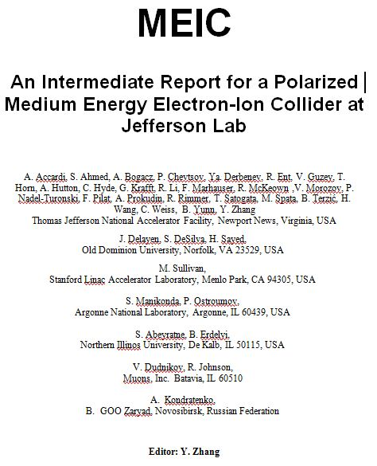
An Intermediate Design Report
Purpose
A general and systematic description of the present MEIC baseline design
A repository of machine information (layout, drawing and parameters) as references for all future works
help to keep consistency
A guideline for the next level design studies
A complete list (and good assessments) of required accelerator R&D
Scope
“ZDR minus R&D results”
About 70 pages
Status
In final editing
Independent reader/guest editor
Joe Bisognano (U. of Wisconsin)
http://casa.jlab.org/meic/meic.shtml

Slide 11
2. MEIC Baseline Design

Slide 12
MEIC Design Goal
Energy
  Full coverage in s from a few hundreds to a few thousands
  Bridging the gap of 12 GeV CEBAF and HERA/LHeC
  Electron 3 to 11 GeV, proton 20 to 100 GeV, ion 12 to 40 GeV/u
  Design point: 60 GeV proton on 5 GeV electron
Ion species
  Polarized light ion: p, d, ³He and possibly Li
  Un-polarized ions up to A=200 or so (Au, Pb)
Detectors
  Up to three interaction points, two for medium energy (20 to 100 GeV)
  One full-acceptance detector (primary), 7 m between IP & 1st final focusing quad
  One high luminosity detector (secondary), 4.5 m between IP and 1st final focusing quad

Slide 13
MEIC Design Goal (cont.)
Luminosity
  About 10³⁴ cm⁻² s⁻¹ (e-nucleon) per interaction point
  Maximum luminosity should optimally be around s=2000 GeV²
Polarization
  Longitudinal at the IP for both beams, transverse at IP for ions only
Spin-flip of both beams (at least 0.1 Hz)
All polarizations >70% desirable
Upgradeable to higher energies and luminosity
  20 GeV electron, 250 GeV proton and 100 GeV/u ion
Positron beam highly desirable
  Positron-ion collisions with similar luminosity

Slide 14
Technical Design Strategy
Limit as many design parameters as we can to within or close to the present state-of-art in order to minimize technical uncertainty and R&D tasks
  Stored electron current should not be larger than 3 A
  Stored proton/ion current should be less than 1 A (better below 0.5 A)
  Maximum synchrotron radiation power density is 20 kW/m
  Maximum peak field of warm electron magnet is 1.7 T
  Maximum peak field of ion superconducting dipole magnet is 6 T
  Maximum betatron value at FF quad is 2.5 km
New beta-star, appropriate to the detector requirements
2.5 km β^{max} + 7 m ➔ β_{y}*= 2 cm
2.5 km β^{max} + 4.5 m ➔ β_{y}*=0.8 cm
This conservative design will form a base for future optimization guided by
  Evolution of the science program
  Technology innovation and R&D advances

Slide 15
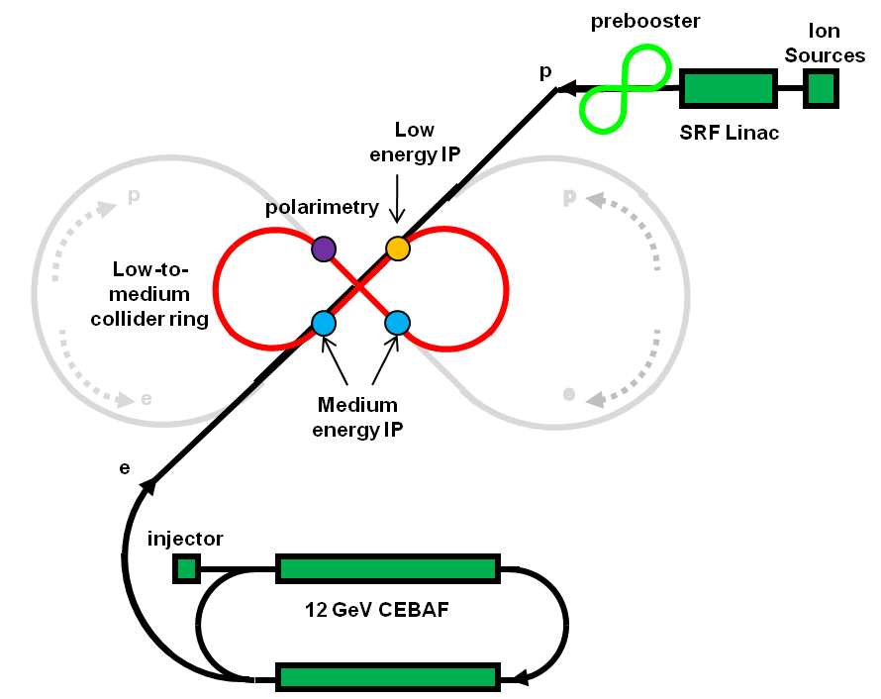
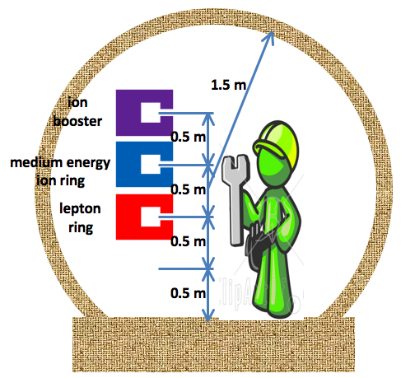
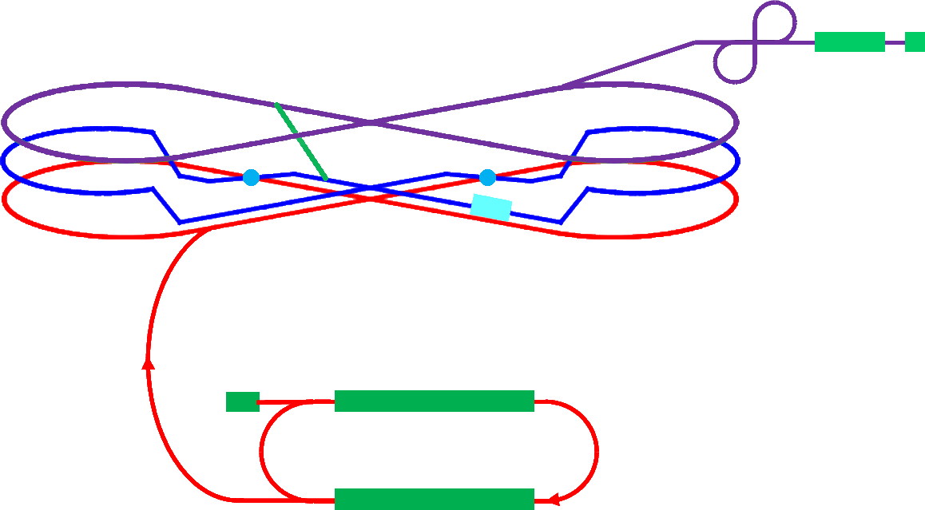
MEIC Layout
medium energy IP
Three compact rings:
3 to 11 GeV electron
Up to 20 GeV/c proton (warm)
Up to 100 GeV/c proton (cold)
low energy IP
Prebooster
Ion
source
Warm large booster
(up to 20 GeV/c)
Ion transfer beam line
SRF linac
Cold 97 GeV/c proton collider ring
Three Figure-8
rings stacked vertically
Medium energy IP with
horizontal crab crossing
Electron ring
Injector
12 GeV CEBAF

Slide 16
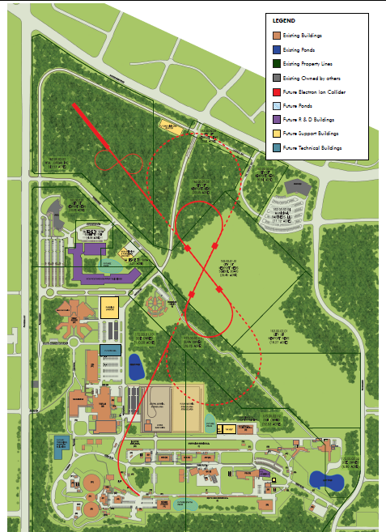
MEIC and Upgrade on JLab Site Map

Slide 17
Parameters for A Full Acceptance Detector
 |  | Proton | Electron
Beam energy | GeV | 60 | 5
Collision frequency | MHz | 750 | 750
Particles per bunch | 10¹⁰ | 0.416 | 2.5
Beam Current | A | 0.5 | 3
Polarization | % | > 70 | ~ 80
Energy spread | 10⁻⁴ | ~ 3 | 7.1
RMS bunch length | cm | 10 | 7.5
Horizontal emittance, normalized | µm rad | 0.35 | 54
Vertical emittance, normalized | µm rad | 0.07 | 11
Horizontal β* | cm | 10 | 10
Vertical β* | cm | 2 | 2
Vertical beam-beam tune shift |  | 0.014 | 0.03
Laslett tune shift |  | 0.06 | Very small
Distance from IP to 1st FF quad | m | 7 | 3.5
Luminosity per IP, 10³³ | cm⁻²s⁻¹ | 5.6
Notes:
17

Slide 18
Parameters for A High Luminosity Detector
 |  | Proton | Electron
Beam energy | GeV | 60 | 5
Collision frequency | MHz | 750 | 750
Particles per bunch | 10¹⁰ | 0.416 | 2.5
Beam current | A | 0.5 | 3
Polarization | % | > 70 | ~ 80
Energy spread | 10⁻⁴ | ~ 3 | 7.1
RMS bunch length | cm | 10 | 7.5
Horizontal emittance, normalized | µm rad | 0.35 | 54
Vertical emittance, normalized | µm rad | 0.07 | 11
Horizontal β* | cm | 4 | 4
Vertical β* | cm | 0.8 | 0.8
Vertical beam-beam tune shift |  | 0.014 | 0.03
Laslett tune shift |  | 0.06 | Very small
Distance from IP to 1st FF quad | m | 4.5 | 3.5
Luminosity per IP, 10³³ | cm⁻²s⁻¹ | 14.2

Slide 19
Luminosity Concept: Following the Leader
Luminosity of KEKB and PEP II follow from
  Very small β* (~6 mm)
  Very short bunch length (σ_{z}~ β*)
  Very small bunch charge (5.3 nC)
  High bunch repetition rate (509 MHz)
➔ KEK-B already over 2x10³⁴ /cm²/s
Low Charge Intensity
JLab is poised to replicate same success in electron-ion collider:
  A high repetition rate electron beam from CEBAF
  A green-field ion complex (so can match e-beam)
 |  | KEK B | MEIC
Repetition rate | MHz | 509 | 750
Particles per bunch | 10¹⁰ | 3.3 / 1.4 | 0.42 / 2.5
Beam current | A | 1.2 / 1.8 | 0.5 / 3
Bunch length | cm | 0.6 | 1 / 0.75
Horizontal & vertical β* | cm | 56/0.56 | 10 / 2
Luminosity per IP, 10³³ | cm⁻²s⁻¹ | 20 | 5.6 ~ 14

Slide 20
3. Design Details

Slide 21
The Big Picture
The electron complex
CEBAF as a full energy injector
  Already exist! Possible top-off mode
Electron collider ring
  Linear optics design: done!
The ion Complex
  Ion sources
  Identified ABPIS for polarized H⁻/D⁻, light ions
  Identified ECR/EBIS for heavy ions
Linac
  Technical design: done!
  Design of component (RFQ, cavity, etc): done!
Pre-booster
  Linear optics design: done!
  Injection, accumulation, acceleration: done!
  Conventional DC electron cooling exist!
Large booster
  Ring optics design: work in progress!
Ion collider ring
  Llinear optics design: done!
Interaction region
  Electron IR
    Optics design & chromatic correction: done!
    Tracking & dynamic aperture: in progress
  Ion IR
    Optics design & chromatic correction: done!
    Tracking & dynamic aperture: in progress!
  Crab crossing: has concept
  Synchrotron radiation at IP and detector background: checked!
Beam polarization
Electron polarization design: done!
Proton/deuteron polarization design: done!
Spin matching & tracking: in progress!
Electron cooling in collider ring
Staged electron cooling concept: done!
ERL-circulator e-cooler concept: done!
Fast kicker development: has a concept
Beam synchronization: done!

Slide 22
This Presentation
I will only discuss the following issues very briefly in this presentation
  Ion pre-booster
  Ion collider ring
  Interaction region & chromatic correction
  Ion polarization
  Staged electron cooling and electron cooler
  beam synchronization
For other design issues
  Can be found in additional 40+ slides in the back-up slide section of this presentation
More information can be found at
MEIC accelerator design web site: http://casa.jlab.org/meic/meic.shtml
The MEIC Intermediate Design Report (expected in a month but a draft is available now)

Slide 23
A Green Field Ion Complex
MEIC ion complex design goal
  Be able to generate/accumulate and accelerate ion beams for collisions
  Covering all required varieties of ion species
  Matching the time, spatial and phase space structure of the electron beam
  (bunch length, transverse emittance and repetition
Schematic layout
cooling
cooling
to high energy collider ring
ion sources
SRF Linac
pre-booster
(accumulator ring)
barge booster
medium energy collider ring
 | Length (m) | Max. energy (GeV/c) | Electron Cooling | Process
SRF linac |  | 0.2 (0.08)
Pre-booster | ~300 | 3 (1.2) | DC | accumulating
booster | ~1300 | 20 (8 to 15)
collider ring | ~1300 | 96 (40) | Staged/ERL
* Numbers in parentheses represent energies per nucleon for heavy ions

Slide 24
Ion Pre-booster
Purpose of pre-booster
  Accumulating ions injected from linac
  Accelerating ions
  Extracting/sending ions to the large booster
Design Concepts
Figure-8 shape
(Quasi-independent) modular design
FODO arcs for simplicity and ease optics corrections
Layout
Design constraints
Maximum bending field: 1.5 T
Maximum quad field gradient: 20 T/m
Momentum compaction smaller than 1/25
Maximum beta functions less than 35 m
Maximum full beam size less than 2.5 cm,
5m dispersion-free sections for RF, cooling, collimation and extraction.
Extraction to large booster
Collimation
ARC 1
Electron Cooling
Non dispersive section 1
ARC 3
Injection Insertion
section
Non dispersive section 2
Beam from LINAC
RF Cavities
ARC 2
Solenoids
B. Erdelyi

Slide 25
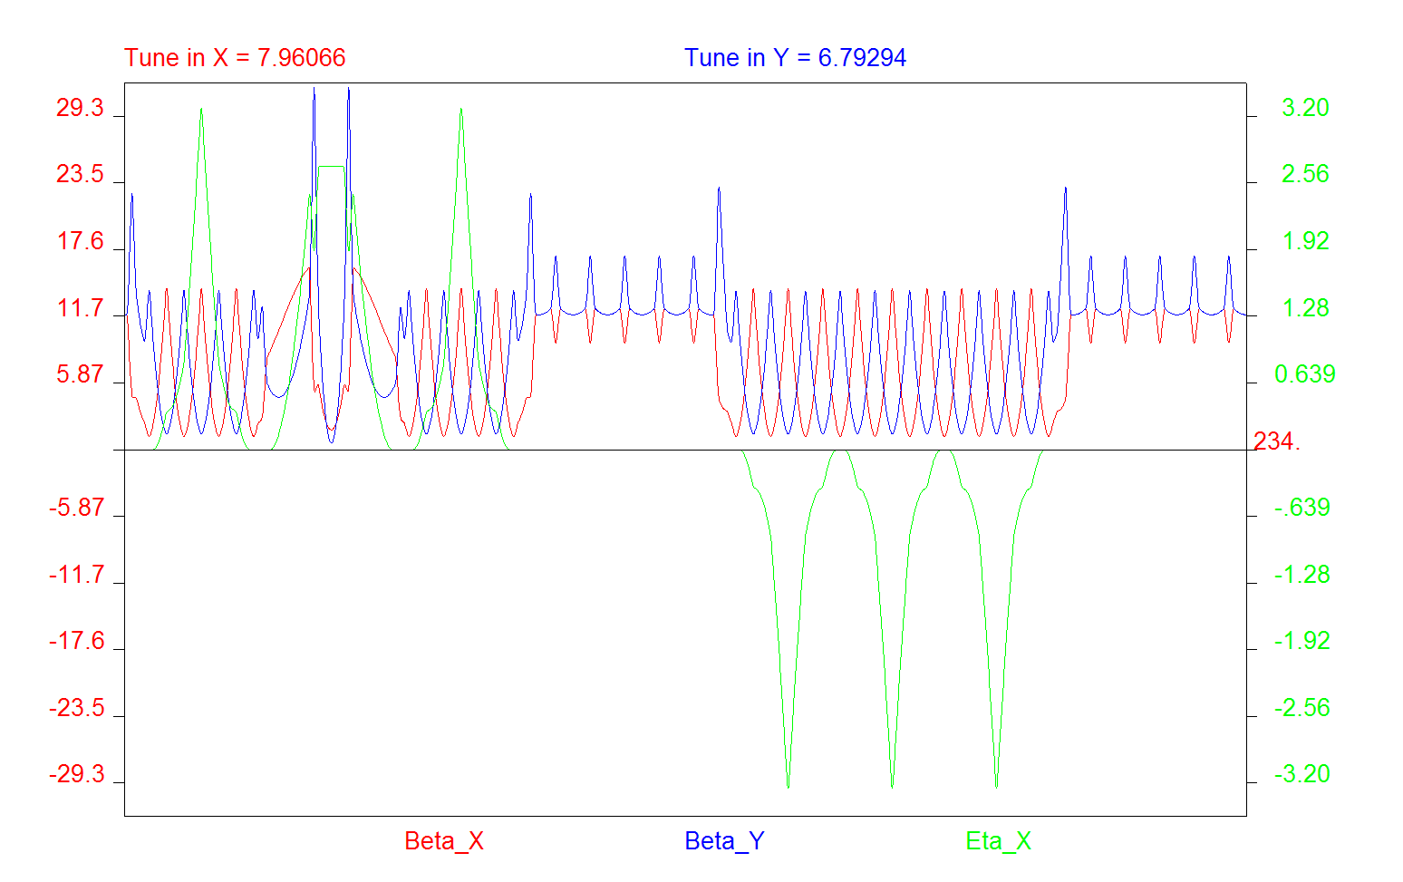
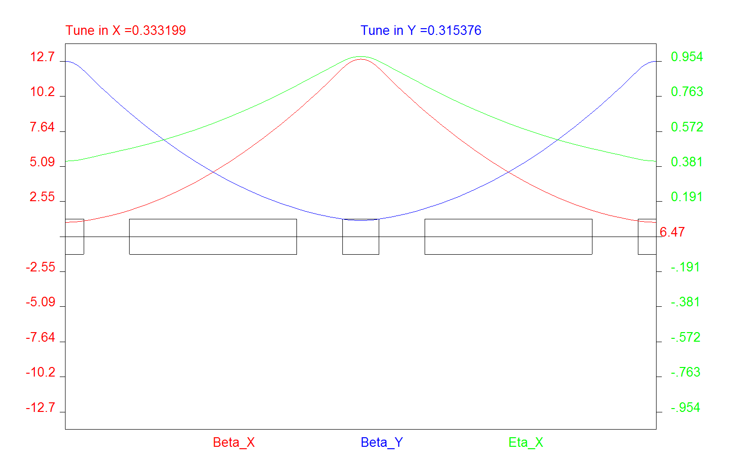
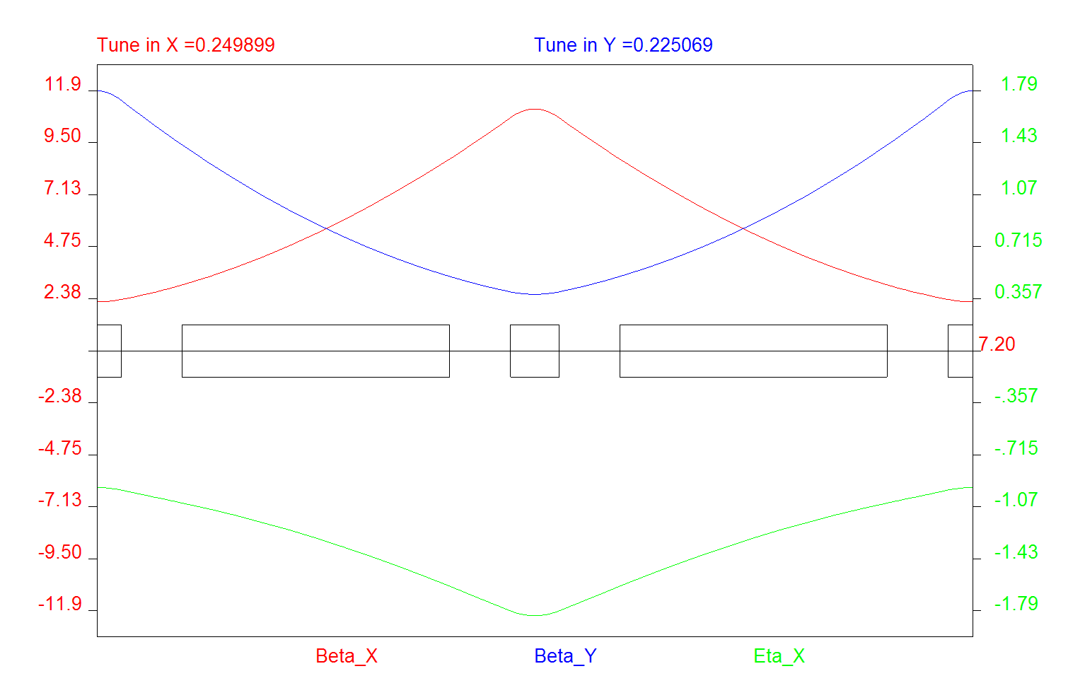
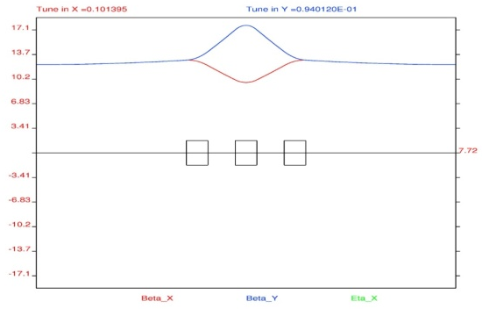
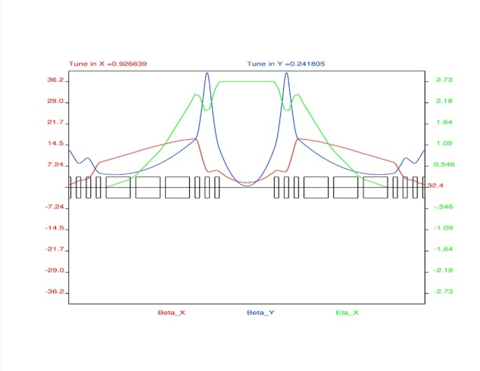
Pre-booster Magnetic Lattices
ARC1&2 FODO
ARC3 FODO
Arc 2
Arc 1
Straight 1
Arc 3
Straight 2
Injection
STRAIGHT TRIPLET
INJECTION INSERT
Circumference | m | 234
Angle at crossing | deg | 75
# of dispersive FODO cells (Type I & 2) |  | 6 & 9
# of triplet cells & # of matching cells (2 types) |  | 10 & 4
Minimum drift length between magnets | cm | 50
Drift in the injection insertion & between triplets | m | 5
Beta maximum in X and Y | m | 16 & 32
Maximum beam size | cm | 2.3
Maximum vertical beam size in dipole magnets | cm | 0.5
Maximum dispersion (x|delta_KE) | m | 3.36
Normalized dispersion value at injection insert | m^{½} | 2.53
Tune in X and Y |  | 7.96 & 6.79
Gamma of particle and transition gamma |  | 4.22 & 5
Momentum compaction |  | 0.04
 | quantity | Parameter | Unit | Value
Quad | 95 | Length | cm | 40
 |  | Half Aperture | cm | 5
 |  | Max. pole tip field | T | 1.53
 |  | Min. pole tip field | T | 0.15
Dipole | 36 | Length | cm | 219
 |  | Radius | cm | 9
 |  | Vertical aperture | cm | 3
 |  | Strength | T | 1.41
 |  | Bending angle | deg | 14

Slide 26
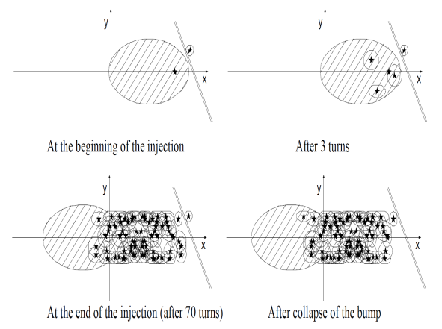
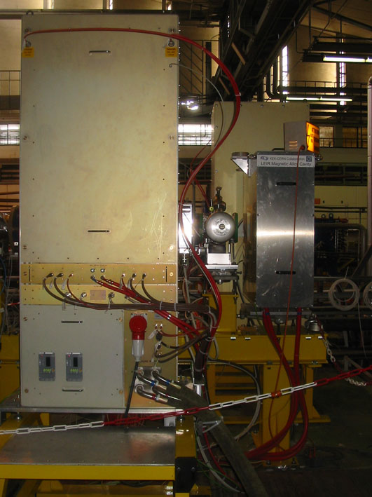
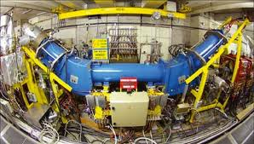
Injection, Accumulating, Electron Cooling, Accelerating and Ejection in Pre-booster
Injection
Proton & light ions: stripping injection
Heavy ions
  Repeated multi-turn injection
  Transverse and longitudinal painting
  (Conventional DC 50 keV) electron cooling for stacking/accumulation
Boosting
RF swing necessary is [0.4,2] MHz
15 kV/cavity, 50kV/turn => 3-4 cavities
56000 turns for 200 MeV➔ 3 GeV
Less than 80 ms acceleration time
Extraction
Conventional single-turn fast extraction
To minimize heavy-ion loss, strip once in linac and once after the pre-booster to maximize fully stripped fraction
Injection & painting
LEIR-Type Cavity
Conventional DC Electron Cooling

Slide 27
MEIC Collider Ring Footprint
Universal
Spin Rotator
(8.8°/4.4°, 50 m)
1/4 Electron Arc (106.8°, 140 m)
IR (125 m)
IR (125 m)
Universal
Spin Rotator (8.8°/4.4°, 50 m)
Experimental Hall (radius 15 m)
RF (25 m)
Figure-8 Crossing Angle: 2x30°
Universal
Spin Rotator (8.8°/4.4°, 50 m)
Compton Polarimeter (28 m)
1/4 Electron Arc (106.8°, 140 m)
3rd IR (125 m)
Universal
Spin Rotator (8.8°/4.4°, 50 m)
Injection from CEBAF
 | m
Quarter arc | 140
Universal spin rotator | 50
IR insertion | 125
Figure-8 straight | 140 x 2
RF short straight | 25
Circumference | ~ 1300
Ring design is a balance between
  Synchrotron radiation ➔ prefers a large ring (arc) length
  Ion space charge ➔ prefers a small ring circumference
Multiple IPs require long straight sections
Straights also hold required service components (cooling, injection and ejection, etc.)

Slide 28
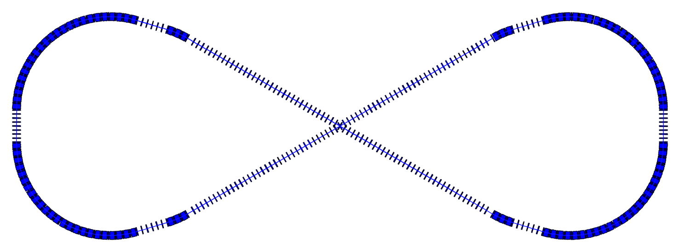
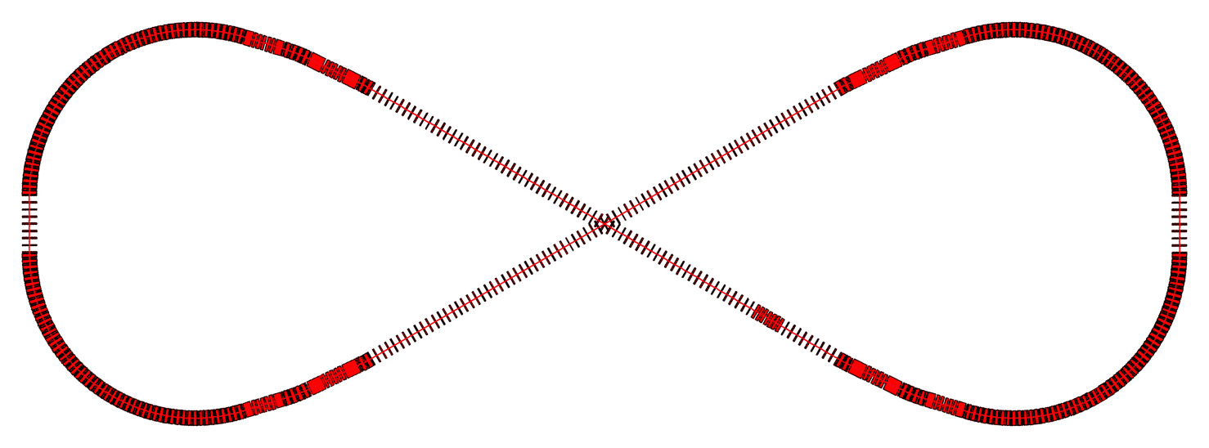
Vertically Stacked & Horizontal Crossing
Ion Ring
IP
Siberian snake
IP
Siberian snake
3rd IP
Electron Ring
IP
IP
RF
Spin rotators
Spin rotators
RF
3rd IP
Vertical stacking for identical ring circumferences
Horizontal crab crossing at IPs due to flat colliding beams
Ion beams execute vertical excursion to the plane of the electron orbit for enabling a horizontal crossing
Ring circumference: 1340 m
Maximum ring separation: 4 m
Figure-8 crossing angle: 60 deg.

Slide 29
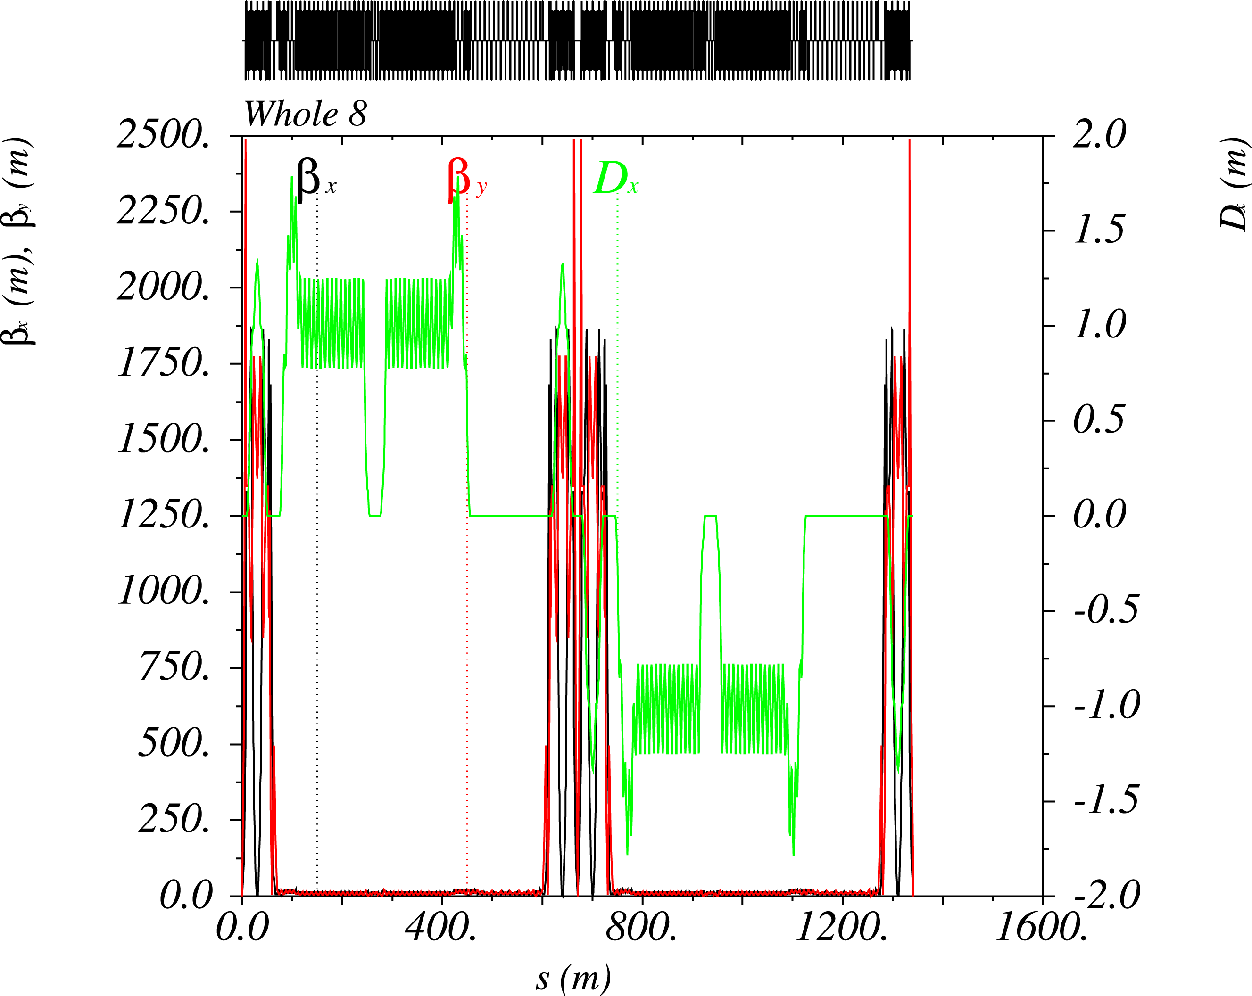
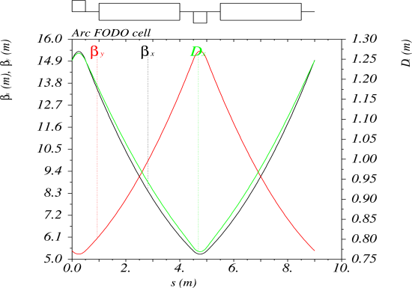
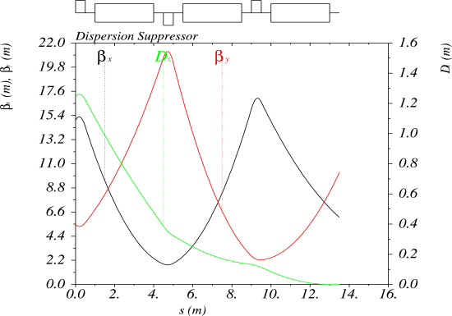
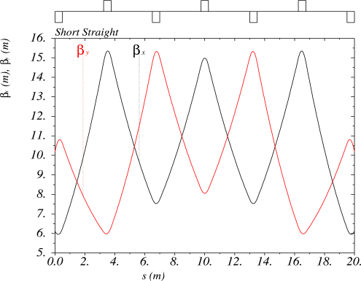
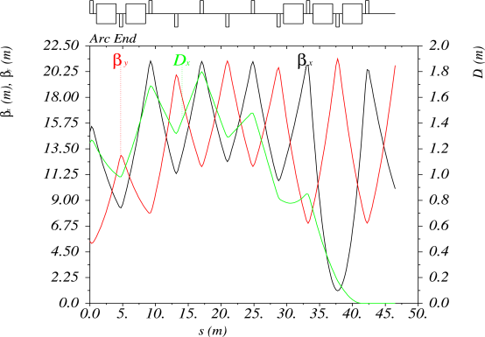
MEIC Ion Collider Ring
Dipole |  | 144
Length | m | 3
Bending radius | M | 53.1
Bending Angle | deg | 3.236
Field @ 60 GeV | T | 3.768
Quad |  | 298
Length | M | 0.5
Strength @ 60 GeV | T/m | 92 / 89
Circumference | m | 1340.92
Total bend angle/arc | deg | 240
Figure-8 crossing angle | deg | 60
Averaged arc radius | m | 93.34
Arc length | m | 391
Long and short straight | m | 279.5 / 20
Lattice base cell |  | FODO
Cells in arc / straight |  | 52 / 20
Arc/Straight cell length | m | 9 / 9.3
Phase advance per cell | m | 60 / 60
Betatron tunes (ν_{x,} ν_{y}) |  | 25.501 /25.527
Momentum compaction | 10⁻³ | 5.12
Transition gamma |  | 13.97
Dispersion suppression |  | Adjusting quad strength
Dispersion Suppressor
ARC FODO CELL
Arc end with dispersion suppression
Short straight
A. Bogacz & V. Morozov

Slide 30
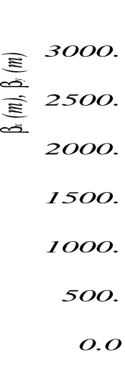
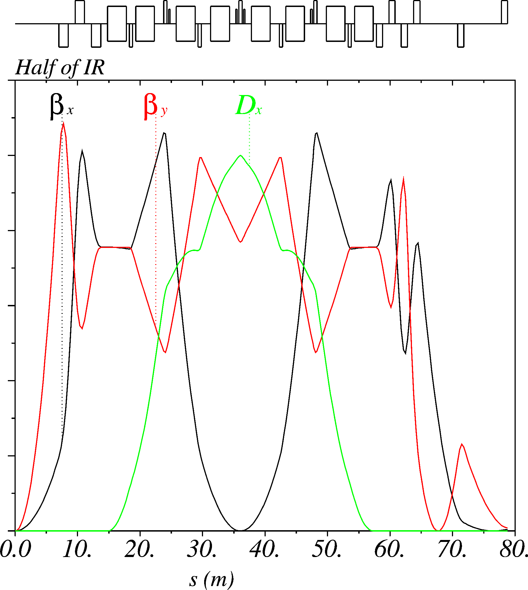
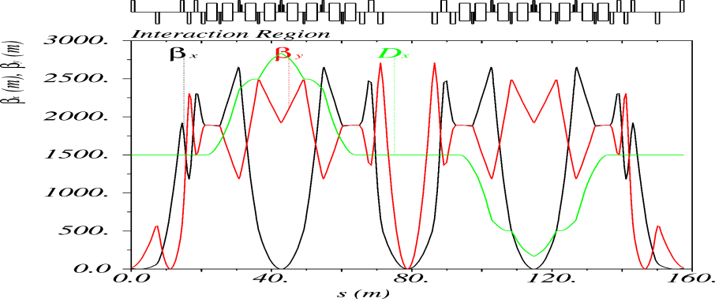
Interaction region: Ions
Final Focusing Block (FFB)
Chromaticity Compensation Block (CCB)
Beam Extension Section
7 m
β_{y}^{max} ~ 2700 m
β_{x}* = 10 cm
β_{y}* = 2 cm
Distance from the IP to the first FF quad = 7 m
Maximum quad strength at 100 GeV/c
  64.5 T/m at Final Focusing Block
  88.3 T/m at Chromaticity Compensation Block
  153.8 T/m at Beam Extension Section
Symmetric CCB design (both orbital motion & dispersion) required for efficient chromatic correction
Whole Interaction Region: 158 m

Slide 31
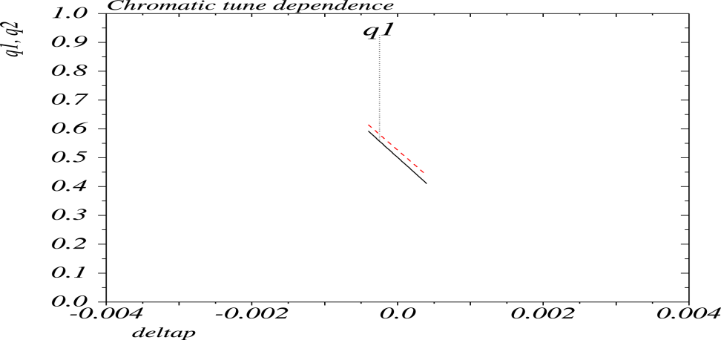
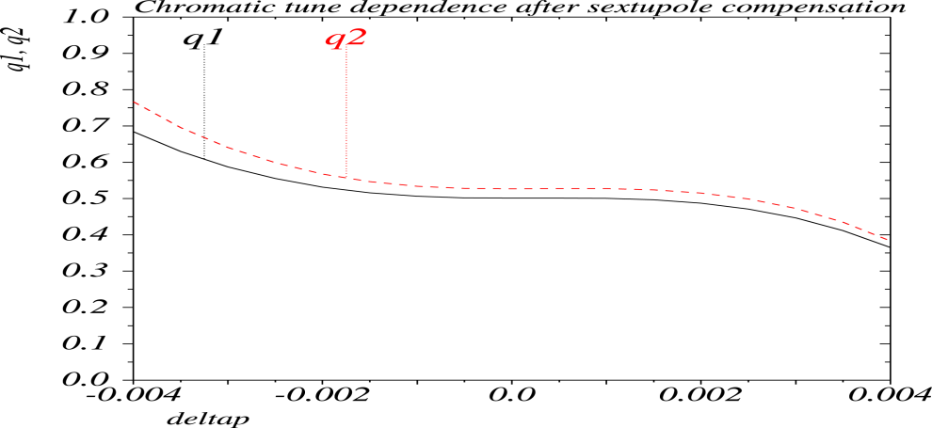
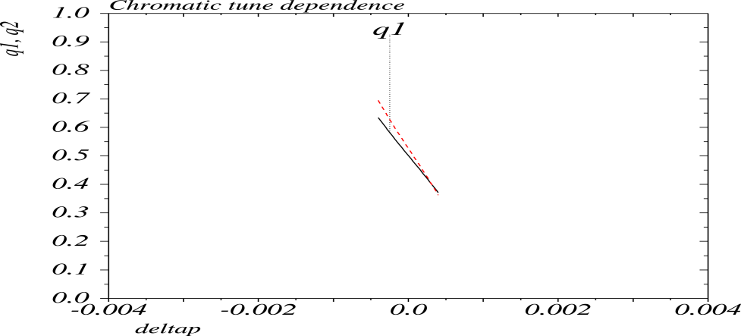
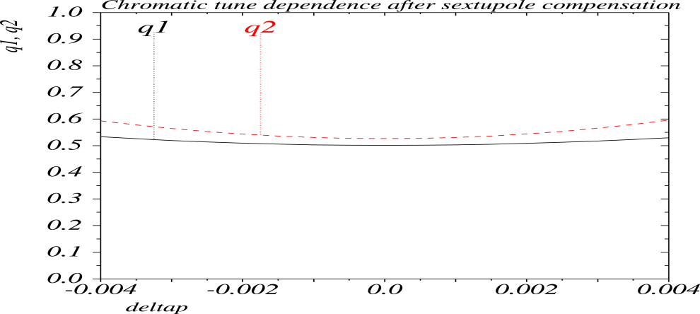
Chromatic Corrections
Scheme: sets of sextuopoles placed in the symmetric chromatic compensation block
Electron
Natural Chromaticity: -226 & -218
Natural Chromaticity: 0, 0
+/- 5 Dp/p
Dp/p = 0.66x10⁻³ for 5 GeV
Before compensation
After compensation
Maximum sextupole strength at 5 GeV/c = 281.4 T/m²
Proton
Natural Chromaticity: -320 & -397
Natural Chromaticity: 0, 0
+/- 5 Dp/p
Dp/p = 5x10⁻⁴ for 60 GeV
Before compensation
After compensation
Maximum sextupole strength at 60 GeV/c = 391.8 T/m²
(Natural) chromaticity correction looks good,
Momentum acceptance for electron is not satisfactory, needs further optimization
Particle tracking simulations & dynamical aperture studies in progress
V. Morozov

Slide 32
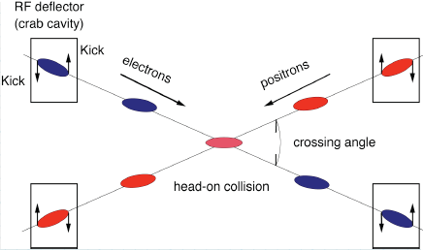
Crab Crossing
High bunch repetition rate requires crab crossing of colliding beams to avoid parasitic beam-beam collisions
Present baseline: 50 mrad crab crossing angle
Schemes to restore head-on collisions
  SRF crab cavity (Like KEK-B)
    ← using transverse RF kicking
  Dispersive crabbing (J. Jackson)
  ← introducing high dispersion in regular accelerating/bunching cavities
Crab Cavity | Energy (GeV/c) | Kicking Voltage (MV) | R&D
electron | 5 | 1.35 | State-of-art
Proton | 60 | 8 | Not too far away
Crab cavity State-of-the-art:
KEKB Squashed cell@TM110 Mode
V_{kick}=1.4 MV, E_{sp}= 21 MV/m
Dispersive crab | Energy (GeV/c) | RF Voltage (MV)
electron | 5 | 34
Proton | 60 | 51
New type SRF crab cavity currently under development at ODU/JLab
Notes:
32

Slide 33
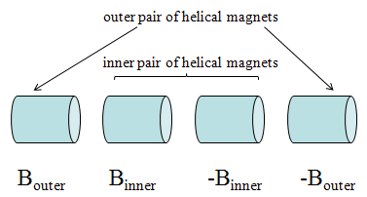
Ion Polarization
Design Requirements
High (>70%) polarization of stored electron beam
Preservation of polarization during acceleration (in boosters and collider ring)
Longitudinal and transverse polarization at interaction points
Polarized deuteron
Design Choices
* Polarized ion sources * Figure-8 ring * Siberian snakes
Polarization schemes we have worked out
Proton: longitudinal, transverse and combined polarizations at IPs
Deuteron: longitudinal and transverse polarization at IPs
BNL type snake
Snake parameters for longitudinal scheme
E (GeV) | 20 | 40 | 60 | 100 | 150
B_{outer} (T) | -2.13 | -2.16 | -2.173 | -2.177 | -2.184
B_{inner} (T) | 2.83 | 2.86 | 2.88 | 2.89 | 2.894
Snake parameters for transverse scheme
E (GeV) | 20 | 40 | 60 | 100 | 150
B_{outer} (T) | -1.225 | -1.241 | -1.247 | -1.251 | -1.253
B_{inner} (T) | 3.943 | 3.994 | 4.012 | 4.026 | 4.033
P. Chevtsov, A. Kondratenko

Slide 34
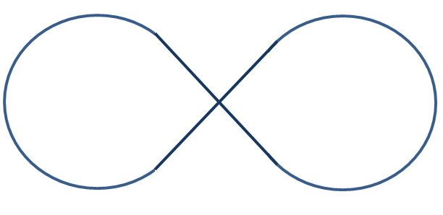
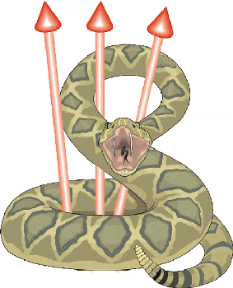

Proton Polarization at IPs
Case 1: Longitudinal Proton Polarization at IP’s
Three Siberian snakes, all longitudinal-axis
Third snake in straight is for spin tune
Spin tune: 1/2
longitudinal axis
Case 2: Transverse proton polarization at IP’s
Vertical axis
Three Siberian snakes, both in horizontal-axis
Vertical polarization direction periodic
Spin tune: 1/2
Case 3: Longitudinal & transverse proton polarization on two straights
Two Siberian snake, with their parameters satisfying certain requirements
Spin tune: 1/2
longitudinal
Vertical
axis in special angle

Slide 35
Staged Electron Cooling In Collider Ring
Not Coherent Electron Cooling. Regular electron cooling
(FNAL, 8 GeV/4 MeV)
Initial cooling: after injection for reduction of longitudinal emittance before acceleration
Final cooling: after boost & rebunching, for reaching design values of beam parameters
Continuous cooling: during collision for suppressing IBS & preserving luminosity lifetime
 |  | Initial Cooling | after boost & bunching | Colliding Mode
Energy | GeV/MeV | 20 / 8.15 | 60 / 32.67 | 60 / 32.67
Beam current | A | 0.5 / 3 | 0.5 / 3 | 0.5 / 3
Particles/Bunch | 10¹⁰ | 0.42 / 3.75 | 0.42 / 3.75 | 0.42 / 3.75
Ion and electron bunch length | Cm | (coasted) | 1 / 2~3 | 1 / 2~3
Momentum spread | 10⁻⁴ | 10 / 2 | 5 / 2 | 3 / 2
Horiz. and vert. emitt, norm. | µm | 4 / 4 |  | 0.35 / 0.07
Laslett’s tune shift | (proton) | 0.002 | 0.006 | 0.07
Cooling length /circumference | m/m | 15 / 1000 | 15 / 1000 | 15 / 1000
 | formula |  | Longitudinal | Horizontal | Vertical
IBS | Piwinski | s | 66 | 86
IBS | Martini (BetaCool) | s | 50 | 100 | 1923
Cooling | Derbenev | s | ~7.9
* Assuming I_{e}=3 A, 60 GeV/32.67 MeV

Slide 36
ERL Based Circulator Electron Cooler
solenoid
Design Choice
to meet design challenges
RF power (up to 50 MW)
Cathode lifetime (130 kC/day)
Required technology
High bunch charge gun (ok)
ERL (50 MeV, 15 mA) (ok)
Ultra fast kicker
ion bunch
electron bunch
Cooling section
Fast kicker
circulator ring
Fast kicker
energy recovery
injector
SRF Linac
dump
Electron bunches circulates 100+ times, leads to a factor of 100+ reduction of current from a photo-injector/ERL
Cooling at the center of Figure-8
10 m
Solenoid (7.5 m)
Beam-beam fast kicker
injector
F
V. Shiltsev, 1996
SRF
surface charge density
v≈c
D
h
dumper
σ_{c}
kicking beam
L
v₀
Eliminating a long return path could
cut cooling time by half, or
reduce the cooling electron current by half, or
reduce the number of circulating by half
Notes:
36

Slide 37
Beam Synchronization
Problem
Electrons travel at the speed of light, protons/ions are slower
  Slower ion bunches will not meet the electron bunch again
  at the collision point after one revolution
  Synchronization condition must be achieved at every
  collision point in the collider ring simultaneously
Path length difference in collider rings
Assuming: (nominal) collider ring circumference ~1000 m
proton: 60 GeV design point
20 GeV → -97.9 cm → 2.44 bunch spacing → 2 unit of HN
Lead: 23.8 GeV/u → -65.7 cm → 1.64 bunch spacing → 2 unit of HN
7.9 GeV/u → -692 cm → 17.3 bunch spacing → 17 unit of HN
Present conceptual solutions
Low energy (up to 30 GeV proton & all energies for ions): change bunch number in ion ring
Medium energy (proton only, 30 GeV & up): change orbit or orbit and RF frequency together
  Option 1: change Ion orbit ➔ mounting SC magnets on movers, unpleasant but affordable
  Option 2: change electron orbit and RF frequency (less than 0.01%) ➔ large magnet bore
Path length difference
A. Hutton, Ya, Derbenev

Slide 38
4. MEIC Accelerator R&D
Crab Cavity Development
Beam-Beam Interactions

Slide 39
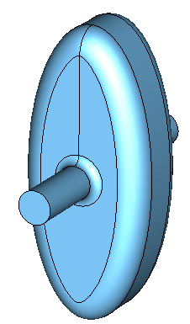
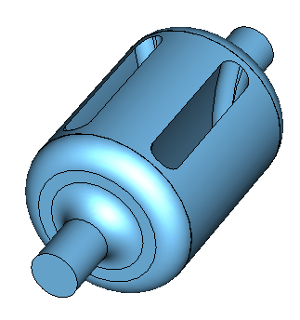
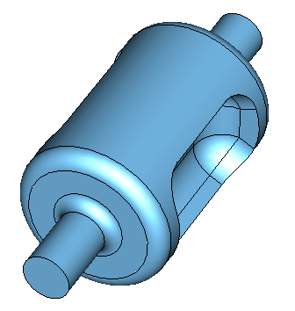
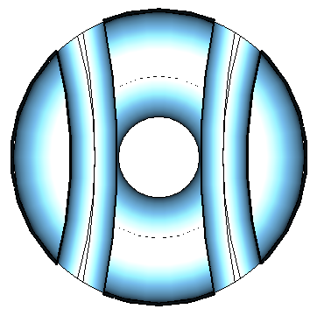
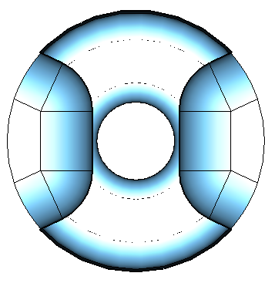
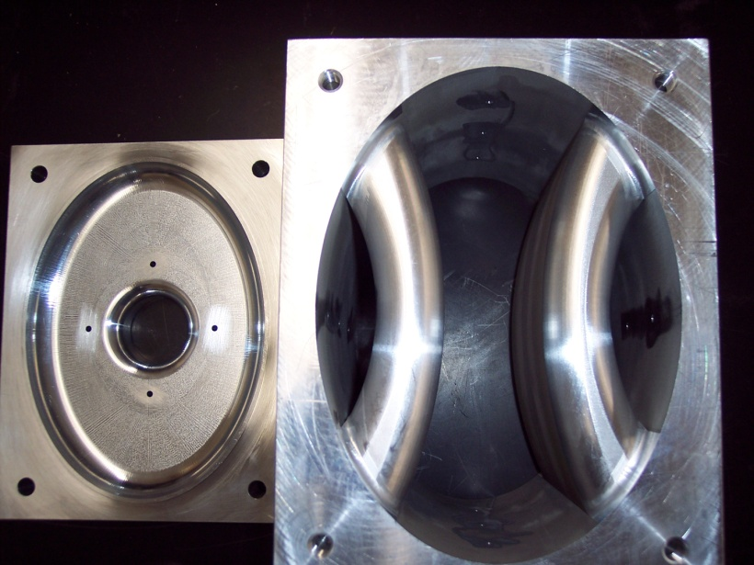
750 MHz SRF Crab Cavity
Parameter | Elliptical (A) | Par. Bar. (B) | Trapezoidal (C) | Units
Freq. of π mode | 749.93 | 750.07 | 750.28 | MHz
λ/2 of π mode | 199.7 | 199.8 | 199.8 | mm
Freq. of 0 mode |  | 1047.7 | 1252.8 | MHz
Freq nearest mode to Pi | 806.19 | 1024 | 1111.7 | MHz
Freq. Lower order modes | 592.7 | -- | -- | MHz
Cavity length | 200 | 280 | 281 | mm
Cavity width | 309.3 | 214 | 196.3 | mm
Cavity height | 698.8 | -- | -- | mm
Bars width | -- | 33.8 | -- | mm
Bars length | -- | 200 | 200 | mm
Aperture diameter | 80 | 60 | 60 | mm
Deflecting voltage (V_{T}*) | 0.2 | 0.2 | 0.2 | MV
Electric field (E_{P}/E_{T}) | 2.32 | 3.95 | 4.2 | MV/m
Magnetic field (B_{P}/E_{T}) | 7.72 | 8.66 | 10.14 | mT
B_{P}/E_{P} | 3.32 | 2.19 | 2.41 | mT/(MV/m)
Geometrical factor | 281.00 | 118.92 | 128.92 | Ω
[R/Q]_{T} | 41.31 | 166.53 | 120.91 | Ω
R_{T}R_{S} | 1.18 e4 | 1.95 e4 | 1.55 e4 | Ω²
Parallel-Bar (B)
Trapezoidal (C)
Elliptical
(A)
Work performed by graduate students at ODU under a DOE STTR with Niowave Inc.
J. Delayen
HOM Properties

Slide 40
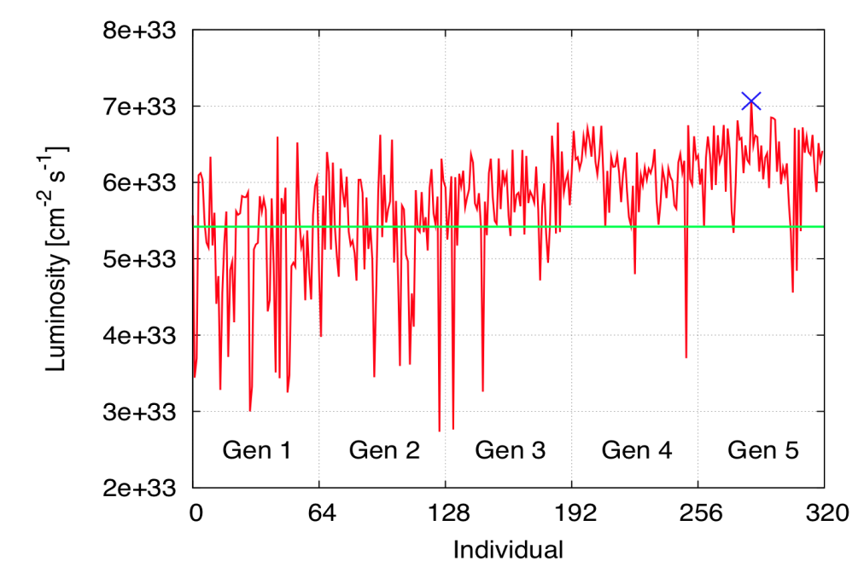
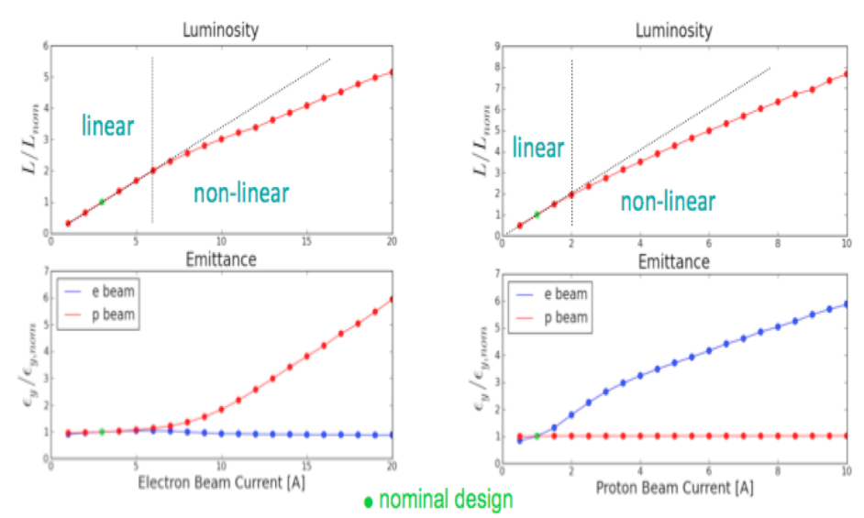
Beam-Beam Simulations
Simulation code: BeamBeam3D code (LBNL)
  Self-consistent, particle-in-cell
  Strong-strong or weak-strong mode
Scope and Model:
  One IP, head-on collision
  Linear transfer map in the ring
  Radiation damping & quantum excitations
  Chromatic optics effects not included
Results
  Beam stability and luminosity verified within the limit of strong-strong simulations
  Coherent beam-beam instability not observed
Evolutionary algorithm:
natural selection, mutation and recombination
  Objective function: collider’s luminosity
  Independent variables.: betatron tunes
  (synchrotron tunes fixed for now; 4D problem)
Found an optimized working point
e-beam: ν_{x} = 0.53, ν_{y} = 0.548456,
p-beam: ν_{x} = 0.501184, ν_{y} = 0.526639,
in only 300 simulations
B. Terzic

Slide 41
5. Outlook and Summary

Slide 42
What is the Next Step?
We have produced in the last 16 months
  Main design concept and parameters
  Design of ion complex (source, linac, pre-booster), two collider rings and interaction regions
  Concept of polarized beams and electron cooler
Job not done yet! In a short term, we will
  Complete the large booster design
  Complete IR design optimization and dynamic aperture studies
  Complete beam instability studies
Pending design revision?
    Based on development of physics program and reviews
      Five CEBAF User Workshop on MEIC (report)
      8-week INT program (report)
      This EIC Advisory Committee review
    Accelerator review and technology development
      MEIC internal review (Sept. 2010)
A new design “contract” for “MEIC 1.1”
    Incorporate change requests from nuclear physics team
    Design optimization

Slide 43
First R&D Award from DOE NP
Program: DOE Financial Assistance Funding Opportunity Announcement LAB 10-339
Research & Development for Next Generation Nuclear Physics Accelerator Facilities
CASA proposal: Advanced Electron Ion Collider Design (PI: Geoffrey Krafft)
  Project 1. Collider Ring Designs
  Project 2: Development of a Spin Manipulation and Stabilization System
Award: total $900k for one year
  $500k from FY2010 fund, available immediately (received Nov., 2010)
  $400k from FY2011 fund, subjected to federal budget appropriation process
CASA plan for using this grant
  Support three new postdoctoral fellows in CASA for MEIC studies ($100k x 3)
  Support collaborations ($150k first year, $100k second year)
Other awards for MEIC Accelerator R&D
  Argonne National Lab, $270k, for MEIC ion linac & small booster design (PI: P. Ostroumov)
  Northern Illinois Univ., $75k, for MEIC electron cooling studies (PI: B. Erdelyi)

Slide 44
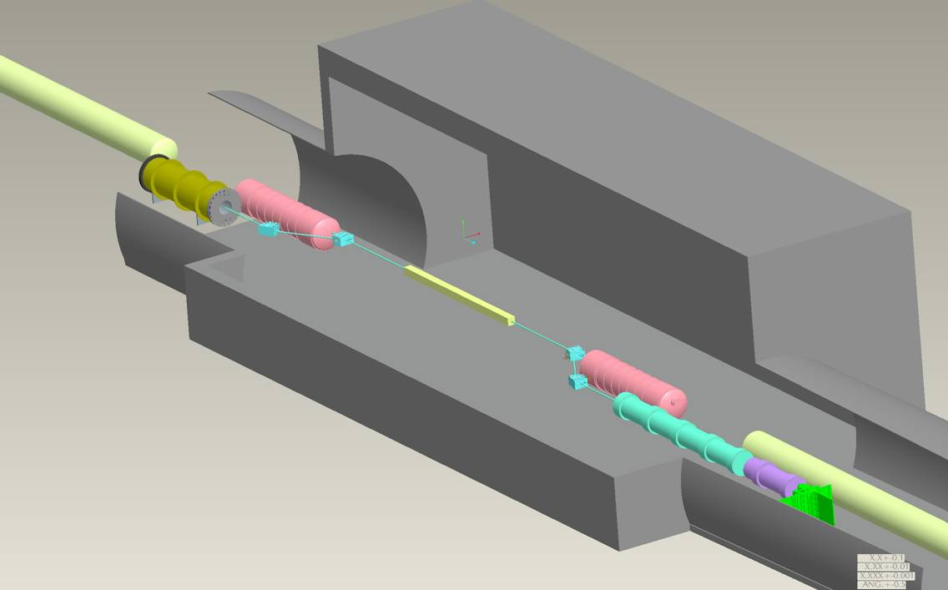
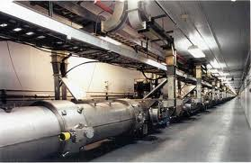
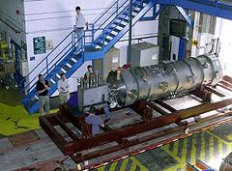
Enthusiastically Supporting EIC Collaborations
Coherent Electron Cooling
A proof-of-principle experiment in RHIC IR 2, aim to demonstrate cooling within 3-4 years
Collaboration between BNL, JLab and Tech X; JLab will provide SRF cavities and support
Coherent Electron Cooling
CEBAF SRF cryomodule
©G.Mahler
We had already been benefited from previous collaborations
Interaction region design (C. Montag) and electron cloud simulations (W. Fischer)
Possible future collaborations
Design of ERL (A. Bogacz recently helped ERL design for LHeC Linac-ring)
JLab polarized electron source
Collaborations of JLab ERL based electron cooler development

Slide 45
JLab Accelerator Teams’ Roadmap Toward the Next NSAC LRP
Nov. 2009 2nd EIC Advisory Committee Meeting (“Finish the MEIC design!”)
Feb. 2010 1st design “contract”: MEIC 1.0
Sept. 2010 1st MEIC Internal Accelerator Design Review
April. 2011 3rd EIC Advisory Committee Meeting (hopefully, now we can focus on R&D)
May 2011 Complete the remaining tasks of MEIC 1.0 and the intermediate design report
Aug. 2011 2nd design “contract”: MEIC 1.1 (hopefully change is not too large)
Dec. 2011 Complete MEIC 1.1 design
2nd MEIC Internal Accelerator Design Review and 1st Cost Review
2012 Focusing on accelerator R&D (electron cooler, polarization and IR)
March 2013 Completion of a full MEIC ZDR
??? 2013 Next NSAC LRP

Slide 46
Summary
Close and frequent collaboration with our nuclear physics colleagues regarding the machine, interaction region and detector requirements have taken place. This has led to agreed-upon and conservative baseline parameters.
Potential ring layouts for MEIC, including integrated interaction regions, have been made. Chromatic compensation for the baseline parameters has been achieved in the design. It remains to quantify the dynamic aperture of the designs.
Suitable electron and ion polarization schemes for MEIC have been worked out and integrated into the designs.
A draft design document has been assembled specifying in great detail an electron-ion collider with luminosity in the range 10³⁴ cm⁻²s⁻¹ . Editing, completing, and issuing the design report are our highest priority near-term goals.

Slide 47
Acknowledgement
Many thanks to
JLab management team, H. Montgomery, R. McKeown, L. Cardman, A. Hutton, F. Pilat, and A. Thomas, for their support and guidance
A. Hutton and G. Krafft for directly involvement in the design effort
Many nuclear physicists in JLab and its user community, particularly, Rolf Ent, to work with the accelerator team over the past decade
Colleagues in the JLab SRF institute leaded by R. Rimmer and in the polarized source group leaded by M. Poelker
All our collaborators in BNL, ANL, SLAC, DESY, Old Dominion U, Northern Illinois Univ., Idaho State Univ., Muons Inc., and STL “Zaryad”,

Slide 48
JLab EIC Study Group
A. Accardi, S. Ahmed, A. Bogacz, P. Chevtsov, Ya. Derbenev, R. Ent, V. Guzey, T. Horn, A. Hutton, C. Hyde, G. Krafft, R. Li, F. Marhauser, R. McKeown ,V. Morozov, P. Nadel-Turonski, F. Pilat, A. Prokudin, R. Rimmer, T. Satogata, M. Spata, B. Terzić, H. Wang, C. Weiss, B. Yunn, Y. Zhang --- Thomas Jefferson National Accelerator Facility
J. Delayen, S. DeSilva, H. Sayed, -- Old Dominion University
M. Sullivan, -- Stanford Linac Accelerator Laboratory
S. Manikonda, P. Ostroumov, -- Argonne National Laboratory
S. Abeyratne, B. Erdelyi, -- Northern Illinos University
V. Dudnikov, R. Johnson, -- Muons, Inc
Kondratenko, -- STL “Zaryad”, Novosibirsk, Russian Federation
Y. Kim -- Idaho State University

Slide 49
Backup Slides

Slide 50
EIC IAC Review Report (Nov. 2009)
“The JLab … concept is at a less mature state. It is difficult to assess the credibility of predicted performance, due to many unresolved but very challenging accelerator aspects. On the other hand, luminosity performance is predicted to be very high. No cost estimate has yet been performed.”
“The JLab design is incomplete, and the portions that exist are at best preconceptual. This, of course, is not a criticism but a statement reflecting the constraints and situations at the two labs.”
“It should be noted that JLab satisfactorily answered the questions from the last committee meeting, addressing what the committee felt were a series of potential show stoppers. Most of which dealt with instabilities. The response is reassuring, and represents good work.”
“Thus the highest R&D priority for JLAB should be the design, even if that activity is not strictly considered R&D, and resources need to be made available to do the work. ”

Slide 51
Draw a Short Term Design “Contract”
(Feb. 11&18, 2010)
Two joint meetings by the physics & accelerator teams
Carefully reviewed the nuclear physics needs and accelerator technology constraints, seeking an optimized balance between them
Discussions were moderated by JLab Associate Director Andrew Hutton and technically assisted by external IR expert M. Sullivan (SLAC)
(believe me, we had many serious negotiations, and several hot debates!)
At the end, we had reached an agreement on a set of “High Level Machine Requirements” as an immediate and short term design goal
Advantage of a “contract”: maintaining a relatively stable design goal so the accelerator team can focus
This “contract” will be “renewed” roughly every 12 months with possible major revision of design specifications due to development of:
  * Nuclear science program * Accelerator R&D

Slide 52
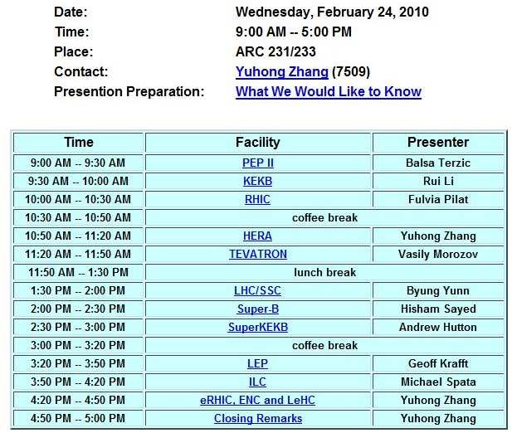
Warm-up: Collider Review Retreat
(Feb. 24, 2010)
Purpose
  Review designs, commissioning & operations of colliders worldwide
  Learn from the experts & previous experiences
  Find out what is the state-of-art
  Check what can be readily adopted in the MEIC design
  Be aware design pitfalls
  Create reference repository
http://casa.jlab.org/meic/workshops/collider_retreat/collider_retreat.shtml

Slide 53
MEIC Design Week
(March 4-8, 2010)
Purpose and deliverables
  Evaluate high level design options & choices
  Specify design guideline (requirement, layout) for major components
  Identify key issues which need future special attention
  Task assignments
Program (3 hours each session)
  * Day 1: Ion collider ring * Day 4: Electron cooler
  * Day 2: Electron collider ring * Day 5: All other remaining issues
  * Day 3: Interaction region * Video-conf (w/ANL): Low energy ion complex
reviewed Issues | Discussion Leaders
Orientation of detector | Nadel-Turonski, Derbenev
Round-to-flat ion beam transform | Derbenev, Yunn
Design polarization rotator | Chetsov
Define beam stay-clear | Terzic, Derbenev
Arc layout (horizontal or stacked) | Morozov
Define strategy for beam synchronization | Derbenev, Hutton
Applicability of nano beam/crab waist | Li
Vertical/horizontal beam emittance | Derbenev, Zhang

Slide 54
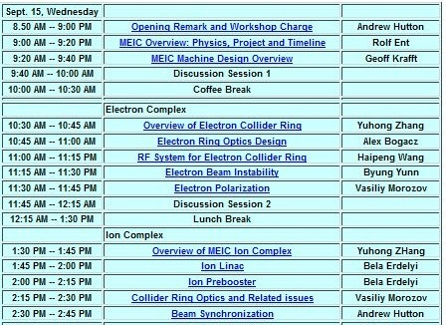
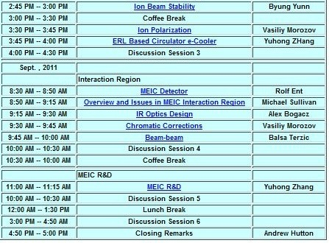
MEIC Internal Machine Design Review
(Sept. 15 & 16, 2010)
Reviewers: Alex Chao (SLAC),Georg Hoffstaetter (Cornell)
Charge: Evaluate the present status of the MEIC design
# Is the basis for the design credible? # Are there things that are missing?
# Are there concepts which need more work? # Are the proposed R&D plans
# Are there any concepts we could incorporate * Reasonable
  * Before the next EIC AC meeting * Properly prioritized
  * After the next EIC AC meeting # Any other suggestion?
  Outcome:
  Baseline design is good, no major problem/show stopper
  List of short, medium and long term R&D issues
http://casa.jlab.org/meic/workshops/review_2010/MEIC_review_2010.shtml

Slide 55
RF & Beam Synchronization Mini Workshop
(Oct. 29, 2010)
Purpose
Evaluating two critical design issues & deciding accelerating RF frequency
  RF system (frequency and RF/SRF technology)
  Synchronization of colliding beams over two IPs (ions not fully relativistic yet).
Conclusions
Luminosity, beam dynamics, synchronization, crab crossing, etc. all preferring higher bunch repetition rate (1.5 GHz or higher)
High RF power (for compensating 6 MW SR loss) for a high average current electron beam preferring a lower RF frequency (less than 1 GHz)
The optimized RF frequency for acceleration cavities will be 750 MHz
(may restore to 1.5 GHz in the future after more R&D)
Bunching and crabbing are still 1.5 GHz
8:30 -- 8:40 | Introduction and Charge | Y. Zhang
8:40 – 9:00 | Beam Dynamics/Accelerator Design Considerations | Ya. Derbenev
9:00 – 9:20 | Beam Synchronization Considerations | A. Hutton
9:20 – 9:40 | Ion beam Formation/Booster Design Considerations | T. Satogata
9:40 – 10:00 | RF System Considerations | R. Rimmer
10:20 – 11:50 | Discussions
11:50 – 12:00 | Closing | Y. Zhang

Slide 56
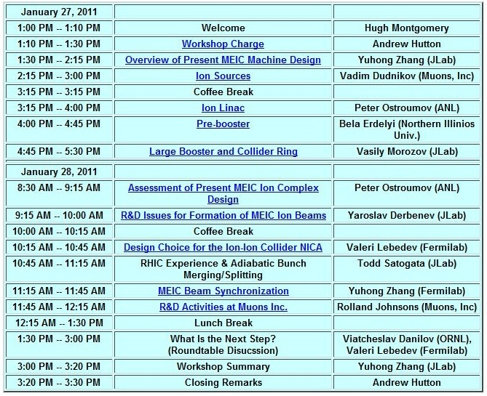
Ion Complex Design Mini-Workshop
Workshop Charge
Review the status of ion complex design
Identify missing parts of the design
Identify design inconsistency
Additional Charge
Identify key R&D required for this stage of conceptual design
Make a plan for future design work & R&D studies
Reach out and establish new collaborations
Participants (in addition to CASA members)
Collaborators: Vadim Dudnikov (Muons. Inc.)
Peter Ostroumov (ANL)
Bela Erdelyi (Nothern Illinonis U.)
Observers: Valeri Lebedev (FNAL)
Viatcheslav Danilov (Oak Ridge)
Charles Ankenbrandt (Muons, Inc)
Galina Dudinkova (U. of Maryland)
Rol Johnson (Muons, Inc.)
(Jan. 27 &28, 2011)
A day and half mini workshop
10 talks, one 90-min round-table discussion
Outcome was reasonably positive
http://casa.jlab.org/meic/workshops/ion_complex_design_2011/ion_complex_design_workshop_2011.shtml

Slide 57
Ion Complex Design Mini-Workshop (cont.)
Very big progress in ion complex design, but not done yet
It seems no fundamental problem or show-stopper, no need of redesign
However lots of small problems
Consistency between components is still a very serious issue, needs to be addressed immediately, at highest priority
Major issues for short term work
  Design of the large booster
  Determine where to re-bunch the beam
  (completing/solidifying ion beam formation scenario)
  Create a set of parameter tables following the ion beam, one for each component
Major issues for intermediate or long term work
  Investigating Optics Stochastic Cooling
  ERL circulator-ring based electron cooler design

Slide 58
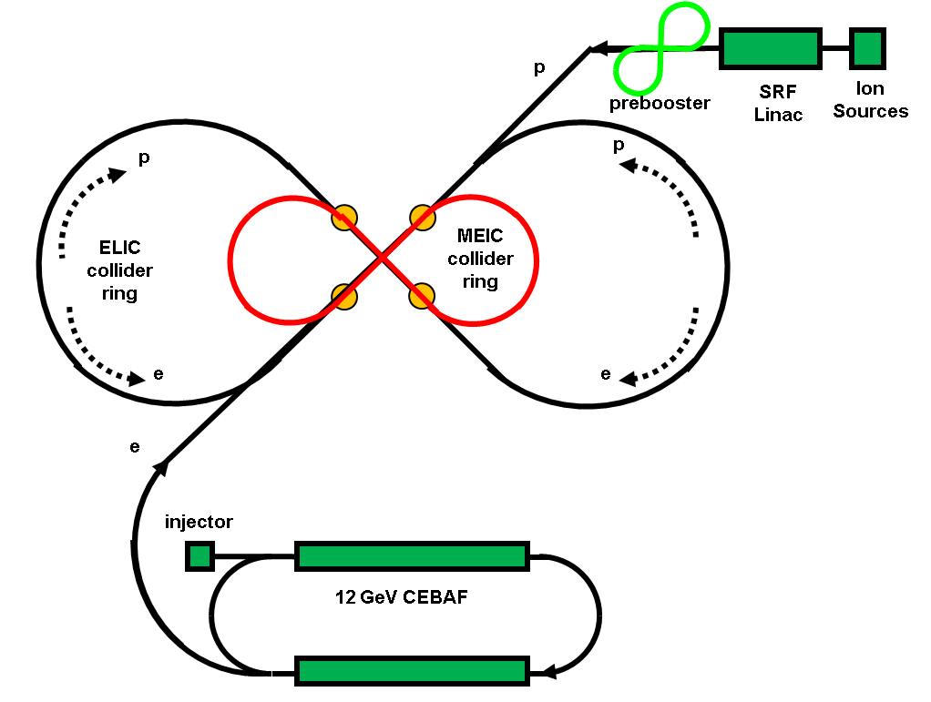
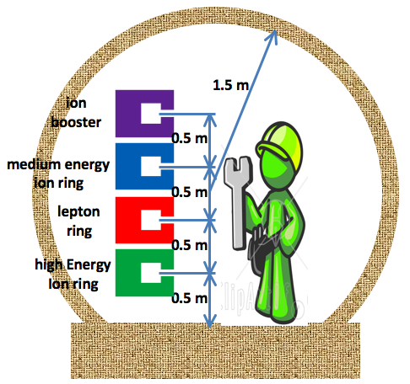
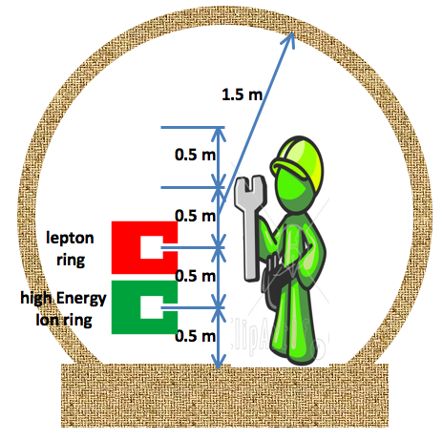
EIC@JLab: Going to High Energy
Straight tunnel
Serves as a large booster to the full energy collider ring
Large ring arc tunnel
Stage | Max. Energy (GeV/c) |  | Ring Size (m) | Ring Type |  | IP #
 | p | e |  | p | e
Medium | 96 | 11 | 1000 | Cold | Warm | 3
High | 250 | 20 | 2500 | Cold | Warm | 4
Notes:
58

Slide 59
MEIC/ELIC in JLab Site Map

Slide 60
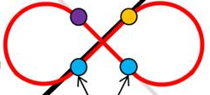
Reaching Down to Low Energy
electron ring
(1 km )
low energy IP
A compact (~200 m) ring dedicated to low energy ion
Compact low energy ion ring
Medium energy IP
Space charge effect is the leading limiting factor of ion beam current and luminosity
A small ring with one IP, two snakes, injection/ejection and RF
Ion energy range from 12 GeV to 20 GeV
Increasing ion current (and luminosity) by a factor of 5

Slide 61


MEIC/ELIC Luminosity Plot
A. Accardi

Slide 62
Achieving High Luminosity at MEIC
Luminosity Concepts (based on proven technologies)
  High bunch collision frequency (0.75 GHz, possibly up to 1.5 GHz)
  Small bunch charge, 4 nC for electron and 0.67 nC for proton
  Short ion bunches (σ_{z} ~ 2 cm)
  Strong final focusing (β*_{y} ~ 5 mm)
  Keys to implement these concepts
  Electron cooling for making short ion bunches with small emittance
  Crab crossing of the colliding beams
  SRF cavities for bunching and crabbing
  Additional ideas/concepts
  Parameters limited by the beam-beam effect
  Hour-glass correction for very low ion energy (bunches longer than β*)
  Large synchrotron tunes to suppress synchrotron-betatron resonances
  Equal (fractional) betatron phase advance between IP
  Advanced achromatic IP region focusing

Slide 63
Design Choices and Features
Figure-8 optimum for polarized ion beams
  Simple solution to preserve ion polarization by avoiding spin resonances during acceleration
  Energy independence of spin tune
  A figure-8 ring is the only practical way to for accelerating, storing and colliding polarized deuterons (g-2 is small for deuterons) .
  MEIC Design Features
Up to three IPs (detectors) for high science productivity
“Figure-8” ion and lepton storage rings
12 GeV CEBAF serves as a full energy injector to the electron ring
Simultaneous operation of the collider & the CEBAF fixed target program is possible
Experiments with a polarized positron beam are possible with addition of a positron source

Slide 64


Ion Sources Prototype & Parameters
Polarized light Ions
Non-Polarized Ions
Universal Atomic Beam Polarized Ion Sources (ABPIS)
Electron-Cyclotron Resonance Ion Source (ECR)
Electron-Cyclotron Resonance Ion Source (ECR)
Ions | Source Type | Pulse Width (µs) | Rep. Rate (Hz) | Pulsed current (mA) | Ions/pulse (10¹⁰) | Polarization (P_{z}) | Emittance (90%) (π·mm·mrad) | Note
H⁻/D⁻ | ABPIS | 500 | 5 | 4 (10) | 1000 | >90% (95) | 1.0 / 1.8 (1.2)
H⁻/D⁻ | ABPIS | 500 | 5 | 150 / 60 | 40000/15000 | 0 | 1.8
³He⁺⁺ | ABPIS-RX | 500 | 5 | 1 | 200 | 70% | 1
³He⁺⁺ | EBIS | 10 to 40 | 5 | 1 | 5 (1) | 70% | 1 | BNL
⁶Li⁺⁺⁺ | ABPIS | 500 | 5 | 0.1 | 20 | 70% | 1
Pb³⁰⁺ | EBIS | 10 | 5 | 1.3 (1.6) | 0.3 (0.5) | 0 | 1 | BNL
Au³²⁺ | EBIS | 10 to 40 | 5 | 1.4 (1.7) | 0.27 (0.34) | 0 | 1 | BNL
Pb³⁰⁺ | ECR | 500 | 5 | 0.5 | 0.5 (1) | 0 | 1
Au³²⁺ | ECR | 500 | 5 | 10.5 | 0.4 (0.6) | 0 | 1
Numbers in red are “realistic extrapolation for future”; numbers in blue are “performance requirements of BNL EBIS
MEIC ion sources rely on existing and matured technologies
Design parameters are within the state-of-art
V. Dudnikov

Slide 65
Ion Linac
Layout
Ion Sources
RFQ
IH
QWR
QWR
HWR
DSR
MEBT
Stripper
Normal conducting
Superconducting
Parameters | Unit | Value
Species |  | p to lead
Reference Design |  | ²⁰⁸Pb
Kinetic energy | MeV/u | 100
Max. averaged pulse current | mA | 2
Pulse repetition rate | Hz | 10
Pulse length | ms | 0.25
Max. beam pulsed power | kW | 680
Fundament frequency | MHz | 115
Total length | M | 150
Originally developed at ANL as a heavy-ion driver accelerator for Rare Isotope Beam Facility
All technical sub-systems are either commercially available or based on well-developed technologies
Adopted for MEIC ion linac for
  Satisfying MEIC ion linac requirement
  Covering similar energy range and variety of ion species
  Excellent and matured design
  Great saving on time and cost
  Only minor adjustments required
P. Ostroumov

Slide 66












Components of the Ion Linac
A Segment of the RFQ
Example of a short MEBT
Frequency | 115 MHz
Total length | 3.6 m
Voltage | 85 kV
Average radius | 7 mm
# segments | 4
Input energy | 25 keV
Output energy | 500 keV/u
Q1
Q2
Q3
Q4
Buncher
 | Length (mm) | Gradient (T/m)
Q1 | 20 | 23
Q2 | 50 | -22
Q3 | 50 | 32.75
Q4 | 50 | -16.5
Cavity | Unit | 1/4 Wave
Volt. | MV | 0.8
Freq. | MHz | 117.3
Length | mm | 340
Buncher Parameters
Quad Parameters
Normal Conducting IH structure
Normal Conducting IH cavities

Slide 67



SRF Components of the Ion Linac
Superconducting cavities
  119 cavities
  21 cryostats
Voltage gain per SRF cavity
Half-Wave Resonator (HWR)
Quarter Wave Resonator (QWR)
Stripping energy (lead)
proton
lead
Double Spoke Resonator (DSR)

Slide 68
Large Ion Booster (Low Energy Collider Ring)
Design consideration
  Accepting and stacking ion beam from pre-booster in 4 or 5 injections
  Accelerating protons to 20 GeV and ions to above 13.1 GeV/u
  Must be a Figure-8 ring
  Same footprint as the electron and medium energy ion collider
Avoiding crossing of transition energy in large booster and in collider ring
The transition energy of medium energy ion collider ring is 13.1 GeV
Must inject into the ion collider ring at above the transition energy
As a low energy collider ring
  Accommodate collisions of ions with energy from 12 to 20 GeV
  Storage of a low energy ion beam
  Electron cooling is also required for the low energy colliding beam
Work in progress

Slide 69
Stacking of Polarized Proton beam with an ABPIS Source
 |  | Source | Linac | Pre-booster |  | Large booster | Collider ring
 |  | ABPIS | exit | At Injection | After boost | After boost | After boost
Charge status |  | -1 | -1 | +1 | +1 | +1 | +1
 |  | H⁻ | H⁻ | H⁺ | H⁺ | H⁺ | H⁺
Kinetic energy | MeV/u | ~0 | 13.2 | 285 | 3000 | 20000 | 60000
γ |  |  |  | 1.3 | 4.2 | 22.3 | 64.9
β |  |  |  | 0.64 | 0.97 | 1 | 1
Velocity boost |  |  |  |  | 1.51 | 1.03 | 1
Pulse current | mA | 2 | 2 | 2
Pulse length | ms | 0.5 | 0.5 | 0.22
Charge per pulse | μC | 1 | 1 | 0.44
ions per pulse | 10¹² | 3.05 | 3.05 | 2.75
Number of pulses |  |  |  | 1
efficiency |  |  |  | 0.9
Total stored ions | 10¹² |  |  | 2.52 | 2.52 | 2.52x 5 | 2.52x5
Stored current | A |  |  | 0.33 | 0.5 | 0.5 | 0.5
Reason of current change |  |  |  |  | Change of velocity | Change of velocity

Slide 70
Stacking of Fully Stripped Lead Ions with an EBIS Source
 |  | Source | Linac | Pre-booster |  | Larger booster |  | Collider ring
 |  | EBIS | After stripper | At Injection | After boost | Stripping before injection | After boost | After boost
Charge status |  | 30 | 67 | 67 | 67 | 82 | 82 | 82
 |  | ²⁰⁸Pb³⁰⁺ | ²⁰⁸Pb⁶⁷⁺ | ²⁰⁸Pb⁶⁷⁺ | ²⁰⁸Pb⁶⁷⁺ | ²⁰⁸Pb⁸²⁺ | ²⁰⁸Pb⁸²⁺ | ²⁰⁸Pb⁸²⁺
Kinetic Energy | MeV/u | ~0 | 13.2 | 100 | 670 | 670 | 7885 | 23653
γ |  |  |  | 1.11 | 1.71 | 1.71 | 9.4 | 26.2
β |  |  |  | 0.43 | 0.81 | 0.81 | 0.99 | 1
Velocity boost |  |  |  |  | 1.88 |  | 1.1
Pulse current | mA | 1 to 4 | 0.28
Pulse length | ms | 0.01 to 0.04 | 0.04
Charge per pulse | μC | 0.056 (@1.4mA) | 0.011
ions per pulse | 10¹⁰ | 1.17 | 0.104
Number of pulses |  |  |  | 62
efficiency |  |  | 0.2 | 0.7 |  | 0.75
Total stored ions | 10¹⁰ |  |  | 4.5 | 4.5 | 3.375x5 | 3.375x5 | 3.375x5
Stored current | A |  |  | 0.26 | 0.5 | 0.447 | 0.54 | 0.54
Reason of current change |  |  | stripping | Multi-pulse injection | Change of velocity | stripping | Change of velocity

Slide 71
Stacking of Fully Stripped Lead Ions with an ECR Source
 |  | Source | Linac | Pre-booster |  | Larger booster |  | Collider ring
 |  | ECR | After stripper | At Injection | After boost | Stripping before injection | After Boost | After boost
Charge status |  | 30 | 67 | 67 | 67 | 82 | 82 | 82
 |  | ²⁰⁸Pb³⁰⁺ | ²⁰⁸Pb⁶⁷⁺ | ²⁰⁸Pb⁶⁷⁺ | ²⁰⁸Pb⁶⁷⁺ | ²⁰⁸Pb⁸²⁺ | ²⁰⁸Pb⁸²⁺ | ²⁰⁸Pb⁸²⁺
Kinetic pnergy | MeV/u | ~0 | 13.2 | 100 | 670 | 670 | 7885 | 23653
γ |  |  |  | 1.11 | 1.71 | 1.71 | 9.4 | 26.2
β |  |  |  | 0.43 | 0.81 | 0.81 | 0.99 | 1
Velocity boost |  |  |  |  | 1.88 |  | 1.22 | 1
Pulse current | mA | .5 | 0.1
Pulse length | ms | 0.25 | 0.25
Charge per pulse | μC | 0.125 | 0.025
ions per pulse | 10¹⁰ | 1.664 | 0.332
Number of pulses |  |  |  | 28
efficiency |  |  | 0.2 | 0.7 |  | 0.75
Total stored ions | 10¹⁰ |  |  | 4.5 | 4.5 | 3.375x5 | 3.375x5 | 3.375x5
Stored current | A |  |  | 0.26 | 0.5 | 0.447 | 0.54 | 0.54
Reason of current change |  |  | stripping | Multi-pulse injection | Change of velocity | stripping | Change of velocity

Slide 72
Formation of Ion Beams in MEIC
Sources
APBIS for H⁻/D⁻ and polarized light ions
ECR/EBIS for heavy ions
Accelerating (proton as an example)
Linac to 200 MeV
Pre-booster to 3 GeV
Large booster to 20 GeV
Ion collider ring to 97 GeV
Accumulation
  Stacking at the pre-booster to full beam current
  Fill large booster in 5 injections from the pre-booster
  Transport to the collider ring
Injection
  APBIS Stripping injection and painting
  DC e-cooling for heavy ions in the pre-booster
De-bunching/re-bunching
Become coast beams in the pre-booster after painting-injection
Recaptured in RF accelerating, then de-bunched
Final re-bunching to 750 MHz beam at the collider ring
Lead
Linac
Pre-booster
Large booster

Slide 73



Acceleration & RF Parameters in Pre-booster
Lead
Proton
Linac
Pre-booster
Longitudinal dynamics during the accelerating ramp in pre-booster
Large booster
Beginning
Middle
End

Slide 74
Proton beam Parameters in Pre-booster
General | Injection Energy | MeV | 285
 | Extraction Energy | MeV | 3000
 | Current at Extraction | A | 0.5
 | Total Number of protons in the ring | 10¹² | 2.52
Beam from Linac | Pulse Length | ms | 0.22
 | Frequency | MHz | 115
 | Number of Bunches in Pulse |  | 25300
 | Average Current per Pulse | mA | 2
 | Charge per Pulse | μC | 0.44
 | Number of Protons per Pulse | 10¹² | 2.75
 | Injection Efficiency |  | 0.9
 | Number of Pulses |  | 1
Timing | RF Acceleration Time | s | 0.12
 | Pre-booster Cycle Time | s | 0.2
Beam profile at Injection | Acceptance in x (ε_{x}) (uniform, normalized) | π mm.mrad | 92
 | Acceptance in y (ε_{y}) (uniform, normalized) | π mm.mrad | 50
 | Momentum Acceptance (Δp/p) | % | ±0.3
Beam profile at Extraction | Momentum Spread (Δp/p) | % | ±0.27
 | Bunch Length | μs | .166
Space Charge | RMS Emittance Un-normalized x | mm.mrad | 26
 | RMS Emittance Un-normalized y | mm.mrad | 14
 | RMS Emittance Un-normalized z | eV.s | 0.016
 | Laslett Tune Shift (after injection) |  | -0.025
 | Max Laslett Tune Shift (beginning of acceleration) |  | -0.038
 | Laslett Tune Shift (at extraction) |  | -0.006

Slide 75
Lead Ion beam Parameters in Pre-booster
General | Injection Energy | MeV/u | 100
 | Extraction Energy | MeV/u | 670
 | of Lead Ions in Pre-booster |  | +67
 | Current at Extraction | A | 0.5
 | Total Number of Lead Ions in the Ring | 10¹⁰ | 4.5
Beam from Linac | Pulse Length | ms | 0.25
 | Frequency | MHz | 115
 | Number of Bunches in Pulse |  | 28750
 | Average Current per Pulse | mA | 0.1
 | Charge per Pulse | μC | 0.025
 | Number of Lead Ions per Pulse | 10⁹ | 2.4
 | Injection Efficiency |  | 0.7
 | Number of Pulses |  | 28
Timing | Electron Energy for Electron Cooling | MeV | [.56,.88]
 | Electron Cooler Current | A | 0.3
 | Electron Cooler Length | m | 3
 | Transverse Cooling Time | ms | 16
 | Longitudinal Cooling Time | ms | 55
 | RF Acceleration Time | ms | 144
 | Pre-booster Cycle Time | s | 3.1
Beam Profile at Injection | Acceptance in x (ε_{x}) (uniform, normalized) | π mm · mrad | 92
 | Acceptance in y (ε_{y}) (uniform, normalized) | π mm · mrad | 50
 | Momentum Acceptance (Δp/p) | % | ±1
 | Emittance in x (ε_{x}) (uniform, normalized) | π mm · mrad | 50
 | Emittance in y (ε_{y}) (uniform, normalized) | π mm · mrad | 25
 | Momentum Spread (Δp/p) | % | ±0.3
Beam Profile after Cooling & Accumulation | Emittance in x (ε_{x}) (full, uniform, normalized) | π mm · mrad | 20
 | Emittance in y (ε_{y}) (full, uniform, normalized) | π mm · mrad | 10
 | Momentum spread (Δp/p) | % | ±0.054
Beam Profile at Extraction | Emittance in x (ε_{x}) (full, uniform, normalized) | π mm · mrad | 20
 | Emittance in y (ε_{y}) (full, uniform, normalized) | π mm · mrad | 10
 | Momentum spread (Δp/p) (95% capture efficiency) | % | ±0.21
 | Bunch Length | μs | 0.386
Space Charge | Laslett Tune Shift (at injection) |  | -0.16
 | Maximum Laslett Tune Shift (beginning of acceleration) |  | -0.3
 | Laslett Tune Shift (at extraction) |  | -0.09

Slide 76
Acceleration & RF Parameters in Booster
 |  | Proton | Lead
Initial Kinetic Energy | MeV/u | 285 | 100
Final Kinetic Energy | MeV/u | 3000 | 670
Initial momentum spread | % | ±0.3 | ±0.054
Initial Beam emittance (RMS) | eV·s | 0.295 | 6.48
RF harmonic number |  | 1 | 1
RF frequency | MHz | [0.82,1.25] | [0.55,1.04]
Maximum RF voltage | kV | 51.2 | 48.8
Maximum phase | deg | 50 | 50
Momentum Compaction |  | 0.039 | 0.039
Final capture efficiency factor |  | 0.999 | 0.95
Final momentum spread | % | ±0.27 | ±0.11
Final Beam emittance (RMS) | eV·s | 0.19 | 8.00
Total turns |  | 130000 | 115000
Acceleration period | ms | 117 | 144
Bunch Length | μs | 0.166 | 0.386
Initial Kinetic Energy | MeV/u | 3000
Final Kinetic Energy | MeV/u | 20000
Assumed Momentum Compaction |  | 0.039
Accumulation Stage
Initial momentum spread | % | ±0.27
Initial Beam emittance (RMS) | eV·s | 0.19
RF harmonic number |  | 5
RF frequency | MHz | 1.21
Maximum RF voltage | kV | 15
Final capture efficiency factor |  | 1
Total turns |  | 194172
Accumulation time | s | 0.8
Minimum bunch separation | μs | 0.25
Maximum bunch separation | μs | 0.48
Acceleration Stage
RF harmonic number |  | 5
RF frequency | MHz | [1.21,1.24]
Maximum RF voltage | kV | 208
Final capture efficiency factor |  | 1
Final momentum spread | % | ±0.4
Final Beam emittance (RMS) | eV·s | 0.38
Total turns |  | 200000
Acceleration period | ms | 806
Average bunch separation | μs | 0.71

Slide 77




MEIC Electron Collider Ring
Circumference | m | 1340.41
Total bend angle/arc | deg | 240
Figure-8 crossing angle | deg | 60
Averaged arc radius | m | 97
Arc length | m | 406
Long and short straight | m | 264 / 20
Lattice base cell |  | FODO
Cells in arc / straight |  | 80 / 40
Arc/Straight cell length | m | 5.25 / 5.58
Phase advance per cell | m | 120 / 120
Betatron tunes (ν_{x,} ν_{y}) |  | 61.501184 / 60. 526639
Transition gamma |  | 42
Dispersion suppression |  | Adjusting quad strength
Dipole
Length | m | 1.5
Bending radius | M | 43.5
Bending Angle | deg | 1.98
Field | T | 0.38
Quad
Length | M | 0.4
Strength @ 5GeV | T/m | 29
ARC FODO CELL
Dispersion Suppressor
Short Straight
A. Bogacz & V. Morozov

Slide 78
Colliding Electron Beam
Electron beam formation
CEBAF as a full energy injector
Multi-turn (10 to 20) injection, phase space equilibrating by radiation damping
(repeat the process until done, about 1 min)
Optional top-off mode
Energy | GeV | 5 | 11
Revolution time | µs | 4.5 | 4.5
Revolution frequency | MHz | 0.22 | 0.22
Beam current | A | 3 | 0.18
Bunch repetition rate | GHz | 0.75 | 0.75
Bunch spacing | m | 0.4 | 0.4
Number of bunches |  | 3350 | 3350
Electrons per bunch | 10¹⁰ | 2.5 | 0.15
Total radiation power | MW | 5.3 | 7.6
Radiation power density | kW/m | 14 | 20
Energy loss per turn | MeV | 1.8 | 41.5
Damping time, longitudinal | ms | 12.6 | 1.2
Hori. emit., norm, uncoupled | µm | 65 | 690
Vert. emit., norm., | µm
Energy spread | 10⁻³ | 0.66 | 1.5
Bunch length, RMS | mm | 5.3 | 4.0
Betatron tune, horizontal |  | 61.501 | 61.50
Betatron tune, vertical |  | 60.526 | 60. 527
Synchrotron tune |  | 0.015 | 0.044
Integrated RF voltage | MV | 4.2 | 83
Synchronous phase | deg | 25 | 30
RF momentum acceptance | 10⁻³ | 11 | 29
From CEBAF SRF Linac
1.33 ns (40 cm)
0.75 GHz
<3.3 ps
(<1 mm)
0.2 pC
Microscopic bunch duty factor 2.5x10⁻³
10-turn injection
33.3 μs (2 pC)
In collider ring
40 ms
(~5 damping times)
25 Hz
Macroscopic bunch duty factor 8.3x10⁻³
80 s

Slide 79
MEIC Primary “Full-Acceptance” Detector
detectors
(approximately to scale)
solenoid
ion FFQs
ion dipole w/ detectors
ions
0 mrad
IP
electrons
50 mrad
2 m
electron FFQs
2+3 m
2 m
Detect particles with angles below 0.5º beyond ion FFQs and in arcs.
Central detector, more detection space in ion direction as particles have higher momenta
Detect particles with angles down to 0.5º before ion FFQs.
Need up to 2 Tm dipole in addition to central solenoid.
Make use of the (50 mr) crossing angle for ions!
Central detector
Solenoid yoke + Muon Detector
TOF
Solenoid yoke + Hadronic Calorimeter
Distance IP – electron FFQs = 3.5 m Distance IP – ion FFQs = 7.0 m (Driven by push to 0.5 degrees detection before ion FFQs)
Cerenkov
Muon Detector
EM Calorimeter
4-5 m
HTCC
Tracking
RICH
EM Calorimeter
Hadron Calorimeter
2 m
3 m
2 m
R. Ent, T. Horn, P. Nadel-Turonski

Slide 80



Interaction region: Electrons
Final Focusing Block (FFB)
Chromaticity Compensation Block (CCB)
Beam Extension Section
3.5 m
β_{y}^{max} ~ 600 m
β_{x}* = 10 cm
β_{y}* = 2 cm
Distance from the IP to the first quad = 3.5 m
Maximum quad strength at 5 GeV/c
  49.5 T/m at Final Focusing Block
  4.2 T/m at Chromaticity Compensation Block
  20.1 T/m at Beam Extension Section
Symmetric CCB design (both orbital motion & dispersion required) for efficient chromatic correction
Whole Interaction Region: 125 m

Slide 81


Chromatic Correction Scheme
Low β* (strong final focusing) is a key ingredient of the high luminosity concept of MEIC deign
Low β* can cause serious chromatic effect
  Large betatron tune shift
  Large beam size spread at interaction point (beta smear)
The leading (linear) chromatic term must be corrected by sextupole compensation
Non-linear field effects must be also accounted for in the scheme
Symmetric Concept (Ya. Derbenev)
Dedicated Chromaticity Compensation Block (CCB) is symmetric (i.e., betatron function and dispersions) around IP
The model assumes large parallel beam and ignores small angular divergence
Symmetry will reduce number of compensation conditions
sextupole

Slide 82
Synchrotron Radiation At IR
P⁺
Synchrotron radiation photons incident on various surfaces from the last 4 electron quads
38
8.5x10⁵
2.5W
4.6x10⁴
240
2
50 mrad
3080
e⁻
Beam current = 2.32 A 2.9x10¹⁰ particles/bunch
Rate per bunch incident on the surface > 10 keV
X
Rate per bunch incident on the detector beam pipe assuming 1% reflection coefficient and solid angle acceptance of 4.4 %
M. Sullivan, July 20, 2010
F$JLAB_E_3_5M_1A
Z
Beam related detector backgrounds must be carefully analyzed and mitigation schemes developed that allow the detector to pull out the physics
  Electron beams: controlling synchrotron radiation backgrounds and lost beam particles
  Ion beams: controlling the lost beam particles
Initial look at synchrotron radiation indicates that this background should not be a problem
The new MEIC design, ion beam will be bent for crab crossing, minimizing SR in IR
Beam stay-clear: 12 sigma
M. Sullivan

Slide 83

Electron Polarization
Design Requirements
High (>80%) polarization of stored electron beam and sufficiently lifetime (>20 min)
Longitudinal polarization at all interaction points
Alternating bunch-to-bunch polarization (“spin flip”)
Comparably high polarization of a stored positron beam (sufficiently fast self-polarization)
Design Choices
Highly polarized beam injected from CEBAF
Maintaining high electron beam polarization through
  Sokolov-Ternov self-polarization (spin anti-parallel to bending field in the arcs)
  Spin-tune solenoid(s) for polarization stability
Longitudinal electron polarization at IP’s using Universal Spin Rotators
Universal Spin Rotator
IP
spin
Spin Tune Solenoid
Spin
P. Chevtsov

Slide 84

Universal Spin Rotator
Rotating spin from vertical to longitudinal
Consists of 2 solenoids & 2 (fixed angle) arc dipoles
Universal
➔ energy independent
works for all energies (3 to 11 GeV)
➔ orbit independent
does not affect orbital geometry
X-Y decoupling of solenoid
V. Livinenko &
A. Zholents, 1980
v
L
e⁻
Decoupling insertion
spin
L/2
L/2
arc dipole
arc dipole
Solenoid 1
Solenoid 2
Electron beam
H. Sayed’s implementation
α₁≈8.8º
φ₁
spin
α₂≈4.4º
φ₂
E (GeV) | ϕ₁ | BL₁ (Tm) | α₁ | ϕ₂ | BL₂ (Tm) | α₂
3 | π/2 | 15.7 | π/3 | 0 | 0 | π/6
6 | 0.62 | 12.3 | 2π/3 | 1.91 | 38.2 | π/3
9 | π/6 | 15.7 | π | 2π/3 | 62.8 | π/2
12 | 0.62 | 24.6 | 4π/3 | 1.91 | 76.4 | 2π/3
solenoid
4.16 m
decoupling quad insert
solenoid 4.16 m
P. Chevtsov, H. Sayed

Slide 85
Deuteron Polarizations at IPs
Case 1: Longitudinal Deuteron Polarization at IP’s
Sable spin orientation can be controlled by magnetic inserts providing small spin rotation around certain axis and shifting spin tune sufficiently away from 0
Polarization is stable as long as additional spin rotation exceeds perturbations of spin motion
Polarization direction controlled in one of two straights
Longitudinal polarization in a straight by inserting solenoid(s) in that straight
Solenoid
Case 2: Transverse Deuteron Polarization at IP’s
Magnetic insert(s) in straight(s) rotating spin by relatively small angle around vertical axis (Prof. A. Kondratenko)
Insertion

Slide 86
Design of Electron Cooler
Requirements and Challenges
  Cooling electron beam
    Up to 1.5 A CW beam at 750 MHz repetition rate, about 4 nC bunch charge
    About 130 kC per day from source/photo-injector (state-of-art is 0.2 kC per day)
    ➔ 1st challenge: cathode lifetime
  Energy of cooling electron beam
      up to 33 MeV for cooling 60 GeV medium energy protons
  Beam power
    Up to 50 MW
      ➔ 2nd challenge: RF power
Design Choice: ERL Based Circulator Cooler (ERL-CCR)
Energy Recovery Linac (ERL) ➔ solving 2nd challenge, RF power
Circulator-cooler ring (CCR) ➔ solving 1st challenge, reducing average
current from source/ERL

Slide 87

Location! Location! It Does Matter !
10 m
Solenoid (7.5 m)
injector
SRF ERL
dumper
Eliminating a long return path of the circulator ring could
cut cooling time by half, or
reduce the cooling electron current by half, or
reduce the number of circulating by half

Slide 88
ELIC e-Cooler Design Parameters
Number of turns in circulator cooler ring is determined by degradation of electron beam quality caused by inter/intra beam heating up and space charge effect.
Space charge effect could be a leading issue when electron beam energy is low.
It is estimated that beam quality (as well as cooling efficiency) is still good enough after 100 to 300 turns in circulator ring.
This leads directly to a 100 to 300 times saving of electron currents from the source/injector and ERL.
Max/min energy of e-beam | MeV | 33/8
Electrons/bunch | 10¹⁰ | 3.75
bunch revolutions in CCR |  | ~300
Current in CCR/ERL | A | 3/0.01
Bunch repetition in CCR/ERL | MHz | 500/1.67
CCR circumference | m | 80
Cooling section length | m | 15
Circulation duration | μs | 27
Bunch length | cm | 1-3
Energy spread | 10⁻⁴ | 1-3
Solenoid field in cooling section | T | 2
Beam radius in solenoid | mm | ~1
Beta-function | m | 0.5
Thermal cyclotron radius | μm | 2
Beam radius at cathode | mm | 3
Solenoid field at cathode | KG | 2
Laslett’s tune shift @60 MeV |  | 0.07
Longitudinal inter/intra beam heating | μs | 200

Slide 89

Technologies for MEIC e-Cooler
High intensity photo-injector
Beam-beam fast kicker
solenoids
SRF modules
F
V. Shiltsev, 1996
300keV DC gun
buncher
surface charge density
v≈c
quads
D
h
σ_{c}
kicking beam
L
v₀
Energy Recovery Linac
JLab is world leader in ERL technology !
A short (1~ 3 cm) electron bunch passes through a long (15 ~ 50 cm) low-energy flat bunch at a very close distance, receiving a transverse kick
Simulation studies will be initiated.
Circulating beam energy | MeV | 33
Kicking beam energy | MeV | ~0.3
Repetition frequency | MHz | 5 -15
Kicking angle | mrad | 0.2
Kinking bunch length | cm | 15~50
Kinking bunch width | cm | 0.5
Bunch charge | nC | 2
Circulator Ring
Number of turns depends on degradation of the electron beam due to inter & intra beam scattering and space charge effects
Duration of kicking should be less than bunch spacing (~0.67 ns) if replacing bunch-by-bunch
An ultra-fast RF kicker is also under development.

Slide 90
Flat-to-Round Beam Transform & Reduction of Space Charge
Flat colliding ion beam and space charge
  Colliding ion beam should be flat at interaction point in order to match flat electron beam (due to synchrotron radiation)
  Space charge tune shift is a leading limiting factor for low energy ion beam, and it further effect luminosity of the collider
  Flat beam enhances space charge tune-shift . i.e., Laslett tune-shift is determined by smaller transverse dimension
Luminosity optimization: flat-to-round transform
if colliding ion beam can be arranged as
  flat at interaction point ➔ matching flat electron beam
  Round in the storage ➔ maintaining large transverse beam area for overcoming space charge
Technical feasibility
  circular (100% coupled) optics (ring) under matched cooling
  Special adapters to converting round beam to flat beam and back to round beam at collision point
Ya. Derbenev
Notes:
90

Slide 91
Advanced Concepts of Electron Cooling
Staged cooling
  Start electron cooling (longitudinal) in collider ring at injection energy,
  Continue e-cooling (in all dimension) after acceleration to high energy
Sweep cooling
  After transverse stochastic cooling, ion beam has a small transverse temperature but large longitudinal one.
  Use sweep cooling to gain a factor of longitudinal cooling time
F(v)
0
v
Dispersive cooling
  compensates for lack of transverse cooling rate at high energies due to large transverse velocity spread compared to the longitudinal (in rest frame) caused by IBS
Flat beam cooling
  based on flattening ion beam by reduction of coupling around the ring
  IBS rate at equilibrium reduced compared to cooling rate
Ya. Derbenev

Slide 92
Beam Synchronization: Change of Number of Bunches In the Ion Ring
Only one IP
Two IPs with equaidistance
Energy (GeV/u) |  |  | β | Harmonic Number
Proton | Deut. | Lead
60 |  |  | 0.99988 | 2500
29.04 | 29.04 |  | 0.99948 | 2501
21.86 | 21.86 | 21.86 | 0.99908 | 2502
 | 18.26 | 18.26 | 0.99868 | 2503
 | 16.01 | 16.01 | 0.99828 | 2504
 | 14.42 | 14.42 | 0.99788 | 2505
Energy (GeV/u) |  |  | β | Harmonic Number
Proton | Deut. | Lead
60 |  |  | 0.99988 | 2500
 | 21.86 | 21.86 | 0.99908 | 2502
 | 16.01 | 16.01 | 0.99828 | 2504
 | 13.23 | 13.23 | 0.99761 | 2506
Assuming two IPs are separated by equal distance on both sides
Harmonic number has to be changed by unit of 2
Change of harmonic number of ion rings could make colliding beam synchronized over a set of discrete energy values of protons/ions.
This could be a solution for low energy (< 30 GeV) protons and all other ions since the discrete energies provides sufficient choices for physics
The case of two IPs requires change of harmonic number by a unit of 2, pushing the next “harmonic energy” even lower however much denser.

Slide 93
Beam Synchronization:
Change of Orbit/RF Frequency
to cover the medium energy of proton (30 to 60 GeV)
Change of path length
it is possible to change the path length in the ion ring or in the electron
  * For one IP, need 20 cm * For two IPs, need 40 cm
  Ion ring: mounting superconducting magnets on movers, unpleasant but possibly affordable
  Electron ring: much easier, by making magnet bore larger
Change of RF frequency
  Technically possible for both worm and cold magnets
  Should not be large than 10⁻³
Scheme | Change of ion pathlength | Change of electron pathlength
Ion Orbit | Varying | Fixed
Electron orbit | Fixed | Varying
e-cooler orbit | Varying | Varying
Ion ring harmonic number | Varying | Varying
Electron ring harmonic number | Fixed | Fixed
Bunch frequency | Fixed | Varying

Slide 94
Beam Synchronization: Change of electron Path-length & RF Frequency
Single IP
Change of ring radius
Energy |  |  |  |  | Collider Ring |  |  |  |  | Circulator Cooler
Proton | Deut. | Lead | γ | β | Harmonic | f | δf/f₀ | δL_{e} | δR_{e} | Harmonic | δL_{c} | δR_{c}
GeV/u |  |  |  |  | Number | MHz | 10⁻⁴ | cm | cm | Number | cm | cm
60 |  |  | 63.95 | 0.99988 | 2500 | 748.5 | 0 | 0 | 0 | 125 | 0 | 0
55 |  |  | 58.62 | 0.99985 | 2500 | 748.483 | -0.23 | 2.3 | 0.28 | 125 | 0 | 0
50 |  |  | 53.29 | 0.99982 | 2500 | 748.457 | -0.54 | 5.4 | 0.64 | 125 | 0 | 0
45 |  |  | 47.96 | 0.99979 | 2500 | 748.429 | -0.95 | 9.53 | 1.14 | 125 | 0 | 0
40 |  |  | 42.63 | 0.99972 | 2500 | 748.386 | -1.53 | 15.3 | 1.83 | 125 | 0 | 0
37.5 |  |  | 39.97 | 0.99969 | 2500 | 748.357 | -1.91 | 19.1 | 2.28 | 125 | 0 | 0
35 |  |  | 37.3 | 0.99964 | 2501 | 748.622 | 1.63 | -16.3 | -1.95 | 125 | -2.0 | -0.24
32.5 |  |  | 34.64 | 0.99958 | 2501 | 748.579 | 1.05 | -10.5 | -1.26 | 125 | -2.0 | -0.24
30 | 30 |  | 31.97 | 0.99951 | 2501 | 748.526 | 0.33 | -3.29 | -0.39 | 125 | -2.0 | -0.24
29.04 | 29.04 |  | 30.95 | 0.99948 | 2501 | 748.5 | 0 | 0 | 0 | 125 | -2.0 | -0.24
28 | 28 |  | 29.84 | 0.99944 | 2501 | 748.470 | -0.40 | 3.96 | 0.47 | 125 | -2.0 | -0.24
26 | 26 |  | 27.71 | 0.99935 | 2501 | 748.403 | -1.29 | 12.95 | 1.55 | 125 | -2.0 | -0.24
25 | 25 |  | 26.65 | 0.99930 | 2501 | 748.363 | -1.83 | 18.28 | 2.18 | 125 | -2.0 | -0.24
24 | 24 |  | 25.58 | 0.99924 | 2502 | 748.618 | 1.57 | 15.7 | 1.88 | 125 | -4.0 | -0.48
23 | 23 | 23 | 24.51 | 0.99917 | 2502 | 748.567 | 0.89 | -8.93 | -1.07 | 125 | -4.0 | -0.48
21.86 | 21.86 | 21.86 | 23.3 | 0.99908 | 2502 | 748.5 | 0 | 0 | 0 | 125 | -4.0 | -0.48

Slide 95
Beam Synchronization: Change of electron Path-length & RF Frequency
Two IPs with equidistance
Energy |  |  |  |  | Collider Ring |  |  |  |  | Circulator Cooler
Proton | Deut. | Lead | γ | β | Harmonic | f | δf/f₀ | δL_{e} | δR_{e} | Harmonic | δL_{c} | δR_{c}
GeV/u |  |  |  |  | Number | MHz | 10⁻⁴ | cm | cm | Number | cm | cm
60 |  |  | 63.95 | 0.99988 | 2500 | 748.5 | 0 | 0 | 0 | 125 | 0 | 0
55 |  |  | 58.62 | 0.99985 | 2500 | 748.483 | -0.23 | 2.3 | 0.28 | 125 | 0 | 0
50 |  |  | 53.29 | 0.99982 | 2500 | 748.457 | -0.54 | 5.4 | 0.64 | 125 | 0 | 0
45 |  |  | 47.96 | 0.99979 | 2500 | 748.429 | -0.95 | 9.53 | 1.14 | 125 | 0 | 0
40 |  |  | 42.63 | 0.99972 | 2500 | 748.386 | -1.53 | 15.3 | 1.83 | 125 | 0 | 0
35 |  |  | 37.3 | 0.99964 | 2500 | 748.323 | -2.37 | 23.8 | 2.84 | 125 | 0 | 0
30 | 30 |  | 31.97 | 0.99951 | 2502 | 748.225 | -3.67 | 36.8 | 4.39 | 125 | 0 | 0
28 | 28 |  | 29.84 | 0.99944 | 2502 | 748.770 | 3.60 | -36.1 | -4.30 | 125 | -4.0 | -0.48
26 | 26 |  | 27.71 | 0.99935 | 2502 | 748.702 | 2.70 | -27.1 | -3.23 | 125 | -4.0 | -0.48
24 | 24 |  | 25.58 | 0.99924 | 2502 | 748.618 | 1.57 | 15.7 | -1.88 | 125 | -4.0 | -0.48
23 | 23 | 23 | 24.51 | 0.99917 | 2502 | 748.567 | 0.89 | -8.93 | -1.07 | 125 | -4.0 | -0.48
21.86 | 21.86 | 21.86 | 23.3 | 0.99908 | 2502 | 748.5 | 0 | 0 | 0 | 125 | -4.0 | -0.48
20 | 20 | 20 | 21.32 | 0.99890 | 2502 | 748.366 | -1.80 | 18.0 | 2.15 | 125 | -4.0 | -0.48
 | 19 | 19 | 20.25 | 0.99878 | 2502 | 748.276 | -3.00 | 29.9 | 3.57 | 125 | -4.0 | -0.48
 | 18 | 18 | 19.18 | 0.99864 | 2504 | 748.770 | 3.61 | -36.1 | -4.31 | 125 | -8.0 | -0.95
Harmonic number has to be changed by a unit of 2

Slide 96
Beam Instabilities & Feedback
The fastest growth times of a dipole mode longitudinal and transverse Coupled Bunch Mode Instabilities (CBMIs) are 43 μs, and 300 μs, respectively, assuming
  ring = 5 GeV MEIC electron ring
  total stored current = 3 A
  total bunches = 5000
  RF frequency = 1500 MHz
  RF cavity = CEBAF type 6 cell normal conducting cavity
All transverse CBMIs can be damped by a bunch-by-bunch digital transverse beam feedback system because the damping time of modern FPGA based transverse feedback system is much faster than 300 μs
examples, 200 μs for NSLS-II, 120 μs for SuperB project.
Since the damping time of modern FPGA based digital feedback system is about 1 ms it will be a challenging for us to develop a digital longitudinal feedback system which can damp all longitudinal CBMIs within 43 μs @ f_{RF} = 1500 MHz.
exception, damping time of feedback system for DAΦNE ~ 90 μs @ f_{RF} = 368 MHz
Y. Kim

Slide 97
Positrons in ELIC
Non-polarized positron bunches generated from modified electron injector through a converter
Polarization realized through self-polarization at ring arcs
Transverse
Transverse
emittance
10
emittance
10
MeV
MeV
filter
filter
e+
5
e+
5
MeV
MeV
Longitudinal
Longitudinal
emittance filter
emittance filter
converter
converter
e
e
-
-
polarized
polarized
source
source
15
15
MeV
e
MeV
e
-
-
e
e
-
-
e
e
-
-
e
e
-
-
e+
e+
e+
e+
e+
e+
dipole
dipole
dipole
dipole
dipole
115
dipole
115
MeV
MeV
e
e
-
-
During positron production:
- Polarized source is off
- Dipoles are turned on
15
15
MeV
unpolarized
MeV
unpolarized
source
source

Slide 98
MEIC Accelerator R&D
Focal Point 1: ERL Based Circulator Electron Cooler Design
Sub tasks: Conceptual design of e-cooler and cooling simulations
Injector/ERL and circulator ring machine design
Tracking studies of cooling electron beam and two beam collective effects
Proof-of-principle experiment for MEIC e-cooler
Focal Point 2: Interaction Region Design
Sub tasks: Optimization of MEIC IR design
Tracking and dynamic aperture studies
Crab crossing with crab cavity and dispersive crabing
Beam-beam simulations (long term behavior and luminosity lifetime)
Focal Point 3: Polarized Beams in Figure-8 Ring
Sub tasks: Spin matching and tracking studies of electron beam
Optimization of ion spin manipulation in Figure-8 ring
Focal Point 4 Collective Beam Effects
Sub tasks: Beam instabilities and feedback

