Slide 1
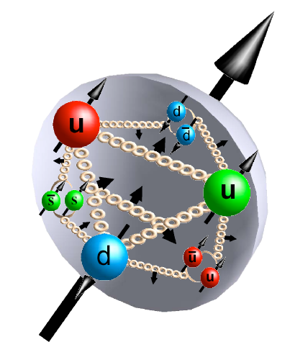
EIC Advisory Committee Meeting April 10, 2011 - Newport News, VA
Compelling Opportunities
in Spin Physics*
at an EIC
Marco Stratmann
marco@bnl.gov
* this talk: focus only on the proton’s helicity structure

Slide 2
outstanding questions in Spin Physics …
vigorous experimental programs in past 25 years (SLAC, CERN, DESY, JLAB, BNL)
matched by theoretical progress (NLO, global analyses, PDF uncertainties, …)
yet, we still lack a satisfactory understanding of the proton’s helicity structure:
gluons appear to carry very little of the proton spin for
but what is their role at small x where they are most abundant ?
--> cannot compute full x-integral reliably (enters proton spin sum)
--> what is the proper QCD dynamics at small x? DGLAP?
what is the flavor decomposition of the polarized sea depending on x ?
models predict certain patterns, e.g., for - not verified yet
hints for unexpectedly small strangeness polarization for
--> does the small x behavior of comply with expectations from SU(3) ?
--> do we observe an asymmetry in ?
do we observe “helicity retention” as ?
strength of JLab 12 but EIC contributes at much larger Q²

Slide 3
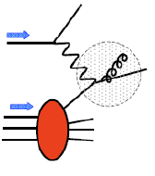
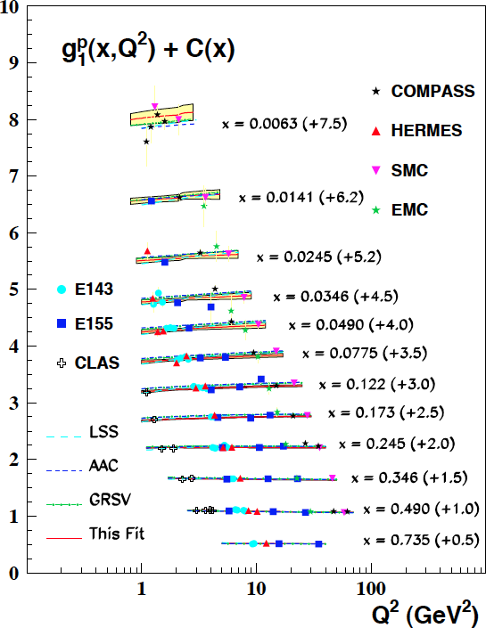
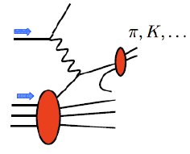
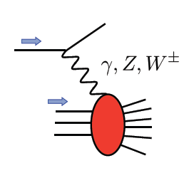
… and how to address them at the EIC
current
x_{min} = 0.006
scaling violations in DIS
world’s best probe of unpol. gluon at small x (HERA)
need large Q² range at any given x to work
key prediction of pQCD
theory well under control
from Blumlein, Bottcher fit
semi-inclusive DIS
successfully used in fixed target regime (HERMES, COMPASS)
requires particle ID in large kinematic range
provides flavor separation
fragmentation functions should be known well enough in 2020+
novel electroweak probes / DIS structure fcts.
HERA measured unpol. NC/CC DIS & extracted e-w parameters
never done with polarized protons; CC inaccessible if Q² << M_{W}² (fixed target regime)
flavor separation for x > 0.01; probes PDFs at medium-to-large x
need to be able to reconstruct x,Q² from hadrons for CC events

Slide 4
why does it matter?
spin deeply rooted in space-time symmetry
mass and spin (Pauli-Lubanski operator) are the two invariants of the Poincare group
learn about QCD dynamics and factorization in the presence of spin
understanding of partonic structure of nucleons otherwise incomplete
need to know both helicity configurations not only their average (= unpol. PDFs)
the spin of the proton is the result of a subtle interplay
of quark and gluon spins and their angular momenta
we should aim to understand this fundamental problem

Slide 5
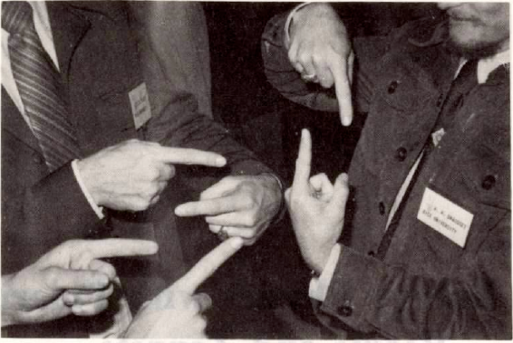
Compelling Spin Measurements at the EIC

Slide 6
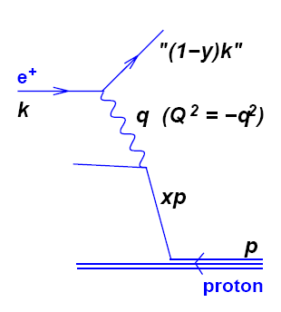
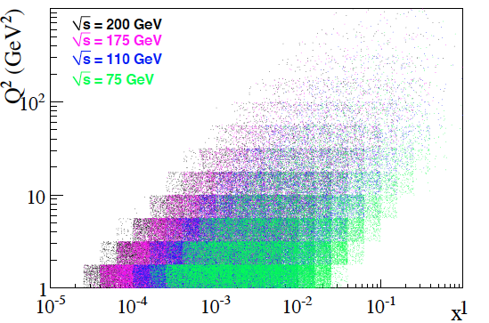
key to EIC program: large & variable kinematic coverage
recall: DIS kinematics
electron
Q² : proton virtuality $ resolution r»1/Q
at which the proton is probed
x: longitudinal momentum fraction of
struck parton in the proton
y: momentum fraction lost by
electron in the proton rest frame
EIC stage-1:
small x pol. DIS
lever arm for F_{L}
eRHIC 5x50, 5x100, …, 5x250, 5x325
MEIC 11x60
EIC:
up to

Slide 7
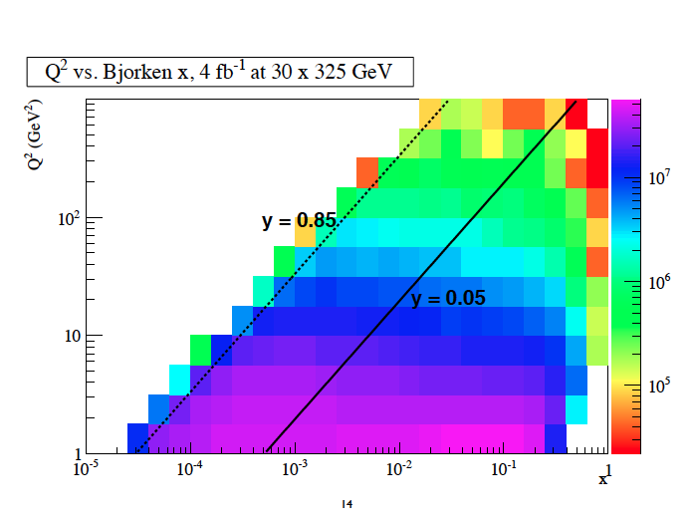
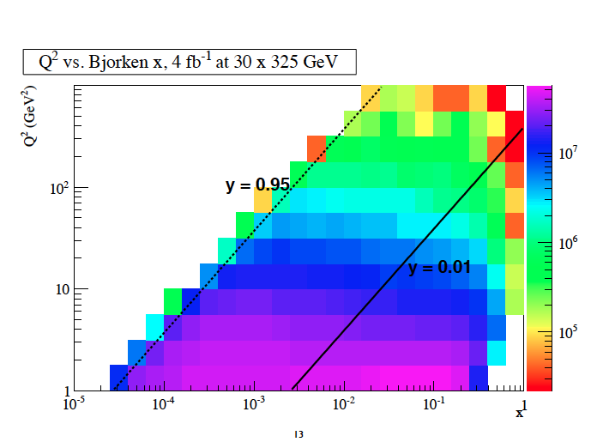
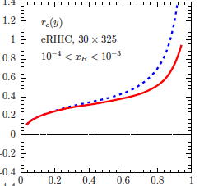
kinematics – a closer look, issues
find out how low in y we can go
E. Aschenauer, T. Burton
increase x,Q² coverage for each S
more overlap between different S
larger lever-arm for Q² evolution
at fixed x
upper y cut much less critical
tagging of the scattered electron
E_{e’}
E_{e}
Θ_{e’}
need to detect electrons at forward Θ=π
QED radiative corrections
known to be significant at HERA
need to control them & reconstruct true x, Q² reliably
unfolding requires iterative procedure
exploit different methods to reconstruct x,Q²
(“electron”, “Jacquet-Blondel”, “combined”)
Spiesberger
y

Slide 8
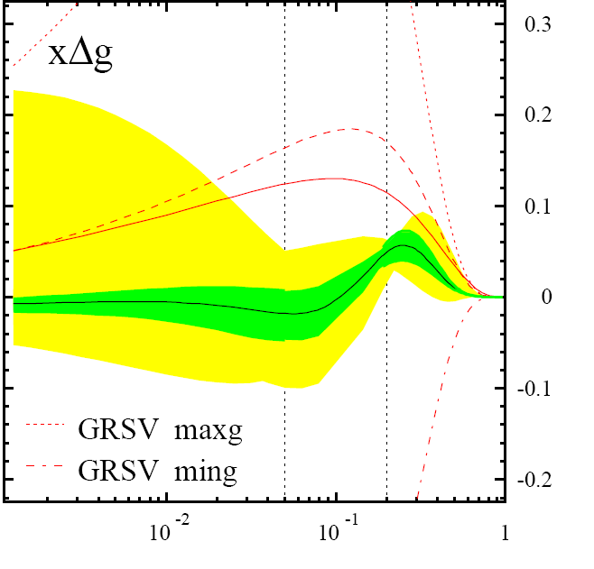
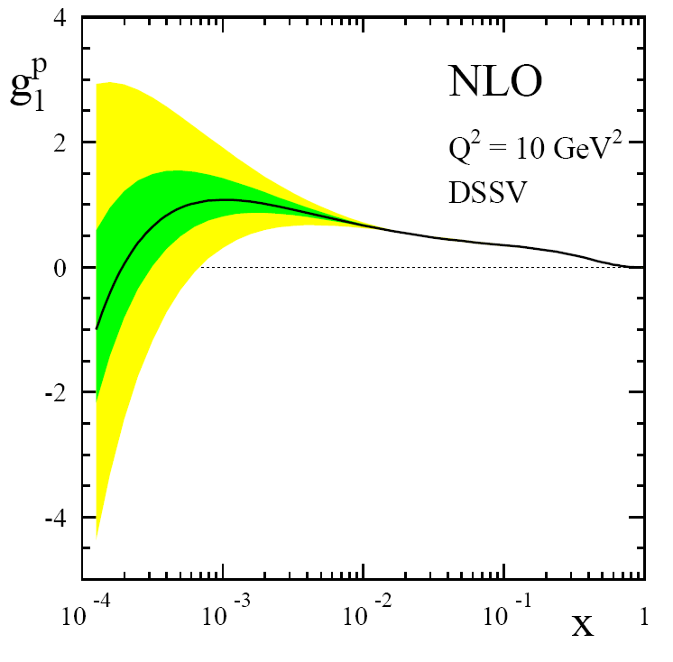
what can be achieved for Δg?
current
status:
low x behavior unconstrained
significant polarization still possible
no reliable error estimate
for 1st moment
(entering spin sum rule)
find
DIS
&
pp
DSSV global fit
de Florian, Sassot,
MS, Vogelsang
RHIC
pp
x
pQCD scaling violations
positive Δg

Slide 9
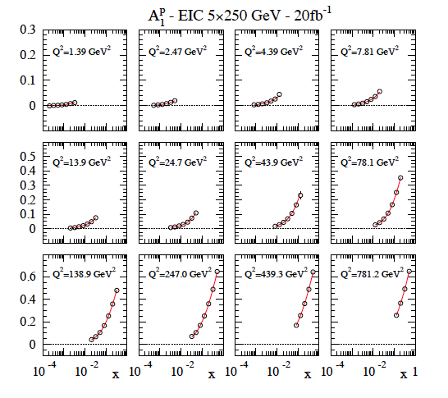
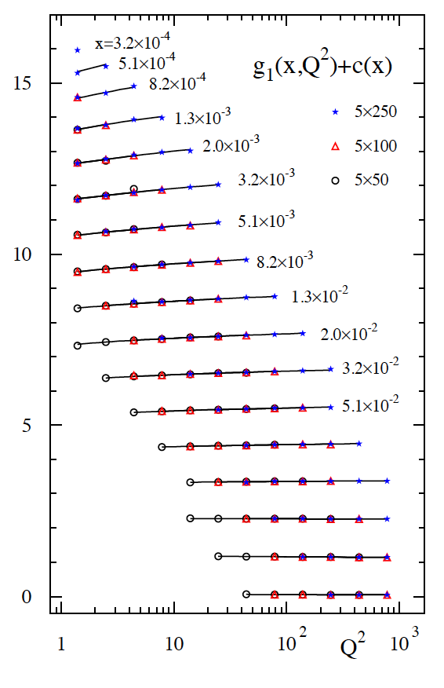
polarized DIS @ EIC and impact on Δg(x,Q²)
strategy to quantify impact: global QCD fits with realistic pseudo-data
current
data
W² > 10GeV²
measurements limited by systematics – need to control them very well
issues: bunch-by-bunch polarimetry, relative luminosity, detector performance, …

Slide 10
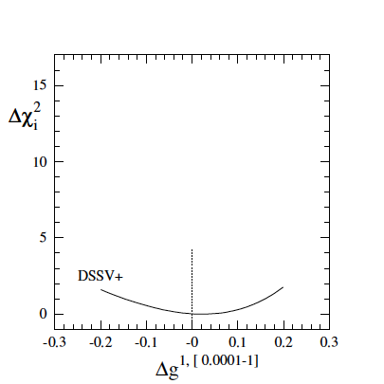
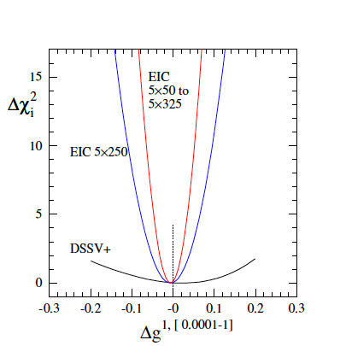
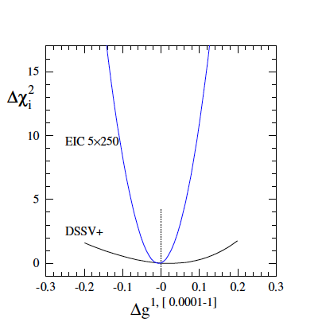
what can be achieved for Δg? – cont’d
how effective are scaling violations with data up to (recall x_{min} ≈ 1.6×10⁻⁴)
Sassot, MS
DSSV+ includes also latest
COMPASS (SI)DIS data
(no impact on DSSV Δg)
χ² profile slims down
significantly already
for stage-1
(one month of running)
with one can reach down to x ≈ 3×10⁻⁵ (impact needs to be quantified)

Slide 11
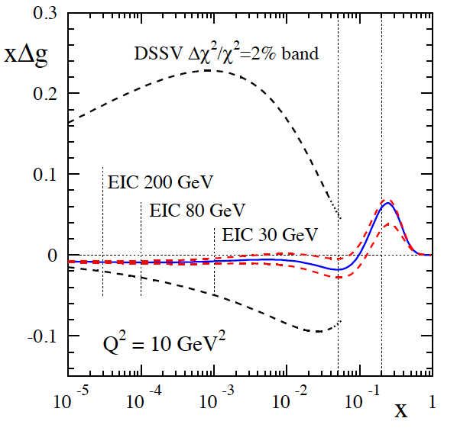
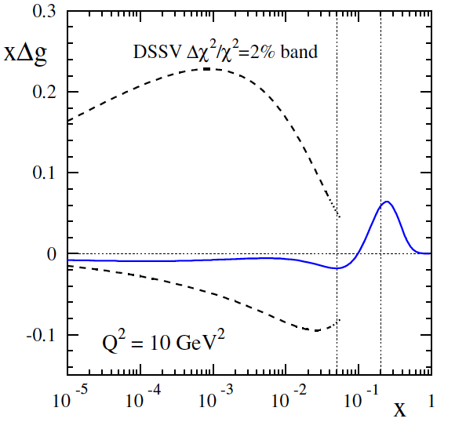
what can be achieved for Δg? – cont’d
what about the uncertainties on the x-shape …
golden measurement
Sassot, MS
unique
feasible
relevant
expect to determine at about 10% level (or better – more studies needed)
kinematic reach down to x = 10⁻⁴ essential to determine integral

Slide 12
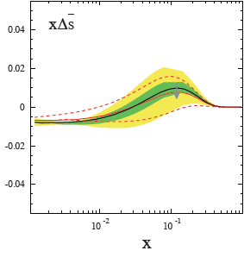
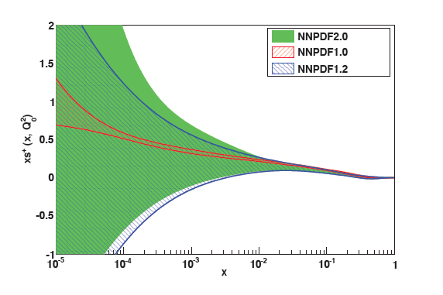
selected open issues in flavor structure
strangeness is one of the least known quantities in hadronic physics
– both unpolarized and polarized – where significant progress is difficult w/o EIC
DSSV (incl. latest COMPASS data)
NNPDF collaboration
data
substantial uncertainties
known issues with HERMES data at large x
hot topic:
surprise: Δs small & positive from SIDIS data
but 1st moment is negative and sizable due
to “constraint” from hyperon decays (F,D)
(assumed SU(3) symmetry debatable M. Savage)
drives uncertainties on ΔΣ (spin sum)
we really need to determine it better ! (including their u,d quark colleagues)

Slide 13
flavor separation with semi-inclusive DIS
at LO:
extra weight
for each quark
allows for full flavor separation if enough hadrons are studied
actual analysis of data requires NLO QCD where x, z dependence is non-trivial
relevant quantities/measurements:
(un)polarized SIDIS cross sections (we don’t want to study asymmetries anymore at EIC)
for u, ubar, d, dbar, s, sbar separation need H = π⁺, π⁻, K⁺, K⁻ (nice to have more)
kinematic coverage in x,Q² similar to inclusive DIS
complications/additional opportunities:
PDF information entangled with fragmentation functions
should be not a problem: already known pretty well (DSS – de Florian, Sassot, MS)
more data (Belle, BaBar, RHIC, LHC, …)

Slide 14
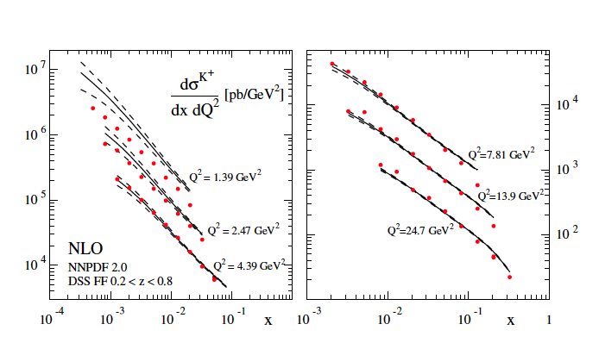
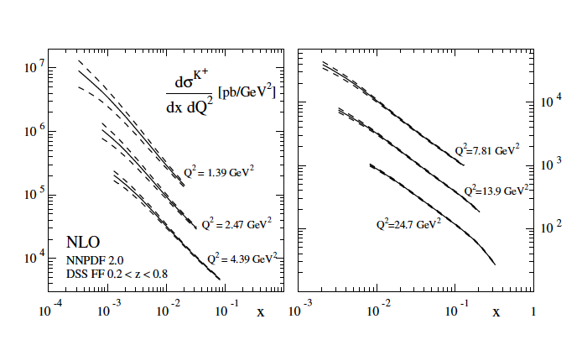
1st studies done for charged kaons
Aschenauer, MS
compute K⁺ yields in unpol. ep at NLO with 100 NNPDF replicas
z integrated to minimize FF uncertainties
5×250 GeV
actual uncertainties
much smaller than points
one month of running
PYTHIA agrees very well (despite very different hadronization model)
--> confidence that we can use MC to estimate yields & generate pseudo-data
work in progress: quantify impact (requires full global analyses); pion yields, SIDIS in polarized ep

Slide 15
electroweak probes: why interesting
studies by Deshpande, Kumar, Ringer, Riordan, Taneja, Vogelsang
at high enough Q² electroweak probes become relevant
neutral currents (γ, Z exchange, γZ interference)
charged currents (W exchange)
parameterized by new structure functions which probe
combinations of PDFs different from photon exchange
--> flavor decomposition without SIDIS, e-w couplings
hadron-spin averaged case: studied to some extent at HERA (limited statistics)
hadron-spin difference:
contains
e-w propagators
and couplings
Wray; Derman; Weber, MS, Vogelsang;
Anselmino, Gambino, Kalinowski;
Blumlein, Kochelev; Forte, Mangano, Ridolfi; …
unexplored so far – unique opportunity for the EIC

Slide 16
what can be learned ?
in the parton model (for simplicity)
NC:
CC:
requires a positron beam
NLO QCD corrections all available
flavor decomposition (no fragmentation); effective neutron beam highly desirable
de Florian, Sassot; MS, Vogelsang, Weber;
van Neerven, Zijlstra; Moch, Vermaseren, Vogt
e.g.
in addition, new Bj-type sum rules

Slide 17
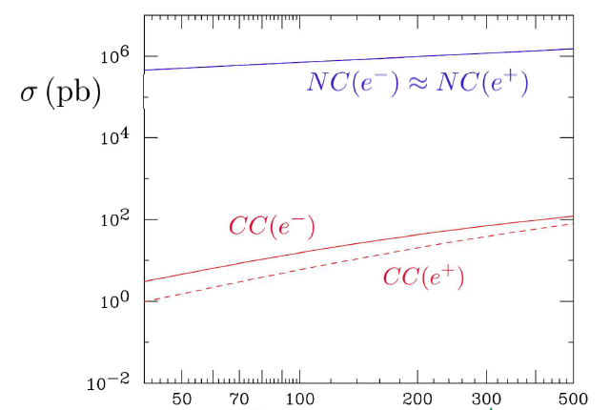
feasibility – 1st exploratory studies
Deshpande, Kumar, Ringer,
Riordan, Taneja, Vogelsang
Q² > 1 GeV²
20×250
HERA
30×325
relatively mild drop of cross section with energy can be compensated by EIC luminosity

Slide 18
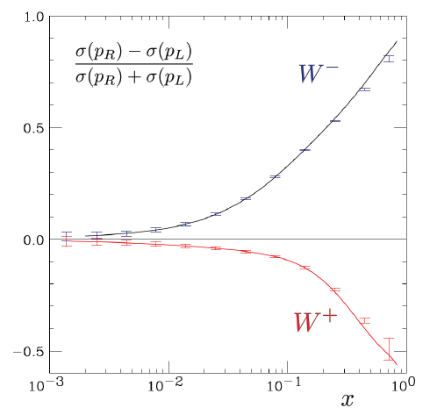
most promising: CC DIS
20 × 250 GeV
Q² > 1 GeV²
0.1 < y < 0.9
10 fb⁻¹
DSSV PDFs
need to be able to reconstruct
x, Q² from hadronic final-state
separate up-type and down-type
PDF combinations by varying y
Cabibbo suppressed contributions neglected

Slide 19
other opportunities in polarized DIS
in 10+ years the NNLO corrections will be available
(certainly needed to match precision of data !)
Moch, Vogt, …
Bartels, Ermolaev, Ryskin;
Ermolaev, Greco, Troyan
watch out for “surprises” at small-x = deviations from DGLAP
(might set in earlier than in unpol. DIS: ; showing up as tension in global fits (?))
tag on g₁^{charm} - irrelevant so far (<< 1%), driven by Δg at small x
Bjorken sum rule:
C_{Bj} known to O(α_{s}⁴)
Kodaira; Gorishny, Larin; Larin, Vermaseren; Baikov, Chetyrkin, Kühn, ...
but not a tool to determine α_{s} (1% change in α_{s} translates in 0.08% change of Bj sum )
experimental challenge: effective neutron beam (³He), very precise polarimetry, …
theor. motivation for precision measurement: Crewther relation
non-trivial relation of two seemingly unrelated quantities
Adler function D(Q²) in e⁺e⁻ Bj sum C_{Bj}(Q²) in DIS
deviation from
exact conformal symmetry

Slide 20
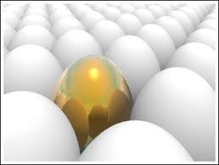
Summary “Golden PDF Measurements”

Slide 21
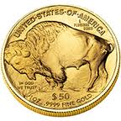
Science Deliverable | Basic Measurement | Uniqueness Feasibility Relevance | Requirements
spin structure at small x contribution of Δg, ΔΣ to spin sum rule | inclusive DIS | ✔ | need to reach x=10⁻⁴ large x,Q² coverage about 10fb⁻¹
full flavor separation in large x,Q² range strangeness, s(x)-s(x) polarized sea | semi-inclusive DIS | ✔ | very similar to DIS excellent particle ID improved FFs (Belle,LHC,…)
electroweak probes of proton structure flavor separation electroweak parameters | inclusive DIS at high Q² | ✔ some unp. results from HERA | 20x250 to 30x325 positron beam ? polarized ³He beam ?
plus several other compelling measurements:
F_{L} , heavy flavor contributions to DIS str. fcts., photoproduction, …

Slide 22
outline/status of the write-up of INT program
Executive Summary - MS
Status of Perturbative QCD Calculations - Moch
Unpolarized Proton Structure – HERA’s Legacy - Cooper-Sarkar
Unp. PDFs: Open Questions to be Addressed at an EIC – Guzzi, Nadolsky, Olness
Flavor Separation from Semi-Inclusive DIS – Aschenauer, MS
The Longitudinal Structure Function F_{L} at an EIC – Aschenauer, Debbe, MS
Theor. Status of Incl. Heavy Quark Production in DIS – Alekhin, Blumlein, Moch
Probing Intrinsic Charm at an EIC – Guzzi, Nadolsky, Olness
F_{2,L} (charm) at an EIC – Aschenauer, Debbe, MS
Status of Helicity-Dependent PDFs and Open Questions – Sassot, MS
Opportunities in Spin Physics at an EIC – Aschenauer, Sassot, MS
Electroweak Str. Fcts. at the EIC – Deshpande, Kumar, Ringer, Riordan, Taneja, Vogelsang
Charged Current Charm Production and the Strange Sea - MS
Photoproduction Processes at an EIC – Spiesberger, MS
Expectations for Heavy Quark Photoproduction - Spiesberger
Expectation for Polarized Photoproducion – Jager, MS
final
some more editing
work in progress

Slide 23
EXTRAS

Slide 24
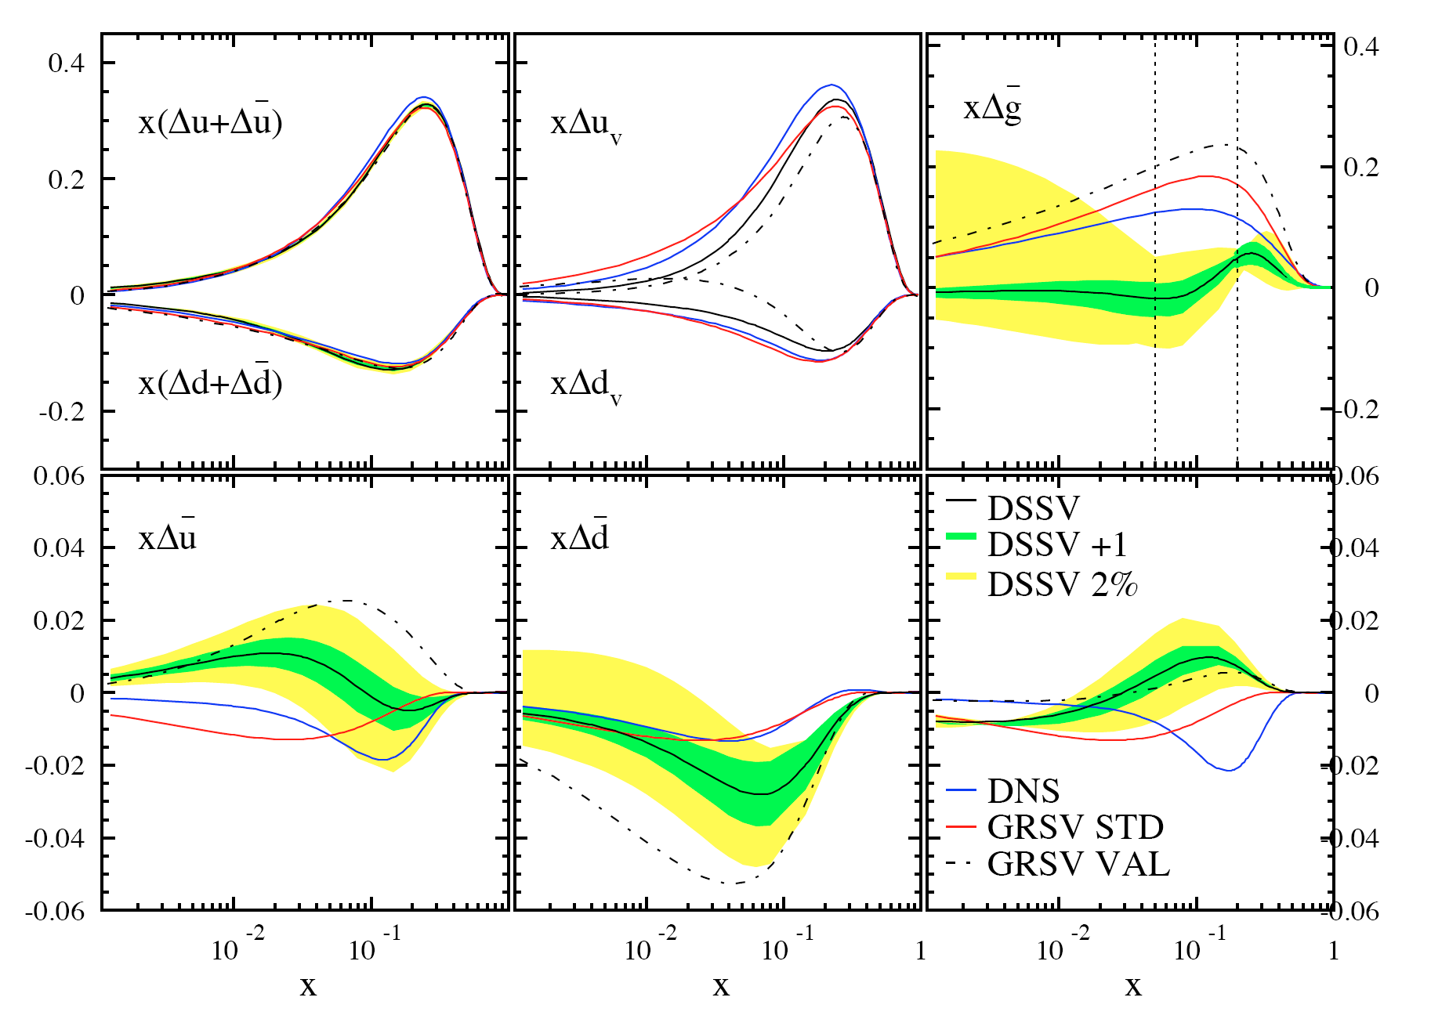
recall: the emerging picture from global QCD analyses
DSSV global analysis
de Florian, Sassot,
MS, Vogelsang
gluon small (node?)
in x-region
constrained by data
well constrained
total quark densities
x -> 1 behavior
to be determined
indications for non-trivial
sea quark polarizations
surprising strangeness polarization
sizable SU(3) breaking?
also seen in latest COMPASS kaon data
note: less pronounced with latest
COMPASS SIDIS data
lattice: Bali et al., 0811.0807; 0911.2407; 1011.2194

Slide 25
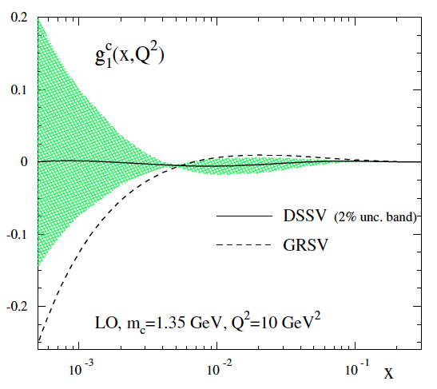
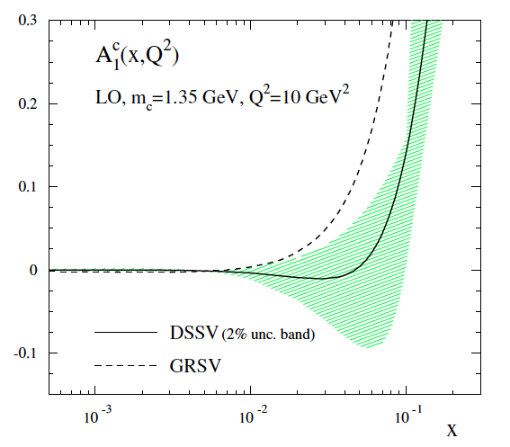
aside: charm contribution to pol. DIS: g₁^{c}
so far safely ignored: << 1% to existing g₁ fixed-target data
numerical relevance at the EIC depends strongly on size of Δg
need massive Wilson coefficients (charm not massless for most of EIC kinematics)
so far only known to LO (NLO is work in progress Kang, MS)
some expectations: (at LO)
very small (1-2% of g₁^{uds})
≈ 2x10⁻⁵
10-15% of g₁^{uds}
≈ 2x10⁻³
heavy flavor contributions to DIS str. fcts. (F₂, F_{L}, and g₁) are an important theme at an EIC

Slide 26
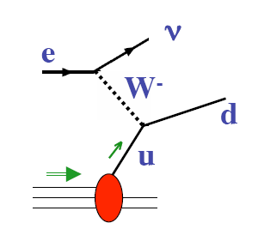
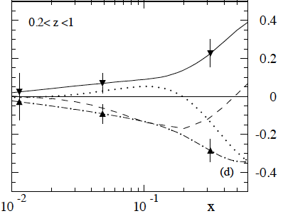
other avenues to be explored further
SIDIS through e-w boson exchange
π, K
some studies available from “Future Physics at HERA” workshops:
Maul, Contreras, Ihssen, Schafer; Contreras, De Roeck, Maul
(based on PEPSI Monte Carlo)
TO DO: re-do for EIC kinematics
CC charm production as a probe of strangeness
idea: at O(α_{s}⁰)
at O(α_{s}¹)
can potentially spoil sensitivity to strangeness
also, need to keep full dependence on charm mass in EIC kinematics
NLO available (pol + unpol) Kretzer, MS
again, studies performed for HERA
gluon channel suppressed for z > 0.2
in D meson production
Δs < 0
Δs ≈ 0
TO DO: exhume codes & re-do for EIC
errors assume 500pb⁻¹

