Slide 1
EIC Update
R. D. McKeown
Presentation to EICAC
April 10, 2011
(Thanks to R. Ent, A. Hutton, H. Montgomery, M. Farkhondeh, others)

Slide 2
Outline
Events since Nov. 2009 (BMcK)
Jlab design effort/timeline (BMcK)
Jlab status summary (BMcK)
BNL design effort/timeline (Vigdor)
Detector R&D program(Vigdor)
White paper  NSAC Long Range Plan (Vigdor)

Slide 3
http://conferences.jlab.org/eic2011

Slide 4
Recent Events (∙ = linked)
EICAC Report (Nov. 2009):
- develop “unimpeachable” science case
- Jlab concept less mature
Jlab increases accelerator design effort to develop conservative
“costable” MEIC design (2010)
Jlab users organize 5 workshops in spring 2010
EICC meeting at Catholic U. (July 2010)
DOE-ONP awards accelerator R&D
Jlab Accelerator division internal review of MEIC design
10 week program at Institute for Nuclear Theory – fall 2010
BNL-sponsored detector R&D program
EICAC – April 2011

Slide 5
JLAB EIC Workshops
Nucleon spin and quark-gluon correlations: Transverse spin, quark and gluon orbital motion, semi-inclusive processes (Duke U., March 12-13, 2010 )
3D mapping of the glue and sea quarks in the nucleon (Rutgers U., March 14-15, 2010)
3D tomography of nuclei, quark/gluon propagation and the gluon/sea quark EMC effect (Argonne National Lab, April 7-9, 2010)
Electroweak structure of the nucleon and tests of the Standard Model (College of W&M , May 17-18, 2010)
EIC Detectors/Instrumentation (JLab, June 04-05, 2010)
4/5 will produce white paper for publication

Slide 6
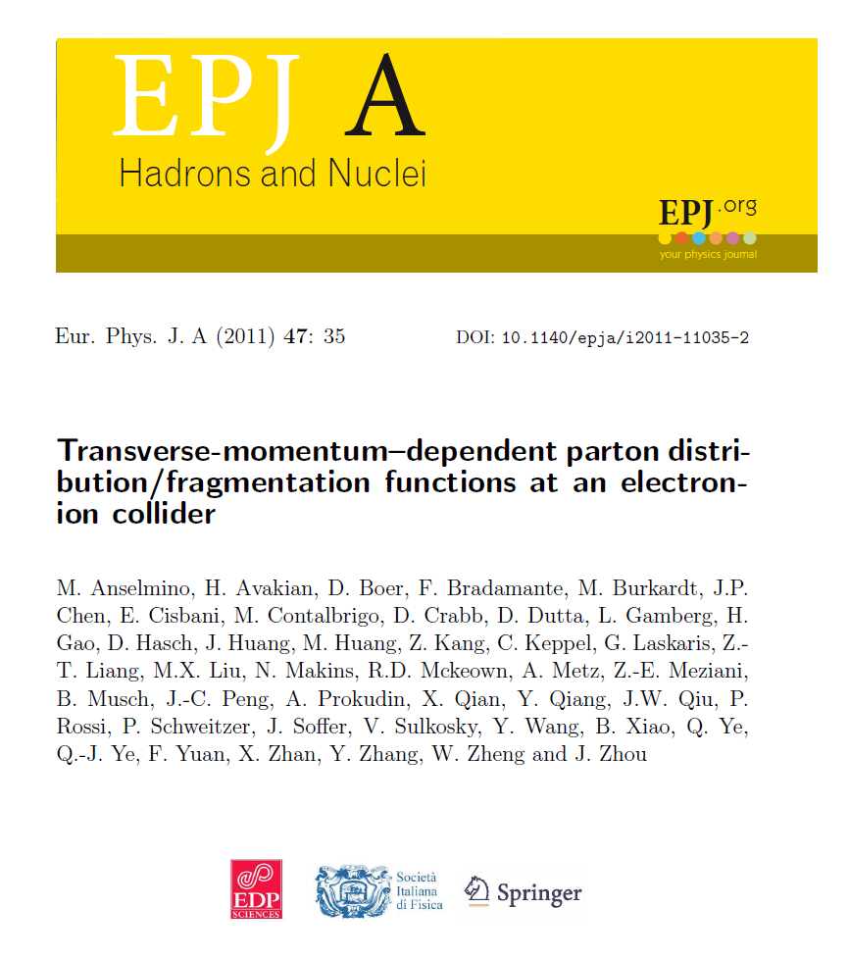

Slide 7
General Emergent Theme
Experimental study of multidimensional
distribution functions that map out the
quark/gluon properties of the nucleon, including:
(quark) flavor
spin and orbital angular momentum
longitudinal momentum
transverse momentum and position
High Luminosity over a
range of energies

Slide 8
Full Acceptance Detector
7 meters
solenoid
detectors
ion dipole w/ detectors
ion FFQs
0 mrad
IP
ions
50 mrad
electron FFQs
electrons
2+3 m
2 m
2 m
Central detector
TOF
Detect particles with angles down to 0.5º before ion FFQs.
Need 1-2 Tm dipole.
Detect particles with angles below 0.5º beyond ion FFQs and in arcs.
Solenoid yoke + Muon Detector
RICH or DIRC/LTCC
EM Calorimeter
Tracking
RICH
4-5m
HTCC
Muon Detector
Hadron Calorimeter
EM Calorimeter
Very-forward detector
Large dipole bend @ 20 meter from IP (to correct the 50 mr ion horizontal crossing angle) allows for very-small angle detection (<0.3º)
Solenoid yoke + Hadronic Calorimeter
2m
3m
2m
Notes:
8
8

Slide 9
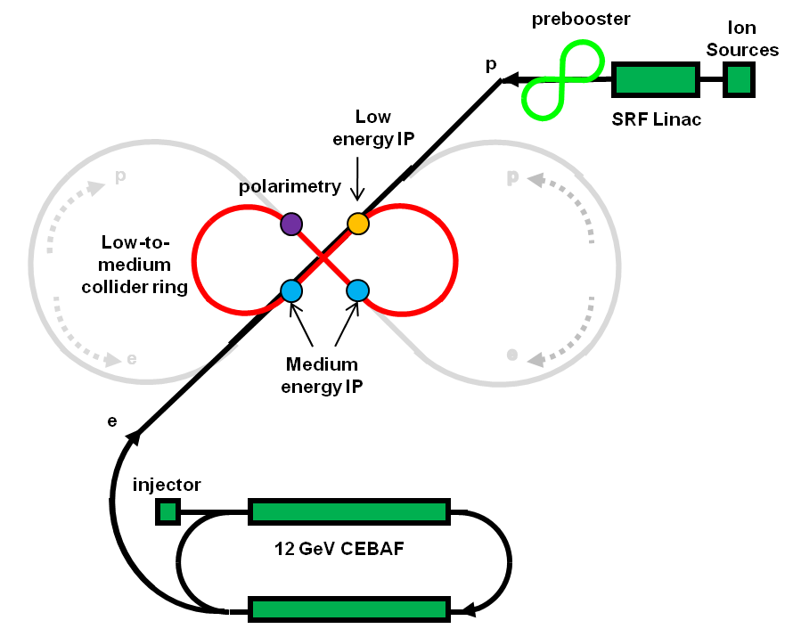
MEIC : Medium Energy EIC
medium-energy IPs
polarimetry
low-energy IP
Three compact rings:
3 to 11 GeV electron
Up to 12 GeV/c proton (warm)
Up to 60 GeV/c proton (cold)
Note: conservative assumptions
6T dipole fields
Synch. Power < 20 kW/m
β_{max} < 2.5 km

Slide 10
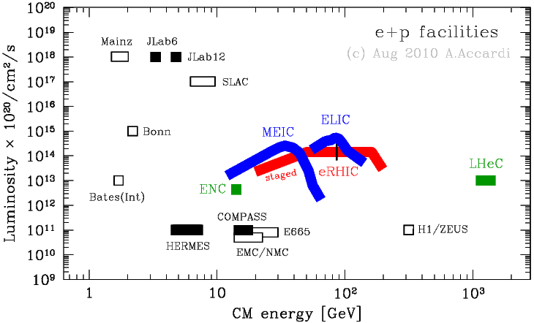
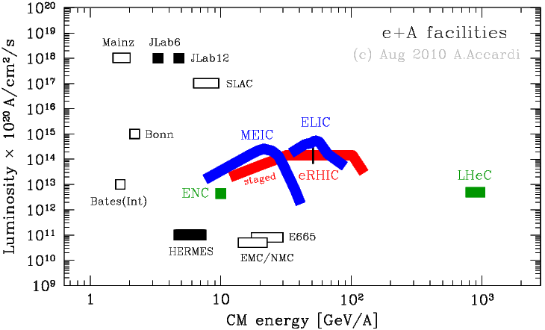
Luminosity Vs. CM Energy
e + p
e + A
Notes:
10

Slide 11
FY10-11 DOE-NP Funded Accelerator R&D

Slide 12
2010 INT Workshop
Organizers: Daniel Boer KVI, University of Groningen
Markus Diehl DESY
Richard Milner MIT
Raju Venugopalan Brookhaven National Laboratory
Werner Vogelsang University of Tübingen
week | dates | topics
1 | 13–17 Sept | Workshop on "Perturbative and Non-Perturbative Aspects of QCD at Collider Energies"
2 | 20–24 Sept | open conceptual issues: factorization and universality, spin and flavor structure, distributions and correlations
3–5 | 27 Sept –15 Oct | small x, saturation, diffraction, nuclear effects; connections to p+A and A+A physics; fragmentation/hadronization in vacuum and in medium
6–7 | 18–29 Oct | parton densities (unpolarized and polarized), fragmentation functions, electroweak physics
8–9 | 1–12 Nov | longitudinal and transverse nucleon structure; spin and orbital effects (GPDs, TMDs, and all that)
10 | 15–19 Nov | Workshop on "The Science Case for an EIC"

Slide 13
EIC Realization Imagined
(Mont@INT)
Activity Name | 2010 | 2011 | 2012 | 2013 | 2014 | 2015 | 2016 | 2017 | 2018 | 2019 | 2020 | 2021 | 2022 | 2023 | 2024 | 2025
12 Gev Upgrade
FRIB
EIC Physics Case
NSAC LRP
EIC CD0
EIC Machine Design/R&D
EIC CD1/Downsel
EIC CD2/CD3
EIC Construction
Note: 12 GeV LRP recommendation in 2002 – CD3 in 2008

Slide 14
A Final Word
(BMcK@INT)
We are on a good path to put the EIC forward at the next NSAC Long Range Plan
We still need additional work, building on the discussions at the INT program, to produce a much more compelling physics justification
We need to sharpen the arguments for a more general audience
How could we expand the community of interested physicists?
We need to continue to work together to advance the physics case for this exciting new facility

Slide 15
Jlab EIC Status
Jlab accelerator team is working effectively to develop a novel design. They have increased manpower and collaboration over the last year and are on track to deliver a costed design in fall 2011.
Accelerator R&D in progress, including some joint effort with BNL.
Jlab users are interested and engaged – 2010 workshops and INT program have increased Jlab community participation.
Jlab is increasing postdoctoral staff on EIC.
3 Jlab proposals to BNL-sponsored detector R&D.

