Slide 1
Searching for a U-boson with a positron beam
Bogdan Wojtsekhowski
Thomas Jefferson National Accelerator Facility
The light dark matter
Properties of a U-boson
Design of the experiment and expected sensitivity
Notes:
There is an interesting widow which was not explored for possible signal beyond Standard Model.
Special interest now related to dark matter, search in the few tens of MeV mass range is hard but possible.
The case for the light dark matter proposed by C.Boehm, P.Fayet and collaborators.
P.Fayet put forward an idea of a U boson in 1980 and investigated possible signatures.
The U boson could be light and weakly coupled to our world.
Electron-positron collider at low energy is the way to search.

Slide 2
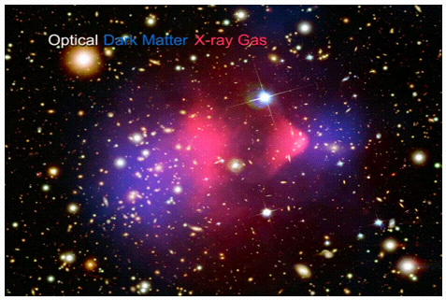
From September 2006, NASA/SLAC
Notes:
Recently astro-physics community discovered direct, like hydro-dynamical picture,
which signals of separation between to masses one of which emit X-rays, but another doesn’t
This direct experimental fact - we like to find particle physics method to detect invisible matter.

Slide 3
From September 2006, NASA/SLAC
Notes:
Recently astro-physics community discovered direct, like hydro-dynamical picture,
which signals of separation between to masses one of which emit X-rays, but another doesn’t
This direct experimental fact - we like to find particle physics method to detect invisible matter.

Slide 4
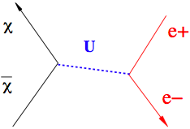
From September 2006, NASA/SLAC
DARK matter directly observed in gravitational experiment
What is the nature and parameters of the constituents?
We will discuss the process:
Notes:
The primary question: what is the nature and parameters of dark matter?
Dark matter could have interaction with the ordinary matter via a weakly coupled boson.
Reaction includes annihilation dark particle and anti-particle to U-boson, which then decay quickly to dark matter, neutrinos, lepton pairs. Decay to electron-positron pair will lead to signal which could be observed.

Slide 5
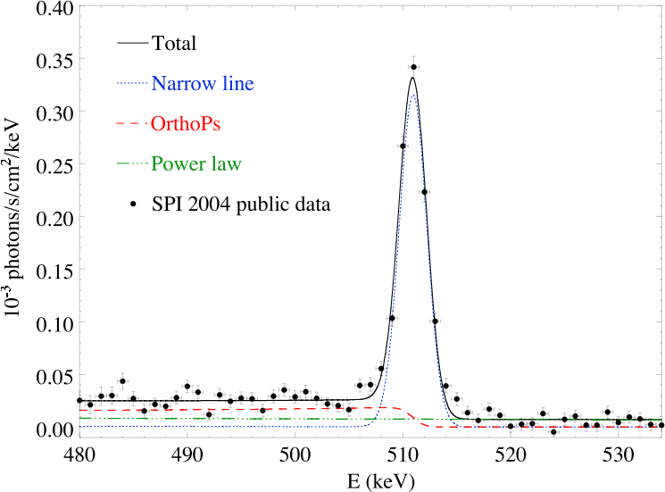
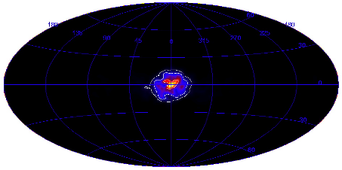
The case of the Light Dark Matter
The 511 keV line in the spectra of photons
Photon energy spectrum
Location of the source
P. Jean etal, Astron. Astrophys. 445, 579 (2006)
Notes:
Very narrow line with intensity of 1 per second per one meter square. Such intensity is difficult to explain by ordinary beta-decay of nuclei.
Location of the source consistent with concentration of mass. Angular distribution is smooth,much wider than experiment resolution.
The main features are: narrow width -> restrict mass of DM candidates, intensity is too large for conventional source; location of the source in a middle of galaxy; smooth distribution without star-like concentration somewhere.

Slide 6
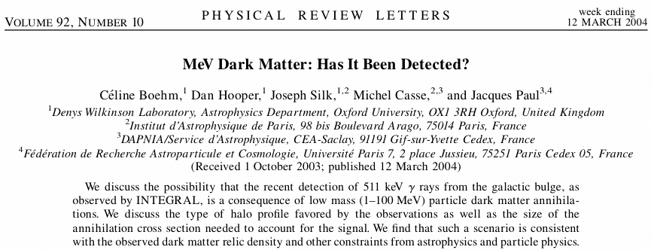
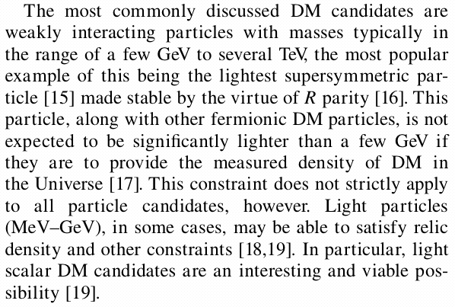
The case of the Light Dark Matter
Scalar DM particles: χ / χ
Notes:
Already two years ago the idea of LDM was proposed, mass could be low for scalar DM. However the energy of existing colliders are very large.
Recently Drees and collaborators suggested to look U-boson in decay to the electron-positron pair.
They pointed that high quality data from “low energy” factories could be used.
That article push me to see how to made real low energy collider.

Slide 7
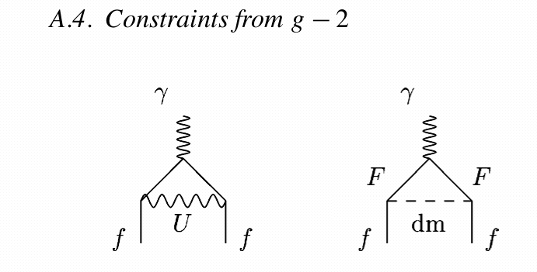
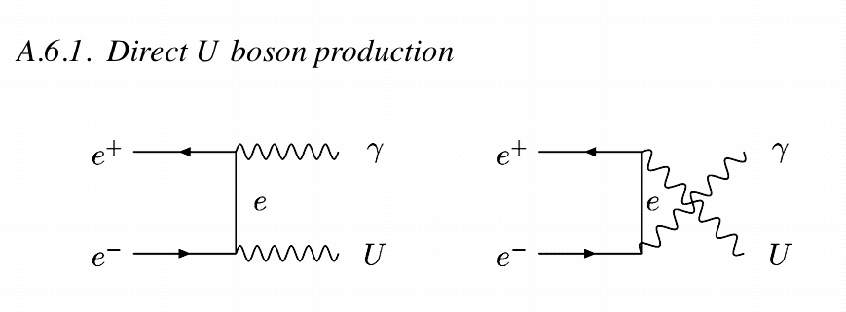
The processes which could has U-boson
C.Boehm, P.Fayet, Nuclear Physics B 683 (2004)
g_{e}-2, g_{μ}-2
π,η decays to Uγ
π,ϕ,ψ decays to γ + invisible
Upper limit for the coupling constant |f_{eU}|² < 2 10⁻⁸ (m_{U})²
Notes:
Phenomenology of U boson was recently reconsidered. However limits for coupling to electron allow for LDM
with U boson for example 10 MeV and dm particle of 4 MeV.
Boehm and Fayet calculated direct U boson production.

Slide 8
The processes which could has U boson
P.Fayet, arXive:0607094 (2006)
U-boson detectability, and LDM
Notes:
Phenomenology of U boson was recently reconsidered. However limits for coupling to electron allow for LDM
with U boson for example 10 MeV and dm particle of 4 MeV.
Boehm and Fayet calculated direct U boson production.

Slide 9
The processes which could has U-boson
Υ decays to γ + invisible BABAR: B_{inv}< 3 10⁻⁶
P.Fayet, arXive:0812390 (2008)
universality of couplings leads to restriction on
the coupling constant |f_{eU}|² < 5 10⁻⁸ (m_{U}[MeV])²
Notes:
Phenomenology of U boson was recently reconsidered. However limits for coupling to electron allow for LDM
with U boson for example 10 MeV and dm particle of 4 MeV.
Boehm and Fayet calculated direct U boson production.

Slide 10
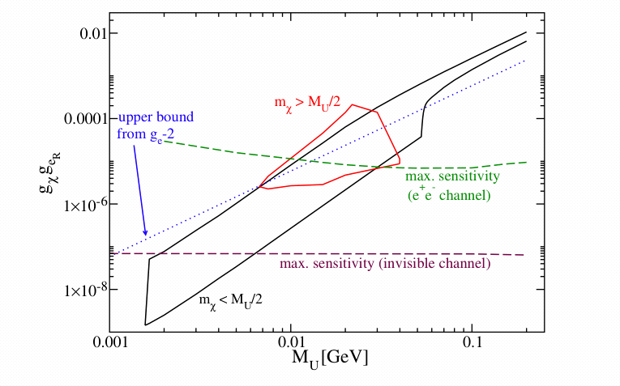
The search for the-U boson in e⁺e⁻
C.Boehm, P.Fayet, Nuclear Physics B 683 (2004)
N.Borodatchenkova, D.Choudhury and M.Drees, PRL 96 (2006)
suggestion: to search in data
from DAΦNE and CLEO; the potential sensitivity for
the coupling f_{e}² ~ 10⁻⁶
Notes:
Already two years ago the idea of LDM was proposed, however the energy of existing colliders are very large.
Recently Drees and collaborators suggested to look U-boson in decay to electron-positron pairs.
They pointed that high quality data in “low energy collider” could be used.
That article push me to see how to made real low energy collider. MASS RANGE for LDM is 1-20 MeV.

Slide 11
The search for new physics in e⁺e⁻
Notes:
Already two years ago the idea of LDM was proposed, however the energy of existing colliders are very large.
Recently Drees and collaborators suggested to look U-boson in decay to electron-positron pairs.
They pointed that high quality data in “low energy collider” could be used.
That article push me to see how to made real low energy collider. MASS RANGE for LDM is 1-20 MeV.

Slide 12
The search for the resonances e⁺e⁻
Notes:
Already two years ago the idea of LDM was proposed, however the energy of existing colliders are very large.
Recently Drees and collaborators suggested to look U-boson in decay to electron-positron pairs.
They pointed that high quality data in “low energy collider” could be used.
That article push me to see how to made real low energy collider. MASS RANGE for LDM is 1-20 MeV.

Slide 13
Another search for the boson
Notes:
Already two years ago the idea of LDM was proposed, however the energy of existing colliders are very large.
Recently Drees and collaborators suggested to look U-boson in decay to electron-positron pairs.
They pointed that high quality data in “low energy collider” could be used.
That article push me to see how to made real low energy collider. MASS RANGE for LDM is 1-20 MeV.

Slide 14
Search experiment with BaBar data
Notes:
Already two years ago the idea of LDM was proposed, however the energy of existing colliders are very large.
Recently Drees and collaborators suggested to look U-boson in decay to electron-positron pairs.
They pointed that high quality data in “low energy collider” could be used.
That article push me to see how to made real low energy collider. MASS RANGE for LDM is 1-20 MeV.

Slide 15
Options for e⁺e⁻ experiment at low s
A “very” low energy s ~ 10-30 MeV
Search in existing data from good detector =>
problem with resolution at low s
b) 5 MeV x 5 MeV collider of e+e- =>
very low luminosity
Sliding beams of e+e- (200 MeV x 200 MeV)=>
need specialized accelerator with two rings
d) Positron beam and atomic electrons
The focus now on a positron beam of 100-400 MeV
incident on the hydrogen target
Notes:
Already two years ago the idea of LDM was proposed, but the energy of existing colliders is very large.
Recently Drees and collaborators suggested to look U-boson in decay to electron-positron pairs.
They pointed that high quality data in “low energy collider” could be used.
That article push me to see how to made real low energy collider.

Slide 16
JLab positron beam considerations
P.Degtyarenko
Production: ~10⁻⁴ positrons per each 160 MeV electron into acceptance SRF
Notes:
The technique was well developed for pulsed beam; need to focus electron beam to minimize emittance of
Produced positrons. Positron beam with 100% duty factor was never produced. Still present advances in beam
Intensity allow to reach required positron intensity.

Slide 17
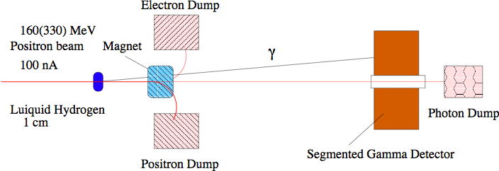
Schematic of the proposed experiment
Positron beam with 1-2 MeV spread
Thin - 1 cm liquid hydrogen target
Direct the rest of the beam to the dumps
Segmented photon detector ~ 1000 modules, ~2% energy resolution.
Parallel DAQ for the total rate of ~50 MHz. Example from kTeV used CsI
Makes use of high luminosity: 1000 parallel 1-d spectra.

Slide 18
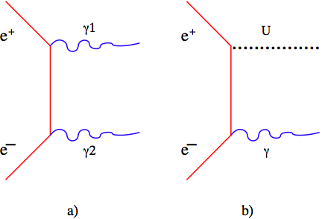
Singles Rates
Rates are calculated for the luminosity = 3 × 10³⁴ cm⁻² s⁻¹ Calculations are based largely on the GEANT3 code
Dominant rate in the peak of two-gamma process.
Intensity drops 100 times below the peak.
The rate per module is about 50 kHz

Slide 19
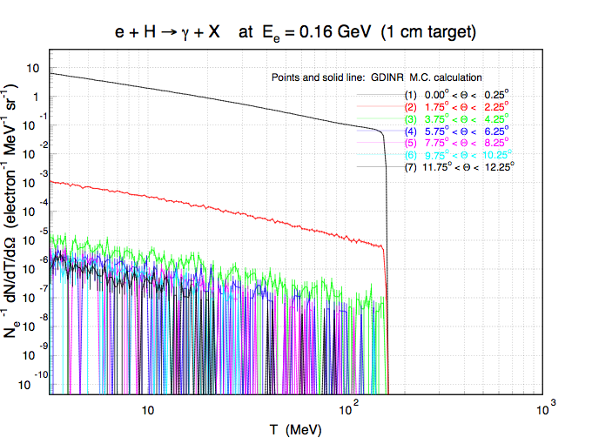
The photo-production processes
Basic QED: e⁺e⁻ → γ γ (mono-energetic)
Search for : e⁺e⁻ → γ U (peak below main)
Basic QED: e⁺Z → γ (smooth brems.)
Detect γ at fixed angle with the beam :
reconstruct the mass
Variation with the angle:
control systematic
Target Z
Hydrogen vs. ¹²C
Notes:
There are high intensity reactions in our energy range.
With high Z of the target we plan to measure the detector response
So, the change of the target is a very important way to suppress systematic from possible irregularities.
Another way is a tagging for two photons events or/and electron/electron(positron) scattering

Slide 20
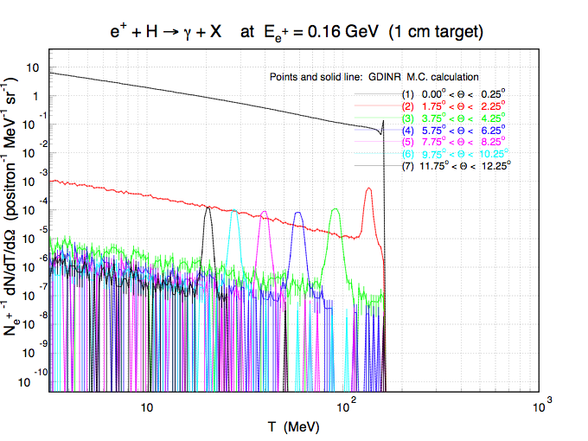
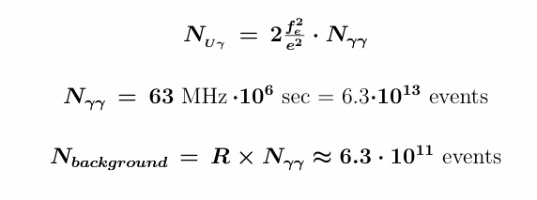
Expected accuracy of the result
f_{e}² < 3 x 10⁻⁸ e² (it is 5 sigma), which is “100+” improvement
relatively to the upper limit obtained from g-2 results at m_{U} = 10 MeV
Notes:
We are going to search for very small bump.
This is possible because of very large statistics, several ways to monitor detector response and calibration directly from data.

Slide 21
What is proposed ?
Photon angle, degree

Slide 22
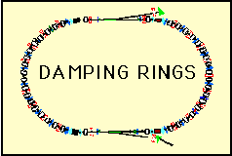
Positron Beams
A beam of 25 nA 400 MeV was produced at Saclay in 1980
Beam of 1 μA was used for SLC (120 Hz), we need d.f. 100%
Positron damping ring up to 1.2 GeV, 200 mA
VEPP-3 energy of 0.6-2 GeV, 10 mA positrons
Notes:
The technique was well developed for pulsed beam; need to focus electron beam to minimize emittance of
Produced positrons. Positron beam with 100% duty factor was never produced. Still present advances in beam
Intensity allow to reach required positron intensity.

Slide 23
Positron Damping Ring Setup
etector
e
Gas Target
Notes:
The technique was well developed for pulsed beam; need to focus electron beam to minimize emittance of
Produced positrons. Positron beam with 100% duty factor was never produced. Still present advances in beam
Intensity allow to reach required positron intensity.

Slide 24
Summary
Observation of a U-boson signal on the level of 5 sigma (statistical), assuming f_{e}² = 3*10⁻⁹, requires 20 days of production running (total~ two-month experiment).
For m_{U} in range 2-15 MeV, this experiment has unique sensitivity, which about 1-2 orders higher than (g-2).
Experiment will explore exciting explanation of the 511 keV signal, light dark matter and search for particle beyond Standard Model.
Development of the positron beam capability has other important physics and technological applications in JLab.
Notes:
Summary

Slide 25
from Trento 2005, Two-Photon Physics workshop

