Slide 1

Positrons for Applied Science
& Materials Science
K.G. Lynn and M.H. Weber
and many others!!
Washington State University, Pullman, WA
JPOS 09
International Workshop on Positrons at Jefferson Lab
Thomas Jefferson National Accelerator Facility
Newport News, VA
March 25-27, 2009

Slide 2
My Concerns in a low energy positron facility
Intense positron sources have not fulfilled its promise to DOE/NSF
The intense sources have been small groups trying to move into a larger facilities based on the researchers interests and lacked the support of the facilitiy and funding agency.
The beams that have operated have not provided the needed user support and users have gone elsewhere.
Neither the brightness nor the intensity has been routinely been achieved
If the Jefferson Lab is planning this facility a real commitment is needed from OS/DOE and local management

Slide 3

Number 1:
Positrons made
the Newsweek
hitlist

Slide 4
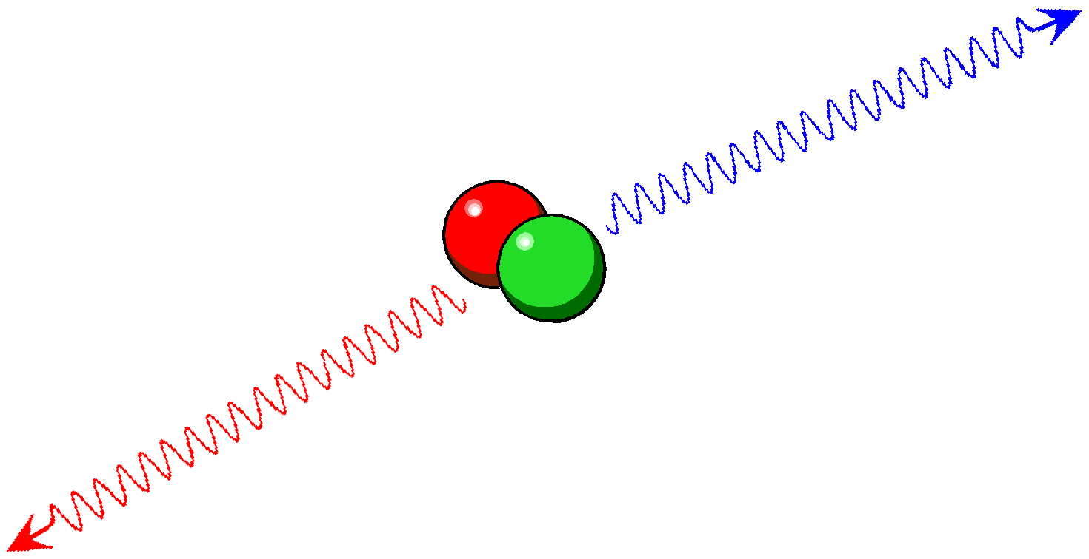
The positron’s death
Eventually, in our world of matter, the positron will annihilate with an electron.
Two (or rarely three) photons (gamma rays) emerge.
The number of electrons
(density) determines
how fast this occurs
Angular deviation from opposite
blue shifted
θ = g(p⊥)
Basic laws of nature (physics) force certain conditions:
2 gammas in opposite direction with small changes in energy (Doppler shifts) and direction.
red shifted
Doppler shifts
JPOS 09 Newport News (March 2009)

Slide 5
Positron characteristics
Unique quantum numbers
  No exchange at the present time
Annihilation with electrons radiation can be detected
  Little interaction with specimen after annihilation
Electron momentum encoded in γ-rays
  Doppler broadening
  Angular correlation
Lifetime is electron density dependent
  Positron lifetimes

Slide 6
Hits in “Defects”
Vacancy formation enthalpies in metals (90%) (1975-present)
Voids in neutron irradiation and deformation of metals
Observation of vacancy migration at stage III (1980)
  Major controversy resolved
Vacancies observations in compound semiconductors (1990)
Vacancy character of EL2 in GaAs (1993)
Role of defects in hi-Tc superconductors (1988-92)
Open volume measurements in polymers (ongoing)
  Gas diffusion, Mechanical properties, Aging
Defects at semiconductor interfaces (ongoing)

Slide 7
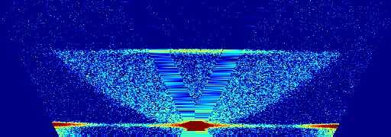
Annihilation at high relative momentum
2D spectrum:
    x: p-parallel <==> Doppler shift
    y: Sum energy <==> rest mass + kinetic energy
1092 keV
1022 keV
340 keV
=> 91.3 a.u.
-340 keV
0 keV
JPOS 09 Newport News (March 2009)

Slide 8
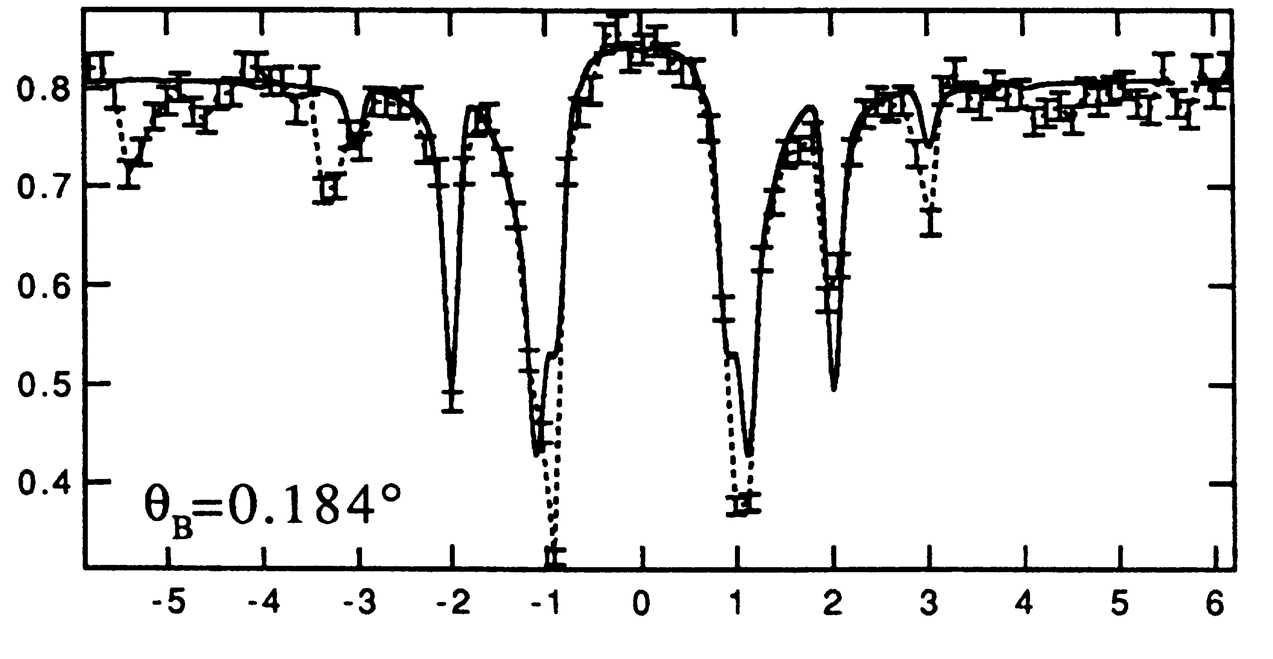
Channeling
Normalized Yield
Angle

Slide 9
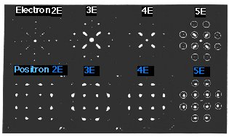
Positron Holography (Never fulfilled)
CdSe
- Electron-electron
interaction
- Multi-layer contribution
- One positron at a time
- Topmost layer only
Now: with electrons ⇒ Future: with positrons
“If positrons were routinely available,
all diffraction would be done with them” S.Y. Tong

Slide 10
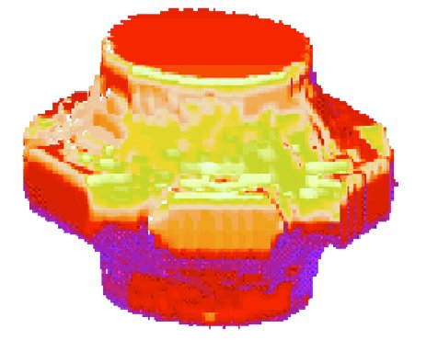
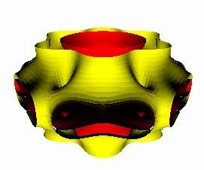
Fermi Surfaces
Ytterbium
Experiment
Resolution limited by acquisition time
Theory
Now: 16 dataset
⇒ Future: Super ACAR 1 shot and depth profiles

Slide 11
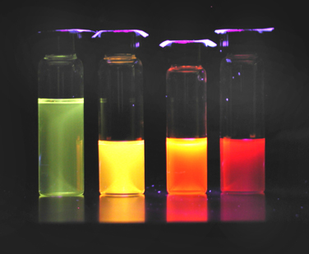
Quantum dots
1.8 nm
4.5 nm
6.0 nm
“baseline”
JPOS 09 Newport News (March 2009)

Slide 12
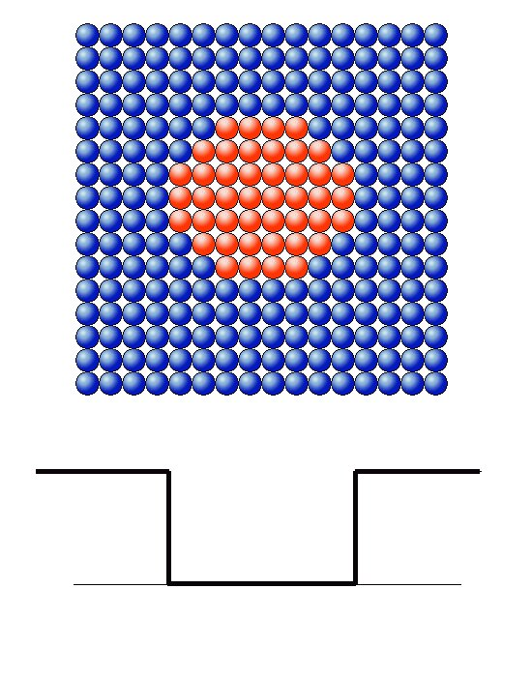
Precipitates-Critical in Reactor
Steels
Cu in Fe
e⁺
Fe
Fe
Potential well
in Fe
Zero point motion
energy
Cu

Slide 13
Atomic scale defects
Missing atoms in crystals are called vacancies
They play a key role in the properties of many metals, semiconductors and insulators
How to tell the difference between impurities and dopants
  One makes the PC work the other turns it to a pile of junk
Understanding them drives progress
  Electronics, solar cells, sensors, optics, detectors (airports), lasers
  Silicon, silicon carbide, ZnO, GaN, GaAs, YAG,…
  Lasers to cut steel, transparent conductors for monitors, sunlight to electricity, longer lasting cell phones, more gigabytes on DVDs beyond Blue-ray, shorter queues at airport baggage scanners…
JPOS 09 Newport News (March 2009)

Slide 14
Trapping in negative or missing atoms
3
Localized trapped state
Delocalized Bloch state
2
1
3
ψ
ψ
2
0
-1
1
10
0
5
10
5
-1
0
0
15
<100>-direction (a.u.)
<010>-direction (a.u.)
15
10
10
5
<100>-direction (a.u.)
5
0
0
<010>-direction (a.u.)

Slide 15
Doppler broadening
Conduction electrons:
delocalized;
low momentum
Potential of atomic cores
Bound electrons:
localized; high
momentum
A positron and many electrons
JPOS 09 Newport News (March 2009)

Slide 16
Doppler broadening
Conduction electrons:
delocalized;
low momentum
Bound electrons:
localized; high
momentum
A positron “likes” vacancy
JPOS 09 Newport News (March 2009)

Slide 17
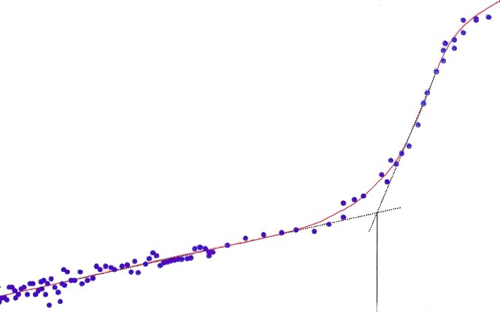
Vacancy formation energy
Mo
Open volume parameter
T_{c}
400
800
1200
1600
2000
2400
Temperature (K)
Now: 1D depth profile ⇒ Future: 3D map with lifetime

Slide 18
Depth profiles
M
e
a
n
i
m
p
l
a
n
t
a
t
i
o
n
d
e
p
t
h
(
n
m
)
1
0
0
3
0
0
5
0
0
1
0
0
0
1
5
0
0
2
0
0
0
3
0
0
0
1
.
0
6
2
)
1
3
1
-
0
m
c
(
1
n
.
0
5
o
i
t
a
r
t
n
2
e
1
0
1
c
0
.
0
4
n
r
o
e
c
t
t
e
c
m
e
a
f
r
e
1
D
.
0
a
3
1
p
1
9
S
0
0
1
0
2
0
3
0
4
0
5
0
6
0
7
0
8
d
D
0
e
p
t
h
(
n
m
e
)
z
i
l
1
.
0
a
2
m
r
o
N
1
.
0
1
1
.
0
Now: layer averaged
⇒ Future: 3D map
with nm³ resolution
0
d
=
1
5
0
n
M
m
B
E
0
.
9
9
0
5
1
0
1
5
2
0
2
P
5
o
s
i
t
r
o
n
e
n
e
r
g
y
(
k
e
V
)

Slide 19
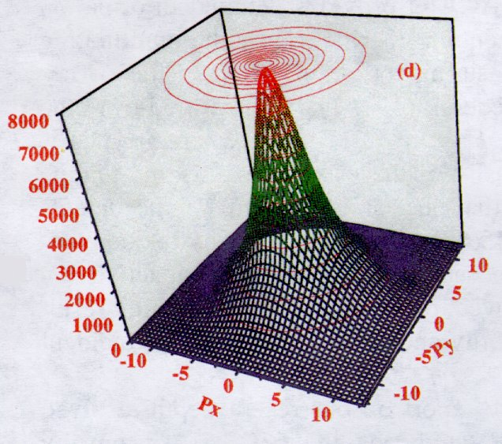
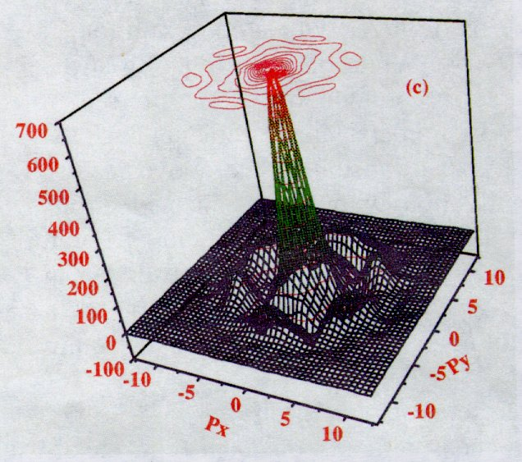
SiO₂-Si interface
Ps trapped in microvoids
at the interface
Without broad component
With broad component

Slide 20
Colloidal silica (50 nm)
Bulk material level
JPOS 09 Newport News (March 2009)

Slide 21
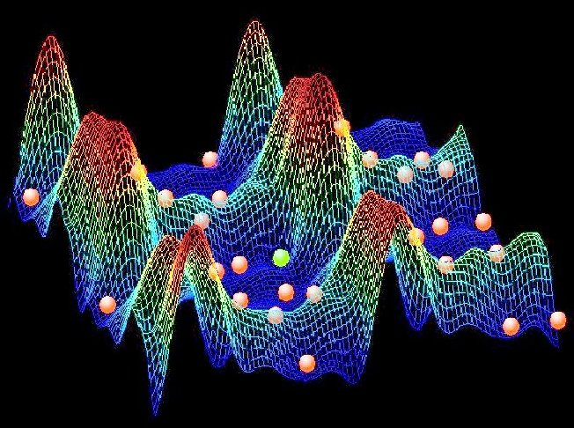
Defects in matter
The mesh represents electrons “flowing” around atoms in silicon. The atoms are indicated by the red spheres.
One atoms is missing and a different atom (green) is replacing a neighboring silicon.
This is hard to “see” but can be detected with positrons.
JPOS 09 Newport News (March 2009)

Slide 22
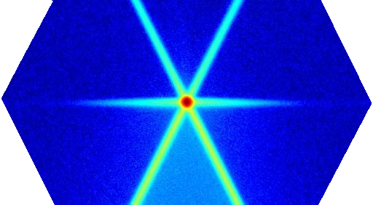
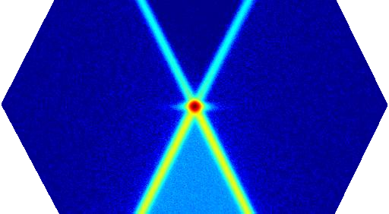
Looking for defects
Highly porous material
Doppler shift momentum
Total energy
JPOS 09 Newport News (March 2009)

Slide 23
Chemical environment
x 1/2
Coincident
positron annihilation
sensitive to
core electrons
Now: 12 hours for 1 sample @ 1 selected depth
⇒ Future: within hours a full depth profile

Slide 24
Micro probes
Combined positron (1-5) and electron (7-6)
Microscope (9-10) to probe cracks in metals (11,13). An electrical prism (6) switched between electrons and positrons to combine electron microscope and defect images.
Greif et al, Appl. Phys. Lett. vol 71, p. 2115 (1997)
Positron probe that
Measures the electron density of patterns on silicon with 2 micrometer resolution
JPOS 09 Newport News (March 2009)
News item in Nature vol. 412, p.764 (2001)
W. Triftshauser et al, Phys. Rev. Lett. 87, 067402 (2001)

Slide 25
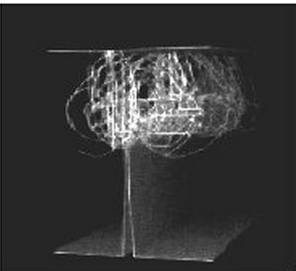
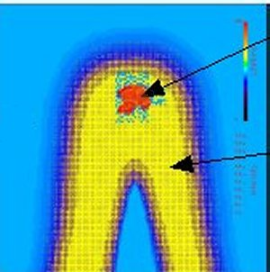
Cracks
Lifetime scale
120 170 350 (ps)
Void
Dislocations
Matrix

Slide 26
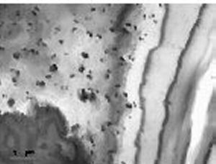
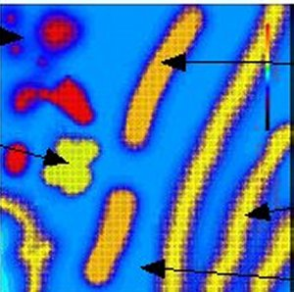
The future of Defects
2D lifetime maps
TEM
Lifetime scale
120 170 350 (ps)
Vacancies
Precipitate
Dislocations
Small void
Matrix
Simulation of the future with e⁺

Slide 27
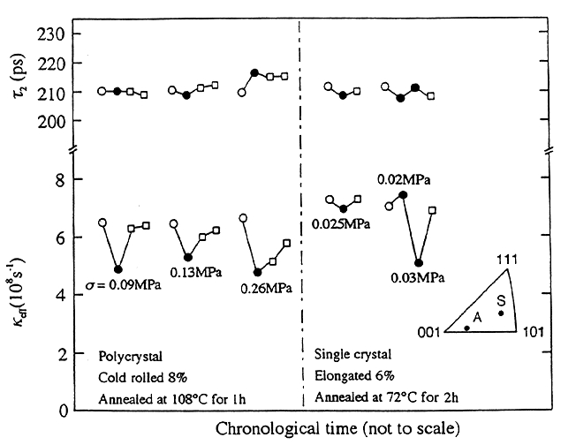
Stress-Are you feeling some??
Direct observation of dislocations in metals during elastic deformation
Lifetime
stress relieved
under stress
Intensity
Now: stop frame
⇒ Future: movie

Slide 28
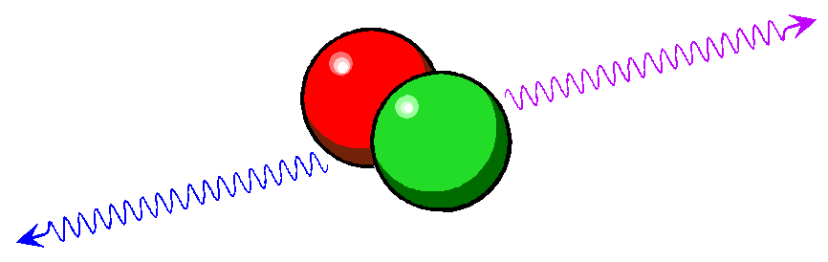
Lifetime apparatus
positron beam
Stop: γ detector
Start: e⁻ detector
discriminator
discriminator
Data collecting
computer
JPOS 09 Newport News (March 2009)

Slide 29
Positron lifetime
No pores
big space between molecules
large pores
JPOS 09 Newport News (March 2009)

Slide 30
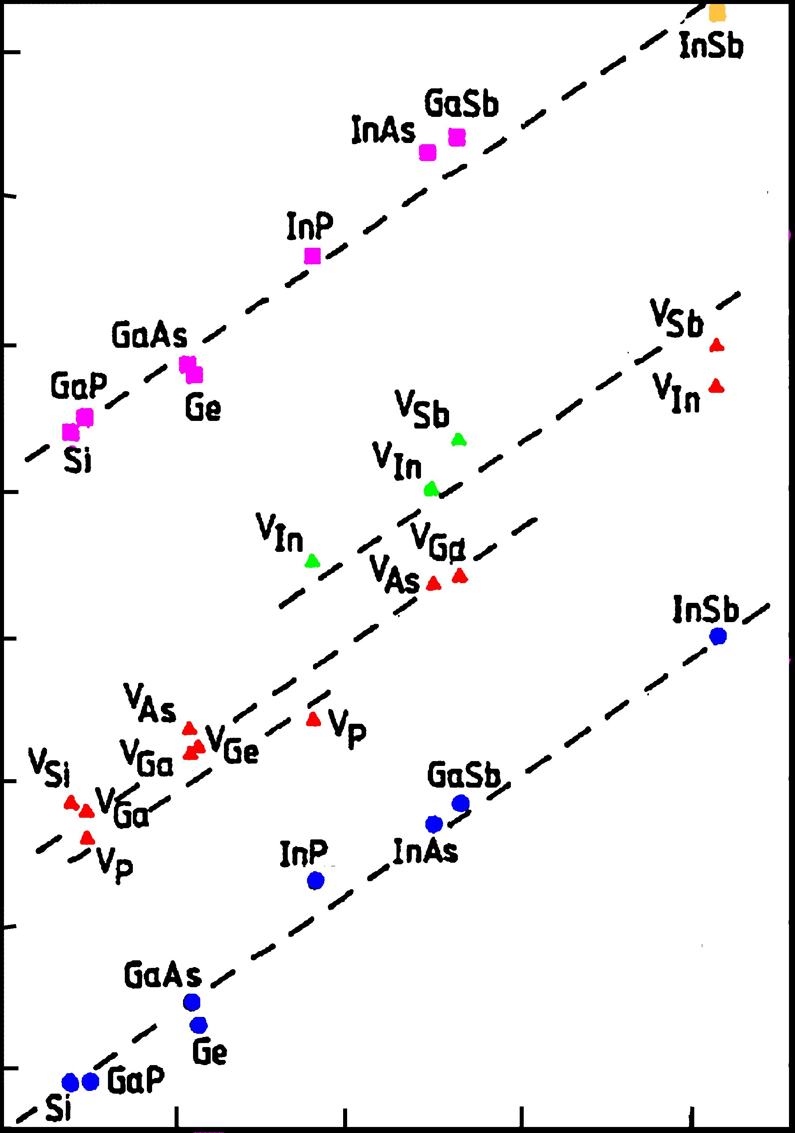
Positron Lifetime
340
300
Positron lifetime (ps)
260
Now: bulk averaged
⇒ Future: 3D map
220
125
150
175
200
225
Unit-cell volume (a.u.)

Slide 31
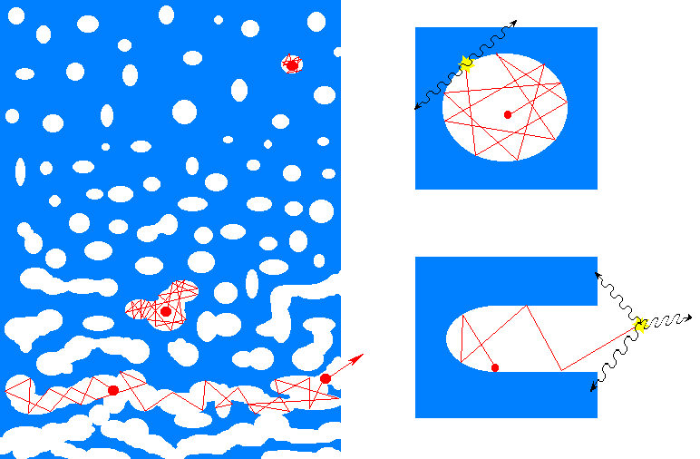
Positronium in Voids & Open Porosity
+
porosity
interconnectivity
surface
JPOS 09 Newport News (March 2009)

Slide 32
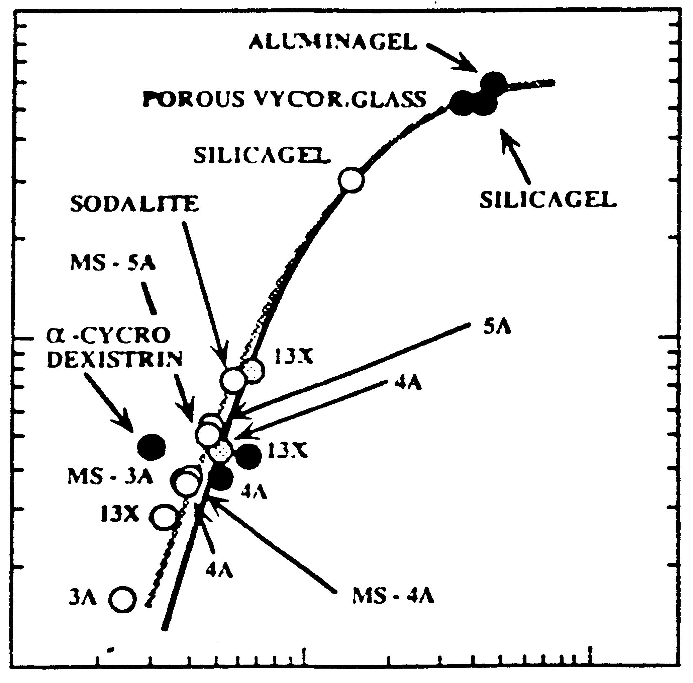
o-Positronium Lifetime
100
ALUMINAGEL
POROUS VYCOR GLASS
SILICAGEL
SODALITE
SILICAGEL
MS-5A
10
α-CYCRO
DEXISTRIN
5A
o-Ps lifetime
13X
4A
MS-3A
13X
4A
13X
Now: bulk averaged
⇒ Future: 3D map
3A
4A
MS-4A
1
0.1 1 10
Pore radius

Slide 33
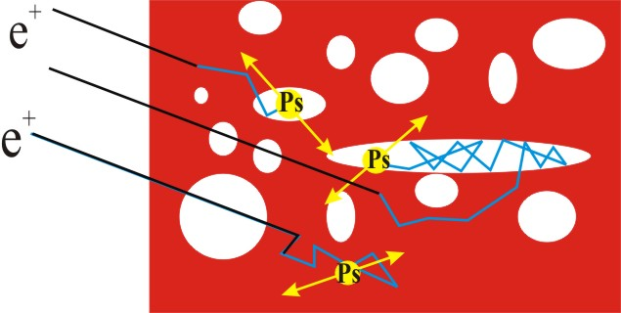
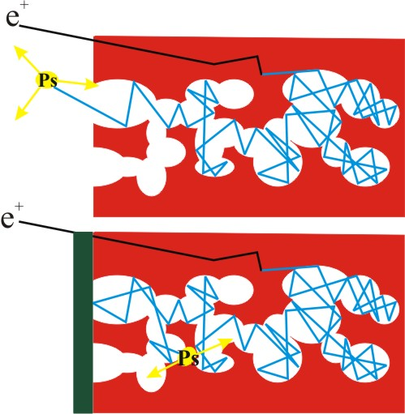
Closed vs open porosity
Open/closed porosity differ qualitatively :
Separating closed and open porosities (at 2 keV)
JPOS 09 Newport News (March 2009)

Slide 34
Percolation Threshold; Open Porosity
JPOS 09 Newport News (March 2009)

Slide 35
Two pore diameters
JPOS 09 Newport News (March 2009)

Slide 36
Pores in materials
The size of pores determines
  what size molecules pass
  how long a pill can deliver drugs
  the function of fuel cells
  the mechanical properties of plastics
  how fast a computer can calculate
  the purity of filtered water
Filters, membranes, drug-delivery, microelectronics
How to measure the size?
  These are nanometers.
JPOS 09 Newport News (March 2009)

Slide 37
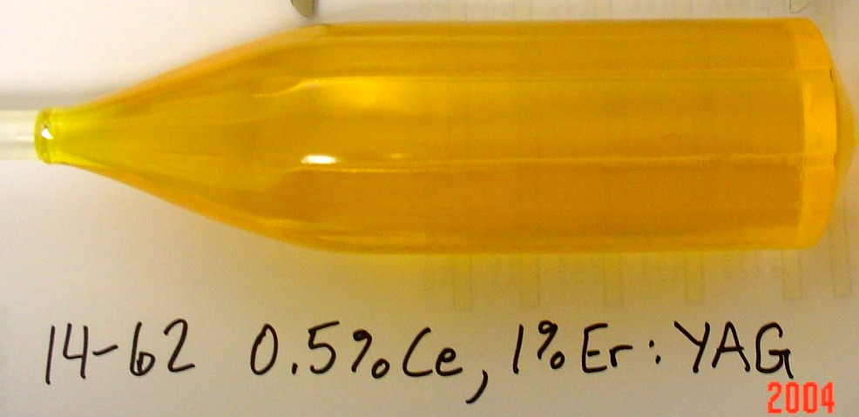
Ce:YAG Boule
JPOS 09 Newport News (March 2009)

Slide 38
JPOS 09 Newport
News (March 2009)

Slide 39

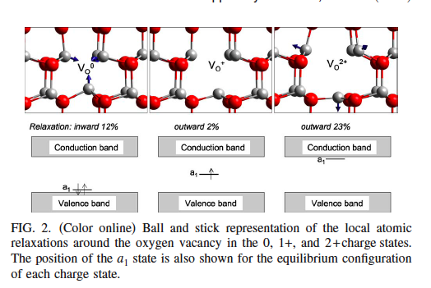
JPOS 09 Newport News (March 2009)

Slide 40
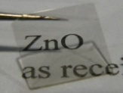
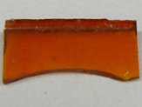
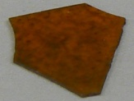
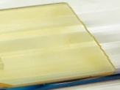
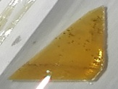
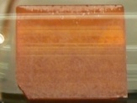
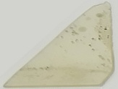
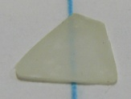
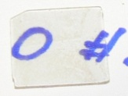
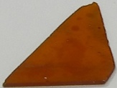
As rec.: clear
A
#1
Ref [24]
#2
#3
B
C
D
E
Zn
Ti(H)
Ti(H dep)
Ti(D)
F
G
Zn
Ti(H dep)
H
I
J
O₂
Ti(H dep)
Zn
JPOS 09 Newport News (March 2009)

Slide 41
Oxidation of a layer on Si
layer Si

Slide 42
Zero Temperature Limit of 3γ/2 γ ratio
Extrapolate to 0 K
Ps does not die out
Initial Amount of Ps ⇓ with ⇓ in T c.f results of Goworek.
Increase in R due to increase in pore lifetimes
Less initial Ps but less pick-off
“Purification”: Greater relative intensity of self-annihilation
JPOS 09 Newport News (March 2009)

