Slide 1

Beam Diagnostic
Needs and Challenges of some
Future Light Sources
Pavel Evtushenko, JLab
This talk to a large extend based on discussion and comments:
Storage Rings and USRs: Michael Borland, Glenn Decker, Fernando Sannibale
Single Pass XFELs: Henrik Loos, Joe Frisch
ERLs: Bruce Dunham

Slide 2
Energy Recovery LINACs
ERLs Outline
Essence of and ERL based LS – run high average current (~ 100 mA) of
non equilibrium (Gaussian) beam with high peak brightness
Injector:
- generate and maintain high peak brightness beam
- monitor when going to high average current
Full current beam vs. tune-up beam
Two beams in the LINACs – position and transverse profile
Large Dynamic range – understanding beam Halo origins and evolution
Non Gaussian beams – can be really difficult, hopefully better with well built
injectors

Slide 3
Drive Laser “ghost” pulses
For machine tune up, beam studies, intercepting diagnostics a “diagnostic
beam” with very low average current but nominal bunch charge is used
(all beam can be lost without damaging machine)
For example, JLab FEL:
max rep. rate 74.85 MHz (CW)
diagnostic mode: rep. rate 4.678125 MHz (÷16), 250 μs / 2 Hz (÷2000)
average current ~300 nA
Most of the laser pulses are “stopped” by EO cell(s), but the extinction ratio
of the an EO cell is about 200 (typical), two in series ~ 4×10⁴
Another example: want to reduce 1300 MHz (100 mA) to 300 nA (2¹⁸)
than for every bunch Q_{b} we want
we also get 6.55×Q_{b} of “ghost” pulses (655 % !!!) we do not want
“ghost” pulses overall intensity must be kept much lower than real pulses!!!
for “usual” measurements ~ 1% might be fine
much bigger problem if want to study halo, let’s say 10⁻⁶ effects, than
“ghost” pulses should be kept at 10⁻⁸ (???)

Slide 4
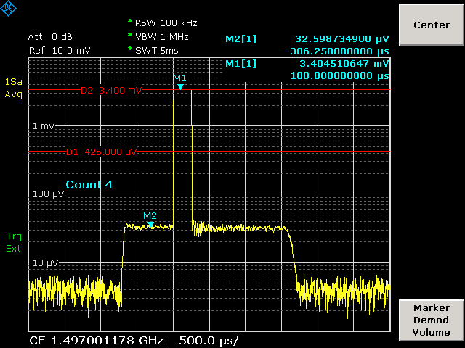
Drive Laser “ghost” pulses
Using a Log-amp is an easy way to diagnose presence of the “ghost” pulses
Log-amps with dynamic range 100 dB are available
631 uA (100%)
135 pC x 4.678125 MHz
5.7 uA (~0.9 %)
37.425 MHz “ghost”
pulses

Slide 5
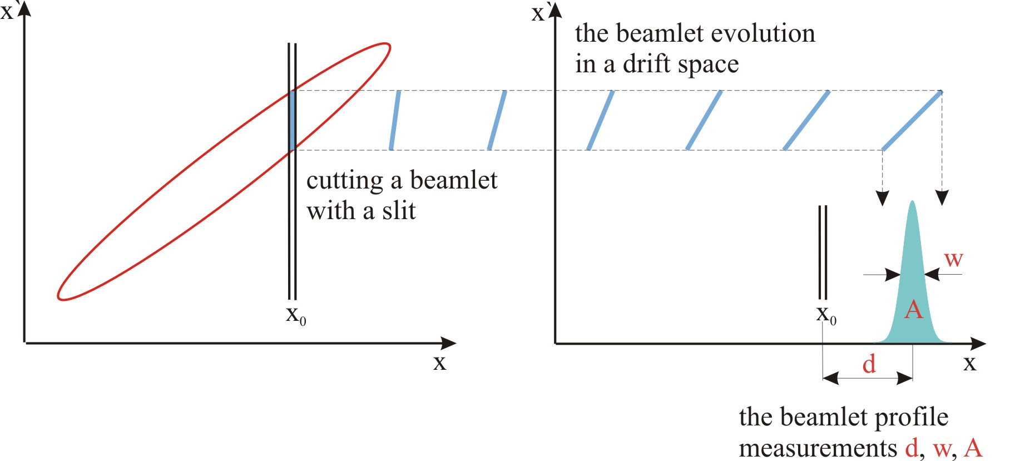
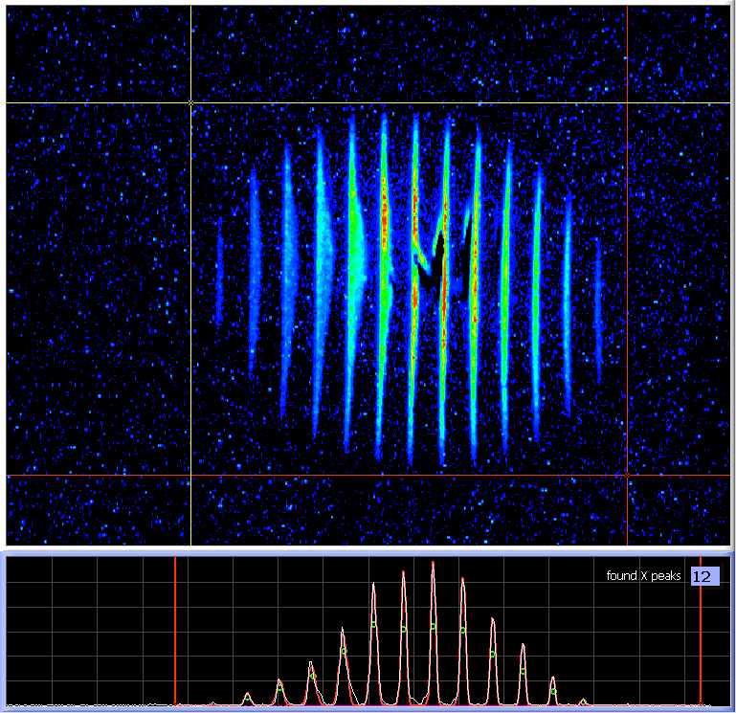
Injector emittance trans. phase space
Mask or a slit is used to cut out small emittance dominated beamlet(s)
Beamlet profile measurements
- Intensity (A)
- width (w)
- displacement (d)
Dynamic range ~ 500 if gain is fixed
Works for space charge dominated beams
Measures emittance and the Twiss parameters in a single shot
Destructive to the beam - works with diagnostics tune-up mode only (low duty cycle or average current)
How to monitor emittance or just beam size, when going to high current???

Slide 6
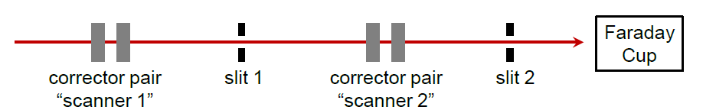
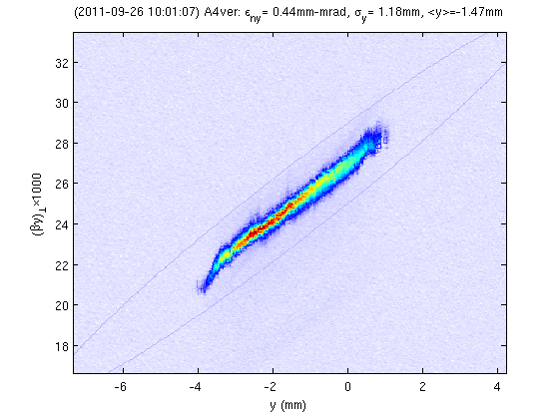
Injector emittance trans. phase space
Two fixed slits and beam scanning across
them
Faraday cup for current measurements
Beam at several kHz - good measurements
in a few seconds
Turns injector into an analog computer for
optimizations
I. Bazarov ,et al PRSTAB 11, 100703 (2008)
Slide courtesy of B. Dunham , ERL 2011

Slide 7
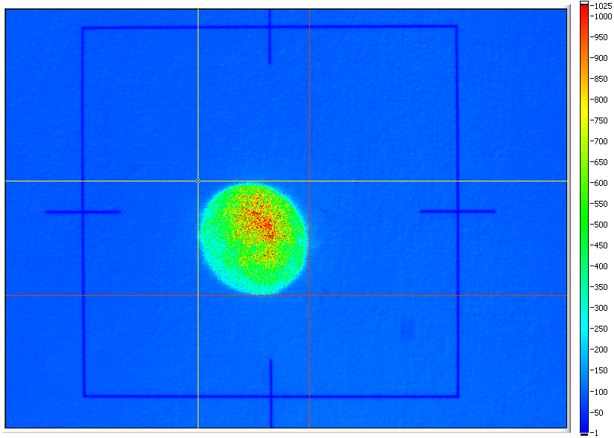
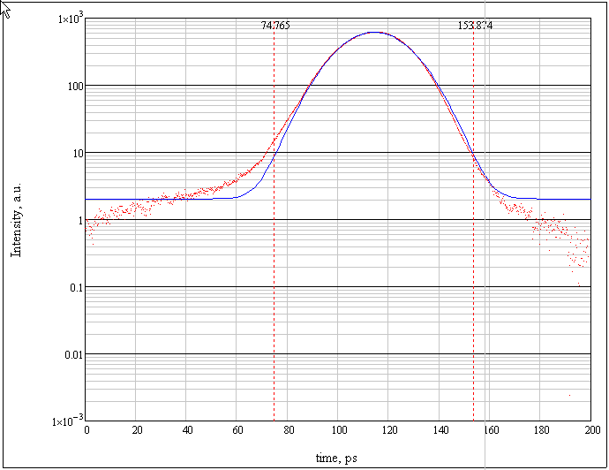
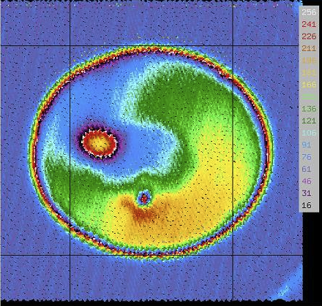
Injector: Drive Laser and Cathode Diagnostics
In a real machine for understanding of the dynamics i.e. to see what it is and comparison with a model measured laser distributions (transverse and longitudinal) needs to be used.
The same is true for the cathode Q.E. distribution of the cathode since the emission profile is the product of this and the laser distribution.
Drive Laser transverse profile - quite easy with the dynamic range ~ 500, probably, need much higher for high current systems.
For longitudinal auto- and cross-correlation are used
DR of this is limited to ~ 10⁴ (scattered light)
Time Correlated Single Photon Counting (TCSPC) can have a ps resolution and very large DR, well suited for high rep. rate sources, but takes time to measure
If/When longitudinal pulse shaping is used – must know that it is stable under high average power.

Slide 8
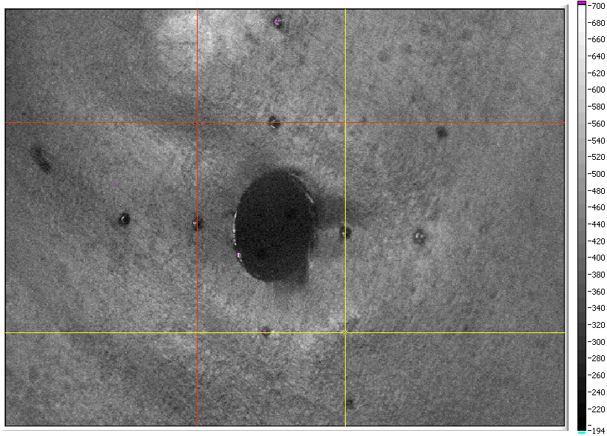
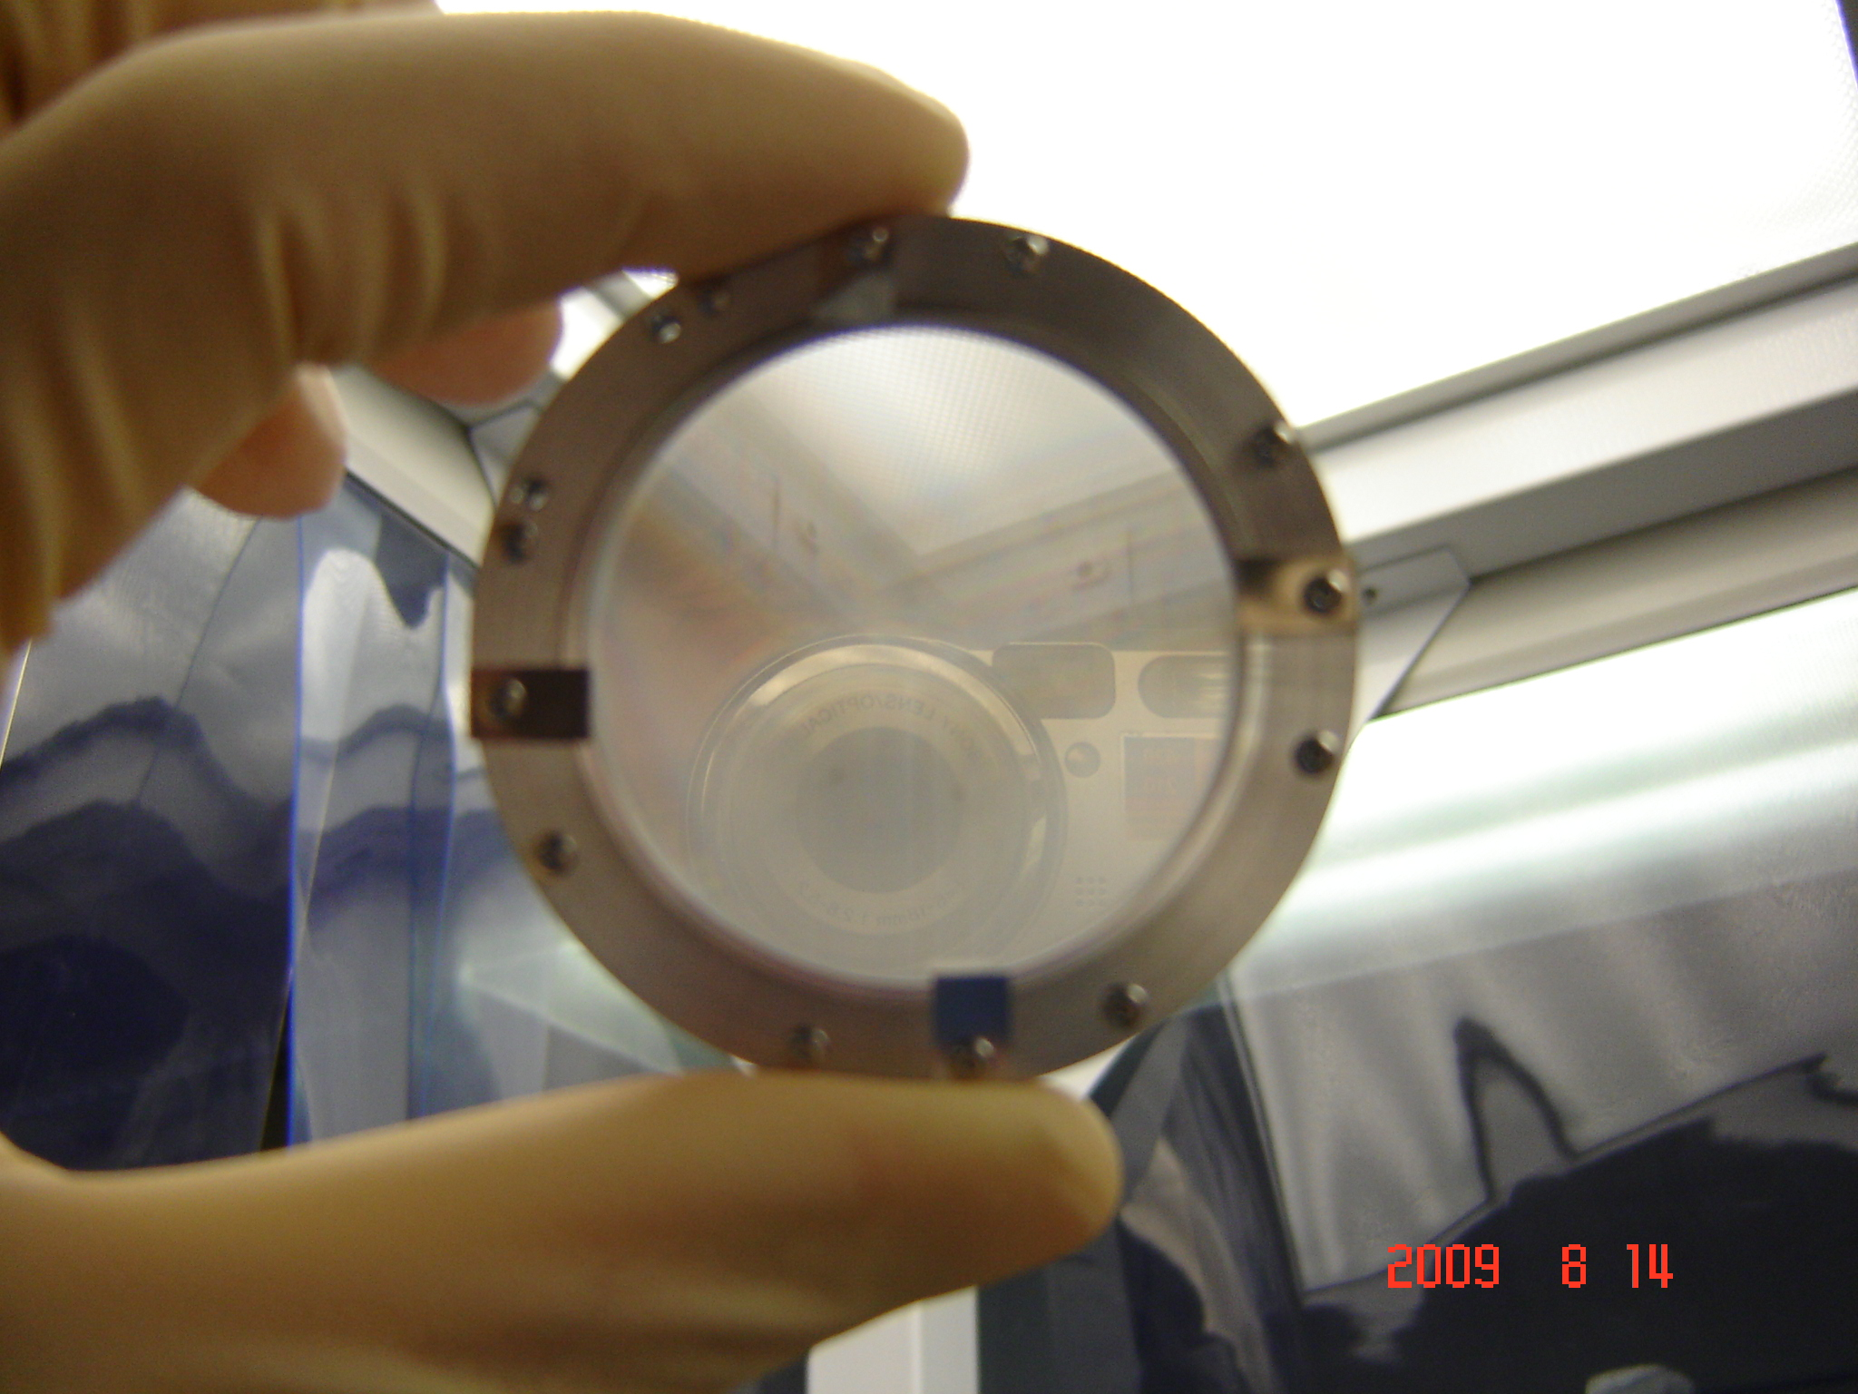
2-pass viewers
There are two beams in the LINAC
When trying to measure decelerated beam with a viewer the accelerated one gets also intercepted
Ultimately need non intercepting technique
JLab FEL uses OTR viewers with 5 mm hole (first beam goes in to the hole)
Difficult to make very thin and flat viewer with the hole
44% transparent mesh 5 micron thin
SRF cavities see the radiation due to the intercepted beam (and “does not like it”)
JLab FEL LINAC OTR viewer
With the ultra bright beam OTR might be useless (OTR becomes COTR)
Wire scanners is a solution (no 2D distribution measured) difficult near LINAC
If the scanner measures radiation created by the wire, must take care of the background.
Need cheap Laser Wire scanner (take advantage of the high rep. rate i.e. <J>)

Slide 9
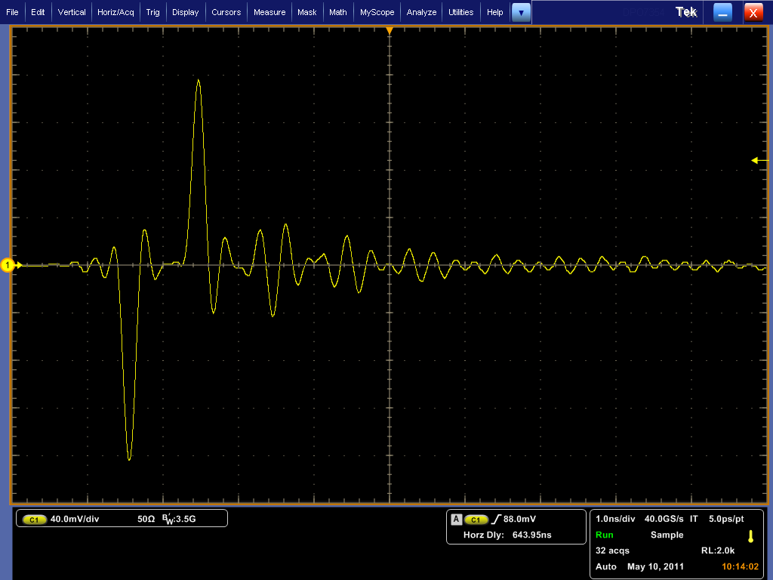
2-pass BPM
Stripline BPM signal
Motivation:
For differential orbit measurements
with both beams in the LINAC
The decelerating beam gets adiabatically
“anti-dumped” – small errors corrections in
the beginning leads to big orbit change at
the end
Orbit stabilization and feedback
There are a few ideas in work now; Both time domain and frequency domain
Solution can be very different for different machines
long recirculation time vs. short;
every bucket filled vs. not
The phase difference is not always 180 deg, especially when tuning machine
this is some what a problem for both time domain and frequency domain
Time domain approach requires very-very-very carefully built pickups (no ringing)

Slide 10
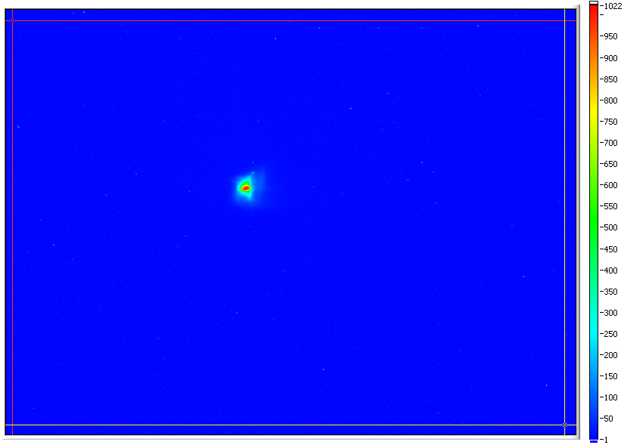
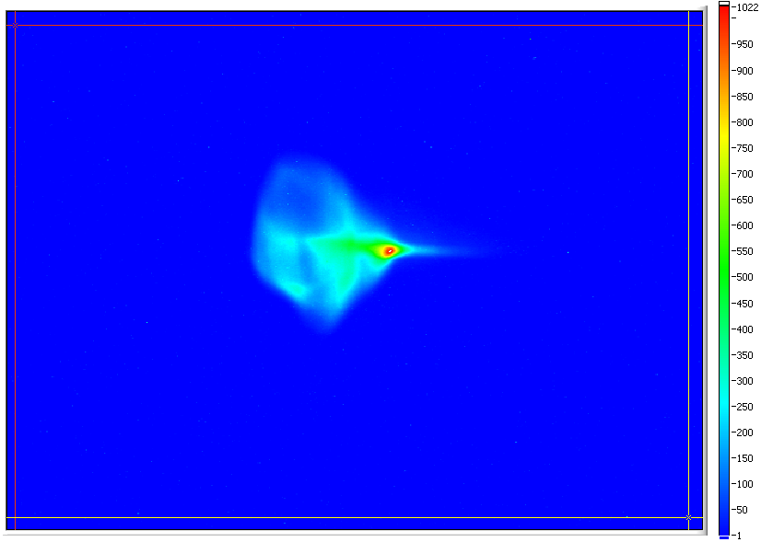
On LINAC non Gaussian beams
Measured at JLab FEL
Obtained in a specially setup measurements to show how much beam is non Gaussian
It in not how we have it during standard operation
There is no Halo shown in this measurements in sense that all of it participates in FEL
interaction (we think) and it is only Dynamic Range of ~ 500.
The techniques we can borrow from rings assume Gaussian beam and therefore
are concentrating on beam size (RMS) measurements

Slide 11
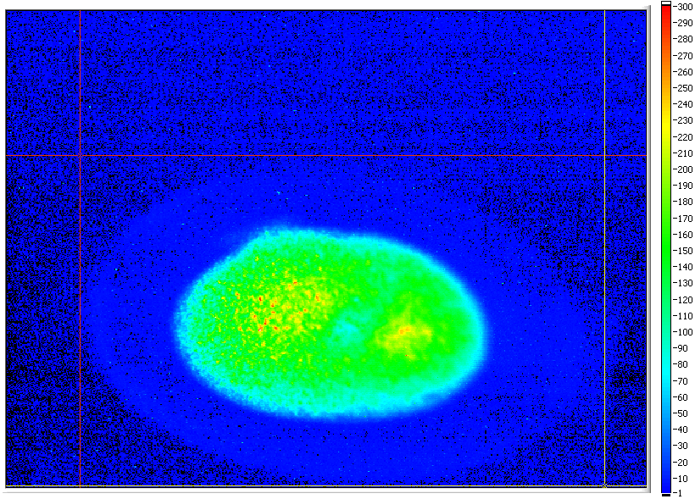
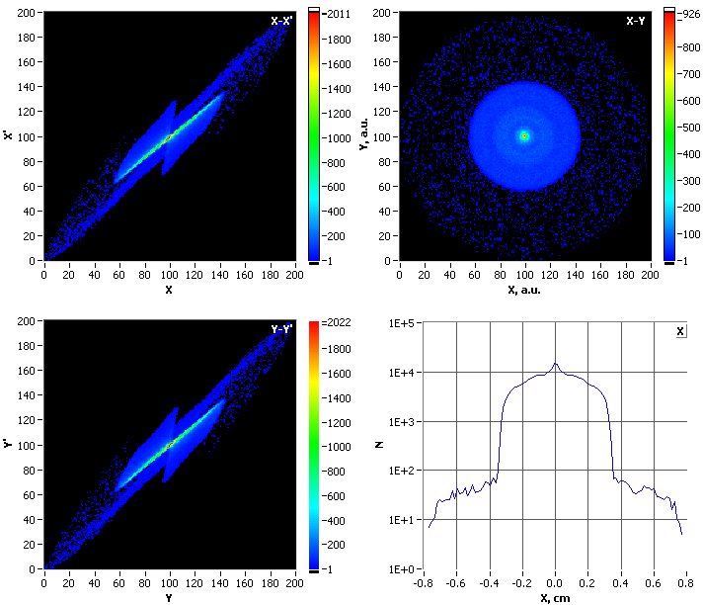
Large dynamic range measurements
Measured in JLab FEL injector,
local intensity difference of the
core and halo is about 300.
(500 would measure as well)
10-bit frame grabber & a CCD
with 57 dB dynamic range
PARMELA simulations of the same setup with 3e5 particles:
X and Y phase spaces, beam profile and its projection show
the halo around the core of about 3e-3.
Even in idealized system (simulation) beam dynamics can
lead to formation of halo.

Slide 12
Single Pass FELs
LCLS, FLASH, SACLA alike – extreme peak beam brightness
Transverse diagnostics – COTR (big setback), wire scanners (need faster)
Eventually very small transverse beams (diffraction limited resolution)
Longitudinal diagnostics – TCAV (great, but complex and expansive)
Timing – good for RF, main things is to sync the FEL to the user lasers
Orbit stability – (“not too bad”, RF cavity BPMs are very good!)
LINAC’s non Gaussian beam - does not seem to be a big problem
(very well made injector/beam, but also low rep. rate)
For seeded systems the overlap between the seed and the beam
(phase/time measurements of the beam and seed laser)

Slide 13

OTR turns COTR
an old working horse that tells you – “you will have a different transportation in the future”
The Optical Transition Radiation has been a true working horse for the transverse beam profile measurements, from 10 keV to many GeV with resolution down to few microns
Main advantage - simplicity, resolution - diffraction limited (energy independent), enough yield for single bunch measurements
COTR first observed at LCLS with gain ~ 10, then at other facilities too
Now gain up to ~10⁵ at LCLS at the optical wavelength
Attributed to micro bunching instability that has gain at the optical λ – key parameter is the small slice energy spread (longitudinally bright beams)
The are several mitigation scheme proposed but … 10⁵ gain !!!
The replacement with best results so far – YAG:Ce plus gaited CCD – this is expansive and eventually scintillators get to saturation
Catastrophe equals opportunity

Slide 14
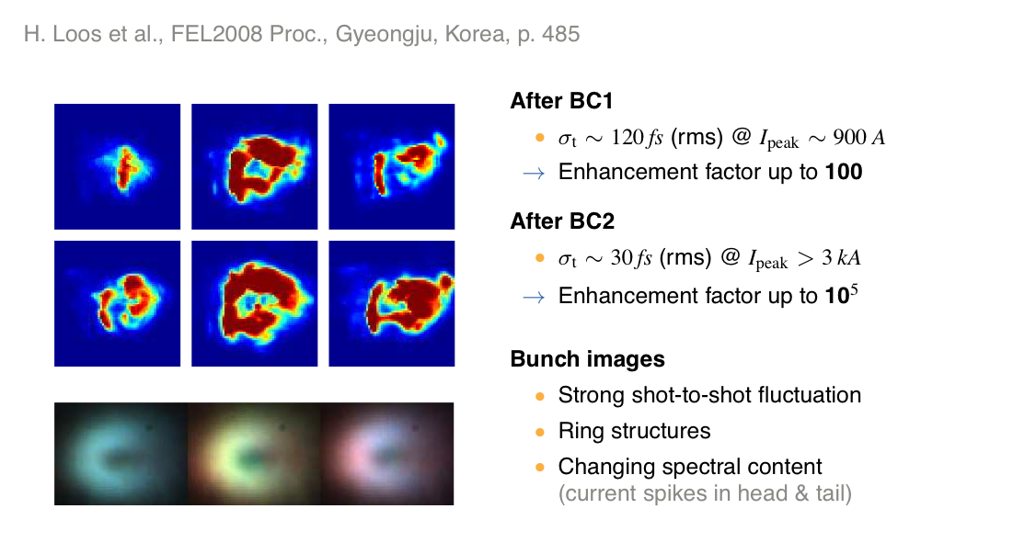
COTR
Also good overview by S. Wesch, DIPAC 2011

Slide 15
Another problem with OTR
OTR image of a beam ~ 10 μm × 10 μm
before (up) and after (down)
the OTR radiator was exposed to 5×10¹⁰ e⁻/train;
rep. rate of the bunch trains 1.5 Hz for 5 minutes
OTR radiator (initially) optically polished 500 μm Be
With ~ 10 time less charge per train for 30 min no degradation
Suggested explanation – radiator deformation beyond elastic limit 5×10¹⁰ e– ≈ 100×77 pC bunches
Radiators with small thermal expansion and large elasticity modulus might be the solution. Si is a good candidate, already used as OTR radiators – canbe optically polished.
Optics for such beams is essentially a microscope
(must collect light in a very large angle)
From SLAC-PUB-9280, courtesy of M. Ross

Slide 16
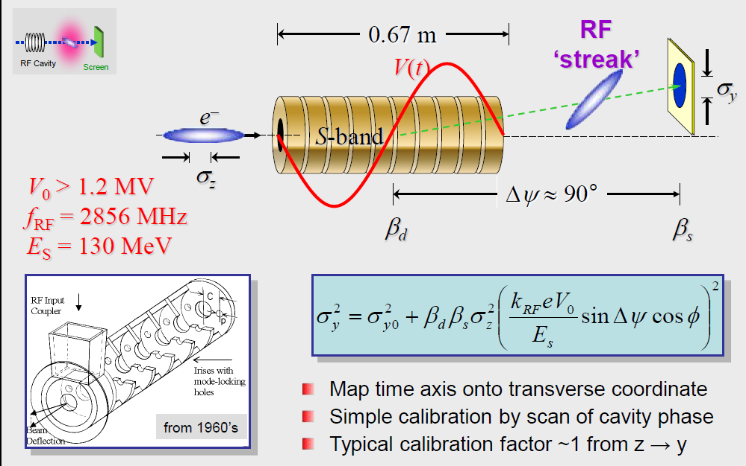
Bunch Length Measurements
Now at LCLS bunch is so short – the measurements are resolution limited
Transverse deflecting cavity – “gold standard”; direct, time domain, self calibrating measurements.
Going to X-band ➔ 1 fs resolution.
But expansive and complex. Not every facility can afford it.
However, provide absolute measurements which can be used to calibrate spectral (frequency) domain diagnostics
Frequency domain techniques:
Compact and affordable, Used with CTR and CSR in THz range, few ps to ~50 fs as is
Going to the shorter buncher is shifting the CTR to visible and UV diapason (already now)
Simplest – Martin-Puplett interferometer, multiple shots
Single shot spectrometers – DESY demonstrated, LCLS another under development
Main issue – phase information is lost

Slide 17
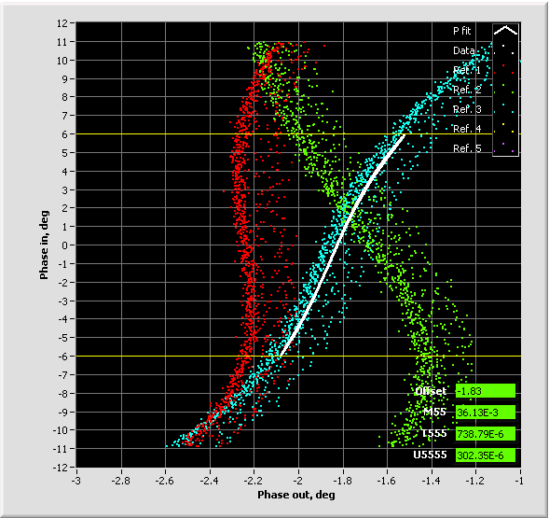
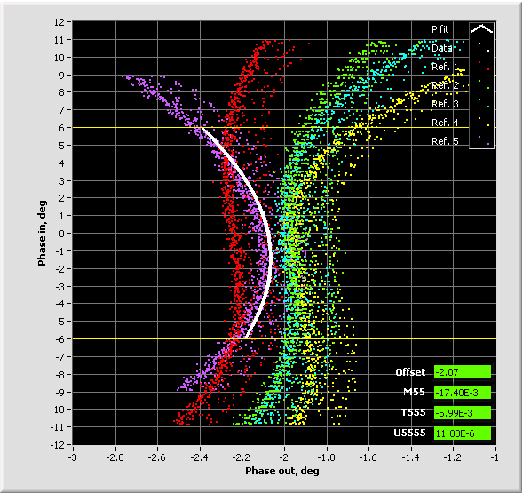
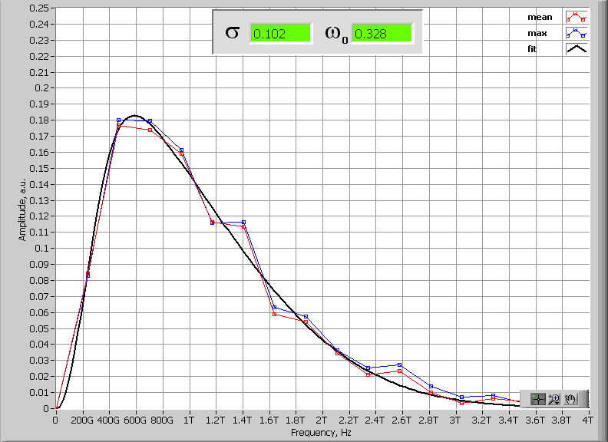
JLab FEL bunch compression diagnostics
JLab IR/UV Upgrade FEL operates with bunch compression ration of 90-135 (cathode to wiggler); 17-25 (LINAC entrance to wiggler).
To achieve this compression ratio nonlinear compression is used – compensating for LINAC RF curvature (up to 2nd order).
The RF curvature compensation is made with multipoles installed in dispersive locations of 180° Bates bend with separate function magnets - D. Douglas design (no harmonic RF)
Operationally longitudinal match relies on:
a. Bunch length measurements at full compression (Martin-Puplett Interferometer)
b. Longitudinal transfer function measurements R₅₅, T₅₅₅, U₅₅₅₅
c. Energy spread measurements in injector and exit of the LINAC
Trim quads
(B’dL) 740 G
Sextupoles
(B’dL) 12730 G
Trim quads
(B’dL) 700 G
Sextupoles
(B’dL) 10730 G
Trim quads
(B’dL) 660 G
Sextupoles
(B’dL) 8730 G
Martin-Puplett Interferometer data
in frequency domain – give upper limit on the RMS bunch length

Slide 18
Storage Rings
Ultimate storage rings – full transverse coherence
Small transverse beam size (is the point of the USRs)
Small source size requires corresponding transverse stability
X-ray BPM
Sort Pulse X-rays (SPX system)
For a proper overview of the SR diagnostics status see:
G. Decker at FLS2010 workshop
C. Steier at the ERL09 workshop

Slide 19
Transverse Beam Stability
Pointed out by C. Steier at ERL2009 and M. Borland now again.
USRs and high-energy ERLs will converge toward requirements that are similar to those that "leading" present-day storage rings must meet in the vertical plane.
Emittance sets the scale for beam stability requirements.
The best present vertical-plane emittance in third generation rings (5~10 pm) is similar to what's projected in the both planes for ERLs and USRs.
Also, as the beam gets smaller going below the diffraction limit e⁻ beam will be some what smaller than the “optical mode” size of the x-ray beam and, thus the latter one will care less about variations of the former one.
The difference at ERLs will be the sources of the beam instability. Starting from the Cathode Drive Laser, Gun, Injector. So, one will have to have additional feedback/forward for the new sources of the instabilities.

Slide 20
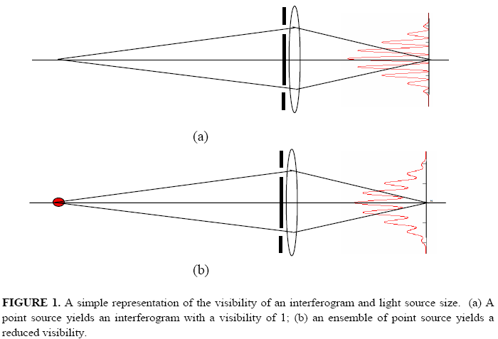

Transverse Beam Size
When SR is used to measure the transverse beam size – the resolution is diffraction limited
Therefore one went now to x-ray wavelength for the measurements
However, if below diffraction limit of λ_{xray} – beam is smaller than what can be measured with the help of λ_{xray} (if doing imaging) i.e. if this diagnostics works the USR is not succeeding
The way around the diffraction limit was found by astronomers when measuring size of the stars – two slit interferometer.
It also has been adopted by T. Mitsuhashi for beam size measurements at optical λ.
T. Mitsuhashi, PAC97, 766, (1997); Phys. Rev. ST Accel. Beams 9, 122802 (2006)
Point source
Courtesy of
F. Sannibale
γ = 1
By measuring the visibility and first minimum position (phase) vs. the distance between the two slits the full beam distribution projection can be reconstructed.
If the beam distribution is symmetric, the phase measurement is not required.
Extended source
0 < γ < 1

