Slide 1
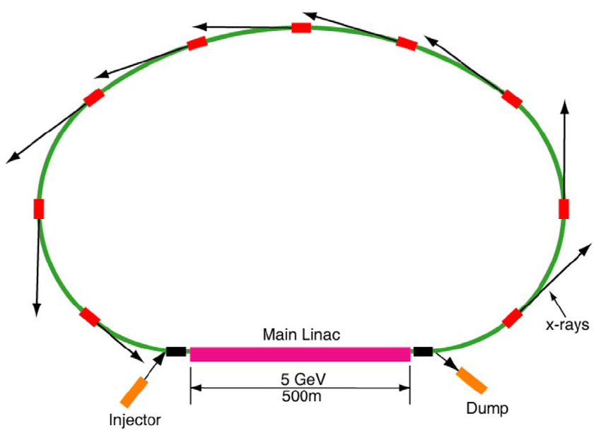
Cornell Laboratory for Accelerator-based ScienceS and Education (CLASSE)
Overview of ERL R&D Towards Coherent X-ray Source
Ivan Bazarov
Cornell University
ERL x-ray light source concept

Slide 2
Acknowledgements
Matthias Liepe for SRF slides; Georg Hoffstaetter for slides from his ERL’11 talk – and by proxy to the entire international ERL community
Cornell team:
  D. H. Bilderback, M. G. Billing, J. D. Brock, B. W. Buckley, S. S. Chapman, E. P. Chojnacki, Z. A. Conway, J. A. Crittenden, D. Dale, J. A. Dobbins, B. M. Dunham, R. D. Ehrlich, M. P. Ehrlichman, K. D. Finkelstein, E. Fontes, M. J. Forster, S. W. Gray, S. Greenwald, S. M. Gruner, C. Gulliford, D. L. Hartill, R. G. Helmke, G. H. Hoffstaetter, A. Kazimirov, R. P. Kaplan, S. S. Karkare, V. O. Kostroun, F. A. Laham, Y. H. Lau, Y. Li, X. Liu, M. U. Liepe, F. Loehl, L. Cultrera, C. E. Mayes, J. M. Maxson, A. A. Mikhailichenko, D. Ouzounov, H. S. Padamsee, S. B. Peck, M. A. Pfeifer, S. E. Posen, P. G. Quigley, P. Revesz, D. H. Rice, D. C. Sagan, J. O. Sears, V. D. Shemelin, D. M. Smilgies, E. N. Smith, K. W. Smolenski, A. B. Temnykh, M. Tigner, N. R. A. Valles, V. G. Veshcherevich, Z. Wang, A. R. Woll, Y. Xie, Z. Zhao
NSF DMR-0807731 for ERL R&D support at Cornell

Slide 3
Outline
Introduction & motivation
Main technological challenges
Alternative ideas
Outlook

Slide 4
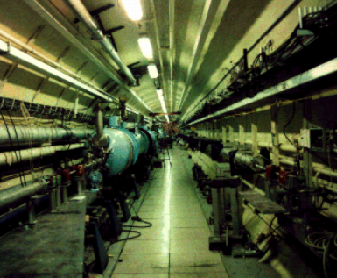
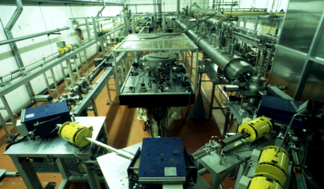
ERL development timeline
KEK, BESSY, China
2010
1986: Stanford SCA
T. Smith et al.
NIM A 259 (1987) 1
2000
1990
2004: ERL-P
2004: BNL R&D ERL
1965: M. Tigner
Nuovo Cimento
37 (1965) 1228
2005: Cornell gets $
1980
1998: BINP FEL
1970
1999: JLAB DEMO-FEL
1990: S-DALINAC
(Darmstadt)
2002: JAEI FEL
1960
2004: JLAB FEL Upgrade

Slide 5
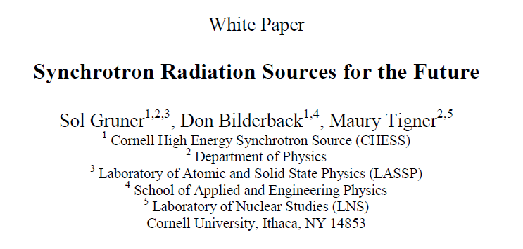
Cornell ERL white paper (2000)
http://erl.chess.cornell.edu/papers/2000/ERLPub00_1.pdf
Geoff Krafft and Dave Douglas talk about ERL-based X-ray light source around that time (slightly earlier); MARS proposal by Gennady Kulipanov et al. (1998)
discusses 10^23 brightness (s.u.) out of an ERL

Slide 6
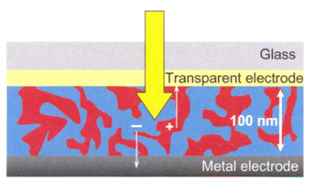
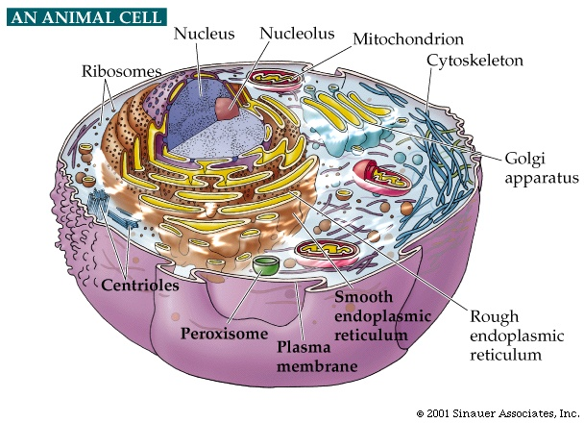
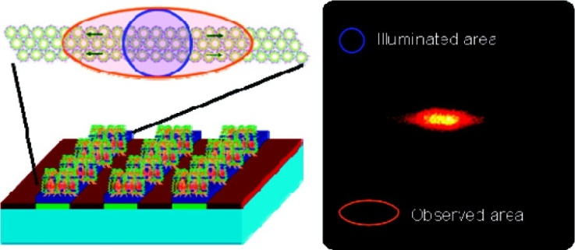
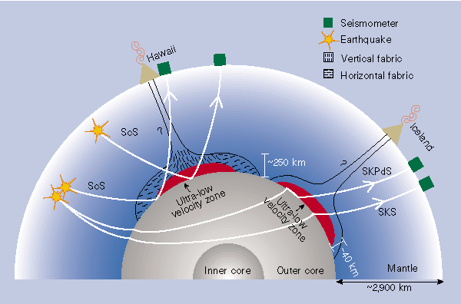
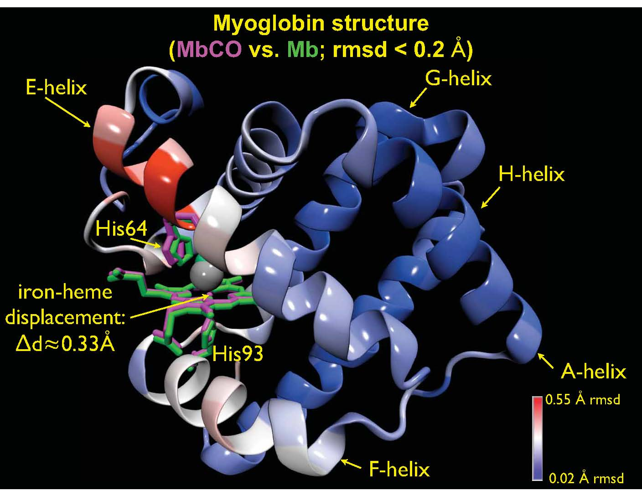
Progress in ERLs for Light Sources
XDL’11 workshops – exciting science enabled by X-ray ERLs
CDI
XDM
Tickle-Probe
SAXS/WAXS @ sub-ps
IXS

Slide 7
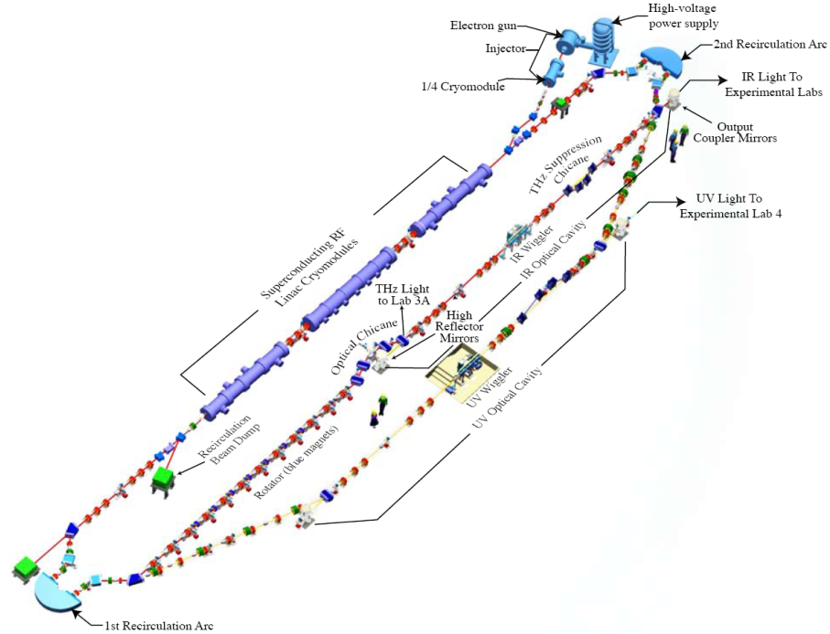
Progress in ERLs for Light Sources
Operations at JLAB

Slide 8
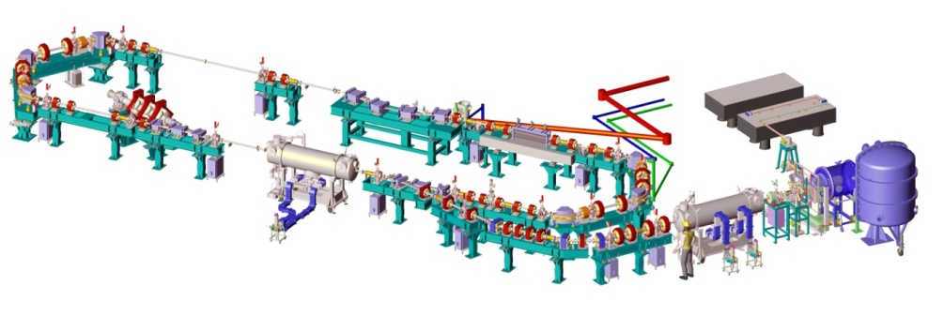
Progress in ERLs for Light Sources
Operations at JLAB, Daresbury,

Slide 9
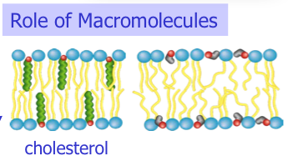
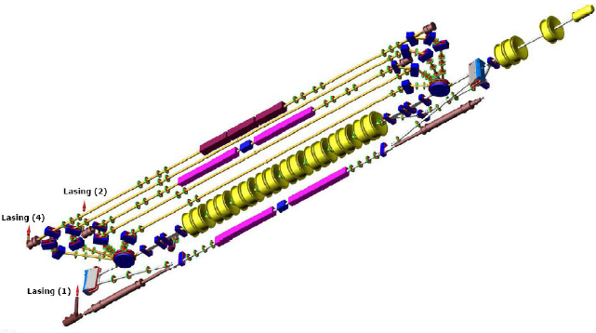
Progress in ERLs for Light Sources
Operations at JLAB, Daresbury, BINP

Slide 10
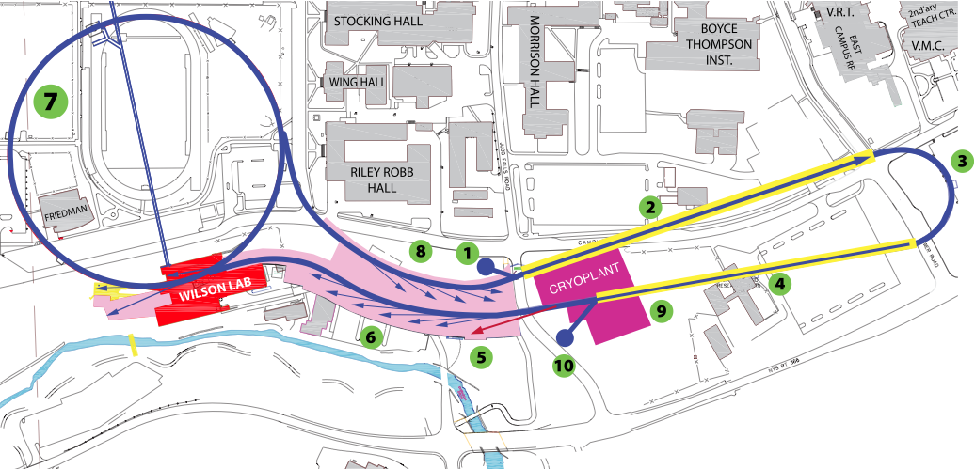
Progress in ERLs for Light Sources
Operations at JLAB, Daresbury, BINP
Designs at Cornell

Slide 11
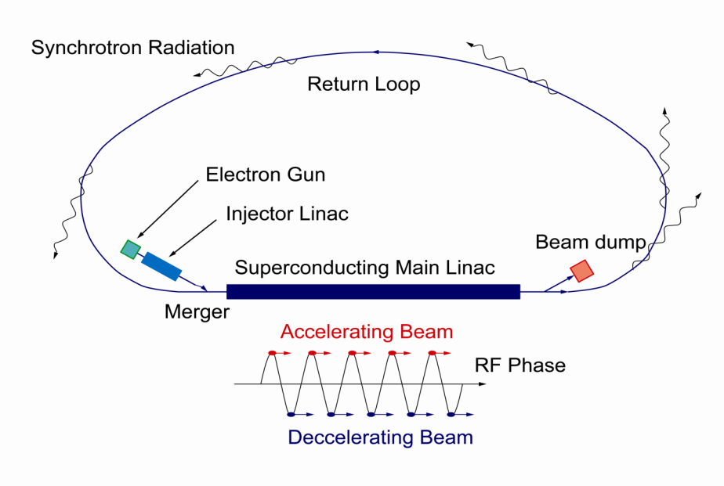
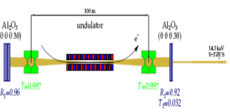
Progress in ERLs for Light Sources
Operations at JLAB, Daresbury, BINP
Designs at Cornell, KEK/JAEA
7GeV
Double Acc.
3GeV ERL
First Stage
XFEL-O Second Phase
11

Slide 12
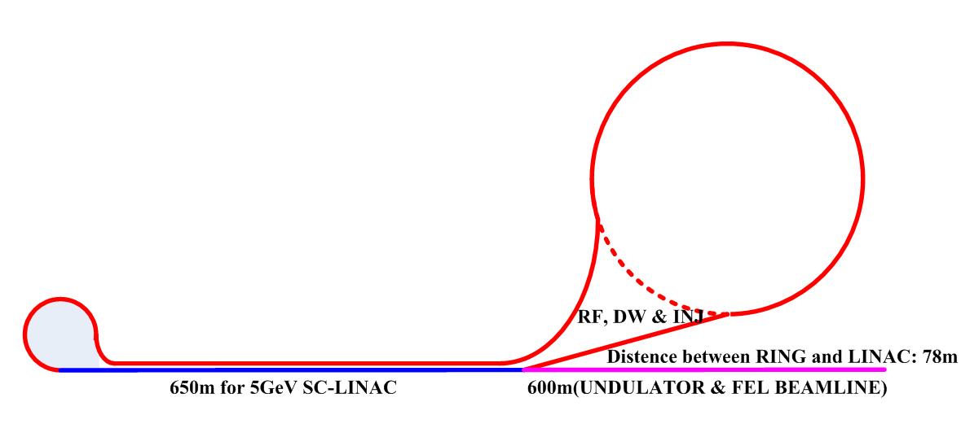
Progress in ERLs for Light Sources
Operations at JLAB, Daresbury, BINP
Designs at Cornell, KEK/JAEA, BAPS
7GeV
Double Acc.
3GeV ERL
First Stage
XFEL-O Second Phase
12
Notes:
BAPS = Beijing Advanced Photon Source

Slide 13
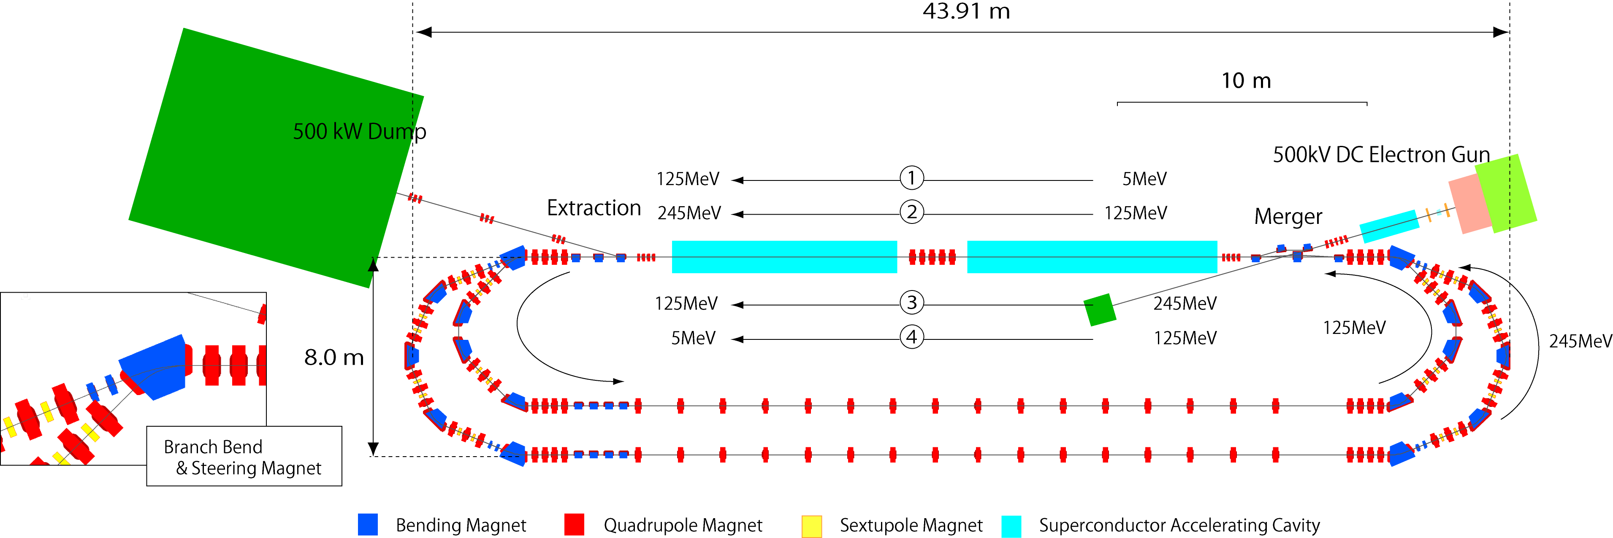
Progress in ERLs for Light Sources
Operations at JLAB, Daresbury, BINP
Designs at Cornell, KEK/JAEA, BAPS
Test loops at KEK
7GeV
Double Acc.
3GeV ERL
First Stage
XFEL-O Second Phase
13

Slide 14
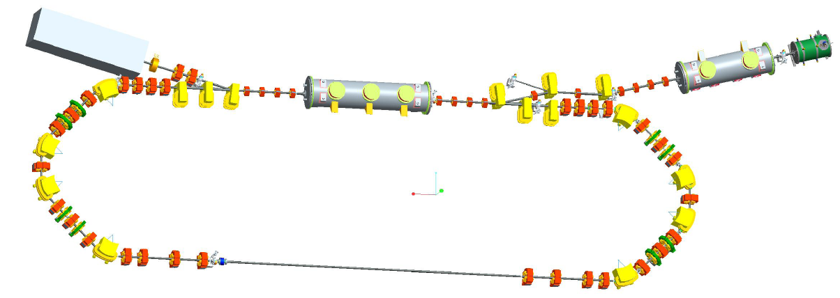
Progress in ERLs for Light Sources
Projects, projects, projects … progress
Envisioned, developed,
Operations at JLAB, Daresbury, BINP
Designs at Cornell, KEK/JAEA, BAPS
Test loops at KEK, HZB
7GeV
Double Acc.
3GeV ERL
First Stage
XFEL-O Second Phase
14

Slide 15
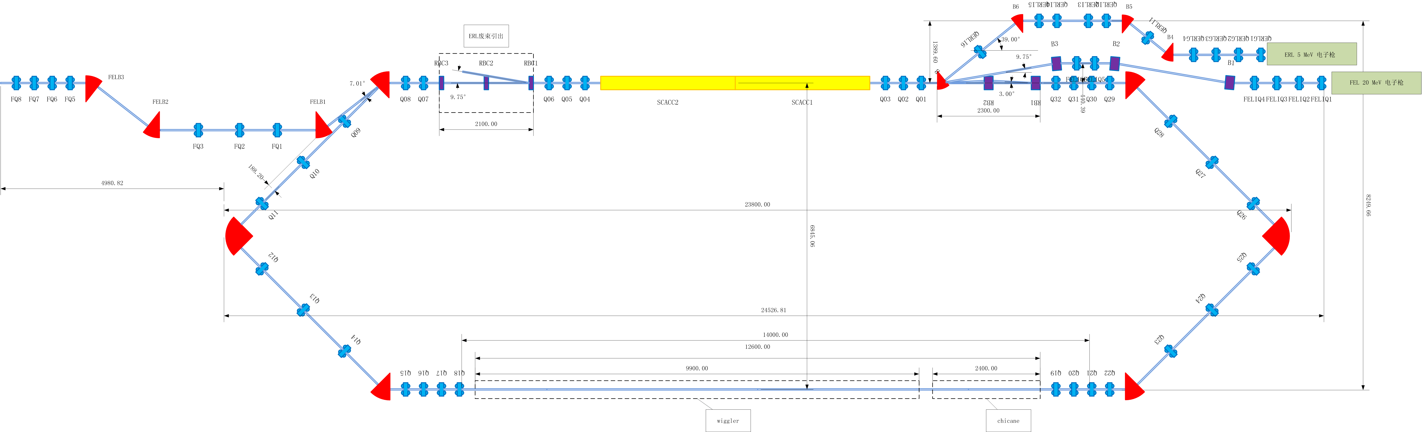
Progress in ERLs for Light Sources
Projects, projects, projects … progress
Envisioned, developed, operational
Operations at JLAB, Daresbury, BINP
Designs at Cornell, KEK/JAEA, BAPS
Test loops at KEK, HZB, IHEP
7GeV
Double Acc.
3GeV ERL
First Stage
XFEL-O Second Phase
15
Notes:
IHEP = Institute of High Energy Physics in China

Slide 16

Energy Recovery Installations:
Successful tests for ERL beam dynamics, controls, and technology
ALICE, 21MeV, 20pC
Demonstrated 9 mA CW at 150 MeV, 14kW (Jlab FEL)
VUV loop: Lasing at 10eV, achieved 2010
Other achieved Energy Recovery
Demonstrated 9 mA CW two-pass at 30 MeV (BINP)
Demonstrated 70 µA CW at 1 GeV (JLab CEBAF)
Demonstrated 2.3kW FEL, 17MeV (JAEA)

Slide 17
New test installations
Double Loop Compact ERL (KEK)
Why did we choose a double loop circulator?
Injection energy | 5-10 MeV
Full energy | 245 MeV
Electron charge | 77 pC
Normalized emittance | < 1 mm-mrad
Bunch length | 1-3 ps
It is for saving
construction area
number of accelerator cavities
running cost of the refrigerators
Main parameters
Layout of double loop Compact ERL

Slide 18
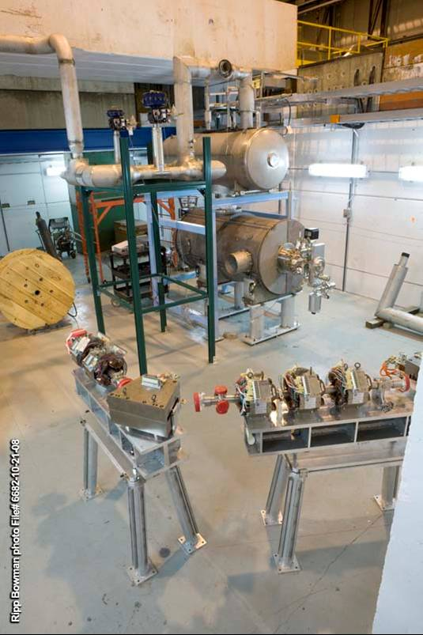
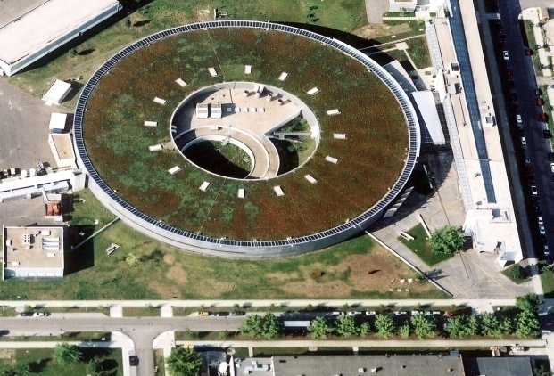
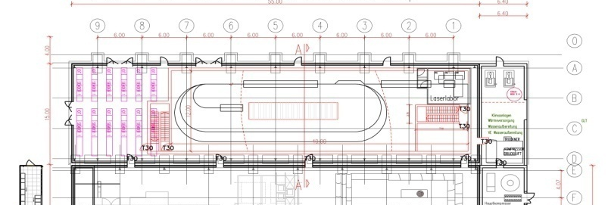
New test installations
BNL, KEK, BESSY, and IHEP
IHEP Compact TF-- 35 MeV-10 mA
BERLinPro: ERL demonstration facility
Cryogenic plant
BESSY II
BNL ERL test for coherent e-cooling of RHIC
BESSY II

Slide 19
ERL X-ray source R&D
Essentials
  SRF (high Q₀ , Q_{L} for low operation cost; HOM damping for > 100mA; cost-efficient cryomodule design & fabrication)
  Photoinjector (demonstrate high current, longevity, brightness)
  Generic facility strawman (undulators, magnets, power budget, cryoplant)
And beyond
  Multi-turn designs (depends on how cheap/efficient SRF can be made)
  Marry XFEL solutions (simultaneous low rep rate beam operation with high current – e.g. KEK design)

Slide 20
Significant photoinjector developments
First beam from new SRF electron sources (HZB/JLAB for ERLs; Niowave/NPS; more coming up)
More new guns (DC, NCRF, and SRF) with ~100mA in mind either being commissioned or under construction
Cornell photoinjector highlights (over the last year):
  Maximum average current of 50 mA from a photoinjector demonstrated (Feb 2012)
  Demonstrated feasibility of high current operation (~ kiloCoulomb extracted with no noticeable QE at the laser spot)
  Original emittance spec achieved: now getting x1.8 the thermal emittance values, close to simulations (Sept 2011)
  Beam brightness @5GeV same as 100 mA 0.5x0.005nm-rad SR

Slide 21
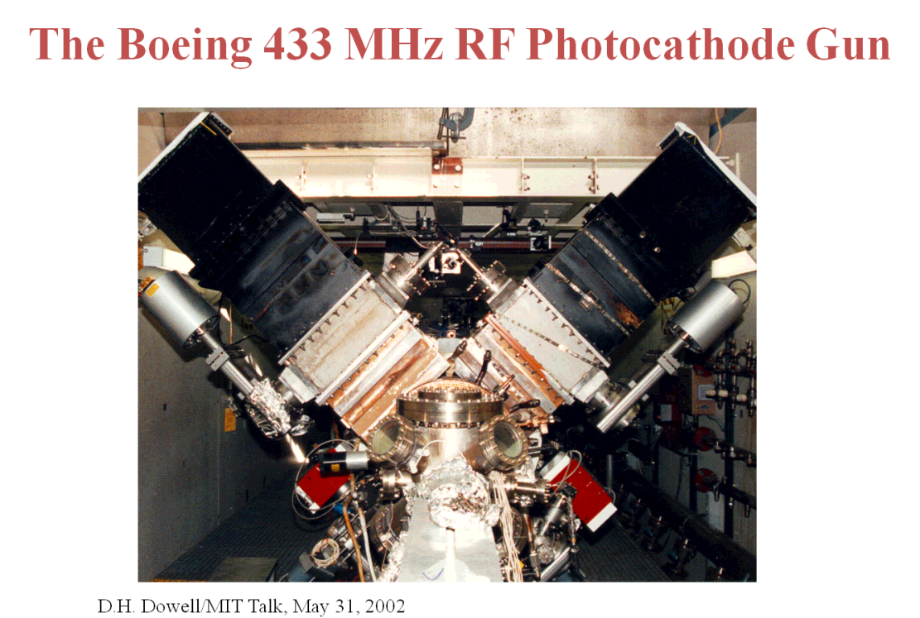
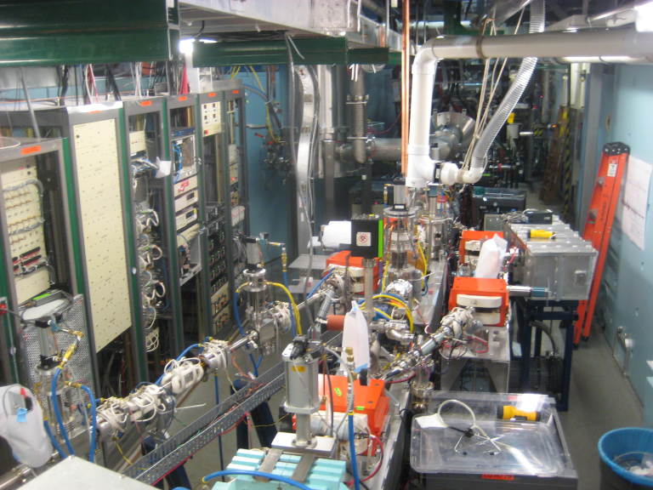
Boeing/LANL RF gun tribute
New current record is 52 mA at Cornell
  beats Dave Dowell’s 32 mA record of 20 years!
More in my photoinjector overview talk
Cornell photoinjector: 52 mA (Feb 9, 2012)

Slide 22
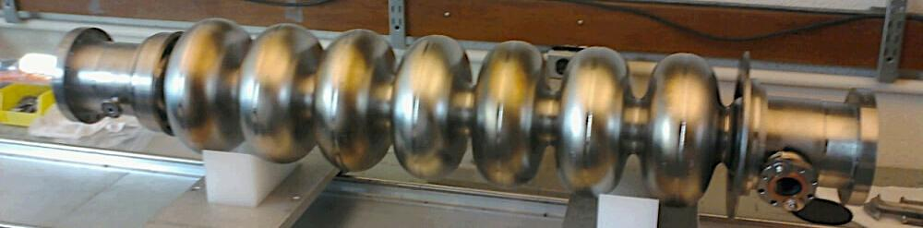
Main Linac Cavity Development and high Q₀
courtesy M. Liepe
Specs: Support ERL operation with >100 mA; must minimize cryogenic wall losses (Q~2⋅10¹⁰ at 1.8 K)
Completed :
RF design
Mechanical design
Cavity fabrication
Vertical cavity RF test
Horizontal cavity test in cryomodule
Meets ERL specs: 16 MV/m, Q₀ ~2⋅10¹⁰
Notes:
point out cavity!

Slide 23

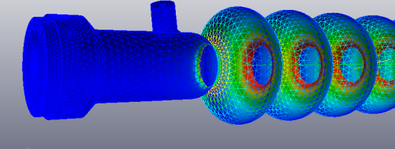
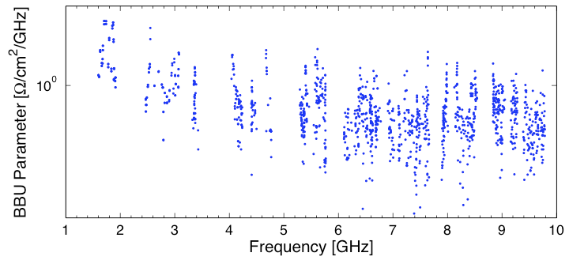
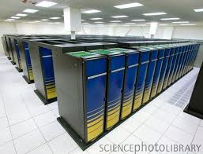
RF Optimization for >100 mA ERL Operation (I)
courtesy M. Liepe
Cell shape optimization:
  ~20 free parameters
  Full Higher-Order Mode characterization (1000’s of eigenmodes)
  Verification of robustness of cavity design
I_{BBU} ~ 1/(worst BBU-parameter)
Franklin Cray XT4
Dipole mode damping calculated up to 10 GHz with realistic RF absorbers
Worst mode limits beam current!
Notes:
optimization used an unconstrained downhill simplex search method.
the simultaneous mini- mization of n-HOMs was treated as the analytic problem of minimizing the worst HOM, under the non-analytic con- straint that each BBU parameter of all other dipole modes in the spectrum be less than the maximal BBU parameter of all the modes ≡ M

Slide 24
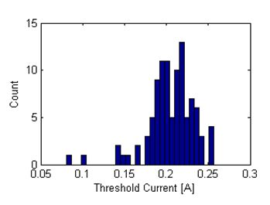
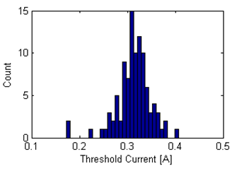
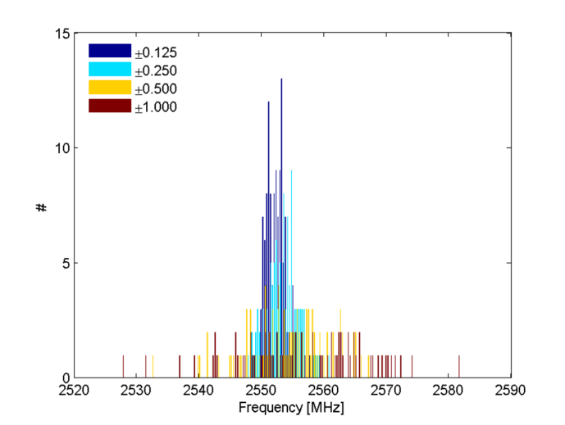
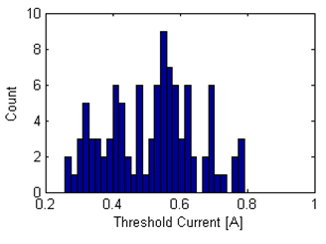
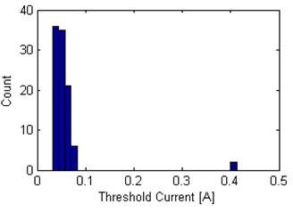
RF Optimization for >100 mA ERL Operation (II)
courtesy M. Liepe
Optimize Cavity
W.R.T. BBU parameter
Introduce realistic shape variations
(400 cavities)
Compute dipole HOMs to 10 GHz
(1692 modes /cavity)
Generate realistic ERL
(x100)
Compute BBU current
± 0.125 mm error
± 0.250 mm error
Key: simulate realistic linac
± 0.500 mm error
± 1.000 mm error
Optimized cavity shape robust up to ±0.25 mm shape imperfections!
Notes:
Point out grad student Nick Valles!!!

Slide 25
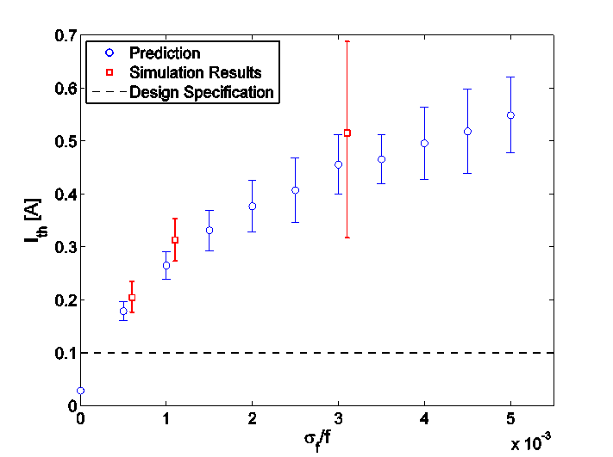
RF Optimization for >100 mA ERL Operation (III)
courtesy M. Liepe
Results of Beam-Break-Up simulations:
Note: includes realistic fabrication errors and HOM damping materials!
±0.5mm
±0.25mm
±0.125mm
±1mm
Optimized cavity with ±0.25 mm shape imperfections supports ERL beam currents well above 100 mA!
Some of this work is summarized in N. Valles & M. Liepe, PAC’11, TUP064, p. 937

Slide 26
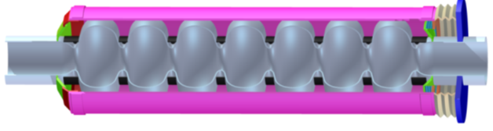
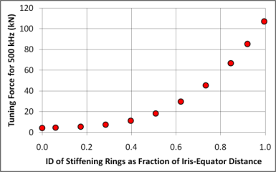


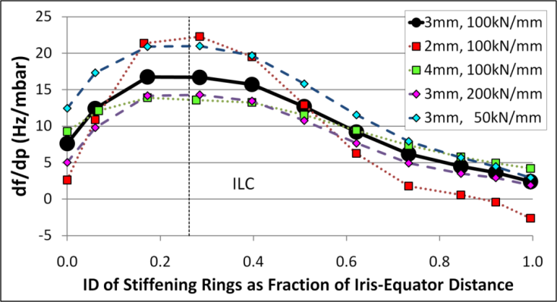

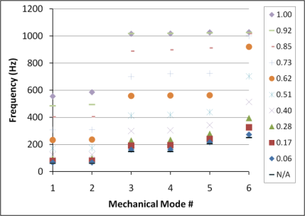




Mechanical Design for efficient Cavity Operation
courtesy M. Liepe
Small bandwidth cavity vulnerable cavity microphonics (frequency modulation), especially by helium pressure fluctuations
Diameter of cavity stiffening rings used as free parameter to reduce df/dp
ANSYS simulations: large diameter rings and no rings at all have smallest df/dp
Build two prototype cavities (with and without rings) to explore both options
Model of Cornell ERL Main Linac Cavity
Stiffening rings can vary from ID at iris to OD at equator
No Rings
ID of rings as Fraction of Iris-Equator Distance
Cavity optimized!
No Rings
S. Posen & M. Liepe, PRST-AB 15 (2012) 022002
Notes:
Point out grad student Sam Posen

Slide 27
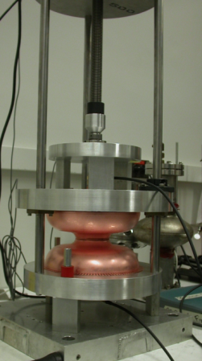
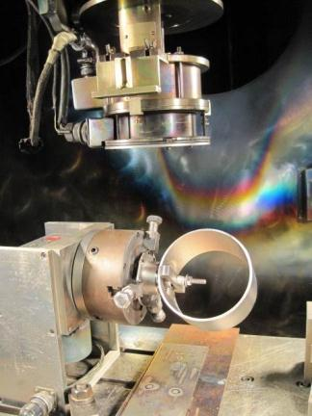
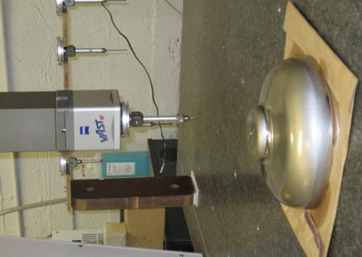
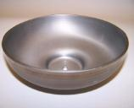
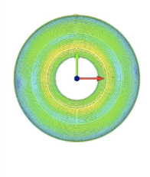
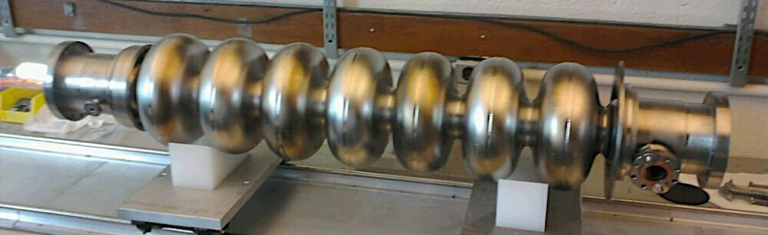
Prototype Cavity Fabrication
courtesy M. Liepe
Electron Beam Welding
Quality control: CMM and frequency check
Finished main linac cavity with very tight (±0.25 mm) shape precision ⇒ important for supporting high currents (avoid risk of trapped HOMs!)
Notes:
Mention CMM!

Slide 28
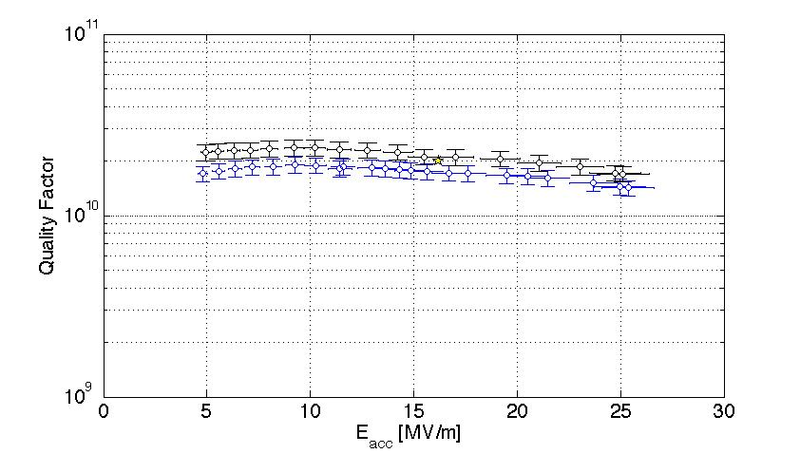
Vertical Performance Test of Prototype Cavity
courtesy M. Liepe
Cavity surface was prepared for high Q₀ while keeping it as simple as possible: bulk BCP, 650C outgassing, final BCP, 120C bake
Vertical cavity test results at 1.6K and 1.8K
ERL main linac spec
Cavity meets ERL gradient and Q₀ specifications in its first test!
The achievement of high Q is relevant not only to Cornell's ERL but also to Project-X at Fermilab, to the Next Generation Light Source, to Electron-Ion colliders, spallation-neutron sources, and accelerator-driven nuclear reactors.

Slide 29
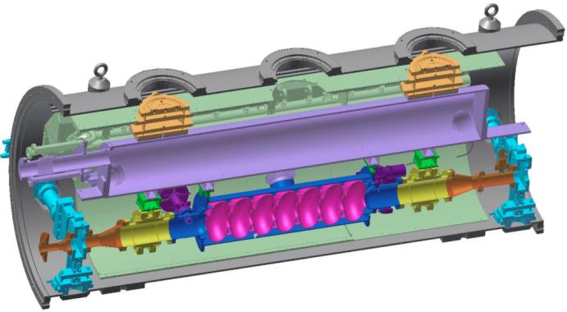
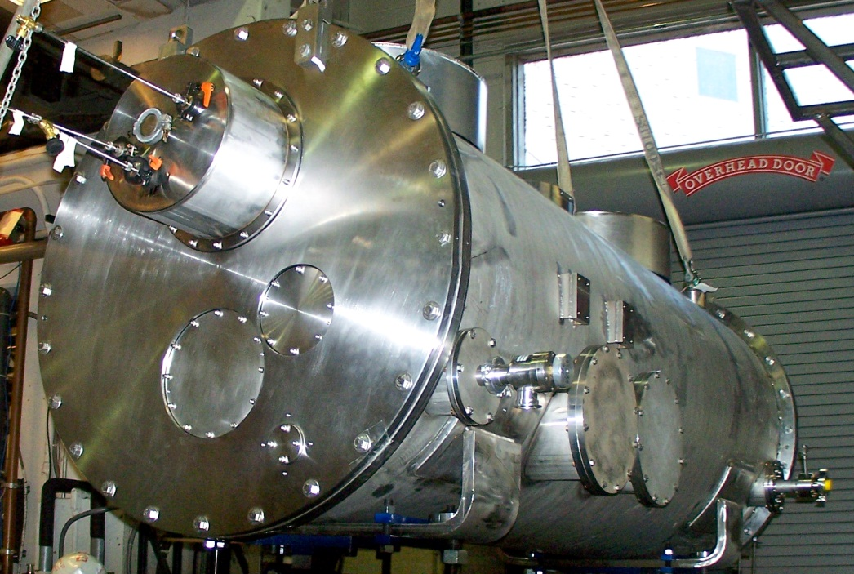
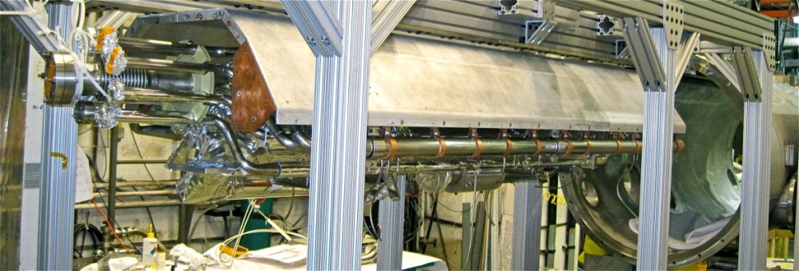
One-Cavity ERL Main Linac Test Cryomodule
courtesy M. Liepe
80K shield
HGRP
Assembled and currently under testing at Cornell:
  First full main linac system test
  Focus on cavity performance and cryogenic performance
HOM load
cavity
HOM load
Gate valve

Slide 30
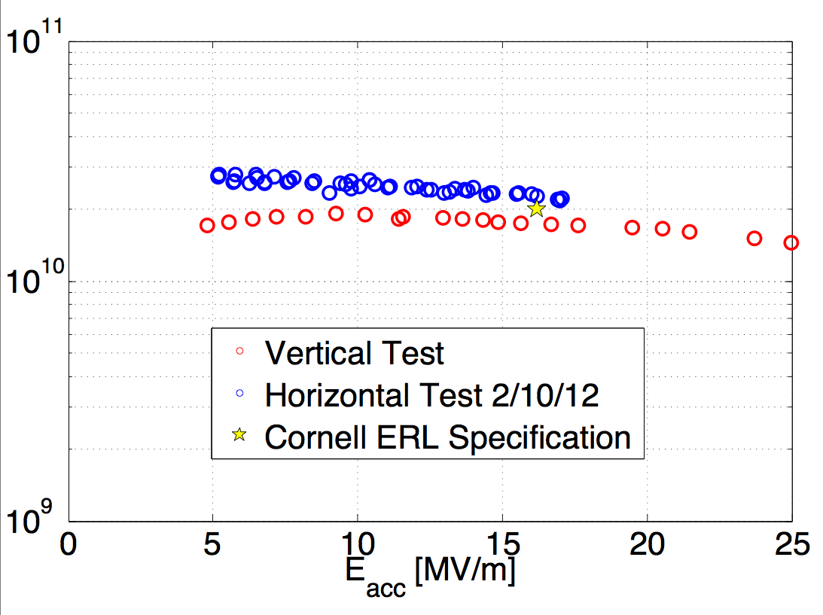
Preliminary Test Results of First ERL Main Linac Cavity in Test Cryomodule
courtesy M. Liepe
Cryomodule cavity test results at 1.8K
Q₀
Administrative limit. Cavity can go to higher fields
Cavity exceeds ERL gradient and Q₀ specifications in its first cryomodule test!

Slide 31

Alternative & developing ideas
MARS by G. Kulipanov et al.
MARS
  Trade off current for higher undulator N~10⁴, use many passes
  Much reduced injector requirements can use lower gradient linac
  Becomes less appealing as injector & SRF performance/efficiency improves
Moderate number, e.g. two-pass, approaches
  Several labs pursuing, capital and operational cost savings
  Full energy CW linac is a nice investment if can afford
Extend ERL’s to x-ray free electron laser techniques
  Not appealing for GHz rep. rates; instead use simultaneous operation with a lower rep rate beam

Slide 32
When to use energy recovery
Simultaneous operation with high current at e.g. XFELO specs
Keep additional (unrecovered) RF load ~1-2kW per SRF cavity
Rep. rate Beam power @ 5GeV
100pC @ 100MHz 50MW
100pC @ 10MHz 5MW
100pC @ 1MHz 0.5MW
100pC @ 0.1MHz 0.05MW
Absolutely
Maybe
No

Slide 33

Simultaneous short pulses for XFEL and generic ERL running
from Cornell ERL Science Workshops, June 2006
Initial analysis to meet XFELO specs shows it’s doable using non-energy recovered beamline
<0.5 MW dump
<100 μA source
BC1
BC2
100pC@1MHz
or less
500 MeV
5 GeV
80 m long undulator
or ID farm
3rd harmonic linearizer
100 mA source

Slide 34


KEK plans for ERL with XFELO
Others to follow?
Narrower and less divergent e-beams
More mono-energetic e-beams all of the above
Shorter pulses
3 GeV ERL with XFEL-O at KEK
7GeV
Double Acc.
3GeV ERL
First Stage
XFEL-O Second Phase

Slide 35
Summary & Outlook
Based on demonstrated source performance: if a hard X-ray ERL were to be built today, it would already be the brightest quasi-CW source of x-rays
There is a long list of technical issues still requiring attention, but also great progress over the last 2 years
Further light source evolution calls for free-electron laser techniques married to ERLs (or rather its CW linac at a reduced bunch rep rate) to enhance brightness and better control coherence

Slide 36
END

Slide 37
Advantages of ERL beams for light sources
ERLs have advanced, science enabling capabilities:
  Large currents for Linac quality beams
  Continuous beams with flexible bunch structure
  Small emittances for round beams
  [similar transverse properties have recently been proposed for 3km long rings]
  Openness to future improvements
  [today’s rings can also be improved, improvements beyond ring performances mentioned under c) may be harder to imagine]
  Small energy spread (2.e-4 rather than conventional 1.e-3)
  Variable Optics
  Short bunches, synchronized and simultaneous with small emittances
  Thus : many advantages beyond increased spectral brightness !
The breadth of science and technology enabled is consequently very large and the ERL will be a resource for a very broad scientific community.
X-ray ERLs are at the beginning of a development sequence, and extensions can be envisioned, e.g. XFEL-O.

Slide 38
Advantages of ERL beams: Variable electron optics
Beam size vs. divergence can be optimized on each undulator straight section, without limitations by dynamic apertures.
    APS: one set of beta functions
    ESRF: two sets of beta functions (hi, low)
    ERL: all choices are possible, not “one size fits all”
2) Move position of minimum electron beam waist along straight section by changing quadrupole settings, without moving components, e.g. move apparent x-ray source point to compensate for changes in focal length on refractive lenses and zone plates, or move x-ray focus to the sample.
3) There may be other New Features (e.g. optimizing flux through a collimator, monochromator because of extra free knobs) that can be developed because x-ray ERLs are at the start of development.

