Slide 1
Future Synchrotron Light Sources Based on Ultimate Storage Rings
Yunhai Cai
FEL & Beam Physics Department
March 6, 2012
ICFA Workshop for Future Light Source 2012
JLab, Newport News, VA, USA

Slide 2
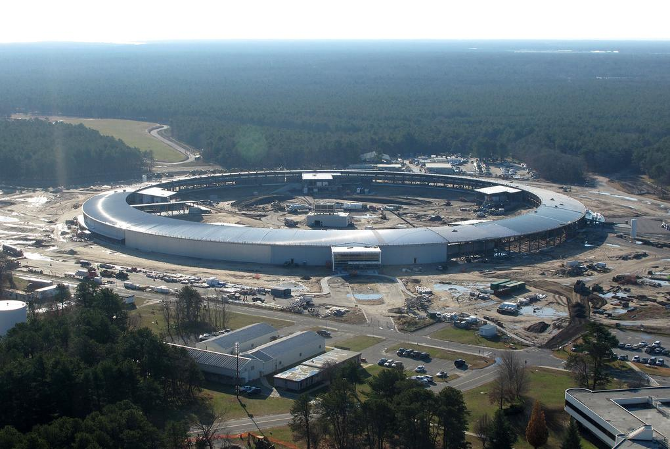
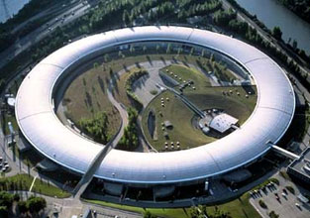
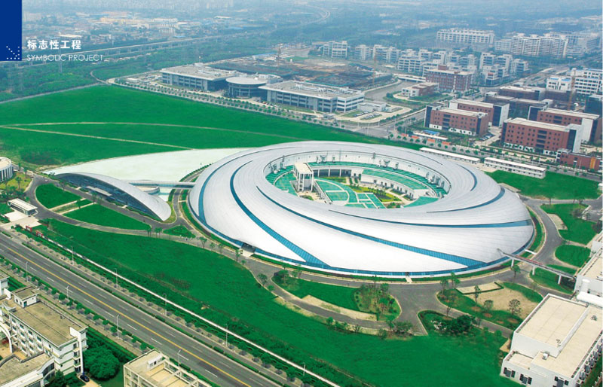

3rd Generation Light Sources
Existing Under construction
ESRF
NLSL-II
SSRF
Max-IV
Notes:
Range of energy and emittance
Mention undulator

Slide 3
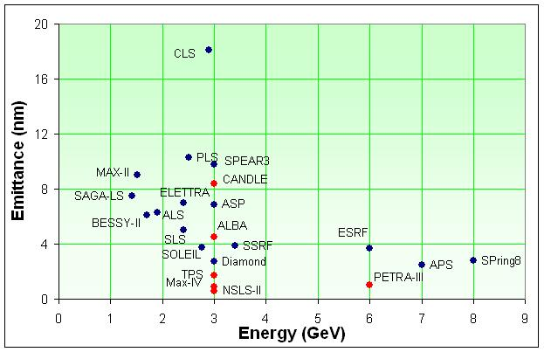
Storage Ring Light Sources
Courtesy of R. Bartolini, Low Emittance Rings Workshop, 2010, CERN
3/6/2012
Yunhai Cai, SLAC
3
Notes:
Range of energy and size
Trend

Slide 4
Synchrotron Radiation
Electron beam in undulator Photon spectral flux in 0.1% BW
N
S
N
S
S
N
S
N
n^{th} harmonic wavelength:
Notes:
K is about 3, lambda_u is at cm, lambda_n is 1 angstrom, E0 about a few GeV.
Q1 is at an order of 1, there is not much room to increase Fn.

Slide 5
Spectral Brightness
Brightness of electron beam radiating
at n^{th} (odd) harmonics in a undulator
is given by
Spectral brightness of PEP-X
If the electron beam phase
space is matched to those of photon’s,
the brightness becomes optimized
Finally, even for zero emittances, there
is an ultimate limit for the brightness
A diffraction limited ring at 1 angstrom
or 10 pm-rad emittance
Notes:
An ultimate limit is applicable to ERL as well.
Increase in brightness is linear with respect to the emittance.
Linear in beam current: I.

Slide 6
USRs - Spectral Brightness
Courtesy of R. Hettel

Slide 7
Parameter | PEP-X | Spring8-II | TeVUSR
Beam energy [GeV] | 4.5 | 6.0 | 11.0
Circumference [m] | 2200 | 1436 | 6283
Current [mA] | 200 | 300 | 100
Betatron tune (H/V) | 113.23/65.14 | 141.865/36.65 | 403.098/222.198
Natural chromaticity (H/V) | -162/-130 | -477/-191 | -580/-468
Momentum compaction | 4.96x10⁻⁵ | 1.55x10⁻⁵ | 4.47x10⁻⁶
Emittance [pm-rad] | 12/12 | 68 (natural) | 1/1
Bunch length [mm] | 3 | 3.8 | 3
Energy spread | 1.25x10⁻³ | 0.96x10⁻³ | 1.4x10⁻³
Energy loss per turn [MeV] | 2.95 | 4.0 | 18
RF voltage [MV] | 8.3 | 16 | 24
RF frequency [MHz] | 476 | 508 | 500
Wiggler length [m] | 90 | 50 (may be) | 188
Length of ID straight [m] | 5 | 4 | 5
Beta at ID center (H/V) [m] | 4.9/0.8 | 1.0/1.4 | 5/0.8

Slide 8
Energy Spread and Emittance
Balance between the quantum excitation and radiation damping results
in an equilibrium Gaussian distribution with relative energy spread σ_{δ}
and horizontal emittance ε_{x}:
where and
The quantum constant C_{q} = 3.8319x10⁻¹³ m for electron
γ is the Lorentz factor (energy)
Notes:
Stronger focusing and reduce the dispersion lead to even stronger sextupoles.

Slide 9
Minimization of Emittance
For an electron ring without damping wigglers, the horizontal emittnace
is given by
where F_{c} is a form factor determined by choice of cell and q is bending angle of dipole magnet in cell. In general, stronger focusing makes F_{c} smaller. Often there is a minimum achievable value of F_{c} for any a given type of cell. For example, we have
There is a factor of three between the minimum values of DBA and
TME cells. That’s the price paid for an achromat, namely fixing the
dispersion and its slop at one end of dipole.
Notes:
Do not forget about two strategies of reduce the emittance.
Dynamic aperture is proportional to the bending angle.

Slide 10
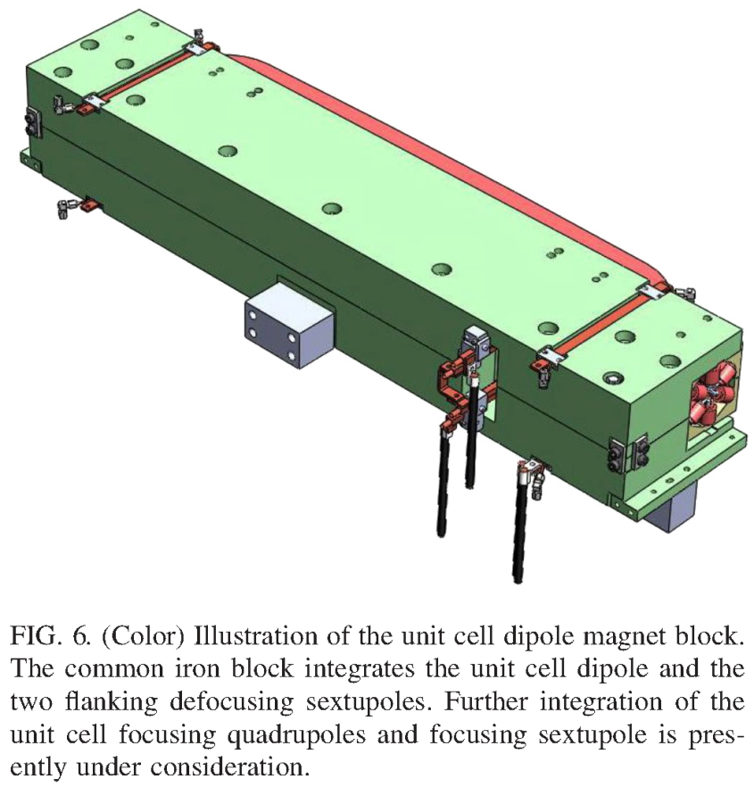
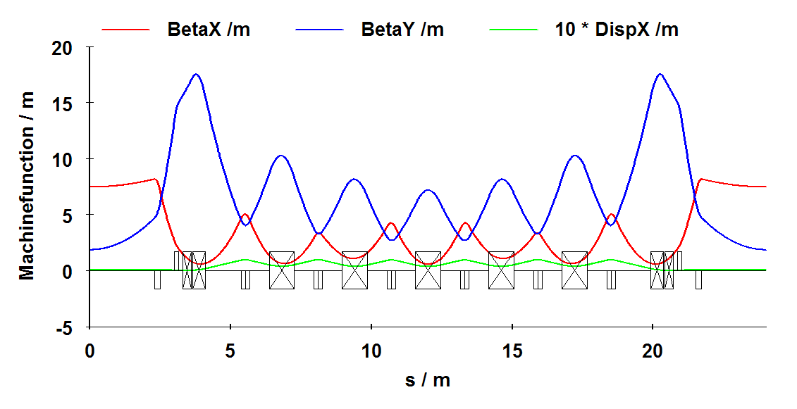
MAX-IV Light Source
7 Bend Achromat, at 3 GeV
MAX-IV dipole
+ 2 sextupoles in one block
Innovations:
Multi-bend achromat
Compact and combined function magnets
Octupoles

Slide 11
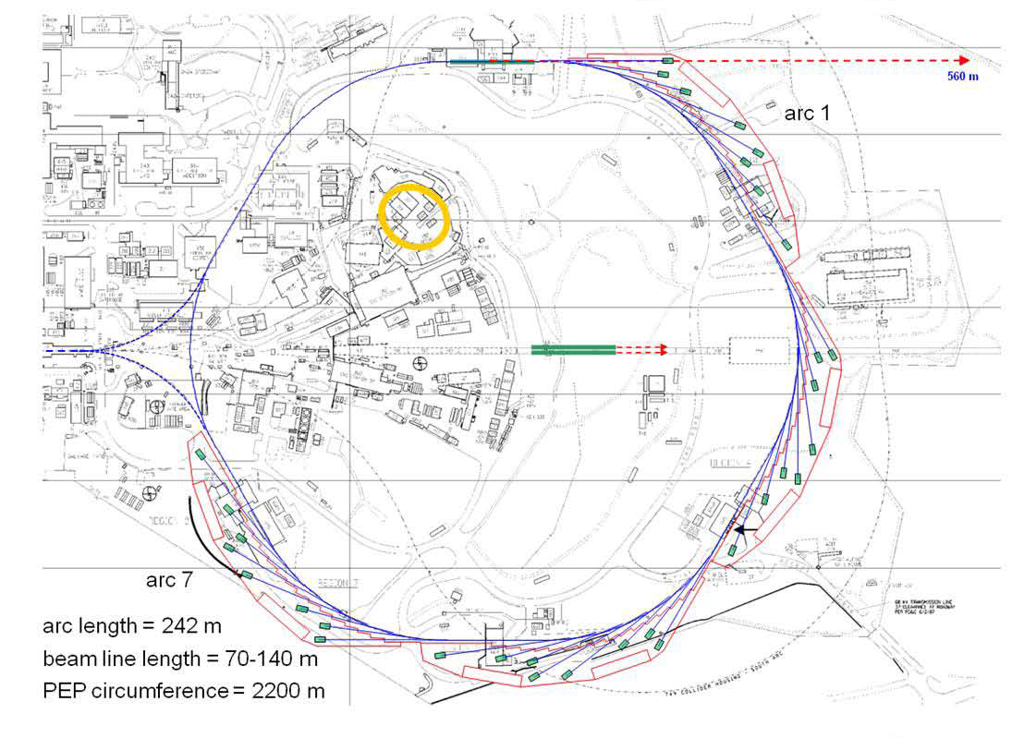
PEP-X Layout & Parameters
An ultimate storage ring
Energy, GeV 4.5
Circumference, m 2199.32
Natural emittance, pm 11
Beam current, mA 200
Emittance at 200 mA, x/y, pm 12 / 12
Tunes, x/y/s 113.23 /65.14/0.007
Bunch length, mm 3.1
Energy spread 1.25x10⁻³
Energy loss per turn, MeV 2.95
RF voltage, MV 8.3
RF harmonic number 3492
Length of ID straight, m 5.0
Wiggler length, m 90.0
Beta at ID center, x/y, m 4.92 / 0.80
Touschek lifetime, hour 10
Dynamic aperture , mm 10
To be Built with 4th-order geometrical achromats in the PEP tunnel.

Slide 12
PEP-X 7 Bend Achromat
29 pm at 4.5 GeV
Cell phase advances: μ_{x}=(2+1/8) x 360⁰, μ_{y}=(1+1/8) x 360⁰.
Notes:
It follows from MAX-VI. Talk about common and different features.
Sextupole positions. Ten families. But no octopoles.

Slide 13
Resonance in Storage Rings
Dynamic aperture in a two-dimensional tune scan for the baseline
design of PEP-X (2008).
Where these resonances come from?
Notes:
1) Talk about traditional treatment.

Slide 14
Presentations for Magnetic Elements
Lie factors
engine in MARYLIE ( A. Dragt)
violates symplecticity when evaluates
Dragt-Finn
engine in TRANSPORT, MAD, COSY
(K. Brown and M. Berz), simple R-matrix
but high-order one violates
Taylor map
TPSA
Symplectic
Integrator
engine in TEAPOT, SAD, TRACY, LEGO,
PTC (E. Forest, R. Ruth, and K. Hirata)
preserves symplecticity
simple and based on several known solutions
emphasis on numerical process

Slide 15
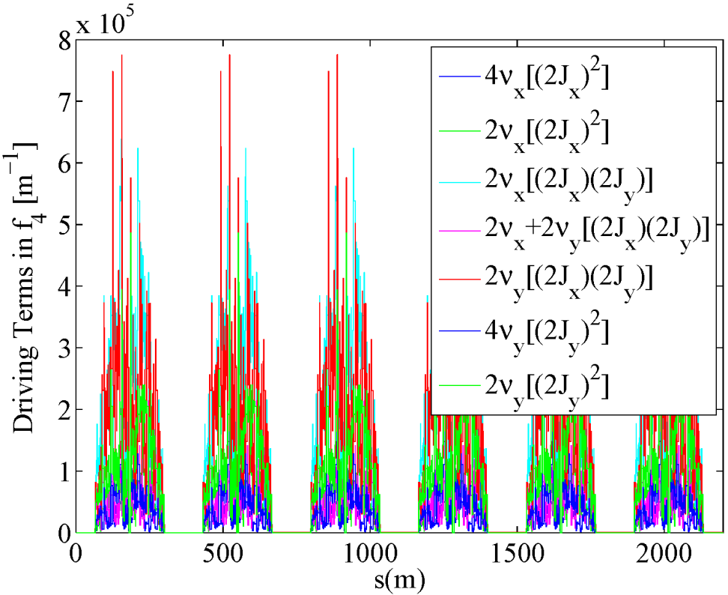
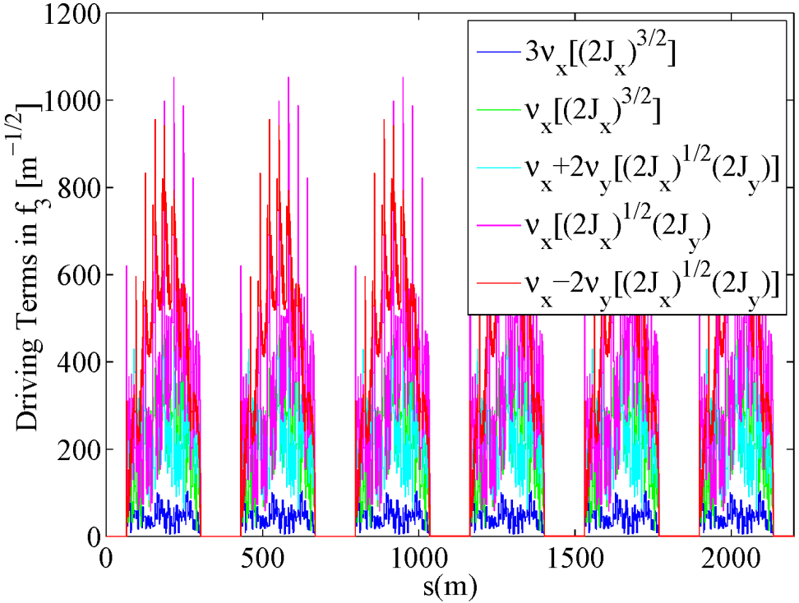
Cancellation of All Geometric 3rd and 4th Resonances Driven by Strong Sextupoles except 2ν_{x}-2ν_{y}
Third Order Fourth Order
K.L. Brown & R.V. Servranckx Yunhai Cai
Nucl. Inst. Meth., A258:480–502, 1987 Nucl. Inst. Meth., A645:168–174, 2011.
There are still three tune shift terms.
Notes:
How about skew sextupoles? Any cancellation?
Talk about speed compare to the tune scan.
General, does not depends where are the sextupole, how many families of sextupole. Work for thick sextupoles as well.

Slide 16
Harmonic Sextupoles
For Tune Shifts and 2ν_{x}-2ν_{y}Resonance
Without harmonic sextupoles With harmonic sextupoles
OPA is used for optimizing the setting of 10 families of sextupoles. Due to the
cancellation of many resonances, the optimization becomes much simpler and easier.
OPA is an Accelerator Design Program from SLS PSI developed by A. Streun.
Notes:
1) Explain how the OPA solution was obtained including chromatic sextupoles and using ten families of sextupoles.

Slide 17
4th Order Geometric Achromat
4th order geometric achromat Chromatic effects
 | 0,0
 | -57,-89
 | 1332,-150
 | 0,0
 | 0,0
There are 4 families of chromatic sextupoles and 6 families of harmonic ones.
The 4th order geometric achromat (f₃=f₄=0) was obtained with the analytical
Lie method. It was documented in SLAC-PUB-14785 and submitted to PRSTAB.
Notes:
1) Explain how the OPA solution was obtained including chromatic sextupoles and using ten families of sextupoles.

Slide 18
Tune Scan of Dynamic Aperture
PEP-X: Baseline (2008)
PEP-X: USR (2011)
The dynamic aperture is in unit of sigma of the equilibrium beam size. The USR design
is built with 4th-order geometric achromats and therefore no 3rd and 4th order
resonances driven by the sextupoles seen in the scan.

Slide 19
Frequency Map Analysis
PEP-X: Baseline (2008)
PEP-X: USR (2011)
Y
X [mm] X [mm]
The dynamic aperture is in unit of mm at the injection. The baseline design has
a factor of ten larger emittance than the one in the USR design.
Notes:
1) At design tunes.

Slide 20
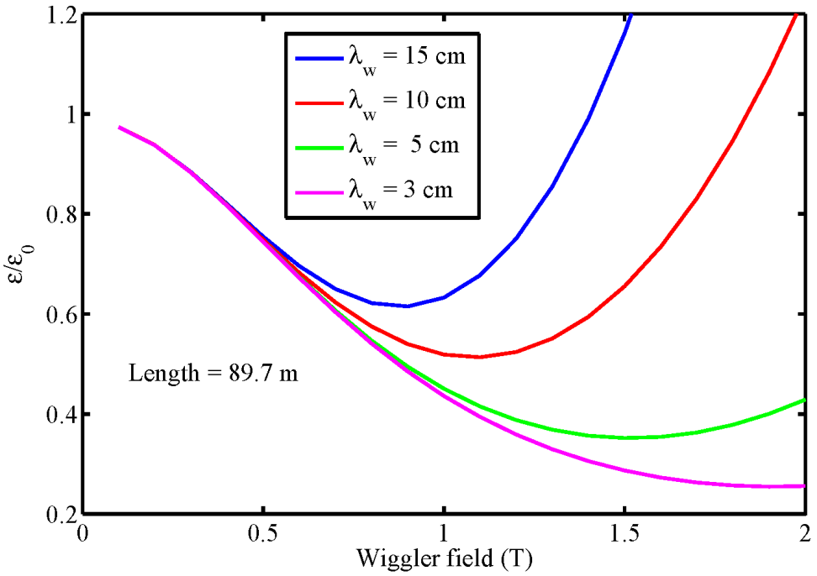
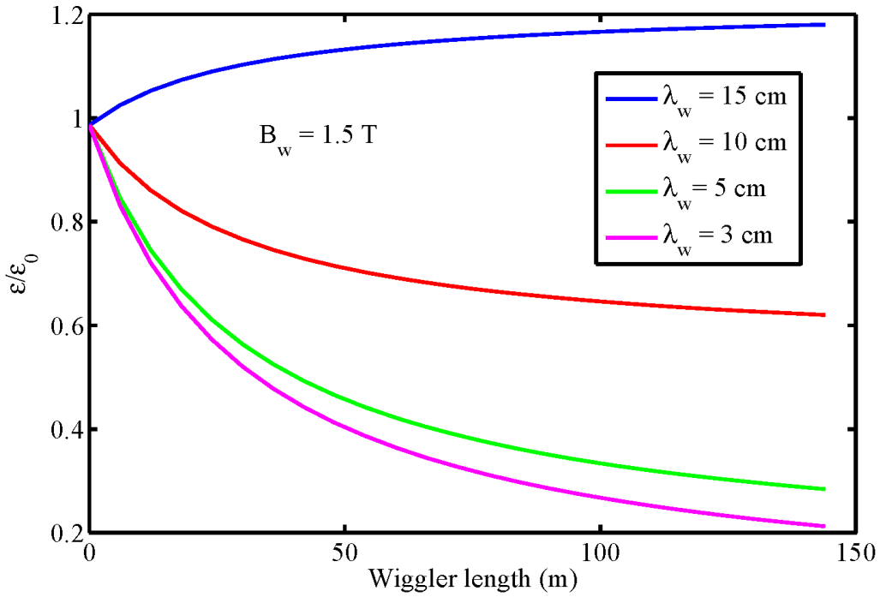
Reduce Emittance with Damping Wigglers
Emittance = 11 pm-rad at 4.5 GeV with parameters λ_{w}=5 cm, B_{w}=1.5 T
Wiggler Field Optimization
Wiggler Length Optimization
Average beta function at the wiggler section is 12.4 meter.
Notes:
1) Talk about trend: Wiggler to Undulator.

Slide 21
Dynamic Aperture with Machine Errors
ELEGANT Tracking
LEGO Tracking
1% coupling & 1% beta beating Misalignments 20 microns in x.
Notes:
1) Two different codes gave similar results.

Slide 22
Intra-Beam Scattering
The growth rate in the relative energy spread σ_{δ} is given by
where N_{b} is the bunch population and (log) the Coulomb log factor and
the other factors are defined by
Combined with
synchrotron
radiation
And the horizontal growth rate is given by

Slide 23
Optimization of Energy

Slide 24
Touschek Lifetime
When a pair of electrons go through a hard scattering, their momentum
changes are so large that they are outside the RF bucket or the momentum
aperture. This process results in a finite lifetime of a bunched beam. The
lifetime is given by
momentum aperture
with
lifetime
where δ_{m} is the momentum acceptance.
Notes:
1) What’s the reason for the variation in the momentum aperture?

Slide 25
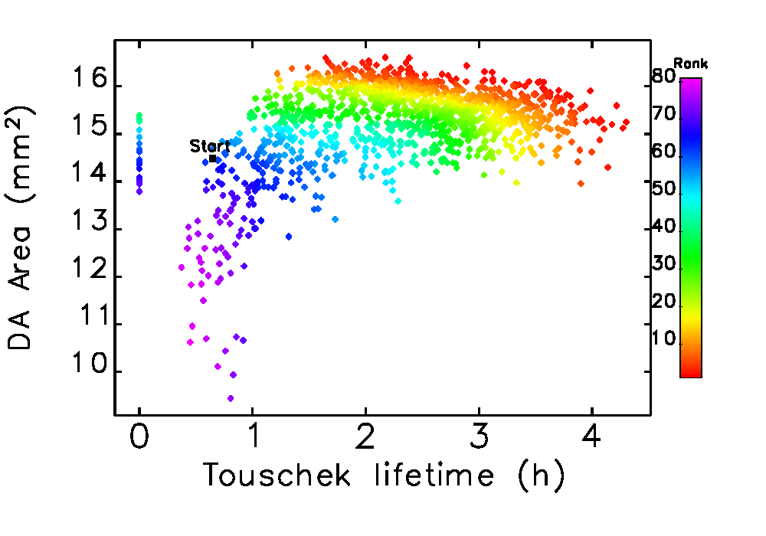
Optimization Using Elegant
M. Borland et al. Multi-objective direct optimization of dynamic acceptance
and lifetime for potential upgrades of the advanced photon light source.
APS LS 319, Argonne, August 2010.

Slide 26
Achievements
We have developed an excellent design of an ultimate storage ring
  Diffraction limit at 1 angstrom
  Reasonable beam current 200 mA
  Good beam lifetime 3 hours
  Good injection with 10 mm acceptance
  Achievable machine tolerances 20 microns

Slide 27
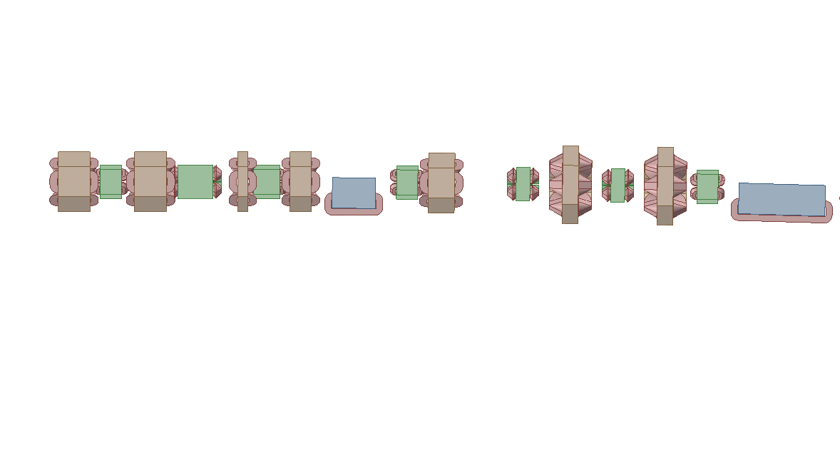
General R&D Items for Ultimate Storage Rings
Better understanding of beam dynamics
How to make a round beam in storage ring
New injection scheme for smaller dynamic aperture
Compact and strong magnets (sextupoles)
Higher harmonic RF system
Precise magnet alignment
Accurate beam position monitors
Undulator with shorter period
Lengthen the beam

Slide 28
Beyond the Ultimate Brightness
Parameter | PEP-X | LCLS-(1.5nm)
Energy [GeV] | 4.5 | 4.3
Normalized emittance [um-rad] | 0.1 | 0.4
Peak current [A] | 17 | 500-3000
Energy spread | 1.25x10⁻³ | (0.5-3.0)x10⁻⁴
Increase the peak current by much stronger longitudinal focusing
  1.5 GHz, 200 MV CW SCRF
Any FEL schemes to accommodate larger energy spread?
Can we achieve lasing or at least partial lasing?
3/6/2012
Yunhai Cai, SLAC
28
Notes:
1) SCRF is the same technology used in ELR or NGLS but a fraction of SCRF in the other approaches.

Slide 29
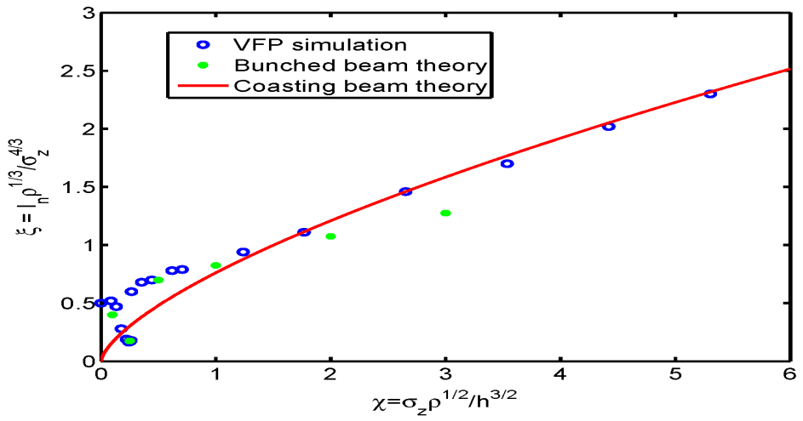
Threshold of Instability
Driven by CSR
Based on the bunched beam theory,
the threshold can be written as
Measured bursting threshold at ANKA
See M.Klein et al. PAC09, 4761 (2009)
where ξ^{th} is given by
(courtesy of M. Klein, ξ^{th}=0.5 used.)
My talk, IPAC 2011, San Sebastian, Spain

Slide 30
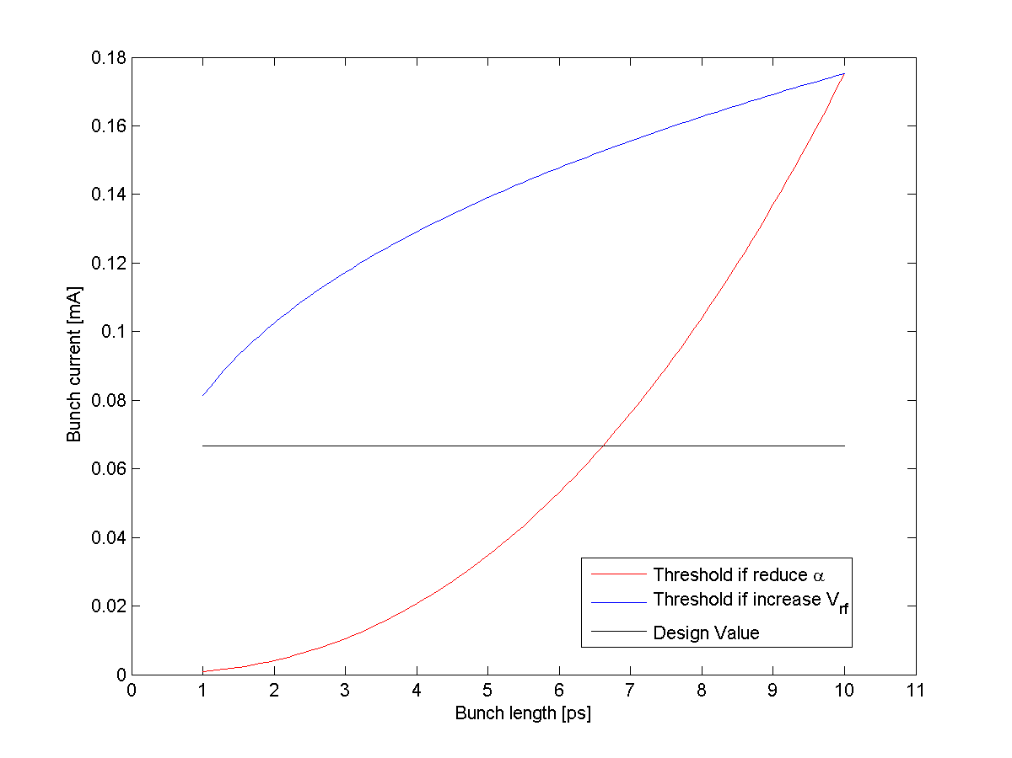
Reduce Bunch Length from 10 ps to 1 ps without reducing bunch current
Calculation of threshold
An illustration using PEP-X nominal parameters: f_{rf} = 476 MHz, V_{rf}=8.3 MV, f_{rev} = 136.312 kHz, σ_{z}=3 mm, I_{b}=0.067 mA.

Slide 31
Conclusion
Diffraction limited (1 angstrom) light source is clearly feasible. Some R&D are necessary to further advance the design for construction.
High-order achromats can be used in realistic design of ultimate storage rings. This approach significantly simplified the optimization process and improved the dynamic aperture.
Analytical and numerical methods are complementary to each other. We should spend more time to understand what computers have provided us.
Longitudinal beam dynamics will be the key to break the barrier of the ultimate brightness in the storage-ring-based light source.

Slide 32
Acknowledgements
PEP-X-USR design team:
Karl Bane, Robert Hettel, Yuri Nosochkov,
Min-Huey Wang (SLAC)
Michael Borland (ANL) for collaboration of the
PEP-X-USR design
K. Kubo (KEK) for verifying the IBS calculation using SAD
Michael Borland (ANL) and K. Soutome (Spring8) for provided their talks about the ultimate storage rings

