Slide 1
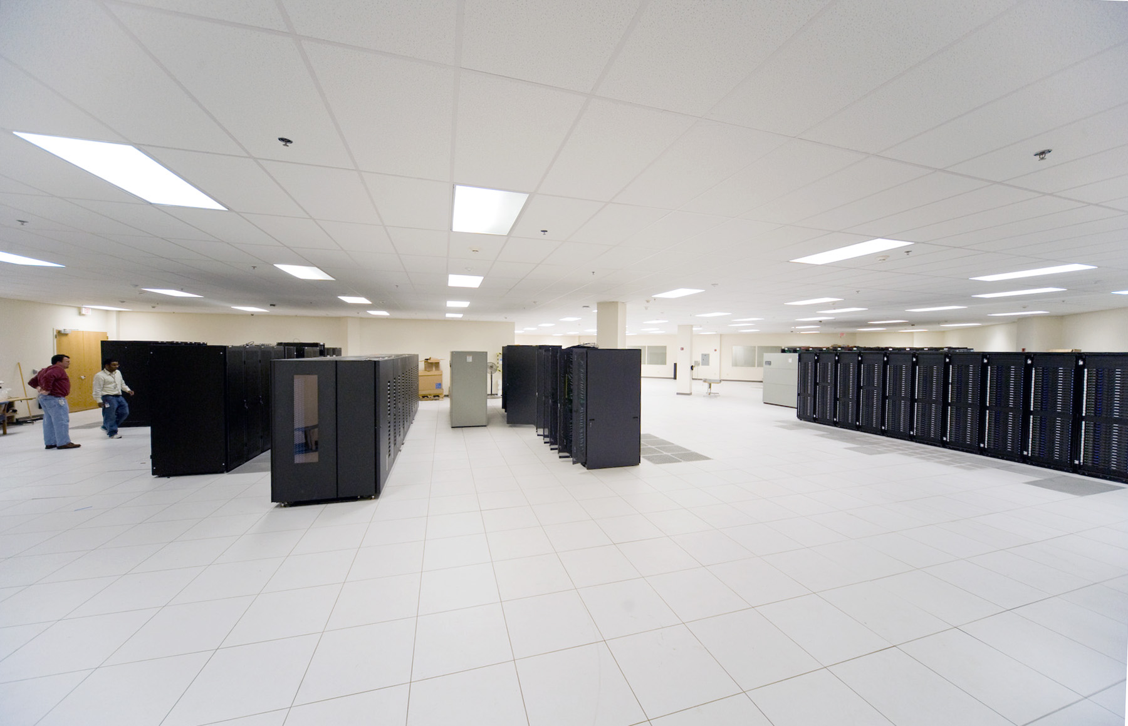
Scientific Computing at Jefferson Lab Petabytes, Petaflops and GPUs
Chip Watson
Scientific Computing Group
Jefferson Lab
Presented at CLAS12 Workshop, May 25, 2010

Slide 2
Purpose of this Talk
Inform
you about Jefferson Lab’s resources and plans
Entertain
with useless (?) trivia about computing trends
Provoke
conversation about computing plans & strategies

Slide 3
Scientific Computing at JLab
Significant computing capacity
1400 compute servers
leading edge GPU cluster
(single most powerful dedicated LQCD resource)
growing repository of 6 GeV data, more than 4 PB today
rapidly growing disk capacity and bandwidth,
~ 600 TB disk, half on a 20 Gb/s Infiniband fabric
exploiting & developing leading edge open source tools
Lustre file system, Auger / PBS / Maui batch system, Jasmine storage
Software developments
multi-threading and multi-GPU libraries for high performance computing
LQCD algorithm development, performance optimizations
highly scalable analysis database for LQCD
system management tools
batch, disk management
power & system monitoring

Slide 4
Simulation & Data Analysis
Hardware
farm of ~200 nodes, of which ~50 are recent generation
cache disk (70 TB) and work disk (110 TB)
8 LTO-4, 4 LTO-5 tape drives, aggregate bandwidth of 1 GB/s
Near term improvements
Cache disk capacity & bandwidth: upgrade this summer
Compute capacity: 6n LQCD cluster (>200 nodes) to be loaned to the farm for the anticipated summer rush (50% capacity bump)
Additional nodes to be purchased in the Fall
Annual upgrades (next 3 years)
Requirements driven (have you submitted yours???)
Budget in round numbers: $50K for compute + $50K disk + $50K for tape capacity and bandwidth
Budget is balanced against needs for 6 GeV staging & running of high priority experiment (i.e. more computing = less running)

Slide 5
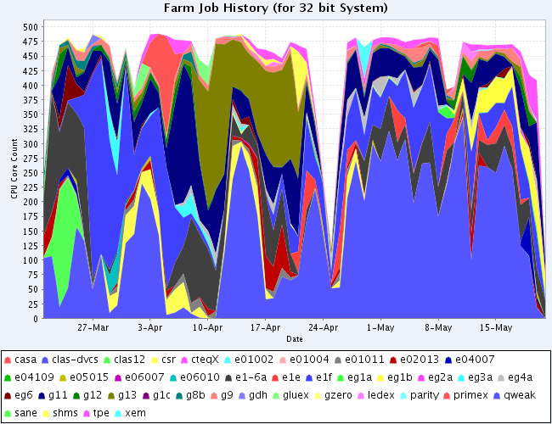
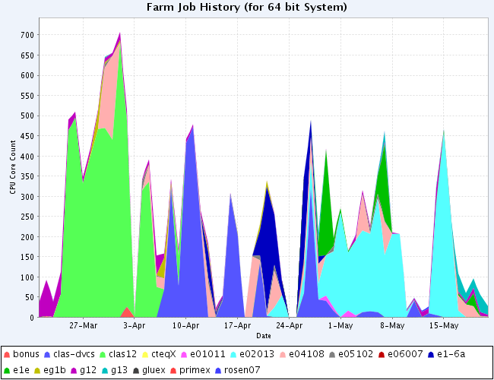
Migrating to 64 bit
32 bit Farm
It is past time!
Just do it!
Over 50% of the JLab farm is idle!
64 bit Farm

Slide 6
The Computing Challenge
Science has an ever increasing appetite for computing power, sustained (mostly) by Moore’s Law trends in transistor density.
In the 1970’s and 1980’s, clock speeds increased 10x/decade. In the 1990’s, 100x in one decade. Since then they have gone flat – chips got too hot (power hungry).
Also during this time clock cycles per instruction were reduced, so that now we do several instructions per clock cycle, but that has also hit a wall for serial code (hard for the complier and silicon to find enough concurrency)
Instead, CPU performance is now growing by increasing in the number of cores per chip, from 2 in 2005, to 12 in 2010.
Science requirements have grown much faster, requiring ever larger budgets and machines.

Slide 7
Current State-of-the-art
8 cores per commodity server (dual socket) is now common
AMD is soon to release the Magny Cours CPU:
2 quad hex core CPUs in one socket (MCC)
no price penalty for quad socket vs. dual socket
48 cores per commodity server (this summer)
Memory bandwidth per CPU continues to climb:
Nehalem (Intel, 2009) 3 DDR3-1333 controllers per CPU
Magny Cours (AMD, 2010) 4 DDR3-1333 controllers
(future, 2011) 4 DDR3-1600 or even -1866
Good news: memory capacity therefore also grows!
quad socket MC has 16 memory buses * 4GB = 64GB for 48 cores
So, for a while longer, 1 GB / core remains affordable
BUT: memory now costs more than CPUs!!!
($800 / 24 GB server vs $500 / dual socket Nehalem server)

Slide 8
Disruptive Technology: GPUs
A Graphics Processing Unit is a device that does simple arithmetic (+-*/) very fast.
High performance is driven by the video gaming market (both PC/workstation, and game consoles): matrix transformations (movement, rotation, perspective), lighting effects, and other visual depth queues.
In order to yield high frame rates at high resolution with a large number of objects in a scene, each with many facets to render (to appear realistically smooth), a very high floating point rate is required. But the software is relatively simple: lots of linear algebra.
GPUs are now so fast, that they vastly outperform CPUs in doing algebra, and have become a target for computational science.

Slide 9
Modern GPUs
Characteristics of GPUs:
Lots of simple cores with fast context switching to hide latency
SIMD architecture (single instruction, multiple data)
High memory bandwidth
Complex memory hierarchy, to achieve high bandwidth at low cost
Recent evolution: IEEE floating point to intentionally support science: GPGPU = general purpose GPU
Commodity Processors | CPU | NVIDIA GPU
#cores | 4 (12) | 240 (480)
Clock speed | 3.2 (2.x) GHz | 1.4 GHz
Main memory bandwidth | 18 (20) GB/s | 159 (177) GB/s (gaming card)
I/O bandwidth | 7 GB/s (dual QDR IB) | 5 GB/s
Power | 80 watts | 185 watts

Slide 10
(GT200)
10-Series Architecture
240 Scalar Processor (SP) cores execute kernel threads
30 Streaming Multiprocessors (SMs) each contain
8 scalar processors
2 Special Function Units (SFUs)
1 double precision unit
Shared memory enables thread cooperation
Multiprocessor
Scalar
Processors
Double
Shared
Memory

Slide 11
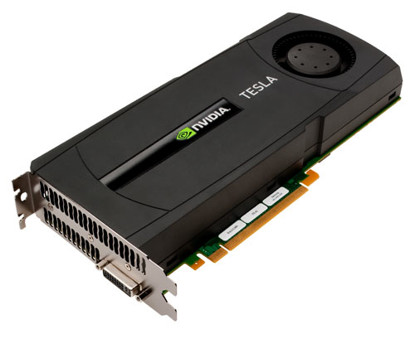
New: “Fermi” GPU
Major Changes from last version:
up to 512 cores (32 sets of 16)
cache memory: L1 (single SM) and L2 (all cores)
ECC memory, 2.6 GB or 5.2 GB (or 3 - 6 with ECC off)
8x double precision peak rate of prior GPU (1 for every 2 cores; aggregate now >600 Gflops)
wider memory bus, GDDR-5 instead of GDDR-3 (allows future versions to increase bandwidth)
Software model remains similar: lots of cores, context switching every clock cycle

Slide 12
GPU Best Fit
High data parallelism
Perform the same set of operations on many data items
High flop count on a small kernel
Problem needs to fit into the GPU (1 - 6 Gbytes)
Little data dependent branching, no recursion
Need to do enough work to amortize cost of pushing the problem into the GPU and getting the results back
(it is possible to pipeline the problem and data)
High memory bandwidth requirements
And problem doesn’t fit into CPU cache

Slide 13
Parallel Software Models
on CPU: thread libraries to use all the cores
OpenMP is the easiest
also: POSIX threads, MPI
on GPU: parallel languages
CUDA: mature, NVIDIA specific, widely used
(Compute Unified Device Architecture, refers to hardware & language+library)
OpenCL: new standard
Can also run on CPU cores (common abstraction)
Task parallel as well as data parallel models
Much less mature compilers exist for GPUs than CPUs
Need to do manual optimizations, like loop unrolling, data movement to faster scratch pad (similar to a cache memory)
Simple code: 30 Gflops, hand optimized: 260 Gflops !

Slide 14
Amdahl’s Law (Problem)
A major challenge in exploiting GPUs is Amdahl’s Law:
If 60% of the application running time is GPU accelerated by 6x, the net gain is only 2x:
2x clock time improvement
Also disappointing: the GPU is idle 80% of the time!
Conclusion: need to move more code to the GPU, and/or
need task level parallelism (overlap CPU and GPU)

Slide 15
Quick Look: LQCD
Lattice QCD is very memory bandwidth intensive
1 instruction per byte of memory touched; repetitive sweeps through memory
Size of lattice problem ~1000 x CPU cache memory size
Flops (sustained) is about ½ memory bandwidth
Dual Nehalem:
Streams 37 GB/s, LQCD: ~20 Gflops
GPU (GTX-285 gaming card):
Streams 159 GB/s, LQCD: 120 Gflops
(with “tricks” up to 200 Gflops!)
GPU programming is difficult, but the end result is compelling for many science problems

Slide 16
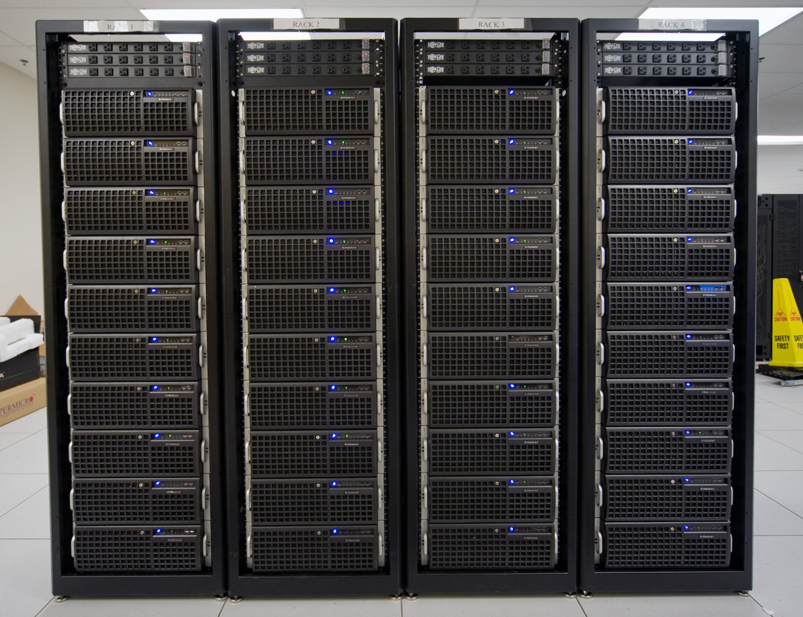
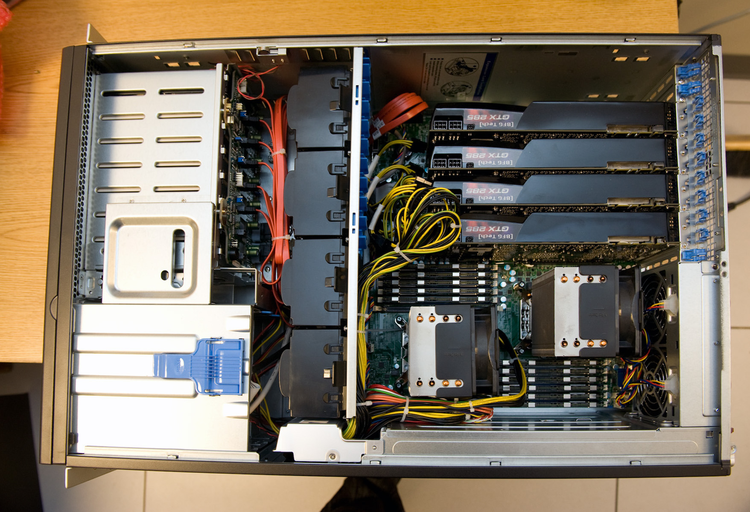
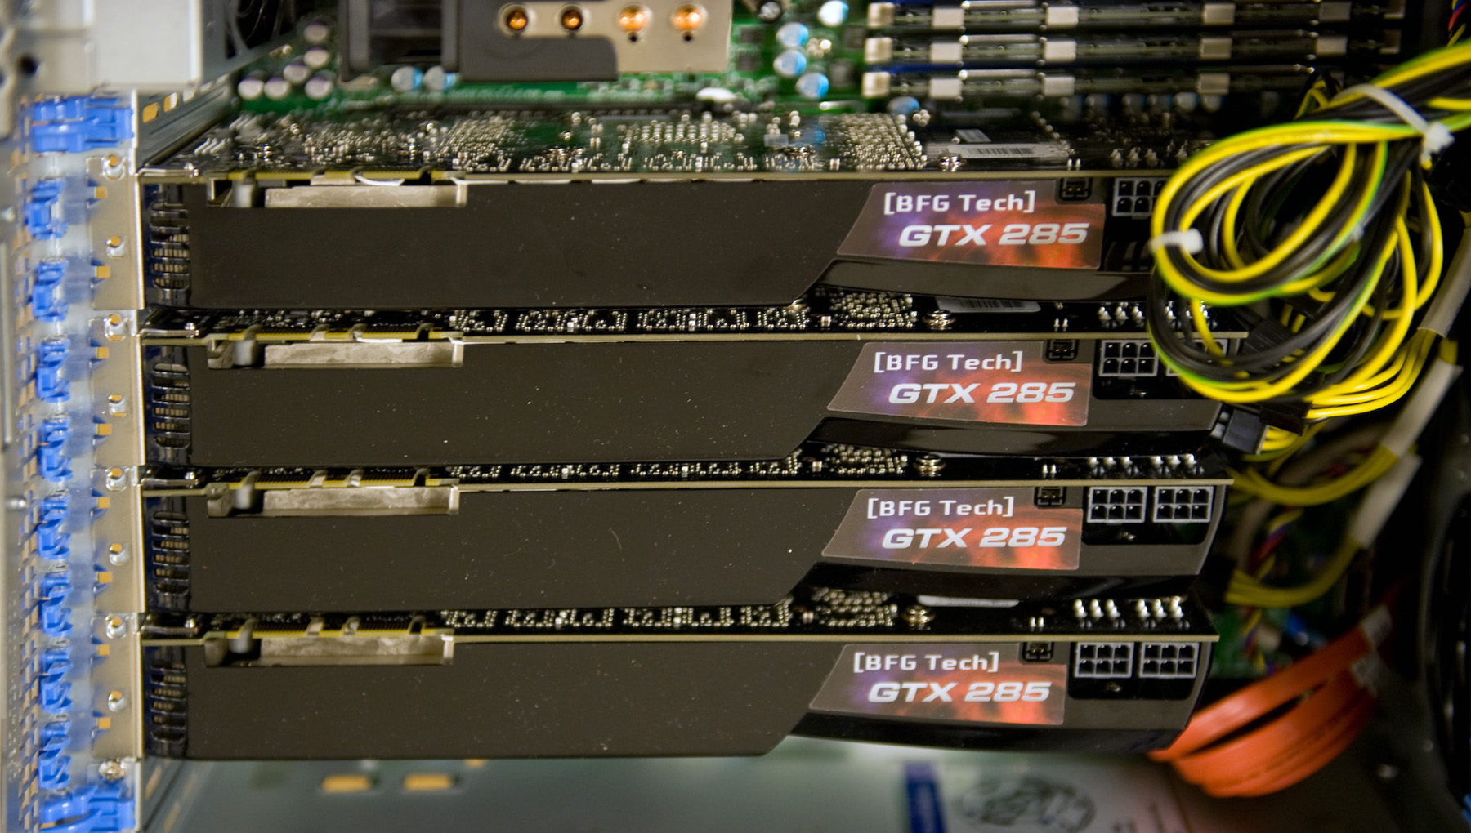
Hardware: ARRA GPU Cluster
Host:
2.4 GHz Nehalem
48 GB memory / node
65 nodes, 200 GPUs
Original configuration:
40 nodes w/ 4 GTX-285 GPUs
16 nodes w/ 2 GTX-285 + QDR IB
2 nodes w/ 4 Tesla C1050 or S1070
One quad GPU node = one rack of conventional nodes

Slide 17
10x Reduction in $/MFlops
Usage model
Single job / GPU; multiple jobs / host
Parallel GPU (one host, multi-host)
Scaling to teraflops, but constrained by Amdahl’s law
High Capacity Computing Example
Dual Nehalem 2.4 GHz host, ~$3,200
$0.16 / LQCD Mflops
4 2GB gaming cards, each $400
4 jobs, 1 per GPU (low hanging fruit), 1 core on host, 99% of code in the GPU
Quad GPU performance: average of 400 Gflops, $4,800
on kernel, we achieve $0.008 / LQCD Mflops
w/ Amdahl’s Law we achieve < $0.02 / MFlops

Slide 18
Science per Dollar for (some) LQCD Capacity Applications
GPUs are a highly cost effective technology
2010 GPU cluster
10²
Optimized LQCD Clusters
?
Mflops / $
A 300 node cluster, optimized to a limited number of science problems, yields a very cost effective platform. GPUs beat that by a factor of ten!
2009
10¹
2007
2006
BlueGene/P
QCDOC
10⁰
2004
USQCD Clusters
2003
BlueGene/L
2002
10⁻¹
QCDSP
Vector Supercomputers, including the Japanese Earth Simulator
Japanese Earth Simulator
10⁻²
Cluster Performance
1990
2000
2010

Slide 19
A Large Capacity Resource
530 GPUs at Jefferson Lab (July)
200,000 cores (1,600 million core hours per year)
600 Tflops peak single precision
100 Tflops aggregate sustained in the LQCD matrix inverter, (mixed half / single precision)
Significant increase in dedicated USQCD resources
All this for only $1M with hosts, networking, etc.
Disclaimer: to exploit this performance, code has to be run on the GPUs, not the CPU (Amdahl’s Law problem). This is a software development problem.

Slide 20
Another Example: Folding @ home
The second generation GPU core, aka GPU2 (April 2008)
“…One of the really exciting aspects about GPUs is that not only can they accelerate existing algorithms significantly, they get really interesting in that they can open doors to new algorithms that we would never think to do on CPUs at all (due to their very slow speed on CPUs, but not GPUs)... The preliminary results so far from it look very exciting, and we're excited to now open up the client for FAH donors to run.”

Slide 21
Looking forward
Jefferson Lab can make available GPUs for software development & testing for 12 GeV work
If GPUs prove advantageous, we can deploy GPUs as part of the annual farm upgrades
Needed:
clever programmers who can exploit this powerful tool!

Slide 22
Back to the Future
or, Jefferson Lab’s 12 GeV Computing Model
Assumptions
Moore’s Law will hold for another 4 years (in core counts)
Your software will become multi-threaded to use the cores
A 10x growth in computing power is free, and matches the expected growth from the 6 GeV era to the 12 GeV era
While computing is (approximately) free, people are not
(currently 80% of farm related budget goes into people)
The 12 GeV operations budget will allow an additional doubling in compute capacity (hardware) with no discussion (i.e. upon demand); this is only a 20% budget impact
All raw, reconstructed, and simulation data will be held at Jlab, with redundant copies for all raw data

Slide 23
Tape Trends
Tape Library & LTO Technology
LTO-5 today: 2 TB / cartridge, 140 MB/s
2x in capacity in 3 years: 4 TB per LTO-6 tape
LTO plan: 1.5x in bandwidth per generation but,
LTO-5 missed this target (only 1.2x)
assume LTO-6 does likewise=> 170 MB/s per drive
price model: $40 / tape, $30 / slot, $10K / drive
capacity thus dropping from $70/TB to $50/TB this year
bandwidth: $70K / GB/s today; ~$60K / GB/s at turn on
implications: we will need to pay more for bandwidth in the future

Slide 24
Archival Storage for 12 GeV
Tape library today:
LTO-4 5,500 slots, can go to 10,800:
~20 PB LTO-5 capacity @$70/TB
2nd library of 20K slots, LTO-6 expansion as needed, FY13
+ 80 PB LTO-6, $30/TB
6 GeV era: 1 PB/year, $80K / year (FY2009, includes bandwidth increase)
12 GeV era, 10 PB/year, $300K / year (largest offline component)
at 40 PB / year, storage cost becomes very significant, as does footprint, and we may need to evaluate on-demand simulation instead of storage of pre-simulated data

Slide 25
Thought Experiment
“Generate on demand” cost:
What does computing cost today to generate 100 MB/s of simulated data (2.8PB / year)?
Divide this by 4 for 2013, and by 10 for 2015
“Store and retrieve” cost:
Cost of storage divided by average number of times each simulated event will be re-used
Cost of bandwidth to/from tape: $12K per 100 MB/s stream, amortized over 3 years
Example: Generate at 100 MB/s, reuse=2, so consume at 200 MB/s; storage cost = 130 + 3*12/3 = $142K / year (plus library maintenance)
If the simulation cost of 100 MB/s is a farm with replacement cost of $112K (i.e. $50K / year), then doubling the size of the simulation farm and doing “generate on demand” saves $30K in the first year, and $100K+ in future years (computing falls faster than storage)
Notes:
10^12 events per year = 5PB / year (from Graham from CLAS ?)
10^8 events per hour
3*10^4 events per second, 173 MB/s (call it 200)
farm = $250K today, need 2x to meet need
so, $500K resource today yields 10^12 events per year
half as many events needed in 2012, full in 2013+
in 2012, $125K resource needed (1 doubling, half volume)
in 2013, $125K resource is needed (2 doublings, full volume)
in 2015, $60K resource is needed
5 PB / year = 5000*45 = $225K / year in 2011, 2012
=5000*30 = $150K / year in 2013, 2014
i.e. storage cost = 3x generation cost
Moore's Law constant dollars: 1, 1.61, 2.6, 4.2 = 9.4, so 44% in last year

Slide 26
Disk Trends
Capacity Costs
Disk: $400 / TB (moderate performance)
Low bandwidth disk: $200 / TB
Tape: $50 / TB, so 8x below cache disk, 4x below archival disk
Trends
Disk is falling faster than tape, but won’t overtake it in 4 years
Statements 5 years ago that disk would overtake tape in 5 years remain “true” today
My model: disk will gain by 2x in 4 years
If deployed disk is 10% of tape capacity (moderate performance cache & workspace), then disk is 44% of cost today, and 28% in 2014

Slide 27
Grid vs Mostly Central
Observations
The grid does not address the largest cost item in the budget (storage)
A fully functional computational & storage grid adds ~1 FTE in labor at Jefferson Lab, between $150K and $200K with overhead, or 3x to 4x times the computing hardware budget
Based upon current requirements, a mostly central computing model is the most cost effective (highest performing) solution
There are other advantages to a grid (easier transparent use of a user local resource), but these mostly exist for larger institutions that are LHC collaborators (costs already paid by HEP)
There may be other advantages in other software tools, but these have not yet been captured by requirements
There are non-trivial disadvantages to using a grid, even beyond labor costs for the computer center

Slide 28
Current 12 GeV Computing Plan
Centralized computing model
full computing capacity for reconstruction, simulation, analysis
storage for all raw, reconstructed and simulation data
high network bandwidth for fast transport of reduced (cooked) data to home institutions for interactive analysis
Planned improvements
better process for updating computing requirements, to allow sufficient lead time to meet those requirements
easier tools for managing fair share (priority) by hall computing coordinators
easier tools for managing storage (quotas) by hall computing coordinators
easier tools for access to farm visible disks, and the tape library from offsite (although not necessarily a full blown data grid)

Slide 29
(Questions / Discussion)

